Slide 1
Three Angels Messages
Accepting or Rejecting?

Slide 2
Summary
Revelation 14:6-12 “And I saw another angel fly in the midst of heaven, having the everlasting gospel to preach unto them that dwell on the earth, and to every nation, and kindred, and tongue, and people, Saying with a loud voice, Fear God, and give glory to him; for the hour of his judgment is come: and worship him that made heaven, and earth, and the sea, and the fountains of waters. And there followed another angel, saying, Babylon is fallen, is fallen, that great city, because she made all nations drink of the wine of the wrath of her fornication. And the third angel followed them, saying with a loud voice, If any man worship the beast and his image, and receive his mark in his forehead, or in his hand, The same shall drink of the wine of the wrath of God, which is poured out without mixture into the cup of his indignation; and he shall be tormented with fire and brimstone in the presence of the holy angels, and in the presence of the Lamb: And the smoke of their torment ascendeth up for ever and ever: and they have no rest day nor night, who worship the beast and his image, and whosoever receiveth the mark of his name. Here is the patience of the saints: here are they that keep the commandments of God, and the faith of Jesus. “

Slide 3
We have seen…………………..
1. The sum and substance of the messages is total submission to Jesus Christ that leads to honoring all of His commandments.
2. The investigative judgment began in 1844.
3. True worship vs. false worship is the marquee issue in these messages.
A. True worship is honoring God’s commandments/ false worship is honoring man-made traditions.

Slide 4
There is more……………………….
B. The commandment that reveals God as the Creator/Sanctifier is the 7th day Sabbath, or Saturday.
C. The tradition of the beast is the Sunday tradition which represents rebellion/doing things our way, against God.
4. Maintaining solid health keeps our minds clear to discern God’s voice and truth and to detect and resist lies/evil.

Slide 5
Finally………………………………..
5. Babylon falls around 1844. She represents the apostate Protestant churches that rejected the Sabbath and held onto her traditions.
6. The beast is the papacy. Her image is the fallen, apostate Protestant churches. Her mark is Sunday keeping. This is rebellion against God. The result of rejecting God’s truth will be receiving the wrath of God………..

Slide 6
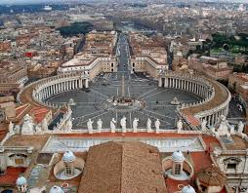
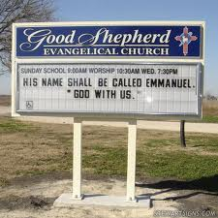
2/3 of the Messages are politically Incorrect

Slide 7
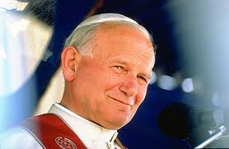
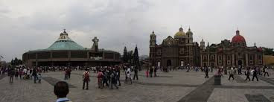
And Illegal! And Hate Speech!

Slide 8
Mexico’s A.R.
This act prohibits any group from speaking ill of any other religious group. This makes it legally impossible to preach the 2nd and 3rd Angel’s messages. The SDA Church, called to proclaim these messages, signed this document and now no longer preaches these messages in Mexico. The Lord is raising up stones to proclaim the truth!

Slide 9
The Context……………………………..
Revelation 14:14-19 “And I looked, and behold a white cloud, and upon the cloud one sat like unto the Son of man, having on his head a golden crown, and in his hand a sharp sickle. And another angel came out of the temple, crying with a loud voice to him that sat on the cloud, Thrust in thy sickle, and reap: for the time is come for thee to reap; for the harvest of the earth is ripe. And he that sat on the cloud thrust in his sickle on the earth; and the earth was reaped. And another angel came out of the temple which is in heaven, he also having a sharp sickle. And another angel came out from the altar, which had power over fire; and cried with a loud cry to him that had the sharp sickle, saying, Thrust in thy sharp sickle, and gather the clusters of the vine of the earth; for her grapes are fully ripe. And the angel thrust in his sickle into the earth, and gathered the vine of the earth, and cast it into the great winepress of the wrath of God.”

Slide 10
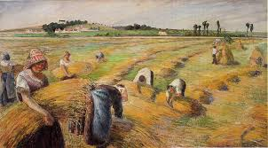
The Harvest

Slide 11
The Harvest
Christ comes with a sickle to harvest the earth. The Bible is very clear what the harvest is………..” The field is the world; the good seed are the children of the kingdom; but the tares are the children of the wicked one; The enemy that sowed them is the devil; the harvest is the end of the world; and the reapers are the angels. As therefore the tares are gathered and burned in the fire; so shall it be in the end of this world. The Son of man shall send forth his angels, and they shall gather out of his kingdom all things that offend, and them which do iniquity; And shall cast them into a furnace of fire: there shall be wailing and gnashing of teeth. Then shall the righteous shine forth as the sun in the kingdom of their Father. Who hath ears to hear, let him hear.” Matthew 13:38-43

Slide 12
Christ is Coming
The messages of Revelation 14 are given to prepare people for the 2nd coming of Christ. By how we respond to these messages will determine our destiny; whether to be saved in Christ’s kingdom or to be lost. These are the messages for this hour. The entire world hangs in the balances and are weighed up against these testing truths for this time.

Slide 13
The Messages of Destiny
Before 1844
1. White Horse- Message of the Righteousness of Christ.
2. Red Horse-Message of Warning, fallen into sin.
3. Black Horse-Final Warning.
4. Pale Horse-Wrath of God.
Since 1844
1. 1st Angel’s Message-Christ’s Righteousness in the judgment, Sabbath.
2. 2nd Angel’s Message-Message of Warning, fallen into sin.
3. 3rd Angel’s Message-Final Warning
4. Result of rejecting these messages ‘the wrath of God

Slide 14
What do you Expect?
Revelation 14 has given us three messages. By how people respond determines their destiny. Revelation 15 should give us some idea about the destiny of the saved and the lost. We should hear something about the righteous and their destiny and the destiny of the wicked. What will be the reward for accepting the three angels messages? What will be the punishment for rejecting them? Revelation 15 should give us the answers…………………………….

Slide 15
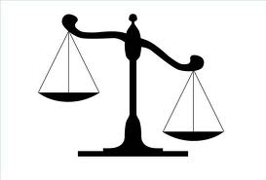
Weighed in the Balances
Revelation 14 has given us three messages. By how people respond determines their destiny. Revelation 15 should give us some idea about the destiny of the saved and the lost. We should hear something about the righteous and their destiny and the destiny of the wicked. What will be the reward for accepting the three angels messages? What will be the punishment for rejecting them? Revelation 15 should give us the answers…………………………….

Slide 16
Revelation 15:1-8
“And I saw another sign in heaven, great and marvellous, seven angels having the seven last plagues; for in them is filled up the wrath of God. And I saw as it were a sea of glass mingled with fire: and them that had gotten the victory over the beast, and over his image, and over his mark, and over the number of his name, stand on the sea of glass, having the harps of God. And they sing the song of Moses the servant of God, and the song of the Lamb, saying, Great and marvellous are thy works, Lord God Almighty; just and true are thy ways, thou King of saints. Who shall not fear thee, O Lord, and glorify thy name? for thou only art holy: for all nations shall come and worship before thee; for thy judgments are made manifest. And after that I looked, and, behold, the temple of the tabernacle of the testimony in heaven was opened: And the seven angels came out of the temple, having the seven plagues, clothed in pure and white linen, and having their breasts girded with golden girdles. And one of the four beasts gave unto the seven angels seven golden vials full of the wrath of God, who liveth for ever and ever. And the temple was filled with smoke from the glory of God, and from his power; and no man was able to enter into the temple, till the seven plagues of the seven angels were fulfilled.”

Slide 17
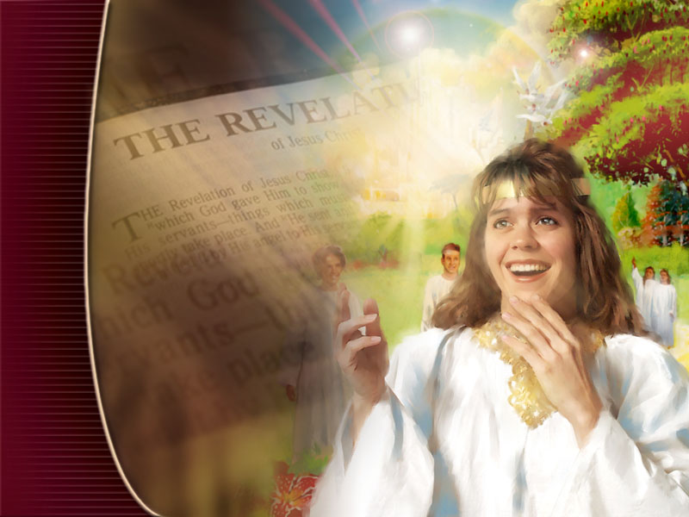
Victors/Losers
The victors are the 144,000 that sing the song of Moses and Christ. “And they sung as it were a new song before the throne, and before the four beasts, and the elders: and no man could learn that song but the hundred and forty and four thousand, which were redeemed from the earth.”
Revelation 14:3

Slide 18
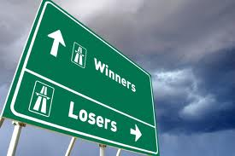
The Losers
Those who reject the three angel’s messages will receive of the seven last plagues. “Then Jesus will step out from between the Father and man, and God will keep silence no longer, but pour out His wrath on those who have rejected His truth. …The nations are now getting angry, but when our High Priest has finished His work in the sanctuary, He will stand up, put on the garments of vengeance, and then the seven last plagues will be poured out.
I saw that the four angels would hold the four winds until Jesus' work was done in the sanctuary, and then will come the seven last plagues. These plagues enraged the wicked against the righteous.” Maranatha, 258

Slide 19
Comments on the end
“When Christ ceases His intercession in the sanctuary, the unmingled wrath threatened against those who worship the beast and his image and receive his mark (Revelation 14:9, 10), will be poured out. The plagues upon Egypt when God was about to deliver Israel were similar in character to those more terrible and extensive judgments which are to fall upon the world just before the final deliverance of God's people. Says the revelator, in describing those terrific scourges: "There fell a noisome and grievous sore upon the men which had the mark of the beast, and upon them which worshipped his image." The sea "became as the blood of a dead man: and every living soul died in the sea." And "the rivers and fountains of waters . . .became blood." Terrible as these inflictions are, God's justice stands fully vindicated. The angel of God declares: "Thou art righteous, O Lord, . . . because thou hast judged thus. For they have shed the blood of saints and prophets, and thou hast given them blood to drink; for they are worthy." Revelation 16:2-6.

Slide 20
Continued
“By condemning the people of God to death, they have as truly incurred the guilt of their blood as if it had been shed by their hands. . . . In the plague that follows, power is given to the sun "to scorch men with fire. And men were scorched with great heat." Verse 8, 9. . . .
These plagues are not universal, or the inhabitants of the earth would be wholly cut off. Yet they will be the most awful scourges that have ever been known to mortals. All the judgments upon men, prior to the close of probation, have been mingled with mercy. The pleading blood of Christ has shielded the sinner from receiving the full measure of his guilt; but in the final judgment, wrath is poured out unmixed with mercy. The bolts of God's wrath are soon to fall, and when He shall begin to punish the transgressors, there will be no period of respite until the end. The storm of God's wrath is gathering, and those only will stand who are sanctified through the truth in the love of God. They shall be hid with Christ in God till the desolation shall be overpast. “ Maranatha, 267

Slide 21
Continued
“Solemn events before us are yet to transpire. Trumpet after trumpet is to be sounded; vial after vial poured out one after another upon the inhabitants of the earth.--3SM 426 (1890). {LDE 238.1}
The world is soon to be left by the angel of mercy and the seven last plagues are to be poured out. . . . The bolts of God's wrath are soon to fall, and when He shall begin to punish the transgressors there will be no period of respite until the end.--TM 182 (1894). {LDE 238.2}
Four mighty angels hold back the powers of this earth till the servants of God are sealed in their foreheads. The nations of the world are preparing for conflict, but they are held in check by the angels. When this restraining power is removed there will come a time of trouble and anguish. Deadly instruments of warfare will be invented. Vessels with their living cargo will be entombed in the great deep. All who have not the spirit of truth will unite under the leadership of satanic agencies, but they are to be kept under control till the time shall come for the great battle of Armageddon.--7BC 967 (1900). {LDE 238.3}

Slide 22
The Spirit Lets Us know
“Angels are now restraining the winds of strife that they may not blow until the world shall be warned of its coming doom, but a storm is gathering, ready to burst upon the earth, and when God shall bid His angels loose the winds there will be such a scene of strife as no pen can picture.--Ed 179, 180 (1903). {LDE 239.1}
The Saviour's prophecy concerning the visitation of judgments upon Jerusalem is to have another fulfillment, of which that terrible desolation was but a faint shadow. In the fate of the chosen city we may behold the doom of a world that has rejected God's mercy and trampled upon His law.--GC 36 (1911). {LDE 239.2}
Satan will then plunge the inhabitants of the earth into one great, final trouble. As the angels of God cease to hold in check the fierce winds of human passion, all the elements of strife will be let loose. The whole world will be involved in ruin more terrible than that which came upon Jerusalem of old.--GC 614 (1911). {LDE 239.3}
It is the glory of God to be merciful, full of forbearance, kindness, goodness, and truth. But the justice shown in punishing the sinner is as verily the glory of the Lord as is the manifestation of His mercy.--RH March 10, 1904. {LDE 240.1}
The Lord God of Israel is to execute judgment upon the gods of this world as upon the gods of Egypt. With fire and flood, plagues and earthquakes, He will spoil the whole land. Then His redeemed people will exalt His name and make it glorious in the earth. Shall not those who are living in the last remnant of this earth's history become intelligent in regard to God's lessons?--10MR 240, 241 (1899). {LDE 240.2}

Slide 23
Interesting
“The plagues of God are already falling upon the earth, sweeping away the most costly structures as if by a breath of fire from heaven. Will not these judgments bring professing Christians to their senses? God permits them to come that the world may take heed, that sinners may be afraid and tremble before Him.--Ms 99, 1902, pp. 12, 13. ("Fragments--a Holy People," typed July 12, 1902.)
I expect that during the year 1890 there will be great mortality. There will be crimes greater than any now on record. There will be weeping and lamentation and woe. During the past year, 1889, there has been brought to us almost daily the news of disasters by sea and by land--unusually destructive fires; earthquakes burying cities and villages with their inhabitants; railway accidents most terrible; tornadoes and floods that destroyed an immense amount of property, including the terrible Johnstown and Williamsport floods, which destroyed more than two thousand lives.
The disasters of the past year in America have caused hearts to tremble, and similar disasters have fallen upon other countries. Already sprinklings from the vials of God's wrath have been let fall upon land and sea, affecting the elements of the air. The causes of these unusual conditions are being searched for, but in vain.” 5MR , 15,16

Slide 24
The Plagues/Trumpets Similar
1. Rev. 8:7- falls on the earth.
2. Rev. 8:8-10- falls on the sea.
3. Rev. 8:10-11- falls on the rivers/ fountains.
4. Rev. 8:12- sun, moon, and stars are hit.
5. Rev. 9:2- darkness falls.
1. Rev. 16:2- falls on the earth.
2. Rev. 16:3- falls on the sea.
3. Rev. 16:4- falls on rivers/fountains.
4. Rev. 16:8- sun is hit.
5. Rev. 16:10,11- darkness falls.

Slide 25
Similarity between Plagues/Trumpets
6. Rev. 9:13,14- the great river Euphrates is the focus of this trumpet.
7. Rev. 11:15-18- Great voices out of heaven are heard.
The trumpets were partial judgments upon impenitent peoples in history.
6. Rev. 16:12- this plague strikes the river Euphrates.
7. Rev. 16:17,18- Great voice from heaven is heard.
The plagues are the final outpouring of judgment upon guilty humanity at the end of time.

Slide 26
God’s Strange Act
“In the issue of the contest, all Christendom will be divided into two great classes, -- those who keep the commandments of God and the faith of Jesus, and those who worship the beast and his image, and receive his mark. Although church and state will unite their power to compel "all, both small and great, rich and poor, free and bond," to receive "the mark of the beast," yet the true people of God will not receive it. The prophet of Patmos beholds "them that had gotten the victory over the beast, and over his image, and over his mark, and over the number of his name, stand on the sea of glass, having the harps of God," and singing the "song of Moses the servant of God, and the song of the Lamb." The third angel's message increases in importance as we near the close of this earth's history. It is the last offer of mercy to the world, the most solemn message ever given to mortals. In heaven there is a record kept of the impieties of nations, of families, of individuals…………………………………….

Slide 27
Continued
God may bear long while the account goes on; calls to repentance and offers of pardon may be given; yet a time will come when the account will be full, when the soul's decision will have been made, when by his own choice man's destiny will have been fixed. Then the signal will be given for judgment to be executed. The forbearance that God has exercised toward the wicked has emboldened men in transgression; but their punishment will be none the less certain and terrible for being long delayed. "The Lord shall rise up as in Mount Perazim, He shall be wroth as in the valley of Gibeon, that He may do His work, His strange work; and bring to pass His act, His strange act." To our merciful God the act of punishment is a strange act. Yet He will "by no means clear the guilty." By terrible things in righteousness He will vindicate the authority of His downtrodden law. The very fact of His reluctance to execute justice, testifies to the enormity of the sins that call forth His judgments, and to the severity of the retribution awaiting the transgressor. {ST, January 25, 1910 par. 16}

Slide 28
Again
The Amalekites had been the first to make war upon Israel in the wilderness; and for this sin, together with their defiance of God and their debasing idolatry, the Lord, through Moses, had pronounced sentence upon them. By divine direction the history of their cruelty toward Israel had been recorded, with the command, "Thou shalt blot out the remembrance of Amalek from under heaven; thou shalt not forget it." Deuteronomy 25:19. For four hundred years the execution of this sentence had been deferred; but the Amalekites had not turned from their sins. The Lord knew that this wicked people would, if it were possible, blot out His people and His worship from the earth. Now the time had come for the sentence, so long delayed, to be executed. The forbearance that God has exercised toward the wicked, emboldens men in transgression; but their punishment will be none the less certain and terrible for being long delayed. "The Lord shall rise up as in Mount Perazim, He shall be wroth as in the valley of Gibeon, that He may do His work, His strange work; and bring to pass His act, His strange act." Isaiah 28:21. To our merciful God the act of punishment is a strange act. "As I live, saith the Lord God, I have no pleasure in the death of the wicked; but that the wicked turn from his way and live." Ezekiel 33:11.

Slide 29
Finished
“The Lord is "merciful and gracious, long-suffering, and abundant in goodness and truth, . . . forgiving iniquity and transgression and sin." Yet He will "by no means clear the guilty." Exodus 34:6, 7. While He does not delight in vengeance, He will execute judgment upon the transgressors of His law. He is forced to do this, to preserve the inhabitants of the earth from utter depravity and ruin. In order to save some He must cut off those who have become hardened in sin. "The Lord is slow to anger, and great in power, and will not at all acquit the wicked." Nahum 1:3. By terrible things in righteousness He will vindicate the authority of His downtrodden law. And the very fact of His reluctance to execute justice testifies to the enormity of the sins that call forth His judgments and to the severity of the retribution awaiting the transgressor. But while inflicting judgment, God remembered mercy. The Amalekites were to be destroyed, but the Kenites, who dwelt among them, were spared. This people, though not wholly free from idolatry, were worshipers of God and were friendly to Israel. Of this tribe was the brother-in-law of Moses, Hobab, who had accompanied the Israelites in their travels through the wilderness, and by his knowledge of the country had rendered them valuable assistance. “ PP, 627,628

