Slide 1
Near Miss!
Obama’s Failed Slaughter

Slide 2
Holding it Back!
“And after these things I saw four angels standing on the four corners of the earth, holding the four winds of the earth, that the wind should not blow on the earth, nor on the sea, nor on any tree. And I saw another angel ascending from the east, having the seal of the living God: and he cried with a loud voice to the four angels, to whom it was given to hurt the earth and the sea, Saying, Hurt not the earth, neither the sea, nor the trees, till we have sealed the servants of our God in their foreheads.” Rev. 7:1-3

Slide 3
Just Waiting!
“God's word has given warning of the impending danger; let this be unheeded, and the Protestant world will learn what the purposes of Rome really are, only when it is too late to escape the snare. She is silently growing into power. Her doctrines are exerting their influence in legislative halls, in the churches, and in the hearts of men. She is piling up her lofty and massive structures in the secret recesses of which her former persecutions will be repeated. Stealthily and unsuspectedly she is strengthening her forces to further her own ends when the time shall come for her to strike. All that she desires is vantage ground, and this is already being given her. We shall soon see and shall feel what the purpose of the Roman element is. Whoever shall believe and obey the word of God will thereby incur reproach and persecution. “ GC, pg. 581

Slide 4
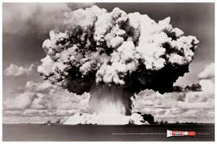
Almost Happened Here!
It almost happened in America? Are you kidding? And, it would have been ‘Compliments of the president of the United States!’ And now, for the rest of the story…………………

Slide 5
Senator Lindsey Graham
GOOSE CREEK, S.C. (CBS Charlotte/AP) — “South Carolina U.S. Sen. Lindsey Graham says he’s convinced that Syrian President Assad used chemical weapons on his own people. Graham told reporters in Goose Creek on Tuesday that taking action against Syria in response to the situation is not a question of yes or no, but rather a question of bad or worse choices. He says if there is no U.S. response, Iran will not believe America’s resolve to block Iran from developing nuclear weapons. Graham also says those nuclear weapons in the hands of terrorists could result in a bomb coming to Charleston Harbor. He says he’s working to convince South Carolinians weary of war that the situations in Syria and Iran are linked. Graham says Syria could destabilize the entire Middle East.” Sept 3, 2013

Slide 6
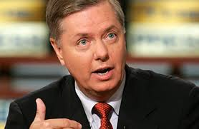
From Where?
Also on SEP-3,2013, Senator Lindsey Graham of South Carolina said in response to blocking Iran from developing nuclear weapons, “…those nuclear weapons in the hands of terrorists could result in a bomb coming to Charleston Harbor,” according to a report from CBS-Charlotte.

Slide 7
Not From Iran or Syria!
The brief report from the top level military source, which was written in a rush to get the information out, reads:
“Dyess is beginning to move out nuclear war heads today. I got a tap from DERMO earlier. He said it was the first time they have been even acknowledged since being put there in the 80′s. No signature was required for transfer… There was no directive. He said that Dyess Commander was on site to give authority to release. No one knew where they were going really, but the truck driver said to take them to South Carolina and another pick up will take them from there.” Sept. 3, 2013

Slide 8
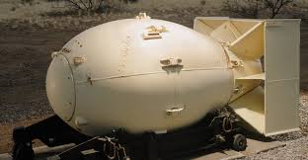
Summation
Graham was warning South Carolinians that if we didn’t go to war with Syria, and thus start WW III with Russia and China, then Iran would consider our lack of resolve as being soft! Iran would then use an atomic weapon and attack South Carolina. At the same time, Obama was moving atomic weaponry from Dyess Air Force Base in Texas to South Carolina and was going to use these warheads to create war with Syria!!!

Slide 9
The Fallout
If this weaponry had been used in Charleston Harbor, the fallout would have been horrific. The type of warheads being transferred from Dyess were EMP. Electro Magnetic pulse weaponry would fry electrical systems, let alone kill many, many people in the process! Anything that has electric charge would be shut down! Computers, cars, everything would stop functioning. This would take us back to the days of the Pilgrims!

Slide 10
Exploded, but Not!
NOW – The European Union Times - online newspaper is reporting that:
“A shocking new Main Intelligence Directorate (GRU) report
circulating in the Kremlin today states that President Barack Obama, while in a rage, ousted four of the United States top ranking military officers after they refused to detonate a nuclear device “in/near” Charleston, South Carolina this past week and, instead, exploded it off the Atlantic Coast.”
According to this report, Strategic Missile Forces Command (SMF) notified both President Putin and the General Staff this past Tuesday (8 October) that at 01:58:11 GMT/UTC an atomic device was exploded in the seabed off the US Atlantic Ocean, barely 1,000 km (620 miles) from Charleston, causing a 4.5 magnitude earthquake measurement that SMF experts equate to being a 1-kiloton yield, which is equal to the power of 1,000 tons of TNT.”

Slide 11
Earthquake Report
Moderate earthquake – Off East Coast Of United States on October 8, 2013
Last update: October 8, 2013 at 2:15 am by By Ashish Khanal
655
40 82 4281
–
Most important Earthquake Data:
Magnitude : 4.5
Local Time (conversion only below land) : Unknown
GMT/UTC Time : 2013-10-08 01:58:11
Depth (Hypocenter) : 10 km
Depth and Magnitude updates in the list below.
Share your earthquake experience (I Have Felt It) with our readers.

Slide 12
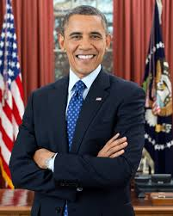
Barack ‘Insane’ Obama
As a member of the Jesuit front organization, called the Council on Foreign Relations, Obama will do exactly as he is told. The Jesuits hate Protestant America and want to see it destroyed! The Lord stopped this from happening!

Slide 13
The Lord at the Helm!
“The tireless vigilance of the heavenly messengers, and their unceasing employment in their ministry in connection with the beings of earth, show us how God's hand is guiding the wheel within a wheel. The divine Instructor is saying to every actor in His work, as He said to Cyrus of old: "I girded thee, though thou hast not known Me." In Ezekiel's vision God had His hand beneath the wings of the cherubim. This is to teach His servants that it is divine power that gives them success. He will work with them if they will put away iniquity and become pure in heart and life.” 5 Testimonies 753, 754

Slide 14
Generals Fired
Vice Admiral Tim Giardina, United States Navy - Deputy Commander of the United States Strategic Command. Commander of the Submarine Group Trident, Submarine Group 9 and Submarine Group 10, where every single one of the 18 Nuclear Submarines with Nuclear Trident Missiles of those three groups were in his command. He was removed from service and fired from the military for the charge of using counterfeit poker chips (not making that up).
Major General Michael Carey, United States Air Force - Commander 20th Air Force in charge of 9,600 people and 450 Intercontinental Ballistic Missiles (ICBM) at three operational wings and served in both Operation Iraqi Freedom and Operation Enduring Freedom. He was Fired October 11, 2013, for “Personal Misbehavior” is what was told to ABC News.

Slide 15
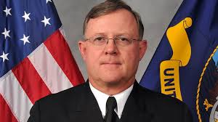
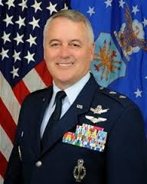
Men Fired by Obama!

Slide 16
Tight Lipped!
Major Gen. Michael Carey, Air Force
Commander 20th Air Force in charge of 9,600 people and 450 Intercontinental Ballistic Missiles at three operational wings and served in both Operation Iraqi Freedom and Operation Enduring Freedom. Carey was fired October 11, 2013, for “personal misbehavior,” according to ABC News. Pentagon and Air Force senior officials have remained relatively tight-lipped about Carey’s firing.

Slide 17
Cut Them Down!
A defense official said Wednesday that "based upon a recommendation from the Secretary of Defense Chuck Hagel, the president determined Oct. 3 that Vice Adm. Timothy M. Giardina, former Deputy Commander, U.S. Strategic Command (O-9), should be relieved." President Obama became involved in the case because only the president can relieve a three- and four-star officer from his post.
Giardina has been reassigned to an undetermined position within the Navy. The vice admiral remains under investigation by the Navy Criminal Investigative Service (NCIS) which launched its own probe of Giardina after being contacted by Iowa authorities in mid-July.

Slide 18
Summation
The President of the United States, along with high level aids, in cahoots with the sinister and evil Jesuits, who want to see the annihilation of Protestant America, sought to DESTROY America with the detonation of an EMP bomb in Charleston, S. Carolina harbor. This would have taken America back to the Pilgrims and killed millions and millions of Americans!

Slide 19
Modern American Heroes!
Some high ranking men in the military, Vice Admiral Tim Giardina and Major General Michael Carey refused to carry out this dastardly plot and instead exploded the bomb some hundreds of miles out at sea. While it was reported to be an earthquake, it was actually the bomb! These men, for their heroism, were demoted from their positions and given menial jobs!!!

Slide 20
Still In Control
“The wheels were so complicated in arrangement that at first sight they appeared to be in confusion; yet they moved in perfect harmony. Heavenly beings, sustained and guided by the hand beneath the wings of the cherubim, were impelling those wheels; above them, upon the sapphire throne, was the Eternal One; and round about the throne was a rainbow, the emblem of divine mercy. As the wheel like complications were under the guidance of the hand beneath the wings of the cherubim, so the complicated play of human events is under divine control. Amidst the strife and tumult of nations He that sitteth above the cherubim still guides the affairs of this earth. The history of nations speaks to us today. To every nation and to every individual God has assigned a place in His great plan. Today men and nations are being tested by the plummet in the hand of Him who makes no mistake. All are by their own choice deciding their destiny, and God is overruling all for the accomplishment of His purposes.” PK, pg. 535, 536

