Slide 1
Still Standing, Desmond! Sorry, pt. 3

Slide 2

Desmond Ford was used by the devil to destroy the mission and message of Seventh Day Adventists. He started doing this in the early 1950’s and continued down that path for the next 70 years! He started doing this in Australia and then later at Pacific Union College in America! He assaulted:
1. the sanctuary.
2. the atonement.
3. the books of Daniel and Revelation.
4. the year day principle.
5. the 3 Angel’s messages.
6. the gift of prophecy.

Slide 3
Ford’s Failure
Desmond Ford understood that the key to destroying SD Adventism is twofold. One, taking out Adventism’s eyes by discrediting Ellen White and her work. Two, attack the Adventism teaching on a continual atonement by declaring that atonement was finished at the cross. Ford realized that:
1. if atonement was finished at the cross, then: there is no 1844.
2. If no 1844, then there is no Most Holy Place work and no law.
3. If there is no law, then the 7th day Sabbath is gone!
4. If the Sabbath is gone, then the 3 Angel’s messages are gone.
5. If the 3 Angel’s messages are gone, then the role of apostate Protestants and the papacy is gone.
6. If the 3 angel’s messages are gone, then SD Adventism is gone.
7. The SOP is gone, the movement is gone: All is gone!!!!

Slide 4

Falling Dominoes
The Advent messages are all interlocking and interconnected. If you strike one, then you end up knocking down another one, and another, until finally they all collapse!

Slide 5
Ford Hates the year day principle
“The Year-Day Principle is Not a Biblically-Derived Principle, but Merely a Tool of Prophetic Research Developed Providentially by Human Thought Long After New Testament Times.[8] Reasons: 1. The usual "proof texts" for the year-day principle, Numbers 14:34 and Ezekiel 4:6, do not state this in the form of a principle, nor do they state that "each day for a year" should apply to biblical prophecies in general. There is no explicit statement on the year-day principle elsewhere in Scripture, setting forth the manner in which biblical time prophecies should be interpreted. Comment: The year-day principle is not very conducive to the apotelesmatic principle; in fact, the two are incompatible. There simply is not enough time between Daniel's day and 1844 for two or more fulfillments of the 1260 days, of the 1335 days, and of the 2300 days, if these refer to 1260 years, 1335 years, and 2300 years. However, it would be conceivable to have any number of literal 3 1/2 year periods matching the description of Daniel 7:25, if the year-day principle were abolished. (Note: It would seem that if the year-day principle is to be abolished because of the lack of explicit Scriptural support, then the apotelesmatic principle must be abolished because of the lack of both explicit and implicit support in Scripture.)

Slide 6

Ford Goes After the Year Day Principle
Ford believed that all prophecy had to be fulfilled by the end of the 1st century. He was a preterist like the Jesuit, Louis de Alcazar. Therefore, all time prophecy had to be fulfilled by the end of the first century. The 1260 years, the 2300 years, and the 490 years were all literal time and fulfilled by 100 AD!! This smacks directly in opposition to the very words of Christ Himself!!

Slide 7
Jesus Believed in a Day for a Year!
“And straightway coming up out of the water, he saw the heavens opened, and the Spirit like a dove descending upon him: And there came a voice from heaven, saying, Thou art my beloved Son, in whom I am well pleased. And immediately the Spirit driveth him into the wilderness. And he was there in the wilderness forty days, tempted of Satan; and was with the wild beasts; and the angels ministered unto him. Now after that John was put in prison, Jesus came into Galilee, preaching the gospel of the kingdom of God, And saying, The time is fulfilled, and the kingdom of God is at hand: repent ye, and believe the gospel.” After His baptism, when He was anointed with the Holy Spirt, Jesus said, The time is fulfilled. To what time was Christ referring? Clearly, a time prophecy foretold Jesus being anointed by the Holy Spirit. There is only one time period coupled with Christ being anointed and it is found in Daniel 9:25. The Bible says “ Know therefore and understand, that from the going forth of the commandment to restore and to build Jerusalem unto the Messiah the Prince shall be seven weeks, and threescore and two weeks: the street shall be built again, and the wall, even in troublous times.” From the time of the command to restore and build Jerusalem, which was 457 BC, to the Anointed One would be 69 weeks or 483 days. If we compute the days as literal days, then Christ was baptized in the year 457 BC!!!! That is a joke.

Slide 8
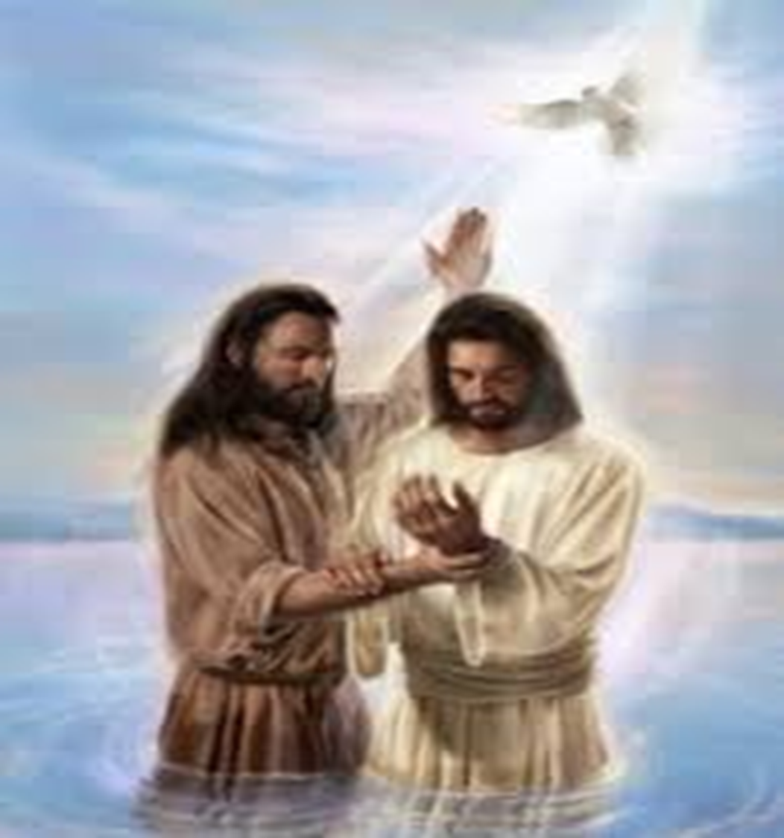
Jesus and Ford Disagree!
However, if we apply the day for a year principle, as Jesus did, then the 483 days/years extend down to 27 AD, which is when Christ said, The time is fulfilled.” Jesus understood the time prophecy of Daniel 9 as pointing specifically to His baptism in 27AD. Jesus clearly believed in the year day principle. Desmond Ford clearly did not follow the teachings of Jesus Christ!!!!

Slide 9
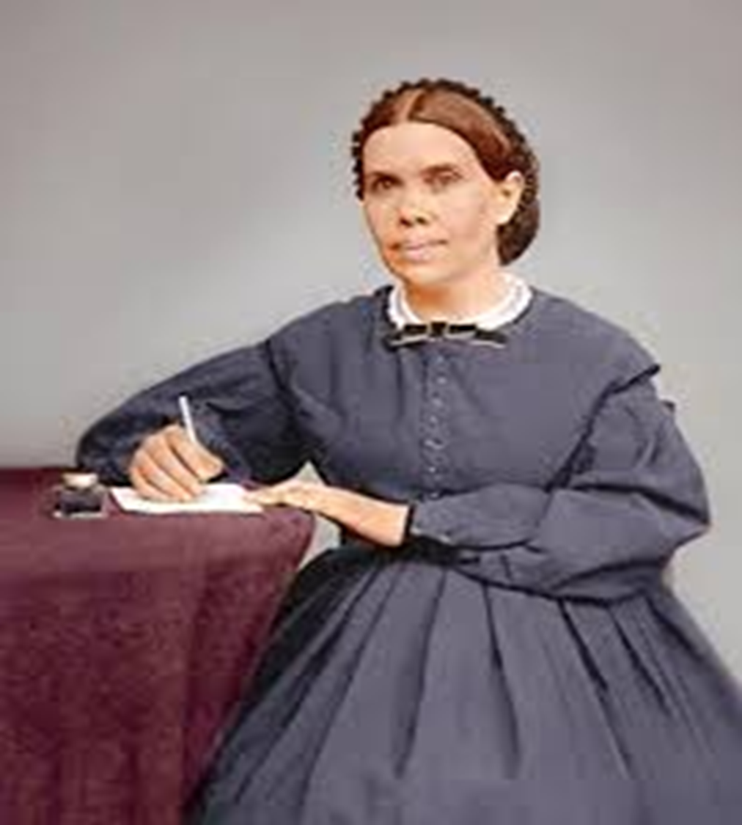
The SOP Disagrees with Ford!
“ The “time” which He declared to be fulfilled was the period made known by the angel Gabriel to Daniel. “Seventy weeks,” said the angel, “are determined upon thy people and upon thy holy city, to finish the transgression, and to make an end of sins, and to make reconciliation for iniquity, and to bring in everlasting righteousness, and to seal up the vision and prophecy, and to anoint the most holy.” Daniel 9:24. A day in prophecy stands for a year. See Numbers 14:34; Ezekiel 4:6. The seventy weeks, or four hundred and ninety days, represent four hundred and ninety years. A starting point for this period is given: “Know therefore and understand, that from the going forth of the commandment to restore and to build Jerusalem unto the Messiah the Prince shall be seven weeks, and threescore and two weeks,” sixty-nine weeks, or four hundred and eighty-three years.” DA, pg. 233

Slide 10
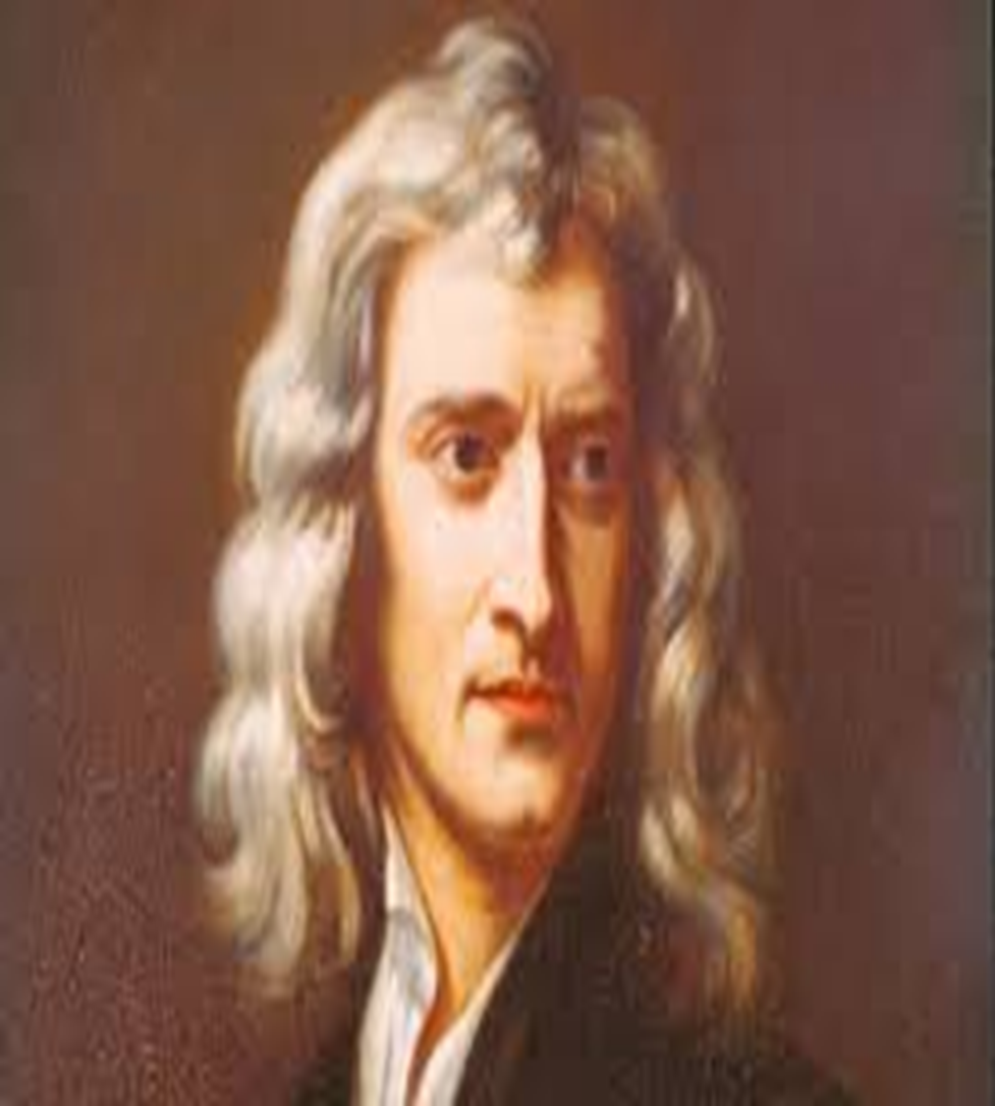
Concerning the historicist view, Gregg says: "A unique characteristic of this line of interpretation is its advocacy of what is called the "year-for-a-day principle."'" He lists the following among the many adherents of this view: "John Wycliffe, John Knox, William Tyndale, Martin Luther, John Calvin, Ulrich Zwingli, Phillip Melanchthon, Sir Isaac Newton, Jan Huss, John Foxe, John Wesley, Jonathan Edwards, George Whitefield, Charles Finney, C. H. Spurgeon, Matthew Henry, Adam Clarke, Albert Barnes, E. B. Elliot, H. Grattan Guinness, and Bishop Thomas Newton." (S. Gregg, "Revelation: Four Views," Nashville: Thomas Nelson Pub, 1997, p. 34.)

Slide 11

Showdown at Glacier View, 1980
After speaking in Paulin Hall/ PUC in October of 1979, Ford had 9 months to prepare a book on what he believed. As he assaulted everything for which Adventism stands, he pompously came to Glacier View and declared, “the primary point of tension at Glacier View as a split between the administrators present and their methodology, and theologians and biblical scholars present and their methodology. Administrators, the book contends, adhered primarily to the proof-text method of biblical interpretation, while scholars held to the historical method, which factored in biblical languages, context, original intent, and so forth. “In the thinking of the majority at Glacier View, Adventist tradition was the norm for interpreting the Bible, rather than the Bible for tradition” (pg. 61).

Slide 12
The Problem at Glacier View-Illustrated
In a post exilic class in college, the instructor took Micah 5:2 and said the historical method of study was the only way the verse could be interpreted. Micah 5:2 reads, “But thou, Bethlehem Ephratah, though thou be little among the thousands of Judah, yet out of thee shall he come forth unto me that is to be ruler in Israel; whose goings forth have been from of old, from everlasting.” He said it only applied to Micah’s day.
I challenged him with “The Son of David must be born in David's city. Out of Bethlehem, said the prophet, “shall He come forth ... that is to be ruler in Israel; whose goings forth have been from of old, from the days of eternity.” Micah 5:2
PK, pg. 697 says it applied to the Messiah. Matthew 2:6 says it applied to the Messiah. “And when he had gathered all the chief priests and scribes of the people together, he demanded of them where Christ should be born. And they said unto him, In Bethlehem of Judaea: for thus it is written by the prophet, And thou Bethlehem, in the land of Juda, art not the least among the princes of Juda: for out of thee shall come a Governor, that shall rule my people Israel.” Matthew 2:4-6
Do we take the prophet and the Bible, or the scholar and the historical method???

Slide 13

What if ‘scholarly research’ leads one to reject the papacy as the antichrist, to reject the investigative judgment beginning in 1844, to believe that Christ took a sinless nature in His incarnation and so on? What then?? Are we at the mercy of SCHOLARS who are as plentiful as used cars?? How do we determine what is right and who is telling the truth?? There must be an absolute authority upon whom we can depend to help us understand with confidence the Bible!! That absolute, canonical, divine interpreter is Ellen White. If she is not this, then she is from the devil. She is NOT just pastoral!!!!

Slide 14
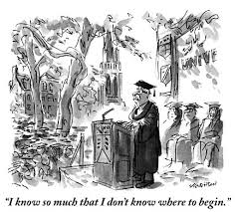
Scholarly Trash!!!
When someone, like my college professor, or like Desmond Ford, become so intelligent that they bypass the plain teaching of the Bible and the simple statements of Ellen White; then, their scholarship becomes stupidity; their intelligence becomes insanity!! Fortunately, at Glacier View, there were still a few clear heads that held firm to the Bible and the SOP!!!

Slide 15
How very Sad!
“It was Ford’s views on righteousness by faith which shone high above the sterile controversies over apocalyptic prophecy. Ford’s preaching of forensic atonement was a breath of fresh air blowing softly on weary, desert-bound souls like me, withering in legalistic perfectionism….The fact is that Adventism continues to stumble under the rigor mortis of the failed doctrinal experiment it still carries on its back. Ford knew that about 1844 and moved on; many scholars gathered at Glacier View agreed with him on many points, before administrators hijacked the meeting and issued the papal bull Adversus Haereses Glacierum Vieworum. Likewise, hundreds of ministers and tens of thousands of members have moved on to superior matters of the faith. (Read here the independent report Spectrum published in 1980.) Many left the church altogether; others decided to stay because, like Des, they refuse to leave Adventism for disagreeing over the interpretation of an obscure passage in the book of Daniel. Adventism means more to them than doctrinal acrobatics, ancient numerology and administrative tunnel vision.” André Reis, Ph.D., is the author of the upcoming book The Day of Atonement in the Book of Revelation. ‘Adventism Today.org April 10, 2019

Slide 16
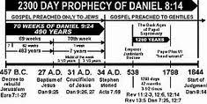
You Do Not Like 1844, then Leave!

Slide 17

Ashamed or Grateful???
Do you hide your face in shame when Ellen White is mentioned? Do you shy away from the investigative judgment because you have never studied it or because you agree with Martin, Froom ,and Barnhouse?? Would you just as soon not hear about the antichrist because you are so close to Rome, you want to kiss Francis's toes?? Are you weary of hearing about 1844 when you should be rejoicing in God’s greatness? A day of reckoning is coming!

Slide 18

Fordite or Historic?????????
It was 1991. He was a visiting evangelist. He said things a little strange and I thought he might be a follower of the teachings of Desmond Ford. So, I asked him right at the table, “What do you think of Desmond Ford?” “Ford was just a little early.” If he came 10 years later, he would have been heralded as the savior of Adventism.” Friend, how about you? Do you still love the old, Advent truths, or are you an evangelical, saved in your sins Adventist who doesn’t want to hear the SOP or speak of the sanctuary and 1844??? The choice is yours.

Slide 19
Still Happening Today!
Sydney Adventist Forum Honours the Legacy of Dr Desmond Ford
Presenters: Mrs Althea Halliday, Dr Norm Young, Dr Trevor Lloyd and Dr Lynden Rogers
Date and Time: November 9, 3:00 pm
Venue: Church in the Trees, Morisset
Desmond Ford did much for Adventism. Forum is taking this opportunity of honouring this gracious, 65-year contribution. We will briefly review the historical lead-up to Glacier View and examine aspects of the event itself. Over the last 22 years Forum has hosted a number of full-day events involving Des, and we will revisit highlights from these. Along the way we will hear from Des himself, Dr Arthur Patrick and Dr Alwyn Salom, as they answer questions about Glacier View at Epping Boys High on Oct 22, 2005, the only occasion on which Dr Salom spoke publicly about GV. And there will be a wonderful collection of messages and anecdotes. Come along and help us honour the memory and the contribution of Dr Ford.
Kind regards,
Nadine Ferreira
Administration Assistant—Discipline of Science & Mathematics
Avondale College of Higher Education
avondale-full-logo

