Slide 1
Behind the Door pt 11:
World War I

Slide 3
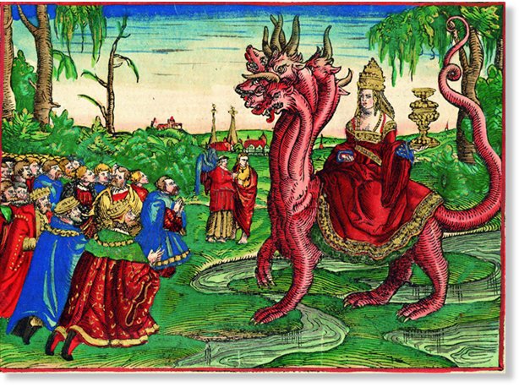
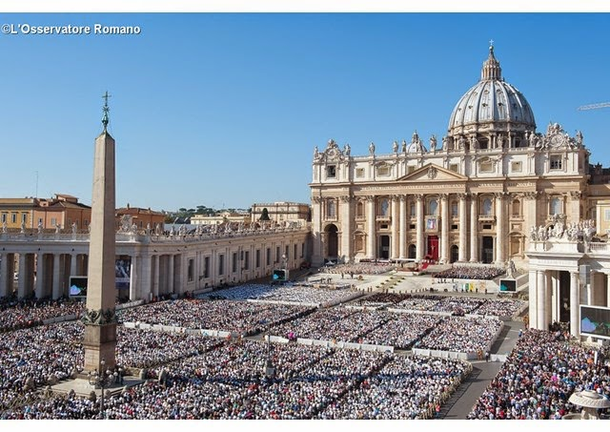

Slide 7
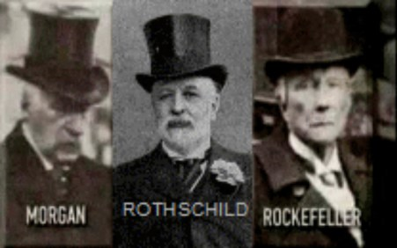
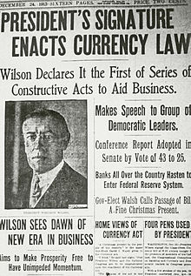

Slide 8
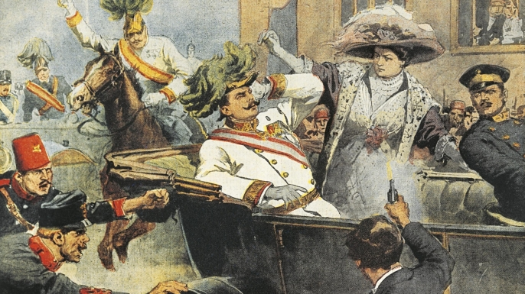
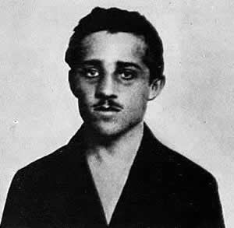
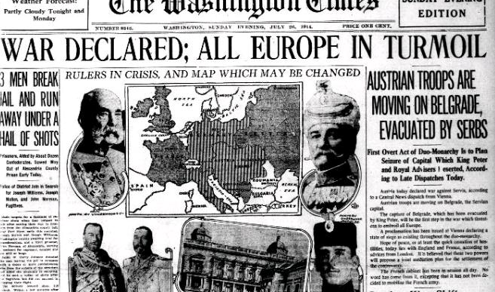
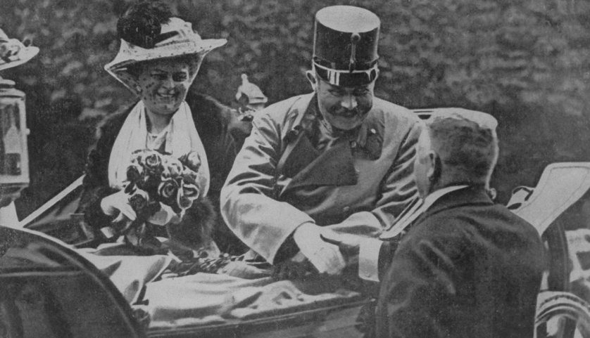
Assassin: Gavrilo Princip
Archduke Franz Ferdinand

Slide 11
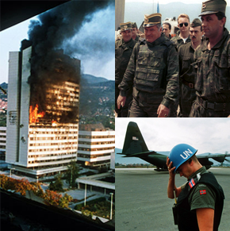
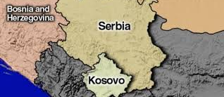
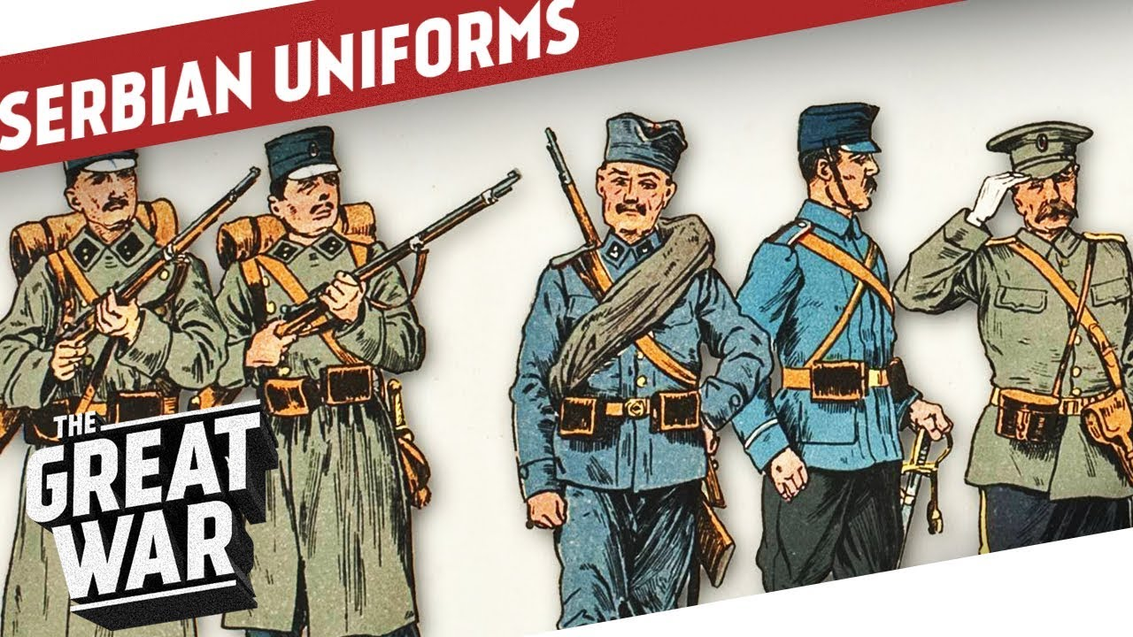

Slide 12
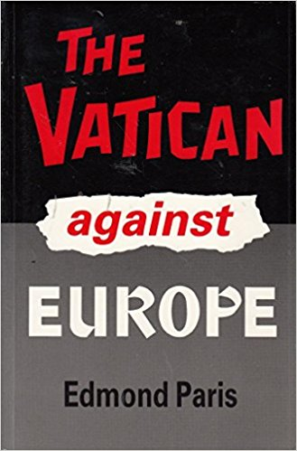
“The Pope approves of Austria’s harsh treatment of Serbia. He has no great opinion of the armies of Russia and France in the event of a war with Germany. The Cardinal Secretary of State does not see when Austria could make war if she does not decide to do so now….” There, in true colours, is the Vicar of Christ [the pope], the gentle apostle of peace, the Holy Pontiff whom pious authors represent as having died of sorrow at seeing the outbreak of war. — Edmund Paris. The Vatican against Europe, The Wickliffe Press, p. 14.

Slide 13
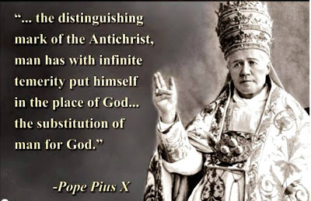
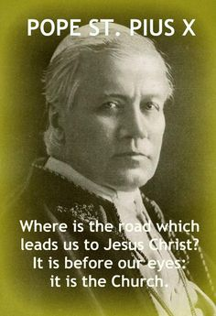
Pope Pius X (1903-1914)

Slide 14
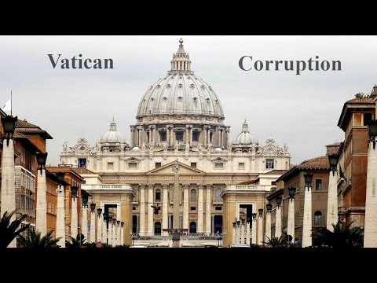
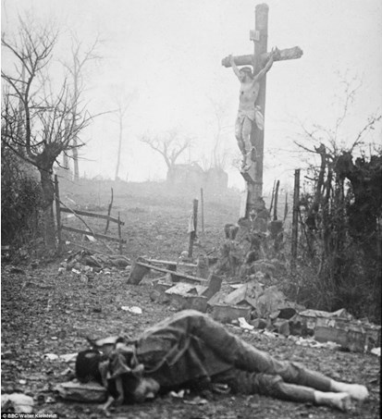

Slide 15
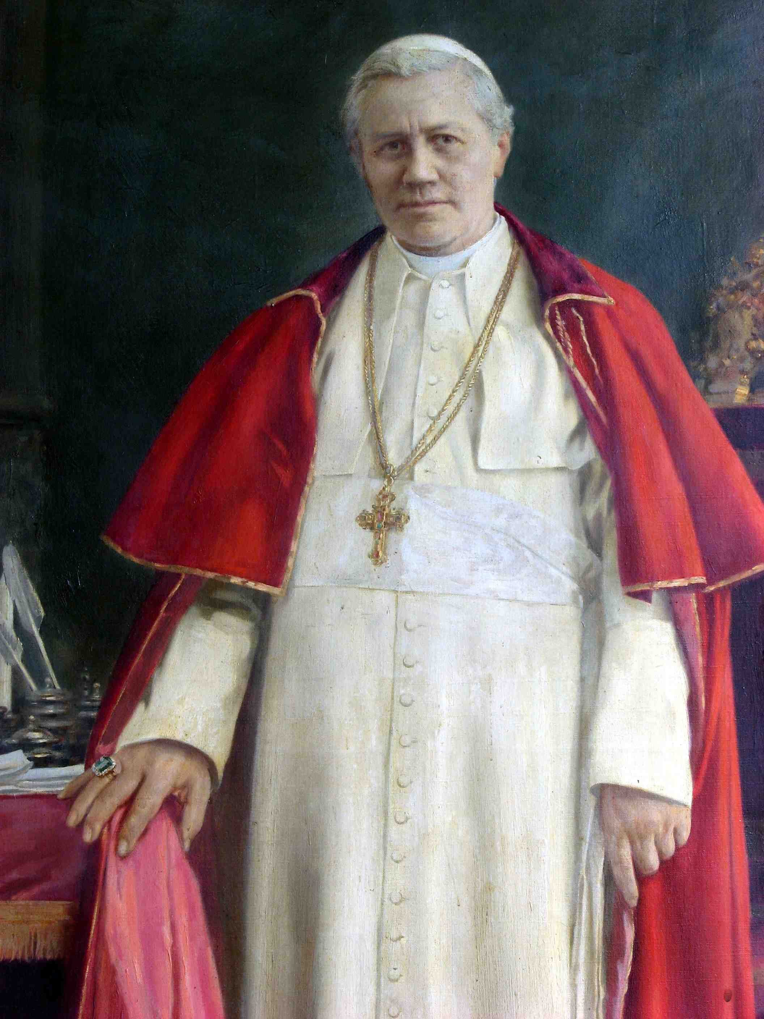
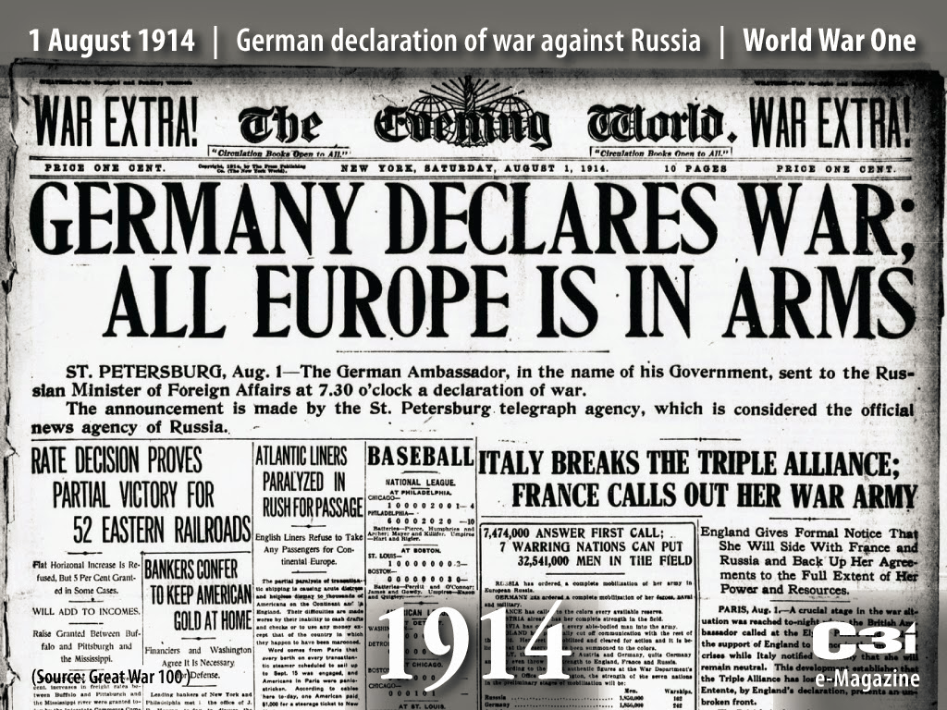

Slide 16
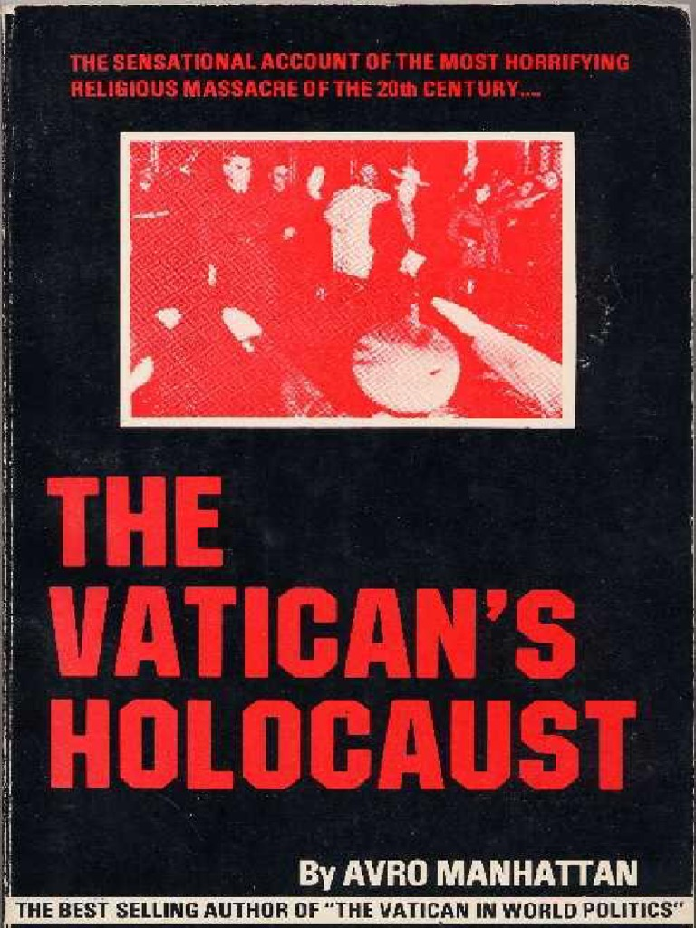
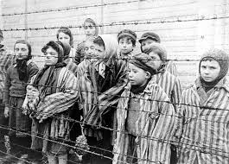

Slide 17
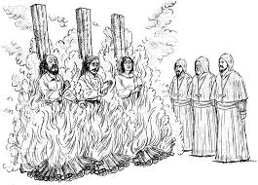

Slide 18
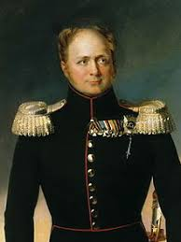
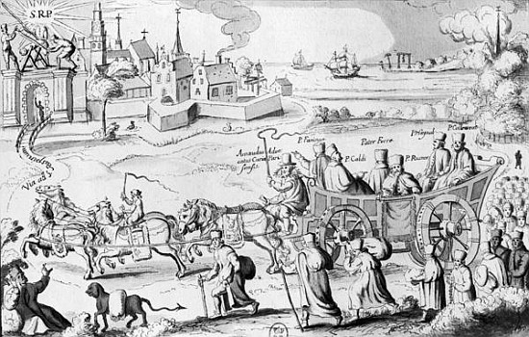
Russian Emperor Alexander I (1801-1825)

Slide 19
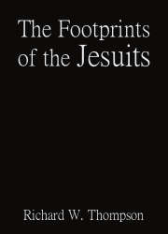
The Russian emperor, Alexander, was currently compelled to issue a royal decree in 1816, by which he expelled them [the Jesuits] from St. Petersburg and Moscow. This proving ineffectual, he issued another in 1820, excluding them entirely from the Russian dominions. — R.W. Thompson, The Footprints of the Jesuits, Hunt and Eaton, pp. 245, 246.

Slide 20
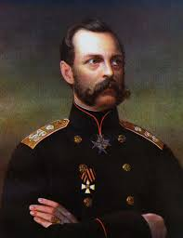
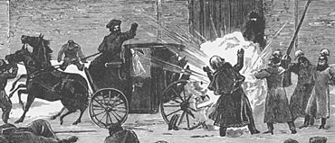
Alexander II had progressed well with his great reforms and had attached his signature to a Constitution to be adopted by Russia. The next day a bomb was thrown at his carriage, which killed and wounded a number of Cossacks, who accompanied the carriage. The Emperor in deep sympathy left the carriage to look at the dying men, when a second bomb blew him to pieces. — Arno Gaebelien, Conflict of the Ages, The Exhorters, p. 85.
Alexander II of Russia (1855-1881)

Slide 21
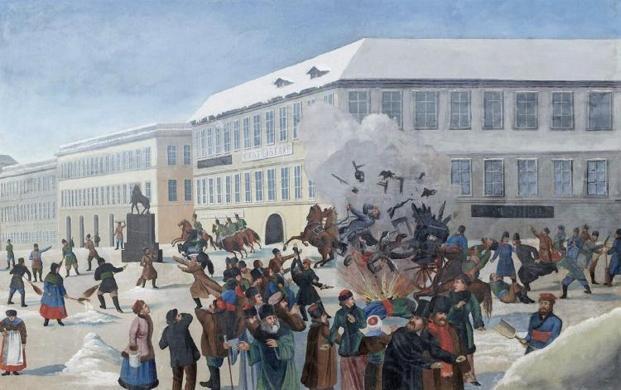

Slide 22
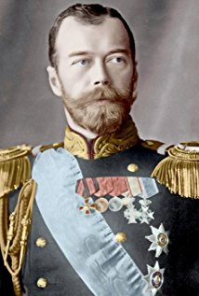
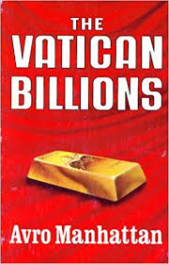
Czar Nicholas II (1894-1917)

Slide 23
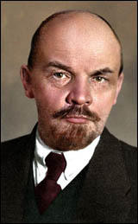
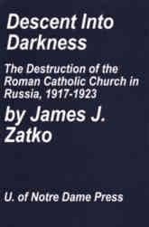
The instruments of this new alliance between the Soviets and the Vatican were to be the Jesuits, described as the hereditary enemies of the Orthodox Church. Reportedly, there were large numbers of representatives of the Jesuit Order in Moscow during the Revolution. — James Zatko, Descent into Darkness, University of Notre Dame Press, p. 111.
Vladimir Lenin

Slide 24
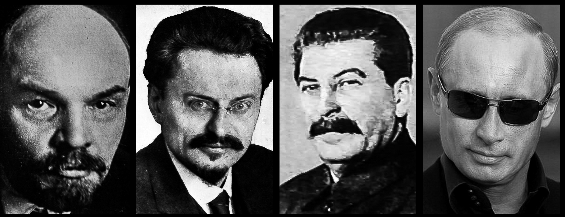
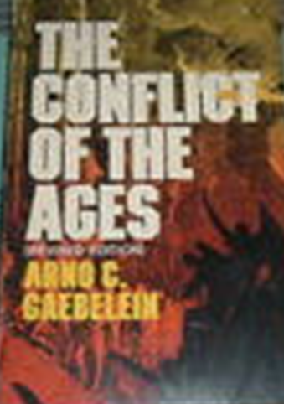
Lenin Trotsky Stalin
Among the 1,766,188 victims up to the beginning of 1922, figures obtained from the Soviet documents, nearly five thousand were priests, teachers, nuns, etc. of the Orthodox Church.... Nearly 100,000 Lutherans banished..... Whole villages were wiped out.... Thousands of churches of the different branches have been demolished and the work of destruction goes on...... — Arno Gaebelien, Conflict of the Ages, The Exhorters, pp. 103-106.

Slide 26
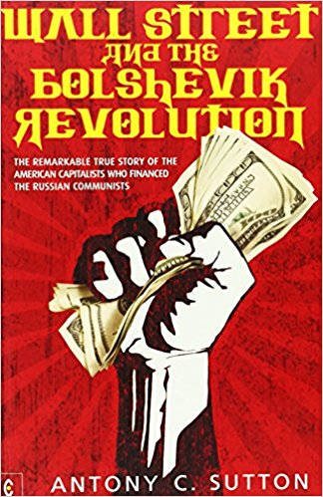
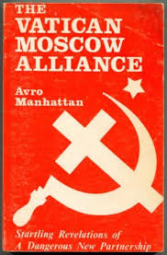
William Franklin Sands, a director of the Federal Reserve Bank of New York, had just contributed $1,000,000 to the Bolsheviks. — Anthony Sutton, Wall Street and the Bolshevik Revolution, Veritas Publishing, pp. 133, 134.

Slide 27
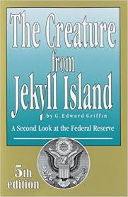
In the February 3, 1949, issue of the New York Journal American, Schiff’s grandson, John, was quoted by columnist Cholly Knickerbocker as saying that his grandfather [Jacob Schiff] had given about twenty million dollars for the triumph of Communism in Russia. — G. Edward Griffin, The Creature from Jekyll Island, American Opinion Publishing, p. 265.

Slide 28
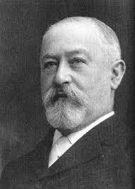
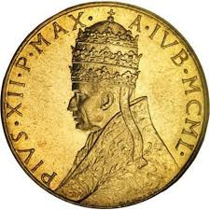
Jacob Schiff

Slide 30
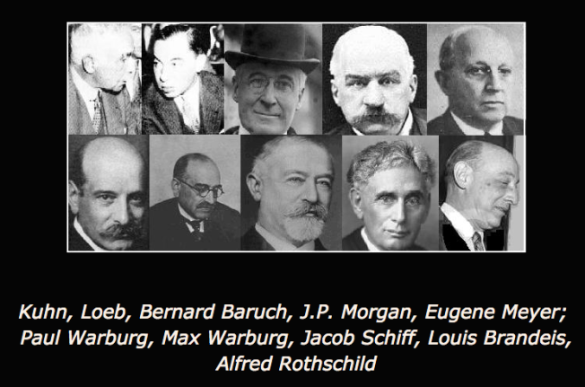

Slide 31
