Slide 1
Titanic: the Unsinkable
WHY?

Slide 2
One Thing in Common
1. Why was the War of 1812 fought and millions died?
2. Why was Andrew Jackson almost killed by an assassins bullet in 1835?
3. Why was Abraham Lincoln gunned down in April of 1865?
4. Why were the wealthy aboard the Titanic killed when Titanic went down?
5. Why was Louis T. McFadden, who served as Chairman of the United States House Committee on Banking and Currency during the Sixty-sixth through Seventy-first Congresses, or 1920-1931, poisoned to death in 1936?
6. Why was John Kennedy killed in Dallas, Nov. 22, 1963?

Slide 3
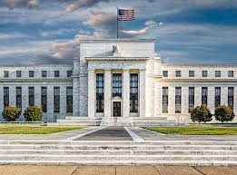
Opposed to the Central Bank
The war, the assassinations, and the sinking of a ship all had to do with one thing. These men and untimely deaths that came to them because they opposed a central bank in the US! They realized, like their opponents the golden rule- “the one who has the gold makes the rules”.

Slide 4
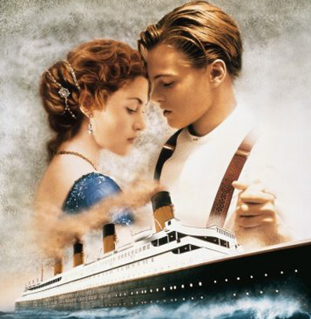
They Made it a Love Story!

Slide 5
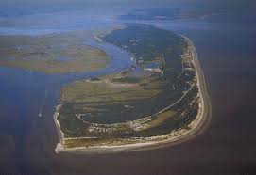
Where The Story Begins!

Slide 6
The Meeting
In 1910, seven men met on Jekyll Island just off the coast of Georgia to establish a central bank, which they called the Federal Reserve Bank. These men were Nelson Aldrich and Frank Vanderlip, both representing the Rockefeller financial empire; Henry Davison, Charles Norton, and Benjamin Strong, representing J.P. Morgan; and Paul Warburg, representing the Rothschild banking dynasty of Europe. With the setting up of a central bank, the Jesuits and these men realized that they had a bottomless pit of money to use for wars and to control America by its jugular vein. With a central bank at its disposal, America would become a debtor nation, reduced to a two class system, and become a 3rd world country. With the central bank in place, the Jesuits could bring America and the world to a time ‘when no man could buy or sell, save he that had the mark……….” Revelation 13:16,17

Slide 7
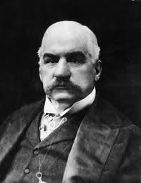
He Built it!

Slide 8
JP had Connections
The Titanic was one of a fleet of ships owned by the White Star Line, an international shipping company.
“Banking was not the only business in which Morgan had a strong financial interest. Using his control over the nation’s railroads as financial leverage, he had created an international shipping trust which included Germany’s two largest lines plus one of the two in England, the White Star
Lines.” G. Edward Griffin, The Creature from Jekyll Island, p. 246.

Slide 9
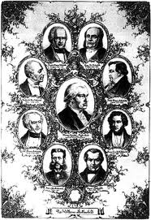
Morgan’s and Rothschild’s/ Presto!!!
“The Morgan’s were friendly competitors with the Rothschild’s and became socially close to them. Morgan’s London-based firm was saved from financial ruin in 1857 by the Bank of England over which the Rothschild’s held great influence. Thereafter, Morgan appears to have served as a Rothschild financial agent and went to great lengths to appear totally American....” CFJI, pg. 209

Slide 10
Rockefeller/Rothschild Connection
“Schiff’s ‘important financial connections in Europe’ were the Rothschild's and their German representatives, the M.M. Warburg Company of Hamburg Amsterdam. Within twenty years the Rothschild's, through their Warburg-Schiff connection,
had provided the capital that enabled John D. Rockefeller to greatly expand his Standard Oil empire. They also financed the activities of Edward Harriman
(Railroads) and Andrew Carnegie (Steel). – Des Griffin, Descent into Slavery,
Emissary Publications, pp. 36, 37.

Slide 11
Morgan/Rockefeller/Rothschild/Jesuit Connection
“Aware that the Rothschild’s are an important Jewish family, I looked them up in Encyclopedia Judaica and discovered that they bear the title ‘Guardians of the Vatican Treasury’…. The appointment of Rothschild gave the black papacy absolute financial privacy and secrecy. Who would ever search a family of orthodox Jews for the key to the wealth of the Roman Catholic Church? — F. Tupper Saussy, Rulers of Evil, Harper Collins, page 160, 161

Slide 12
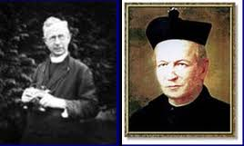
He Boarded it!

Slide 13
The Provincial Gets Off
“A vacationing priest, Father Francis Browne, caught these poignant snapshots of his fellow passengers, most of them on a voyage to eternity. The next day Titanic made her last stop off the coast of Queenstown, Ireland. Here tenders brought out the last passengers; mostly Irish immigrants headed for new homes in America. And here, the lucky Father Browne disembarked.... Father Browne caught Captain Smith peering down from Titanic’s bridge, poised on the brink of destiny. — The Secrets of the Titanic, National Geographic, video tape, 1986.
Here is Jesuit treachery at its finest. The Provincial [Father
Francis Browne] boards Titanic, photographs the victims, most assuredly briefs the Captain concerning his oath as a Jesuit, and the following morning bids him farewell. — Eric J. Phelps, Vatican Assassins, Halycon Unified Services, p. 427

Slide 14
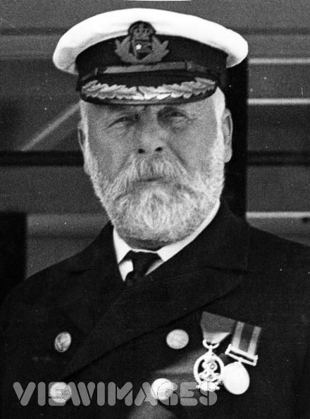
He Sunk it

Slide 15
Shocking!
“On board the Titanic that night, Edward Smith knew his duty. He was under oath. The ship had been built for the enemies of the Jesuits. After three days at sea with only one pair of glasses for the bridge, Edward Smith propelled the Titanic full speed ahead, twenty-two knots, on a moonless dark night through a gigantic ice field nearly eighty square miles in area. Edward Smith did this despite at least eight telegrams warning him to be more cautious because he was going too fast. Did Edward Smith need one caution? No, he had been traveling those waters for twenty-six years. He knew there were icebergs in that area. But eight cautions did not stop this man who was under the Jesuit oath, and under orders to destroy the Titanic.” Secret Terrorists, pg. 62

Slide 16
Where did You Go?
“The absurdity of warning veteran Captain Edward Smith repeatedly on Titanic’s tragic night to slow down is nothing short of preposterous. The fact that Smith never listened or heeded the warnings is insane. He had been given orders from his god in the Vatican, and nothing would turn him from his course. The encyclopedias paint a very tragic picture of Smith in his last hours. When it came time to give the order to load and lower the lifeboats, Smith wavered and one of his aids had to approach him for the order to be given. Smith’s legendary skills of leadership seem to have left him; he was curiously indecisive and unusually cautious on that fatal night. Are these words to describe a legendary sea captain with 26 years of experience, or are these words to describe a man who was struggling in his mind whether he should do his duty as a sea captain or obey his master who told him to sink the ship?” ST, pg. 62,63

Slide 17
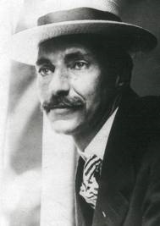
He went down with it!

Slide 18
Bye, bye Gold!
“There were a number of very rich and powerful men who made it abundantly clear that they were not in favor of the Federal Reserve System. J.P. Morgan was ordered by the Jesuits to build the Titanic. This ‘unsinkable’ ship would serve as the death ship for those who opposed the Jesuits’ plan for a Federal Reserve system. These rich and powerful men would have been able to block the establishment of the Federal Reserve, and their power and fortunes had to be taken out of their hands. They had to be destroyed by a means so preposterous that no one would suspect that they were murdered, and no one would suspect the Jesuits. The Titanic was the vehicle of their destruction.” ST, pg. 59

Slide 19
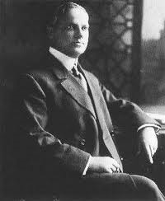
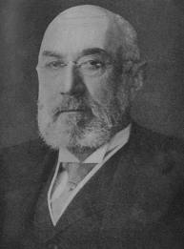
So did THEY

Slide 20
It is Over!
“All the wealthy and powerful men the Jesuits wanted to get rid of were invited to take the cruise. Three of the richest and most important of these were Benjamin Guggenheim, Isador Strauss, the head of Macy’s Department Stores, and John Jacob Astor, probably the wealthiest man in the world. Their total wealth, at that time, using dollar values of their day was more than 500 million dollars. Today that amount of money would be worth nearly eleven billion dollars. These three men were coaxed and encouraged to board the floating palace. They had to be destroyed because the Jesuits knew they would use their wealth and influence to oppose a Federal Reserve Bank.” ST, pg. 59

Slide 21
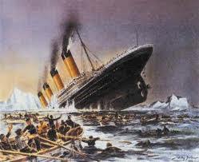
So did others

Slide 22
He Foretold it!
Futility, or the Wreck of the Titan was an 1898 novella written by Morgan Robertson. The story features the ocean liner Titan, which sinks in the North Atlantic after striking an iceberg. The Titan and its sinking have been noted to be very similar to the real-life passenger ship RMS Titanic, which sank fourteen years later.

Slide 23
Similarities
Unsinkable
  The Titanic was the world's largest luxury liner (882 feet, displacing 53,000 long tons), and was once described as being (nearly) "unsinkable".
  The Titan was the largest craft afloat and the greatest of the works of men (800 feet, displacing 75,000 tons), and was considered "unsinkable".
Lifeboats
  The Titanic carried only 20 lifeboats, less than half the number required for her passenger capacity of 3000.
  The Titan carried "as few as the law allowed", 24 lifeboats, less than half needed for her 3000 capacity.

Slide 24
Amazing!!!
Struck an iceberg
  Moving too fast at 23 knots, the Titanic struck an iceberg on the night of April 14, 1912 in the North Atlantic 400 miles away from Terranova.
  Also on an April night in North Atlantic 400 miles from Newfoundland (Terranova) , the Titan hit an iceberg while traveling at 25 knots.
The Unsinkable Sank
  The unsinkable Titanic sank, and more than half of her 2208 passengers died.
  The indestructible Titan also sank, more than half of her 2500 passengers drowning, their "voices raised in agonized screams."

Slide 25
Summary
1. In order to bring the world to a place where no man can buy or sell, the money system of the planet must be controlled.
The Jesuit Order/Papacy was all over Titanic:
a. controlled the builder-JP Morgan
b. controlled the captain
c. had the motive to eliminate opposers of the central bank.
d. war, assassination, and economic turmoil have been the results of Titanic’s sinking!
e. The Jesuits/papacy alone benefitted from the sinking of the Titanic!

