Slide 1
Final Scenes, pt. 22
‘The Unsure Conference Men’

Slide 2
A Must!
“It would be well for us to spend a thoughtful hour each day in contemplation of the life of Christ. We should take it point by point, and let the imagination grasp each scene, especially the closing ones. As we thus dwell upon His great sacrifice for us, our confidence in Him will be more constant, our love will be quickened, and we shall be more deeply imbued with His spirit. If we would be saved at last, we must learn the lesson of penitence and humiliation at the foot of the cross.” DA, pg. 83

Slide 3
Unknown
So many revealed their true feelings about Jesus at the cross. This was a deciding moment in the minds of those who were there, plus the untold millions who have been influenced by that event through all time. Many characters would never be known save for their behavior at the cross. The man we will look at this morning is one of them.

Slide 4
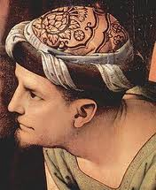
Joseph of Arimathea
Arimathea is the Greek form for the word Ramah. Ramah was a common name used in Israel for towns. Therefore, it is difficult to pinpoint exactly to which one Joseph belonged.

Slide 5
What we know of him!
The Bible tells us that he was ‘an honorable counselor’. Mk 15:43 Luke tells us that he was ‘a good man, and a just.’ Lk. 23:50,51 John tells us that ‘he was a secret disciple of Jesus…for fear of the Jews.” Jn. 19:38 We know too that Joseph was a member of the Sanhedrin, the highest religious body in Israel, and he also was very wealthy.

Slide 6
Not Summoned for Jesus’ Trial
“(The same had not consented to the counsel and deed of them;) he was of Arimathaea, a city of the Jews: who also himself waited for the kingdom of God.” Lk. 23:51
“Not a few among the priests and rulers had been convicted by Christ's teaching, and only fear of excommunication prevented them from confessing Him. The priests well remembered the question of Nicodemus, "Doth our law judge any man, before it hear him, and know what he doeth?" John 7:51. This question had for the time broken up the council, and thwarted their plans. Joseph of Arimathaea and Nicodemus were not now to be summoned, but there were others who might dare to speak in favor of justice.” DA, pg. 699

Slide 7
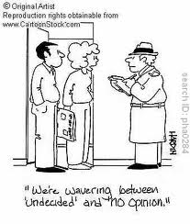
Summation
1. Joseph was a rich leader in ancient Adventism.
2. He was a good man and a fair one too.
3. He was an honorable counselor.
4. He was a secret follower of Christ.
5. He tried to use his position to protect Christ.
6. He feared coming out in favor of Christ until the crucifixion.

Slide 8
The same today
There are many in Adventism today just like these men. They see the apostasy, just like Joseph and Nicodemus did, but instead of speaking out boldly in defense of the truth, they fear lest they will step on someone’s toes and hurt their influence with the ‘brethren’. They regretted their decision. “He felt that he had lost much by not connecting himself with the Saviour during His life.” DA, pg. 775

Slide 9
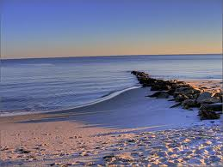
The Fear of the Jews
“These words spake his parents, because they feared the Jews: for the Jews had agreed already, that if any man did confess that he was Christ, he should be put out of the synagogue.” Jn. 9:22
“Nevertheless among the chief rulers also many believed on him; but because of the Pharisees they did not confess him, lest they should be put out of the synagogue:” Jn. 12:42

Slide 10
They Finally Come Forward
“Neither Joseph nor Nicodemus had openly accepted the Saviour while He was living. They knew that such a step would exclude them from the Sanhedrin, and they hoped to protect Him by their influence in its councils. For a time they had seemed to succeed; but the wily priests, seeing their favor to Christ, had thwarted their plans. In their absence Jesus had been condemned and delivered to be crucified. Now that He was dead, they no longer concealed their attachment to Him. While the disciples feared to show themselves openly as His followers, Joseph and Nicodemus came boldly to their aid. The help of these rich and honored men was greatly needed at this time. They could do for their dead Master what it was impossible for the poor disciples to do; and their wealth and influence protected them, in a great measure, from the malice of the priests and rulers.” DA, pgs. 773,774

Slide 11
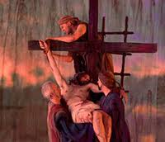
Big Help
“This man went unto Pilate, and begged the body of Jesus. And he took it down, and wrapped it in linen, and laid it in a sepulchre that was hewn in stone, wherein never man before was laid. And that day was the preparation, and the sabbath drew on.” Lk. 23:52-54

Slide 12
Did what Disciples Couldn’t
“The request of Joseph was granted. While John was troubled about the burial of his Master, Joseph returned with Pilate's order for the body of Christ; and Nicodemus came bringing a costly mixture of myrrh and aloes, of about a hundred pounds' weight, for His embalming. The most honored in all Jerusalem could not have been shown more respect in death. The disciples were astonished to see these wealthy rulers as much interested as they themselves in the burial of their Lord.” DA, pg. 773

Slide 13
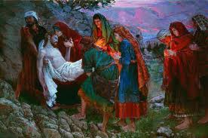
Joseph Helps
The event that crushed the disciples solidified Joseph and Nicodemus. The cross ended the disciples hopes, but it confirmed the hopes of Joseph and Nicodemus. Now, the disciples were afraid, but Joseph and Nicodemus were courageous and bold!

Slide 14
A New Day!
“Gently and reverently they removed with their own hands the body of Jesus from the cross. Their tears of sympathy fell fast as they looked upon His bruised and lacerated form. Joseph owned a new tomb, hewn in a rock. This he was reserving for himself; but it was near Calvary, and he now prepared it for Jesus. The body, together with the spices brought by Nicodemus, was carefully wrapped in a linen sheet, and the Redeemer was borne to the tomb. There the three disciples straightened the mangled limbs, and folded the bruised hands upon the pulse less breast. The Galilean women came to see that all had been done that could be done for the lifeless form of their beloved Teacher. Then they saw the heavy stone rolled against the entrance of the tomb, and the Saviour was left at rest.” DA, pg. 774

Slide 15
Unwavering Faith
On that Sabbath, when Christ lay in the grave, Nicodemus had opportunity for reflection. A clearer light now illuminated his mind, and the words which Jesus had spoken to him were no longer mysterious. He felt that he had lost much by not connecting himself with the Saviour during His life. Now he recalled the events of Calvary. The prayer of Christ for His murderers and His answer to the petition of the dying thief spoke to the heart of the learned councilor. Again he looked upon the Saviour in His agony; again he heard that last cry, "It is finished," spoken like the words of a conqueror. Again he beheld the reeling earth, the darkened heavens, the rent veil, the shivered rocks, and his faith was forever established. The very event that destroyed the hopes of the disciples convinced Joseph and Nicodemus of the divinity of Jesus. Their fears were overcome by the courage of a firm and unwavering faith.” DA, pgs. 775,776

Slide 16
Another Test is Coming
The test for the world in the first century was the cross. The cross changed the thinking/stance of two conference men in the long ago. Before, they had been hiding their faith in the Son of God; now, with the death of Christ, they came boldly to the front and were willing to give all for Jesus!
Are their conference men today doing the same thing? Do they see the apostasy, but biding their time, waiting for something before they make a firm decision for Christ? The test in the near future called Sunday will be their Rubicon!!

Slide 17
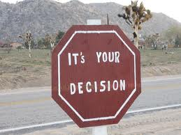
Decision Time
“And the word of God increased; and the number of the disciples multiplied in Jerusalem greatly; and a great company of the priests were obedient to the faith.” Acts 6:7
It wasn’t just Joseph and Nicodemus that embraced Christ; others within ancient Adventism did too! Will it happen again?

