Slide 1
What An Unkind Individual!

Slide 2
Could that be Justified?
Would Someone dare to call a group of people ‘children of hell’? Would Someone dare to call a group of people ‘blind and foolish?’ In our vernacular, we would say idiots and blind as bats! Would Someone dare to call a group of people ‘hypocrites’ and those people were the greatest religionists in Bible history? Would Someone dare call a group of people a bunch of ‘serpents and snakes’? And this Someone said all this in a brief sermon no less!

Slide 3
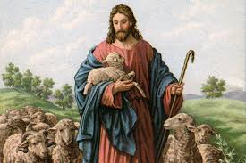
Who was this Someone?
Jesus, the most wonderful Man who ever lived felt compelled to call the 7th Adventist leaders and scholars of the first century those names.’
1. children of hell.
2. fools or as we would say ‘idiots’.
3. blind as bats.
4. hypocrites.
5. serpents.
6. snakes.
And, He did it all in one sermon. And, He had a specific reason for doing so.

Slide 4
What Was the Reason?
“They had assailed Him in great numbers, but their schemes to ensnare and condemn Him had been in vain. Challenge after challenge He had met, presenting the pure, bright truth in contrast to the darkness and errors of the priests and Pharisees. He had set before these leaders their real condition, and the retribution sure to follow persistence in their evil deeds. The warning had been faithfully given. Yet another work remained for Christ to do. Another purpose was still to be accomplished. The interest of the people in Christ and His work had steadily increased. They were charmed with His teaching, but they were also greatly perplexed. They had respected the priests and rabbis for their intelligence and apparent piety. In all religious matters they had ever yielded implicit obedience to their authority. Yet they now saw these men trying to cast discredit upon Jesus, a teacher whose virtue and knowledge shone forth the brighter from every assault……

Slide 5
Breaking the Chains of Deception
“They looked upon the lowering countenances of the priests and elders, and there saw discomfiture and confusion. They marveled that the rulers would not believe on Jesus, when His teachings were so plain and simple. They themselves knew not what course to take. With eager anxiety they watched the movements of those whose counsel they had always followed. In the parables which Christ had spoken, it was His purpose both to warn the rulers and to instruct the people who were willing to be taught. But there was need to speak yet more plainly. Through their reverence for tradition and their blind faith in a corrupt priesthood, the people were enslaved. These chains Christ must break. The character of the priests, rulers, and Pharisees must be more fully exposed.” Desire of Ages, pgs. 610-612

Slide 6
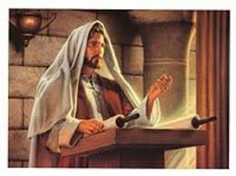
Exposing the Error
Error was being exalted as truth. Adventist leaders were telling the people lies and these lies had to be exposed!

