Slide 1
Charlie Kirk—My Turn

Slide 2
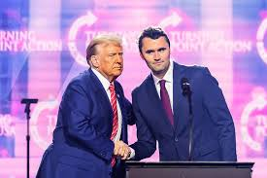
Never Heard of Him!!
Before September 10, 2025, I had never heard of Charlie Kirk. Since then, I have listened to several of his combative, straight up campus discussions with students and adults. I must say there is much that he said that resonates with me. At the same time, there were other things with which I didn’t agree.

Slide 3
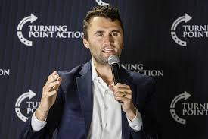
News to Me!!
Charlie Kirk, a young man of 31 with a young family, was horribly killed September 10, 2025 by an assassins bullet. Kirk was a public speaker, predominately speaking across university campuses across America and internationally as well. He was a very plain spoken person, leaning strongly on basic, fundamental beliefs. He firmly was against:
1. abortion
2. illegal immigration
3. the LGBTQ movement
4. affirmative action

Slide 4
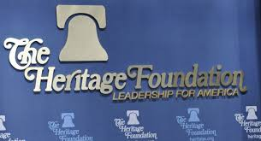
Kirk’s stands on almost everything were right down the line with the ultra conservative, right wing group called ‘The Heritage Foundation’. This is the group that President Trump has followed religiously in his policies!
However, there is ONE BIG thing with which Charlie Kirk was not in line with this group. Charlie Kirk had very strong convictions. The Lord used that to bring Charlie to embrace the 7th Day Sabbath or Saturday and this was a BIG PROBLEM!! This went contrary to the Heritage Group! BIG TIME!

Slide 5
Charlie Kirk’s Sabbath Keeping would Not Jive!
Meanwhile in his chapter on the U.S. Department of Labor, Jonathan Berry frames his proposals as part of divine history. “The Judeo-Christian tradition, stretching back to Genesis, has always recognized fruitful work as integral to human dignity, as service to God, neighbor, and family,” he writes, while claiming the Biden administration “has been hostile to people of faith.”
Berry worries that “God ordained the Sabbath as a day of rest, and until very recently the Judeo-Christian tradition sought to honor that mandate by moral and legal regulation of work on that day” and blames consumerism and secularism for the decline in Sabbath observance.
But he’s not content to reminisce about the good ol’ days when Americans went to church. He wants the federal government to push people back to church, and calls on Congress to “encourage communal rest by amending the Fair Labor Standards Act (FLSA) to require that workers be paid time and a half for hours worked on the Sabbath.” Berry argues this would lead to higher costs that would reduce work on the Sabbath.

Slide 6
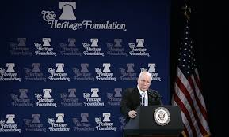
He Had to be Removed
Having such a well spoken, young man like Kirk standing for the Sabbath would not and could not be tolerated by the Heritage Foundation. Kirk had to be removed! How could you have the Heritage Foundation pushing for Sunday and one of its main spokesman advocating the Sabbath? Clearly, an irresolvable conflict that had to be dealt with immediately!

Slide 7
The Results of Kirk Being Slain
“Many across the country agree Kirk's tragic assassination in Utah on Sept. 10 — after his years of outreach to young people about faith, family, values and country — has sparked a religious revival, with scores of non-believers picking up a Bible for the first time. It's been dubbed the "Charlie Kirk Effect."
Matt Zerrusen, co-founder of Newman Ministry, a Catholic nonprofit organization that supports over 200 campus ministries nationwide, said he's seen an increase in student faith engagement. "I have not talked to anyone who has not seen an increase in Mass attendance," he recently told Catholic News Agency. "Some schools are reporting increases of 15%.“ Fox News 9-28-2025
“Kirk’s death has ignited an unexpected spiritual awakening, particularly among young people. Known for his bold declaration that he wanted to be remembered for his “courage of faith,” Kirk frequently shared the gospel at his events. Now, in the wake of his passing, churches are reporting unprecedented attendance, and Bible sales are soaring.” Washington Stand, Sept. 29, 2025

Slide 8
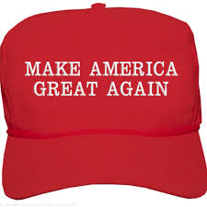
Saving America
“I’ve never seen politicians speak with this much conviction about their own faith, and be so confident in coming out publicly about their belief system and faith, and that may encourage more people to come to God,” said Morstad, who hosts a podcast, GSD Nation, on Christianity with his sons. “We obviously believe in Christian ethics in this family, and that the deterioration of those over the past several decades is a big reason why America is struggling — and coming back to that is part of what saving America looks like.”

Slide 9
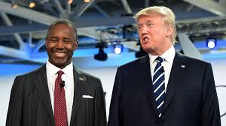
Forked Tongue!!
“Get on board of the revival that is coming… I want us all to remember, you cannot be the land of the free if you aren’t the home of the brave.” at Kirk’s funeral
Ben Carson encouraged everyone to be swept up by this false revival that is coming!! Since he’s an Adventist Catholic, who doesn’t read the Great Controversy, he encourages this revival!!

Slide 10
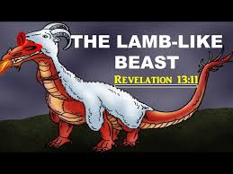
Someone Once Said…
“And I beheld another beast coming up out of the earth; and he had two horns like a lamb, and he spake as a dragon. And he exerciseth all the power of the first beast before him, and causeth the earth and them which dwell therein to worship the first beast, whose deadly wound was healed. And he doeth great wonders, so that he maketh fire come down from heaven on the earth in the sight of men, And deceiveth them that dwell on the earth by the means of those miracles which he had power to do in the sight of the beast; saying to them that dwell on the earth, that they should make an image to the beast, which had the wound by a sword, and did live.” Rev. 13:11-15

Slide 11
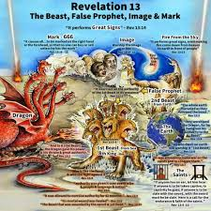
The 2 Beasts, and the image
The Bible declares THAT BEASTS IN PROPHECY REPRESENT KINGDOMS OR WORLD POWERS. (Daniel 7:17,23)
The first beast in Revelation 13:1-10;
1. rises in the Old World of the Mediterranean.
2. claims to be God on earth and claims power to forgive sins.
3. rules during the Dark Ages for 1,260 years.
4. demands that people honor her Sunday tradition.
5. persecutes those that resist her claims.
6. this power is the papacy!

Slide 12
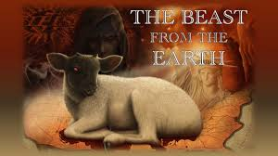
The 2nd beast/world power
The lamb like power:
1. begins with Christlike govt.– ends with a dragon styled govt.
2. keeps the church and state separate!
3. grants inalienable rights to its people.
4. ends up a persecutor.
5. tells the world to honor Sunday keeping like Rome.
6. rises in the New World
7. the 2nd power is America!

Slide 13

The Image looks just like the Papacy
The Image rise in America and looks just like the papacy;
Therefore,
1. it is a religious, political entity.
2. it will use American government to bring America back to morality.
3. it will want to impose its religious ideas just as Rome did!
4. The image will push her religious ideas on America and the world!
5. The image of the beast is the Apostate Protestant churches when she uses government to enforce her beliefs!! Namely, Sunday!

Slide 14
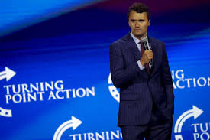
The Charlie Kirk Effect: Could it Be??
Charlie Kirk’s death has brought people back to church.
Charlie Kirk’s death is bringing a false revival to get people back to God.
Charlie Kirk’s death is making America religious again.
Will this be part of bringing in a Sunday Law?
Will this be part of pushing apostate Protestantism to legislate Sunday worship?
Time ONLY will tell!!

