Slide 1
Francis Speaks!
The Halls of Congress

Slide 2
Insanity!
“In a landmark event that could have many holding their breath, Pope Francis has agreed to address a joint meeting of Congress this fall. That sets the stage for an oration by an outspoken pontiff whose views on immigration and global warming clash with those of many Republicans who run the House and Senate.
Francis will speak Sept. 24, marking the first time the head of the world's Roman Catholics will address Congress. It will come during the first U.S. visit of Francis' two-year-old papacy, a trip also expected to include a White House meeting with President Barack Obama, a speech to the United Nations in New York and a Catholic rally for families in Philadelphia.
Saying he had "a bit of good news," House Speaker John Boehner delivered first word of Francis' speech at his weekly news conference Thursday.” Taken from Associated Press 2-5-2015

Slide 3
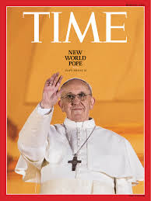
A Jesuit Speaks to Congress
The Jesuits were raised up in the late 1530’s for two reasons. One they were to destroy ever vestige of Protestantism: destroy religious liberty, destroy the middle class, and destroy civil liberty. Two, they were to restore the papacy to world dominance! He comes with a dagger behind his white robe!!!

Slide 4
Coming to Speak?!?!?
“Throughout Christendom, Protestantism was menaced by formidable foes. The first triumphs of the Reformation past, Rome summoned new forces, hoping to accomplish its destruction. At this time the order of the Jesuits was created, the most cruel, unscrupulous, and powerful of all the champions of popery. Cut off from earthly ties and human interests, dead to the claims of natural affection, reason and conscience wholly silenced, they knew no rule, no tie, but that of their order, and no duty but to extend its power. (See Appendix.)…

Slide 5
Continued
…The gospel of Christ had enabled its adherents to meet danger and endure suffering, undismayed by cold, hunger, toil, and poverty, to uphold the banner of truth in face of the rack, the dungeon, and the stake. To combat these forces, Jesuitism inspired its followers with a fanaticism that enabled them to endure like dangers, and to oppose to the power of truth all the weapons of deception. There was no crime too great for them to commit, no deception too base for them to practice, no disguise too difficult for them to assume. Vowed to perpetual poverty and humility, it was their studied aim to secure wealth and power, to be devoted to the overthrow of Protestantism, and the re-establishment of the papal supremacy.” GC, pg. 234

Slide 6
Part of Jesuit Oath
“I furthermore promise and declare that I will, when opportunity presents, make and wage relentless war, secretly or openly, against all heretics, Protestants and Liberals, as I am directed to do, to extirpate and exterminate them from the face of the whole earth; and that I will spare neither age, sex or condition; and that I will hang, burn, waste, boil, flay, strangle and bury alive these infamous heretics, rip up the stomachs and the wombs of their women and crush their infants heads against the walls, in order to annihilate forever their execrable race.”

Slide 7
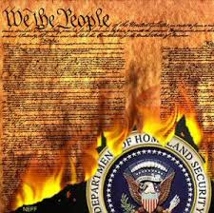
Wonder?
With their hate for Protestantism, what do they think of a Protestant document called the Constitution?
“The Vatican condemned the Declaration of Independence as ‘wickedness’… and called the Constitution of the United States ‘a Satanic document.’ — Avro Manhattan, The Dollar and the Vatican, Ozark Book Publishers, page 26.

Slide 8
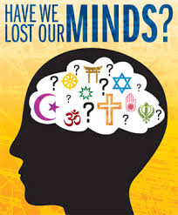
America’s Biggest Enemy!
Have we lost our minds? Are we now insane? What are we doing allowing this murderer to come to America, to speak in the halls of Congress? Only evil will come to America as a result of this heinous, wicked, and despicable act!!!

Slide 9
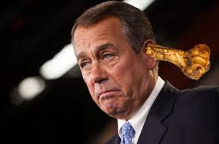
The Invitee
Attended Archbishop Moeller (Catholic) HS in Cincinnati and went to Xavier University, the 4th oldest Jesuit University in America! Boehner is simply following orders of his masters in bringing Francis here to America! He loves this because he isn’t working for America; he works for Rome! Second in line to the Presidency!!!!

Slide 10
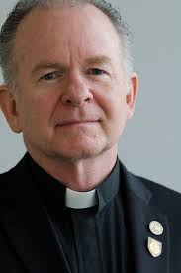
His Mentor/Advisor
‘He said that one of his goals would be to "help House members and staff discern which urges are coming from God and which are coming from them...[because] you need to know the difference.” Wikipedia

Slide 11
Rome Above All Others!
“The Roman Catholic Church, with all its ramifications throughout the world, forms one vast organization under the control, and designed to serve the interests, of the papal see. Its millions of communicants, in every country on the globe, are instructed to hold themselves as bound in allegiance to the pope. Whatever their nationality or their government, they are to regard the authority of the church as above all other. Though they may take the oath pledging their loyalty to the state, yet back of this lies the vow of obedience to Rome, absolving them from every pledge inimical to her interests.” GC, pg. 580

Slide 12
Surely Congress Would Object
“The numbers don't lie. Once again, there are more Catholics in Congress than members of any other religious denomination. And the numbers stay strong term after term.
Even though Catholics account for only about 22 percent of the U.S. population—admittedly the largest body of religious belief in the country—they make up 31 percent of the House and the Senate.” from ‘America, The National Catholic Review

Slide 13
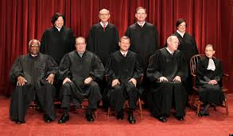
What About Supreme Court?
6 Supreme Court justices are Catholic, including the chief, John Roberts. The other 3 are Jewish and 2 of them are members of the CFR, a front organization of the Jesuits! They want their master to speak in Congress!!

Slide 14
A Priest Hit it!
“We are also determined to take possession of the United States; but we must proceed with the utmost secrecy.
Silently and patiently, we must mass our Roman Catholics in the great cities of the United States, remembering that the vote of a poor journeyman, though he be covered with rags, has as much weight in the scale of powers as the millionaire Astor, and that if we have two votes against his one, he will become as powerless as an oyster. Let us then multiply our votes; let us call our poor but faithful Irish Catholics from every corner of the world, and gather them into the very hearts of the cities of Washington, New York, Boston, Chicago, Buffalo, Albany, Troy, Cincinnati.
Under the shadows of those great cities, the Americans consider themselves a giant unconquerable race. They look upon the poor Irish Catholics with supreme contempt, as only fit to dig their canals, sweep their streets and work in their kitchens…

Slide 15
Right Before our Eyes!
…Let no one awake those sleeping lions, today. Let us pray God that they continue to sleep a few years longer, waking only to find their votes outnumbered as we will turn them forever, out of every position of honor, power and profit!… What will those so-called giants think when not a single senator or member of Congress will be chosen, unless he has submitted to our holy father the pope!
We will not only elect the president, but fill and command the armies, man the navies, and hold the keys of the public treasury!…
Then, yes! then, we will rule the United States and lay them at the feet of the Vicar of Jesus Christ, that he may put an end to their godless system of education and impious laws of liberty of conscience, which are an insult to God and man! — Charles Chiniquy, Fifty Years in the Church of Rome, Chick Publications, pp. 281,282.

Slide 16
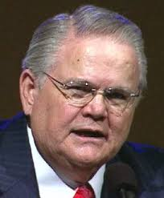
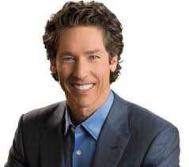
Surely the Churches

Slide 17
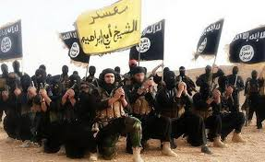
No More Protesting
The Protestants no longer are protesting Rome!! They are focusing on everyone in the Islamic world; ISIS, the Taliban, the PLO, anyone in the Islamic world has become the focus today. Francis comes riding in on a beautiful white horse; he is the man!
No one is protesting the hellish wickedness of Rome!!

Slide 18
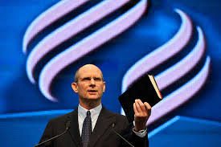
But, in Adventism, there…
For the last 5 years, Ted Wilson, the GC President, has advocated the preaching of the 3 Angel’s messages, but has never once specified that the papacy is the antichrist. He supported the ‘Great Hope, and the gutting of the message of the papacy as antichrist. He even doesn’t confess Sunday as the mark of the beast!!! Shocking!!!

Slide 19
Dumb Dogs!!
“His watchmen are blind: they are all ignorant, they are all dumb dogs, they cannot bark; sleeping, lying down, loving to slumber. Yea, they are greedy dogs which can never have enough, and they are shepherds that cannot understand: they all look to their own way, every one for his gain, from his quarter.” Isa. 56:10,11

Slide 20
What About You?
“They were impelled to zealously declare the truth and the danger which threatened souls. The words which the Lord gave them they uttered, fearless of consequences, and the people were compelled to hear the warning.
Thus the message of the third angel will be proclaimed. As the time comes for it to be given with greatest power, the Lord will work through humble instruments, leading the minds of those who consecrate themselves to His service. The laborers will be qualified rather by the unction of His Spirit than by the training of literary institutions. Men of faith and prayer will be constrained to go forth with holy zeal, declaring the words which God gives them. The sins of Babylon will be laid open. The fearful results of enforcing the observances of the church by civil authority, the inroads of spiritualism, the stealthy but rapid progress of the papal power--all will be unmasked. By these solemn warnings the people will be stirred. Thousands upon thousands will listen who have never heard words like these.” GC, pg. 606

