Slide 1
Israel, Hamas Battle!!

Slide 2
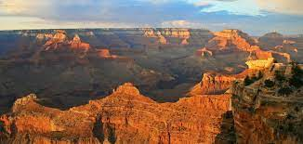
Sure Word of Prophecy
“We have also a more sure word of prophecy; whereunto ye do well that ye take heed, as unto a light that shineth in a dark place, until the day dawn, and the day star arise in your hearts:” 2 Peter 1:19
Clarity in the midst of a 1,000 voices!!!

Slide 3
Something Firm!
“Seventh-day Adventists are a prophetic people, living in a prophetic time, and delivering a prophetic message to a world bereft of hope and salvation. To fulfill our unique role in trying times, we must depend upon the guidance of the Holy Spirit as never before. The gift of prophecy, one of many charisms showered on the people of God by the Holy Spirit, represents God’s effort to communicate to and through human beings as He prepares a people to meet Him in peace. True prophecy—that of predicting the future, as well as its many other facets—is impossible for human beings to produce, but not for God. It falls neatly within His portfolio of divine responsibilities. It was the prophet Amos who declared: “Surely the Lord God does nothing, unless He reveals His secret to His servants the prophets” (Amos 3:7, NKJV). Beginning first in Eden with the pronouncement of the proto-gospel (Gen. 3:15) and onward to the present day, God has not left His people without a sure prophetic word. Peter continues the theme in his now-famous explanation of the divine/human harmony of prophetic discourse.” Gift of Prophecy, pgs. 71,72

Slide 4
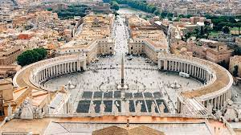
Blood from Someplace
“And the light of a candle shall shine no more at all in thee; and the voice of the bridegroom and of the bride shall be heard no more at all in thee: for thy merchants were the great men of the earth; for by thy sorceries were all nations deceived. And in her was found the blood of prophets, and of saints, and of all that were slain upon the earth.” Revelation 18:23,24

Slide 5
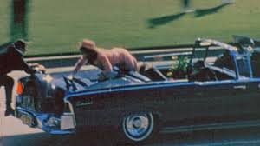
War and Terror and Assassination
1. Civil War, WW1, WW2, Korea, Vietnam, Balkans, Middle East-----
2. all over the world, 9-11, Oklahoma City, Gunpowder Plot----
3. Harrison, Taylor, Lincoln, McFadden, Kennedy, Henry 4, Alexander 1 and 2 of Russia----
We could go on and on!!! The Bible says Rome instigated these horrors!!!!

Slide 6
War from Where?
“Pope Pius X, in his hatred of the Orthodox Christians, was continually inciting Emperor Francis Joseph of Austria-Hungary to ‘chastise the Serbians.’ After Sarajevo, on July 26, 1914, Baron Ritter, Bavarian representative at the Holy See, wrote to his government: “The Pope approves of Austria’s harsh treatment of Serbia. He has no great opinion of the armies of Russia and France in the event of a war with Germany. The Cardinal Secretary of State does not see when Austria could make war if she does not decide to do so now….” There, in true colours, is the Vicar of Christ [the pope], the gentle apostle of peace, the Holy Pontiff whom pious authors represent as having died of sorrow at seeing the outbreak of war. — Edmund Paris. The Vatican against Europe, The Wickliffe Press, p. 14.
“One may say quite specifically that in 1914, the Roman Catholic Church started the series of hellish wars. It was then that the tribute of blood which she has always taken from the peoples began to swell into a veritable torrent. — Ibid, p. 48.

Slide 7
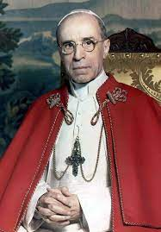
Current War—Vatican Connection
Where does the Vatican fit into the current war in the Middle East? In order to figure this out, we need to peel away a few layers of onion and it will become clear how they are connected and why!!
During WW2, the Vatican was intimately connected to the origins/leaders of the CIA. In fact, the man who founded the CIA/OSS was knighted by Pius 12 for his mission. The man was Wild Bill Donovan, a Catholic!

Slide 8
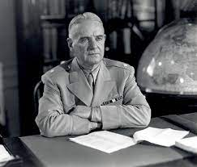
PAPACY Used the CIA to Create War, Terror!!
“One day in July 1944, as the Second World War raged throughout Europe, General William “Wild Bill” Donovan was ushered into an ornate chamber in Vatican City for an audience with Pope Pius XII. Donovan bowed his head reverently as the pontiff intoned a ceremonial prayer in Latin and decorated him with the Grand Cross of the Order of Saint Sylvester, the oldest and most prestigious of papal knighthoods. This award has been given to only 100 other men in history, who “by feat of arms, or writings, or outstanding deeds, have spread the Faith, and have safeguarded and championed the Church.”

Slide 9
Donovan and the CIA(Catholic Intel. Agency)
“Although a papal citation of this sort rarely, if ever, states why a person is inducted into the “Golden Militia,” there can be no doubt that Donovan earned his knighthood by virtue of the services he rendered to the Catholic hierarchy in World War II, during which he served as chief of the Office of Strategic Services (OSS), the wartime predecessor to the Central Intelligence Agency (CIA)…. Pope Pius’ decoration of Wild Bill Donovan marked the beginning of a long-standing, intimate relation-ship between the Vatican and U.S. intelligence that continues to the present day.”
Many CIA workers come from Fordham University, a preeminent Jesuit University!!

Slide 10
Hundreds of Terror Groups
“The holy war in Afghanistan, in the view of American geostrategists, offered many benefits, including the possible downfall of the Soviet Union and the possibility of gaining access and control over the vast natural gas and oil resources of Eurasia. Months before the Soviet invasion in 1979, the CIA launched Operation Cyclone, an attempt to destabilize the Soviet Union by spreading militant Islam throughout the central Asian republics.— Eventually, this operation would serve to create hundreds of Islamic terror organizations, including al-Qaeda, al-Jihad, the Ulema Union of Afghanistan, the Salafi Group for Proselytism and Combat, the Islamic Movement of Uzbekistan, Harkat ul-Ansar, Jamiat Ulema-e-Islam, Jamiat Ulema-e-Pakistan, Lashkar e-Taiba, and the al-Jihad Group. It would also give rise to terror attacks that would kill and maim millions of people throughout the world and the dream of a New Islamic World Order, which would be espoused by Fethullah Giilen and his disciples.” P. Williams ‘Operation Gladio: The Unholy Alliance between the Vatican, The CIA, and the Mafia, pg. 170

Slide 11
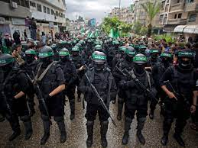
Hamas
Hamas is one of the hundreds of CIA sponsored terror groups. Hamas is and has been funded, trained by the CIA to create terror in the Middle East. Standing behind the CIA in this is the papacy!! Why would the papacy create terror in the Middle East? What do they hope to accomplish?

Slide 12
Rome Wants Jerusalem
“A Jesuit cardinal named Augustine Bea showed us how desperately the Roman Catholics wanted Jerusalem at the end of the third century. Because of its religious history and its strategic location, the Holy City was considered a priceless treasure. A scheme had to be developed to make Jerusalem a roman Catholic city. The great untapped source of manpower that could do this job was the children of Ishmael. The poor Arabs fell victim to one of the most clever plans ever devised by the powers of darkness....The Vatican desperately wanted Jerusalem because of its religious significance, but was blocked by the Jews. Another problem was the true Christians in North Africa preaching the gospel. Roman Catholicism was growing in power and would not tolerate any opposition. Somehow the Vatican had to create a weapon to eliminate both the Jews and the true Christian believers who refused to accept Roman Catholicism. Looking to North Africa, they saw the multitudes of Arabs as a source of manpower to do their dirty work...The Vatican wanted to create a messiah for the Arabs, someone they could raise up as a great leader, a man with charisma who they could train, and eventually unite all the non-Catholic Arabs behind him... creating a mighty army that would ultimately capture Jerusalem for the pope. -- Jack Chick, The Prophet, Alberto part 6, Chick Publications, pp. 5, 18.

Slide 13
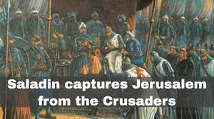
Alberto Rivera’s explanation of the papacy wanting Jerusalem is the only statement that fits the history of the Crusades that went on for over a 1,000 years and Rivera’s explanation is the only one that fits the Great Controversy. However, to accept it is to be believe in the conspiratorial view of history and Adventism/Doug Bachelor don’t want the shame of being labeled conspiracists!! The truth still stands!

Slide 14
Is This the WW3?
“Pike stated that the First World War was to be fomented in order to destroy Czarist Russia- and to place that vast land under the direct control of Illuminati agents. Russia was then to be used as a ‘bogey man’ to further the aims of the Illuminati worldwide. World War II was to be fomented through manipulation of the differences that existed between the German Nationalists and the Political Zionists. This was to result in an expansion of Russian influence and the establishment of a state of Israel in Palestine. The Third World War was planned to result from the differences stirred up by Illuminati agents between the Zionists and the Arabs. The conflict was planned to spread worldwide. The Illuminati planned to unleash the Nihilists and Atheists and provoke a formidable social cataclysm which in all its horror will show clearly to the nations the effect of absolute atheism, origin of savagery and of the most bloody turmoil. Then everywhere, the citizens, obliged to defend themselves against the world minority of revolutionaries, will exterminate those destroyers of civilization, and the multitude, disillusioned with Christianity, whose deistic spirits will from that moment be without compass [direction], anxious for an ideal, but without knowing where to render its adoration, will receive the true light through the universal manifestation of the pure doctrine of Lucifer, brought finally out in the public view, a manifestation which will result from the general reactionary movement which will follow the destruction of Christianity and atheism, both conquered and exterminated at the same time. -- Des Griffin, Descent Into Slavery, Emissary Publications, pp. 38, 39.

Slide 15

Pike Talks about Sunday!
Pike has been right too many times for us to bypass his words as a relic from the past. He nailed the first two wars to a tee! He said the third war would be between Arabs and pro Israelite forces! We will see!!

Slide 16
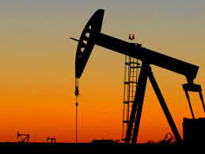
If the War Spreads…………..
Covid was many things. One thing that came under fire during Covid was the economy!
The war in the Ukraine is many things. One thing that came under fire during this war was the economy.
If this war in Gaza-Israel escalates, the mid-east oil fields could come into play and that would result in an assault on the global economy!!
“Thy throne, O God, is for ever and ever: the sceptre of thy kingdom is a right sceptre.” Ps. 45:6
Let us get out work done!!

