Slide 1
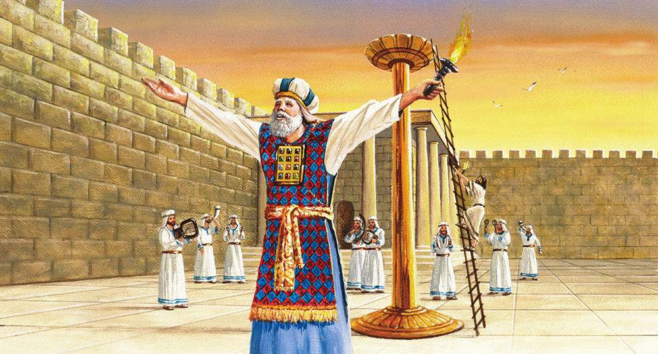
The Sanctuary pt 73: The Feast of Tabernacles 3

Slide 3
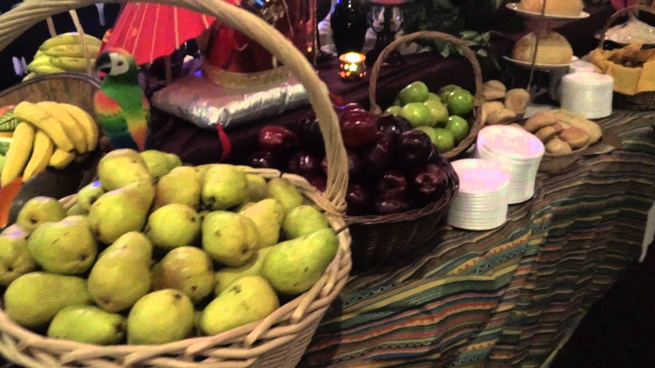
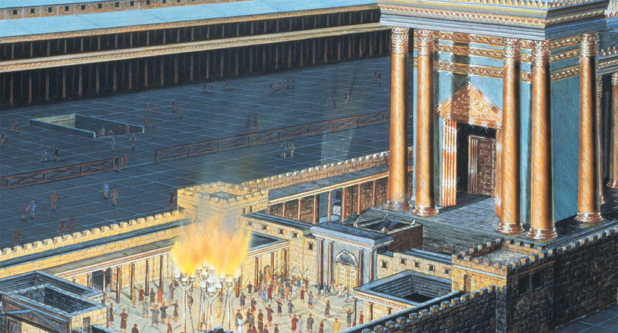
Recap
Lev. 23:40-43 “Also in the fifteenth day of the seventh month, when ye have gathered in the fruit of the land, ye shall keep a feast unto the Lord seven days: on the first day shall be a sabbath, and on the eighth day shall be a sabbath. And ye shall take you on the first day the boughs of goodly trees, branches of palm trees, and the boughs of thick trees, and willows of the brook; and ye shall rejoice before the Lord your God seven days. And ye shall keep it a feast unto the Lord seven days in the year. It shall be a statute for ever in your generations: ye shall celebrate it in the seventh month. Ye shall dwell in booths seven days; all that are Israelites born shall dwell in booths: That your generations may know that I made the children of Israel to dwell in booths, when I brought them out of the land of Egypt: I am the Lord your God.”

Slide 4
What Prophetic Event is the Feast of Tabernacles Antitype???

Slide 5
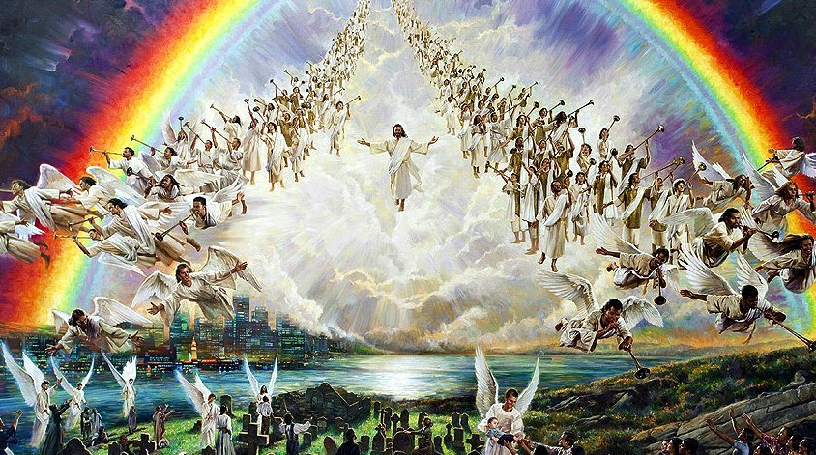

Slide 6
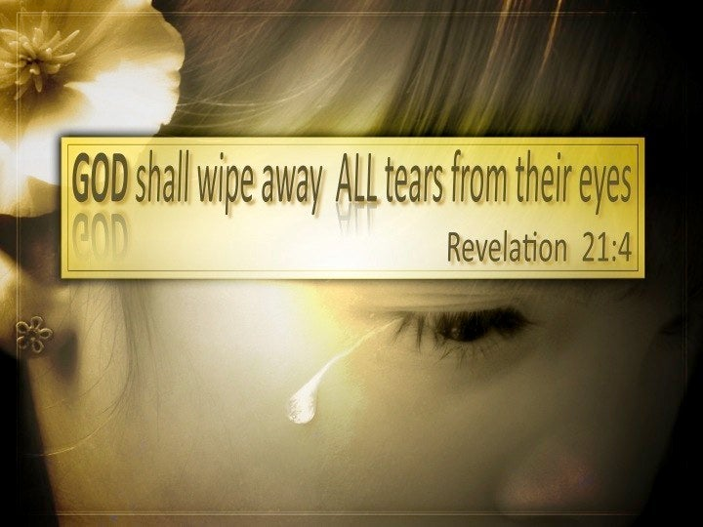
When We Are With Him Forever
Rev. 21:1-5 “And I saw a new heaven and a new earth: for the first heaven and the first earth were passed away; and there was no more sea. And I John saw the holy city, new Jerusalem, coming down from God out of heaven, prepared as a bride adorned for her husband. And I heard a great voice out of heaven saying, Behold, the tabernacle (4633-skene [skay-nay]—tabernacle/habitation) of God is with men, and he will dwell (4637-tabernacle) with them, and they shall be his people, and God himself shall be with them, and be their God. And God shall wipe away all tears from their eyes; and there shall be no more death, neither sorrow, nor crying, neither shall there be any more pain: for the former things are passed away. And he that sat upon the throne said, Behold, I make all things new. And he said unto me, Write: for these words are true and faithful.”

Slide 7
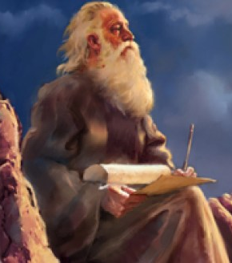
Bible Proof:
John 1:12-14 “But as many as received him, to them gave he power to become the sons of God, even to them that believe on his name: Which were born, not of blood, nor of the will of the flesh, nor of the will of man, but of God. And the Word was made flesh, and dwelt (4637) among us, (and we beheld his glory, the glory as of the only begotten of the Father,) full of grace and truth.”
4637: dwelt- skenoo (skay-no-o): dwell, 1) to fix one’s tabernacle, have one’s tabernacle, abide (or live) in a tabernacle (or tent), tabernacle 2) to dwell

Slide 8
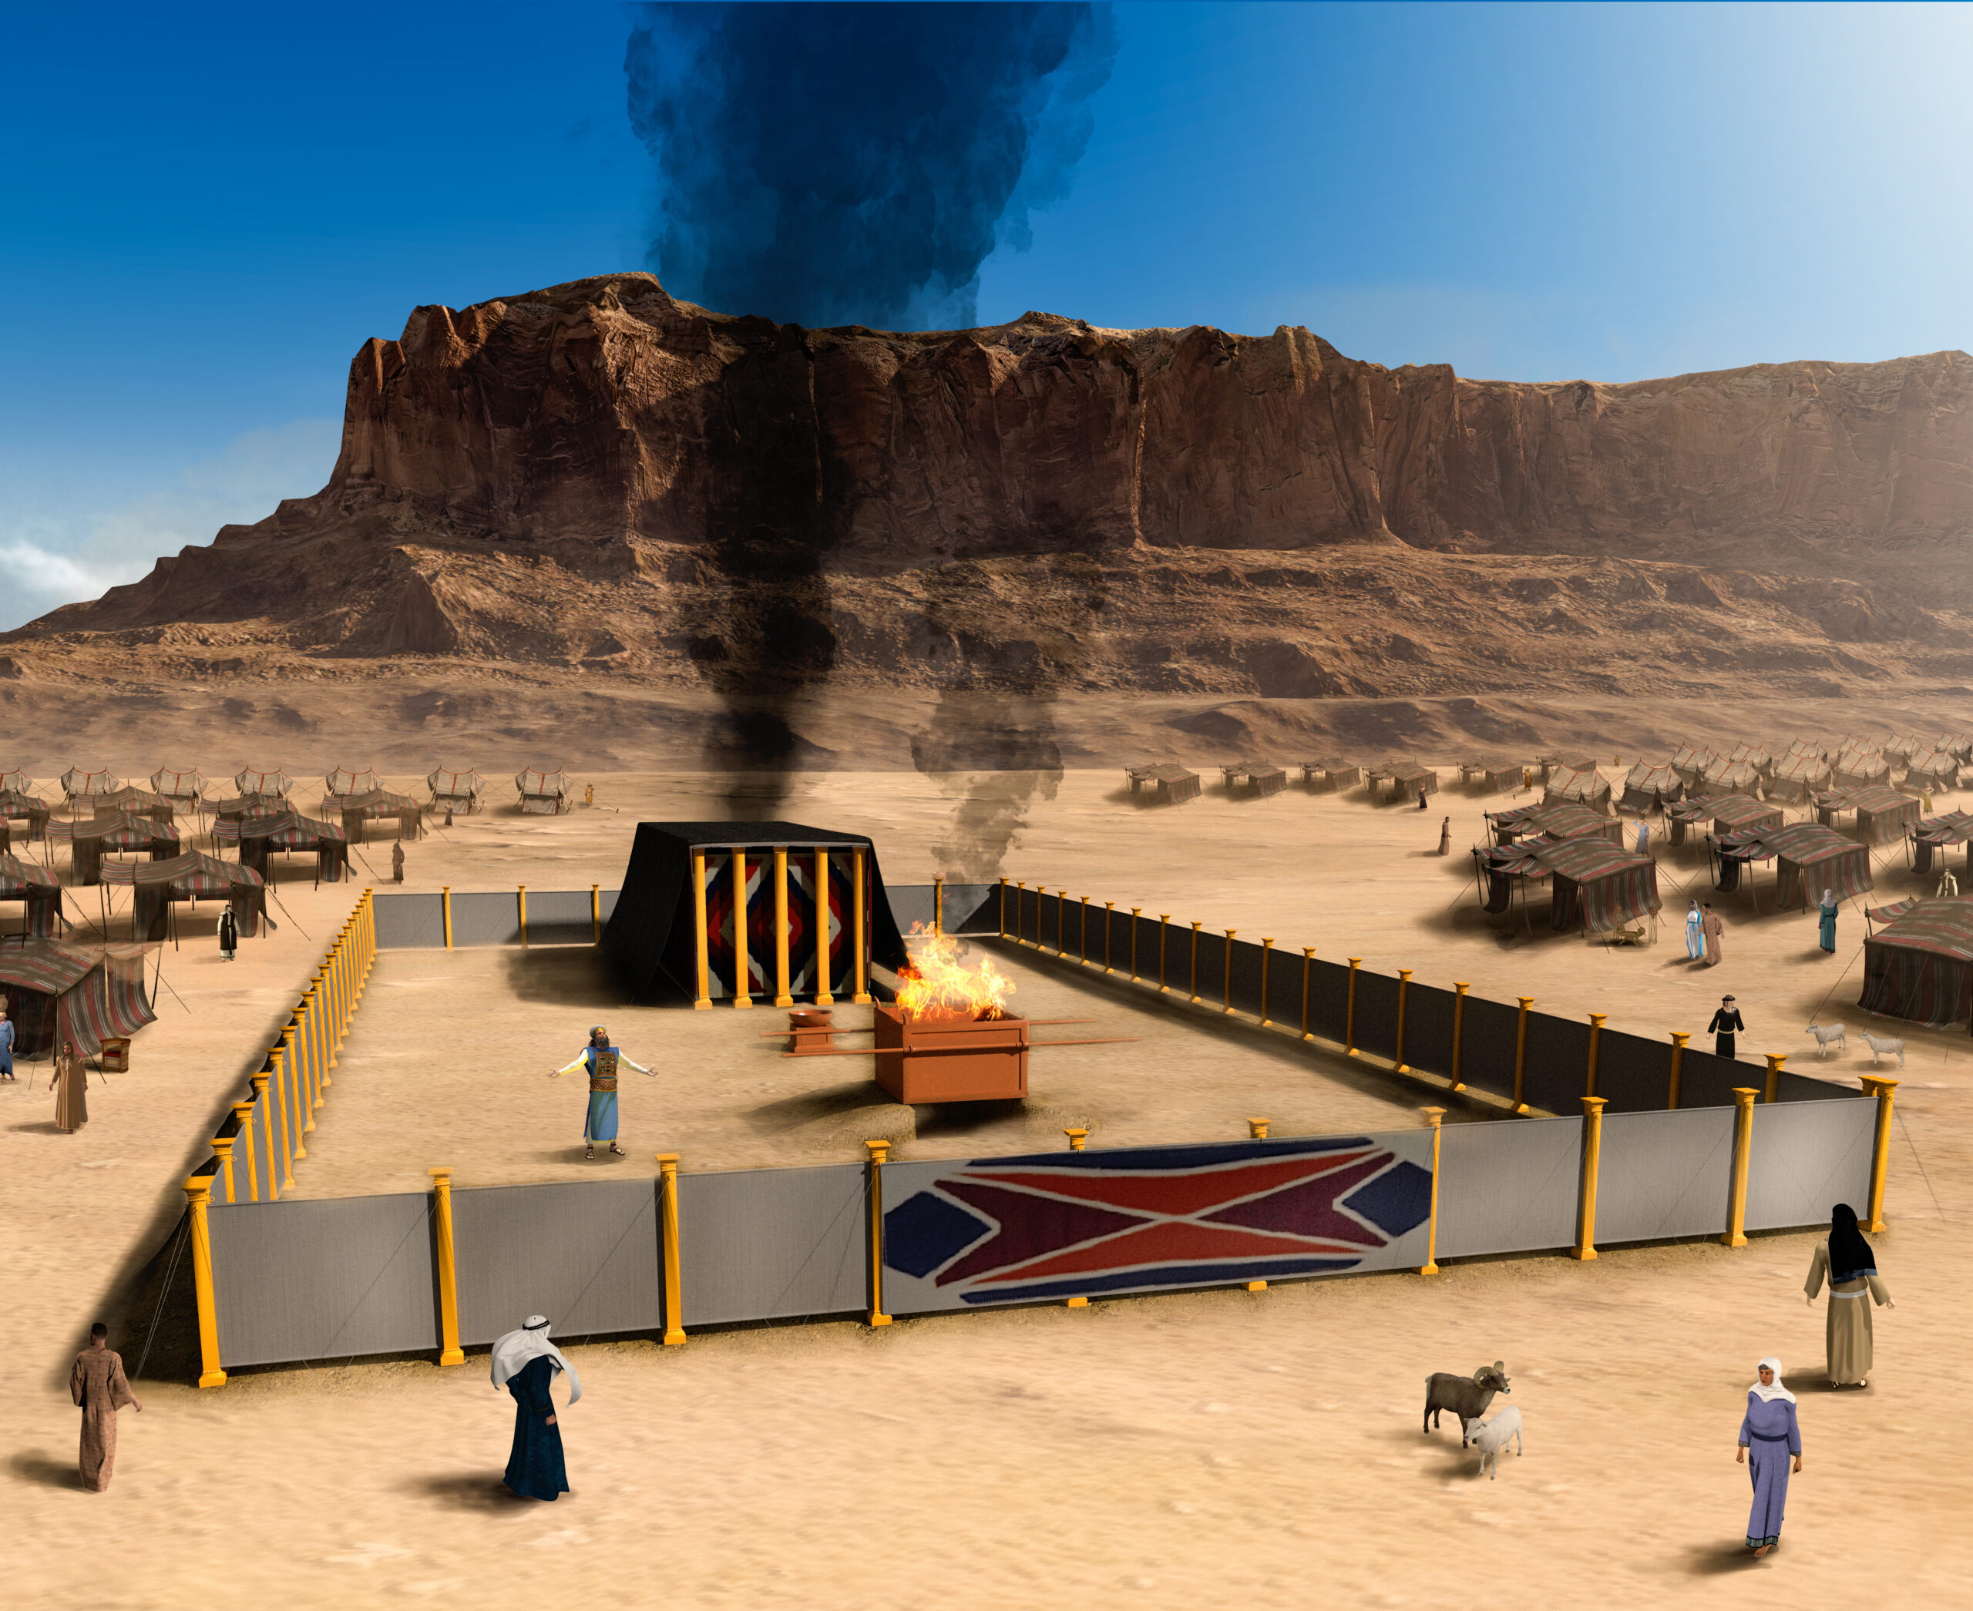
That God May Dwell Among Us
Ex. 25:8 “And let them make me a sanctuary; that I may dwell (7931-shakan [skaw-kan]—tabernacle) among them.”
John 14:2-3 “In my Father's house are many mansions: if it were not so, I would have told you. I go to prepare a place for you. And if I go and prepare a place for you, I will come again, and receive you unto myself; that where I am, there ye may be also.”

Slide 9
The Return!!!
“Soon our eyes were drawn to the east, for a small black cloud had appeared, about half as large as a man’s hand, which we all knew was the sign of the Son of man. We all in solemn silence gazed on the cloud as it drew nearer and became lighter, glorious, and still more glorious, till it was a great white cloud. The bottom appeared like fire; a rainbow was over the cloud, while around it were ten thousand angels, singing a most lovely song; and upon it sat the Son of man. His hair was white and curly and lay on His shoulders; and upon His head were many crowns. His feet had the appearance of fire; in His right hand was a sharp sickle; in His left, a silver trumpet. His eyes were as a flame of fire, which searched His children through and through. Then all faces gathered paleness, and those that God had rejected gathered blackness. Then we all cried out, “Who shall be able to stand? Is my robe spotless?” Then the angels ceased to sing, and there was some time of awful silence, when Jesus spoke: “Those who have clean hands and pure hearts shall be able to stand; My grace is sufficient for you.” At this our faces lighted up, and joy filled every heart. And the angels struck a note higher and sang again, while the cloud drew still nearer the earth. Then Jesus’ silver trumpet sounded, as He descended on the cloud, wrapped in flames of fire. He gazed on the graves of the sleeping saints, then raised His eyes and hands to heaven, and cried, “Awake! awake! awake! ye that sleep in the dust, and arise.” Then there was a mighty earthquake. The graves opened, and the dead came up clothed with immortality. The 144,000 shouted, “Alleluia!” as they recognized their friends who had been torn from them by death, and in the same moment we were changed and caught up together with them to meet the Lord in the air” EW, p. 15-16

Slide 10
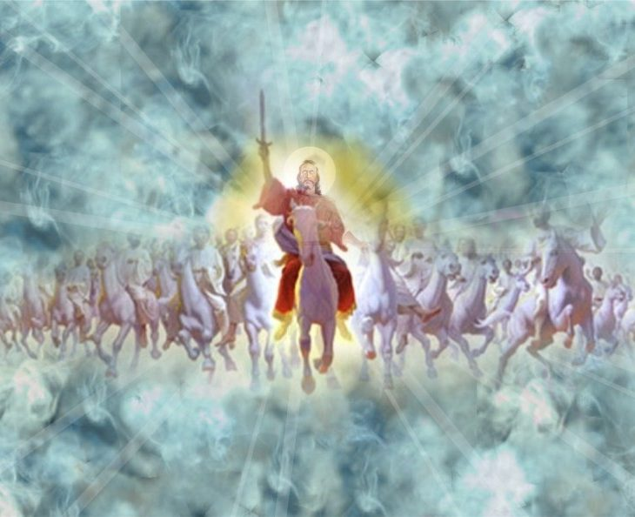
At Last!
“We all entered the cloud together, and were seven days ascending to the sea of glass, when Jesus brought the crowns, and with His own right hand placed them on our heads. He gave us harps of gold and palms of victory. Here on the sea of glass the 144,000 stood in a perfect square. Some of them had very bright crowns, others not so bright. Some crowns appeared heavy with stars, while others had but few. All were perfectly satisfied with their crowns EW, p. 16

Slide 11
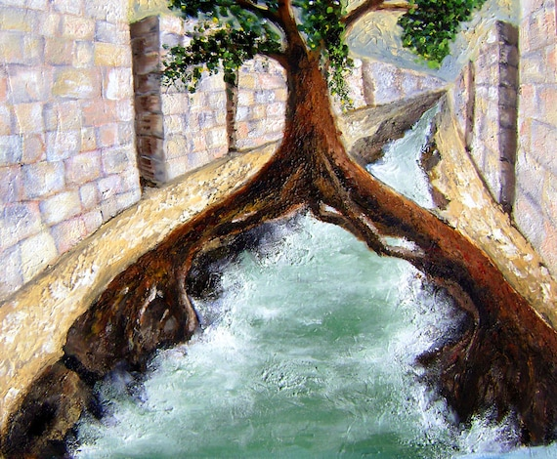
Heaven
“Angels were all about us as we marched over the sea of glass to the gate of the city. Jesus raised His mighty, glorious arm, laid hold of the pearly gate, swung it back on its glittering hinges, and said to us, "You have washed your robes in My blood, stood stiffly for My truth, enter in." We all marched in and felt that we had a perfect right in the city. Here we saw the tree of life and the throne of God. Out of the throne came a pure river of water, and on either side of the river was the tree of life. On one side of the river was a trunk of a tree, and a trunk on the other side of the river, both of pure, transparent gold. At first I thought I saw two trees. I looked again, and saw that they were united at the top in one tree. So it was the tree of life on either side of the river of life. Its branches bowed to the place where we stood, and the fruit was glorious; it looked like gold mixed with silver.” EW, p. 17

Slide 12
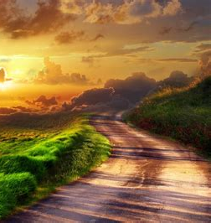
Heaven is Cheap Enough!
“We all went under the tree and sat down to look at the glory of the place, when Brethren Fitch and Stockman, who had preached the gospel of the kingdom, and whom God had laid in the grave to save them, came up to us and asked us what we had passed through while they were sleeping. We tried to call up our greatest trials, but they looked so small compared with the far more exceeding and eternal weight of glory that surrounded us that we could not speak them out, and we all cried out, “Alleluia, heaven is cheap enough!” and we touched our glorious harps and made heaven’s arches ring.” EW, p. 17

Slide 13
Marching to Zion
Then we began to look at the glorious things outside of the city. There I saw most glorious houses, that had the appearance of silver, supported by four pillars set with pearls most glorious to behold. These were to be inhabited by the saints. In each was a golden shelf. I saw many of the saints go into the houses, take off their glittering crowns and lay them on the shelf, then go out into the field by the houses to do something with the earth; not as we have to do with the earth here; no, no. A glorious light shone all about their heads, and they were continually shouting and offering praises to God. I saw another field full of all kinds of flowers, and as I plucked them, I cried out, "They will never fade." Next I saw a field of tall grass, most glorious to behold; it was living green and had a reflection of silver and gold, as it waved proudly to the glory of King Jesus. Then we entered a field full of all kinds of beasts—the lion, the lamb, the leopard, and the wolf, all together in perfect union. We passed through the midst of them, and they followed on peaceably after. Then we entered a wood, not like the dark woods we have here; no, no; but light, and all over glorious; the branches of the trees moved to and fro, and we all cried out, "We will dwell safely in the wilderness and sleep in the woods." We passed through the woods, for we were on our way to Mount Zion.” EW, p. 18

Slide 14
To The Temple
“With them was an innumerable company of little ones; they also had a hem of red on their garments. Mount Zion was just before us, and on the mount was a glorious temple, and about it were seven other mountains, on which grew roses and lilies. And I saw the little ones climb, or, if they chose, use their little wings and fly, to the top of the mountains and pluck the never-fading flowers. There were all kinds of trees around the temple to beautify the place: the box, the pine, the fir, the oil, the myrtle, the pomegranate, and the fig tree bowed down with the weight of its timely figs—these made the place all over glorious. And as we were about to enter the holy temple, Jesus raised His lovely voice and said, "Only the 144,000 enter this place," and we shouted, "Alleluia.“ This temple was supported by seven pillars, all of transparent gold, set with pearls most glorious. The wonderful things I there saw I cannot describe. Oh, that I could talk in the language of Canaan, then could I tell a little of the glory of the better world. I saw there tables of stone in which the names of the 144,000 were engraved in letters of gold. After we beheld the glory of the temple, we went out, and Jesus left us and went to the city. Soon we heard His lovely voice again, saying, "Come, My people, you have come out of great tribulation, and done My will; suffered for Me; come in to supper, for I will gird Myself, and serve you." We shouted, "Alleluia! glory!" and entered into the city” EW, p. 19

Slide 15
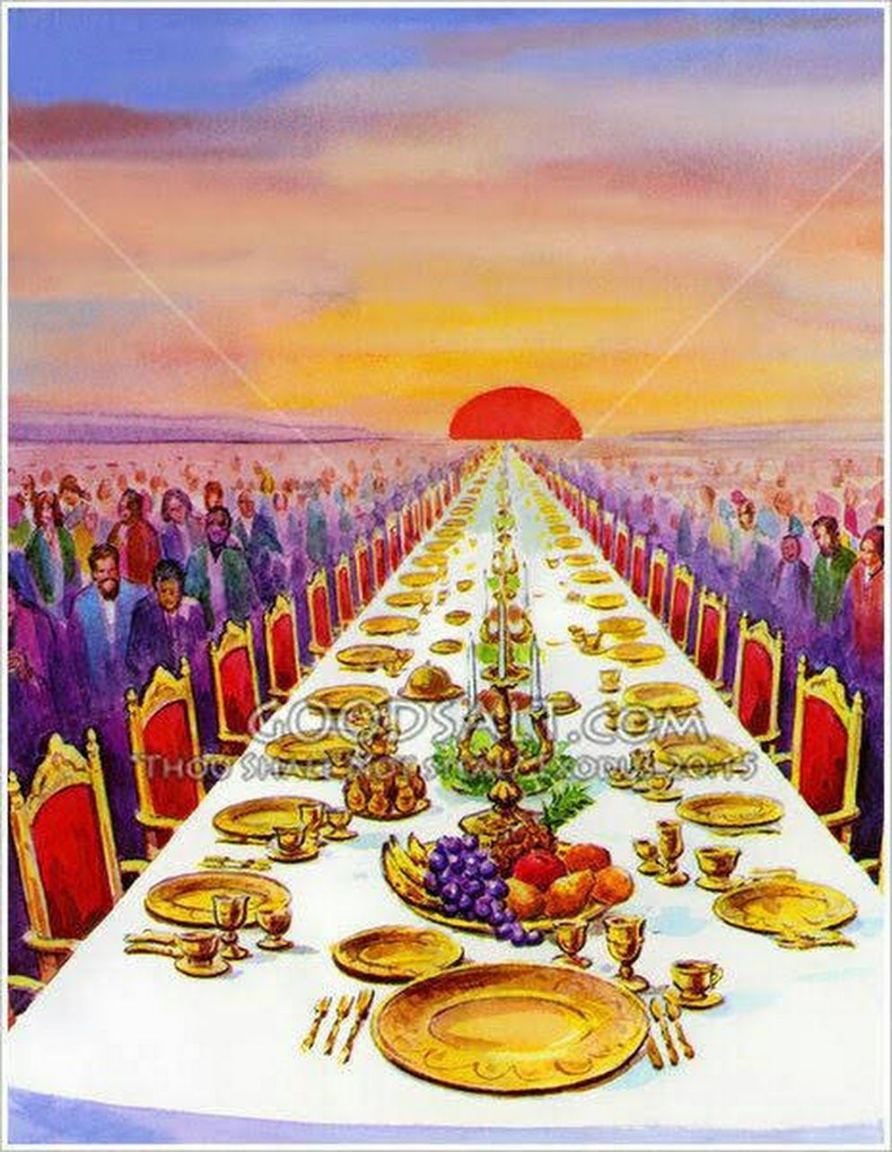
The Wedding Feast
Rev. 19:6-9 “And I heard as it were the voice of a great multitude, and as the voice of many waters, and as the voice of mighty thunderings, saying, Alleluia: for the Lord God omnipotent reigneth. Let us be glad and rejoice, and give honour to him: for the marriage of the Lamb is come, and his wife hath made herself ready. And to her was granted that she should be arrayed in fine linen, clean and white: for the fine linen is the righteousness of saints. And he saith unto me, Write, Blessed are they which are called unto the marriage supper of the Lamb. And he saith unto me, These are the true sayings of God.”

Slide 16
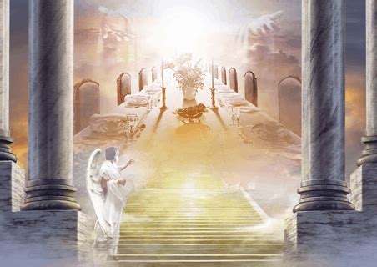
Mrs. White’s Vision of the Marriage Supper
“And I saw a table of pure silver; it was many miles in length, yet our eyes could extend over it. I saw the fruit of the tree of life, the manna, almonds, figs, pomegranates, grapes, and many other kinds of fruit. I asked Jesus to let me eat of the fruit. He said, “Not now. Those who eat of the fruit of this land go back to earth no more. But in a little while, if faithful, you shall both eat of the fruit of the tree of life and drink of the water of the fountain.” And He said, “You must go back to the earth again and relate to others what I have revealed to you.” EW, p. 19-20

Slide 17
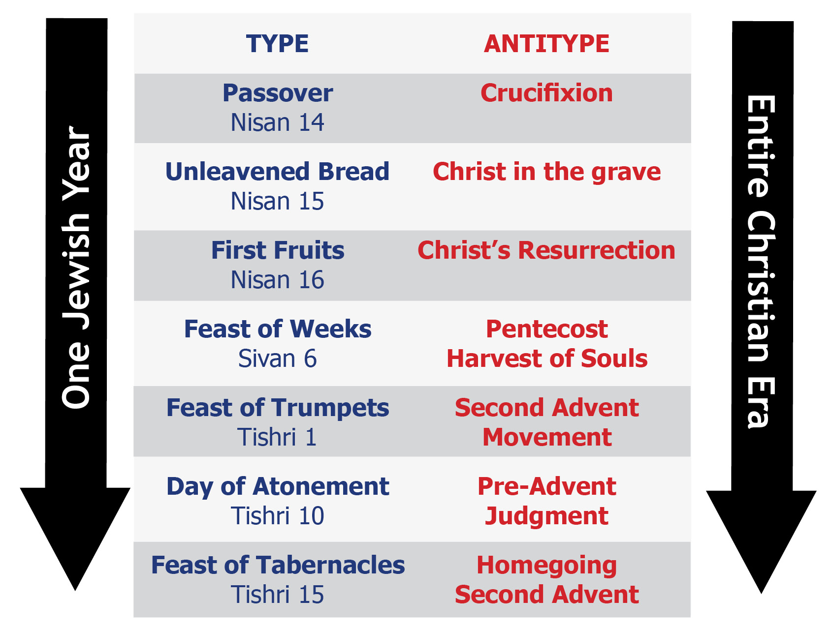

Slide 18
The World Now Darkened
“Then an angel bore me gently down to this dark world. Sometimes I think I can stay here no longer; all things of earth look so dreary. I feel very lonely here, for I have seen a better land. Oh, that I had wings like a dove, then would I fly away and be at rest! After I came out of vision, everything looked changed; a gloom was spread over all that I beheld. Oh, how dark this world looked to me. I wept when I found myself here, and felt homesick. I had seen a better world, and it had spoiled this for me” EW, p. 19-20

Slide 19
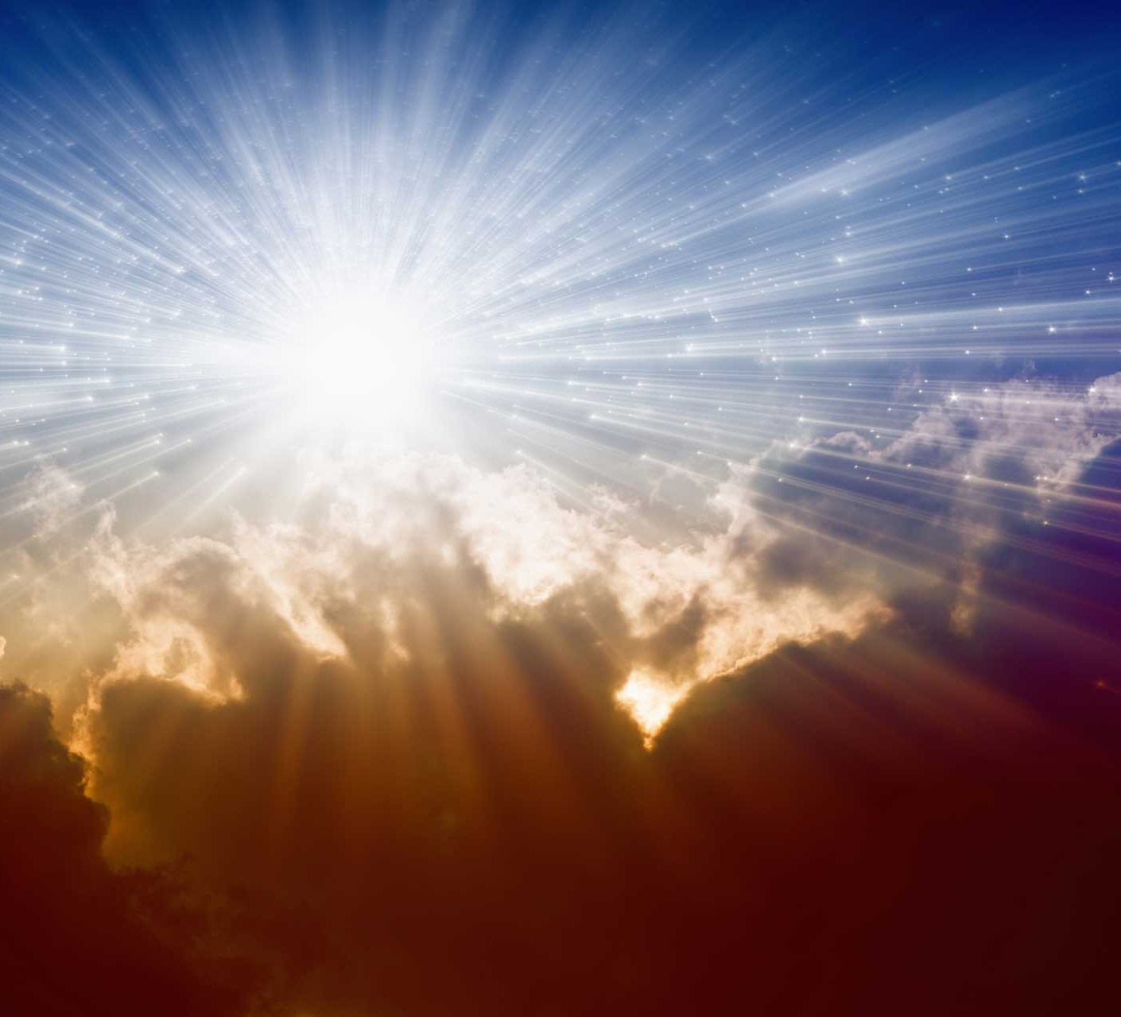
The New Earth
“In the earth made new the redeemed will engage in the occupations and pleasures that brought happiness to Adam and Eve in the beginning. The Eden life will be lived, the life in garden and field. "They shall build houses, and inhabit them; and they shall plant vineyards, and eat the fruit of them. They shall not build, and another inhabit; they shall not plant, and another eat: for as the days of a tree are the days of My people, and Mine elect shall long enjoy the work of their hands." There every power will be developed, every capability increased. The grandest enterprises will be carried forward, the loftiest aspirations will be reached, the highest ambitions realized. And still there will arise new heights to surmount, new wonders to admire, new truths to comprehend, fresh objects to call forth the powers of body and mind and soul.” Adventist Home, p. 549

Slide 20
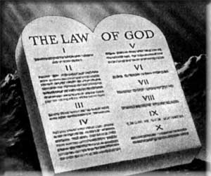
Studying the Plan of Salvation
“And the years of eternity, as they roll, will bring richer and still more glorious revelations of God and of Christ. As knowledge is progressive, so will love, reverence, and happiness increase. The more men learn of God, the greater will be their admiration of His character.” Adventist Home , p. 548
Is. 66:22-23 “For as the new heavens and the new earth, which I will make, shall remain before me, saith the Lord, so shall your seed and your name remain. And it shall come to pass, that from one new moon to another, and from one sabbath to another, shall all flesh come to worship before me, saith the Lord.”

Slide 21
1 Cor. 2:9 “But as it is written, Eye hath not seen, nor ear heard, neither have entered into the heart of man, the things which God hath prepared for them that love him.”

