Slide 1
Revelation 17 and its Kings
A New World Order

Slide 2
What Does it Mean?
With the startling news of Pope Benedict’s resignation, countless expositors of Scripture declared that his fall was part of the fulfillment of Revelation 17. Did Benedict’s fall have anything to do with that chapter? Let us examine the cryptic symbols therein to ascertain the truth.
Beginning in earnest at the time of the Reformation, the identity of the great whore of Revelation 17 has not been in doubt. All of the Protestant Reformers agreed that the great whore of Revelation 17 is the system of Roman Catholicism.

Slide 3
Characteristics
It unites with the leaders/state governments bringing the church and state together. (V.2)
It commits blasphemy. (V. 3)
This is claiming to be God. (John 10:30-33)
This is claiming power to forgive sins. (Matthew 2:5-7)
It is very wealthy. (V. 4)
It has killed millions of Christ’s followers for centuries. (V. 6)
Its geographical foundation is founded on 7 hills/mountains. (V. 9)
Its name is found in a great city in our world. (V. 18)

Slide 4
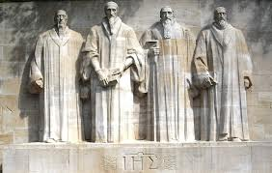
All Reformers Agreed
From Luther to Zwingli to Calvin, there was no question as to the identity of the Great Whore. There was disagreement on predestination, communion, and the law, but no problem with who the whore is!!

Slide 5
Revelation 17 Key-TIME
Revelation 17:3. “So he carried me away in the spirit into the wilderness: and I saw a woman sit upon a scarlet coloured beast, full of names of blasphemy, having seven heads and ten horns.”

Slide 6
Seclusion and obscurity
In order to behold the workings of the papacy, John had to go into the wilderness. What does the wilderness represent and when did the papacy go there? We know that the true church had to flee into the wilderness during the Dark Ages. “And the woman fled into the wilderness, where she hath a place prepared of God that they should feed her there a thousand two hundred and threescore days.” Rev. 12:6 The place where the true church fled was into seclusion and obscurity. “Persecution opened upon the faithful with greater fury than ever before, and the world became a vast battlefield. For hundreds of years the church of Christ found refuge in seclusion and obscurity. Thus says the prophet: "The woman fled into the wilderness, where she hath a place prepared of God that they should feed her there a thousand two hundred and three-score days." Revelation 12:6. The accession of the Roman Church to power marked the beginning of the Dark Ages.” Great Controversy, pgs. 54, 55

Slide 7
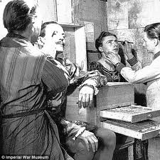
1798
John, in Revelation 17:3 had to behold the papacy in seclusion and obscurity. When was this? For over 1,000 years, the papacy wielded universal power; they surely weren’t in seclusion and obscurity. A change occurred in 1798 when Pope Pius the 6th was taken captive and died in exile. It was in 1798 that the papacy went into seclusion and obscurity. This is the time frame of Rev. 17.

Slide 8
1798-Latter Rain
Revelation 18:1 pinpoints another key event just into the near future. Rev. 18:1 reads, “And after these things I saw another angel come down from heaven, having great power; and the earth was lightened with his glory.” This passage highlights the falling of the Latter Rain in which the 3rd Person of the Godhead, the Holy Spirit, will empower God’s children to:
Live the character of God in their own lives.
Preach the final message of warning to the world.
Prepare to stand through the 7 last plagues.
Enable them to stand when Jesus comes.
The time frame for these two chapters is from 1798 to the out pouring of the latter rain power of the Holy Spirit.

Slide 9
Kryptonite
“And the angel said unto me, Wherefore didst thou marvel? I will tell thee the mystery of the woman, and of the beast that carrieth her, which hath the seven heads and ten horns. The beast that thou sawest was, and is not; and shall ascend out of the bottomless pit, and go into perdition: and they that dwell on the earth shall wonder, whose names were not written in the book of life from the foundation of the world, when they behold the beast that was, and is not, and yet is.” Rev. 17:7, 8

Slide 10
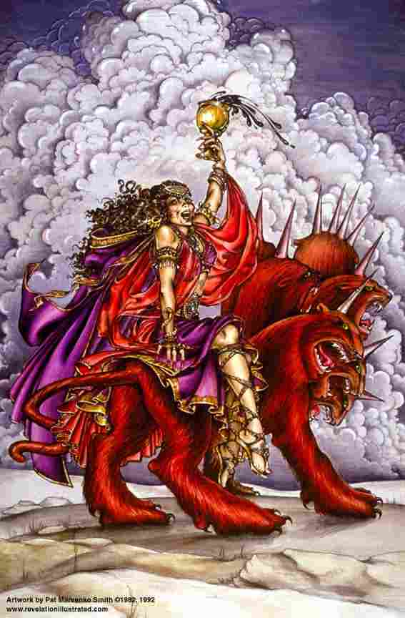
3 Lives
A beast is carrying the whore, giving her force, power, and authority. The beast is intriguing because he has a time when he was powerful, then has a time when he isn’t existing, and then he comes back to life one last time, only to go into oblivion! The beast has three periods of existence. Rev. 17:11 also declares that “And the beast that was, and is not, even he is the eighth, and is of the seven, and goeth into perdition.”

Slide 11
Beast Identified
The books of Daniel and Revelation pinpoint several powers that impacted God’s people in dramatic ways. Rev. 17 mentions 7 of them and tells us that the beast is the 8th and he is also one of the 7 powers!!
Who can this beast be? Given the characteristics, it becomes clear that the beast represents the political power given to the papacy by the governments of the world. Notice, the political powers gave the papacy their power during the Dark Ages. Then, in 1798, the papacy lost political power, and since then, she has been gradually regaining that power! In the light of Revelation’s picture of the papacy’s political power at a height, then losing it, and then regaining it one final time, it becomes obvious that the New World Order today is not new at all. The New World Order is simply the revival of the political power of Rome one last time!!

Slide 12
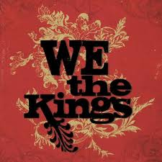
The 7 Kings
Well, then what about those other kings? “And there are seven kings: five are fallen, and one is, and the other is not yet come; and when he cometh, he must continue a short space. And the beast that was, and is not, even he is the eighth, and is of the seven, and goeth into perdition.” Rev. 17:10, 11

Slide 13
Five Fallen
Remembering clearly that the time frame for this passage is 1798- to the latter rain, which kings/kingdoms had fallen by the time of 1798? Bible prophecy admits of none other. We behold through Revelation’s sister book, Daniel, the rise and fall of kingdoms. We have in prophetic order:
Babylon 605-539 BC
Media-Persia 539-331 BC
Greece 331-168 BC
Pagan Rome 168 BC- to 476 AD
Papal Rome (holding political power given her by governments) 538-1798 AD

Slide 14
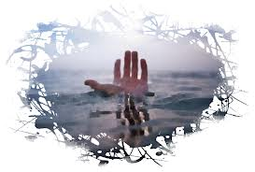
One Will Rise Again
As John discussed the seven kings, he said that 5 had fallen and the time frame was 1798. By 1798, the five fallen kingdoms were the ones just mentioned. From Babylon and Nebuchadnezzar to the deadly wound of the papacy in 1798, we have five fallen kingdoms.

Slide 15
Kings #6,7
“And there are seven kings: five are fallen, and one is, and the other is not yet come; and when he cometh, he must continue a short space.” (V. 10)
Then, John says, that there is one kingdom, and another that would come. Who might this kingdom be that was in existence in 1798 and would grow into a superpower in this world? What world power would have great weight in the effect it would have on God’s people? Clearly, the nation referred to here is the United States. She fulfills every specification of this portion of this prophecy. America was on the rise in 1798, would continue on its path to being a superpower in this world, and had great influence on the work of God’s people.

Slide 16
A Short Space
We are fortunate to have the added light of 200 years of history since 1798. It seems clear that the power described here would be atheistic Communism as seen in Russia. No other world power in the last 200 years has influenced the world as has Russia. No other power has affected the work of God’s people as Russia. While America has made possible the promulgation of God’s truth throughout the world, Russia, for the greater part of this time, has sought to squelch the work of God’s people in this world!

Slide 17
Beast Identified
As we have already noticed, the beast is the 8th king/kingdom and is one of the original 7. Looking over the 7 kingdoms, it is very obvious that the one kingdom that was powerful, went into obscurity, and then rises again, can only be the political power of the papacy granted to them one last time by the governments of the world. The papacy, the governments of the world, the churches, and the financial elite, are warring with the Lamb, Jesus Christ today. The outcome of this final battle is not left to doubt for we read, “These shall make war with the Lamb, and the Lamb shall overcome them: for he is Lord of lords, and King of kings: and they that are with him are called, and chosen, and faithful.” Revelation 17:14

Slide 18
The Mightiest Force in the Universe
“I saw the latter rain is coming suddenly, as the midnight cry and with ten times the power.” Ellen White letter, Spalding-Megan Collection, pages 3,4
How powerful was the midnight cry?
“In the parable of Matthew 25 the time of waiting and slumber is followed by the coming of the bridegroom. This was in accordance with the arguments just presented, both from prophecy and from the types. They carried strong conviction of their truthfulness; and the "midnight cry" was heralded by thousands of believers.
Like a tidal wave the movement swept over the land. From city to city, from village to village, and into remote country places it went, until the waiting people of God were fully aroused.

