Slide 1
Judges, pt. 10 Samson, pt. 2

Slide 2
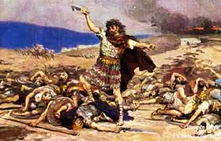
It Finally Caught Up to Him
He dillydallied too long. He married outside the covenant of Israel. He went to Philistine whores in Gaza. He refused to bring his mind into captivity to the will of Christ and it finally caught up with him!
The Bible says, “And it came to pass afterward, that he loved a woman in the valley of Sorek, whose name was Delilah.” Judges 16:4
A very DUMB move! Delilah was a Philistine, wrong! Sorek was known for its grape products, wrong! Samson was to stay away from them!!

Slide 3
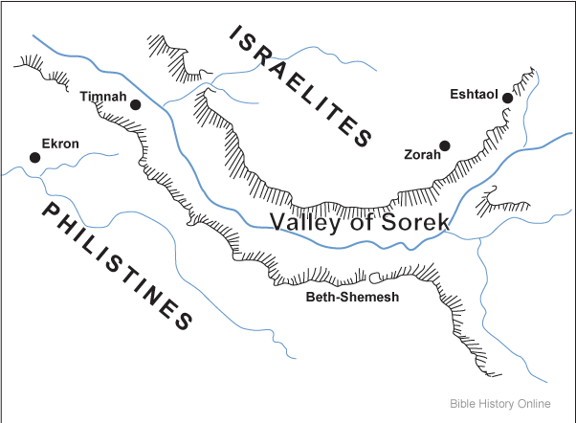
Samson-A Philistine in Heart
“that he loved a woman in the valley of Sorek, whose name was Delilah.”
Correction, Samson passionately, sexually lusted after Delilah! Love is a heaven, born principle that loves, sacrifices, and endures. Lust is the desire to have sex with someone outside of the marriage bond! The two are mutually exclusive!!

Slide 4
Even in Marriage, Men Beware!
It is not pure love which actuates a man to make his wife an instrument to minister to his lust. It is the animal passions which clamor for indulgence. How few men show their love in the manner specified by the apostle: “Even as Christ also loved the church, and gave Himself for it; that He might [not pollute it but] sanctify and cleanse it;... that it should be holy and without blemish” (Ephesians 5:25-27). This is the quality of love in the marriage relation which God recognizes as holy. Love is a pure and holy principle, but lustful passion will not admit of restraint and will not be dictated to or controlled by reason. It is blind to consequences; it will not reason from cause to effect. Many women are suffering from great debility and settled disease because the laws of their being have been disregarded; nature’s laws have been trampled upon. The brain nerve power is squandered by men and women, being called into unnatural action to gratify base passions; and this hideous monster—base, low passion—assumes the delicate name of love.—Testimonies for the Church 2:473, 474 (1870). (p.223)

Slide 5
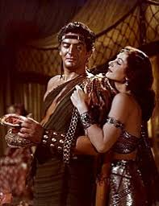
Delilah-the Whore
“And the lords of the Philistines came up unto her, and said unto her, Entice him, and see wherein his great strength lieth, and by what means we may prevail against him, that we may bind him to afflict him: and we will give thee every one of us eleven hundred pieces of silver. And Delilah said to Samson, Tell me, I pray thee, wherein thy great strength lieth, and wherewith thou mightest be bound to afflict thee.” Judges 16:5,6

Slide 6
A Loving Union
“A deputation consisting of one leading man from each of the Philistine provinces was sent to the vale of Sorek. They dared not attempt to seize him while in possession of his great strength, but it was their purpose to learn, if possible, the secret of his power. They therefore bribed Delilah to discover and reveal it. As the betrayer plied Samson with her questions, he deceived her by declaring that the weakness of other men would come upon him if certain processes were tried. When she put the matter to the test, the cheat was discovered. Then she accused him of falsehood.” PP, pg. 565

Slide 7
The Axe Falls!
“And she made him sleep upon her knees; and she called for a man, and she caused him to shave off the seven locks of his head; and she began to afflict him, and his strength went from him. And she said, The Philistines be upon thee, Samson. And he awoke out of his sleep, and said, I will go out as at other times before, and shake myself. And he wist not that the LORD was departed from him. But the Philistines took him, and put out his eyes, and brought him down to Gaza, and bound him with fetters of brass; and he did grind in the prison house.” Judges 16:19-21

Slide 8
Symbol Was Sacrificed
“What a change to him who had been the judge and champion of Israel!—now weak, blind, imprisoned, degraded to the most menial service! Little by little he had violated the conditions of his sacred calling. God had borne long with him; but when he had so yielded himself to the power of sin as to betray his secret, the Lord departed from him. There was no virtue in his long hair merely, but it was a token of his loyalty to God; and when the symbol was sacrificed in the indulgence of passion, the blessings of which it was a token were also forfeited. In suffering and humiliation, a sport for the Philistines, Samson learned more of his own weakness than he had ever known before; and his afflictions led him to repentance. As his hair grew, his power gradually returned; but his enemies, regarding him as a fettered and helpless prisoner, felt no apprehensions.” PP, pg. 566

Slide 9
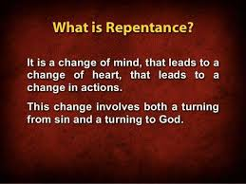
Samson’s Hair Begins to Grow!
“In suffering and humiliation, a sport for the Philistines, Samson learned more of his own weakness than he had ever known before; and his afflictions led him to repentance. As his hair grew, his power gradually returned; but his enemies, regarding him as a fettered and helpless prisoner, felt no apprehensions.” PP, pg. 566
Oh, the amazing grace of God! Broken, blind, wretched, God heard the prayers of this repentant man!!!
“Howbeit the hair of his head began to grow again after he was shaven.” Verse 22

Slide 10
True Repentance
“Repentance includes sorrow for sin and a turning away from it. We shall not renounce sin unless we see its sinfulness; until we turn away from it in heart, there will be no real change in the life. There are many who fail to understand the true nature of repentance. Multitudes sorrow that they have sinned and even make an outward reformation because they fear that their wrongdoing will bring suffering upon themselves. But this is not repentance in the Bible sense. They lament the suffering rather than the sin. Such was the grief of Esau when he saw that the birthright was lost to him forever. Balaam, terrified by the angel standing in his pathway with drawn sword, acknowledged his guilt lest he should lose his life; but there was no genuine repentance for sin, no conversion of purpose, no abhorrence of evil. Judas Iscariot, after betraying his Lord, exclaimed, “I have sinned in that I have betrayed the innocent blood.” Matthew 27:4. The confession was forced from his guilty soul by an awful sense of condemnation and a fearful looking for of judgment. The consequences that were to result to him filled him with terror, but there was no deep, heartbreaking grief in his soul, that he had betrayed the spotless Son of God and denied the Holy One of Israel. Pharaoh, when suffering under the judgments of God, acknowledged his sin in order to escape further punishment, but returned to his defiance of Heaven as soon as the plagues were stayed. These all lamented the results of sin, but did not sorrow for the sin itself.” Steps to Christ, pgs. 23,24

Slide 11
Making Sport
“And it came to pass, when their hearts were merry, that they said, Call for Samson, that he may make us sport. And they called for Samson out of the prison house; and he made them sport: and they set him between the pillars. And Samson said unto the lad that held him by the hand, Suffer me that I may feel the pillars whereupon the house standeth, that I may lean upon them. Now the house was full of men and women; and all the lords of the Philistines were there; and there were upon the roof about three thousand men and women, that beheld while Samson made sport. And Samson called unto the LORD, and said, O Lord GOD, remember me, I pray thee, and strengthen me, I pray thee, only this once, O God, that I may be at once avenged of the Philistines for my two eyes.” Judges 16:25-28

Slide 12
Mocking the Follower of God!
The enemies of God are making a mockery out of this man of God! Makes my blood boil! How, oh we shame the Lord with our foolishness, with our compromise and our love for this world!! “If those who hide and excuse their faults could see how Satan exults over them, how he taunts Christ and holy angels with their course, they would make haste to confess their sins and to put them away. Through defects in the character, Satan works to gain control of the whole mind, and he knows that if these defects are cherished, he will succeed. Therefore he is constantly seeking to deceive the followers of Christ with his fatal sophistry that it is impossible for them to overcome.” GC, pg. 489

Slide 13
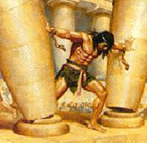
Samson was truly repentant. He knew his sin; he asked for forgiveness, and for power to turn away from his sin. His hair was now fully grown, and the Lord could use him again. The outward symbol of his long hair represented the inward dependence on the power of God in his life! The time and place were ripe. Multitudes of Philistines were in that wicked temple of Dagon!!

Slide 14
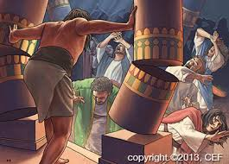
Samson Would Die Too!
“And Samson took hold of the two middle pillars upon which the house stood, and on which it was borne up, of the one with his right hand, and of the other with his left. And Samson said, Let me die with the Philistines. And he bowed himself with all his might; and the house fell upon the lords, and upon all the people that were therein. So the dead which he slew at his death were more than they which he slew in his life.” judges 16:29,30

Slide 15
Strongest and Weakest of Men
“The idol and its worshipers, priest and peasant, warrior and noble, were buried together beneath the ruins of Dagon's temple. And among them was the giant form of him whom God had chosen to be the deliverer of His people. Tidings of the terrible overthrow were carried to the land of Israel, and Samson's kinsmen came down from their hills, and, unopposed, rescued the body of the fallen hero. And they “brought him up, and buried him between Zorah and Eshtaol, in the burying place of Manoah his father.”
God's promise that through Samson He would “begin to deliver Israel out of the hand of the Philistines” was fulfilled; but how dark and terrible the record of that life which might have been a praise to God and a glory to the nation! Had Samson been true to his divine calling, the purpose of God could have been accomplished in his honor and exaltation. But he yielded to temptation and proved untrue to his trust, and his mission was fulfilled in defeat, bondage, and death.
Physically, Samson was the strongest man upon the earth; but in self-control, integrity, and firmness, he was one of the weakest of men. Many mistake strong passions for a strong character, but the truth is that he who is mastered by his passions is a weak man. The real greatness of the man is measured by the power of the feelings that he controls, not by those that control him.” PP, pg. 567

Slide 16
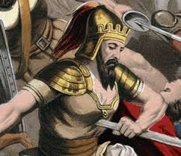
Samson Dies By Suicide????
Some have condoned people committing suicide and used Samson’s example to say the ones committing suicide will be in heaven. Samson’s death was very Different than Saul, the first king of Israel. Saul was depressed, discouraged, and had no desire to live and committed suicide in this mindset. Samson didn’t have that mindset at all. He just knew that there was no other way to defeat Israel’s enemies than for him to die. He decided it was fine for him to die if only God could be glorified! Big Difference!

Slide 17
Self Murder of Saul!
“ Saul fought with desperate valor for his throne and his kingdom. But it was in vain. “The men of Israel fled from before the Philistines, and fell down slain in Mount Gilboa.” Three brave sons of the king died at his side. The archers pressed upon Saul. He had seen his soldiers falling around him and his princely sons cut down by the sword. Himself wounded, he could neither fight nor fly. Escape was impossible, and determined not to be taken alive by the Philistines, he bade his armor-bearer, “Draw thy sword, and thrust me through therewith.” When the man refused to lift his hand against the Lord's anointed, Saul took his own life by falling upon his sword.
Thus the first king of Israel perished, with the guilt of self-murder upon his soul. His life had been a failure, and he went down in dishonor and despair, because he had set up his own perverse will against the will of God.” PP, pgs. 681, 682

Slide 18
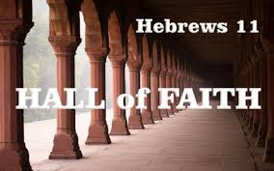
“And what shall I more say? for the time would fail me to tell of Gideon, and of Barak, and of Samson, and of Jephthah; of David also, and Samuel, and of the prophets: Who through faith subdued kingdoms, wrought righteousness, obtained promises, stopped the mouths of lions, Quenched the violence of fire, escaped the edge of the sword, out of weakness were made strong, waxed valiant in fight, turned to flight the armies of the aliens.” Hebrews 11:32-34

