Slide 1
Heaven’s Plan
Keys to Health

Slide 2
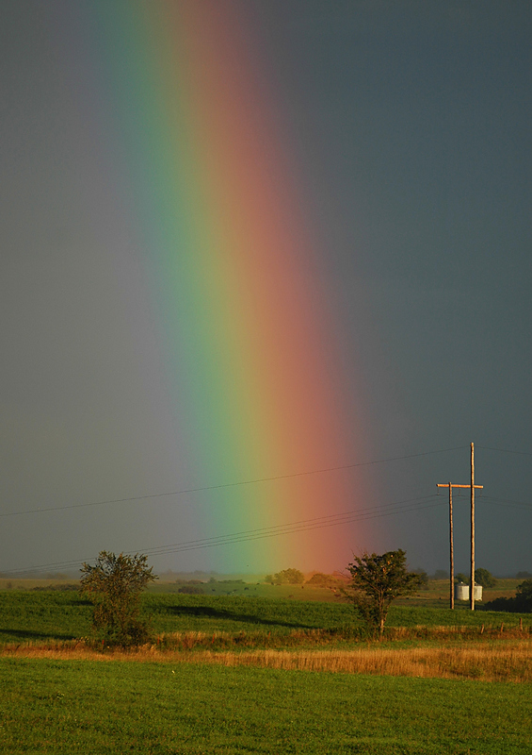
The First Angel’s Message
“Saying with a loud voice, Fear God, and give glory to him; for the hour of his judgment is come: and worship him that made heaven, and earth, and the sea, and the fountains of waters.” Rev. 14:7
“What? know ye not that your body is the temple of the Holy Ghost which is in you, which ye have of God, and ye are not your own?
20: For ye are bought with a price: therefore glorify God in your body, and in your spirit, which are God's.” 1 Corinthians 6:19,20

Slide 3
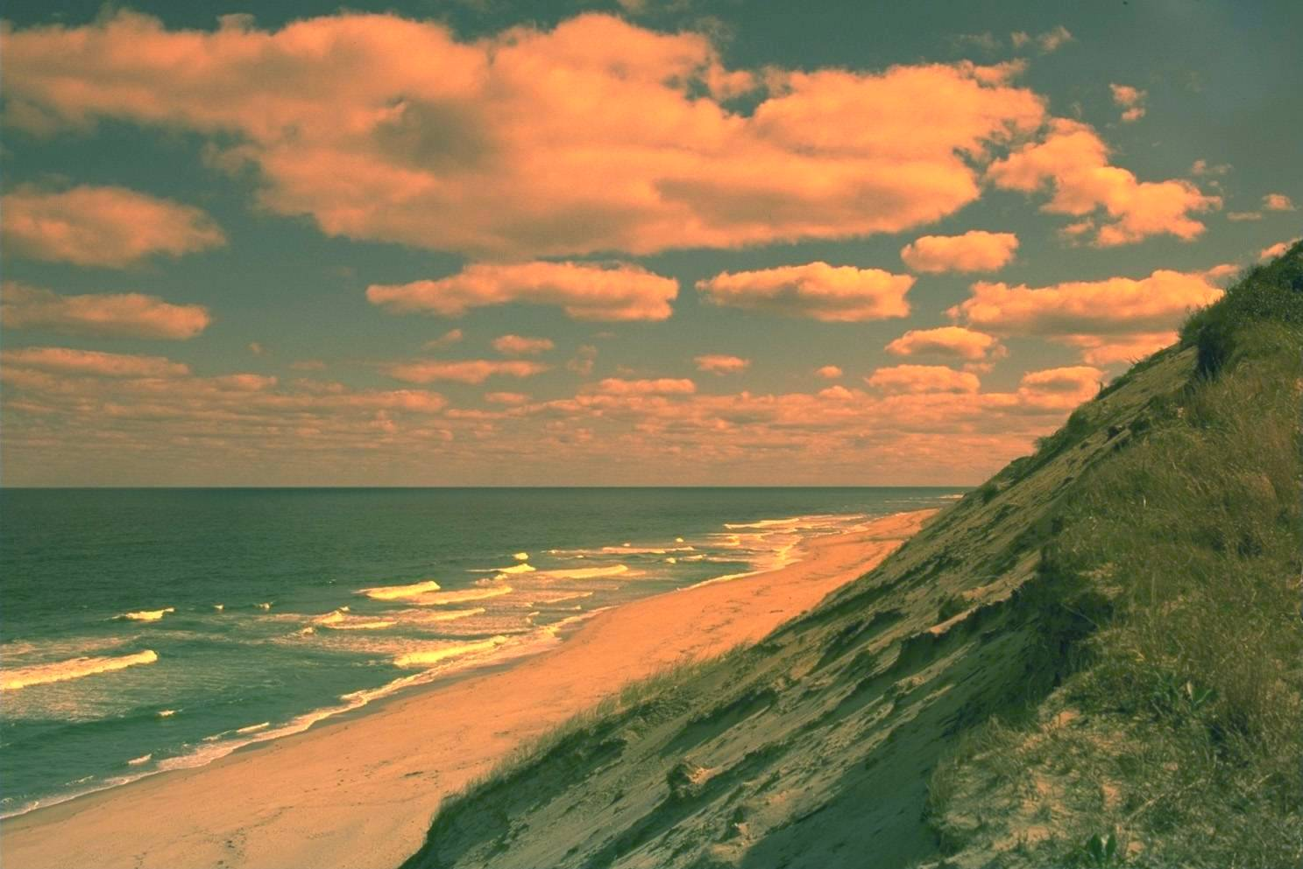
Health is Key
Health plays a vital role in Heaven’s final message of restoration of the body, but more importantly, the mind. It is in the mind where the great controversy takes place. It is in the mind where sin is conceived and carried out. How vital then that we guard our health habits!

Slide 4
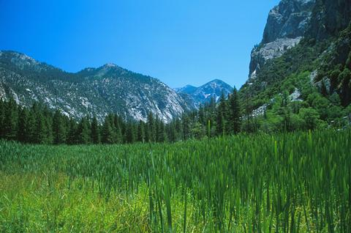
God’s Eight Doctors
1. nutrition
2. exercise
3. water
4. sunshine
5. temperance
6. air
7. rest
8. trust in God

Slide 5
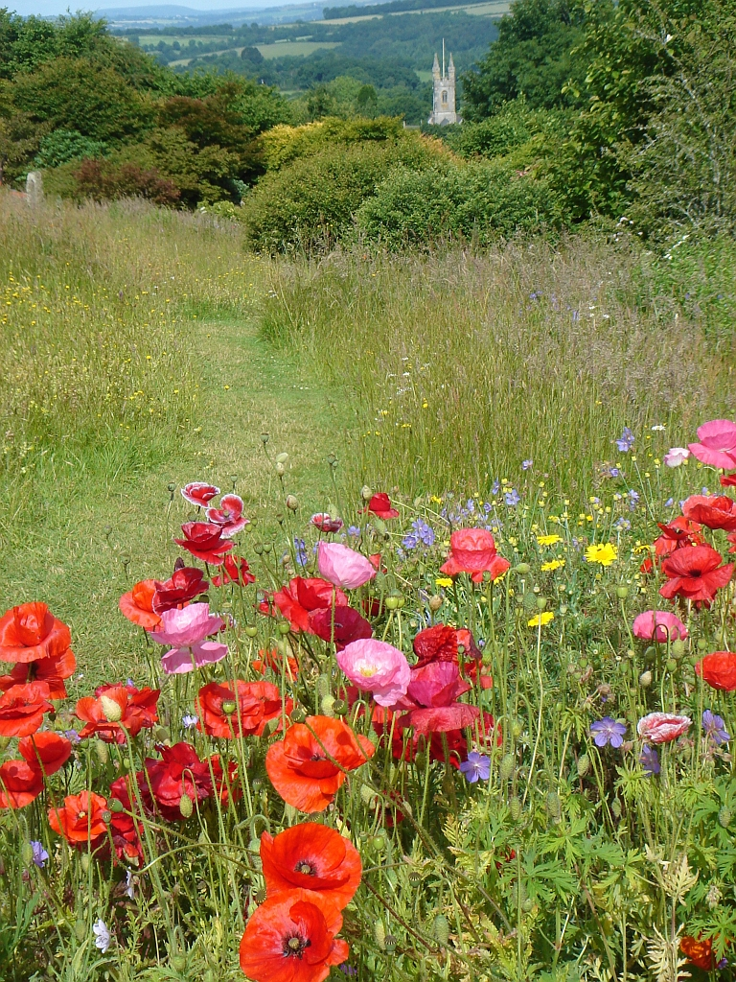
Nutrition and Diet
The first of God’s 8 doctors is nutrition. What we eat, when we eat, how much we eat, and how fast we eat are all very important in maintaining a healthy body and mind. One aspect we will look at today is what we eat.

Slide 6
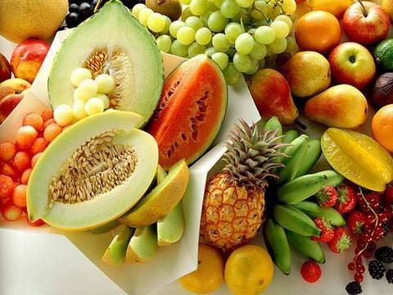
The Garden of Delights
“And God said, Behold, I have given you every herb bearing seed, which is upon the face of all the earth, and every tree, in the which is the fruit of a tree yielding seed; to you it shall be for meat.” Genesis 1:29 Man’s original diet consisted of fruits, nuts, and grains. In the context of this verse, meat means food.

Slide 7
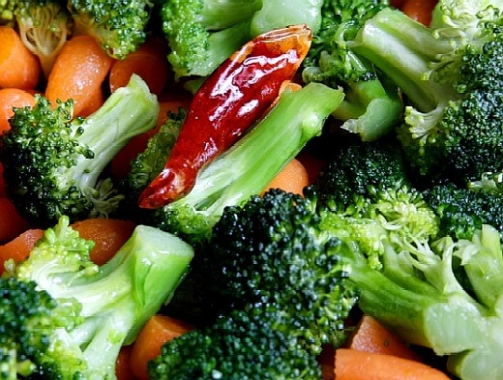
Vegetables Came after Sin
“And unto Adam he said, Because thou hast hearkened unto the voice of thy wife, and hast eaten of the tree, of which I commanded thee, saying, Thou shalt not eat of it: cursed is the ground for thy sake; in sorrow shalt thou eat of it all the days of thy life; Thorns also and thistles shall it bring forth to thee; and thou shalt eat the herb of the field; In the sweat of thy face shalt thou eat bread, till thou return unto the ground; for out of it wast thou taken: for dust thou art, and unto dust shalt thou return.” Genesis 3:17-19 Because of sin, mankind would physically breakdown. Vegetables would help man in his fallen condition.

Slide 8
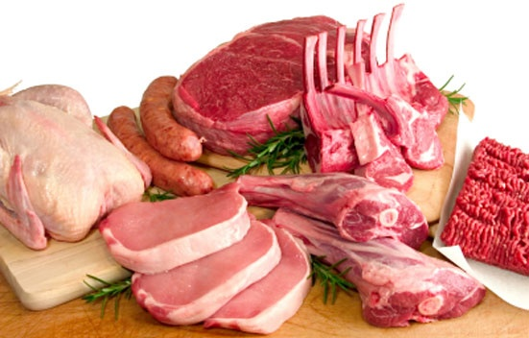
Why Flesh Food
“Every moving thing that liveth shall be meat for you; even as the green herb have I given you all things. But flesh with the life thereof, which is the blood thereof, shall ye not eat.” Genesis 9:3,4
Again, meat here means food.

Slide 9
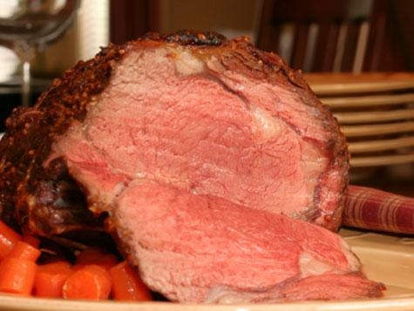
Prohibitions
It was after the flood; at a time when there was basically nothing else to eat did God say it was all right to eat flesh food. One prohibition given was to not eat the flesh with blood in it. “But flesh with the life thereof, which is the blood thereof, shall ye not eat.” Genesis 9:4 The reason for this was that the blood contains the nutrients and the waste of the animal. When eating the flesh with blood, it would put an extra burden upon the human system to throw off the impurities and waste. Why do we have so many heart attacks and heart disease?
Even before the flood, everyone already knew what animals were considered clean and unclean. Unclean animals were strictly forbidden!

Slide 10
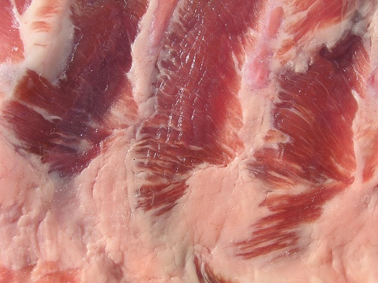
Unclean Flesh Food
“And the hare, because he cheweth the cud, but divideth not the hoof; he is unclean unto you. And the swine, though he divide the hoof, and be clovenfooted, yet he cheweth not the cud; he is unclean to you. Of their flesh shall ye not eat, and their carcase shall ye not touch; they are unclean to you. These shall ye eat of all that are in the waters: whatsoever hath fins and scales in the waters, in the seas, and in the rivers, them shall ye eat. And all that have not fins and scales in the seas, and in the rivers, of all that move in the waters, and of any living thing which is in the waters, they shall be an abomination unto you: They shall be even an abomination unto you; ye shall not eat of their flesh…”Leviticus 11:6-11

Slide 11
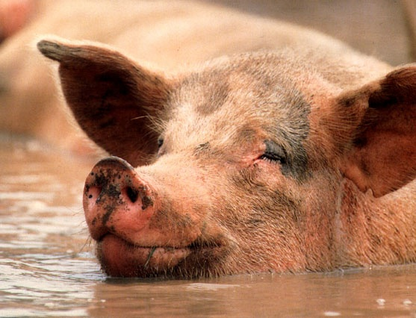
UNCLEAN!!!

Slide 12
What About Peter’s Vision?
“On the morrow, as they went on their journey, and drew nigh unto the city, Peter went up upon the housetop to pray about the sixth hour: And he became very hungry, and would have eaten: but while they made ready, he fell into a trance, And saw heaven opened, and a certain vessel descending unto him, as it had been a great sheet knit at the four corners, and let down to the earth: Wherein were all manner of fourfooted beasts of the earth, and wild beasts, and creeping things, and fowls of the air. And there came a voice to him, Rise, Peter; kill, and eat. But Peter said, Not so, Lord; for I have never eaten any thing that is common or unclean. And the voice spake unto him again the second time, What God hath cleansed, that call not thou common. This was done thrice: and the vessel was received up again into heaven. Now while Peter doubted in himself what this vision which he had seen should mean, behold, the men which were sent from Cornelius had made inquiry for Simon's house, and stood before the gate,” Acts 10:9-17
“And the morrow after they entered into Caesarea. And Cornelius waited for them, and had called together his kinsmen and near friends. And as Peter was coming in, Cornelius met him, and fell down at his feet, and worshipped him. But Peter took him up, saying, Stand up; I myself also am a man. And as he talked with him, he went in, and found many that were come together. And he said unto them, Ye know how that it is an unlawful thing for a man that is a Jew to keep company, or come unto one of another nation; but God hath shewed me that I should not call any man common or unclean.” Acts 10:24-28

Slide 13
Peter’s Difficulty
Peter and the rest of the Jews were very bigoted and exclusive. They felt that they were the chosen people and everyone else were heathen dogs.
“Then Jesus went thence, and departed into the coasts of Tyre and Sidon. And, behold, a woman of Canaan came out of the same coasts, and cried unto him, saying, Have mercy on me, O Lord, thou Son of David; my daughter is grievously vexed with a devil. But he answered her not a word. And his disciples came and besought him, saying, Send her away; for she crieth after us. But he answered and said, I am not sent but unto the lost sheep of the house of Israel. Then came she and worshipped him, saying, Lord, help me. But he answered and said, It is not meet to take the children's bread, and to cast it to dogs. And she said, Truth, Lord: yet the dogs eat of the crumbs which fall from their masters' table. Then Jesus answered and said unto her, O woman, great is thy faith: be it unto thee even as thou wilt. And her daughter was made whole from that very hour.” Matthew 15:21-28

Slide 14
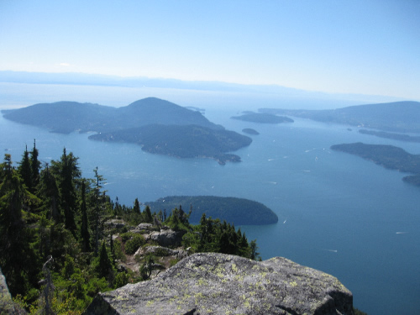
Bigotry
“Among the Jews this question caused endless dispute. They had no doubt as to the heathen and the Samaritans; these were strangers and enemies. But where should the distinction be made among the people of their own nation, and among the different classes of society? Whom should the priest, the rabbi, the elder, regard as neighbor? They spent their lives in a round of ceremonies to make themselves pure. Contact with the ignorant and careless multitude, they taught, would cause defilement that would require wearisome effort to remove. Were they to regard the "unclean" as neighbors?
Again Jesus refused to be drawn into controversy. He did not denounce the bigotry of those who were watching to condemn Him. But by a simple story He held up before His hearers such a picture of the outflowing of heaven-born love as touched all hearts, and drew from the lawyer a confession of the truth.” DA, pg. 498

Slide 15
All Food is Sanctified by Prayer!!
“Now the Spirit speaketh expressly, that in the latter times some shall depart from the faith, giving heed to seducing spirits, and doctrines of devils; Speaking lies in hypocrisy; having their conscience seared with a hot iron; Forbidding to marry, and commanding to abstain from meats, which God hath created to be received with thanksgiving of them which believe and know the truth. For every creature of God is good, and nothing to be refused, if it be received with thanksgiving: For it is sanctified by the word of God and prayer.” 1 Timothy 4:1-5
The word for meats is bromata. It simply means food. There were those in Paul’s day who told others to stay away from eating things that God condoned in the Garden of Eden. “Every creature” means everything God made in the Garden for food. Only the diet God gave in the Garden is sanctified by prayer. Some say ‘If I pray over my pork, then it becomes clean.’ If I pray over food filled with poison, will I eat it, believing that the poison is somehow taken away by prayer?

Slide 16
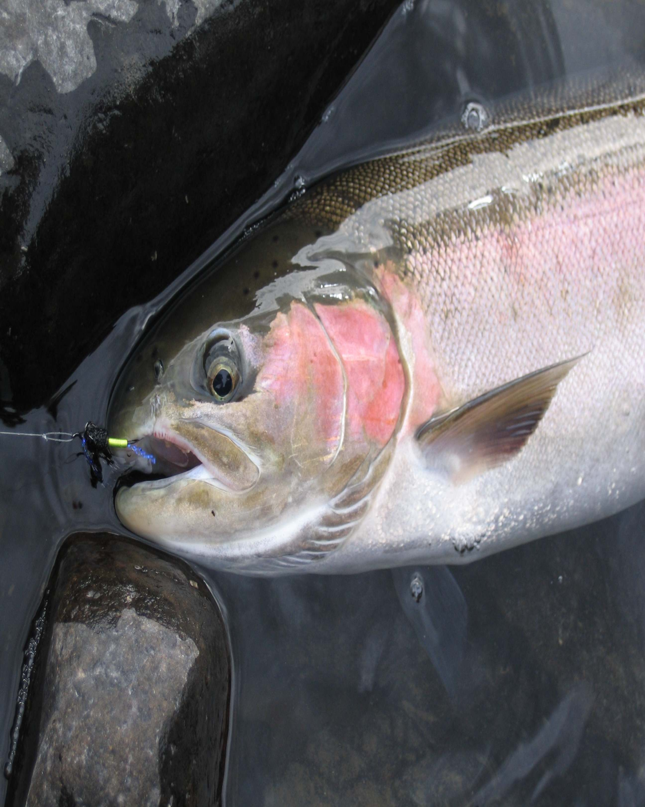
Jesus Ate Fish-So Can I!
Christ ate clean fish, from clean water, and didn’t have the abundance of foods available like we have today. We can’t find clean fish, from clean water, and we have an abundance of good food available. Our times and Christ’s time are very different.

Slide 17
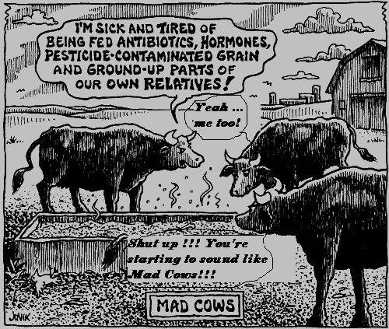
I’ll Stick with Beef
With the horrible reality of Mad Cows Disease and its clear connection to Alzheimer’s, are we going to dare say this is still clean meat? How about the hormones and the rendering being done? Is this the best source of food? Besides this, what about heart disease and colon cancer?

Slide 18
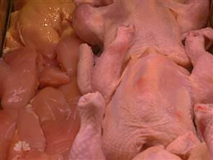
Chicken
From salmonella to ecoli and a ton of other diseases, there is no such thing as clean chicken.

Slide 19
A Solemn Warning
The human family have been growing more and more self-indulgent, until health has been most successfully sacrificed upon the altar of lustful appetite. The inhabitants of the old world were intemperate in eating and drinking. They would have flesh-meats, although God had given them no permission to eat animal food. They ate and drank to excess, and their depraved appetites knew no bounds. They gave themselves up to abominable idolatry. They became violent and ferocious, and so corrupt that God could bear with them no longer. Their cup of iniquity was full, and God cleansed the earth of its moral pollution by a flood. As men multiplied upon the face of the earth after the flood, they forgot God, and corrupted their ways before him. Intemperance in every form increased to a great extent. {RH, June 6, 1899 par. 5}
The Lord brought his people out of Egypt in a victorious manner. He led them through the wilderness to prove them and try them. He repeatedly manifested his miraculous power in their deliverances from their enemies. He promised to take them to himself as his peculiar treasure if they would obey his voice and keep his commandments. He did not forbid them to eat the flesh of animals, but withheld it from them in great measure. He provided them food which was the most healthful. He rained their bread from heaven, and gave them purest water from the flinty rock. He made a covenant with them: if they would obey him in all things, he would preserve them from disease. {RH, June 6, 1899 par. 6}
But the Hebrews were not satisfied. They despised the food given them from heaven, and wished themselves back in Egypt, where they could sit by the flesh-pots. They preferred slavery, and even death, rather than to be deprived of meat. God, in his anger, gave them flesh to gratify their lustful appetites, and great numbers of them died while eating the meat for which they had lusted. {RH, June 6, 1899 par. 7}

Slide 20
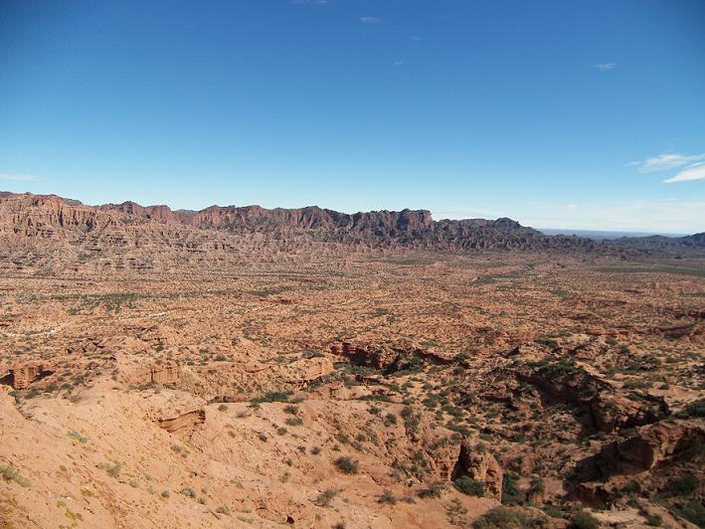
The Israelites and Their Diet
“And the mixt multitude that was among them fell a lusting: and the children of Israel also wept again, and said, Who shall give us flesh to eat? We remember the fish, which we did eat in Egypt freely; the cucumbers, and the melons, and the leeks, and the onions, and the garlick: But our soul is dried away: there is nothing at all, beside this manna, before our eyes.” Numbers 11:4-6
“And the people stood up all that day, and all that night, and all the next day, and they gathered the quails: he that gathered least gathered ten homers: and they spread them all abroad for themselves round about the camp. And while the flesh was yet between their teeth, ere it was chewed, the wrath of the LORD was kindled against the people, and the LORD smote the people with a very great plague. And he called the name of that place Kibroth-hattaavah: because there they buried the people that lusted.” Numbers 11:32-34

Slide 21
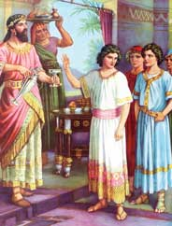
A Shining Example
“But Daniel purposed in his heart that he would not defile himself with the portion of the king's meat, nor with the wine which he drank: therefore he requested of the prince of the eunuchs that he might not defile himself. Now God had brought Daniel into favour and tender love with the prince of the eunuchs. And the prince of the eunuchs said unto Daniel, I fear my lord the king, who hath appointed your meat and your drink: for why should he see your faces worse liking than the children which are of your sort? then shall ye make me endanger my head to the king. Then said Daniel to Melzar, whom the prince of the eunuchs had set over Daniel, Hananiah, Mishael, and Azariah, Prove thy servants, I beseech thee, ten days; and let them give us pulse to eat, and water to drink.” Daniel 1:8-12

Slide 22
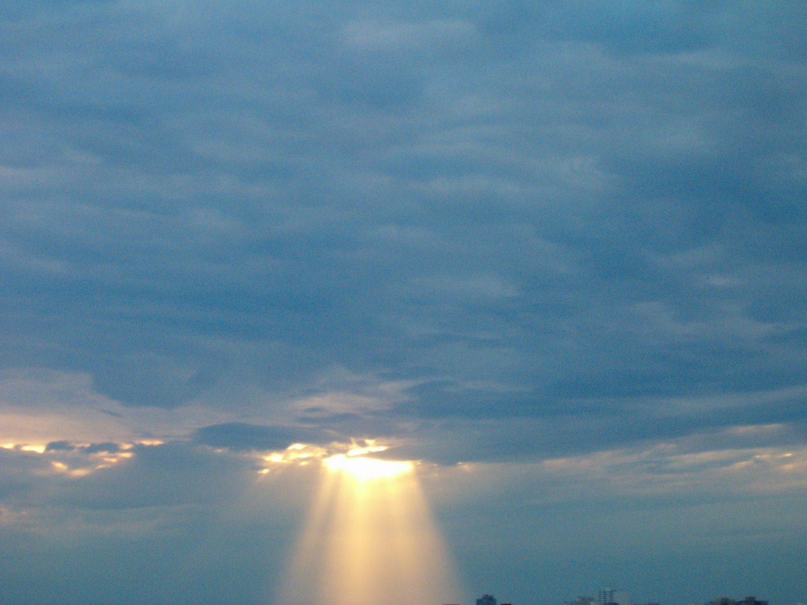
The Result
“As for these four children, God gave them knowledge and skill in all learning and wisdom: and Daniel had understanding in all visions and dreams. Now at the end of the days that the king had said he should bring them in, then the prince of the eunuchs brought them in before Nebuchadnezzar. And the king communed with them; and among them all was found none like Daniel, Hananiah, Mishael, and Azariah: therefore stood they before the king.
And in all matters of wisdom and understanding, that the king inquired of them, he found them ten times better than all the magicians and astrologers that were in all his realm.” Daniel 1:17-20

Slide 23
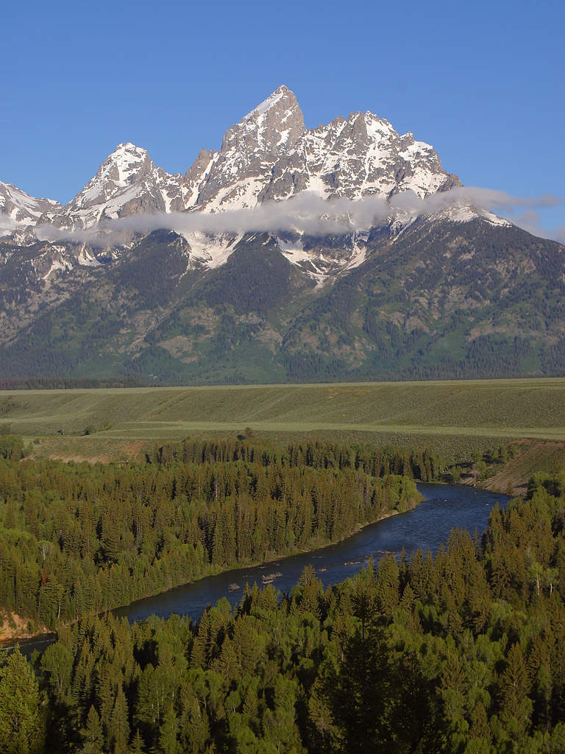
Peter’s Ladder
“And beside this, giving all diligence, add to your faith virtue; and to virtue knowledge; And to knowledge temperance; and to temperance patience; and to patience godliness; And to godliness brotherly kindness; and to brotherly kindness charity.” 2 Peter 1:5-7

