Slide 1

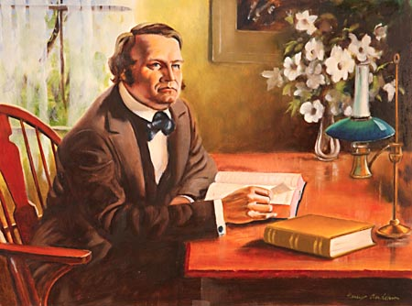
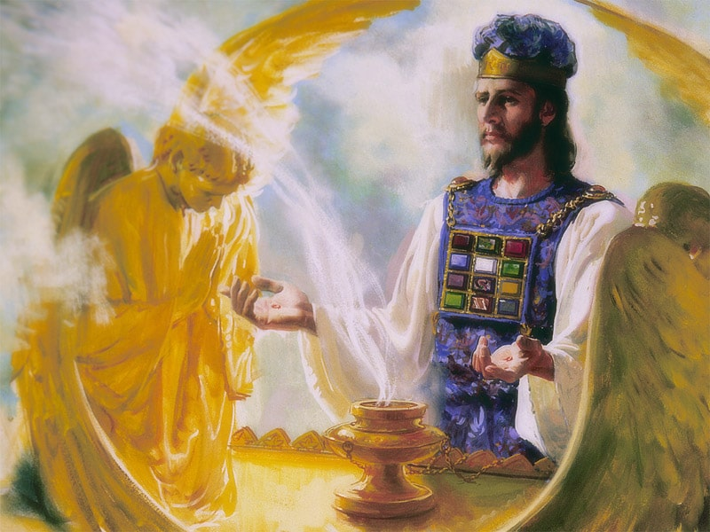
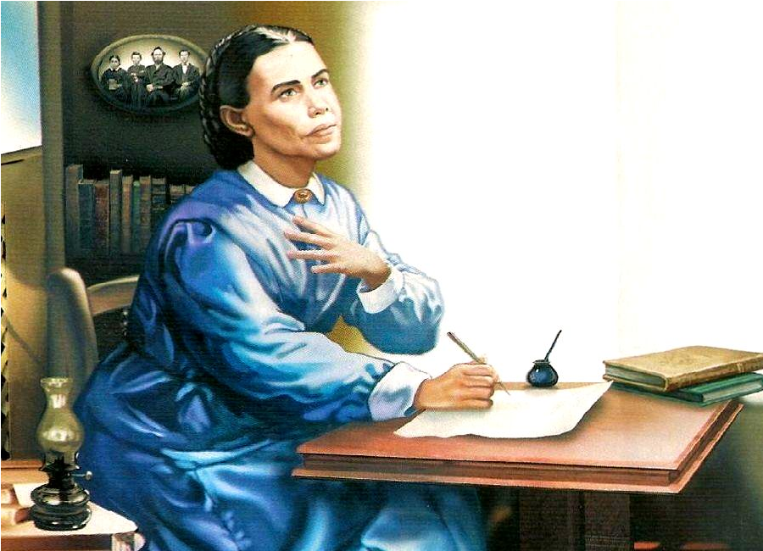
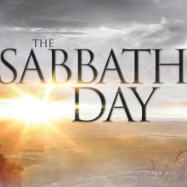
The 2300 Days

Slide 2
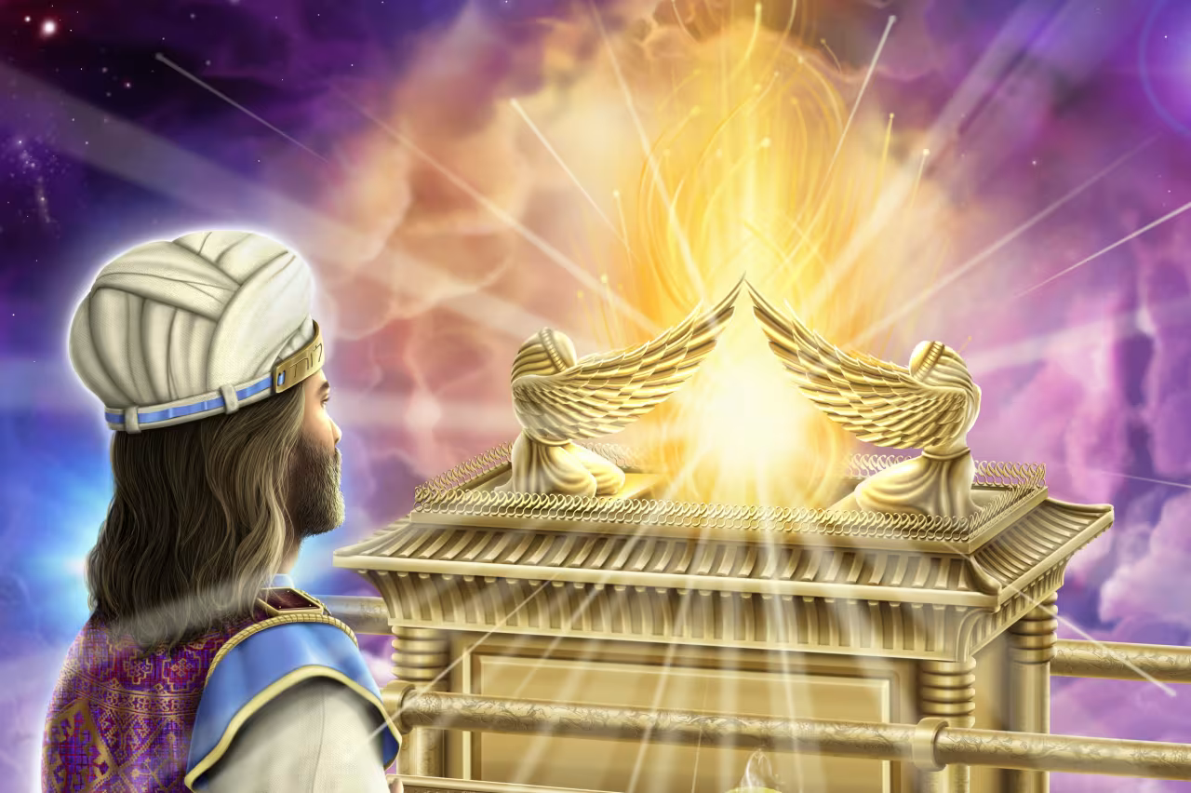
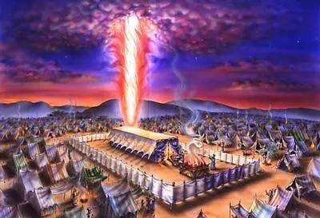
Recap…
So far we have found that the Millerite Movement of 1844 was ordained of God to:
Complete the work of the Reformation in “restoring” the Sanctuary
Fulfills to the day the prophetic time periods of Daniel 8, from 457BC-1844
Fulfills the event to take place, which was the cleansing of the Sanctuary (Day of Atonement)
Fulfills the time period of the “blessed” in Daniel 12, from 508AD-1843
Fulfills the prophetic events of the Midnight Cry from the Parable of the Ten Virgins
Is the only movement to share in the identical experience of the Disciples Great Disappointment
Fulfills the prophetic experience from Revelation 10
Revelation 14 “judgment hour” measure comes before the Harvest of the earth.

Slide 3
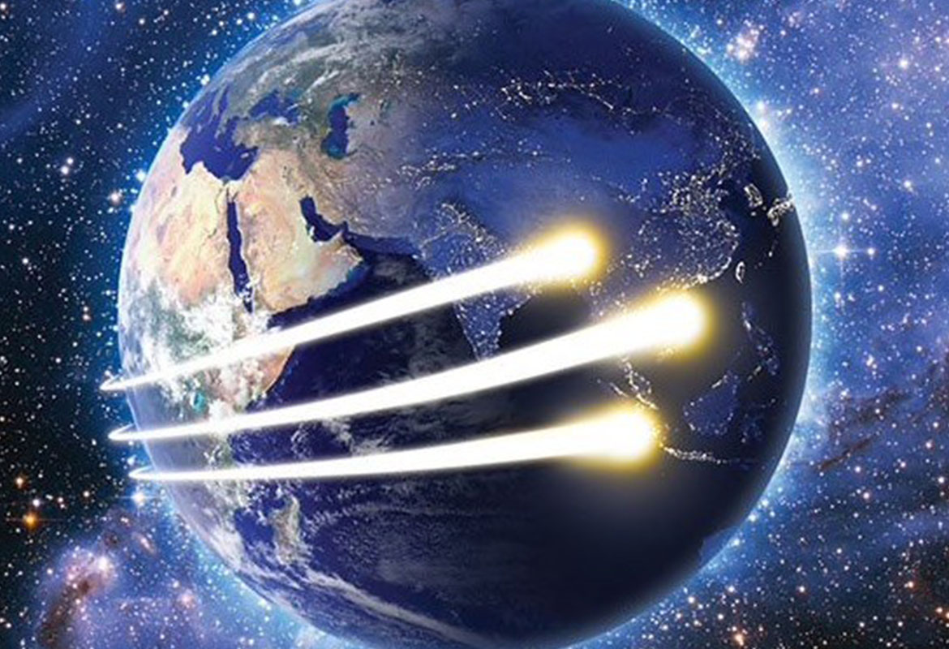
What Are the Three Angel’s Messages?
FIRST: Rev. 14:6-7 “And I saw another angel fly in the midst of heaven, having the everlasting gospel to preach unto them that dwell on the earth, and to every nation, and kindred, and tongue, and people, Saying with a loud voice, Fear God, and give glory to him; for the hour of his judgment is come: and worship him that made heaven, and earth, and the sea, and the fountains of waters.”

Slide 4
The Everlasting Gospel
“The power of Christ, the crucified Saviour, to give eternal life, should be presented to the people. We should show them that the Old Testament is as verily the gospel in types and shadows as the New Testament is in its unfolding power. The New Testament does not present a new religion; the Old Testament does not present a religion to be superseded by the New. The New Testament is only the advancement and unfolding of the Old. Abel was a believer in Christ, and was as verily saved by His power as was Peter or Paul. Enoch was a representative of Christ as surely as was the beloved disciple John. Enoch walked with God, and he was not, for God took him. To him was committed the message of the second coming of Christ. "And Enoch also, the seventh from Adam, prophesied of these, saying, Behold, the Lord cometh with ten thousands of His saints, to execute judgment upon all." Jude 14, 15. The message preached by Enoch and his translation to heaven were a convincing argument to all who lived in his time. These things were an argument that Methuselah and Noah could use with power to show that the righteous could be translated. That God who walked with Enoch was our Lord and Saviour Jesus Christ. He was the light of the world then just as He is now. Those who lived then were not without teachers to instruct them in the path of life; for Noah and Enoch were Christians. The gospel is given in precept in Leviticus. Implicit obedience is required now, as then. How essential it is that we understand the importance of this word! The question is asked: What is the cause of the dearth in the church? The answer is: We allow our minds to be drawn away from the word. If the word of God were eaten as the food for the soul, if it were treated with respect and deference, there would be no necessity for the many and repeated testimonies that are borne. The simple declarations of Scripture would be received and acted upon.” (6T, 392, 393)

Slide 5
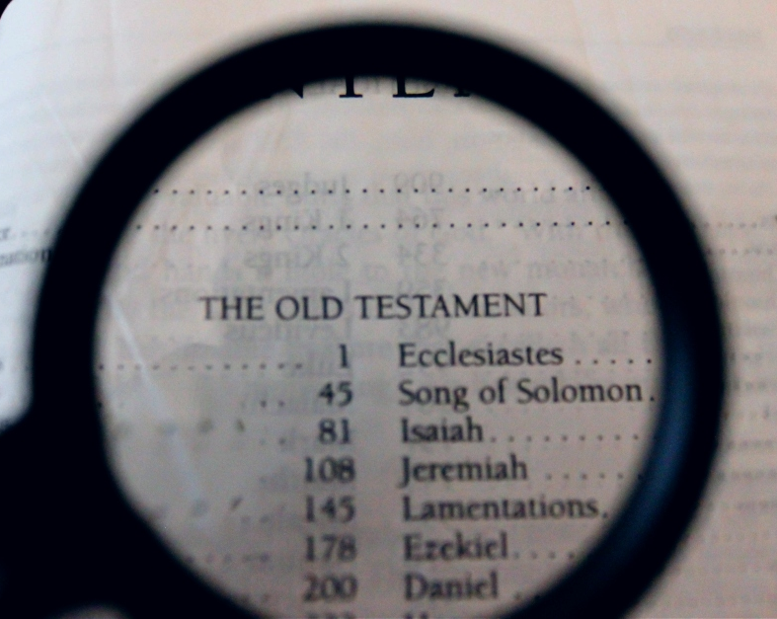
Some Old Testament Teachings…
Keeping all 10 of the Commandments of God (Ex. 20; Deut. 5).
Gift of (Spirit of) Prophecy (Daniel 2; 7; 8; 9; 11; 12)
Righteousness is by Faith Alone (Leviticus Sanctuary System; Ps. 5:8; Jer. 23:6)
Grace and Indwelling of the Holy Spirit (Ps. 51)
Repentance (Ez. 18:21-22)
The Judgment (Ecc. 12:14)
State of the Dead (death is sleep Ecc. 9:6)
Day for a year Principle (Ez. 4:6; Num. 14:34)

Slide 6
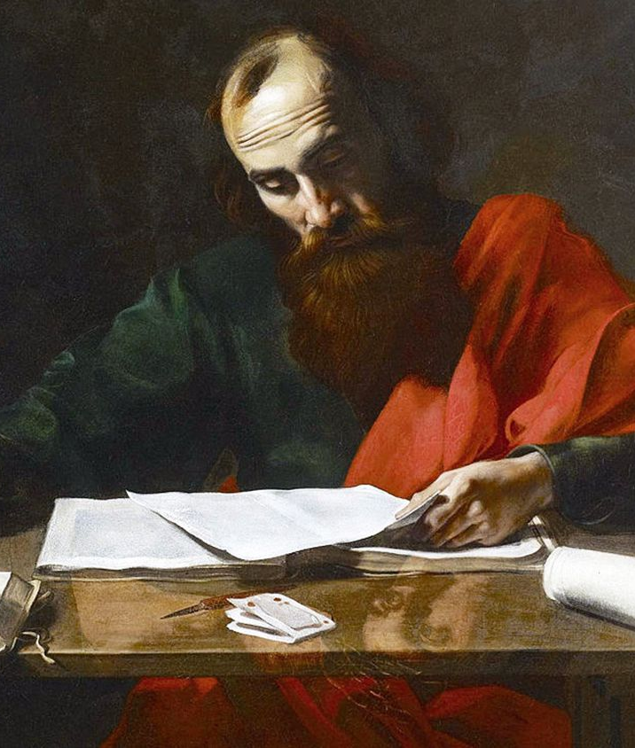
Apostle Paul Confirms!
1 Cor. 10:8-11 “Neither let us commit fornication, as some of them committed, and fell in one day three and twenty thousand. Neither let us tempt Christ, as some of them also tempted, and were destroyed of serpents. Neither murmur ye, as some of them also murmured, and were destroyed of the destroyer. Now all these things happened unto them for examples: and they are written for our admonition, upon whom the ends of the world are come.”

Slide 7
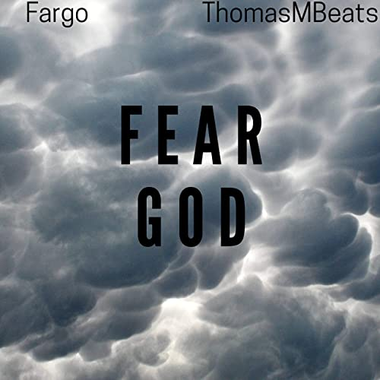
Fear God!
Strong’s Concordance: phobeo (fob-eh’-o)- fear, be afraid, be afraid of, reverence, 1) to put to flight by terrifying (to scare away), 1a) to put to flight, to flee, 1b) to fear, be afraid, 1) to be struck with fear, to be seized with alarm of those started by strange occurrences, of those struck with amazement, 2) to fear, to be afraid of one, 3) to fear (i.e. hesitate) to do something (for fear of harm), 1c) to reverence, venerate, to treat with deference or reverential obedience

Slide 8
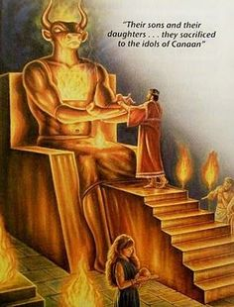
OT: We are Not to Fear False Gods
2 Kings 17:35 “With whom the LORD had made a covenant, and charged them, saying, Ye shall not fear other gods, nor bow yourselves to them, nor serve them, nor sacrifice to them”
Deut. 7:17-18,21 “If thou shalt say in thine heart, These nations are more than I; how can I dispossess them? Thou shalt not be afraid of them: but shalt well remember what the Lord thy God did unto Pharaoh, and unto all Egypt. Thou shalt not be affrighted at them: for the Lord thy God is among you, a mighty God and terrible.”

Slide 9
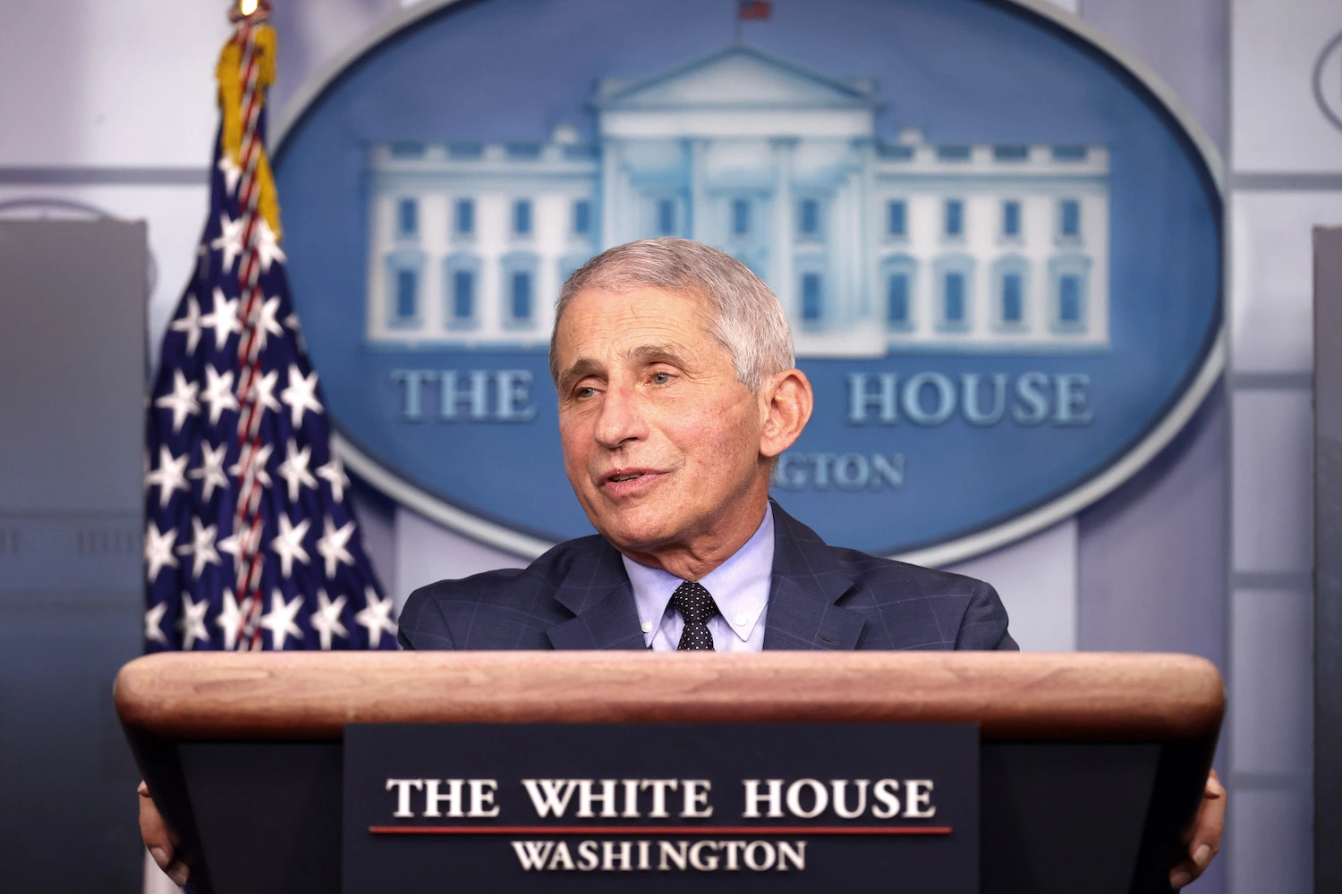

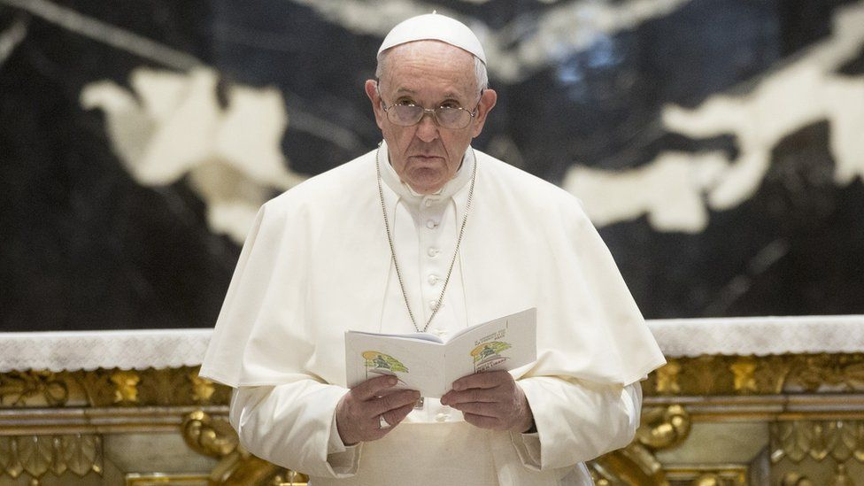
Cursed are those who trust in man
Jer. 17:5-7 “Thus saith the Lord; Cursed be the man that trusteth in man, and maketh flesh his arm, and whose heart departeth from the Lord. For he shall be like the heath in the desert, and shall not see when good cometh; but shall inhabit the parched places in the wilderness, in a salt land and not inhabited. Blessed is the man that trusteth in the Lord, and whose hope the Lord is.”
Ps. 146:3-5 “Put not your trust in princes, nor in the son of man, in whom there is no help. His breath goeth forth, he returneth to his earth; in that very day his thoughts perish. Happy is he that hath the God of Jacob for his help, whose hope is in the Lord his God:

Slide 10
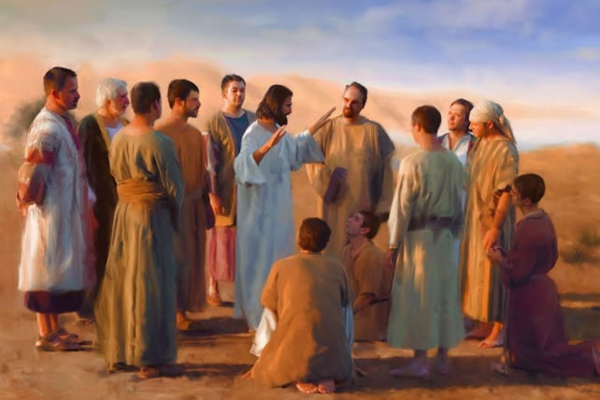
NT Fearing God
Matt. 10:28-31 “And fear not them which kill the body, but are not able to kill the soul: but rather fear him which is able to destroy both soul and body in hell. Are not two sparrows sold for a farthing? and one of them shall not fall on the ground without your Father. But the very hairs of your head are all numbered. Fear ye not therefore, ye are of more value than many sparrows.”

Slide 11
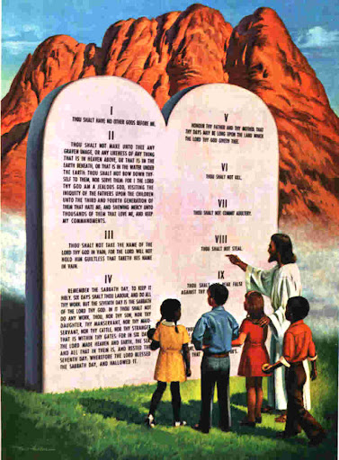
Fear God=Keep the Commandments
Deut. 5:29 “O that there were such an heart in them, that they would fear me, and keep all my commandments always, that it might be well with them, and with their children for ever!”
Prov. 8:13 “The fear of the Lord is to hate evil: pride, and arrogancy, and the evil way, and the froward mouth, do I hate.”
Job 28:28 “And unto man he said, Behold, the fear of the Lord, that is wisdom; and to depart from evil is understanding.”

Slide 12
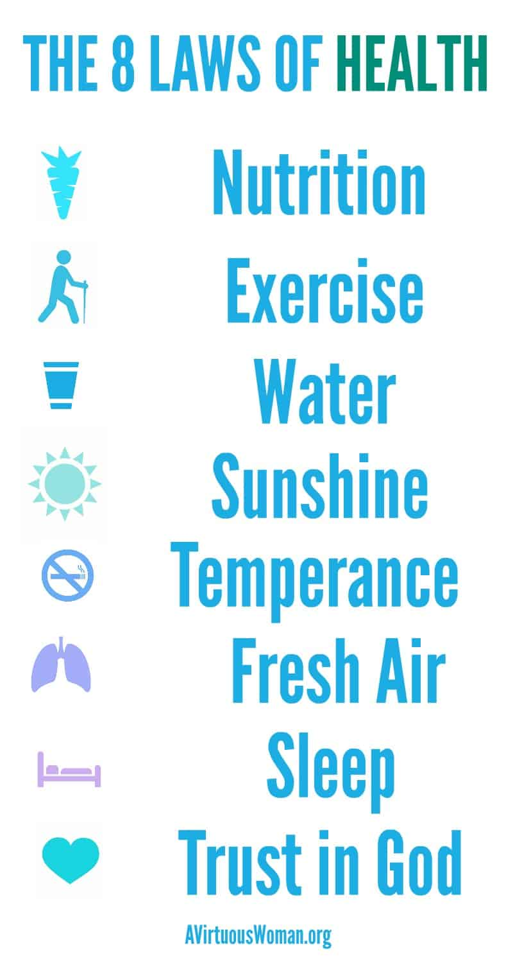

Give Glory to Him!
1 Cor. 10:31 “Whether therefore ye eat, or drink, or whatsoever ye do, do all to the glory of God.”
John 15:1-2,5-8 “I am the true vine, and my Father is the husbandman. Every branch in me that beareth not fruit he taketh away: and every branch that beareth fruit, he purgeth it, that it may bring forth more fruit. . . . I am the vine, ye are the branches: He that abideth in me, and I in him, the same bringeth forth much fruit: for without me ye can do nothing. If a man abide not in me, he is cast forth as a branch, and is withered; and men gather them, and cast them into the fire, and they are burned. If ye abide in me, and my words abide in you, ye shall ask what ye will, and it shall be done unto you. Herein is my Father glorified, that ye bear much fruit; so shall ye be my disciples.”

Slide 13
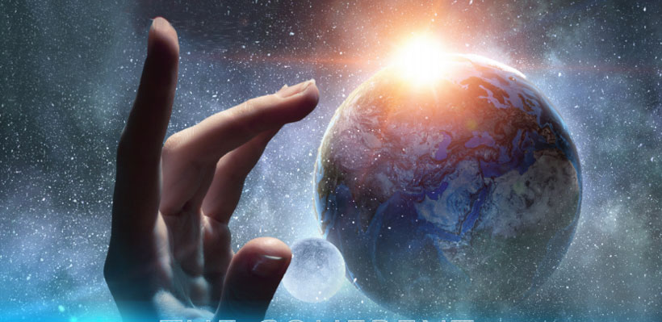
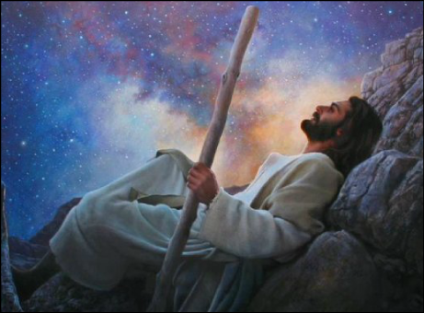
Worship the Creator
Rev. 14:7 “and worship him that made heaven, and earth, and the sea, and the fountains of waters”
Gen. 2:1-3 “Thus the heavens and the earth were finished, and all the host of them. And on the seventh day God ended his work which he had made; and he rested on the seventh day from all his work which he had made. And God blessed the seventh day, and sanctified it: because that in it he had rested from all his work which God created and made.”

Slide 14
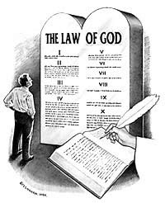
The Lost Commandment Restored!
Ex. 20:8-11 “Remember the sabbath day, to keep it holy. Six days shalt thou labour, and do all thy work: But the seventh day is the sabbath of the Lord thy God: in it thou shalt not do any work, thou, nor thy son, nor thy daughter, thy manservant, nor thy maidservant, nor thy cattle, nor thy stranger that is within thy gates: For in six days the Lord made heaven and earth, the sea, and all that in them is, and rested the seventh day: wherefore the Lord blessed the sabbath day, and hallowed it.”

Slide 15
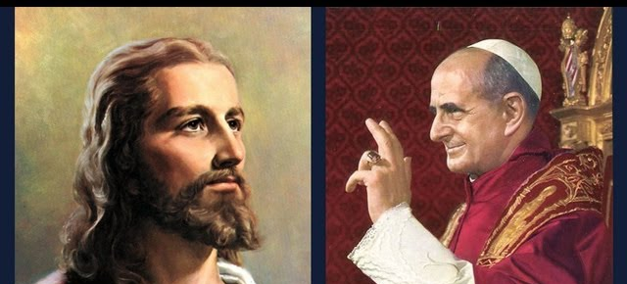
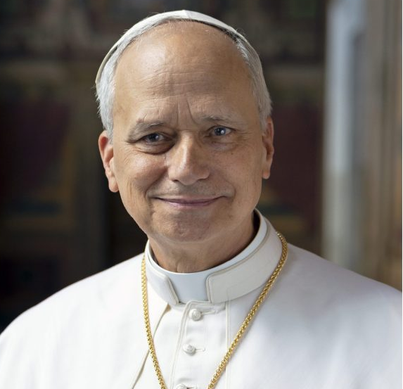
What Will We Choose?

Slide 16
Explain the time of the end and the Reformation, restoring the Sanctuary
Elijah and the restoration of the altar
Explain the Millerite movement and the 2300 days as the only ones who understood the significance of this passage
Walk through the events and the errors, highlight the importance of the sanctuary throughout
Loughborough’s account, etc.
3 Angel’s Messages—the worldwide message, the Second Great Awakening, Great Disappointment of the disciples

