Slide 1
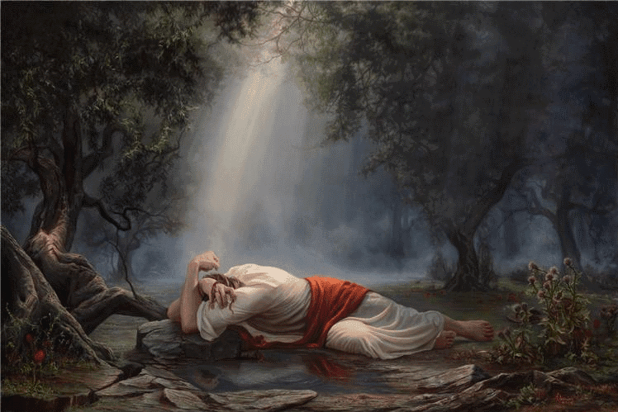
A Medical Examination of the Closing Scenes of Christ’s Life…

Slide 2
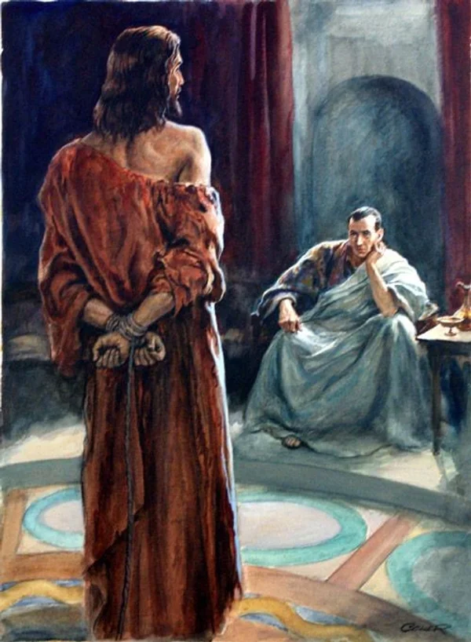
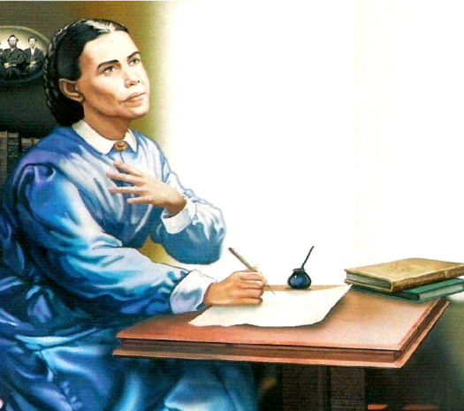
Why It’s Important:
“It would be well for us to spend a thoughtful hour each day in contemplation of the life of Christ. We should take it point by point, and let the imagination grasp each scene, especially the closing ones. As we thus dwell upon His great sacrifice for us, our confidence in Him will be more constant, our love will be quickened, and we shall be more deeply imbued with His spirit. If we would be saved at last, we must learn the lesson of penitence and humiliation at the foot of the cross.” DA, p. 83

Slide 3
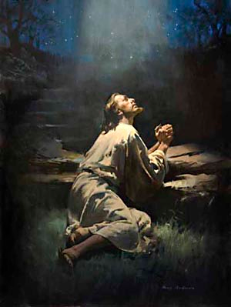
In Gethsemane: The Courageous Lamb!
“Jesus had been earnestly conversing with His disciples and instructing them; but as He neared Gethsemane, He became strangely silent. He had often visited this spot for meditation and prayer; but never with a heart so full of sorrow as upon this night of His last agony. Throughout His life on earth He had walked in the light of God's presence. When in conflict with men who were inspired by the very spirit of Satan, He could say, ‘He that sent Me is with Me: the Father hath not left Me alone; for I do always those things that please Him.’ John 8:29. But now He seemed to be shut out from the light of God's sustaining presence. Now He was numbered with the transgressors. The guilt of fallen humanity He must bear. Upon Him who knew no sin must be laid the iniquity of us all. So dreadful does sin appear to Him, so great is the weight of guilt which He must bear, that He is tempted to fear it will shut Him out forever from His Father's love. Feeling how terrible is the wrath of God against transgression, He exclaims, ‘My soul is exceeding sorrowful, even unto death.’” DA, p. 685

Slide 4
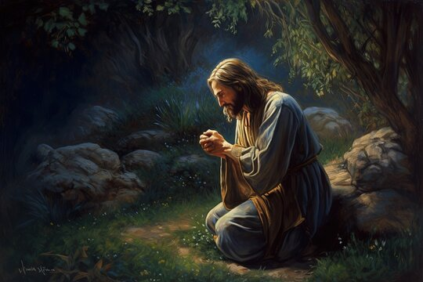
Retired the Mount of Olives
“As they approached the garden, the disciples had marked the change that came over their Master. Never before had they seen Him so utterly sad and silent. As He proceeded, this strange sadness deepened; yet they dared not question Him as to the cause. His form swayed as if He were about to fall. Upon reaching the garden, the disciples looked anxiously for His usual place of retirement, that their Master might rest. Every step that He now took was with labored effort. He groaned aloud, as if suffering under the pressure of a terrible burden. Twice His companions supported Him, or He would have fallen to the earth. Near the entrance to the garden, Jesus left all but three of the disciples, bidding them pray for themselves and for Him. With Peter, James, and John, He entered its secluded recesses.” DA, p. 685-686

Slide 5
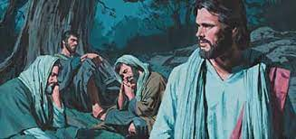
In Gethsemane….
“And they came to a place which was named Gethsemane [1068]: and he saith to his disciples, Sit ye here, while I shall pray. And taketh with him Peter and James and John, and began to be sore amazed and to be very heavy; And saith unto them, My soul is exceeding sorrowful unto death: tarry ye here and watch. And he went forward a little and prayed that if it were possible, the hour might pass from him. And he said, Abba, Father, all things are possible unto thee; take away this cup from me: nevertheless not what I will, but what thou wilt” Mark 14:32-36

Slide 6
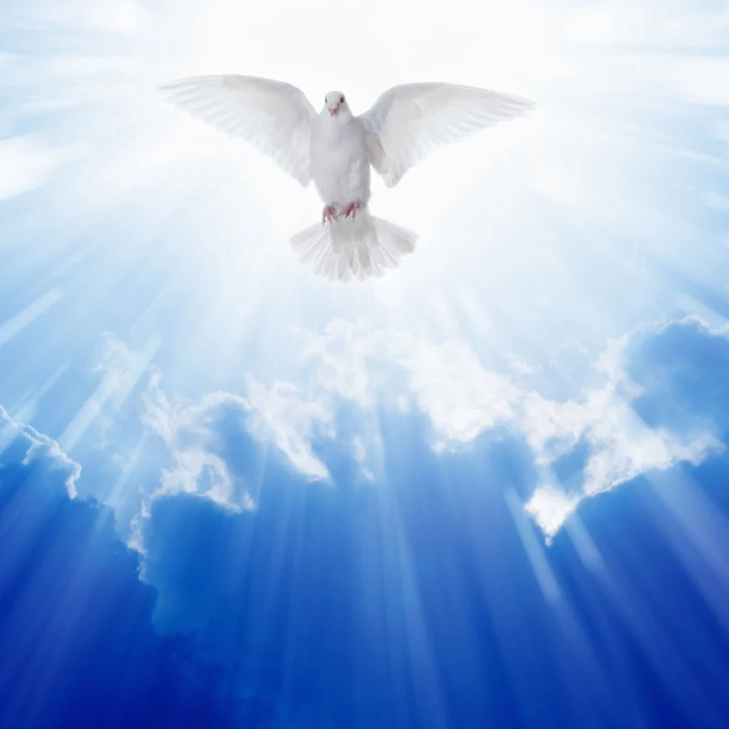
Gethsemane = The Oil Press!
Gethsemane 1068 Strong’s Concordance (gheth-say-man-ay): An oil press, 1) the name of the place at the foot of the Mount of Olives, beyond the torrent Kidron
Acts 10:38 “How God anointed Jesus of Nazareth with the Holy Ghost and with power: who went about doing good, and healing all that were oppressed of the devil; for God was with him.”

Slide 7
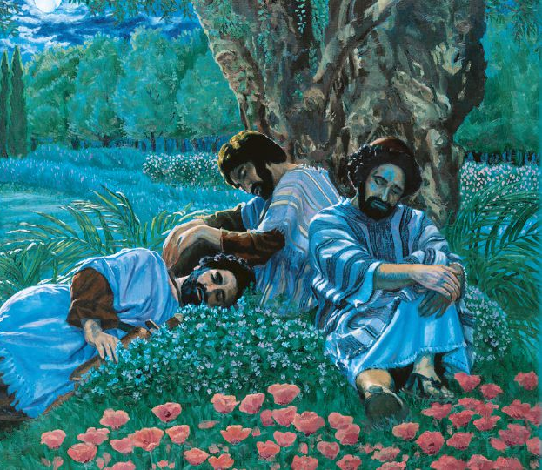
No Human Sympathizer
“The sins of men weighed heavily upon Christ, and the sense of God's wrath against sin was crushing out His life. . . . The human heart longs for sympathy in suffering. This longing Christ felt to the very depths of His being. In the supreme agony of His soul He came to His disciples with a yearning desire to hear some words of comfort from those whom He had so often blessed and comforted, and shielded in sorrow and distress. The One who had always had words of sympathy for them was now suffering superhuman agony, and He longed to know that they were praying for Him and for themselves. How dark seemed the malignity of sin! Terrible was the temptation to let the human race bear the consequences of its own guilt, while He stood innocent before God. If He could only know that His disciples understood and appreciated this, He would be strengthened.” DA, p. 687-688

Slide 8
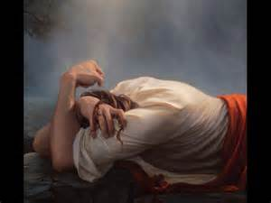
Drops of Blood: Hematidrosis
Luke 22:42-44 “Father, if thou be willing, remove this cup from me: nevertheless not my will, but thine, be done. And there appeared an angel unto him from heaven, strengthening him. And being in an agony he prayed more earnestly: and his sweat was as it were great drops of blood falling down to the ground.”

Slide 9
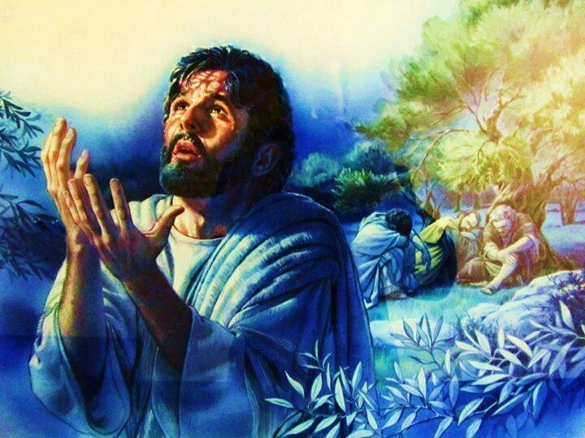
A Doctor Explains…
“Sweating blood, called hematidrosis in medical terminology, is a rarely observed phenomenon. It is the spontaneous discharge of blood through the skin, sweating blood. Descriptions and symptoms vary. In some people, the skin can become sensitive and blood expressible from the skin. Others experience less pronounced manifestations . . . Anxiety or fear appear to be the triggering factors. For example, a ten year old girl in India developed hematidrosis after seeing her elder sister being abducted.” Joseph W. Bergeron, M.D., The Crucifixion of Jesus, p. 128

Slide 10
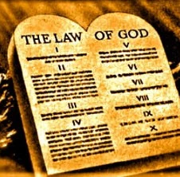
Was There Another Way?
“Instead of proclaiming the abolition of the law, Calvary's cross proclaims in thunder tones its immutable and eternal character. Could the law have been abolished, and the government of heaven and earth and the unnumbered worlds of God maintained, Christ need not have died. The death of Christ was to forever settle the question of the validity of the law of Jehovah. Having suffered the full penalty for a guilty world, Jesus became the mediator between God and man, to restore the repenting soul to favor with God by giving him grace to keep the law of the Most High.” The Signs of the Times, June 20, 1895.

Slide 11
Strengthened by the Angel
“a light shone forth amid the stormy darkness of the crisis hour, and the mighty angel who stands in God's presence, occupying the position from which Satan fell, came to the side of Christ. The angel came not to take the cup from Christ's hand, but to strengthen Him to drink it, with the assurance of the Father's love. He came to give power to the divine-human suppliant. He pointed Him to the open heavens, telling Him of the souls that would be saved as the result of His sufferings. He assured Him that His Father is greater and more powerful than Satan, that His death would result in the utter discomfiture of Satan, and that the kingdom of this world would be given to the saints of the Most High. He told Him that He would see of the travail of His soul, and be satisfied, for He would see a multitude of the human race saved, eternally saved.” DA, p. 693-694

Slide 12
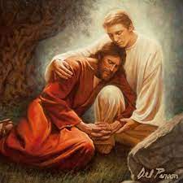
His Sufferings at a Glance:
As we move through the sufferings of Christ. Things to keep in mind:
The sins of the whole world—past, present, future of every person ever were placed upon Jesus as he entered the Oil Press—the Holy Spirit was pressed out of Him and He felt the mental anguish of eternal separation from the Father
His anxiety causes Jesus’ sweat glands to rupture, and He begins to sweat great drops of blood—Hematidrosis, Jesus is dying in Gethsemane from the weight of sin!
Once captured he will be kept awake for about 36 hours
No food for 12-16 hours
No water for 12-16 hours
Forced to walk roughly 4Km in this state
He is physically struck when speaking to the Sanhedrin
He was humiliated, mocked, derided
Scourged naked, then marched through the city with the cross

Slide 13
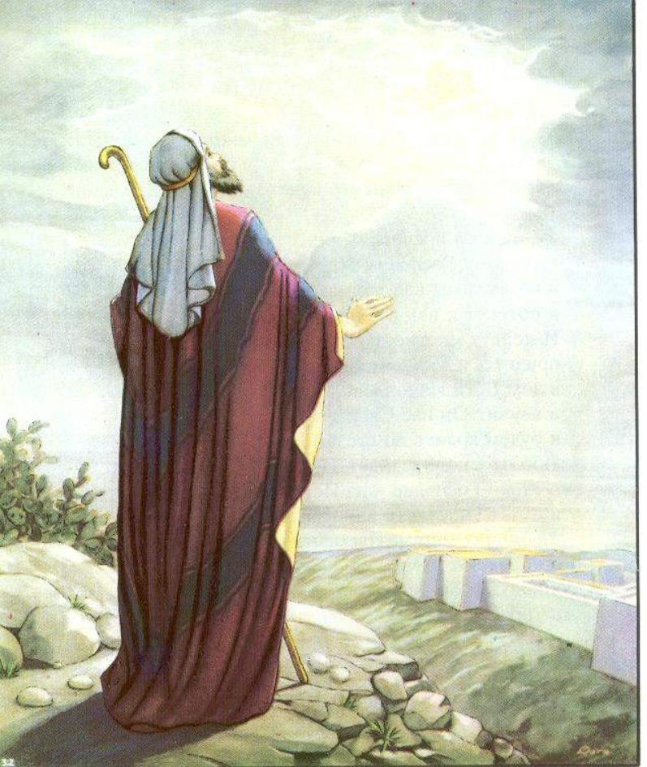
Isaiah Foretold: With His Stripes….
Is. 53:3-6 “He is despised and rejected of men; a man of sorrows, and acquainted with grief: and we hid as it were our faces from him; he was despised, and we esteemed him not. Surely he hath borne our griefs, and carried our sorrows: yet we did esteem him stricken, smitten of God, and afflicted. But he was wounded for our transgressions, he was bruised for our iniquities: the chastisement of our peace was upon him; and with his stripes we are healed. All we like sheep have gone astray; we have turned every one to his own way; and the Lord hath laid on him the iniquity of us all.”

Slide 14
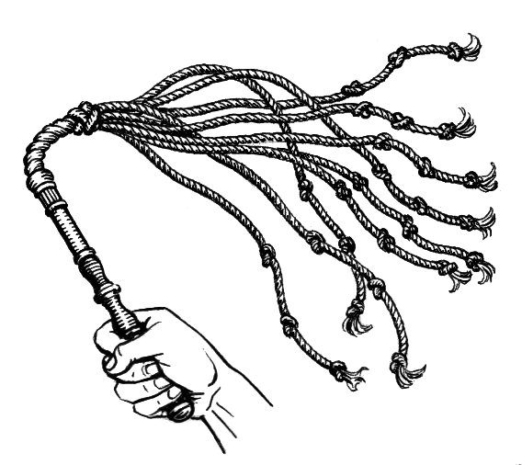
The Roman Scourging…
“The leather whip usually had pieces of steel, balls of lead and sharp bones attached. At the Praetorium, Jesus was severely whipped. It is not known whether the number of lashes was limited to 39, in accordance with Jewish law. The severe scourging, with its intense pain and appreciable blood loss, most probably left Jesus in a preshock state. Moreover, hematidrosis had rendered his skin particularly tender. The physical and mental abuse meted out by the Jews and the Romans, as well as the lack of food, water, and sleep, also contributed to his generally weakened state. Moreover he was mocked, beaten and made fun by Soldiers” Gerald H Bradley M.D., The Medical View of His Sufferings

Slide 15
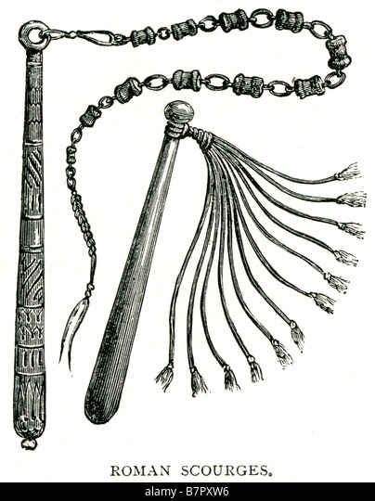
The Outcome of the Scourging
“As the Roman soldiers repeatedly struck the victim's back with full force, the iron balls would cause deep contusions, and the leather thongs and sheep bones would cut into the skin and subcutaneous tissues. Then, as the flogging continued, the lacerations would tear into the underlying skeletal muscles and produce quivering ribbons of bleeding flesh. Pain and blood loss generally set the stage for circulatory shock. The extent of blood loss may well have determined how long the victim would survive on the cross.” Ibid.

Slide 16
A Medical Perspective…
Dr. David Acuna, Trauma Surgeon, The Crucifixion | A Medical Perspective

Slide 17
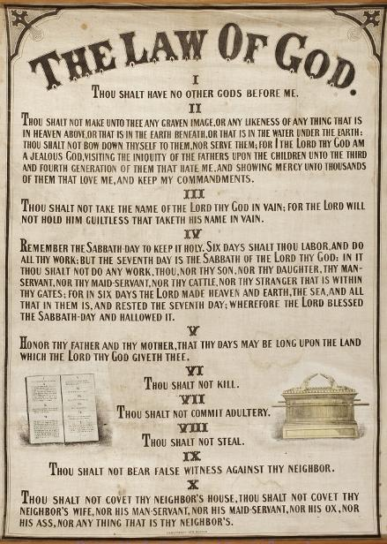
Marred More Than Any Man!!!!
Is. 52:14 “As many were astonied at thee; his visage was so marred more than any man, and his form more than the sons of men”
Is. 50:6 “I gave my back to the smiters, and my cheeks to them that plucked off the hair: I hid not my face from shame and spitting.”
Is. 42:21 “The Lord is well pleased for his righteousness' sake; he will magnify the law, and make it honourable.”

Slide 18
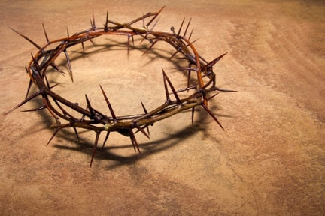
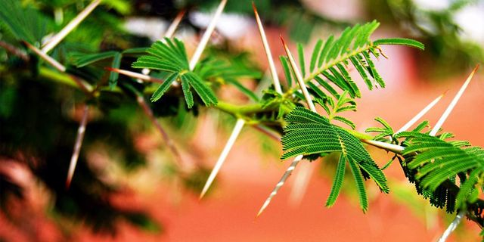
Mocked and Derided… To Save Us!!!
Matt. 27:27-29 “Then the soldiers of the governor took Jesus into the common hall, and gathered unto him the whole band of soldiers. And they stripped him, and put on him a scarlet robe. And when they had platted a crown of thorns, they put it upon his head, and a reed in his right hand: and they bowed the knee before him, and mocked him, saying, Hail, King of the Jews!”
Euphorbia milii.

Slide 19
Then The Cross
As they mocked, derided, spit in His face, instead of releasing Christ, Barabbas was set free—the crowd roaring “Crucify Him! Crucify Him!”, so the murderer was loose and the innocent sent to the Cross!
Matt. 27:35 “And they crucified him, and parted his garments, casting lost: that it might be fulfilled which was spoken by the prophet, They parted my garments among them, and upon my vesture did they cast lots”

Slide 20
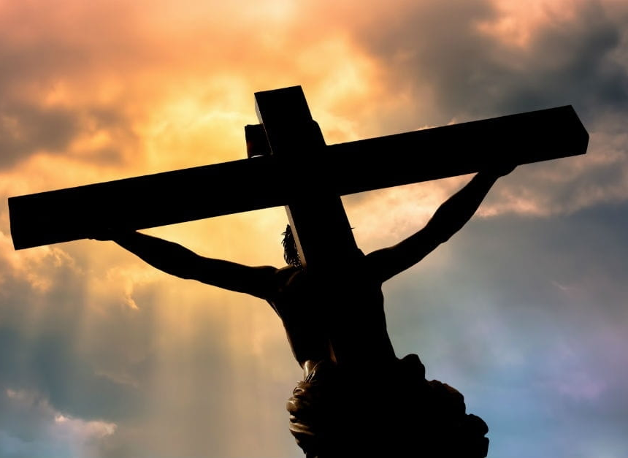
The Cross… A Medical View
“After all the cruel scourging, His flesh is hanging in ribbons. While he suffered, he was ordered to carry a cross weighing over 100 pounds, 650 yards to the place of execution (Golgotha). The rough wood gouged into His torn back. By now He was dehydrated. Only miracle was that he was living. Rusty nails were driven on both his hands and his feet. It was driven amongst the carpal bones of the wrists instead of his palms. Because of the weight of his body would have ripped away the flesh between his fingers. In ROME, they considered the wrist to be part of the hand.” Gerald H Bradley M.D., The Medical View of His Sufferings

Slide 21
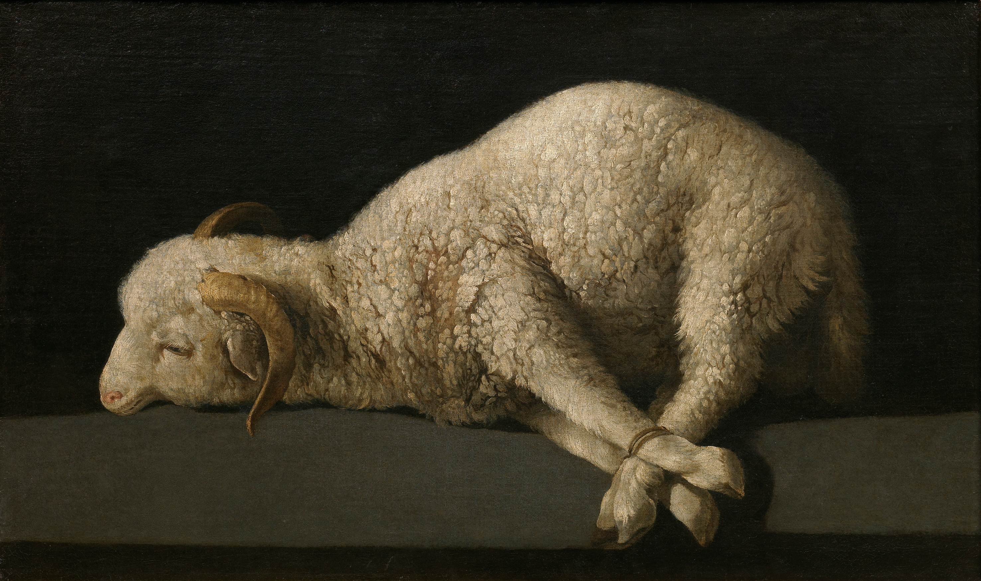
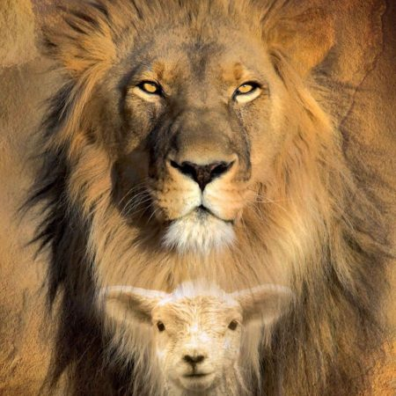
The Physical Pain…. Hardly Felt????
“Upon Christ as our substitute and surety was laid the iniquity of us all. He was counted a transgressor, that He might redeem us from the condemnation of the law. The guilt of every descendant of Adam was pressing upon His heart. The wrath of God against sin, the terrible manifestation of His displeasure because of iniquity, filled the soul of His Son with consternation. All His life Christ had been publishing to a fallen world the good news of the Father's mercy and pardoning love. Salvation for the chief of sinners was His theme. But now with the terrible weight of guilt He bears, He cannot see the Father's reconciling face. The withdrawal of the divine countenance from the Saviour in this hour of supreme anguish pierced His heart with a sorrow that can never be fully understood by man. So great was this agony that His physical pain was hardly felt.” DA, p. 753

Slide 22
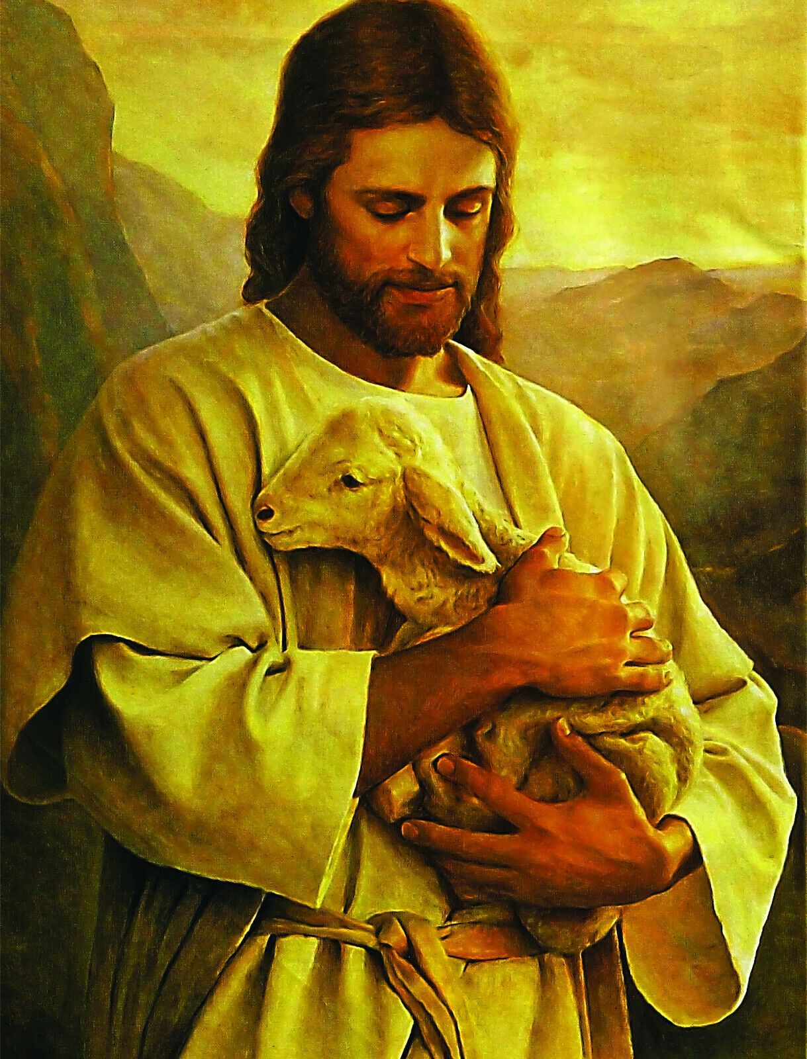
All for Thee!
“The spotless Son of God hung upon the cross, His flesh lacerated with stripes; those hands so often reached out in blessing, nailed to the wooden bars; those feet so tireless on ministries of love, spiked to the tree; that royal head pierced by the crown of thorns; those quivering lips shaped to the cry of woe. And all that He endured—the blood drops that flowed from His head, His hands, His feet, the agony that racked His frame, and the unutterable anguish that filled His soul at the hiding of His Father's face—speaks to each child of humanity, declaring, It is for thee that the Son of God consents to bear this burden of guilt; for thee He spoils the domain of death, and opens the gates of Paradise. He who stilled the angry waves and walked the foam-capped billows, who made devils tremble and disease flee, who opened blind eyes and called forth the dead to life,—offers Himself upon the cross as a sacrifice, and this from love to thee. He, the Sin Bearer, endures the wrath of divine justice, and for thy sake becomes sin itself.” DA, p. 755-756

Slide 23
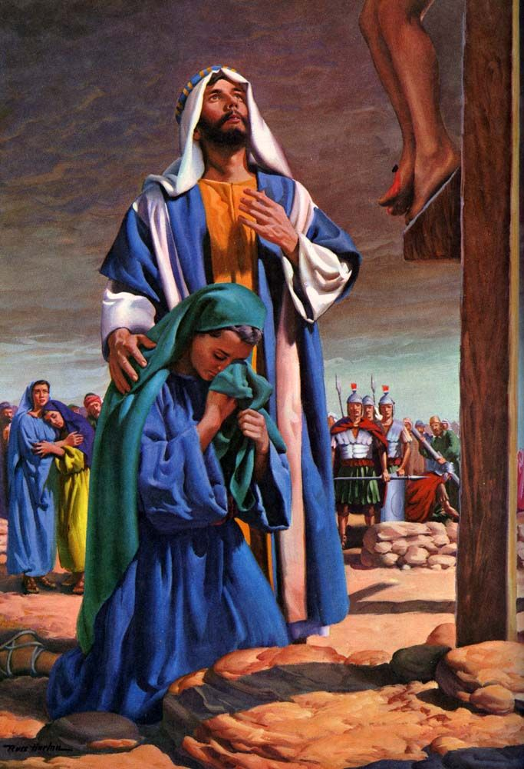
The Last 7 Painful Sayings of Jesus
1. “Then said Jesus, Father, forgive them; for they know not what they do” Luke 23:34
2. “And Jesus said unto him, Verily I say unto thee, Today shalt thou be with me in paradise.” Luke 23:43
3. “Woman, behold thy son! . . . Behold thy mother!” John 19:26,27
4. “Eloi, Eloi, lama sabachthani? which is, being interpreted, My God, my God, why hast thou forsaken me?” Mark 15:34
5. “After this, Jesus knowing that all things were now accomplished, that the scripture might be fulfilled, saith, I thirst.” John 19:28
6. “When Jesus therefore had received the vinegar, he said, It is finished: and he bowed his head, and gave up the ghost.” John 19:30
7. “ And when Jesus had cried with a loud voice, he said, Father, into thy hands I commend my spirit: and having said thus, he gave up the ghost.” Luke 23:46

Slide 24
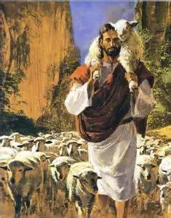
Just For One!?!?
“Even though but few accept the grace of our Lord Jesus Christ, their work will not be in vain; for one soul is precious, very precious, in the sight of God. Christ would have died for one soul in order that that one might live through eternal ages.” 8T, p. 73

Slide 25
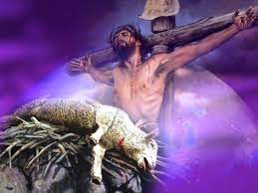
The Good Shepherd: How Did He Die???
John 10:11,17-18 “I am the good shepherd: the good shepherd giveth his life for the sheep. . . . Therefore doth my Father love me, because I lay down my life, that I might take it again. No man taketh it from me, but I lay it down of myself. I have power to lay it down, and I have power to take it again. This commandment have I received of my Father.”
John 15:12-13 “This is my commandment, That ye love one another, as I have loved you. Greater love hath no man than this, that a man lay down his life for his friends.”

Slide 26
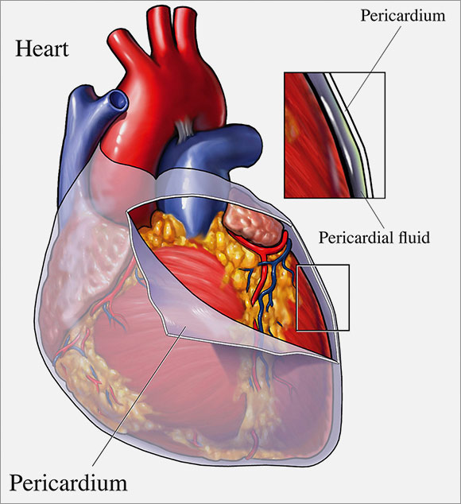
A Broken Heart…???
“In another prophecy the Saviour declared, "Reproach hath broken My heart; and I am full of heaviness: and I looked for some to take pity, but there was none; and for comforters, but I found none. They gave Me also gall for My meat; and in My thirst they gave Me vinegar to drink." Psalm 69:20, 21. . . . Satan with his fierce temptations wrung the heart of Jesus. The Saviour could not see through the portals of the tomb. Hope did not present to Him His coming forth from the grave a conqueror, or tell Him of the Father's acceptance of the sacrifice. He feared that sin was so offensive to God that Their separation was to be eternal. Christ felt the anguish which the sinner will feel when mercy shall no longer plead for the guilty race. It was the sense of sin, bringing the Father's wrath upon Him as man's substitute, that made the cup He drank so bitter, and broke the heart of the Son of God.” DA, p. 746, 753
Rupture of the Free Wall of the Heart…

