Slide 1
Feast Days, pt. 4
Blow the Trumpet

Slide 2
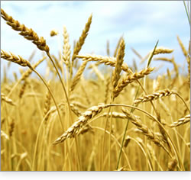
Brief Review
Thus far, we have seen that their were two springtime feasts. These were Passover/Unleavened Bread and Pentecost. Both of these feasts were mandatory for all Hebrew males 12 years old and above. They pointed to Christ as:
1. Passover sacrifice
2. High Priest in heaven

Slide 3
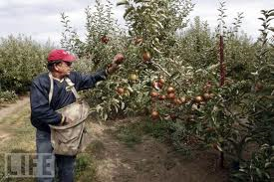
Springtime Feasts
As the springtime feasts took place in the beginning of the Jewish year, so the fulfillment of these feasts took place at the beginning of the gospel commission. The fulfillment of these feasts took place in the 1st century. As we turn toward the three fall festivals, let us realize that they take place at the end of the Jewish harvest cycle. We should expect to see their fulfillment somewhere down at the end of this earth’s history!

Slide 4
Fulfilled in Event and Time!
“These types were fulfilled, not only as to the event, but as to the time. On the fourteenth day of the first Jewish month, the very day and month on which for fifteen long centuries the Passover lamb had been slain, Christ, having eaten the Passover with His disciples, instituted that feast which was to commemorate His own death as "the Lamb of God, which taketh away the sin of the world." That same night He was taken by wicked hands to be crucified and slain. And as the antitype of the wave sheaf our Lord was raised from the dead on the third day, "the first fruits of them that slept," a sample of all the resurrected just, whose "vile body" shall be changed, and "fashioned like unto His glorious body." Verse 20; Philippians 3:21.
In like manner the types which relate to the second advent must be fulfilled at the time pointed out in the symbolic service.” GC, pgs. 399,400

Slide 5
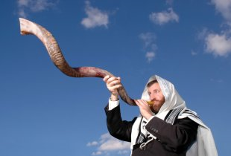
Sound an Alarm
The first of the three autumn feasts was the feast of trumpets. This one fell each year on the 7th month and the first day of the month.
“And the LORD spake unto Moses, saying, Speak unto the children of Israel, saying, In the seventh month, in the first day of the month, shall ye have a sabbath, a memorial of blowing of trumpets, a holy convocation. Ye shall do no servile work therein: but ye shall offer an offering made by fire unto the LORD.” Leviticus 23:23-25

Slide 6
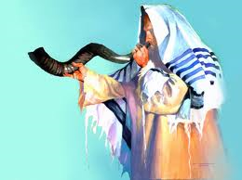
Beginning of Civil Year
The feast of trumpets fell on the 1st day of the seventh month. This month was known as Tishri. It was considered to be the beginning of the civil year for the Israelites. This day would begin the ten days of repentance as the Day of Atonement approached!

Slide 7
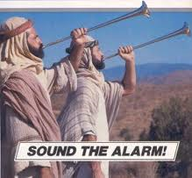
The purpose of the Feast of Trumpets
This feast took place 10 days before the Day of Atonement.
The Jewish people call this feast Rosh Hashanah, which literally means "Head of the Year," and it is observed as the start of the civil year (in contrast with the religious year which starts with Passover) on the Jewish calendar.
The Feast of Trumpets is so important in Jewish thinking that it stands alongside Yom Kippur ("Day of Atonement") to comprise what Judaism calls "the high holy days" on the Jewish religious calendar. It begins the "ten days of awe" before the Day of Atonement.
It was a warning blast to prepare for the Day of Atonement.

Slide 8
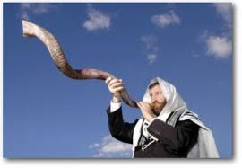
Distinct Horn
The trumpet referred to here was the shofar, a ram's horn. It was distinctive from the silver trumpets blown on the other new moons. Silver trumpets were sounded at the daily burnt offering and at the beginning of each new month (Numbers 10:10), but the shofar specifically was blown on the beginning of the month Tishri. It had a special sound to get ready for the Day of Atonement!!

Slide 9
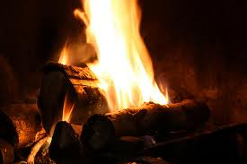
How could Everyone hear?
The call of the trumpets, summoning everyone to prepare for the Day of Atonement, could only be heard by those living closest to the temple. To make sure that everyone knew, a torch was lighted on the height of the Mt. of Olives. This signaled to watchers on other strategic hills, who also kindled their lights, and soon, the country was flooded with light from end to end!

Slide 10
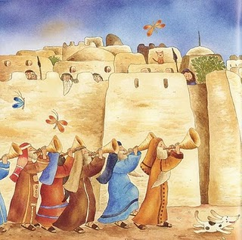
The Trumpet Blast
Locked into the psyche of God’s people was the trumpet blast and judgment. This began with the feast of trumpets and would continue to be used throughout the history of God’s people. Notice several examples from Scripture………..

Slide 11
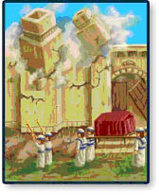
Jericho
“And seven priests shall bear before the ark seven trumpets of rams' horns: and the seventh day ye shall compass the city seven times, and the priests shall blow with the trumpets. And it shall come to pass, that when they make a long [blast] with the ram's horn, [and] when ye hear the sound of the trumpet, all the people shall shout with a great shout; and the wall of the city shall fall down flat, and the people shall ascend up every man straight before him.” Joshua 6:4,5

Slide 12
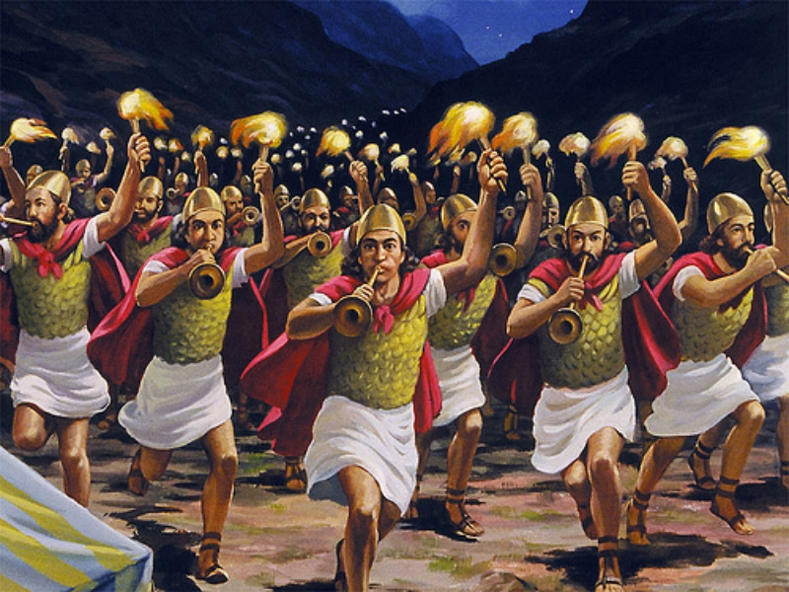
Gideon and Midian
“And he divided the three hundred men [into] three companies, and he put a trumpet in every man's hand, with empty pitchers, and lamps within the pitchers. And he said unto them, Look on me, and do likewise: and, behold, when I come to the outside of the camp, it shall be [that], as I do, so shall ye do. When I blow with a trumpet, I and all that [are] with me, then blow ye the trumpets also on every side of all the camp, and say, [The sword] of the LORD, and of Gideon. So Gideon, and the hundred men that [were] with him, came unto the outside of the camp in the beginning of the middle watch; and they had but newly set the watch: and they blew the trumpets, and brake the pitchers that [were] in their hands. And the three companies blew the trumpets, and brake the pitchers, and held the lamps in their left hands, and the trumpets in their right hands to blow [withal]: and they cried, The sword of the LORD, and of Gideon.” Judges 7:16-20

Slide 13
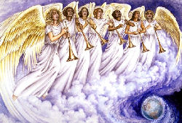
Revelation’s Trumpets
“And the seven angels which had the seven trumpets prepared themselves to sound. The first angel sounded, and there followed hail and fire mingled with blood, and they were cast upon the earth: and the third part of trees was burnt up, and all green grass was burnt up. And the second angel sounded, and as it were a great mountain burning with fire was cast into the sea: and the third part of the sea became blood; And the third part of the creatures which were in the sea, and had life, died; and the third part of the ships were destroyed.” Revelation 8:6-9

Slide 14
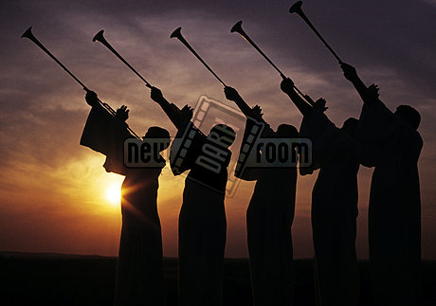
Warning: Judgment Coming
Since, Rev. 14:7 warns of ‘the hour of His judgment has come’, pointing clearly to a specific time when judgment would begin; and since, Daniel 8:14 pinpoints that the cleansing of the sanctuary, or judgment would occur in 2,300 years; Bible students have concluded that this judgment would begin in 1844; therefore, the last days blowing of the trumpet would occur in the 1830’s!!!!

Slide 15
Ten Days Before
The Feast of Trumpets was 10 days before the Day of Atonement. Due to the fact that this feast had end-time ramifications, like all the other feasts, this corresponds with the blowing trumpet of William Miller and others, calling the world to judgment in 1844. This feast of trumpets would correspond to the mid 1830’s and the warning message ‘to prepare to meet thy God.’

Slide 16
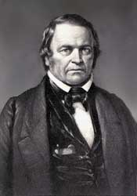
Prepare, Prepare,………….
“An upright, honest-hearted farmer, who had been led to doubt the divine authority of the Scriptures, yet who sincerely desired to know the truth, was the man specially chosen of God to lead out in the proclamation of Christ's second coming. Like many other reformers, William Miller had in early life battled with poverty and had thus learned the great lessons of energy and self-denial.” GC, pg. 317

Slide 17
The Trumpet Call
“They carried strong conviction of their truthfulness; and the "midnight cry" was heralded by thousands of believers.
Like a tidal wave the movement swept over the land. From city to city, from village to village, and into remote country places it went, until the waiting people of God were fully aroused. Fanaticism disappeared before this proclamation like early frost before the rising sun. Believers saw their doubt and perplexity removed, and hope and courage animated their hearts. The work was free from those extremes which are ever manifested when there is human excitement without the controlling influence of the word and Spirit of God. It was similar in character to those seasons of humiliation and returning unto the Lord which among ancient Israel followed messages of reproof from His servants. It bore the characteristics that mark the work of God in every age. There was little ecstatic joy, but rather deep searching of heart, confession of sin, and forsaking of the world. A preparation to meet the Lord was the burden of agonizing spirits. There was persevering prayer and unreserved consecration to God.” GC., pgs. 400,401

Slide 18
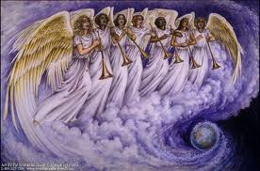
Judgment is Here!!!
Since the call of the Millerite preachers in the 1830’s, God has been warning the world of coming judgment. Rev. 14:7 tells us that that judgment has come. Soon, that judgment will pass to those who are living. May God help us to prepare to meet thy God!!!!

