Slide 1
Romans, pt.11
Wanted Dead or Alive!

Slide 2
Summary: Romans, 5:13-21
1. We are born condemned by Adam’s sin, but not guilty of it.
2. Christ’s death was part of the atonement process.
3. Atonement means taking care of the sin problem.
4. We all received condemnation from the first Adam. We can all receive eternal life if we accept Christ’s life.
5. For most, Christ’s death will be in vain.

Slide 3
Romans 6:1-4
“What shall we say then? Shall we continue in sin, that grace may abound? God forbid. How shall we, that are dead to sin, live any longer therein? Know ye not, that so many of us as were baptized into Jesus Christ were baptized into his death? Therefore we are buried with him by baptism into death: that like as Christ was raised up from the dead by the glory of the Father, even so we also should walk in newness of life.”

Slide 4
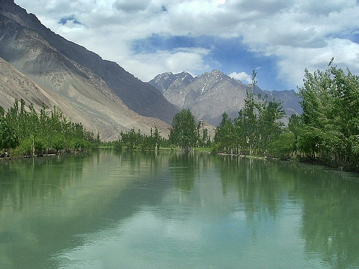
Baptized Dead or Alive?
Do we continue a life of sin so that the grace of Christ can bring us forgiveness? The old man of sin is supposed to have died. When the old man goes under the water in baptism, this represents his death. When he rises, Christ, the new man, is to now be in control.

Slide 5
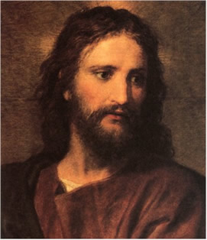
The New Man!
Why is the old man of sin still alive? If the old man of sin, who was suppose to have died at baptism, is still alive, then it means that he is being fed, clothed, and encouraged to live. The old man must be kicked out of the life. Only One Man can do that for us today, now!

Slide 6
Feeding the New Man
“Now it came to pass, as they went, that he entered into a certain village: and a certain woman named Martha received him into her house. And she had a sister called Mary, which also sat at Jesus' feet, and heard his word. But Martha was cumbered about much serving, and came to him, and said, Lord, dost thou not care that my sister hath left me to serve alone? bid her therefore that she help me. And Jesus answered and said unto her, Martha, Martha, thou art careful and troubled about many things: But one thing is needful: and Mary hath chosen that good part, which shall not be taken away from her.” Luke 10:38-42

Slide 7
Are We Dead?
Christ dies at the cross/ the old man of sin dies when we accept Christ.
Christ is buried in the tomb/ the old man is buried in the waters of baptism.
Christ rises from the dead/ the life of Christ is now to be our life.
Immersion in baptism is what symbolizes Christ’s death and resurrection.
The lie today that Sunday represents the resurrection has no Biblical authority!

Slide 8
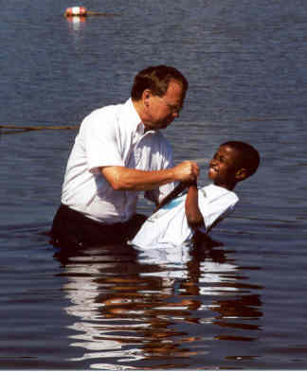
Baptism
Because Baptism represents the death of the old man of sin, it is obvious that the only correct form of baptism is burial in the water. Sprinkling, infant baptism, or whatever, have no basis in the Bible.

Slide 9
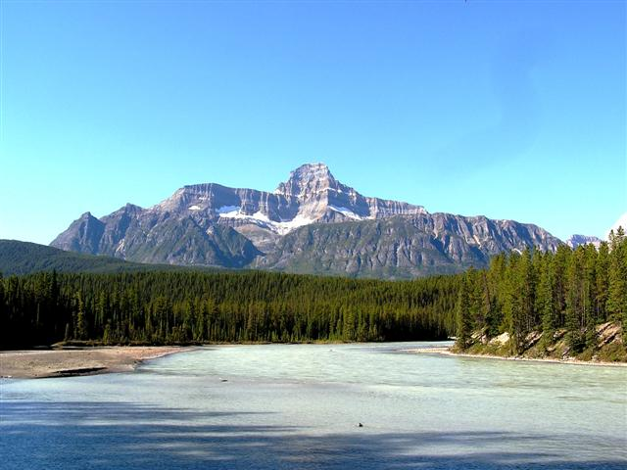
Romans 6:5,6
“For if we have been planted together in the likeness of his death, we shall be also in the likeness of his resurrection: Knowing this, that our old man is crucified with him, that the body of sin might be destroyed, that henceforth we should not serve sin.”

Slide 10
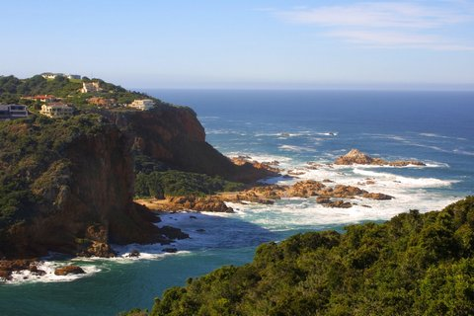
I Die, Christ Lives!
“I am crucified with Christ: nevertheless I live; yet not I, but Christ liveth in me: and the life which I now live in the flesh I live by the faith of the Son of God, who loved me, and gave himself for me.” Galatians 2:20

Slide 11

New Life
This idea runs throughout Paul’s writings.
“Mortify therefore your members which are upon the earth; fornication, uncleanness, inordinate affection, evil concupiscence, and covetousness, which is idolatry: For which things' sake the wrath of God cometh on the children of disobedience: In the which ye also walked some time, when ye lived in them. But now ye also put off all these; anger, wrath, malice, blasphemy, filthy communication out of your mouth. Lie not one to another, seeing that ye have put off the old man with his deeds; And have put on the new man, which is renewed in knowledge after the image of him that created him:” Colossians 3:5-10

Slide 12

Very Clear
"God commendeth his love toward us, in that, while we were yet sinners, Christ died for us." The love of God is unmistakable and unquestionable, if we accept the word of God as his word. But when those who claim to be followers of Christ, still cherish idols of sinful practices that annoy their friends and those who have their good at heart, and still cling to their own way, which is full of defects, they misrepresent Christ. They claim to be converted, but what is the character of such a conversion? Have they met the high claim that is presented as service to God? "I beseech you therefore, brethren, by the mercies of God, that ye present your bodies a living sacrifice, holy, acceptable unto God, which is your reasonable service. And be not conformed to this world; but be ye transformed [how? By keeping the old ideas of sin, the old practices of evil, the old objectionable traits of character?--No] by the renewing of your mind, that ye may prove what is that good, and acceptable, and perfect, will of God. For I say, through the grace given unto me, to every man that is among you, not to think of himself more highly that he ought to think; but to think soberly, according as God hath dealt to every man the measure of faith." Mrs. E. G. White. {YI, September 21, 1893 par. 1}

Slide 13
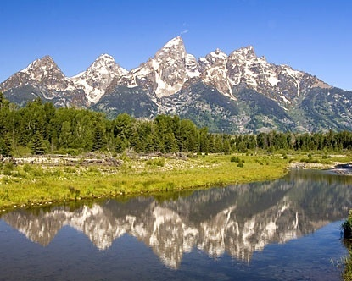
Romans 6:7
“For he that is dead is freed from sin.”
When the old man of sin dies, then the new man, Christ Jesus, takes control and enables us to walk in freedom.
“The only defense against evil is the indwelling of Christ in the heart through faith in His righteousness.” DA, pg. 324

Slide 14

The old man dies Daily
With the death of the old man, temptation is still there, but the new man, even Christ Jesus, who never sinned, now is in charge of the life. With Christ at the helm, living without sin is assured for those who have Christ in control.

Slide 15

Freedom thru Christ
“If ye continue in My word, then are ye My disciples indeed, and ye shall know the truth, and the truth shall make you free.” Jn. 8:31,32
“And I will walk at liberty, because I seek Thy precepts.” Ps. 119:45

Slide 16
Romans 6:8,9
“Now if we be dead with Christ, we believe that we shall also live with Him: Knowing that Christ being raised from the dead dieth no more; death hath no more dominion over Him.”
If the old man of sin is dead, and Christ is alive in our lives; then, if we die and are buried; then when Christ comes and calls for the dead to rise, the life of Christ in us will respond to His voice and we will rise in the resurrection.

Slide 17
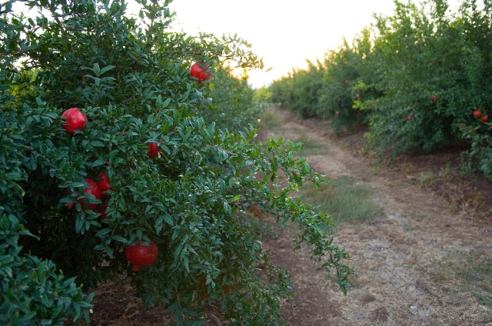
Who Reigns?
“Set your affection on things above, and not on things on the earth. For ye are dead and your life is hid with Christ in God. And when Christ, who is our life, shall appear, then shall ye also appear with Him in glory.” Col. 3:2-4

Slide 18

Let the new man live!
If the new man, Jesus Christ, is alive in our lives, then death and sin no longer have dominion over us. Christ, the new man, lives His life in us and we experience His life in our life, even victory over sin. This we can attain only through faith in Him.

Slide 19
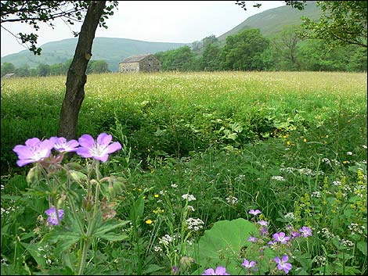
Romans 6:10,11
“For in that he died, he died unto sin once: but in that he liveth, he liveth unto God. Likewise reckon ye also yourselves to be dead indeed unto sin, but alive unto God through Jesus Christ our Lord.”
““The only defense against evil is the indwelling of Christ in the heart through faith in His righteousness.” DA, pg. 324

Slide 20
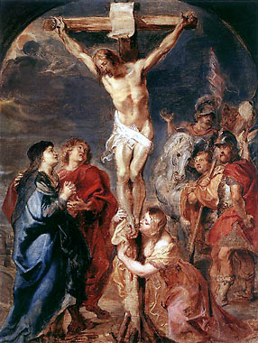
Our only Hope
It is nice to think that we are capable of producing righteousness or good deeds by ourselves, but this is untrue. The old man of sin and selfishness can produce only one thing. “The heart is deceitful above all things, and desperately wicked: who can know it?” Jer. 17:9 This is all we can produce. We desperately need Christ. This is our only hope!

