Slide 1
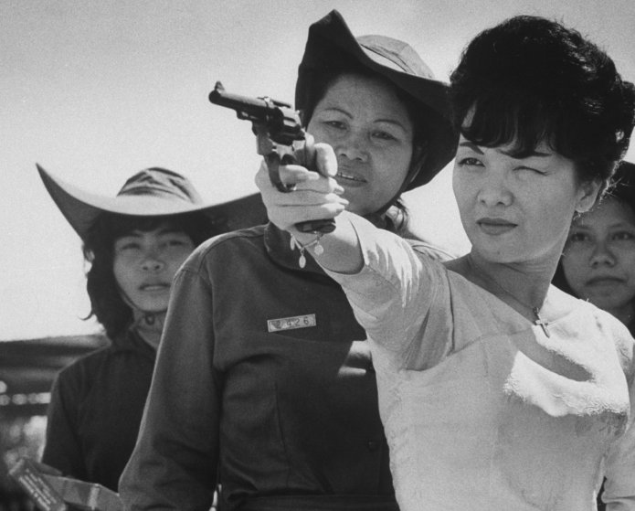
Madam Nhu, President Diem’s sister told a news reporter in 1963, in response to Buddhist Self-Immolation protests: “What have the Buddhist leaders done? The only thing they have done, they have barbecued one of their monks—and even that barbecuing was done not even with self-sufficient means because they used imported gasoline”—the interview can be found on YouTube
She was also known to clap as the monks burned themselves alive

Slide 2
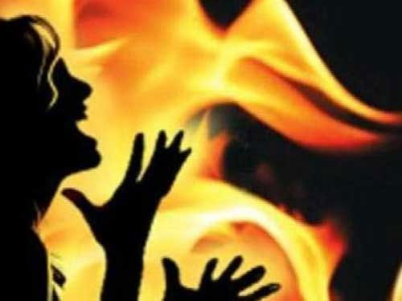
Whether one agrees with the religion of Buddhism or not is unimportant compared to the oppressive hardships they faced. It is sad that these religious persons felt driven to commit suicide by fire (self immolation) rather than “convert” to Catholicism and hold Roman Catholic laws and traditions over their own. All this was done in the name of Christ. This is not how Jesus or any of the Apostles spread the Gospel. God does not work by convulsion, but by love, service, and selflessness. Where is the meekness, humility, long suffering, compassion, respect, and love in the Catholic dealings with the Buddhists in Vietnam? Their protocol is the same today as it was in the Dark Ages—convert or die

Slide 3
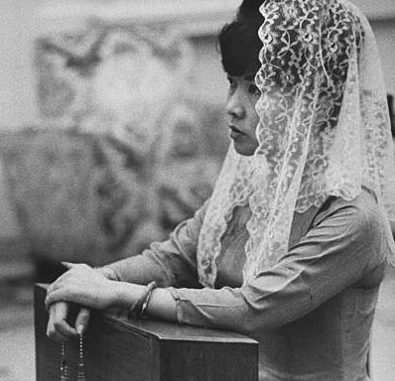
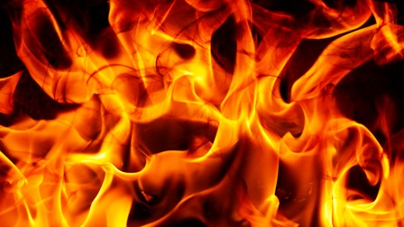
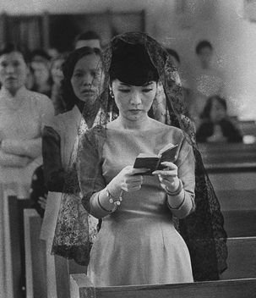
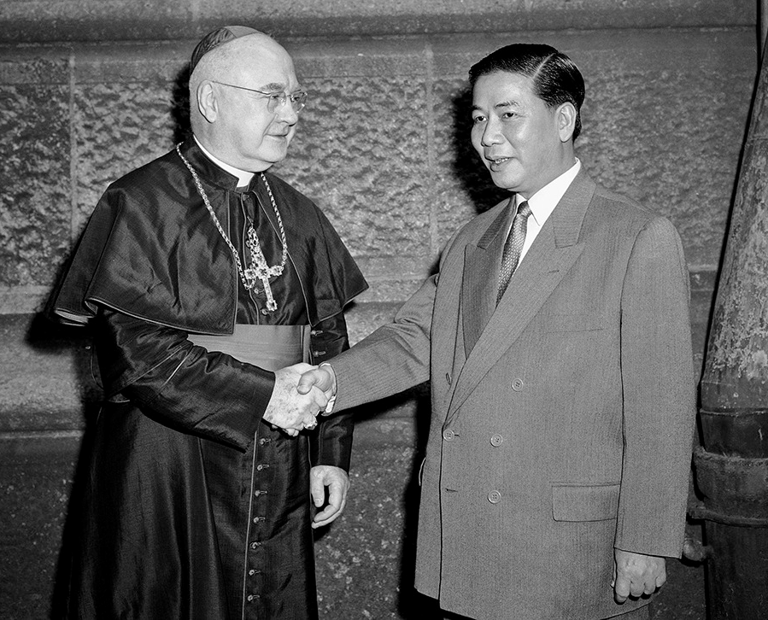
The Catholic state-machinery of suppression became so overpowering and ruthless that the U.S. had to protest, privately and officially, the barefaced religious character of Diem’s Catholic policy—Vietnam, why did we go? P. 117

Slide 4
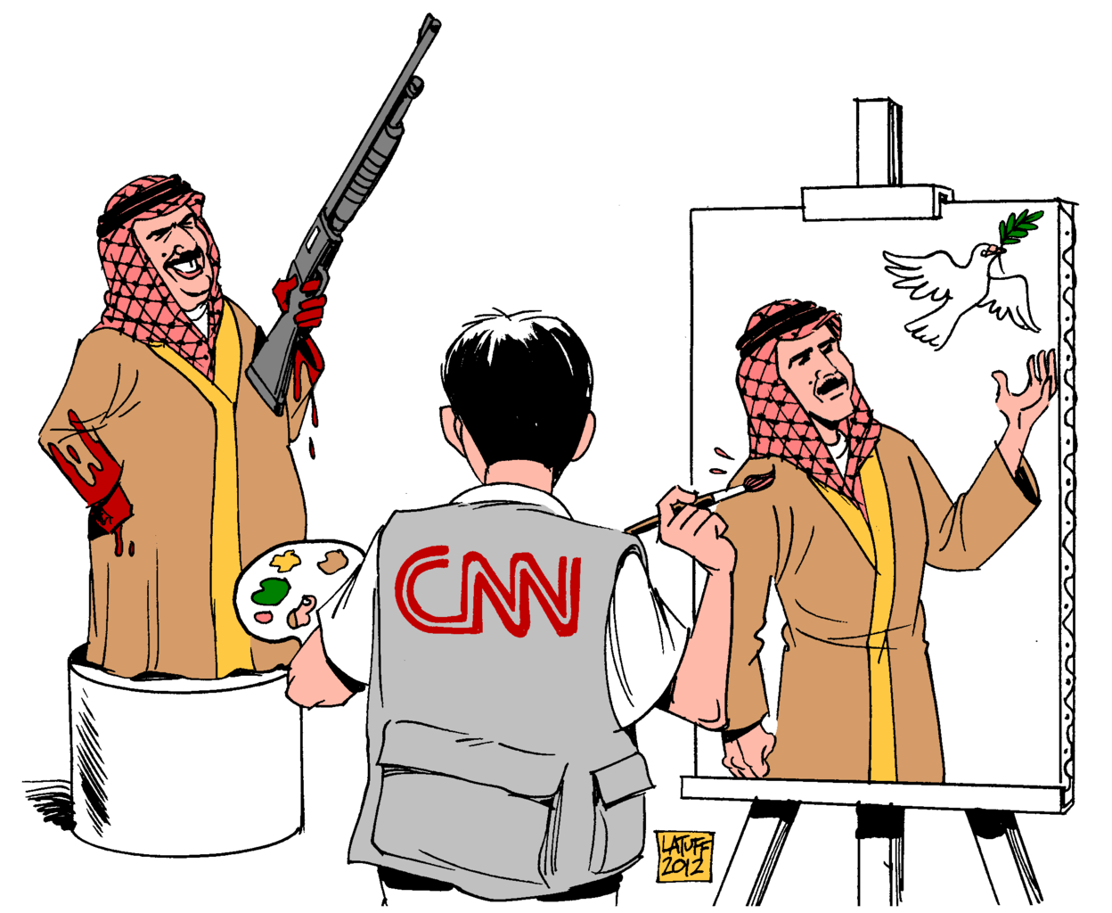
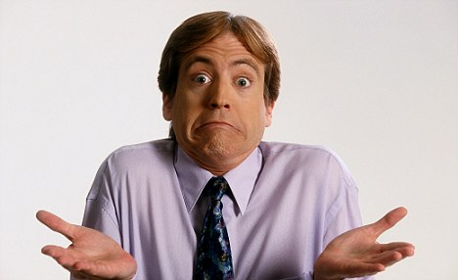
The Media took their time getting the truth out to the U.S. citizens about Vietnam in the 1960s, how much worse do you think they are now???

Slide 5
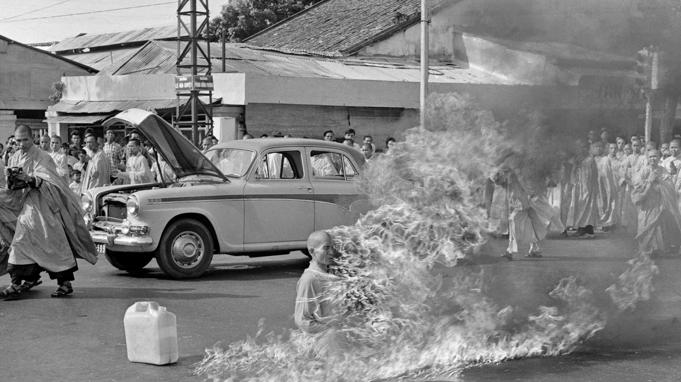
Why did it have to come to this? Why did a man have to burn himself alive before the world took notice of the severe tyranny of Diem’s Catholic inspired policy and regime?

Slide 6
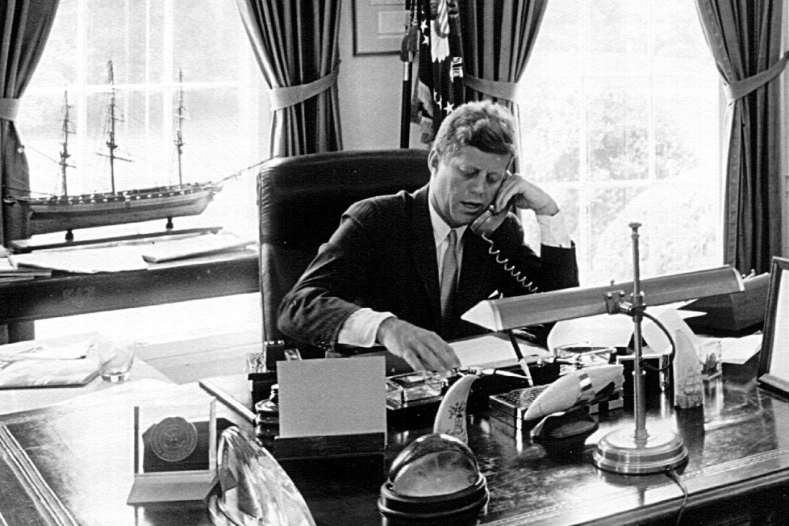
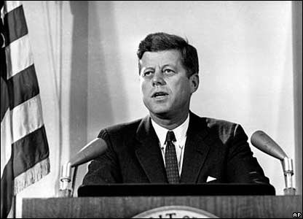
Shortly after JFK’s change of heart and decision to withdraw from Vietnam against the Roman Catholic Pontiff’s wishes, Catholic JFK was assassinated by a plot forged by the Jesuit Order (See Behind the Door pt 2)

Slide 7
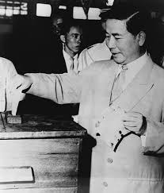
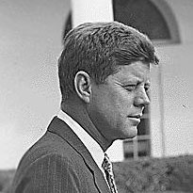
It does NOT pay to deal with Rome!
Diem’s obedience to Rome’s commands led to his death
JFK’s disobedience to Rome’s commands led to his death

Slide 8
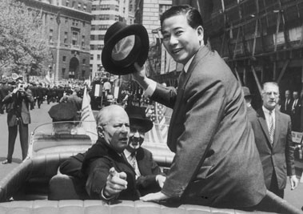
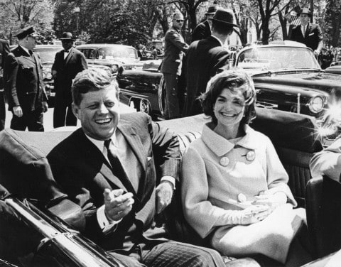
John F. Kennedy, first Catholic president of the U.S. . . . was part of the Catholic lobby which pushed for the installation of a catholic president in South Vietnam. . . . he advocated military intervention to help the French hold back communist advancement in North Vietnam. He was instrumental in the installation of Ngo Dunh Diem as Prime Minister. When Kennedy became president, he rapidly escalated the U.S. military involvement in support of Diem’s Catholic regime. Later when Diem’s persecution of the Buddhists begame to draw fire from world opinion, Kennedy had to choose between supporting his church’s effort or promoting his own political career. He chose to pressure Diem to let up on the persecutions. Diem’s Buddhist generals seized the opportunity to assassinate Diem. Three weeks later Kennedy himself fell to an assassin’s bullet—Vietnam, why did we go? P. 109

Slide 9
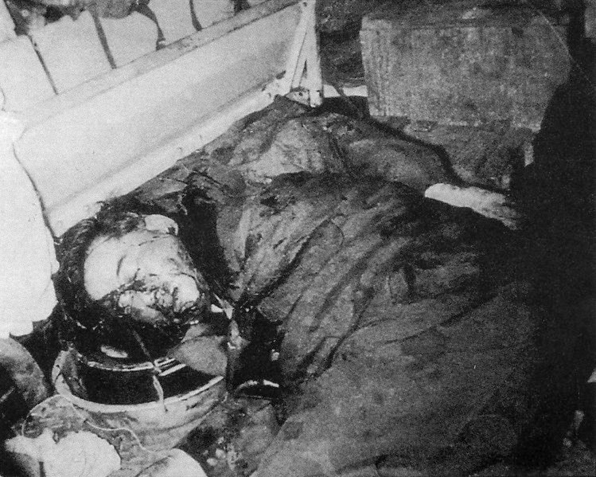
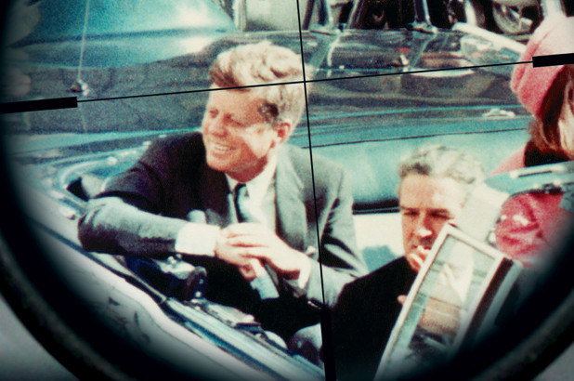
Coincidence? or Cause and Effect?
Cause: America withdraws support and Diem is vulnerable
Effect: Close enemies seize the opportunity to assassinate their threat
Cause: JFK disobeys Rome’s agenda and withdraws support from Diem
Effect: JFK’s actions of defiance and Diem’s death is held as unacceptable, JFK is assassinated

Slide 10
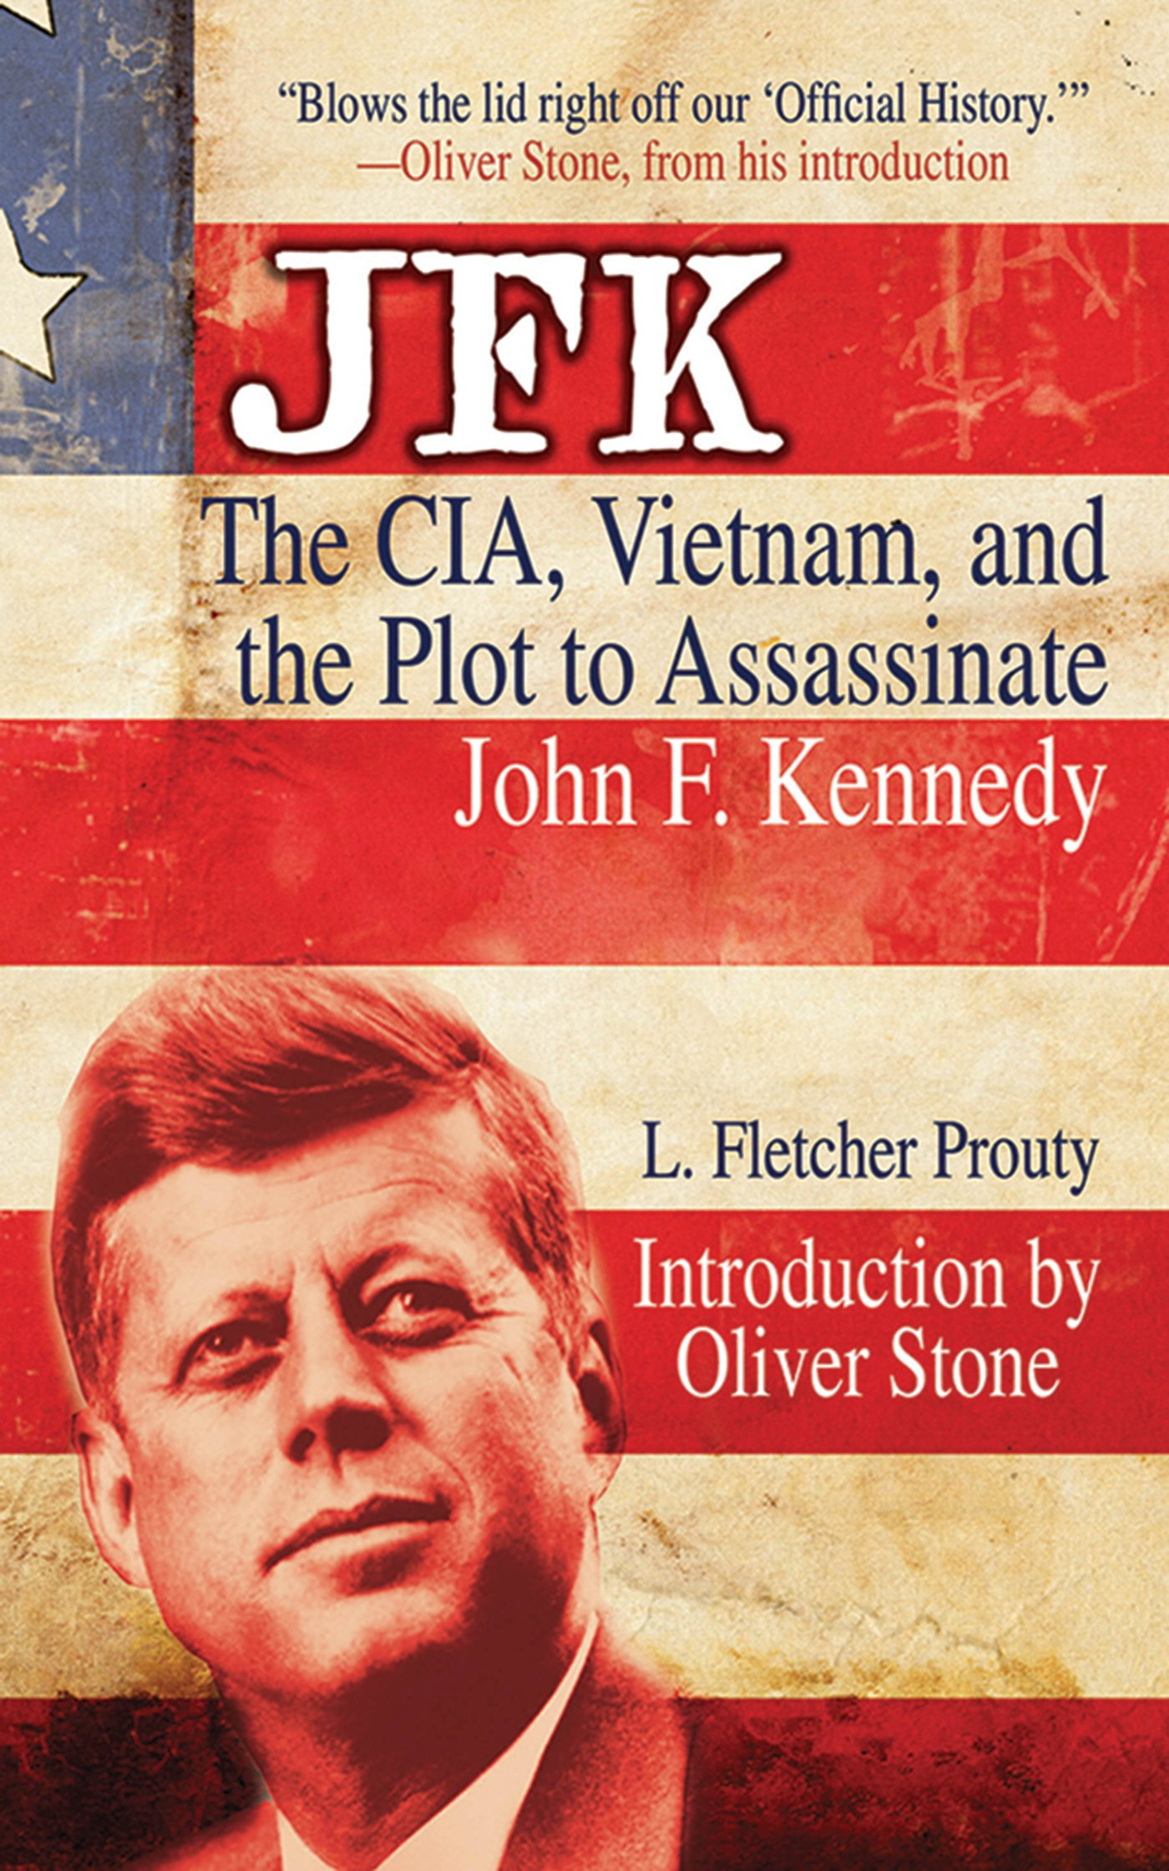
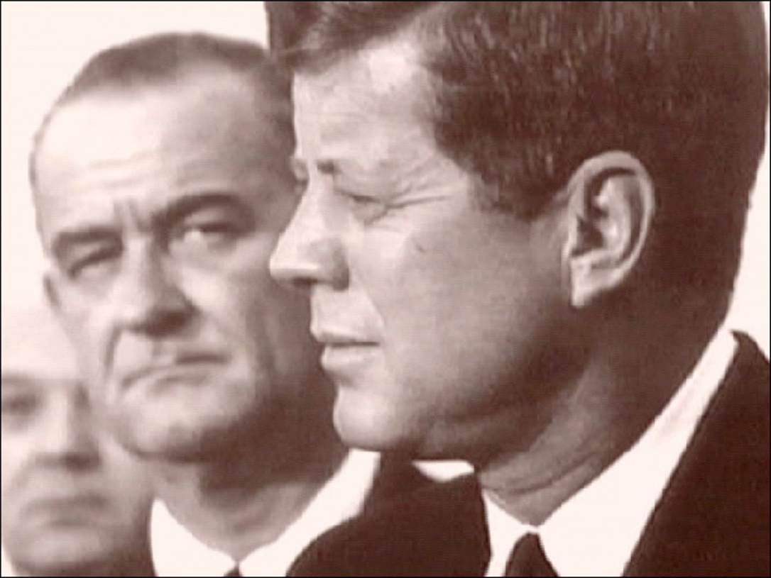
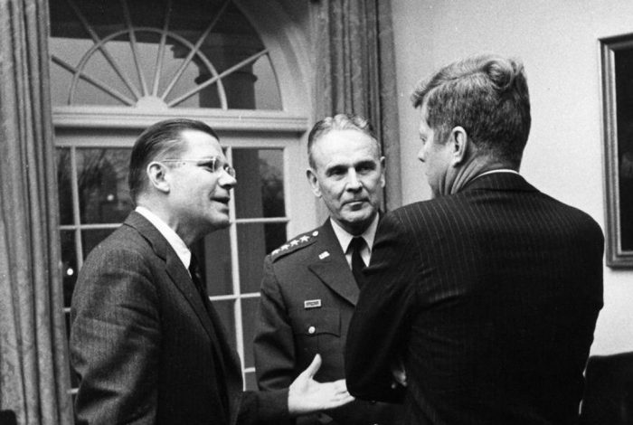

Slide 11
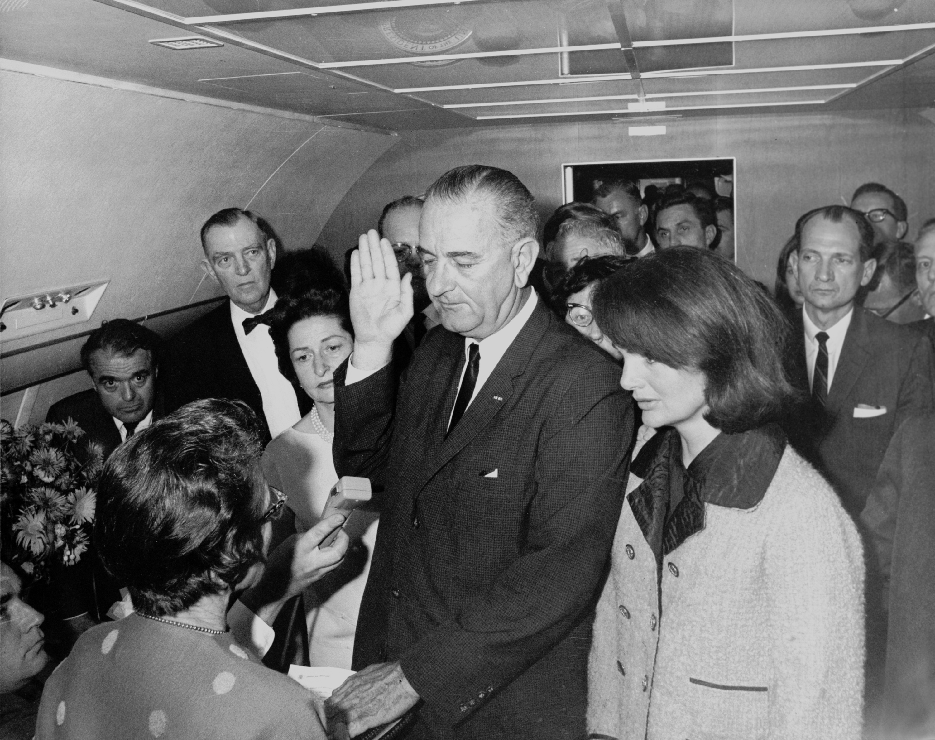
One of the very first actions by Lyndon B. Johnson after sworn in after the assassination of John F. Kennedy, was to increase the war effort again in South Vietnam, directly opposite to the plans that JFK was had prior to his murder.

Slide 12
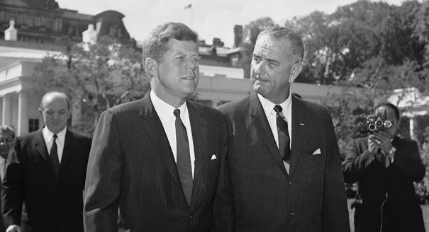
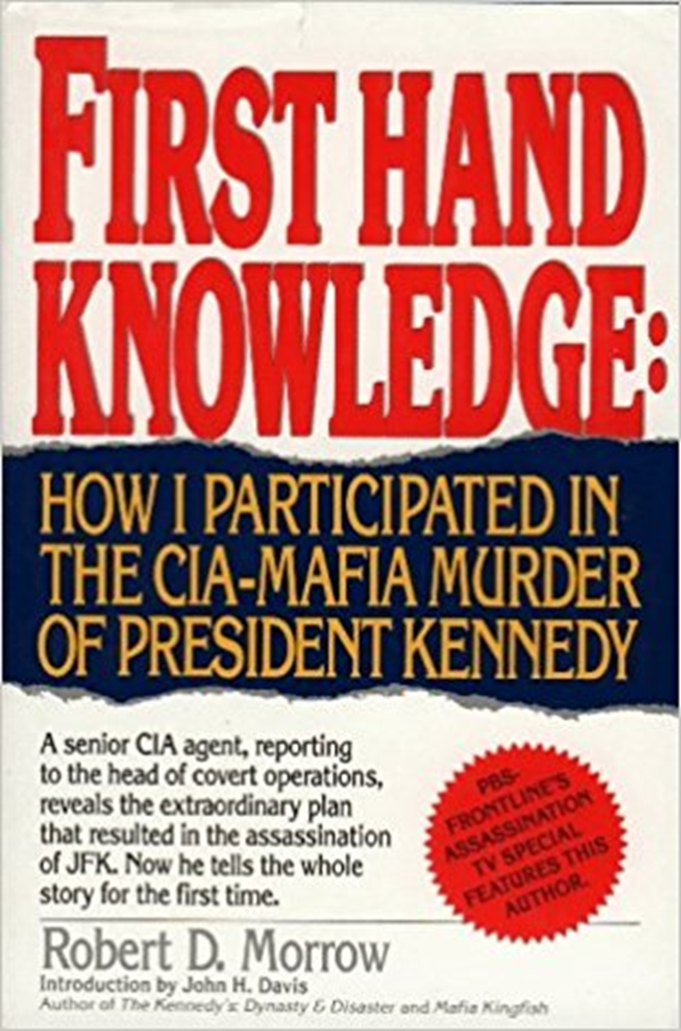
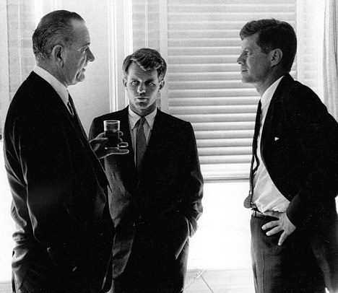

Slide 13
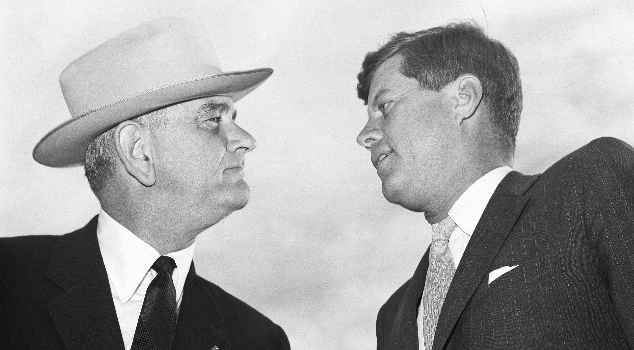
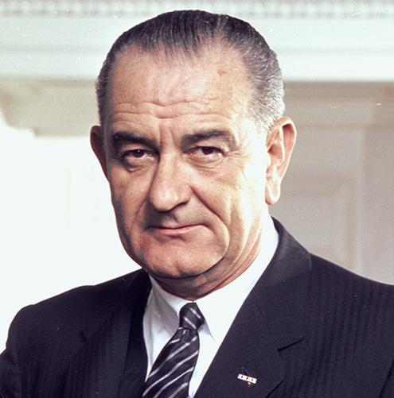
Rome’s Man: Lyndon B. Johnson
Memorandum 278 Reverses ALL of JFK’s plans to deescalate the war effort in Vietnam. Just a coincidence? Why really was Kennedy murdered? Answer: Because he defied Rome’s plans.

Slide 14
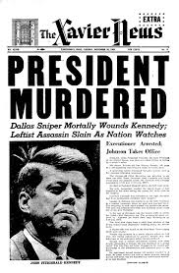
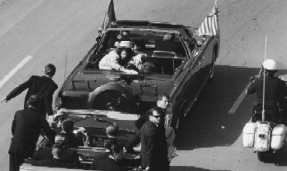
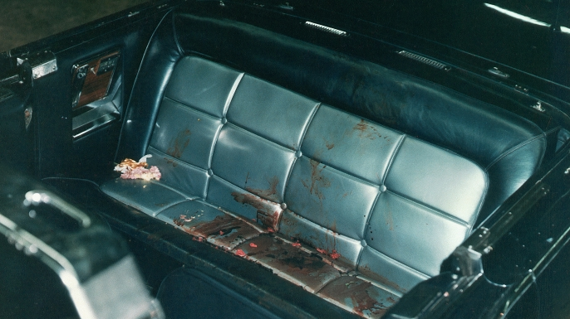

Slide 15
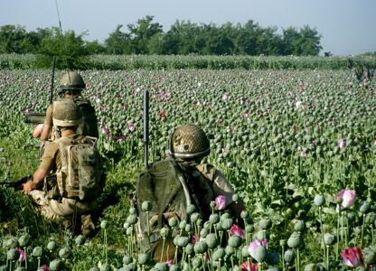

Slide 16
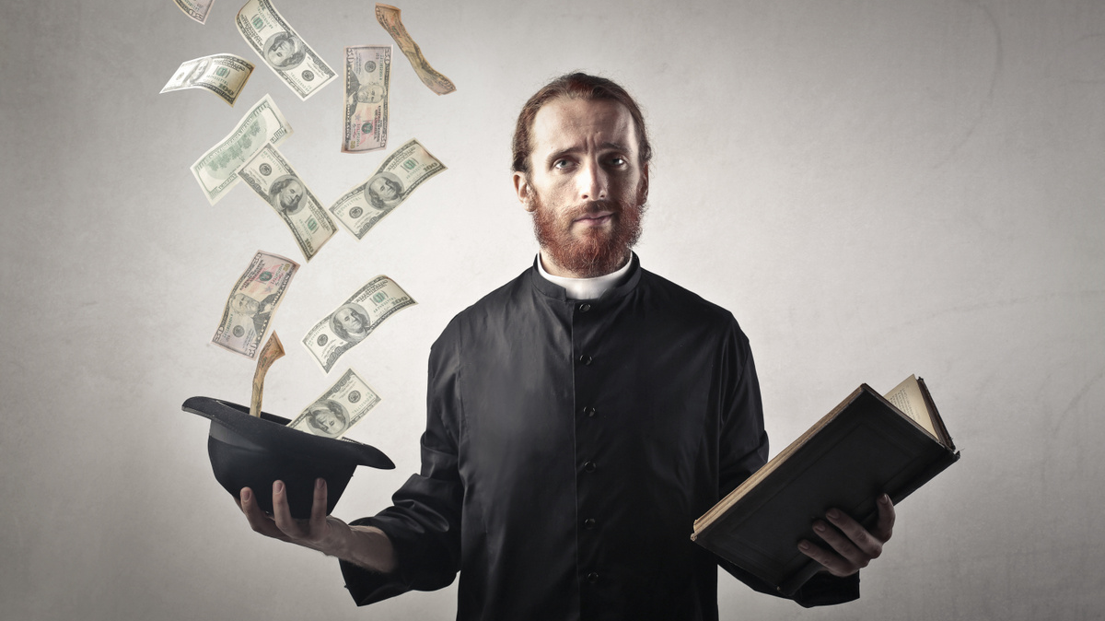

Slide 17
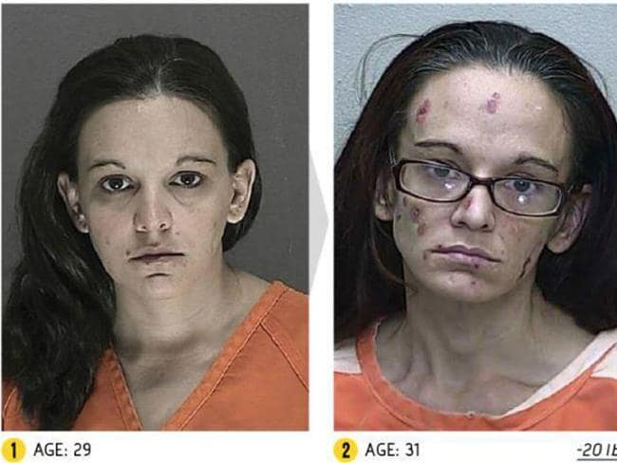
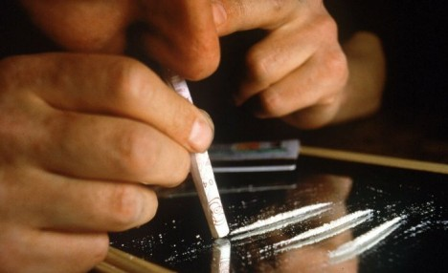
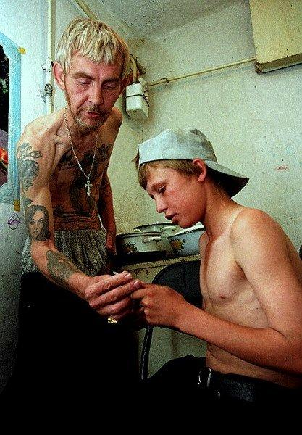
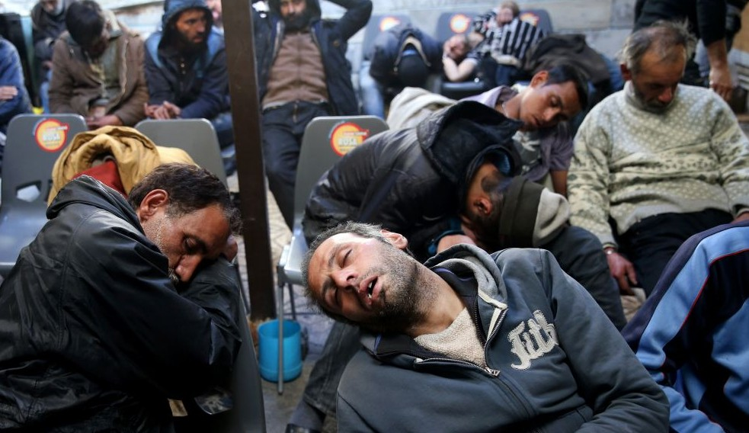
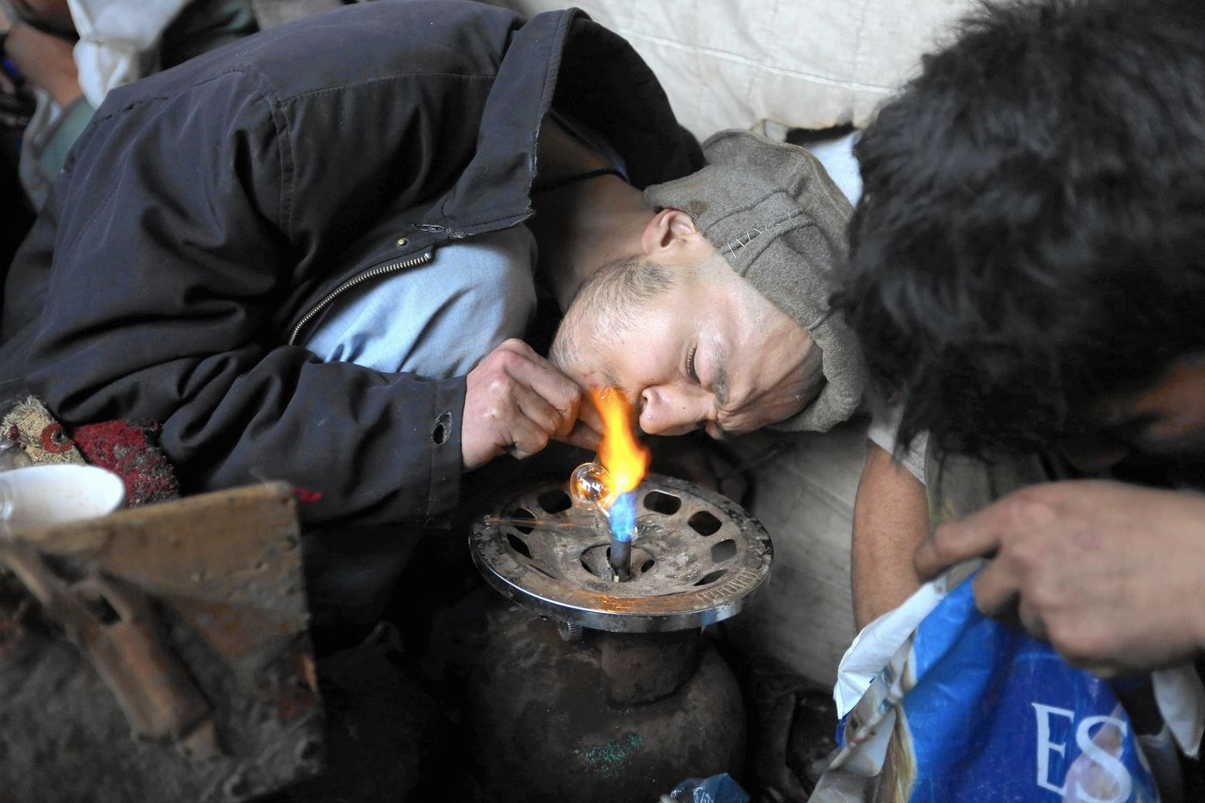
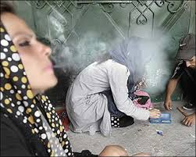

Slide 18
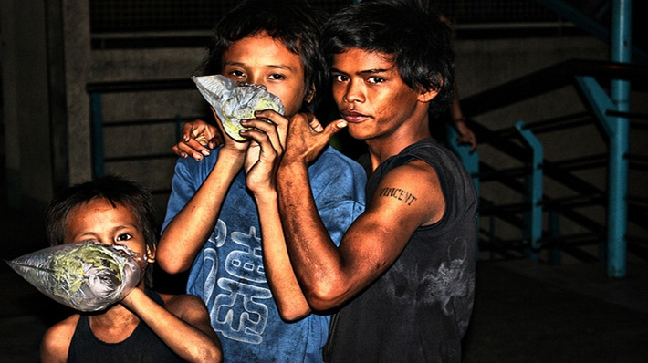
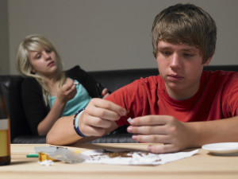
Drugs destroy lives. How much worse when children become hooked on various addictions at startlingly young ages. Why? So Rome can make money? Our children die so a church can fill their pockets; destroying families, friendships, careers, households. How many crimes are committed under the influence of drugs? How many sins can be laid at the feet of the Roman Catholic Church?

Slide 19
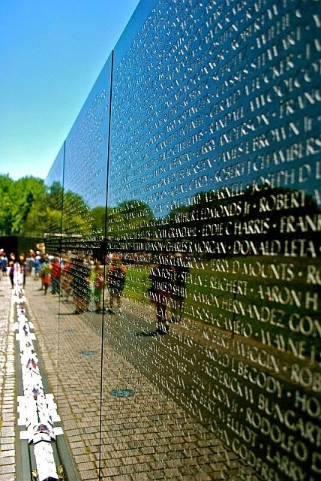
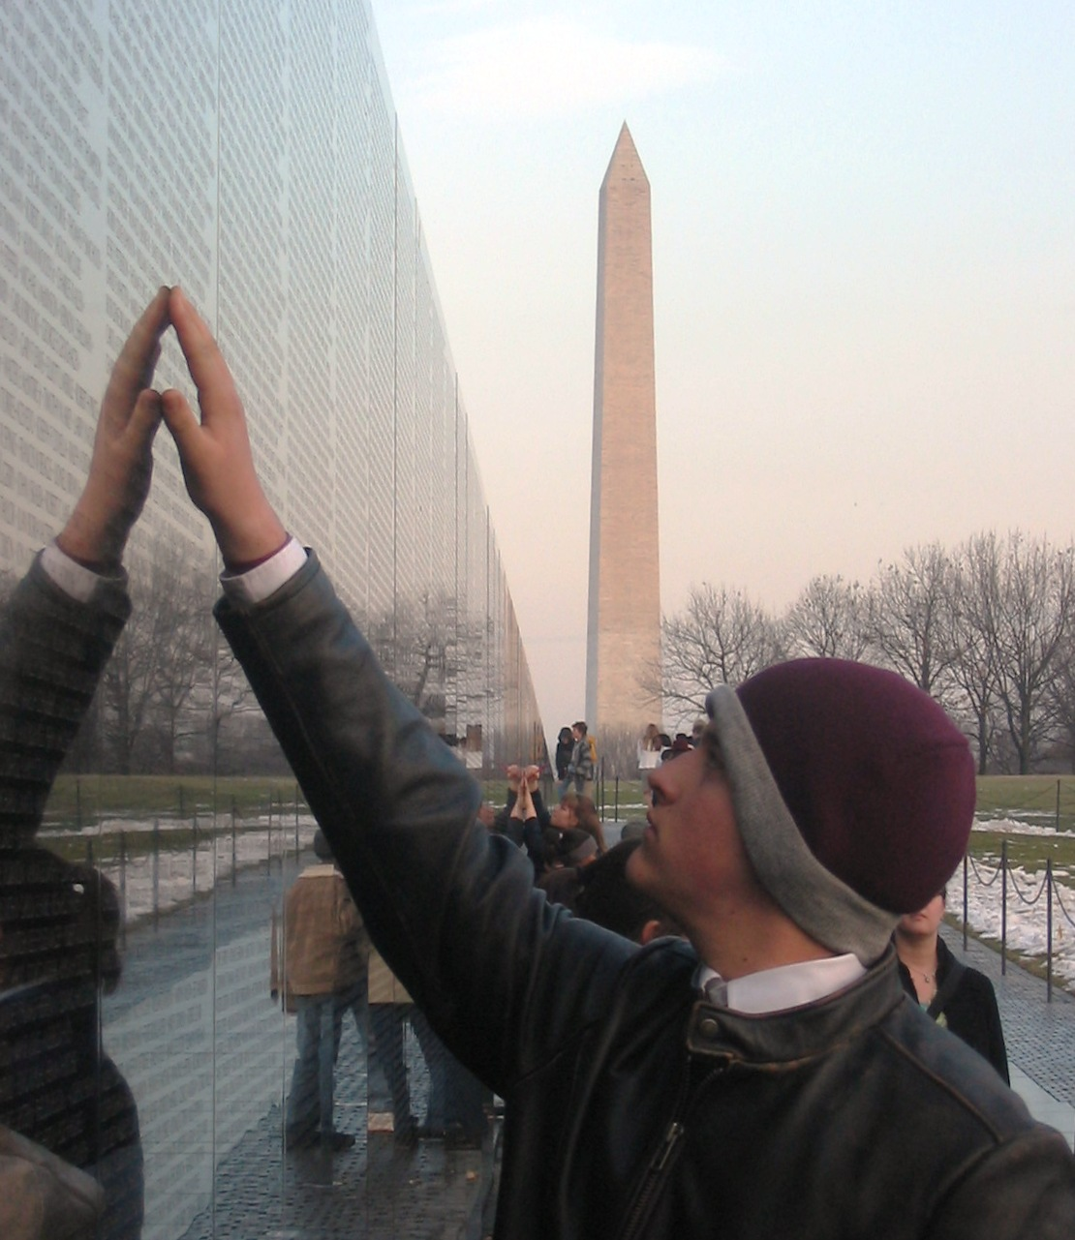

Slide 20
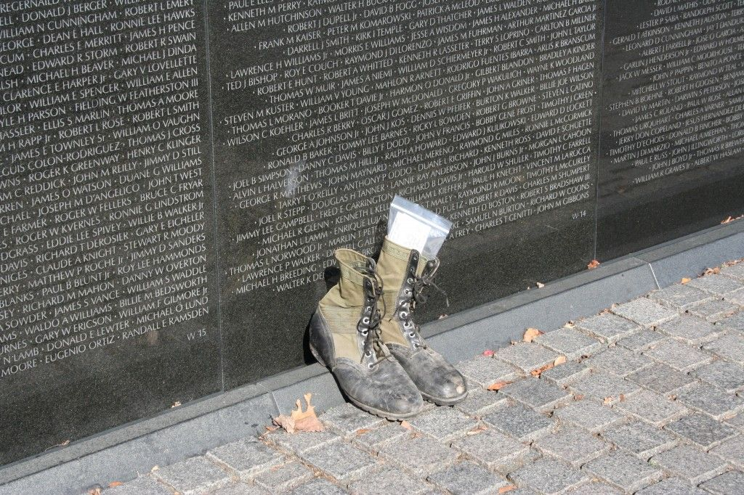

Slide 21
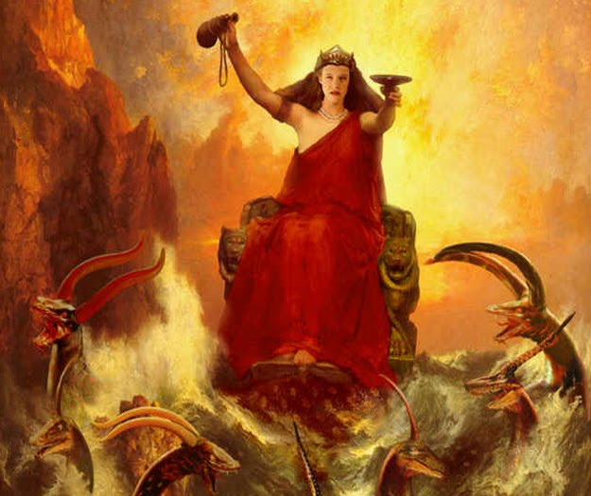
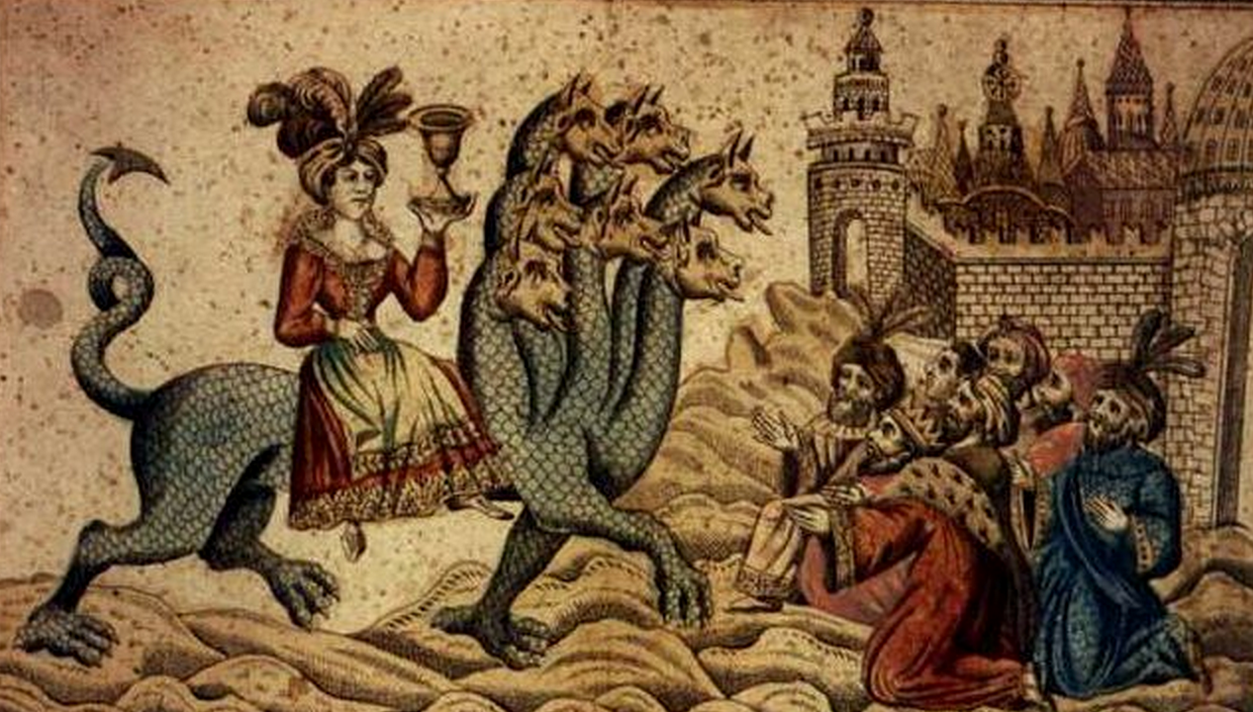
Revelation 18:24: “And in her was found the blood of prophets, and of saints, and of all that were slain upon the earth.”

Slide 23
