Slide 1
The Golden Rule Summary

Slide 2
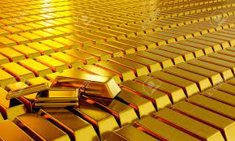
The Golden Rule
We all know the golden rule; do unto others as you would have them do unto you!! Others do not see it quite like that! They say the golden rule is:
The one who has the gold makes the rules! Sounds ruthless and the people we are looking at are ruthless! In fact, these people have been working at this for hundreds of years. The book of Revelation makes it clear that money will be used to strangle the world at the end of time. Economic sanctions will be used to coerce worship in the near future!

Slide 3
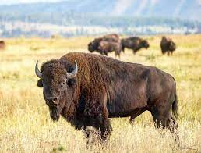
“And he had power to give life unto the image of the beast, that the image of the beast should both speak, and cause that as many as would not worship the image of the beast should be killed. And he causeth all, both small and great, rich and poor, free and bond, to receive a mark in their right hand, or in their foreheads: And that no man might buy or sell, save he that had the mark, or the name of the beast, or the number of his name.” Rev. 13:15-17

Slide 4
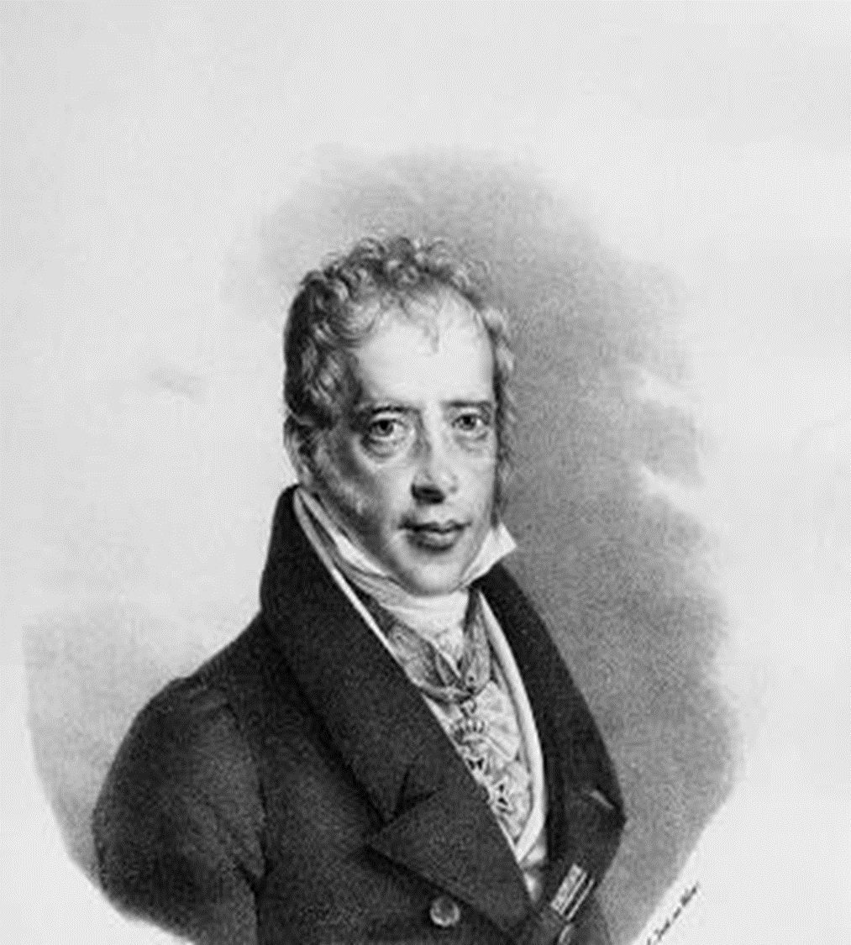
Who would Do Such a Thing?
The founder of the money power of the Rothschild’s was this man, Mayer Amchel Rothschild. He once made an interesting comment, ““GIVE me control of a nation’s money supply, and I care not who makes its laws.” Rothschild understood that money was the ultimate source of power in this world and if he could control a nation’s money flow, then he could eventually destroy all the laws of that nation!

Slide 5
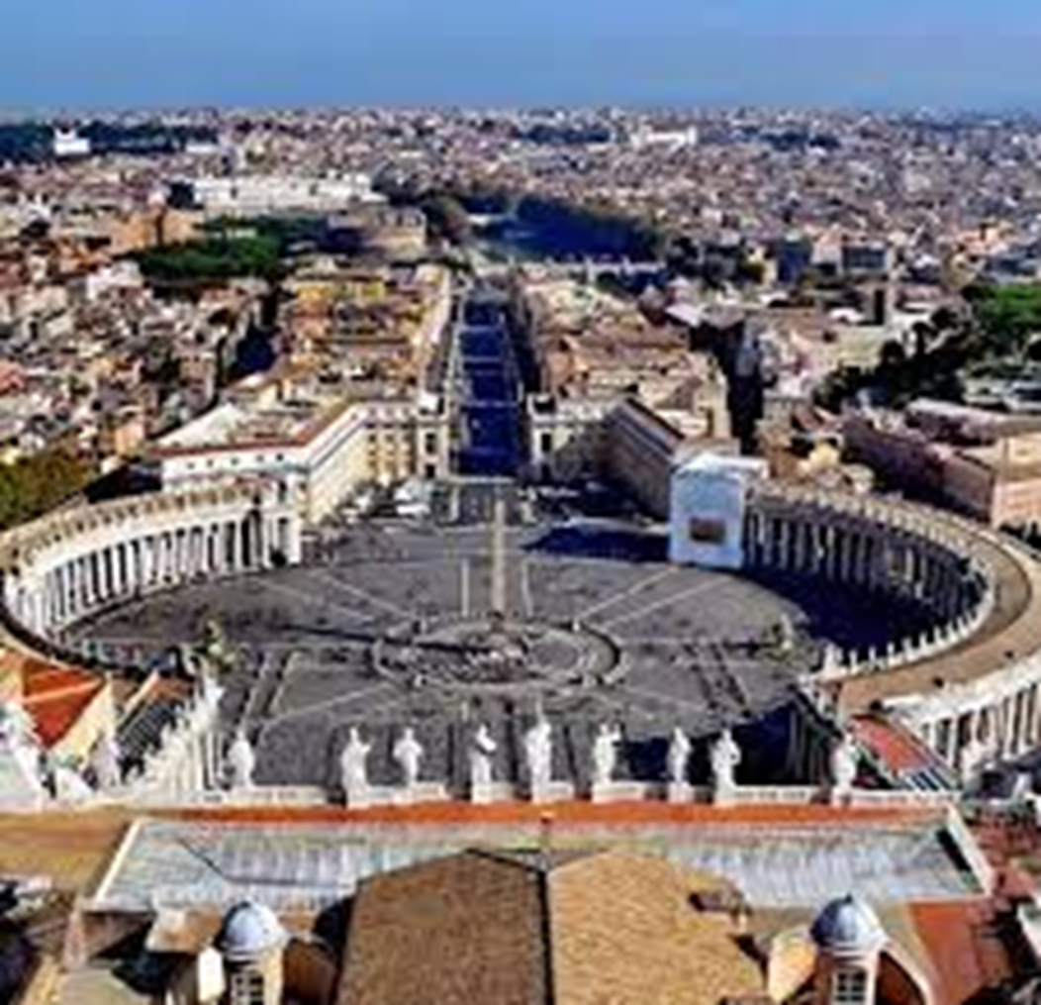
“Aware that the Rothschilds are an important Jewish family, I looked them up in Encyclopedia Judaica and discovered that they bear the title 'Guardians of the Vatican Treasury.'... The appointment of Rothschild gave the black papacy absolute financial privacy and secrecy. Who would ever search a family of orthodox Jews for the key to the wealth of the Roman Catholic Church? -- F. Tupper Saussy, Rulers of Evil, Harper-Collins, pp. 160,161.

Slide 6
They Have Been at it Ever Since!!
Biographer Frederick Morton concluded that ‘through the effective use of money the Rothschilds had successfully conquered the world more thoroughly, more cunningly, and much more lastingly than all the Caesar's before or all the Hitler’s after them. -- Frederic Morton, The Rothschilds: A Family Portrait, Atheneum, p. 14.
“Under the surface, the Rothschilds long had a powerful influence in dictating American financial laws. The law records show that they were the power in the old Bank of the United States. -- Gustavus Myers History of the Great American Fortunes, Random House, p. 556 [emphasis added].
“Over the years since N.M. [Nathan Rothschild], the Manchester textile manufacturer, had bought cotton from the Southern states, Rothschilds had developed heavy American commitments Nathan... had made loans to various states of the Union, had been, for a time, the official European banker for US government and was a pledged supporter of the Bank of the United States. --
Derek Wilson, Rothschild: The Wealth and Power of a Dynasty, Charles Scribner’s Sons, p. 178.

Slide 7
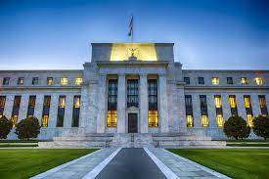
Attempts at a National/Central Bank
Robert Morris-1781. Established after the Bank of England/Rothschild run!
Alexander Hamilton-1791. The ping pong ball man! Established after the Bank of England/ Guess who?
Nicolas Biddle- 1816. Notice the date. After war of 1812! Biddle buddies with Rothschilds!
The Jekyll Island cartel- 1910 Remains today. Guess who controls it?

Slide 8
Quantum Shift
“Secretary of the Treasury, Alexander Hamilton, submitted a proposal to Congress in 1790 for a central bank. Interestingly enough, Hamilton had been an aide of Robert Morris in the initial experience of central banking in North America. Surprisingly, during the Constitutional convention of 1787, Hamilton had been a strong supporter of sound money. That Hamilton completely shifted within three years and proposed a central bank, which could generate money as the Federal Reserve Bank does, shows that Hamilton’s loyalty was compromised by the Jesuits. This is hard to reconcile, and one must suspect that, even the most well intentioned of men can become corrupted by the temptations of wealth and power. -- G. Edward Griffin, The Creature from Jekyll Island, American Opinion,
p. 328.
Note carefully Griffin’s conclusion. For Alexander Hamilton to have shifted so
drastically within a few short years would lead us to believe that he had been
bribed or blackmailed by the ‘secret investors’; either that , or joined them.

Slide 9
Notice the Dominance
In 1816, the third Bank of the United States was established in order to bring stability to the national economy, serve as the depository for national funds, and provide the government with the means of floating loans and transferring money across the country. In reality, the central bank was set up to help the Rothschild’s/papacy control the money, the economy, and the government of the United States!! This was at the time William Miller started studying the Bible!!
“Biddle had one powerful advantage over his adversary. For all practical
purposes, Congress was is his pocket. Or, more accurately, the product of his
generosity was in the pockets of Congressmen. Following the Rothschild
Formula, Biddle had been careful to reward compliant politicians with success in
the business world. Few of them would bite the hand that fed them. Even the
great Senator, Daniel Webster, found himself kneeling at Biddle’s throne.-- G.
Edward Griffin, The Creature from Jekyll Island, American Opinion, p. 351.

Slide 10
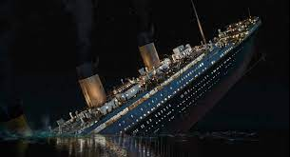
Consequences for Refusal
1. War of 1812.
2. Jackson almost killed 1835.
3. Lincoln assassinated.
4. Titanic.
5. Louis T. McFadden killed 1936.
6. JFK, 1963

Slide 11
Lincoln and high finance!
“The division of the United States in federations of equal force was decided long before the Civil War by the high financial powers of Europe. These bankers were afraid that the United States, if they remained in one block and as one nation, would attain economic and financial independence, which would upset their financial domination over Europe and the world. Of course, in the 'inner circle’ of Finance, the voice of the Rothschilds prevailed. They saw an opportunity for prodigious booty if they could substitute two feeble democracies, burdened with debt to the financiers,...in place of a vigorous Republic sufficient unto herself. Therefore, they sent their emissaries into the field to exploit the question of slavery and to drive a wedge between the two parts of the Union...The rupture between the North and the South became inevitable; the masters of European finance employed all their forces to bring it about and to turn it their advantage. --[Quoted in] G. Edward Griffin, The Creature from Jekyll Island, American Opinion, p. 374.

Slide 12
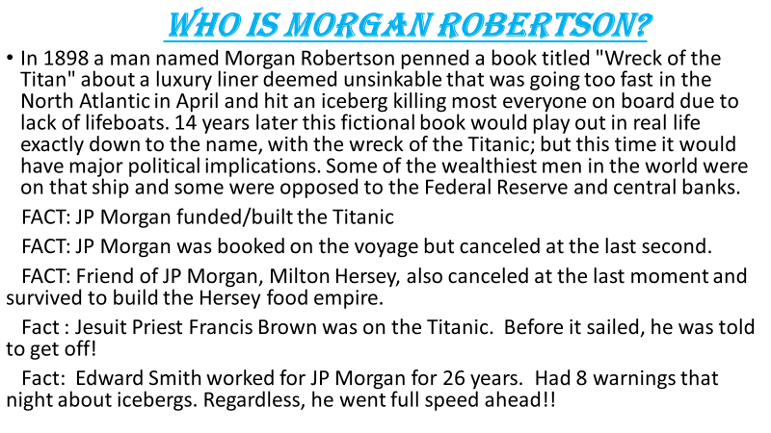

Slide 13
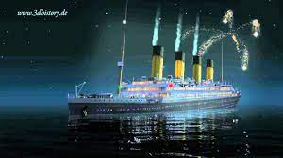
“Like the Titanic, the fictional ship sank after wrecking on an iceberg in April in the North Atlantic Ocean, and there were not enough lifeboats for all the passengers. The Titan would have survived a head-on collision with the iceberg, but a glancing encounter did more extensive damage. There are also similarities in size (800 ft [244 m] long for the Titan versus 882 ft 9 in [269 m] long for the Titanic), speed, and life-saving equipment. After the Titanic's sinking, some people credited Robertson with precognition and clairvoyance, which he denied. Scholars attribute the similarities to Robertson's extensive knowledge of shipbuilding and maritime trends.” Wikipedia

Slide 14
Why a Central Bank?
Here, roughly, is how the operation proceeds. Suppose the United States government wants to borrow a billion dollars. The government issues a bond for this amount, much as a water company does when it wants to raise money for a new pipeline or a new dam. The government delivers this bond for the billion dollars to the Federal Reserve Bank. The Federal Reserve Bank takes the bond and writes an order to the Department of Printing and Engraving to print the billion dollars’ worth of bills. After about two weeks or so, when the bills are printed, the Department of Printing and Engraving ships the bills to the Federal Reserve Bank, which then writes a check for about two thousand dollars to pay for printing the billion dollars’ worth of bills. The Federal Reserve Bank then takes the billion dollars and lends the billion dollars to the United States government, and the people of the country pay interest at an exorbitant rate each year on this money, which came out of nothing. The owners of the Federal Reserve Bank put up nothing for this money. We see, therefore, that when the United States government goes into debt one dollar, a dollar plus the interest goes into the pockets of the owners of the Federal Reserve Bank. This is the largest, the most colossal theft ever perpetrated in the history of mankind, and it is so slick, so subtle, and so

Slide 15
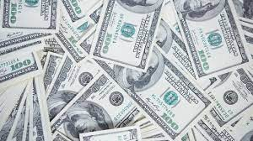
obfuscated by propaganda from the news media that the victims are not even aware of what is happening. You can see why the Jesuits want to keep this operation secret. The Constitution of the United States gives to Congress the power to coin money. If Congress coined it own money as the Constitution directs, it would not have to pay the hundreds of billions of dollars of interest that it now pays each year to the bankers for the national debt, for money that came out of nothing. Money coined by Congress would be debt free. All the central banks in other countries operate the way the Federal Reserve does.” Enemy Unmasked

Slide 16
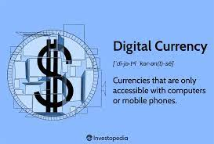
“And he had power to give life unto the image of the beast, that the image of the beast should both speak, and cause that as many as would not worship the image of the beast should be killed. And he causeth all, both small and great, rich and poor, free and bond, to receive a mark in their right hand, or in their foreheads: And that no man might buy or sell, save he that had the mark, or the name of the beast, or the number of his name.” Rev. 13:15-17

