Slide 1
Ship is Going Thru!!
What is the ship?

Slide 2
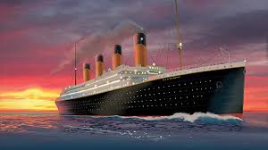
The Unsinkable Ship

Slide 3
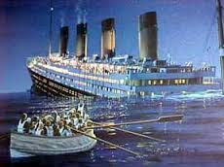
What Went Thru?

Slide 4
Appears to Fall
“The church may appear as about to fall, but it does not fall. It remains, while the sinners in Zion will be sifted out--the chaff separated from the precious wheat. This is a terrible ordeal, but nevertheless it must take place. None but those who have been overcoming by the blood of the Lamb and the word of their testimony will be found with the loyal and true, without spot or stain of sin, without guile in their mouths. . . . The remnant that purify their souls by obeying the truth gather strength from the trying process, exhibiting the beauty of holiness amid the surrounding apostasy (Letter 55, 1886).” 7BC 911

Slide 5
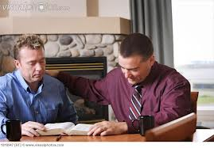
The church is God's fortress. His city of refuge, which He holds in a revolted world. Any betrayal of the church is treachery to Him who has bought mankind with the blood of His only-begotten Son. From the beginning, faithful souls have constituted the church on earth. In every age the Lord has had His watchmen, who have borne a faithful testimony to the generation in which they lived.” AA, pg. 11

Slide 6
Conjecture Doesn’t Cut it!
The ship is going thru to the end. Just stay in the church and you will be fine. While that sounds well and good, does history bear out this feeling of carnal security as really Biblical?
What is it that really goes thru to the end? What will survive the throes of these last days as Babylon the Great flexes her muscles for one final assault on God’s people? Babylon and Rome will give us the answer.

Slide 7
Jeremiah’s Time
“Thus saith the LORD of hosts, the God of Israel, Amend your ways and your doings, and I will cause you to dwell in this place. Trust ye not in lying words, saying, The temple of the LORD, The temple of the LORD, The temple of the LORD, are these. For if ye thoroughly amend your ways and your doings; if ye thoroughly execute judgment between a man and his neighbor; If ye oppress not the stranger, the fatherless, and the widow, and shed not innocent blood in this place, neither walk after other gods to your hurt: Then will I cause you to dwell in this place, in the land that I gave to your fathers, for ever and ever. Behold, ye trust in lying words, that cannot profit. Will ye steal, murder, and commit adultery, and swear falsely, and burn incense unto Baal, and walk after other gods whom ye know not; And come and stand before me in this house, which is called by my name, and say, We are delivered to do all these abominations? Is this house, which is called by my name, become a den of robbers in your eyes?”

Slide 8
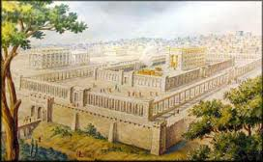
Trusting in the Temple
Because of their association with Solomon’s temple, the people felt secure. They could excuse wrong doing and sin because they came into the temple every Sabbath!
The temple was their security blanket! Did it save God’s people when Babylon the Great arrived? Did Solomon’s temple survive?

Slide 9
“Israel had vainly thought that, notwithstanding their sinful practices, the presence of the ark would ensure them victory over the Philistines. In like manner, during the days of Jeremiah, the inhabitants of Judah were prone to believe that a strict observance of the divinely appointed services of the temple would preserve them from a just punishment for their wicked course.
What a lesson is this to men holding positions of responsibility today in the church of God! What a solemn warning to deal faithfully with wrongs that bring dishonor to the cause of truth! Let none who claim to be the depositaries of God's law flatter themselves that the regard they may outwardly show toward the commandments will preserve them from the exercise of divine justice. Let none refuse to be reproved for evil, nor charge the servants of God with being too zealous in endeavoring to cleanse the camp from evil-doing. A sin-hating God calls upon those who claim to keep His law to depart from all iniquity. A neglect to repent and to render willing obedience will bring upon men and women today as serious consequences as came upon ancient Israel.” PK, pgs. 416, 417

Slide 10
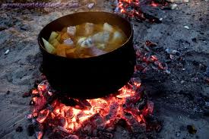
Ezekiel Saw it Too!
Just stay in the pot, the people were told. Jeremiah and Ezekiel both ran into this mentality. The people were led to believe themselves totally secure from any outside trouble. Boy, were they deluded!! Hello!!!

Slide 11
We Are SAFE
“ Moreover the spirit lifted me up, and brought me unto the east gate of the LORD'S house, which looketh eastward: and behold at the door of the gate five and twenty men; among whom I saw Jaazaniah the son of Azur, and Pelatiah the son of Benaiah, princes of the people. Then said he unto me, Son of man, these are the men that devise mischief, and give wicked counsel in this city: Which say, It is not near; let us build houses: this city is the caldron, and we be the flesh. Therefore prophesy against them, prophesy, O son of man. And the Spirit of the LORD fell upon me, and said unto me, Speak; Thus saith the LORD; Thus have ye said, O house of Israel: for I know the things that come into your mind, every one of them. Ye have multiplied your slain in this city, and ye have filled the streets thereof with the slain.” Ezek. 11:1-6

Slide 12
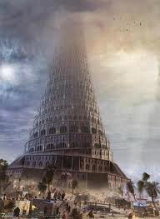
Adventism’s Folly
“Which say, It is not near; let us build houses: this city is the caldron, and we be the flesh.” Ezekiel 11:3
Ancient Adventism thought they were safe/protected simply because they were in the eternal city. Salvation came by church affiliation and being part of the denomination!!
“Neither is there salvation in any other: for there is none other name under heaven given among men, whereby we must be saved.” Acts 4:12

Slide 13
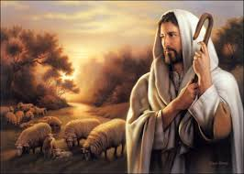
Christ Alone!
“Now unto him that is able to keep you from falling, and to present you faultless before the presence of his glory with exceeding joy,” Jude 24
“I can do all things through Christ which strengthens me.” Phil. 4:13

Slide 14
“To a people in whose hearts His law is written, the favor of God is assured. They are one with Him. But the Jews had separated themselves from God. Because of their sins they were suffering under His judgments. This was the cause of their bondage to a heathen nation. Their minds were darkened by transgression, and because in times past the Lord had shown them so great favor, they excused their sins. They flattered themselves that they were better than other men, and entitled to His blessings.” DA, pg. 106

Slide 15
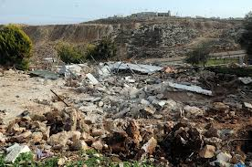
Demolished!
“ Therefore shall Zion for your sake be plowed as a field, and Jerusalem shall become heaps, and the mountain of the house as the high places of the forest.” Micah 3:12

Slide 16
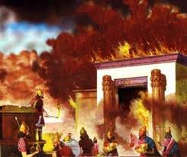
Solomon’s Temple Gone
One of the great wonders of the ancient world has disappeared from the earth. Solomon’s temple is no more. Obviously, the ship isn’t buildings or organized worship in buildings. The only thing that survived Babylon the Great were faithful souls. Men like Daniel, Ezekiel, and their friends left a great testimony to the power of God. They clung to God’s truth and the world still is blessed by their witness!

Slide 17
Herod’s Temple
“Before them lay Jerusalem in its glory, now bathed in the light of the declining sun. The temple attracted all eyes. In stately grandeur it towered above all else, seeming to point toward heaven as if directing the people to the only true and living God. The temple had long been the pride and glory of the Jewish nation. The Romans also prided themselves in its magnificence. A king appointed by the Romans had united with the Jews to rebuild and embellish it, and the emperor of Rome had enriched it with his gifts. Its strength, richness, and magnificence had made it one of the wonders of the world.
While the westering sun was tinting and gilding the heavens, its resplendent glory lighted up the pure white marble of the temple walls, and sparkled on its gold-capped pillars. From the crest of the hill where Jesus and His followers stood, it had the appearance of a massive structure of snow, set with golden pinnacles.” DA, pg. 575

Slide 18
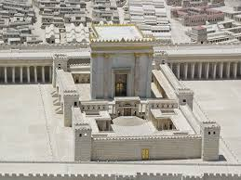
A Stunner!
Another ancient wonder, Herod’s temple, stunned the world for decades. Its opulence and magnificence awed the old world for a long time. Many felt it would stand forever.

Slide 19
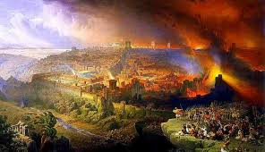
Rebellion Collapsed it?!?!
“ And when he was come near, he beheld the city, and wept over it, Saying, If thou hadst known, even thou, at least in this thy day, the things which belong unto thy peace! but now they are hid from thine eyes. For the days shall come upon thee, that thine enemies shall cast a trench about thee, and compass thee round, and keep thee in on every side, And shall lay thee even with the ground, and thy children within thee; and they shall not leave in thee one stone upon another; because thou knewest not the time of thy visitation.” Luke. 19:41-44

Slide 20
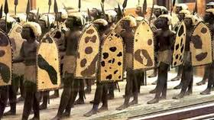
Defense and Shield!
“ For thou, LORD, wilt bless the righteous; with favour wilt thou compass him as with a shield.” Ps. 5:12
“But the LORD is my defense; and my God is the rock of my refuge.” Ps. 94:22

Slide 21
No Help There!
“The worshipers were stricken down before the altar, and the sanctuary was polluted with the bodies of the slain. Yet in their blind and blasphemous presumption the instigators of this hellish work publicly declared that they had no fear that Jerusalem would be destroyed, for it was God's own city. To establish their power more firmly, they bribed false prophets to proclaim, even while Roman legions were besieging the temple, that the people were to wait for deliverance from God. To the last, multitudes held fast to the belief that the Most High would interpose for the defeat of their adversaries. But Israel had spurned the divine protection, and now she had no defense. Unhappy Jerusalem! rent by internal dissensions, the blood of her children slain by one another's hands crimsoning her streets, while alien armies beat down her fortifications and slew her men of war!” GC, pg. 29

Slide 22
Apostasy Goes Thru to Hell!
“The enemy of souls has sought to bring in the supposition that a great reformation was to take place among Seventh-day Adventists, and that this reformation would consist in giving up the doctrines which stand as the pillars of our faith, and engaging in a process of reorganization. Were this reformation to take place, what would result? The principles of truth that God in His wisdom has given to the remnant church, would be discarded. Our religion would be changed. The fundamental principles that have sustained the work for the last fifty years would be accounted as error. A new organization would be established. Books of a new order would be written. A system of intellectual philosophy would be introduced. The founders of this system would go into the cities, and do a

Slide 23
It Will Be Swept Away!!!
wonderful work. The Sabbath of course, would be lightly regarded, as also the God who created it. Nothing would be allowed to stand in the way of the new movement. The leaders would teach that virtue is better than vice, but God being removed, they would place their dependence on human power, which, without God, is worthless. Their foundation would be built on the sand, and storm and tempest would sweep away the structure.” 1 SM pgs 204,205

Slide 24
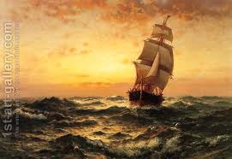
Faithful People Go Thru!!!
In the days of Babylon, faithful souls went thru and carried the glad tidings of Christ throughout the earth. In the days of Imperial Rome, again, faithful souls went thru and carried the truth worldwide. The same will happen today!

Slide 25
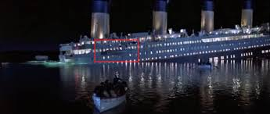
Stay With the Life-giver!!

