Slide 1
Daniel 12
The Time

Slide 2
Daniel 12:1-3
“And at that time shall Michael stand up, the great prince which standeth for the children of thy people: and there shall be a time of trouble, such as never was since there was a nation even to that same time: and at that time thy people shall be delivered, every one that shall be found written in the book. And many of them that sleep in the dust of the earth shall awake, some to everlasting life, and some to shame and everlasting contempt. And they that be wise shall shine as the brightness of the firmament; and they that turn many to righteousness as the stars for ever and ever.”

Slide 3
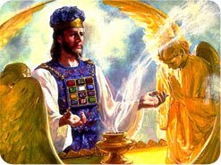
Probation is Over
“When Michael stands up, probation closes for all the world. Once everyone has decided for or against Christ, every decision will be sealed and then the plagues will come. (Rev. 16)
2. Daniel 12 calls it the ‘time of trouble’.
3. Those who are one with Christ, in submission to Him, will be delivered in this time of the plagues. Their names are retained in the book of life, having passed thru the judgment found in Daniel 7:9,10.”

Slide 4
Explanation
4. Verse 2 brings us down to the end of the plagues when a special resurrection will occur just before the Second Coming. Those who persecuted Christ while He was here and those who persecuted His people thru the ages will rise to see Christ come. Note Rev. 1:7 “Behold, he cometh with clouds; and every eye shall see him, and they also which pierced him: and all kindreds of the earth shall wail because of him. Even so, Amen.” Also, some who followed Christ during horrible apostasy will rise to see Christ come.
“Graves are opened, and "many of them that sleep in the dust of the earth. . . awake, some to everlasting life, and some to shame and everlasting contempt." Daniel 12:2. All who have died in the faith of the third angel's message come forth from the tomb glorified, to hear God's covenant of peace with those who have kept His law. "They also which pierced Him" (Revelation 1:7), those that mocked and derided Christ's dying agonies, and the most violent opposers of His truth and His people, are raised to behold Him in His glory and to see the honor placed upon the loyal and obedient.” GC, pg. 637

Slide 5

The Stars of God
A special blessing is pronounced upon those who turn people to righteousness. In the Bible, Christ and His 10 commandments are referred to as righteousness.
“this is his name whereby he shall be called, THE LORD OUR RIGHTEOUSNESS.” Jer. 23:6
“My tongue shall speak of thy word: for all thy commandments are righteousness.” Psalm 119:172
Those who exalt Christ and His law will shine as the stars in the sky!

Slide 6
Daniel 12:4
“But thou, O Daniel, shut up the words, and seal the book, even to the time of the end: many shall run to and fro, and knowledge shall be increased.”
Daniel was to seal his book till the time of the end. “But since 1798 the book of Daniel has been unsealed, knowledge of the prophecies has increased, and many have proclaimed the solemn message of the judgment near.” GC, pg. 356
History records for us that as the 1800’s dawned, understanding in Daniel’s prophecies jumped exponentially. Countless books and pamphlets were written on Daniel.
“many shall run to and fro, and knowledge shall be increased.” This phrase here means- as it relates to the prophecies in Daniel- knowledge of them would increase. Prophecy has been fulfilled! “Are we never to know that period, whilst He Himself exhorteth us not only to read Daniel the prophet, but to understand it? and in that very Daniel, where it is said that the words were shut up to the time of the end (which was the case in his time), and that 'many shall run to and fro' (a Hebrew expression for observing and thinking upon the time), 'and knowledge' (regarding that time) 'shall be increased.' Daniel 12:4. Besides this, our Lord does not intend to say by this, that the approach of the time shall not be known, but that the exact 'day and hour knoweth no man.' Enough, He does say, shall be known by the signs of the times, to induce us to prepare for His coming, as Noah prepared the ark."--Wolff, Researches and Missionary Labors, pages 404, 405. GC, pg. 360

Slide 7
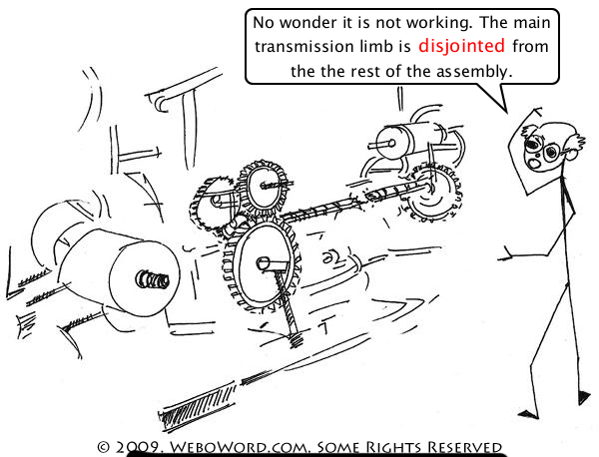
Not in chronological sequence
Portions of Daniel’s book follow chronological order. Daniel 12 doesn’t. Verses 1and 2 looked at the close of probation, the time of trouble, and the special resurrection near Christ’s coming. Verses 3 and 4 break this order with a blessing upon those who turn people to Christ and His law, plus a mentioning of the sealing of Daniel’s book until 1798!

Slide 8
Daniel 12:5,6
“Then I Daniel looked, and, behold, there stood other two, the one on this side of the bank of the river, and the other on that side of the bank of the river. And one said to the man clothed in linen, which was upon the waters of the river, How long shall it be to the end of these wonders?” The man in linen was Christ.
“Then I lifted up mine eyes, and looked, and behold a certain man clothed in linen, whose loins were girded with fine gold of Uphaz: His body also was like the beryl, and his face as the appearance of lightning, and his eyes as lamps of fire, and his arms and his feet like in colour to polished brass, and the voice of his words like the voice of a multitude.” Daniel 10:5,6
“His head and his hairs were white like wool, as white as snow; and his eyes were as a flame of fire; And his feet like unto fine brass, as if they burned in a furnace; and his voice as the sound of many waters. “And he had in his right hand seven stars: and out of his mouth went a sharp twoedged sword: and his countenance was as the sun shineth in his strength.” Rev. 1:14-16

Slide 9
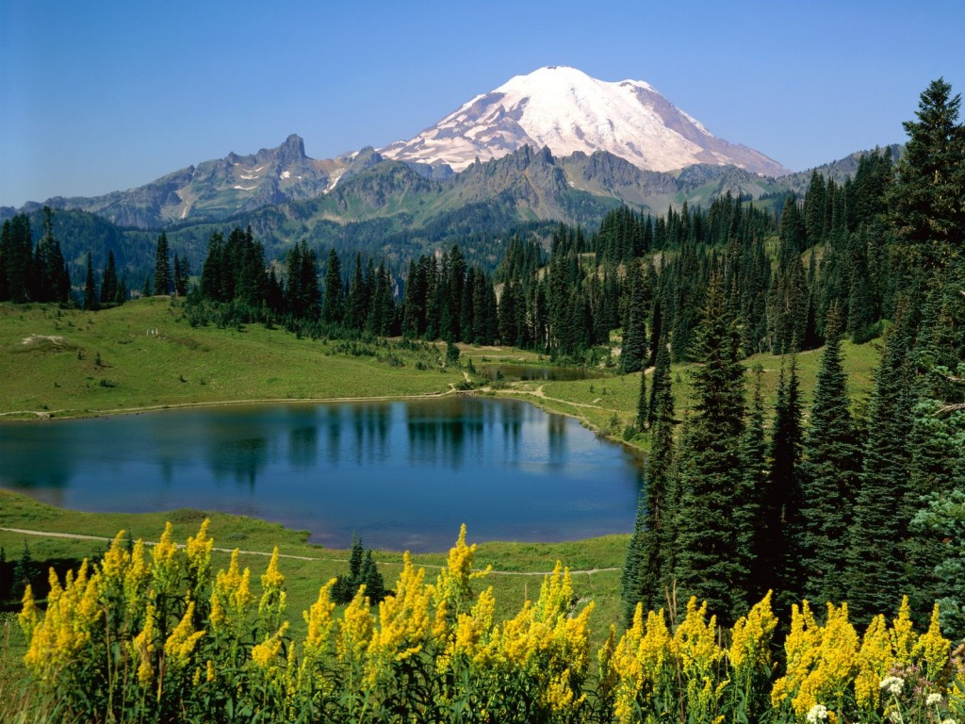
The end
Daniel mentioned the end several times toward the end of his book.
“And at the time of the end shall the king of the…” Dan. 11:40
“seal the book, even to the time of the end:” Dan. 12:4
“How long shall it be to the end of these wonders? “ Dan. 12:6
“that it shall be for a time, times, and an half; and when he shall have accomplished to scatter the power of the holy people, all these things shall be finished.”
Dan. 12:7
“O my Lord, what shall be the end of these things?” Dan. 12:8
“Go thy way, Daniel: for the words are closed up and sealed till the time of the end.’ Dan. 12:9
“But go thou thy way till the end be: for thou shalt rest, and stand in thy lot at the end of the days.” Dan. 12:13

Slide 10
The time of the end or the end of time?
This concept is crucial if we are going to rightly understand the closing verses and chapter 12 of Daniel’s book. 3 times the phrase ‘time of the end’ is specifically stated. This we know already to be 1798. 5 times reference is made to the end. Is this talking about the very close of time?
Daniel 12:13 is the key. “But go thou thy way till the end be: for thou shalt rest, and stand in thy lot at the end of the days.” In this passage, the end is referred to as the time when Daniel’s book will be opened. This is 1798! The focus of Daniel 12 is 1798 and the surrounding events and time prophecies.

Slide 11

Daniel 12:7
“And I heard the man clothed in linen, which was upon the waters of the river, when he held up his right hand and his left hand unto heaven, and sware by him that liveth for ever that it shall be for a time, times, and an half; and when he shall have accomplished to scatter the power of the holy people, all these things shall be finished.” A repeat of the same time period is here specified. This is the 1260 years of papal supremacy through the Dark Ages as we have seen in Daniel 7:25. Some believe this to be referring to literal time down at history’s close. If this were so, then the obvious question would be, ‘Can’t God make up His mind?’

Slide 12
Literal Time?
Some would interpret Daniel 12 as literal time. Some would interpret these prophecies as coming down near closing events and Christ’s coming. I will let the prophet speak,
“There were many proclaiming a new time after [1844], but I was shown that we should not have another definite time to proclaim to the people…But oft repeated message of definite time was exactly what the enemy wanted, and it served his purpose well to unsettle the faith in the first proclamation of time which was of heavenly origin…Our position has been one of waiting and watching, with no time-proclamation to intervene between the close of prophetic periods in 1844 and the time of the Lord’s coming.” Letter 38, 1888

Slide 13
No Definite Time AFTER 1844!
“I plainly stated at the Jackson camp meeting to these fanatical parties that they were doing the work of the adversary of souls; they were in darkness. They claimed to have great light that probation would close in October, 1884.
I there stated in public that the Lord had been pleased to show me that there would be no definite time in the message given of God since 1844; and that I knew that this message, which four or five were engaged in advocating with great zeal, was heresy. The visions of this poor child were not of God. This light came not from heaven. Time was short; but the end was not yet. A great work was to be accomplished to prepare a people to be sealed with the seal of the living God.--An Exposure of Fanaticism and Wickedness (Pamphlet), pp. 9, 10 (1885). Quoted in Selected Messages, vol. 2, pg. 73

Slide 14
Repeat of Papal Reign
Daniel 12 is repeating what we saw in chapter 7:25; the time, times, and half a time. This is the 1260 years of papal supremacy. It obviously is prophetic time as it was in Daniel 7:25.
Prophetic time is a day=a year. Literal time is used in the Bible. It is obvious by context and reason. Daniel 1, for instance, discusses Daniel’s diet experiment for 10 days. To interpret that as 10 years is total nonsense, illogical, and out of context. Daniel 1 isn’t dealing in symbols; Daniel 12 IS!!!
Daniel 9:2, referring to the Babylonian captivity is also literal. The Jews were in Babylon for exactly 70 years. To make that prophetic time is nonsense; Israel was not in captivity 490 years. Context and history make it plain!

Slide 15

Daniel 12:8-10
“And I heard, but I understood not: then said I, O my Lord, what shall be the end of these things? And he said, Go thy way, Daniel: for the words are closed up and sealed till the time of the end. Many shall be purified, and made white, and tried; but the wicked shall do wickedly: and none of the wicked shall understand; but the wise shall understand.”

Slide 16
Reiteration
Daniel asks what will be the end of these things. The answer is for him to seal up his book until the time of the end. This we know is 1798. Many will find power thru Christ to overcome sin and have a pure character. While many today give lip service and live lip service Christianity, there is no mistaking the glorious experience of victory over sin that is the delight and privilege of the Christian! “He that overcometh, the same shall be clothed in white raiment; and I will not blot out his name out of the book of life, but I will confess his name before my Father, and before his angels.” Rev. 3:5
Those who are walking with Christ will discern the times, but the wicked, time servers will not. God help us to be among the lowly who follow Christ wherever He goes!

Slide 17
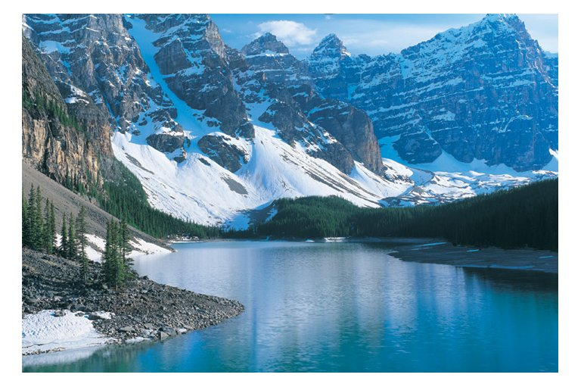
Daniel 12:11
“And from the time that the daily sacrifice shall be taken away, and the abomination that maketh desolate set up, there shall be a thousand two hundred and ninety days.”
The margin reads "To set up the abomination." With this reading the text would stand thus: "From the time that the daily sacrifice shall be taken away to set up [or in order to set up] the abomination that maketh desolate, there shall be a thousand two hundred and ninety days."

Slide 18
In order to set up the abomination
This controversial verse is really quite simple. Some event would trigger the setting up of the other. The daily, or the committing of people to the worship of Christ, would be supplanted by the worship of the one who sets up the abomination that makes desolate.
Christ warned of the abomination of desolation in Matthew 24:15 “When ye therefore shall see the abomination of desolation, spoken of by Daniel the prophet, stand in the holy place, (whoso readeth, let him understand:)” The pagan Romans set up this abomination in 70 AD when they took over Jerusalem. They set up their standard in the holy places which extended some distance outside the city. Their standard had a sundial on the top. Pagan Rome worshipped the sun. The papacy continued this tradition by worshipping the sun as well in their exaltation of Sunday worship!

Slide 19
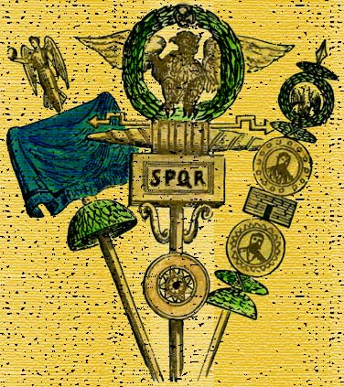
The Roman Standard
Prior to the setting up of the Sunday worship of the papacy in 538 AD, some significant event would occur prior to 538 that would guarantee Rome’s rise in 538. Look at history!
“At the moment of the Frankish conversion they were in constant danger from the Arian Ostrogoths who had just got a firm hold upon Italy. Theodoric had not distributed the religion of Rome, but a new king might arise who should try to force Arianism upon the whole of Italy. The pope was therefore overjoyed to hear that the newly converted Franks had taken his form of the Christian belief. He was ready to bless every undertaking of theirs as the work of God, if only it might be against the worse than heathen Arians. Thus began as early as the year 500 an understanding between the Roman Papacy and the Frankish kingdom which was to ripen into an intimate allegiance and to do very much towards shaping all the future history of Europe." [6]"The event which intensified the fears of all the Arian kings, and which left to each one little more than the hope that he might be the last to be devoured, was the conversion to Catholicism of Clovis, the heathen king of the Franks." [7] Smith’s, DR, pg. 325

Slide 20
The next campaign of the Frankish king was one of far greater importance and success. He was set on trying his fortune against the young king of the Visigoths, whose personal weakness and unpopularity with his Roman subjects tempted him to an invasion of Aquitaine. It would seem that Chlodovech [Clovis] carefully chose as a casus belli the Arian persecutions of the Alaric, who, like his father Euric, was a bad master to his Catholic subjects. . . . In 507 Chlodovech declared war on the Visigoths ."[11] "Why the explosion was delayed until the year 507 is unknown. That the king of the Franks was the aggressor is certain. He easily found a pretext for beginning the war as a champion and protector of Catholic Christianity against the absolutely just measures which Alaric took against his treacherous orthodox clergy. . . . In the spring of 507 he [Clovis] suddenly crossed the Loire and marched toward Poitiers. . . Ten miles from Poitiers, the Visigoths had taken up their position. Alaric put off beginning battle because he was waiting for the Ostrogoth troops, but as they were hindered by the appearance of a Byzantine fleet in Italian waters he determined to fight instead of beating a retreat, as it would have been wise to do. After a short engagement the Goths turned and fled. In the pursuit the king of the Goths was killed, it was said by Clovis's own hand (507). With this overthrow the rule of the Visigoths in Gaul was ended forever." [12]

Slide 21
508 AD
“This disposed of the Visigothic kingdom, but there yet remained the league of Arian powers under Theodoric. Alaric had counted on the assistance of Theodoric, but the latter failed him. The next year, A.D. 508, however, Theodoric came against Clovis and gained a victory, after which he unaccountably made peace with him, and the resistance of the Arian powers was at an end. [16]
Significance of Clovis's Victories.--The eminence which Clovis had attained in the year 508, and the significance of his victories to the future of Europe and the church were so great that historians cannot forbear commenting on them.
"Nor was his a temporary conquest. The kingdom of the West Goths and the Burgundians had become the kingdom of the Franks. The invaders had at length arrived, who were to remain. It was decided that the Franks, and not the Goths, were to direct the future destinies of Gaul and Germany, and that the Catholic faith, and not Arianism, was to be the religion of these great realms." [17] Smith, DR, pg. 328

Slide 22
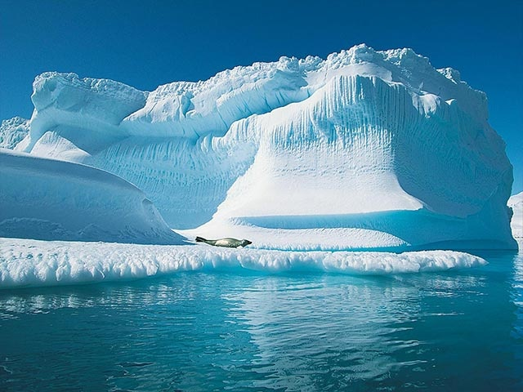
Summary
Clovis’ conversion in 496 AD to Catholicism and his subsequent victories over the Germanic tribes and his peace with Theodoric in 508 paved the way for the rise of the papacy in 538 AD. Worship was transferred from Christ to the pope. Taking 508 as the starting date for the 1,290 year prophecy, it would extend to 1798. The focal point of Daniel 12 is the time of the end, which is 1798.

Slide 23
The blessing
“Blessed is he that waiteth, and cometh to the thousand three hundred and five and thirty days. But go thou thy way till the end be: for thou shalt rest, and stand in thy lot at the end of the days.” Daniel 12:12,13
Since the 1290 years begin in 508, and the 1,335 years are mentioned in the same breath with the 1,290 years, they too begin in 508 AD and extend to 1843. A blessing is pronounced on those who follow the prophetic reckoning to 1843 and see the fulfillment of prophecy to that time. Clearly, the two prophetic forces are identified by two time periods; the enemy of God receiving a deadly wound in 1798 and the rise of God’s final people in the time frame of 1843!

Slide 24
The Time Periods
1335 years
1290 years
1260 years
508------538----------------------------1798-------1843
AD.
Clovis, in 508 AD, paved the way for the papacy’s rise in 538. The 1260 and 1290 year periods both end in 1798 and the 1335 years ends in 1843. Blessed are those who stand with the people of God and follow God’s prophetic hand down to 1843!

