Slide 1
Daniel 9
Pot of Gold or Poison Pill?

Slide 2
One Piece Missing
As Daniel 8 ends, one part of the prophecy was not made known by Gabriel to Daniel. “And the vision of the evening and the morning which was told is true: wherefore shut thou up the vision; for it shall be for many days. And I Daniel fainted, and was sick certain days; afterward I rose up, and did the king's business; and I was astonished at the vision, but none understood it.” Dan. 8:26,27 Since Gabriel was told to explain the entire vision (Daniel 8:16), we should expect him to return in chapter 9 to explain the 2,300 years to Daniel.

Slide 3
Daniel’s Dilemma
Daniel understood the importance of the sanctuary service. He understood its tremendous value to God’s children. The sanctuary in Jerusalem was in ruins and Daniel has now seen in Daniel 8 that the sanctuary would be desolated way down to the time of the end. He fears that the sins of his people have been so great that God will allow the sanctuary in Jerusalem to lay waste for a long time. Daniel is also aware that Jeremiah had said that the temple would lay waste for only 70 years. “In the first year of his reign I Daniel understood by books the number of the years, whereof the word of the LORD came to Jeremiah the prophet, that he would accomplish seventy years in the desolations of Jerusalem.” In his dismay, Daniel begins to pray.

Slide 4
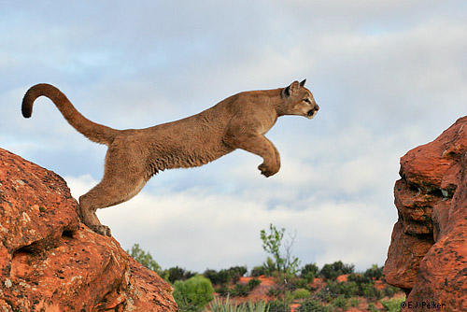
Daniel’s prayer
Daniel focuses on 3 things in his prayer.
1. the goodness of God (verses 4,7)
2. the sinfulness of the people (verses 5,6, 10)
3. the restoration of the temple (verses 16-18)

Slide 5

Guess who Returns?
“And whiles I was speaking, and praying, and confessing my sin and the sin of my people Israel, and presenting my supplication before the LORD my God for the holy mountain of my God; Yea, whiles I was speaking in prayer, even the man Gabriel, whom I had seen in the vision at the beginning, being caused to fly swiftly, touched me about the time of the evening oblation.“ Daniel 9:20,21

Slide 6
And He Said…
If you had been told 13 years before to tell somebody something and you didn’t do it, what would you say when you saw them 13 years later? ‘I’ve come to tell you what I didn’t tell you 13 years ago’. And what did Gabriel say?
“And he informed me, and talked with me, and said, O Daniel, I am now come forth to give thee skill and understanding. At the beginning of thy supplications the commandment came forth, and I am come to shew thee; for thou art greatly beloved: therefore understand the matter, and consider the vision.” Daniel 9:22,23

Slide 7

Understanding About What?
‘I’ve come to explain to you what you didn’t understand last time; namely, the 2,300 years.’ What is Daniel to consider? What is he to understand?
The 2,300 years of Daniel 8!

Slide 8
Another Time Period?
“Seventy weeks are determined upon thy people and upon thy holy city, to finish the transgression, and to make an end of sins, and to make reconciliation for iniquity, and to bring in everlasting righteousness, and to seal up the vision and prophecy, and to anoint the most Holy.” Daniel 9:24 Gabriel begins with another time prophecy and tells Daniel that this time prophecy is cut off from the first one-even the 2,300 years!

Slide 9
Clarification
Through Daniel 8:14 and Daniel 9:24, we now have two time prophecies. The first one is 2,300 years and the second one is 490 years. The 490 year period is cut off from the longer period. They both begin at the same time, but through verse 24 of Daniel 9, we do not know when the two periods begin. All we do know from Daniel 7 is that the judgment takes place after 1798. Thus, the 2,300 year period must end after 1798 because this time period is connected to the judgment.!

Slide 10

The Starting Point-Daniel 9:25
“Know therefore and understand, that from the going forth of the commandment to restore and to build Jerusalem unto the Messiah the Prince shall be seven weeks, and threescore and two weeks: the street shall be built again, and the wall, even in troublous times.”

Slide 11
The Command to Restore and Build Jerusalem
There were three decrees to restore and build Jerusalem. They were:
1. Cyrus 536 B.C.- Ezra 1:1-4
2. Darius 520 B.C.- Ezra 6:1-14
3. Artaxerxes 457 B.C.- Ezra 7:12-26
Cyrus began the process, Darius reaffirmed it, and Artaxerxes brought it to completion. The Bible is clear that it took three decrees. “And the elders of the Jews builded, and they prospered through the prophesying of Haggai the prophet and Zechariah the son of Iddo. And they builded, and finished it, according to the commandment of the God of Israel, and according to the commandment of Cyrus, and Darius, and Artaxerxes king of Persia.” Ezra 6:14

Slide 12
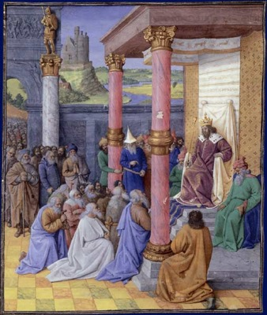
457 B.C.
In the seventh chapter of Ezra the decree is found. Verses 12-26. In its completest form it was issued by Artaxerxes, king of Persia, 457 B.C. But in Ezra 6:14 the house of the Lord at Jerusalem is said to have been built "according to the commandment ["decree," margin] of Cyrus, and Darius, and Artaxerxes king of Persia." These three kings, in
originating, reaffirming, and completing the decree, brought it to the perfection required by the prophecy to mark the beginning of the 2300 years. Taking 457 B.C., the time when the decree was completed, as the date of the commandment, every specification of the prophecy concerning the seventy weeks was seen to have been fulfilled. Now, the pieces are falling together!

Slide 13
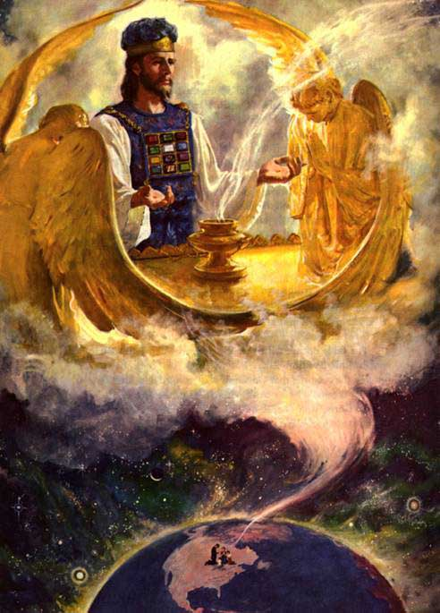
YES!
Taking 457 B.C. as the starting point, it can be easily discerned that the 490 year period ends in 34 A.D. and the 2,300 year period ends in 1844. This perfectly meets what we already know from Daniel 7 that the judgment must be sometime after 1798 because 1844 is after 1798! The pieces are starting to fit together! And there is more!

Slide 14
Christ’s Baptism Predicted!
“Know therefore and understand, that from the going forth of the commandment to restore and to build Jerusalem unto the Messiah the Prince shall be seven weeks, and threescore and two weeks: the street shall be built again, and the wall, even in troublous times.” Daniel 9:25
From the time of 457 B.C., the first 69 weeks or 483 years would extend down to the Messiah the Anointed One. Christ became the Anointed One at His baptism. That would place Christ’s baptism at 27 A.D. Is there any confirmation of this from the Bible? There are two key hints found in the gospels.

Slide 15
Confirmation
“Now in the fifteenth year of the reign of Tiberius Caesar, Pontius Pilate being governor of Judaea, and Herod being tetrarch of Galilee,…Annas and Caiaphas being the high priests, the word of God came unto John the son of Zacharias in the wilderness. And he came into all the country about Jordan, preaching the baptism of repentance for the remission of sins;… Jesus also being baptized, and praying, the heaven was opened, And the Holy Ghost descended in a bodily shape like a dove upon him, and a voice came from heaven, which said, Thou art my beloved Son; in thee I am well pleased.” Luke 3:1-3, 21,22 What was the 15 year of Tiberius? “Thus, when in AD 13, the powers held by Tiberius were made equal, rather than second, to Augustus's own powers, he was for all intents and purposes a "co-princeps" with Augustus…^{31]} Augustus died in AD 14, at the age of 75.^{[32]} He was buried with all due ceremony and, as had been arranged beforehand, deified, his will read, and Tiberius confirmed as his sole surviving heir.^{[33]”} Starting with 13, 15 years later would put the baptism of Christ in 27A.D!

Slide 16
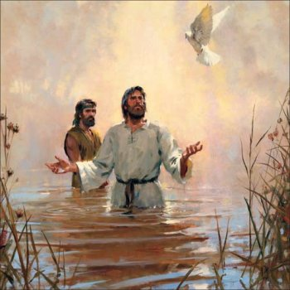
Christ’s Baptism
“And it came to pass in those days, that Jesus came from Nazareth of Galilee, and was baptized of John in Jordan. And straightway coming up out of the water, he saw the heavens opened, and the Spirit like a dove descending upon him: And there came a voice from heaven, saying, Thou art my beloved Son, in whom I am well pleased. And immediately the Spirit driveth him into the wilderness. And he was there in the wilderness forty days, tempted of Satan; and was with the wild beasts; and the angels ministered unto him. Now after that John was put in prison, Jesus came into Galilee, preaching the gospel of the kingdom of God, And saying, The time is fulfilled, and the kingdom of God is at hand: repent ye, and believe the gospel.” Mark 1:9-15

Slide 17
Christ Affirms Many Things
Following the baptism of Christ, when He was anointed with the Holy Spirit, He began to preach the gospel, saying what? “Jesus came into Galilee, preaching the gospel of the kingdom of God, And saying, The time is fulfilled, and the kingdom of God is at hand: repent ye, and believe the gospel. “ Mark 1:14,15
To what time was Christ making reference? What time prophecy specifically pointed to Christ’s anointing and baptism? The time prophecy of Daniel 9:25!
What does this mean?
1. The date Christ used for the originating of these time prophecies was 457 B.C. and the decree of Artaxerxes.
2. The time prophecies, while mentioned as days, are truly based on a day=year principle. This principle is Biblical, valid, and authenticated by Christ Himself!
3. Christ authenticated the prophecy of Daniel 9 AND Daniel 8:14. With the decree of 457 B.C., the 2,300 year period did end in 1844!

Slide 18
Daniel 9:24-27 is Loaded!
“And after threescore and two weeks shall Messiah be cut off, but not for himself: and the people of the prince that shall come shall destroy the city and the sanctuary; and the end thereof shall be with a flood, and unto the end of the war desolations are determined. And he shall confirm the covenant with many for one week: and in the midst of the week he shall cause the sacrifice and the oblation to cease, and for the overspreading of abominations he shall make it desolate, even until the consummation, and that determined shall be poured upon the desolate.”
Not only would Christ be baptized in 27 A.D., but His death is foretold as well. In the midst of the last 7 years, in 31 A.D., Christ would put forever at an end the sacrificial offerings instituted at Eden.
Also, the destruction of Jerusalem and their temple in 70 A.D. are here mentioned.

Slide 19
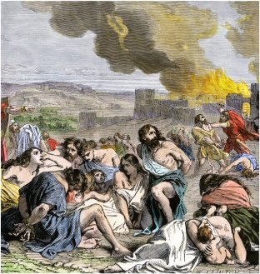
This is a Gold Mine!
Daniel, chapters 8 and 9 tell us so much.
1. The 2,300 years end in 1844. Judgment begins!
2. Probation closed on the Jews in 34 A.D.
3. Christ was baptized in 27 A.D.
4. Christ was crucified in 31 A.D.
5. The gospel went to the Gentiles in force in 34 A.D.
6. God raised up a people in 1844 to restore everything Rome sought to destroy.

Slide 20
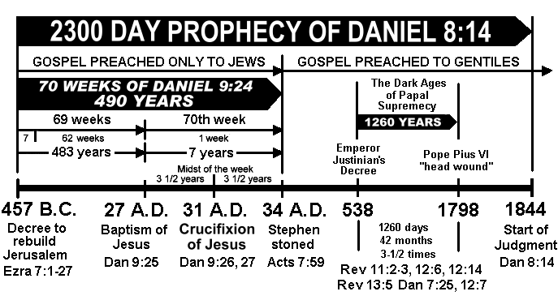

Slide 21
Ellen White is Right!
“Taking 457 B.C., the time when the decree was completed, as the date of the commandment, every specification of the prophecy concerning the seventy weeks was seen to have been fulfilled.
"From the going forth of the commandment to restore and to build Jerusalem unto the Messiah the Prince shall be seven weeks, and threescore and two weeks"--namely, sixty-nine weeks, or 483 years. The decree of Artaxerxes went into effect in the autumn of 457 B.C. From this date, 483 years extend to the autumn of A.D. 27. (See Appendix.) At that time this prophecy was fulfilled. The word "Messiah" signifies "the Anointed One." In the autumn of A.D. 27 Christ was baptized by John and received the anointing of the Spirit. The apostle Peter testifies that "God anointed Jesus of Nazareth with the Holy Ghost and with power." Acts 10:38. And the Saviour Himself declared: "The Spirit of the Lord is upon Me, because He hath anointed Me to preach the gospel to the poor." Luke 4:18. After His baptism He went into Galilee, "preaching the gospel of the kingdom of God, and saying, The time is fulfilled." Mark 1:14, 15.
"And He shall confirm the covenant with many for one week." The "week" here brought to view is the last one of the seventy; it is the last seven years of the period allotted especially to the Jews. During this time, extending from A.D. 27 to A.D. 34, Christ, at first in person and afterward by His disciples, extended the gospel invitation especially to the Jews. As the apostles went forth with the good tidings of the kingdom, the Saviour's direction was: "Go not into the way of the Gentiles, and into any city of the Samaritans enter ye not: but go rather to the lost sheep of the house of Israel." Matthew 10:5, 6.” GC, pg. 327

Slide 22
Adventism Raised Up For Such a Time!
A great movement, foretold in prophecy, was raised up in 1844. This group of people, known as Seventh-day Adventists, were called to restore all the great truths that the papacy sought to destroy through the Dark Ages. As Seventh-day Adventists would share these truths with ‘every nation, kindred, tongue, and people’ (Revelation 14:6), would the Vatican sit by and allow it to happen? Or would the papacy seek to infiltrate Adventism and destroy it? Daniel 11:40-45 gives us the answer! You see, friends, Daniel saw our day!!!!!

