Slide 1
Ezekiel, pt. 11
‘The Accountable’

Slide 2
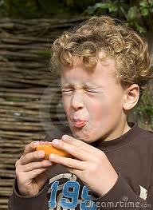
Who is Responsible?
Who is accountable for the pain this little boy is suffering? Is it his parents for giving it to him? Or, is he responsible because he picked it up, took it, and choose to eat it? This is the sum and substance of Ezekiel 18!

Slide 3
Ezekiel 18:1-4
“The word of the LORD came unto me again, saying, What mean ye, that ye use this proverb concerning the land of Israel, saying, The fathers have eaten sour grapes, and the children's teeth are set on edge? As I live, saith the Lord GOD, ye shall not have occasion any more to use this proverb in Israel. Behold, all souls are mine; as the soul of the father, so also the soul of the son is mine: the soul that sinneth, it shall die.”

Slide 4
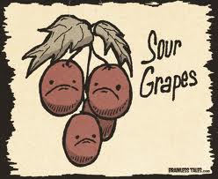
Hurt the Teeth!
In Ezekiel’s day, there was a saying that ‘if the father’s ate wild, sour grapes; then, the children’s teeth would be hurting.’ The point was that the children were not responsible for their current conditions. Their problems, trials, etc. were all the result of their father’s problems and the children could do nothing about it!

Slide 5
Personal Responsibility
“God has appointed you a work to do for Him which will make you colaborers with Him. All around you there are souls to save. There are those whom you can encourage and bless by your earnest efforts. You may turn souls from sin to righteousness. When you have a sense of your accountability to God you will feel the need of faithfulness in prayer and faithfulness in watching against the temptations of Satan. You will, if you are indeed Christians, feel more like mourning over the moral darkness in the world than indulging in levity and pride of dress. You will be among those who are sighing and crying for the abominations that are done in the land. You will resist the temptations of Satan to indulge in vanity and in trimmings and ornaments for display. The mind is narrowed and the intellect dwarfed that can be gratified with these frivolous things to the neglect of high responsibilities.” C.Ch 188

Slide 6
Again!
“The word of God places the sin of gluttony in the same catalogue with drunkenness. So offensive was this sin in the sight of God that He gave directions to Moses that a child who would not be restrained on the point of appetite, but would gorge himself with anything his taste might crave, should be brought by his parents before the rulers of Israel, and should be stoned to death. The condition of the glutton was considered hopeless. He would be of no use to others, and was a curse to himself. No dependence could be placed upon him in anything. His influence would be ever contaminating others, and the world would be better without such a character; for his terrible defects would be perpetuated. None who have a sense of their accountability to God will allow the animal propensities to control reason. Those who do this are not Christians, whoever they may be, and however exalted their profession. The injunction of Christ is, “Be ye therefore perfect, even as your Father which is in heaven is perfect.” He here shows us that we may be as perfect in our sphere as God is in His sphere.—Testimonies for the Church 4:454, 455,

Slide 7
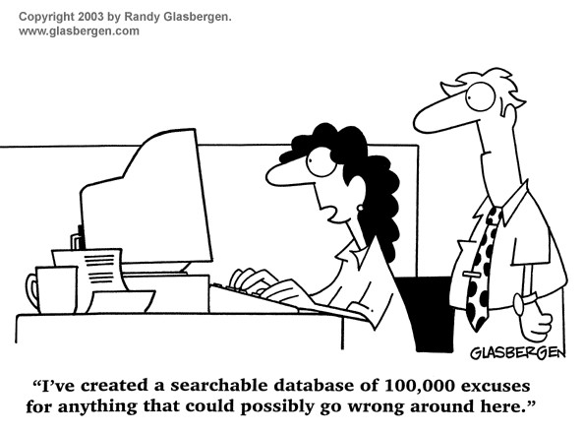
No One is Excusable!!
“And the man said, The woman whom thou gavest to be with me, she gave me of the tree, and I did eat…And the LORD God said unto the woman, What is this that thou hast done? And the woman said, The serpent beguiled me, and I did eat.” Genesis 3:12,13

Slide 8
Ezekiel 18:5-10
“But if a man be just, and do that which is lawful and right, And hath not eaten upon the mountains, neither hath lifted up his eyes to the idols of the house of Israel, neither hath defiled his neighbor's wife, neither hath come near to a menstruous woman, And hath not oppressed any, but hath restored to the debtor his pledge, hath spoiled none by violence, hath given his bread to the hungry, and hath covered the naked with a garment; He that hath not given forth upon usury, neither hath taken any increase, that hath withdrawn his hand from iniquity, hath executed true judgment between man and man, Hath walked in my statutes, and hath kept my judgments, to deal truly; he is just, he shall surely live, saith the Lord GOD.”

Slide 9
The just man’s son
“ If he beget a son that is a robber, a shedder of blood, and that doeth the like to any one of these things, And that doeth not any of those duties, but even hath eaten upon the mountains, and defiled his neighbour's wife, Hath oppressed the poor and needy, hath spoiled by violence, hath not restored the pledge, and hath lifted up his eyes to the idols, hath committed abomination, Hath given forth upon usury, and hath taken increase: shall he then live? he shall not live: he hath done all these abominations; he shall surely die; his blood shall be upon him.” v. 10-13

Slide 10
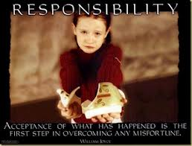
Accountable
Everyone makes their own decisions. Everyone chooses their own lifestyle. We cannot put the blame for our actions on someone else. We choose to steal; we choose to look immorally at others; we make the decision and bear the consequences. Nobody else’s fault, but our own! Individual choice is paramount!!

Slide 11
The message of the Day of Atonement
Into the sanctuary, sin was transferred throughout the year. God was taking responsibility for man’s sin. But, was God truly responsible? On the Day of Atonement, this question was answered. The scapegoat, representing the devil, had all the sins placed on him and was taken into the wilderness. Anyone clinging to sin was removed from the camp. On that day, personal accountability for choices made was clearly revealed!!!

Slide 12
Once Saved Always….
Can a person lose their salvation? Can a person accept Christ and then walk away from their choice and be lost? Or is it rather, once you accept Christ, you can never be lost?
“But when the righteous turneth away from his righteousness, and committeth iniquity, and doeth according to all the abominations that the wicked man doeth, shall he live? All his righteousness that he hath done shall not be mentioned: in his trespass that he hath trespassed, and in his sin that he hath sinned, in them shall he die.” Ezekiel 18:24
“For when they speak great swelling words of vanity, they allure through the lusts of the flesh, through much wantonness, those that were clean escaped from them who live in error. While they promise them liberty, they themselves are the servants of corruption: for of whom a man is overcome, of the same is he brought in bondage….

Slide 13
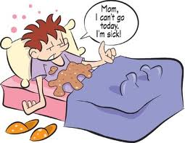
Vomit Again
“…For if after they have escaped the pollutions of the world through the knowledge of the Lord and Saviour Jesus Christ, they are again entangled therein, and overcome, the latter end is worse with them than the beginning. For it had been better for them not to have known the way of righteousness, than, after they have known it, to turn from the holy commandment delivered unto them. But it is happened unto them according to the true proverb, The dog is turned to his own vomit again; and the sow that was washed to her wallowing in the mire.” 2 Peter 2:18-22

Slide 14
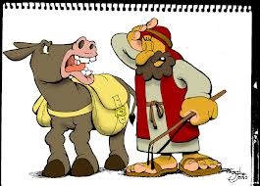
Balaam the Prophet
”Which have forsaken the right way, and are gone astray, following the way of Balaam the son of Bosor, who loved the wages of unrighteousness; But was rebuked for his iniquity: the dumb ass speaking with man's voice forbad the madness of the prophet.” 2 Peter 2:15,16

Slide 15
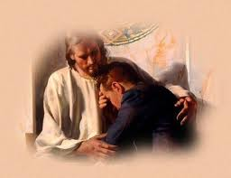
Repent
“Therefore I will judge you, O house of Israel, every one according to his ways, saith the Lord GOD. Repent, and turn yourselves from all your transgressions; so iniquity shall not be your ruin. Cast away from you all your transgressions, whereby ye have transgressed; and make you a new heart and a new spirit: for why will ye die, O house of Israel? For I have no pleasure in the death of him that dieth, saith the Lord GOD: wherefore turn yourselves, and live ye.” Ezekiel 18:30-32

Slide 16
Ezekiel 19:1-9
“ Moreover take thou up a lamentation for the princes of Israel, And say, What is thy mother? A lioness: she lay down among lions, she nourished her whelps among young lions. And she brought up one of her whelps: it became a young lion, and it learned to catch the prey; it devoured men. The nations also heard of him; he was taken in their pit, and they brought him with chains unto the land of Egypt. Now when she saw that she had waited, and her hope was lost, then she took another of her whelps, and made him a young lion. And he went up and down among the lions, he became a young lion, and learned to catch the prey, and devoured men. And he knew their desolate palaces, and he laid waste their cities; and the land was desolate, and the fullness thereof, by the noise of his roaring. Then the nations set against him on every side from the provinces, and spread their net over him: he was taken in their pit. And they put him in ward in chains, and brought him to the king of Babylon: they brought him into holds, that his voice should no more be heard upon the mountains of Israel.”

Slide 17
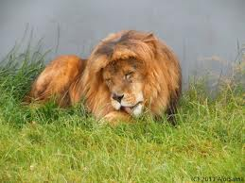
God’s Plan for Israel
King of the Forest. The exalted above the nations; the head and not the tail! Ezekiel shows what God’s people had become. “and they brought him with chains unto the land of Egypt…And they put him in ward in chains, and brought him to the king of Babylon:”

Slide 18
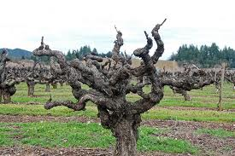
Fruitless Vine
“Thy mother is like a vine in thy blood, planted by the waters: she was fruitful and full of branches by reason of many waters. And she had strong rods for the sceptres of them that bare rule, and her stature was exalted among the thick branches, and she appeared in her height with the multitude of her branches. But she was plucked up in fury, she was cast down to the ground, and the east wind dried up her fruit: her strong rods were broken and withered; the fire consumed them.” Ezek. 19:10-12

