Slide 1
God’s Other Book

Slide 2
It Still Speaks
“The book of nature, which spread its living lessons before them, afforded an exhaustless source of instruction and delight. On every leaf of the forest and stone of the mountains, in every shining star, in earth and sea and sky, God’s name was written. With both the animate and the inanimate creation—with leaf and flower and tree, and with every living creature, from the leviathan of the waters to the mote in the sunbeam—the dwellers in Eden held converse, gathering from each the secrets of its life. God’s glory in the heavens, the innumerable worlds in their orderly revolutions, “the balancing of the clouds” (Job 37:16), the mysteries of light and sound, of day and night—all were objects of study by the pupils of earth’s first school.” Education, pg. 21

Slide 3
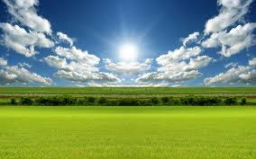
What to Learn?
“Many illustrations from nature are used by the Bible writers; and as we observe the things of the natural world, we shall be enabled, under the guiding of the Holy Spirit, more fully to understand the lessons of God’s Word.” Education, pg. 120.
“In the natural world God has placed in the hands of the children of men the key to unlock the treasure house of His Word. The unseen is illustrated by the seen; divine wisdom, eternal truth, infinite grace, are understood by the things that God has made.” Counsels to Parents, Teachers, and Students, pg. 187.

Slide 4
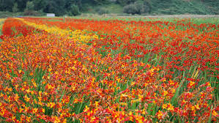
Lillies/Flowers of the Field
“And why take ye thought for raiment? Consider the lilies of the field, how they grow; they toil not, neither do they spin: And yet I say unto you, That even Solomon in all his glory was not arrayed like one of these. Wherefore, if God so clothe the grass of the field, which to day is, and to morrow is cast into the oven, shall he not much more clothe you, O ye of little faith?” Matthew 6:28-30

Slide 5
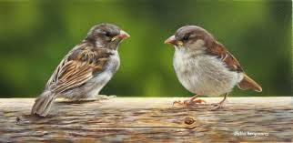
Sparrows
“And fear not them which kill the body, but are not able to kill the soul: but rather fear him which is able to destroy both soul and body in hell. Are not two sparrows sold for a farthing? and one of them shall not fall on the ground without your Father. But the very hairs of your head are all numbered. Fear ye not therefore, ye are of more value than many sparrows.” Matt. 10:28-31

Slide 6
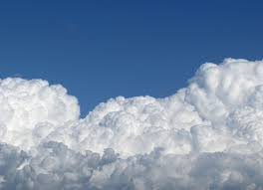
Clouds
“Remember these, O Jacob and Israel; for thou art my servant: I have formed thee; thou art my servant: O Israel, thou shalt not be forgotten of me. I have blotted out, as a thick cloud, thy transgressions, and, as a cloud, thy sins: return unto me; for I have redeemed thee.” Isaiah 44:21,22

Slide 7
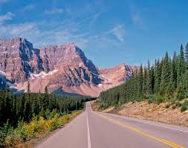
Mountains
“They that trust in the LORD shall be as mount Zion, which cannot be removed, but abideth for ever. As the mountains are round about Jerusalem, so the LORD is round about his people from henceforth even for ever.” Ps. 125:1,2

Slide 8
Smash Them!
“Then he answered and spake unto me, saying, This is the word of the LORD unto Zerubbabel, saying, Not by might, nor by power, but by my spirit, saith the LORD of hosts. Who art thou, O great mountain? before Zerubbabel thou shalt become a plain: and he shall bring forth the headstone thereof with shoutings, crying, Grace, grace unto it.” Zech. 4:6,7

Slide 9
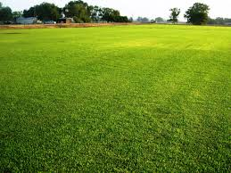
Frailty
“Being born again, not of corruptible seed, but of incorruptible, by the word of God, which liveth and abideth for ever. For all flesh is as grass, and all the glory of man as the flower of grass. The grass withereth, and the flower thereof falleth away: But the word of the Lord endureth for ever. And this is the word which by the gospel is preached unto you.” 1 Peter 1:23-25

Slide 10
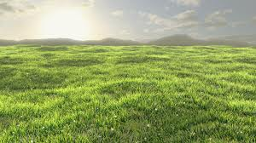
Grass and Adventism!
“ For if a man think himself to be something, when he is nothing, he deceiveth himself.” Galatians 6:3
“Not that we are sufficient of ourselves to think any thing as of ourselves; but our sufficiency is of God;” 2 Cor. 3:5

Slide 11

Great Sea
“Who is a God like unto thee, that pardoneth iniquity, and passeth by the transgression of the remnant of his heritage? he retaineth not his anger for ever, because he delighteth in mercy. He will turn again, he will have compassion upon us; he will subdue our iniquities; and thou wilt cast all their sins into the depths of the sea.” Micah 7:18,19

Slide 12
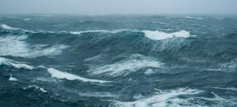
Peace, be still!
“And he arose and rebuked the wind, and said unto the sea, Peace, be still. And the wind ceased, and there was a great calm.” Mk.4:39
“Thou rulest the raging of the sea: when the waves thereof arise, thou stillest them.” Ps. 89:9

Slide 13
Sea-renity
“Jesus read the character of His disciples. He knew how sorely their faith was to be tried. In this incident on the sea He desired to reveal to Peter his own weakness,--to show that his safety was in constant dependence upon divine power. Amid the storms of temptation he could walk safely only as in utter self-distrust he should rely upon the Saviour. It was on the point where he thought himself strong that Peter was weak; and not until he discerned his weakness could he realize his need of dependence upon Christ. Had he learned the lesson that Jesus sought to teach him in that experience on the sea, he would not have failed when the great test came upon him.
Day by day God instructs His children. By the circumstances of the daily life He is preparing them to act their part upon that wider stage to which His providence has appointed them. It is the issue of the daily test that determines their victory or defeat in life's great crisis.” DA, pg. 382

Slide 14
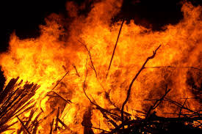
Fire
“I indeed baptize you with water unto repentance: but he that cometh after me is mightier than I, whose shoes I am not worthy to bear: he shall baptize you with the Holy Ghost, and with fire:” Matthew 3:11
“Is not my word like as a fire? saith the LORD; and like a hammer that breaketh the rock in pieces?” Jer. 23:29

Slide 15
Great Book
“Children should be encouraged to search out in nature the objects that illustrate Bible teachings, and to trace in the Bible the similitudes drawn from nature. They should search out, both in nature and in Holy Writ, every object representing Christ, and those also that He employed in illustrating truth. Thus may they learn to see Him in tree and vine, in lily and rose, in sun and star. They may learn to hear His voice in the song of birds, in the sighing of the trees, in the rolling thunder, and in the music of the sea. And every object in nature will repeat to them His precious lessons. To those who thus acquaint themselves with Christ, the earth will nevermore be a lonely and desolate place. It will be their Father’s house, filled with the presence of Him who once dwelt among men.” Education, pg. 120.

Slide 16
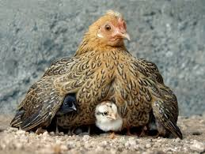
Tender Care!
“O Jerusalem, Jerusalem, thou that killest the prophets, and stonest them which are sent unto thee, how often would I have gathered thy children together, even as a hen gathereth her chickens under her wings, and ye would not! Behold, your house is left unto you desolate.” Matthew 23:37,38

Slide 17
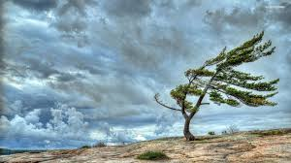
The Wind
“The wind bloweth where it listeth, and thou hearest the sound thereof, but canst not tell whence it cometh, and whither it goeth: so is every one that is born of the Spirit.” Jn. 3:8

Slide 18
The Work of the Spirit
“The wind is heard among the branches of the trees, rustling the leaves and flowers; yet it is invisible, and no man knows whence it comes or whither it goes. So with the work of the Holy Spirit upon the heart. It can no more be explained than can the movements of the wind. A person may not be able to tell the exact time or place, or to trace all the circumstances in the process of conversion; but this does not prove him to be unconverted. By an agency as unseen as the wind, Christ is constantly working upon the heart. Little by little, perhaps unconsciously to the receiver, impressions are made that tend to draw the soul to Christ. These may be received through meditating upon Him, through reading the Scriptures, or through hearing the word from the living preacher. Suddenly, as the Spirit comes with more direct appeal, the soul gladly surrenders itself to Jesus. By many this is called sudden conversion; but it is the result of long wooing by the Spirit of God,--a patient, protracted process. While the wind is itself invisible, it produces effects that are seen and felt. So the work of the Spirit upon the soul will reveal itself in every act of him who has felt its saving power. When the Spirit of God takes possession of the heart, it transforms the life. Sinful thoughts are put away, evil deeds are renounced; love, humility, and peace take the place of anger, envy, and strife. Joy takes the place of sadness, and the countenance reflects the light of heaven.” DA, pgs. 172, 173

Slide 19
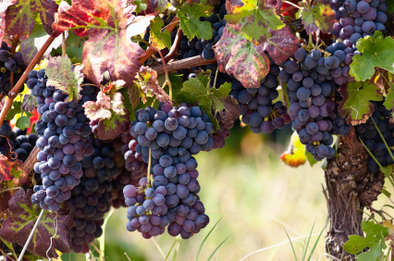
I am the Vine!
“Abide in me, and I in you. As the branch cannot bear fruit of itself, except it abide in the vine; no more can ye, except ye abide in me. I am the vine, ye are the branches: He that abideth in me, and I in him, the same bringeth forth much fruit: for without me ye can do nothing.” John 15:4,5

