Slide 1
Final Scenes, pt. 7
A Triumphant Request

Slide 2
A Thoughtful Hour
“It would be well for us to spend a thoughtful hour each day in contemplation of the life of Christ. We should take it point by point, and let the imagination grasp each scene, especially the closing ones. As we thus dwell upon His great sacrifice for us, our confidence in Him will be more constant, our love will be quickened, and we shall be more deeply imbued with His spirit. If we would be saved at last, we must learn the lesson of penitence and humiliation at the foot of the cross.” Desire of Ages, pg. 83

Slide 3
From the Temple to Olivet
Christ had pronounced woes on the Seventh-day Adventists who were living for themselves. This was recorded in Matthew 23. This was on Wednesday-the fourth day of the week.
As Christ and the disciples made their way from the temple, on their way to the Mount of Olives, they were stopped by an awesome request. It is recorded in John 12:20-23 “And there were certain Greeks among them that came up to worship at the feast: The same came therefore to Philip, which was of Bethsaida of Galilee, and desired him, saying, Sir, we would see Jesus. Philip cometh and telleth Andrew: and again Andrew and Philip tell Jesus. And Jesus answered them, saying, The hour is come, that the Son of man should be glorified.”

Slide 4
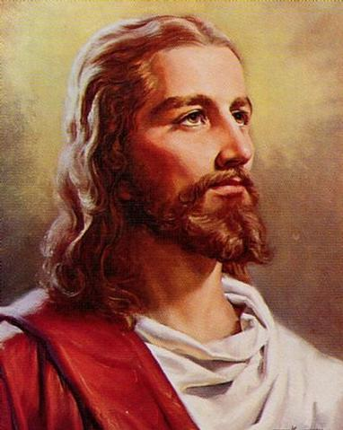
The Need of All Time
These Greeks had come from the west, seeking for Christ. At His birth, the wise men had come from the east, looking for the Messiah. From the east and the west, humanity would/will come, looking for the Messiah. From across the globe, seekers for truth would find in Christ the answer to all of life's problems. ‘We would see Jesus’ is the heartfelt cry of this planet today. Most, however, are looking for Jesus in all the wrong places!

Slide 5
‘We Would See Jesus’
“At this time Christ's work bore the appearance of cruel defeat. He had been victor in the controversy with the priests and Pharisees, but it was evident that He would never be received by them as the Messiah. The final separation had come. To His disciples the case seemed hopeless. But Christ was approaching the consummation of His work. The great event which concerned not only the Jewish nation, but the whole world, was about to take place. When Christ heard the eager request, "We would see Jesus," echoing the hungering cry of the world, His countenance lighted up, and He said, "The hour is come, that the Son of man should be glorified." In the request of the Greeks He saw an earnest of the results of His great sacrifice.
These men came from the West to find the Saviour at the close of His life, as the wise men had come from the East at the beginning. At the time of Christ's birth the Jewish people were so engrossed with their own ambitious plans that they knew not of His advent. The magi from a heathen land came to the manger with their gifts, to worship the Saviour. So these Greeks, representing the nations, tribes, and peoples of the world, came to see Jesus. So the people of all lands and all ages would be drawn by the Saviour's cross. So shall many "come from the east and west, and shall sit down with Abraham, and Isaac, and Jacob, in the kingdom of heaven." Matt. 8:11.” DA, pgs. 621,622

Slide 6
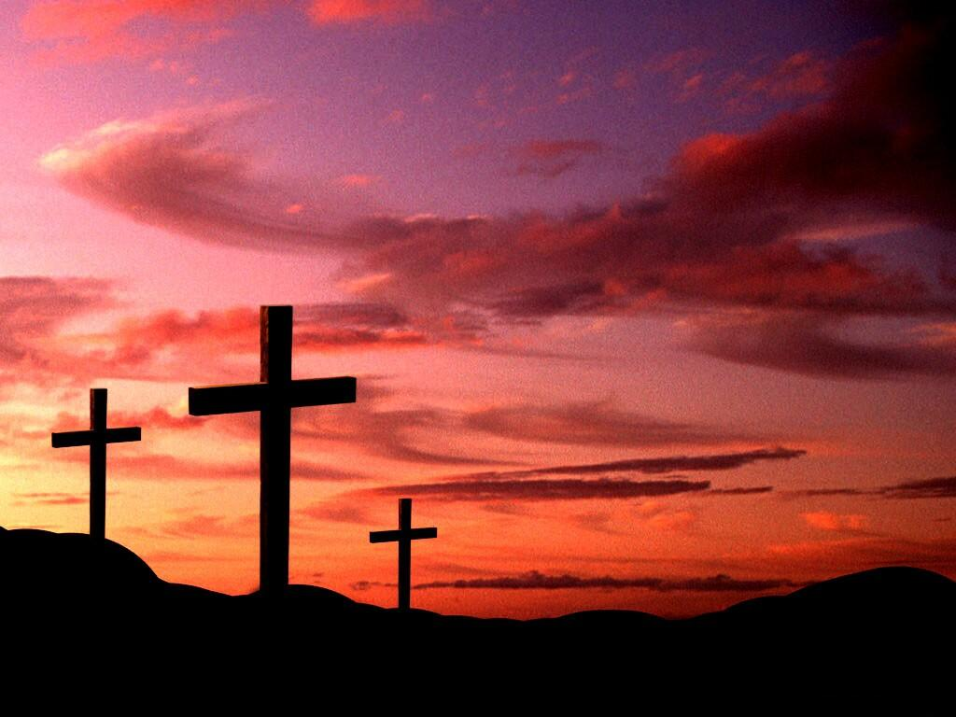
The Way of Triumph
Never far from Christ’s mind was the way whereby men and women could find peace with God. “Verily, verily, I say unto you, Except a corn of wheat fall into the ground and die, it abideth alone: but if it die, it bringeth forth much fruit.” John 12:24

Slide 7
Death Would Bring Life
“The hour of Christ's glorification had come. He was standing in the shadow of the cross, and the inquiry of the Greeks showed Him that the sacrifice He was about to make would bring many sons and daughters to God. He knew that the Greeks would soon see Him in a position they did not then dream of. They would see Him placed beside Barabbas, a robber and murderer, who would be chosen for release before the Son of God. They would hear the people, inspired by the priests and rulers, making their choice…. By making this propitiation for the sins of men, Christ knew that His kingdom would be perfected, and would extend throughout the world. He would work as the Restorer, and His Spirit would prevail. For a moment He looked into futurity, and heard the voices proclaiming in all parts of the earth, "Behold the Lamb of God, which taketh away the sin of the world." John 1:29. In these strangers He saw the pledge of a great harvest, when the partition wall between Jew and Gentile should be broken down, and all nations, tongues, and peoples should hear the message of salvation. The anticipation of this, the consummation of His hopes, is expressed in the words, "The hour is come, that the Son of man should be glorified." But the way in which this glorification must take place was never absent from Christ's mind. The gathering in of the Gentiles was to follow His approaching death. Only by His death could the world be saved. Like a grain of wheat, the Son of man must be cast into the ground and die, and be buried out of sight; but He was to live again.” DA, pgs. 622,623

Slide 8
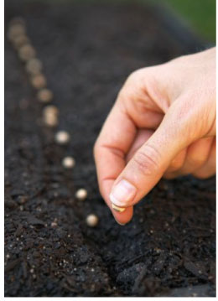
Hating the Carnal Nature/Desires
“He that loveth his life shall lose it; and he that hateth his life in this world shall keep it unto life eternal. If any man serve me, let him follow me; and where I am, there shall also my servant be: if any man serve me, him will my Father honour.” John 12:25,26

Slide 9
Preservation
“Christ presented His future, illustrating it by the things of nature, that the disciples might understand. The true result of His mission was to be reached by His death. "Verily, verily, I say unto you," He said, "Except a corn of wheat fall into the ground and die, it abideth alone: but if it die, it bringeth forth much fruit." When the grain of wheat falls into the ground and dies, it springs up, and bears fruit. So the death of Christ would result in fruit for the kingdom of God. In accordance with the law of the vegetable kingdom, life was to be the result of His death. Those who till the soil have the illustration ever before them. Year by year man preserves his supply of grain by apparently throwing away the choicest part. For a time it must be hidden under the furrow, to be watched over by the Lord. Then appears the blade, then the ear, and then the corn in the ear. But this development cannot take place unless the grain is buried out of sight, hidden, and to all appearance, lost. The seed buried in the ground produces fruit, and in turn this is planted. Thus the harvest is multiplied. So the death of Christ on the cross of Calvary will bear fruit unto eternal life. The contemplation of this sacrifice will be the glory of those who, as the fruit of it, will live through the eternal ages.” DA, pg. 623

Slide 10
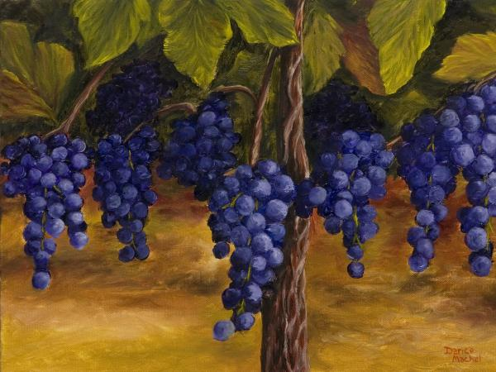
The Apostle Paul
“But if ye be led of the Spirit, ye are not under the law. Now the works of the flesh are manifest, which are [these]; Adultery, fornication, uncleanness, lasciviousness, Idolatry, witchcraft, hatred, variance, emulations, wrath, strife, seditions, heresies, Envyings, murders, drunkenness, revellings, and such like: of the which I tell you before, as I have also told [you] in time past, that they which do such things shall not inherit the kingdom of God. But the fruit of the Spirit is love, joy, peace, longsuffering, gentleness, goodness, faith, Meekness, temperance: against such there is no law. And they that are Christ's have crucified the flesh with the affections and lusts. If we live in the Spirit, let us also walk in the Spirit.” Gal. 5:18-24

Slide 11
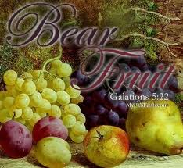
Fruit Results from Death
Christ’s many parables were designed to teach these great truths of which His life was an example. In order for the seed to produce fruit, it must be put into the ground and be buried out of sight. It must die. The result of death in nature, as well as in spiritual life, is life. Only as we die can the life of Christ fill us!

Slide 12
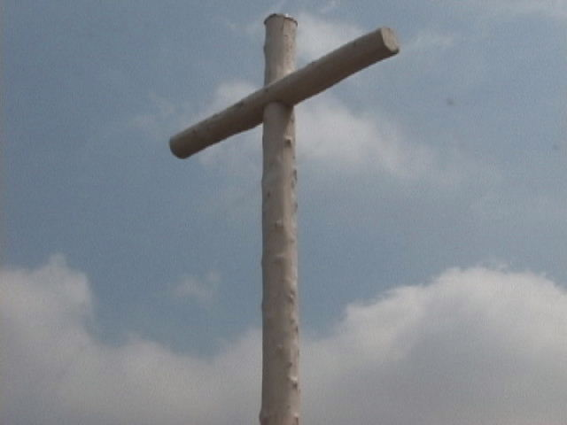
Shadow of the Cross
“Now is my soul troubled; and what shall I say? Father, save me from this hour: but for this cause came I unto this hour. Father, glorify thy name. Then came there a voice from heaven, saying, I have both glorified it, and will glorify it again.” Jn. 12:27,28

Slide 13
Christ Saw it All
“The work of redemption passed before Him, from the time when in heaven the plan was laid, to the death that was now so near at hand. A mysterious cloud seemed to enshroud the Son of God. Its gloom was felt by those near Him. He sat rapt in thought. At last the silence was broken by His mournful voice, "Now is My soul troubled; and what shall I say? Father, save Me from this hour?" In anticipation Christ was already drinking the cup of bitterness. His humanity shrank from the hour of abandonment, when to all appearance He would be deserted even by God, when all would see Him stricken, smitten of God, and afflicted. He shrank from public exposure, from being treated as the worst of criminals, from a shameful and dishonored death. A foreboding of His conflict with the powers of darkness, a sense of the awful burden of human transgression, and the Father's wrath because of sin caused the spirit of Jesus to faint, and the pallor of death to overspread His countenance.” DA, pg. 624

Slide 14
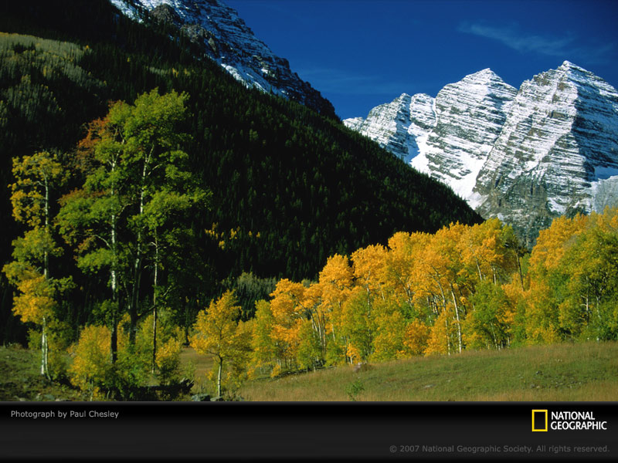
Submission to Anything
Even as Christ began to feel the sorrow of public exposure, of humiliation, He was ready to submit to His Father’s will.
“Father, glorify thy name. Then came there a voice from heaven, saying, I have both glorified it, and will glorify it again.” Jn. 12:28

Slide 15
Willing Submission
We submit to things because we are helpless to do otherwise. Christ submitted, full well knowing that He didn’t have to submit. He knew His Father so well and knew that His plan was best even though Christ knew that the plan included suffering for Him!
“Then came divine submission to His Father's will. "For this cause," He said, "came I unto this hour. Father, glorify Thy name." Only through the death of Christ could Satan's kingdom be overthrown. Only thus could man be redeemed, and God be glorified. Jesus consented to the agony, He accepted the sacrifice. The Majesty of heaven consented to suffer as the Sin Bearer. "Father, glorify Thy name," He said.” DA, pg. 624

Slide 16
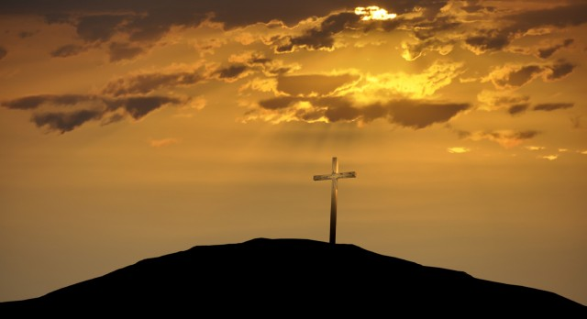
If I be Lifted up
“ Now is the judgment of this world: now shall the prince of this world be cast out. And I, if I be lifted up from the earth, will draw all men unto me.” JN. 12:31,32
Christ’s death would seal forever a judgment for all mankind and all would be judged based on their response to His gracious invitation. The Holy Spirit would take the death of Christ and draw all men to that cross.
“That was the true Light, which lighteth every man that cometh into the world.” John 1:9

Slide 17
All men
“This is the crisis of the world. If I become the propitiation for the sins of men, the world will be lighted up. Satan's hold upon the souls of men will be broken. The defaced image of God will be restored in humanity, and a family of believing saints will finally inherit the heavenly home. This is the result of Christ's death. The Saviour is lost in contemplation of the scene of triumph called up before Him. He sees the cross, the cruel, ignominious cross, with all its attending horrors, blazing with glory. But the work of human redemption is not all that is accomplished by the cross. The love of God is manifested to the universe. The prince of this world is cast out. The accusations which Satan has brought against God are refuted. The reproach which he has cast upon heaven is forever removed. Angels as well as men are drawn to the Redeemer. "I, if I be lifted up from the earth," He said, "will draw all unto Me.“ DA, pgs. 625,626

