Slide 1
The Man For All Apostasies

Slide 2
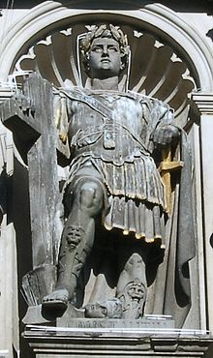
A Man For All Apostasies!
Constantine, the head of the Eastern Roman Empire began ruling in 306 until 337 AD. Probably, the most famous episode in his life was when he professed conversion to Christ, claiming to have seen a cross in the sky, and hearing a voice, which said, “In this, conquer.” Shortly after this, Constantine won some battles, became emperor, baptized all his men, and became a ‘Christian Emperor’.

Slide 3
Bad News!
“Little by little, at first in stealth and silence, and then more openly as it increased in strength and gained control of the minds of men, "the mystery of iniquity" carried forward its deceptive and blasphemous work. Almost imperceptibly the customs of heathenism found their way into the Christian church. The spirit of compromise and conformity was restrained for a time by the fierce persecutions which the church endured under paganism. But as persecution ceased, and Christianity entered the courts and palaces of kings, she laid aside the humble simplicity of Christ and His apostles for the pomp and pride of pagan priests and rulers; and in place of the requirements of God, she substituted human theories and traditions. The nominal conversion of Constantine, in the early part of the fourth century, caused great rejoicing; and the world, cloaked with a form of righteousness, walked into the church. Now the work of corruption rapidly progressed. Paganism, while appearing to be vanquished, became the conqueror. Her spirit controlled the church. Her doctrines, ceremonies, and superstitions were incorporated into the faith and worship of the professed followers of Christ. This compromise between paganism and Christianity resulted in the development of "the man of sin" foretold in prophecy as opposing and exalting himself above God. That gigantic system of false religion is a masterpiece of Satan's power--a monument of his efforts to seat himself upon the throne to rule the earth according to his will.” GC, pgs. 49,50

Slide 4

Constantine Did It All!
Constantine attacked the 4th commandment by setting up the 1st Sunday law in 321 AD. He hoped to unite the Roman Empire by this law. His efforts were futile and Rome collapsed over time.

Slide 5
Sunday
“On the venerable Day of the sun, let the magistrates and people residing in cities rest, and let all workshops be closed. In the country, however, persons engaged in agriculture may freely and lawfully continue their pursuits: because it often happens that another Day is not so suitable for grain sowing or for vine planting: lest by neglecting the proper moment for such operations the bounty of heaven should be lost”…Chamber’s Encyclopedia says this: ‘Unquestionably the first law, either ecclesiastical or civil, by which the Sabbatical observance of that Day is known to have been ordained, is the edict of Constantine, 321 A.D.’ Thus, Constantine gave to the world the first Sunday Law.

Slide 6
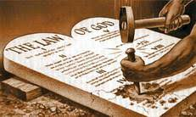
Playing With the Commandments
Constantine placed his grubby fingers on the law of God and thus paved the way for the church of Rome to further this assault. This resulted in the exaltation of Sunday and the denigration of the 7th day Sabbath! Speaking of the little horn of Daniel 7:25, we read, “And he shall speak great words against the most High, and shall wear out the saints of the most High, and think to change times and laws: and they shall be given into his hand until a time and times and the dividing of time.”

Slide 7
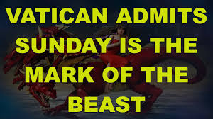
Of course the Catholic Church claims that the change [from Saturday to Sunday] was her act. And the act is a MARK of her ecclesiastical power and authority in religious matters. — C. F. Thomas, Chancellor of Cardinal Gibbons.
Sunday is our MARK of authority.... The church is above the Bible, and this transference of Sabbath observance is proof of that fact. — Catholic Record, September 1, 1923 (Ontario).

Slide 8
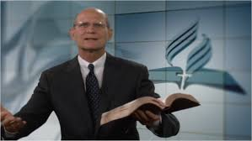
The Spirit of Constantine Still Lives!
Constantine compromised the 7th day Sabbath, bringing in terrible confusion and leading to the papacy’s exaltation of Sunday. Ted Wilson has done a similar thing. Speaking at an ASI meeting, August 9,2014, Wilson declared that the mark of the beast is any other day of the week other than the 7th day Sabbath! This is a compromising position, leaving one open to the mark of the beast being Monday, Wednesday, Friday, or… and the beast being Islam, Communism, or……………..

Slide 9
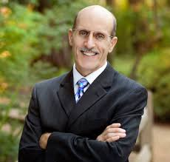
What???
“The book of Revelation is clear: One group of people at the end of time will have the mark of the beast; the other will have the seal of God. First and foremost, this seal is the Holy Spirit (Ephesians 4:30), but there will be something very visible demonstrated in the life of believers. What is it? From ancient times, a king’s seal always contained three main elements: his name, his title, and his territory. It’s no accident that within the law of God, you will find His seal. “The Lord made heaven, and earth, and the sea” (Exodus 20:11). There you have it!
His name, Yahweh; His title, Creator; His territory, the heavens and earth. The seal of God is found in the Sabbath commandment!” Amazing Facts Website

Slide 10
Bible Translations
Constantine created the 1st Sunday law, paving the way for its exaltation by the papacy. Constantine did not stop there. “CONSTANTINE became emperor of Rome in 312 A.D. A little later he embraced the Christian faith for himself and for his empire. As this so called first Christian emperor took the reins of the civil and spiritual world to bring about the amalgamation of paganism and Christianity, he found three types of manuscripts, or Bibles, vying for supremacy: the Textus Receptus or Constantinopolitan, the Palestinian or Eusebio-Origen, and the Egyptian of Hesychius. The adherents of each claimed superiority for their manuscript. Particularly was there earnest contention between the advocates of the Textus Receptus and those of the Eusebio-Origen text. The defenders of the Textus Receptus were of the humbler class who earnestly sought to follow the early church. The Eusebio-Origen text was the product of the Intermingling of the pure word of God and Greek philosophy in the mind of Origen….

Slide 11
Kept the Stream of Filth Flowing!
It might be called the adaptation of the Word of God to Gnosticism. As the Emperor Constantine embraced Christianity, it became necessary for him to choose which of these Bibles he would sanction. Quite naturally he preferred the one edited by Eusebius and written by Origen, the outstanding intellectual figure that had combined Christianity with Gnosticism in his philosophy, even as Constantine himself was the political genius that was seeking to unite Christianity with pagan Rome. Constantine regarded himself as the director and guardian of this anomalous world church, and as such he was responsible for selecting the Bible for the great Christian centers. His predilection was for the type of Bible whose readings would give him a basis for his imperialistic ideas of the great state church, with ritualistic ostentation and unlimited central power. The philosophy of Origen was well suited to serve Constantine’s religio-political theocracy.” Wilkinson, Our Authorized Bible Vindicated, pgs. 13, 14

Slide 12
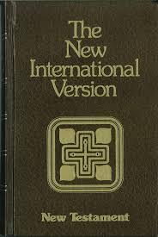
Still Here Today
Constantine absorbed the corrupted translations of Scriptures handed down from Justin Martyr, Clement of Alexandria, and Origen. Constantine then commissioned Eusebius to produce one along the line of Origen. It was this polluted translation that Constantine pushed and promoted. It was from these corrupted translations that Westcott and Hort gave to the world the Revised Version and all other modern translations have come from this polluted well, including the New International Version!

Slide 13
Well?
“We hear a great deal to-day about the Sunday Law of the Roman Emperor Constantine, 321 A.D. Why is it that we do not hear about the corrupt Bible which Constantine adopted and promulgated, the version which for 1800 years has been exploited by the forces of heresy and apostasy? This Bible, we regret to say, lies at the bottom of many versions which now flood the publishing houses, the schools, the churches, yes, many homes, and are bringing confusion and doubt to untold millions.” Wilkinson, Authorized Bible Vindicated

Slide 14

This One As Well
Hebrews 2:16 “For indeed He does not give aid to angels, but He does give aid to the seed of Abraham.” NKJV
Hebrews 2:16 “For verily he took not on him the nature of angels; but he took on him the seed of Abraham.” KJV
Another one of those "obsolete words" is "repent". They take it out 44 times! And how does the NKJV make it "much clearer"? In Matthew 21:32 they use "relent". Matthew 27:3 it's "remorseful" Or Romans 11:29 they change "repentance" to "irrevocable".

Slide 15
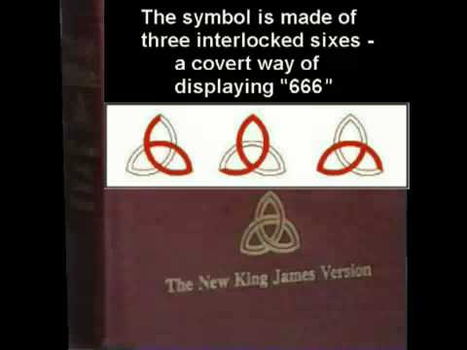

Slide 16
The Ecumenical Kingpin
Constantine, who claimed conversion to Christianity, called for a meeting of bishops to be held in Nicea to resolve some escalating controversies among the church leadership. The issues being debated included the nature of Jesus Christ, the proper date to celebrate Easter, and other matters. The failing Roman Empire, now under Constantine’s rule, could not withstand the division caused by years of hard-fought, “out of hand” arguing over doctrinal differences. The emperor saw the quarrels within the church not only as a threat to Christianity but as a threat to society as well. Therefore, at the Council of Nicea, Constantine encouraged the church leaders to settle their internal disagreements and become Christ like agents who could bring new life to a troubled empire. Constantine felt “called” to use his authority to help bring about unity, peace, and love within the church.

Slide 17
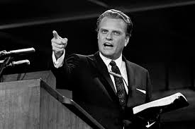
Billy ‘Scam’ Graham
“As far back as 1955 Dr. James E. Bennet and Rev. Jack Wyrtzen met with Billy Graham. Graham told them "that if some minister, who was a modernist, sent 50 of his people to Graham's meetings, and they were saved, he (Billy) would not tell them not to return to that modernistic church, because it would be unfair to the pastor!” Bundy, Billy Graham, op. cit., p.9. See also: David W. Cloud, Flirting with Rome: Evangelical Entanglement with Roman Catholicism.

Slide 18
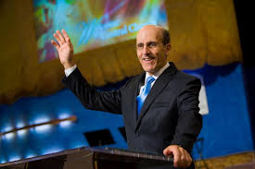
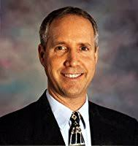
Billy Graham- In Heaven someday? Led by the H.S.

Slide 19
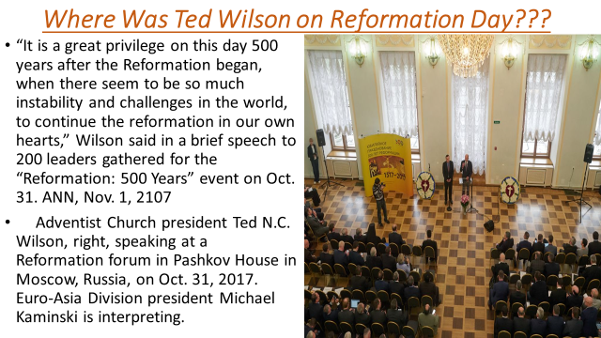

Slide 20
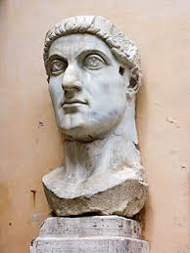
Constantine bequeathed to the world the exaltation of Sunday, thereby confusing the issue over the correct day to worship.
He then continued the stream of corrupted Bibles that ultimately have led to all modern translations, including the NIV and the NKJV.
Finally, he was the ecumenical man of the 4th century.
3 warning signs today that tell us the spirit of Constantine still lives. Be watchful, friend, of these destructive dominoes that will bring nothing but disaster for God’s professed people!

