Slide 1
Hebrews 6 “Within the Veil”
Katapetesma:

Slide 2
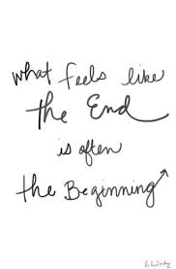
Something Never Done Before!
Well, in the case of the sermon this morning, the passage we are going to begin with today is truly at the end of Hebrews 6. I normally take a chapter and go thru it verse by verse, but today we are not starting at the beginning, but rather at the end! Let me explain………………………………..

Slide 3
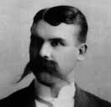
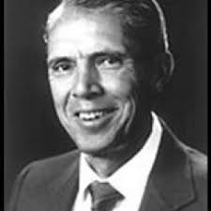
Two Famous Men! Do You Recognize them?

Slide 4
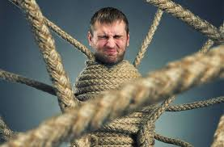
Entangled in Hebrews 6:19,20
“Which hope we have as an anchor of the soul, both sure and stedfast, and which entereth into that within the veil; Whither the forerunner is for us entered, even Jesus, made an high priest for ever after the order of Melchisedec.” Hebrews 6:19, 20 Both men took this passage and said that ‘Within the veil’ meant that Christ went into the Most Holy Place in 31 AD thereby negating 1844, Ellen White, and the rise of SDAdventism! Both men ceased to be SDAdventists over this passage among others!

Slide 5
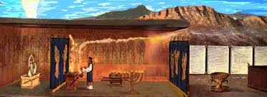
Katapetesma
Katapetesma: a curtain (the inner veil of the temple). (Literally: that which is spread out downwards, that which hangs down), a curtain, veil, of that which separated the Holy of Holies from the outer parts of the temple at Jerusalem. (adapted from www.biblehub.com)

Slide 6
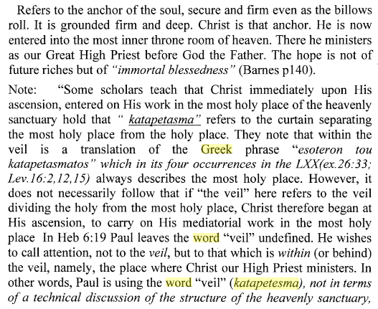

Slide 7
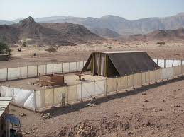
A closer look at the Old Testament translation of the Bible in the Greek Septuagint reveals that katapetesma actually refers to all the veils. It is used to refer to the veil from the outside into the courtyard, the veil separating the courtyard from the holy place, and the veil separating the holy place from the most holy place. It does not exclusively apply solely to the veil going into the Holy of Holies.

Slide 8
Katapetesma in Septuagint
“And thou shalt make for the hanging five pillars of shittim wood, and overlay them with gold, and their hooks shall be of gold: and thou shalt cast five sockets of brass for them.” Ex.26:37
“και ποιησεισ τω καταπετασµατι πεντε στυλουσ και χρυσωσεισ
αυτουσ χρυσιω και αι κεφαλιδεσ αυτων χρυσαι και χωνευσεισ αυτοισ πεντε βασεισ χαλκασ.”
The word in the Septuagint for hanging is katapetesma.
And thou shalt set the altar of gold for the incense before the ark of the testimony, and put the hanging of the door to the tabernacle.” Ex. 40:5
“5και θησεισ το θυσιαστηριον το χρυσουν εισ το θυµιαν εναντιον τησ κιβωτου
και επιθησεισ καλυµµα καταπετασµατοσ επι την θυραν…”

Slide 9
Paul’s word can be used for all vails
“ουτοσ περιηργυρωσεν τουσ στυλουσ και εχωνευσεν τω στυλω δακτυλιουσ χρυσουσ και εχρυσωσεν τουσ µοχλουσ χρυσιω και κατεχρυσωσεν τουσ στυλουσ του καταπετασµατοσ χρυσιω και εποιησεν τασ αγκυλασ χρυσασ.” Ex. 38:18
“And the hanging for the gate of the court was needlework, of blue, and purple, and scarlet, and fine twined linen: and twenty cubits was the length, and the height in the breadth was five cubits, answerable to the hangings of the court.”

Slide 10
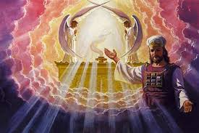
Within the Veil
“Which hope we have as an anchor of the soul, both sure and stedfast, and which entereth into that within the veil; Whither the forerunner is for us entered, even Jesus, made an high priest for ever after the order of Melchisedec.”

Slide 11
Paul’s Argument
Paul’s argument in Hebrews 6:19, 20 has absolutely nothing to do with where Christ went upon His ascension whether He went into the Holy or Most Holy Place. In the mind of Paul and all of his readers, the Old Testament sanctuary services made it clear that the priests carried on work in the holy and most holy places. Christ would clearly have to carry on the same two services in the heavenly. He had to carry on work in the Holy Place (Rev. 1:13-15) at His ascension ,and carry on work in the Most Holy Place since 1844. (Daniel 8:14, Leviticus 16)
Paul is simply encouraging HIS READERS TO LOOK TO Christ as our great high priest in the courts above.

Slide 12
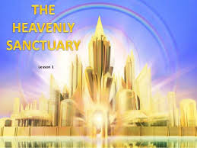
Expansion of the Same Theme!
Paul began his argument in chapter 2; then in chapter 4, and now he is building on it again in chapter 6. That ARGUMENT is simply this: “Seeing then that we have a great high priest, that is passed into the heavens, Jesus the Son of God, let us hold fast our profession. For we have not an high priest which cannot be touched with the feeling of our infirmities; but was in all points tempted like as we are, yet without sin. Let us therefore come boldly unto the throne of grace, that we may obtain mercy, and find grace to help in time of need.” Hebrews 4:14-16

Slide 13
“Therefore leaving the principles of the doctrine of Christ, let us go on unto perfection; not laying again the foundation of repentance from dead works, and of faith toward God, Of the doctrine of baptisms, and of laying on of hands, and of resurrection of the dead, and of eternal judgment. And this will we do, if God permit. For it is impossible for those who were once enlightened, and have tasted of the heavenly gift, and were made partakers of the Holy Ghost, And have tasted the good word of God, and the powers of the world to come, If they shall fall away, to renew them again unto repentance; seeing they crucify to themselves the Son of God afresh, and put him to an open shame.” Hebrews 6:1-6

Slide 14
Do Not Get Complacent
Do not ever think that we have arrived in the Christian life. Even though Christ was the Son of the Most High, ‘Though he were a Son, yet learned he obedience by the things which he suffered; And being made perfect, he became the author of eternal salvation unto all them that obey him;” Heb. 5:8,9
We must daily be dying to self “I protest by your rejoicing which I have in Christ Jesus our Lord, I die daily.” 1 Cor. 15:31
“And he said to them all, If any man will come after me, let him deny himself, and take up his cross daily, and follow me. For whosoever will save his life shall lose it: but whosoever will lose his life for my sake, the same shall save it.” LK. 9:23,24

Slide 15
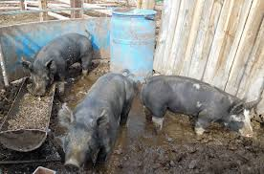
No Once Saved Always Saved Here
“For if after they have escaped the pollutions of the world through the knowledge of the Lord and Saviour Jesus Christ, they are again entangled therein, and overcome, the latter end is worse with them than the beginning.
For it had been better for them not to have known the way of righteousness, than, after they have known it, to turn from the holy commandment delivered unto them. But it is happened unto them according to the true proverb, The dog is turned to his own vomit again; and the sow that was washed to her wallowing in the mire.” 2 Peter 2:20-22

Slide 16
“For the earth which drinketh in the rain that cometh oft upon it, and bringeth forth herbs meet for them by whom it is dressed, receiveth blessing from God: But that which beareth thorns and briers is rejected, and is nigh unto cursing; whose end is to be burned. But, beloved, we are persuaded better things of you, and things that accompany salvation, though we thus speak.” Heb. 6:7-9

Slide 17
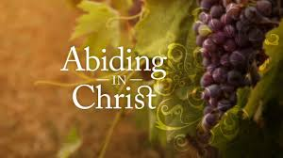
The fruits of abiding in Christ will be manifest for all. Those that refuse to cling to Him in faith will bear the fruits of their decisions. “Abide in me, and I in you. As the branch cannot bear fruit of itself, except it abide in the vine; no more can ye, except ye abide in me. I am the vine, ye are the branches: He that abideth in me, and I in him, the same bringeth forth much fruit: for without me ye can do nothing.” Jn. 15:4,5

Slide 18
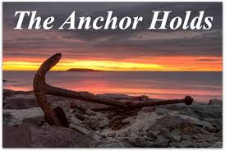
Will your anchor hold in the storms of life,
When the clouds unfold their wings of strife?
When the strong tides lift, and the cables strain,
Will your anchor drift or firm remain?
We have an anchor that keeps the soul
Steadfast and sure while the billows roll,
Fastened to the Rock which cannot move,
Grounded firm and deep in the Savior’s love.

