Slide 1
Feast Days, pt. 2
Passover and Unleavened Bread

Slide 2
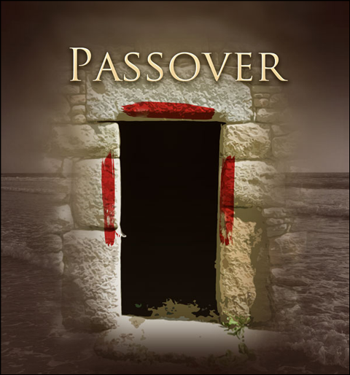
Considered Together
“Now the feast of unleavened bread drew nigh, which is called the Passover.” Luke 22:1
“Now the first day of the feast of unleavened bread the disciples came to Jesus, saying unto him, Where wilt thou that we prepare for thee to eat the passover?” Matthew 26:17

Slide 3
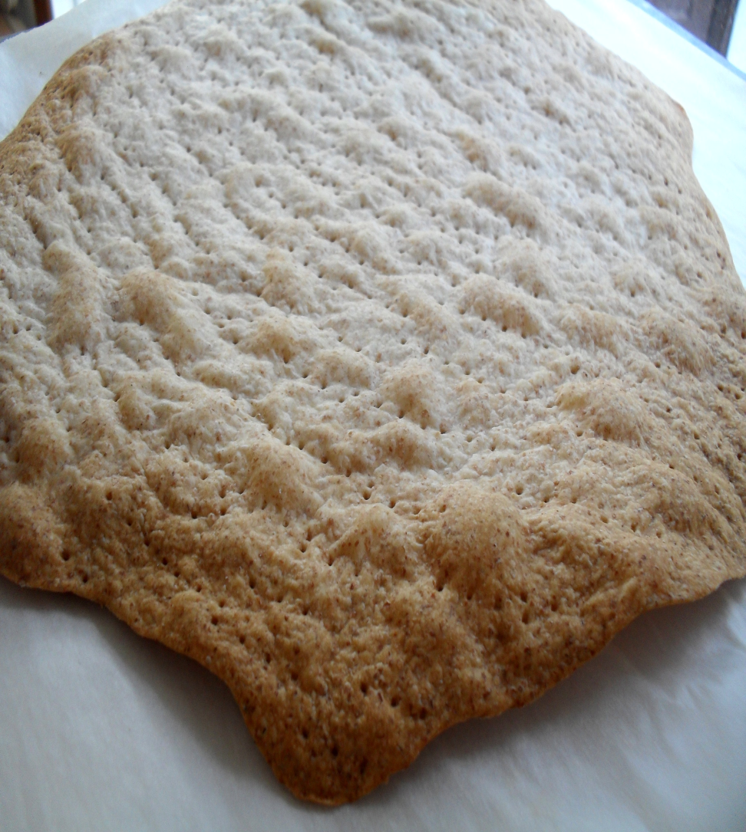
Close Proximity
The Passover was honored/set aside in the first month of the Jewish religious year. This month was known as Abib, corresponding to our March/April. Passover happened on the 14th day of the first month. The Feast of Unleavened Bread began the next day on the 15th day and continued on until the 22nd of the same month. From its beginnings, at the Exodus, Passover and Unleavened Bread remained the same through the centuries.

Slide 4
The First Passover
“And the LORD spake unto Moses and Aaron in the land of Egypt, saying, This month shall be unto you the beginning of months: it shall be the first month of the year to you. Speak ye unto all the congregation of Israel, saying, In the tenth day this month they shall take to them every man a lamb, according to the house of [their] fathers, a lamb for an house: And if the household be too little for the lamb, let him and his neighbour next unto his house take [it] according to the number of the souls; every man according to his eating shall make your count for the lamb. Your lamb shall be without blemish, a male of the first year: ye shall take [it] out from the sheep, or from the goats: And ye shall keep it up until the fourteenth day of the same month: and the whole assembly of the congregation of Israel shall kill it in the evening. And they shall take of the blood, and strike [it] on the two side posts and on the upper door post of the houses, wherein they shall eat it. And they shall eat the flesh in that night, roast with fire, and unleavened bread; [and] with bitter [herbs] they shall eat it. Eat not of it raw, nor sodden at all with water, but roast [with] fire; his head with his legs, and with the purtenance thereof. And ye shall let nothing of it remain until the morning; and that which remaineth of it until the morning ye shall burn with fire. And thus shall ye eat it; [with] your loins girded, your shoes on your feet, and your staff in your hand; and ye shall eat it in haste: it [is] the LORD'S passover. For I will pass through the land of Egypt this night, and will smite all the firstborn in the land of Egypt, both man and beast; and against all the gods of Egypt I will execute judgment: I [am] the LORD. And the blood shall be to you for a token upon the houses where ye [are]: and when I see the blood, I will pass over you, and the plague shall not be upon you to destroy [you], when I smite the land of Egypt.” Exodus 12:1-13

Slide 5
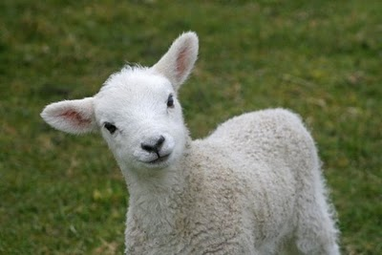
Set Apart on the 10th
On the 10th day of Abib, the lamb was set aside and remained in a public setting for all to see until it was sacrificed on the 14th day. The purpose of this was for all to contemplate the shedding of blood by a spotless lamb for the deliverance of Israel. The sacrifice was put on display for this distinct purpose.

Slide 6
The Chronology of Christ
John 12:1,12,13, and 19 tell us “Then Jesus six days before the passover came to Bethany,…On the next day much people that were come to the feast, when they heard that Jesus was coming to Jerusalem, Took branches of palm trees, and went forth to meet him, and cried, Hosanna: Blessed is the King of Israel that cometh in the name of the Lord…The Pharisees therefore said among themselves, Perceive ye how ye prevail nothing? behold, the world is gone after him.”
That night, the Sanhedrin determined upon the death of Christ and, for the next four days, the Son of God would be set apart, on public display, for all to see. Four days later, the Son of God would be slain as the Passover Lamb!
Sabbath-eats at the home of Lazarus/Mary anoints His feet.
Sunday-triumphal entry into Jerusalem.
Monday-condemned to die by Sanhedrin.
Tuesday-Thursday-controversy/ on display
Friday- Passover Lamb dies for our sins.
Sabbath- Beginning of Feast of Unleavened Bread. Ceremonial Sabbath falls on 7th day Sabbath. John calls it an high day. (John 19:31)

Slide 7
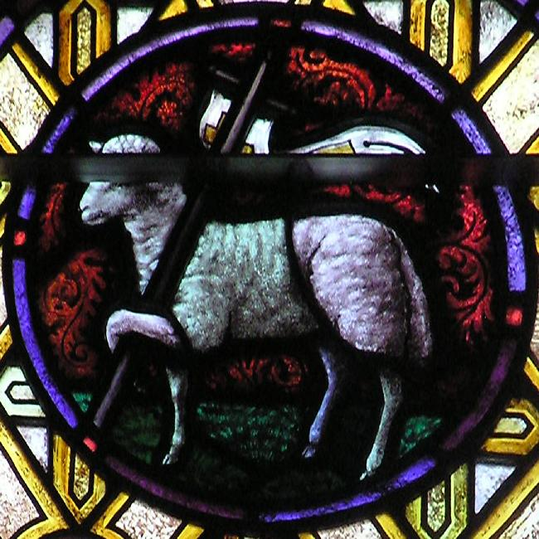
Without Blemish
“The next day John seeth Jesus coming unto him, and saith, Behold the Lamb of God, which taketh away the sin of the world.” John 1:29
“Forasmuch as ye know that ye were not redeemed with corruptible things, as silver and gold, from your vain conversation received by tradition from your fathers; But with the precious blood of Christ, as of a lamb without blemish and without spot:” 1 Peter 1:18,19

Slide 8
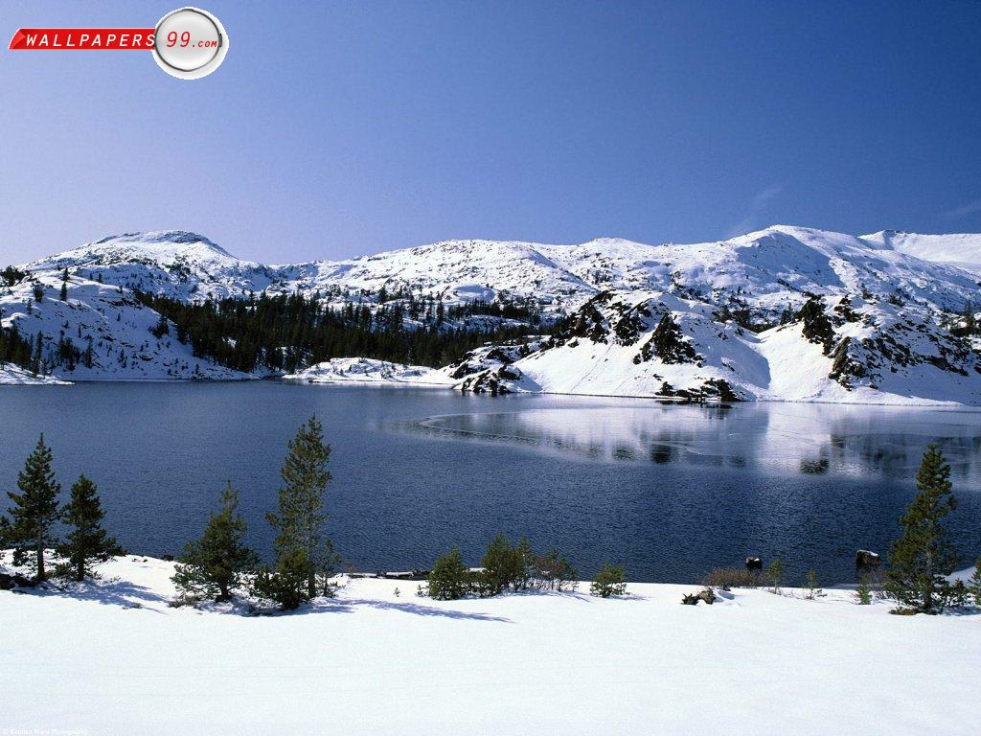
Eat the Flesh of the Lamb
“Then Jesus said unto them, Verily, verily, I say unto you, Except ye eat the flesh of the Son of man, and drink his blood, ye have no life in you. Whoso eateth my flesh, and drinketh my blood, hath eternal life; and I will raise him up at the last day. For my flesh is meat indeed, and my blood is drink indeed. He that eateth my flesh, and drinketh my blood, dwelleth in me, and I in him….”It is the spirit that quickeneth; the flesh profiteth nothing: the words that I speak unto you, [they] are spirit, and [they] are life.” Jn. 6:53-56, 63

Slide 9
Feast of Unleavened Bread
“In the fourteenth [day] of the first month at even [is] the LORD'S passover. And on the fifteenth day of the same month [is] the feast of unleavened bread unto the LORD: seven days ye must eat unleavened bread. In the first day ye shall have an holy convocation: ye shall do no servile work therein. But ye shall offer an offering made by fire unto the LORD seven days: in the seventh day [is] an holy convocation: ye shall do no servile work [therein]. And the LORD spake unto Moses, saying, Speak unto the children of Israel, and say unto them, When ye be come into the land which I give unto you, and shall reap the harvest thereof, then ye shall bring a sheaf of the firstfruits of your harvest unto the priest: And he shall wave the sheaf before the LORD, to be accepted for you: on the morrow after the sabbath the priest shall wave it. And ye shall offer that day when ye wave the sheaf an he lamb without blemish of the first year for a burnt offering unto the LORD. And the meat offering thereof [shall be] two tenth deals of fine flour mingled with oil, an offering made by fire unto the LORD [for] a sweet savour: and the drink offering thereof [shall be] of wine, the fourth [part] of an hin. And ye shall eat neither bread, nor parched corn, nor green ears, until the selfsame day that ye have brought an offering unto your God: [it shall be] a statute for ever throughout your generations in all your dwellings. And ye shall count unto you from the morrow after the sabbath, from the day that ye brought the sheaf of the wave offering; seven sabbaths shall be complete:” Leviticus 23:5-15

Slide 10
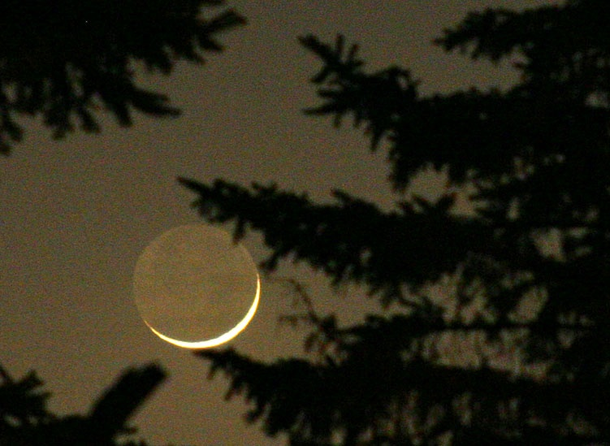
The Order
The Passover fell on the 14th day of the month. The feast of unleavened bread fell on the 15th day of the month and lasted for 7 days. The first day of the feast was considered a ceremonial sabbath feast day and the 7th day of the feast was considered one too. There were two ceremonial sabbaths connected with this feast. The feast of Passover/ Unleavened bread was based on the moon. The omission of leaven in the bread was very important. In fact, so much so, that if anyone ate bread with leaven, the person was booted out of the camp. “Seven days shall there be no leaven found in your houses: for whosoever eateth that which is leavened, even that soul shall be cut off from the congregation of Israel, whether he be a stranger, or born in the land.” Ex. 12:19

Slide 11

Why Unleavened Bread?
leaven n.1. An agent, such as yeast, that causes batter or dough to rise, especially by fermentation.
2. An element, influence, or agent that works subtly to lighten, enliven, or modify a whole.
v. leavened, leavening, leav·ens1. To add a rising agent to.
2. To cause to rise, especially by fermentation.
3. To pervade with a lightening, enlivening, or modifying influence.
Leaven works in bread to change the entire texture, size, and taste. It altars the whole thing.
In Bible imagery, leaven is used as a moral principle, when allowed to penetrate the human will, works quietly within, silently effecting the entire nature of the person. Depending on the context, leaven can be used as a good principle or as an evil one.
“Another parable spake he unto them; The kingdom of heaven is like unto leaven, which a woman took, and hid in three measures of meal, till the whole was leavened.”
“Therefore let us keep the feast, not with old leaven, neither with the leaven of malice and wickedness; but with the unleavened [bread] of sincerity and truth.” 1 Cor. 5:8
Another parable spake he unto them; The kingdom of heaven is like unto leaven, which a woman took, and hid in three measures of meal, till the whole was leavened.

Slide 12
Leaven of the Spirit!
“Among the Jews leaven was sometimes used as an emblem of sin. At the time of the Passover the people were directed to remove all the leaven from their houses as they were to put away sin from their hearts. Christ warned His disciples, "Beware ye of the leaven of the Pharisees, which is hypocrisy." Luke 12:1. And the apostle Paul speaks of the "leaven of malice and wickedness." 1 Cor. 5:8. But in the Saviour's parable, leaven is used to represent the kingdom of heaven. It illustrates the quickening, assimilating power of the grace of God. None are so vile, none have fallen so low, as to be beyond the working of this power. In all who will submit themselves to the Holy Spirit a new principle of life is to be implanted; the lost image of God is to be restored in humanity.
But man cannot transform himself by the exercise of his will. He possesses no power by which this change can be effected. The leaven--something wholly from without--must be put into the meal before the desired change can be wrought in it. So the grace of God must be received by the sinner before he can be fitted for the kingdom of glory. All the culture and education which the world can give will fail of making a degraded child of sin a child of heaven. The renewing energy must come from God. The change can be made only by the Holy Spirit. All who would be saved, high or low, rich or poor, must submit to the working of this power.” COL, pgs. 95-97

Slide 13
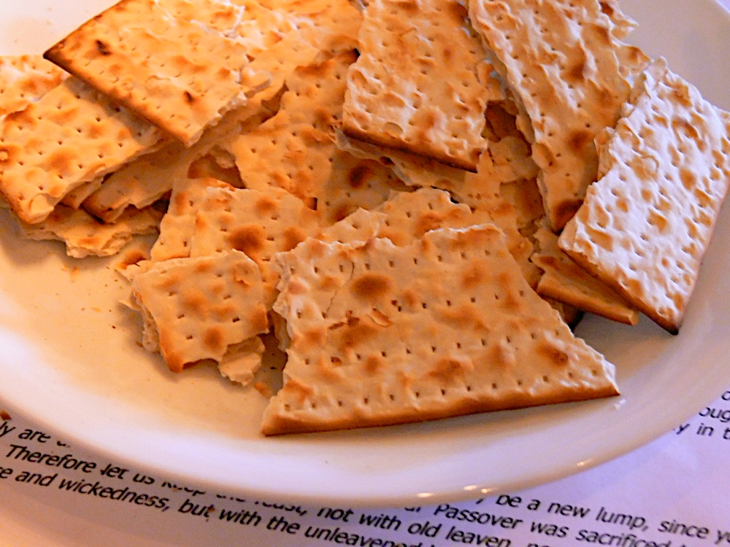
Warning
“Then Jesus said unto them, Take heed and beware of the leaven of the Pharisees and of the Sadducees…Then understood they how that he bade them not beware of the leaven of bread, but of the doctrine of the Pharisees and of the Sadducees.” Matthew 16:6,12
Christ explained what this was.
“Beware ye of the leaven of the Pharisees, which is hypocrisy.” Luke 12:1

Slide 14
Exaltation of Self
“The hypocrisy of the Pharisees was the product of self-seeking. The glorification of themselves was the object of their lives. It was this that led them to pervert and misapply the Scriptures, and blinded them to the purpose of Christ's mission. This subtle evil even the disciples of Christ were in danger of cherishing. Those who classed themselves with the followers of Jesus, but who had not left all in order to become His disciples, were influenced in a great degree by the reasoning of the Pharisees. They were often vacillating between faith and unbelief, and they did not discern the treasures of wisdom hidden in Christ. Even the disciples, though outwardly they had left all for Jesus' sake, had not in heart ceased to seek great things for themselves. It was this spirit that prompted the strife as to who should be greatest. It was this that came between them and Christ, making them so little in sympathy with His mission of self-sacrifice, so slow to comprehend the mystery of redemption. As leaven, if left to complete its work, will cause corruption and decay, so does the self-seeking spirit, cherished, work the defilement and ruin of the soul.
Among the followers of our Lord today, as of old, how widespread is this subtle, deceptive sin! How often our service to Christ, our communion with one another, is marred by the secret desire to exalt self! How ready the thought of self- gratulation, and the longing for human approval! It is the love of self, the desire for an easier way than God has appointed that leads to the substitution of human theories and traditions for the divine precepts. To His own disciples the warning words of Christ are spoken, "Take heed and beware of the leaven of the Pharisees.“ DA, pg. 409

Slide 15
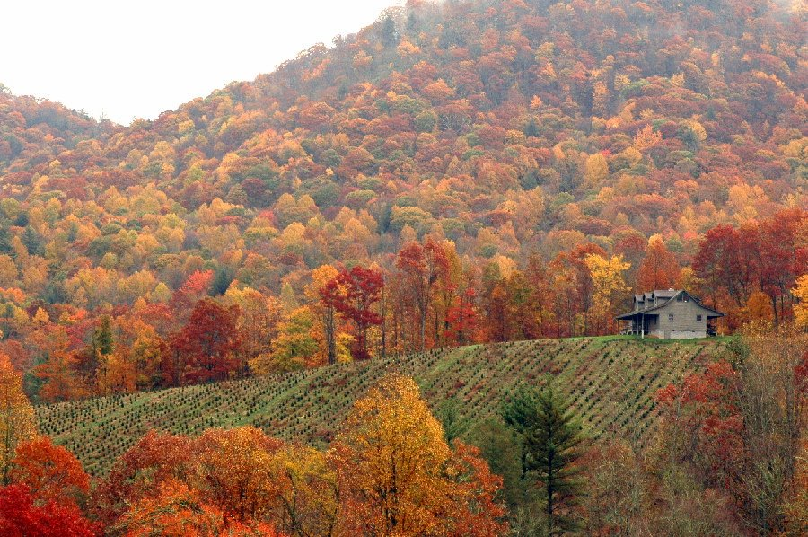
The Leaven of Herod
“And he charged them, saying, Take heed, beware of the leaven of the Pharisees, and of the leaven of Herod.” MK. 8:15
The Herods were known for their brutality. The killing of the babes in Bethlehem, the death of John, and the mockery of Christ revealed all to clearly the vicious cruelty of this clan. Christ warned against this, lest anger permeate our being and destroy us!

Slide 16

Chronology
14th day-Passover
15th day- Unleavened Bread
16th day- waving of sheaf of grain. “ Speak unto the children of Israel, and say unto them, When ye be come into the land which I give unto you, and shall reap the harvest thereof, then ye shall bring a sheaf of the first fruits of your harvest unto the priest: And he shall wave the sheaf before the LORD, to be accepted for you: on the morrow after the sabbath the priest shall wave it.” Leviticus 23:10,11

Slide 17
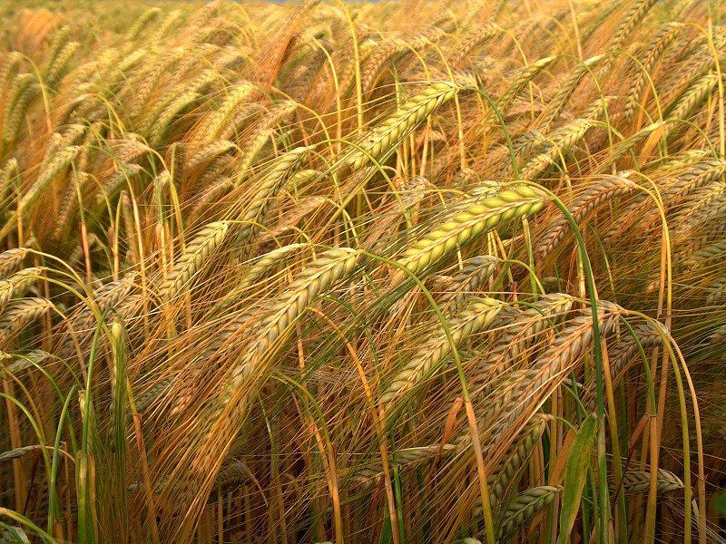
Harvest the Barley
The purpose for waving the sheaf of barley grain on the 16th was to dedicate the grain harvest to the Lord. This ceremony took place before the harvest began. This was considered the first fruits of the grain harvest.
“Speak unto the children of Israel, and say unto them, When ye be come into the land which I give unto you, and shall reap the harvest thereof, then ye shall bring a sheaf of the first fruits of your harvest unto the priest: And he shall wave the sheaf before the LORD, to be accepted for you: on the morrow after the sabbath the priest shall wave it.” Leviticus 23:10,11

Slide 18
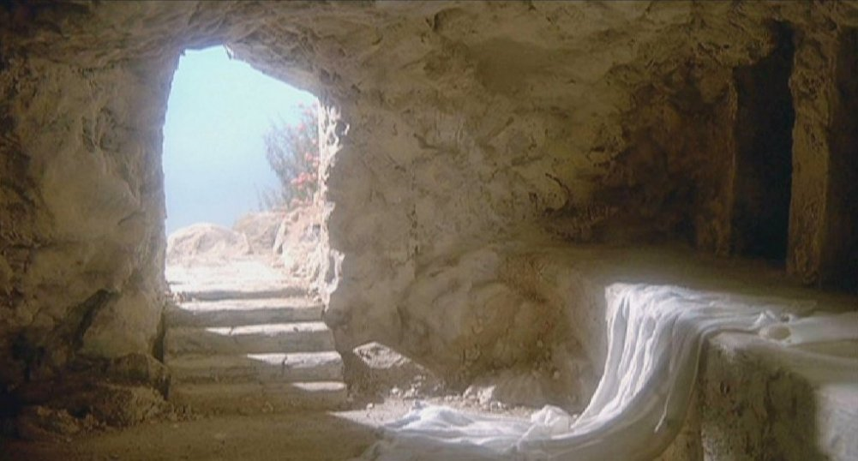
Significance of Service
On the third day of this feast- Passover/Unleavened Bread, the waving of the first fruits of barley grain occurred; then, the harvest of the grain would begin.
Spiritually speaking, on the third day after ‘Christ our Passover was sacrificed for us’, Christ rose from the dead. “But now is Christ risen from the dead, and become the first fruits of them that slept…But every man in his own order: Christ the first fruits; afterward they that are Christ's at his coming.” 1 Corinthians 15:20,23

Slide 19
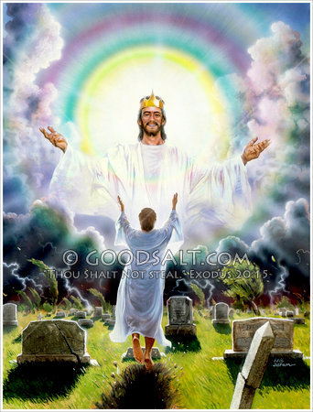
Christ the First Fruits
For 15 centuries, the Jews kept this service. At the death and resurrection of Christ, this shadow met its body and the ceremony took on new significance. Christ’s resurrection was the pre-eminent one, making possible all others, assuring that there would be others! Christ repeatedly drew us to this event by declaring repeatedly His resurrection on the 3rd day. (Matthew 16:21,20:19)

