Slide 1
Ezekiel, pt. 8/ Chap. 14 and 15
Though Daniel, Noah, or Job

Slide 2
Review
1. Encouraging Vision of God
2. The Call
3. The Warning
4. The Remnant
5. The Mark
6. The Departing
7. The Leaky Fence
8. Today ‘The Accountable’

Slide 3
It is on Us!
An Individual Choice to Be Made—Watch and pray, and obtain a personal experience in the things of God. Your parents may teach you, they may try to guide your feet into safe paths; but it is impossible for them to change your heart. You must give your heart to Jesus and walk in the precious light of truth that He has given you. Faithfully take up your duties in the home life, and, through the grace of God, you may grow up unto the full stature of what Christ would have a child grow to be in Him. The fact that your parents keep the Sabbath, and obey the truth, will not insure your salvation. For though Noah and Job and Daniel were in the land, “As I live, saith the Lord God, they shall deliver neither son nor daughter; they shall but deliver their own souls by their righteousness.” Adventist Home, pg. 298

Slide 4

Will God Hear?
“ Then came certain of the elders of Israel unto me, and sat before me. And the word of the LORD came unto me, saying, Son of man, these men have set up their idols in their heart, and put the stumbling block of their iniquity before their face: should I be enquired of at all by them? Therefore speak unto them, and say unto them, Thus saith the Lord GOD; Every man of the house of Israel that setteth up his idols in his heart, and putteth the stumbling block of his iniquity before his face, and cometh to the prophet; I the LORD will answer him that cometh according to the multitude of his idols;” Ezek. 14:1-4

Slide 5
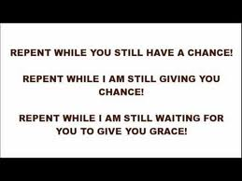
A Solution
“ That I may take the house of Israel in their own heart, because they are all estranged from me through their idols. Therefore say unto the house of Israel, Thus saith the Lord GOD; Repent, and turn yourselves from your idols; and turn away your faces from all your abominations.” Ezekiel 14:5,6

Slide 6
Turning Away
“There are many who fail to understand the true nature of repentance. Multitudes sorrow that they have sinned and even make an outward reformation because they fear that their wrongdoing will bring suffering upon themselves. But this is not repentance in the Bible sense. They lament the suffering rather than the sin. Such was the grief of Esau when he saw that the birthright was lost to him forever. Balaam, terrified by the angel standing in his pathway with drawn sword, acknowledged his guilt lest he should lose his life; but there was no genuine repentance for sin, no conversion of purpose, no abhorrence of evil. Judas Iscariot, after betraying his Lord, exclaimed, "I have sinned in that I have betrayed the innocent blood." Matthew 27:4.” Steps to Christ, pg. 23,24

Slide 7
Personal Accountability
“This is the class that in time of peril are found crying, Peace and safety. They lull their hearts into security, and dream not of danger. When startled from their lethargy, they discern their destitution, and entreat others to supply their lack; but in spiritual things no man can make up another’s deficiency. The grace of God has been freely offered to every soul. The message of the gospel has been heralded, “Let him that is athirst come. And whosoever will, let him take the water of life freely.” Revelation 22:17. But character is not transferable. No man can believe for another. No man can receive the Spirit for another. No man can impart to another the character which is the fruit of the Spirit’s working. “Though Noah, Daniel, and Job were in it [the land], as I live, saith the Lord God, they shall deliver neither son nor daughter; they shall but deliver their own souls by their righteousness.” Ezekiel 14:20. COL 411

Slide 8

Deception
“For every one of the house of Israel, or of the stranger that sojourneth in Israel, which separateth himself from me, and setteth up his idols in his heart, and putteth the stumbling block of his iniquity before his face, and cometh to a prophet to enquire of him concerning me; I the LORD will answer him by myself: And I will set my face against that man, and will make him a sign and a proverb, and I will cut him off from the midst of my people;… And if the prophet be deceived when he hath spoken a thing, I the LORD have deceived that prophet, and I will stretch out my hand upon him, and will destroy him from the midst of my people Israel.” Ezekiel 14:7-9

Slide 9
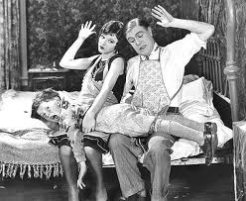
Spanked
“And they shall bear the punishment of their iniquity: the punishment of the prophet shall be even as the punishment of him that seeketh unto him; That the house of Israel may go no more astray from me, neither be polluted any more with all their transgressions; but that they may be my people, and I may be their God, saith the Lord GOD…. Though these three men, Noah, Daniel, and Job, were in it, they should deliver but their own souls by their righteousness, saith the Lord GOD.” Ezekiel 14:10-14

Slide 10
Noah, Daniel, Job
“The Christian life is a battle and a march. In this warfare there is no release; the effort must be continuous and persevering. It is by unceasing endeavor that we maintain the victory over the temptations of Satan. Christian integrity must be sought with resistless energy and maintained with a resolute fixedness of purpose. No one will be borne upward without stern, persevering effort in his own behalf. All must engage in this warfare for themselves; no one else can fight our battles. Individually we are responsible for the issues of the struggle; though Noah, Job, and Daniel were in the land they could deliver neither son nor daughter by their righteousness.” MH, pg. 453

Slide 11
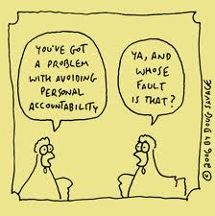
No One Else
“ If I cause noisome beasts to pass through the land, and they spoil it, so that it be desolate, that no man may pass through because of the beasts: Though these three men were in it, as I live, saith the Lord GOD, they shall deliver neither sons nor daughters; they only shall be delivered, but the land shall be desolate. Or if I bring a sword upon that land, and say, Sword, go through the land; so that I cut off man and beast from it: Though these three men were in it, as I live, saith the Lord GOD, they shall deliver neither sons nor daughters, but they only shall be delivered themselves.” Ezekiel 14:15-18

Slide 12
My Decision
“We cannot bless one another. My faith cannot save you, nor your faith avail for my salvation. Though Noah, Daniel, and Job were in the land, they could deliver neither son nor daughter by their righteousness; they could only deliver their own souls. We should seek God now for his pardoning grace. Now is the time to obtain genuine religious experience for the trying scenes that are just before us. God wants us to be in earnest, he wants us to be happy. When he gave Christ to the world, he gave all Heaven in that one priceless gift. He opened up to us all the treasures of his power and grace. By living faith we may grasp the hand of Infinite Power. We may be so connected with the God of Heaven that his grace may be found sufficient in every emergency of life. Says the prophet, “Five of you shall chase an hundred, and an hundred of you shall put ten thousand to flight.” {ST June 10, 1889, par. 3}

Slide 13
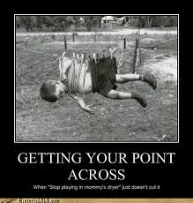
4th Time
“Though Noah, Daniel, and Job, were in it, as I live, saith the Lord GOD, they shall deliver neither son nor daughter; they shall but deliver their own souls by their righteousness.” Ezekiel 14:20 And now, for the 4th time, We are told that these men can save no one but themselves!

Slide 14
The Vine
“And the word of the LORD came unto me, saying, Son of man, What is the vine tree more than any tree, or than a branch which is among the trees of the forest? Shall wood be taken thereof to do any work? or will men take a pin of it to hang any vessel thereon? Behold, it is cast into the fire for fuel; the fire devoureth both the ends of it, and the midst of it is burned. Is it meet for any work?” Ezekiel 15:1-4

Slide 15
Familiar Illustration
“Now will I sing to my wellbeloved a song of my beloved touching his vineyard. My wellbeloved hath a vineyard in a very fruitful hill: And he fenced it, and gathered out the stones thereof, and planted it with the choicest vine, and built a tower in the midst of it, and also made a winepress therein: and he looked that it should bring forth grapes, and it brought forth wild grapes. And now, O inhabitants of Jerusalem, and men of Judah, judge, I pray you, betwixt me and my vineyard. What could have been done more to my vineyard, that I have not done in it? wherefore, when I looked that it should bring forth grapes, brought it forth wild grapes? And now go to; I will tell you what I will do to my vineyard: I will take away the hedge thereof, and it shall be eaten up; and break down the wall thereof, and it shall be trodden down: And I will lay it waste: it shall not be pruned, nor digged; but there shall come up briers and thorns: I will also command the clouds that they rain no rain upon it. For the vineyard of the LORD of hosts is the house of Israel, and the men of Judah his pleasant plant: and he looked for judgment, but behold oppression; for righteousness, but behold a cry.” Isaiah 5:1-7

Slide 16
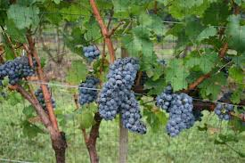
Prosperous Vine!
Ezekiel is using the same illustration. God called Israel to be a choice vine; His representatives in the earth. He did everything possible for their growth and benefit. Instead of using God’s gifts for His glory, they perverted them!

Slide 17
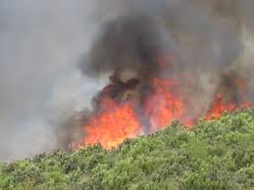
Only Other Purpose
The only other purpose for vines is for it be used for fuel. Ezekiel is being told by the Lord that if His people do not bear fruit to His glory then the only other use for them is for fuel. To the flames!

Slide 18
Well???
“So He had come to Israel, hungering to find in them the fruits of righteousness. He had lavished on them His gifts, that they might bear fruit for the blessing of the world. Every opportunity and privilege had been granted them, and in return He sought their sympathy and co-operation in His work of grace. He longed to see in them self-sacrifice and compassion, zeal for God, and a deep yearning of soul for the salvation of their fellow men. Had they kept the law of God, they would have done the same unselfish work that Christ did. But love to God and man was eclipsed by pride and self-sufficiency. They brought ruin upon themselves by refusing to minister to others. The treasures of truth which God had committed to them, they did not give to the world.” DA, pg. 583

