Slide 1
The Three Angels Messages pt. 1
Revelation 14:6-12

Slide 2
The Verses
“And I saw another angel fly in the midst of heaven, having the everlasting gospel to preach unto them that dwell on the earth, and to every nation, and kindred, and tongue, and people,
‘Saying with a loud voice, Fear God, and give glory to him; for the hour of his judgment is come: and worship him that made heaven, and earth, and the sea, and the fountains of waters.
‘And there followed another angel, saying, Babylon is fallen, is fallen, that great city, because she made all nations drink of the wine of the wrath of her fornication.
‘ And the third angel followed them, saying with a loud voice, If any man worship the beast and his image, and receive his mark in his forehead, or in his hand,
The same shall drink of the wine of the wrath of God, which is poured out without mixture into the cup of his indignation; and he shall be tormented with fire and brimstone in the presence of the holy angels, and in the presence of the Lamb: ’ And the smoke of their torment ascendeth up for ever and ever: and they have no rest day nor night, who worship the beast and his image, and whosoever receiveth the mark of his name. ‘Here is the patience of the saints: here are they that keep the commandments of God, and the faith of Jesus. “

Slide 3
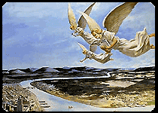
Three Angels Speaking
“These three angels represent the people who accept the light of God's messages, and go forth as His agents to sound the warning throughout the length and breadth of the earth. Christ declared to His followers, "Ye are the light of the world." To every soul that accepts Jesus, the cross of Calvary speaks: "Behold the worth of the soul. 'Go ye into all the world, and preach the Gospel to every creature.'" Nothing is to be permitted to hinder this work. It is the all-important work for this time, and it is to be far-reaching as eternity. “{ST, January 25, 1910 par. 5}

Slide 4
Potent
“Prophecy declares that the first angel would make his announcement to "every nation, and kindred, and tongue, and people." The warning of the third angel, which forms a part of the same threefold message, and is the message for this time, will be no less widespread. The banner on which is inscribed, "The commandments of God and the faith of Jesus," is to be raised aloft. The power of the first and second messages is to be intensified in the third. It is represented in the prophecy as being proclaimed with a loud voice by an angel flying in the midst of heaven, and it will command the attention of the world.” {ST, January 25, 1910 par. 12}

Slide 5
The Cleaver
In this day, God has called His church, as He called ancient Israel, to stand as a light in the earth. By the mighty cleaver of truth,--the messages of the first, second, and third angels,--He has separated a people from the churches and from the world, to bring them into a sacred nearness to Himself. He has made them the depositories of His law, and has committed to them the great truths of prophecy for this time. Like the holy oracles committed to ancient Israel, these are a sacred trust to be communicated to the world. {ST, January 25, 1910 par. 11}

Slide 6
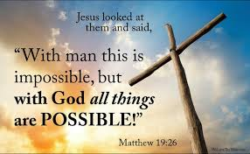
“Fear God”
“And unto man he said, Behold, the fear of the Lord, that is wisdom; and to depart from evil is understanding. “ Job 28:28
“The fear of the LORD is to hate evil: pride, and arrogancy, and the evil way, and the froward mouth, do I hate. “ Proverbs 8:13
“Let us hear the conclusion of the whole matter: Fear God, and keep his commandments: for this is the whole duty of man.” Eccl. 12:13

Slide 7
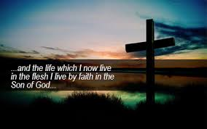
Hate Evil and keep……..
The phrase ‘Fear God’ calls us to forsake sin and keep all of God’s commands. Since this is an impossibility for a person to do by themselves, it behooves us to look outside of ourselves for Someone to help us. “For what the law could not do, in that it was weak through the flesh, God sending his own Son in the likeness of sinful flesh, and for sin, condemned sin in the flesh:
That the righteousness of the law might be fulfilled in us, who walk not after the flesh, but after the Spirit. “ Romans 8:3,4

Slide 8
Obedience Comes Through Faith
“Is the law then against the promises of God? God forbid: for if there had been a law given which could have given life, verily righteousness should have been by the law.
But the scripture hath concluded all under sin, that the promise by faith of Jesus Christ might be given to them that believe.
But before faith came, we were kept under the law, shut up unto the faith which should afterwards be revealed.
Wherefore the law was our schoolmaster to bring us unto Christ, that we might be justified by faith.
But after that faith is come, we are no longer under a schoolmaster. “ Galatians 3:21-25

Slide 9
Our Glory in the Dust
“What is justification by faith? It is the work of God in laying the glory of man in the dust, and doing for man that which it is not in his power to do for himself.” TM 456

Slide 10
Give Glory to Him
The first phrase ‘fear God’ means to turn from evil and keep all of God’s commandments. The next phrase is to ‘give glory to Him’. What does this mean?
“Whether therefore ye eat, or drink, or whatsoever ye do, do all to the glory of God.”
1Corinthians 10:31 From this passage, it is clear that by the health principles we follow, we give glory to God.

Slide 11
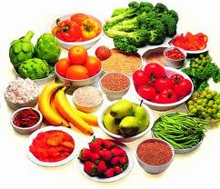
Follow Health Principles
“What? know ye not that your body is the temple of the Holy Ghost which is in you, which ye have of God, and ye are not your own?
For ye are bought with a price: therefore glorify God in your body, and in your spirit, which are God's. “ !Corinthians 6:19,20

Slide 12
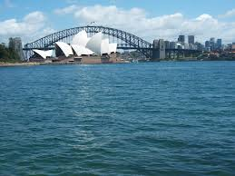
Not Just What We Eat…
1. When we eat.
2. None between meals.
3. None late at night.
4. The other 7 laws of health are just as important.
Exercise, Water
Sunshine, Temperance
Air, Rest
Trust in God

Slide 13
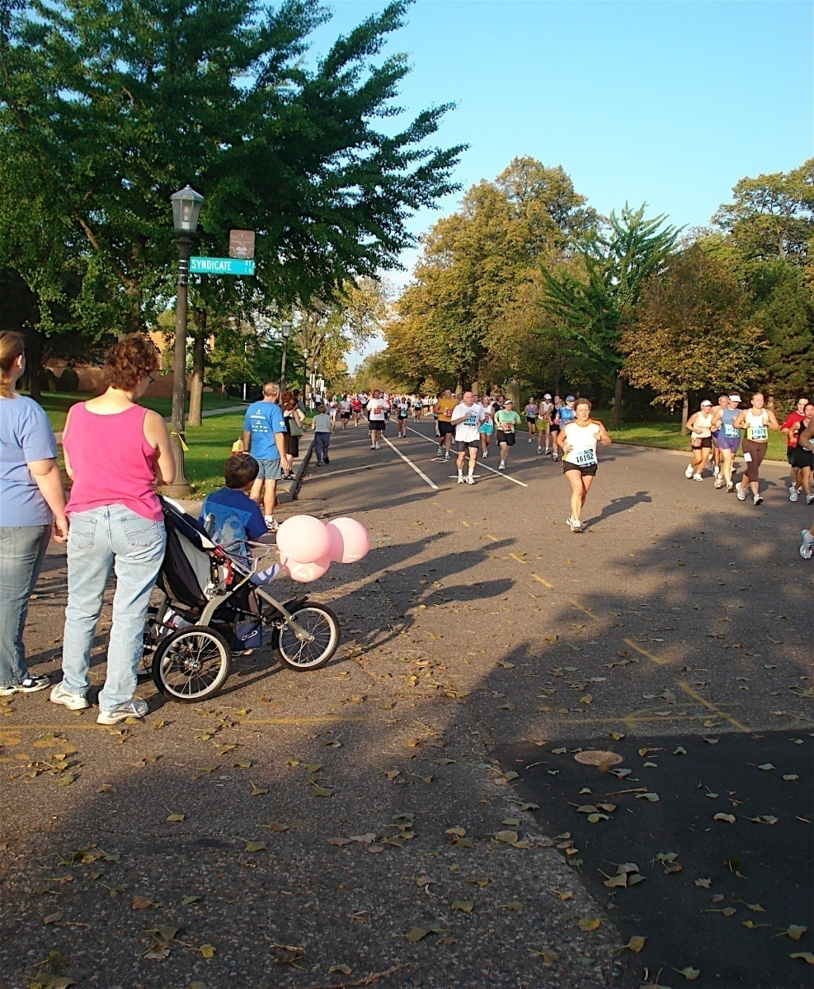
Temperance
“Know ye not that they which run in a race run all, but one receiveth the prize? So run, that ye may obtain. And every man that striveth for the mastery is temperate in all things. Now they do it to obtain a corruptible crown; but we an incorruptible.
I therefore so run, not as uncertainly; so fight I, not as one that beateth the air:
But I keep under my body, and bring it into subjection: lest that by any means, when I have preached to others, I myself should be a castaway.” 1Corinthians 9:24-27

Slide 14
Health
Locked into the three angels messages is the importance of health. It is part of the messages, but not above them. The need to maintain our bodies/minds in sound, healthy condition enables us to follow the principles of Jesus and to help others.
“And beside this, giving all diligence, add to your faith virtue; and to virtue knowledge;
And to knowledge temperance; and to temperance patience; and to patience godliness; And to godliness brotherly kindness; and to brotherly kindness charity. “ 2Peter 1:5-7

Slide 15
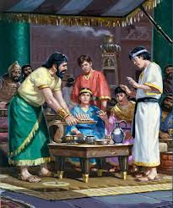
His Future Rested Here!
“But Daniel purposed in his heart that he would not defile himself with the portion of the king's meat, nor with the wine which he drank: therefore he requested of the prince of the eunuchs that he might not defile himself. Now God had brought Daniel into favour and tender love with the prince of the eunuchs. And the prince of the eunuchs said unto Daniel, I fear my lord the king, who hath appointed your meat and your drink: for why should he see your faces worse liking than the children which are of your sort? then shall ye make me endanger my head to the king.” Daniel 1:8-10

Slide 16
Decisive Test!
“Daniel and his associates had been trained by their parents to habits of strict temperance. They had been taught that God would hold them accountable for their capabilities, and that they must never dwarf or enfeeble their powers. This education was to Daniel and his companions the means of their preservation amidst the demoralizing influences of the court of Babylon. Strong were the temptations surrounding them in that corrupt and luxurious court, but they remained uncontaminated. No power, no influence, could sway them from the principles they had learned in early life by a study of the word and works of God.” PK, pg. 482

Slide 17
Another Way to Give God Glory
“Herein is my Father glorified, that ye bear much fruit; so shall ye be my disciples.” Jn. 15:8
“That ye may approve things that are excellent; that ye may be sincere and without offence till the day of Christ; Being filled with the fruits of righteousness, which are by Jesus Christ, unto the glory and praise of God.” Phil. 1:10, 11
The fruits of righteousness are the fruit of the Spirit. “But the fruit of the Spirit is love, joy, peace, longsuffering, gentleness, goodness, faith, Meekness, temperance: against such there is no law.” Galatians 5:22,23

Slide 18
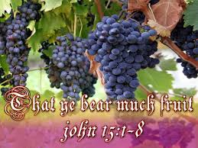
Impossible To Do This!
“Every branch in me that beareth not fruit he taketh away: and every branch that beareth fruit, he purgeth it, that it may bring forth more fruit. Now ye are clean through the word which I have spoken unto you.
Abide in me, and I in you. As the branch cannot bear fruit of itself, except it abide in the vine; no more can ye, except ye abide in me.
I am the vine, ye are the branches: He that abideth in me, and I in him, the same bringeth forth much fruit: for without me ye can do nothing.” Jn. 15:2-5

Slide 19
‘For the hour of His Judgment
“Saying with a loud voice, Fear God, and give glory to him; for the hour of his judgment is come: and worship him that made heaven, and earth, and the sea, and the fountains of waters.” Revelation 14:7
Within this phrase are two things.
1. There is a time prophecy associated with the judgment.
2. This statement connects with the idea of judgment/atonement/
cleansing of the sanctuary. These terms all mean the same thing. These three things all happened the same day.

Slide 20
Judgment/Atonement/Cleansing
“Also on the tenth day of this seventh month there shall be a day of atonement: it shall be an holy convocation unto you; and ye shall afflict your souls, and offer an offering made by fire unto the LORD.
And ye shall do no work in that same day: for it is a day of atonement, to make an atonement for you before the LORD your God.
For whatsoever soul it be that shall not be afflicted in that same day, he shall be cut off from among his people.
And whatsoever soul it be that doeth any work in that same day, the same soul will I destroy from among his people.” Leviticus 23:27-30
“And he shall make an atonement for the holy place, because of the uncleanness of the children of Israel, and because of their transgressions in all their sins:… And he shall go out unto the altar that is before the LORD, and make an atonement for it; …And he shall sprinkle of the blood upon it with his finger seven times, and cleanse it, and hallow it from the uncleanness of the children of Israel.” Leviticus 16:16-19

Slide 21
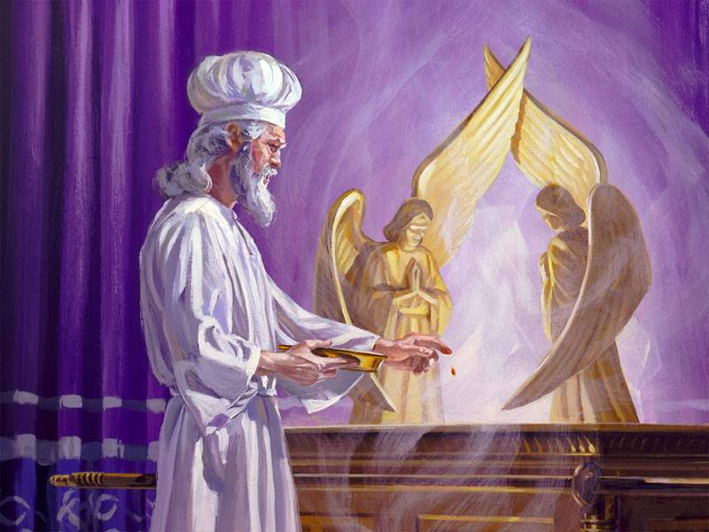
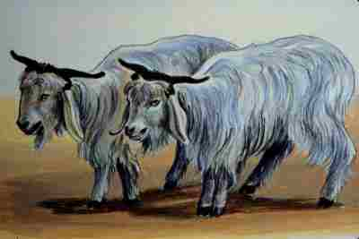
Cleansing

Slide 22
The Mystery unveiled
“Important truths concerning the atonement were taught the people by this yearly service. In the sin offerings presented during the year, a substituted had been accepted in the sinner's stead; but the blood of the victim had not made full atonement for the sin. It had only provided a means by which the sin was transferred to the sanctuary. By the offering of blood, the sinner acknowledged the authority of the law, confessed the guilt of his transgression, and expressed his faith in Him who was to take away the sin of the world; but he was not entirely released from the condemnation of the law. On the Day of Atonement the high priest, having taken an offering for the congregation, went into the most holy place with the blood and sprinkled it upon the mercy seat, above the tables of the law. Thus the claims of the law, which demanded the life of the sinner, were satisfied. Then in his character of mediator the priest took the sins upon himself, and, leaving the sanctuary, he bore with him the burden of Israel's guilt. At the door of the tabernacle he laid his hands upon the head of the scapegoat and confessed over him "all the iniquities of the children of Israel, and all their transgressions in all their sins, putting them upon the head of the goat." And as the goat bearing these sins was sent away, they were, with him, regarded as forever separated from the people. Such was the service performed "unto the example and shadow of heavenly things." Hebrews 8:5.” PP, pgs. 355,356

Slide 23
The Final Atonement
“In the service of the earthly sanctuary, which, as we have seen, is a figure of the service in the heavenly, when the high priest on the Day of Atonement entered the most holy place, the ministration in the first apartment ceased. God commanded: "There shall be no man in the tabernacle of the congregation when he goeth in to make an atonement in the holy place, until he comes out." Leviticus 16:17. So when Christ entered the holy of holies to perform the closing work of the atonement, He ceased His ministration in the first apartment. But when the ministration in the first apartment ended, the ministration in the second apartment began. When in the typical service the high priest left the holy on the Day of Atonement, he went in before God to present the blood of the sin offering in behalf of all Israel who truly repented of their sins. So Christ had only completed one part of His work as our intercessor, to enter upon another portion of the work, and He still pleaded His blood before the Father in behalf of sinners.
This subject was not understood by Adventists in 1844.” GC, pgs. 428,429

Slide 24
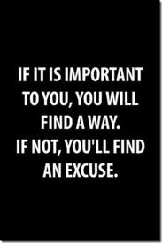
No Room for Lip Service Christianity
The judgment hour message does not allow someone to simply believe in God/Christ without a genuine transformation of life. The gospel of Christ is not an excuse for sinful living, but the power of God to change a person’s life and to live in harmony with all 10 commandments!!!

Slide 25
The Time Prophecy
“for the hour of his judgment is come:” Rev. 14:7 Where in the Bible is there a time prophecy connected to the judgment/cleansing of the sanctuary?.“Unto two thousand and three hundred days; then shall the sanctuary be cleansed.” Daniel 8:14
There is a distinct tie between Daniel 8:14-Revelation 14:7 and Leviticus 16.
“Both the prophecy of Daniel 8:14, "Unto two thousand and three hundred days; then shall the sanctuary be cleansed," and the first angel's message, "Fear God, and give glory to Him; for the hour of His judgment is come," pointed to Christ's ministration in the most holy place, to the investigative judgment, and not to the coming of Christ for the redemption of His people and the destruction of the wicked.” GC, pg. 424

Slide 26
2,300 Years
Daniel 8 is fascinating. The only part of the prophecy that Daniel didn’t understand was the 2,300 years. “And the vision of the evening and the morning which was told is true: wherefore shut thou up the vision; for it shall be for many days. And I Daniel fainted, and was sick certain days; afterward I rose up, and did the king's business; and I was astonished at the vision, but none understood it.” Daniel 9 would give us the answer.

Slide 27
A Starting Date
“And he informed me, and talked with me, and said, O Daniel, I am now come forth to give thee skill and understanding. At the beginning of thy supplications the commandment came forth, and I am come to shew thee; for thou art greatly beloved: therefore understand the matter, and consider the vision. Seventy weeks are determined upon thy people and upon thy holy city, to finish the transgression, and to make an end of sins, and to make reconciliation for iniquity, and to bring in everlasting righteousness, and to seal up the vision and prophecy, and to anoint the most Holy. Know therefore and understand, that from the going forth of the commandment to restore and to build Jerusalem unto the Messiah the Prince shall be seven weeks, and threescore and two weeks: the street shall be built again, and the wall, even in troublous times.” Daniel 9:22-25 Gabriel comes back to explain the 2,300. He begins by saying that a period of 490 years are cut off from the 2,300. He then says that the starting point is the command to restore and build Jerusalem.

Slide 28
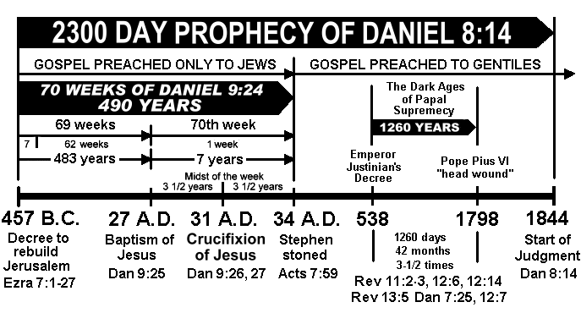
The Time Explained

Slide 29
Confirmation
“The 2300 days had been found to begin when the commandment of Artaxerxes for the restoration and building of Jerusalem went into effect, in the autumn of 457 B.C. Taking this as the starting point, there was perfect harmony in the application of all the events foretold in the explanation of that period in Daniel 9:25-27. Sixty-nine weeks, the first 483 of the 2300 years, were to reach to the Messiah, the Anointed One; and Christ's baptism and anointing by the Holy Spirit, A.D. 27, exactly fulfilled the specification. In the midst of the seventieth week, Messiah was to be cut off. Three and a half years after His baptism, Christ was crucified, in the spring of A.D. 31. The seventy weeks, or 490 years, were to pertain especially to the Jews. At the expiration of this period the nation sealed its rejection of Christ by the persecution of His disciples, and the apostles turned to the Gentiles, A.D. 34. The first 490 years of the 2300 having then ended, 1810 years would remain. From A.D. 34, 1810 years extend to 1844. "Then," said the angel, "shall the sanctuary be cleansed." All the preceding specifications of the prophecy had been unquestionably fulfilled at the time appointed.” GC, pg. 410

Slide 30
Summary
1. The investigative judgment began in 1844.
2. The time frame for the three angels messages to be given is from around 1844 to the end of time.
3. This Biblical and beautiful teaching is clearly marked in Scripture.
4. God raised up a people at that time to give these messages. These messages make the people who they are.
5. By how people respond to these messages will determine their/our destiny! (Rev. 6)

Slide 31
‘Worship Him’
“Fear God, and give glory to him; for the hour of his judgment is come: and worship him that made heaven, and earth, and the sea, and the fountains of waters.” We are called upon to worship the Creator. As we have seen, worship is tied to the 10 commandments. True worship is honoring God’s commands and false worship is honoring man made traditions.

Slide 32
Christ and worship
“But he answered and said unto them, Why do ye also transgress the commandment of God by your tradition?... But in vain they do worship me, teaching for doctrines the commandments of men.” Matthew 15:2,9
Again……………………………
True Worship-honoring God’s commandments.
False Worship-honoring man’s traditions.
Revelation 14:7 calls upon the world to honor the commandment that reveals God as the Creator. Which commandment is that?

Slide 33

The Sabbath
“Remember the sabbath day, to keep it holy. Six days shalt thou labour, and do all thy work: But the seventh day is the sabbath of the LORD thy God: in it thou shalt not do any work, thou, nor thy son, nor thy daughter, thy manservant, nor thy maidservant, nor thy cattle, nor thy stranger that is within thy gates: For in six days the LORD made heaven and earth, the sea, and all that in them is, and rested the seventh day: wherefore the LORD blessed the sabbath day, and hallowed it.” Exodus 20:8-11

Slide 34

The Beneficent Creator
“ To all who receive the Sabbath as a sign of Christ's creative and redeeming power, it will be a delight. Seeing Christ in it, they delight themselves in Him. The Sabbath points them to the works of creation as an evidence of His mighty power in redemption. While it calls to mind the lost peace of Eden, it tells of peace restored through the Saviour. And every object in nature repeats His invitation, "Come unto Me, all ye that labor and are heavy-laden, and I will give you rest." Matt 11:28. DA, 289

Slide 35
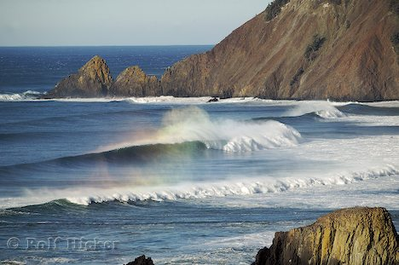
Worship the Creator
The Sabbath reveals Christ as Creator/Redeemer. It reveals His power to create and recreate. “ Speak thou also unto the children of Israel, saying, Verily my sabbaths ye shall keep: for it is a sign between me and you throughout your generations; that ye may know that I am the LORD that doth sanctify you. “ Exodus 31:13

Slide 36
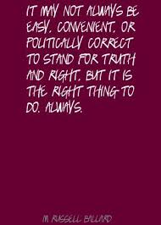
The Sabbath/Saturday
1. The Sabbath is not convenient.
2. The Sabbath does not fit into Friday night dances, games, or graduations.
3. The Sabbath goes completely opposite the world.
4. The Sabbath is still the way of peace, rest, and contentment!

Slide 37
The First Angels Message
1. Exalts Christ and the ten commandments. Christ alone can help the helpless to obey.
2. Exalts health principles and their importance to keep the mind/body clear to discern the voice of Christ.
3. Exalts Christ as our High Priest in the Most Holy Place since 1844 and His desire to cleanse us from all sin.
4. Exalts the Sabbath as Christ’s sign in Creation/Redemption.

