Slide 1
Judges, pt. 4 “ Judges, pt. 4 “Response to Prophetess”

Slide 2
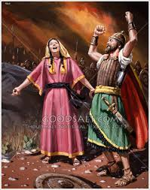
A mighty victory was won by the power of God in the days of Deborah and Barak! Jabin, Sisera, and their 900 chariots looked unstoppable. The Lord took the very simple battle plan and catapulted Israel to a mighty victory. In response to God’s wondrous victory, Deborah and Barak led the troops in a victory song. What they sang is quite interesting!

Slide 3
“Deborah celebrated the triumph of Israel in a most sublime and impassioned song. She ascribed to God all the glory of their deliverance, and bade the people praise Him for His wonderful works. She called upon the kings and princes of surrounding nations to hear what God had wrought for Israel, and to take warning not to do them harm. She showed that honor and power belong to God, and not to men, or to their idols. She portrayed the awful exhibitions of divine power and majesty displayed at Sinai. She set before Israel their helpless and distressed condition, under the oppression of their enemies, and related in glowing language the history of their deliverance.—The Signs of the Times, June 16, 1881.

Slide 4
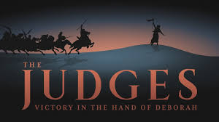
Tribes of Valor!
Some of the tribes of Israel were valiant in fight, risking their lives for the cause of God. Others among God’s people were out having a good time or seeking the riches of this world in this time of crisis! Which tribe are you??

Slide 5
Zebulun, Issachar, and Rueben
“Out of Ephraim was there a root of them against Amalek; after thee, Benjamin, among thy people; out of Machir came down governors, and out of Zebulun they that handle the pen of the writer. And the princes of Issachar were with Deborah; even Issachar, and also Barak: he was sent on foot into the valley. For the divisions of Reuben there were great thoughts of heart. Why abodest thou among the sheepfolds, to hear the bleatings of the flocks? For the divisions of Reuben there were great searchings of heart.” Judges 5:14-16

Slide 6
Many a Star!
“The time is not far distant when the test will come to every soul. The observance of the false Sabbath will be urged upon us. The contest will be between the commandments of God and the commandments of men. Those who have yielded step by step to worldly demands and conformed to worldly customs will then yield to the powers that be, rather than subject themselves to derision, insult, threatened imprisonment, and death. At that time the gold will be separated from the dross. True godliness will be clearly distinguished from the appearance and tinsel of it. Many a star that we have admired for its brilliance will then go out in darkness. Those who have assumed the ornaments of the sanctuary, but are not clothed with Christ's righteousness, will then appear in the shame of their own nakedness.” PK, pg. 188

Slide 7
When you think of the Israelite tribes, you immediately think of the powerhouse ones. Rueben, Simeon, Levi, Judah, and Joseph. They did not play a prominent role in this conflict at all. They were nowhere to be found! It was the unknowns in Israel that led the way. “Blessed are the poor in spirit: for theirs is the kingdom of heaven.” Matthew 5:3

Slide 8
Poor in Spirit
“All who have a sense of their deep soul poverty, who feel that they have nothing good in themselves, may find righteousness and strength by looking unto Jesus. He says, “Come unto Me, all ye that labor and are heavy-laden.” Matthew 11:28. He bids you exchange your poverty for the riches of His grace. We are not worthy of God's love, but Christ, our surety, is worthy, and is abundantly able to save all who shall come unto Him. Whatever may have been your past experience, however discouraging your present circumstances, if you will come to Jesus just as you are, weak, helpless, and despairing, our compassionate Savior will meet you a great way off, and will throw about you His arms of love and His robe of righteousness. He presents us to the Father clothed in the white raiment of His own character. He pleads before God in our behalf, saying: I have taken the sinner's place. Look not upon this wayward child, but look on Me. Does Satan plead loudly against our souls, accusing of sin, and claiming us as his prey, the blood of Christ pleads with greater power. “Surely, shall one say, in the Lord have I righteousness and strength.... In the Lord shall all the seed of Israel be justified, and shall glory.” Isaiah 45:24, 25.” MB, pgs. 8,9

Slide 9
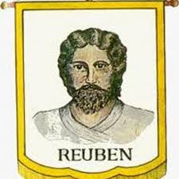
Rueben, in this titanic struggle of God’s people against the enemy, was not sure what to do! While his brethren were falling like flies on the battlefield, Rueben was pondering what to do. Just like in the story of Joseph, Rueben had the power as the eldest to stop the other brothers from their wickedness, but instead, the unstable one leaves the encampment and Joseph is sold. (Genesis 37:22-30) “For the divisions of Reuben there were great thoughts of heart. Why abodest thou among the sheepfolds, to hear the bleatings of the flocks? For the divisions of Reuben there were great searchings of heart.”

Slide 10
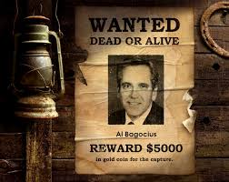
Price on Our Head!
Some of us have a price on our head! The 3 Angel’s messages are in ill repute today and those who present them are terrorists/outlaws. Will we stand with them? Will we finally make a decision and come to the aid of the Lord’s work or will we continue to vacillate and be unstable as water as Rueben. “Reuben, thou art my firstborn, my might, and the beginning of my strength, the excellency of dignity, and the excellency of power: Unstable as water, thou shalt not excel;”” Genesis 49:3,4

Slide 11
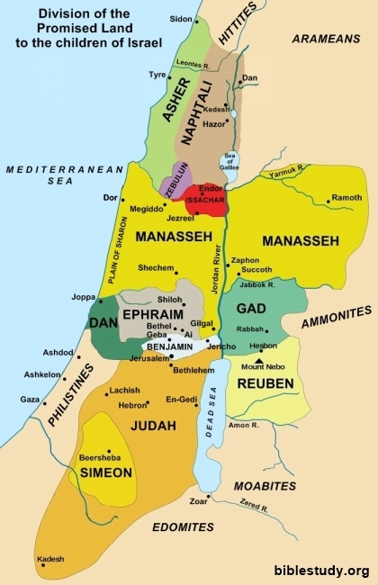
Close Proximity!
“Gilead abode beyond Jordan: and why did Dan remain in ships? Asher continued on the sea shore, and abode in his breaches.” Judges 5:17

Slide 12
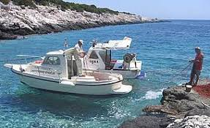
Dan was so close in proximity to the battle. His brothers were fighting for their lives and drawing blood,; yet, there was Dan out on the Mediterranean fishing and having a marvelous time! Everything in Dan’s life was gobbled up in making a living and having a good time! The battle raged, the warriors of Israel fell, and Dan remained aloof because he had more important things to do!!

Slide 13
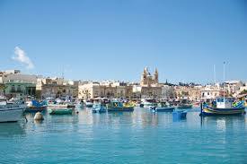
Asher
“Asher continued on the sea shore, and abode in his breaches.” Judges 5:17
When people are risking their lives to preserve your homeland and your faith, Asher’s attitude is totally unacceptable.
“And Jesus came and spake unto them, saying, All power is given unto me in heaven and in earth. Go ye therefore, and teach all nations, baptizing them in the name of the Father, and of the Son, and of the Holy Ghost: Teaching them to observe all things whatsoever I have commanded you: and, lo, I am with you alway, even unto the end of the world. Amen.” Matthew 28:18-20

Slide 14
“In the closing work of God in the earth, the standard of His law will be again exalted. False religion may prevail, [187] iniquity may abound, the love of many may wax cold, the cross of Calvary may be lost sight of, and darkness, like the pall of death, may spread over the world; the whole force of the popular current may be turned against the truth; plot after plot may be formed to overthrow the people of God; but in the hour of greatest peril the God of Elijah will raise up human instrumentalities to bear a message that will not be silenced. In the populous cities of the land, and in the places where men have gone to the greatest lengths in speaking against the Most High, the voice of stern rebuke will be heard. Boldly will men of God's appointment denounce the union of the church with the world. Earnestly will they call upon men and women to turn from the observance of a man-made institution to the observance of the true Sabbath. "Fear God, and give glory to Him," they will proclaim to every nation; "for the hour of His judgment is come: and worship Him that made heaven, and earth, and the sea, and the fountains of waters. . . . If any man worship the beast and his image, and receive his mark in his forehead, or in his hand, the same shall drink of the wine of the wrath of God, which is poured out without mixture into the cup of His indignation." Revelation 14:7-10.

Slide 15
God will not break His covenant, nor alter the thing that has gone out of His lips. His word will stand fast forever as unalterable as His throne. At the judgment this covenant will be brought forth, plainly written with the finger of God, and the world will be arraigned before the bar of Infinite Justice to receive sentence.
Today, as in the days of Elijah, the line of demarcation [188] between God's commandment-keeping people and the worshipers of false gods is clearly drawn. "How long halt ye between two opinions?" Elijah cried; "if the Lord be God, follow Him: but if Baal, then follow him." 1 Kings 18:21. And the message for today is: "Babylon the great is fallen, is fallen. . . . Come out of her, My people, that ye be not partakers of her sins, and that ye receive not of her plagues. For her sins have reached unto heaven, and God hath remembered her iniquities." Revelation 18:2, 4, 5.” PK, pg. 186-188

