Slide 1
“Gad, the Tribe from Gilead”

Slide 2
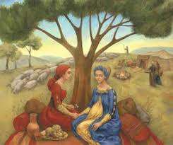
Came from Leah’s Maid
“When Leah saw that she had left bearing, she took Zilpah her maid, and gave her Jacob to wife. And Zilpah Leah's maid bare Jacob a son. And Leah said, A troop cometh: and she called his name Gad. And Zilpah Leah's maid bare Jacob a second son. And Leah said, Happy am I, for the daughters will call me blessed: and she called his name Asher.” Genesis 30:9-13

Slide 3
Zilpah was a Servant Girl
What a change had occurred in the life of Zilpah. She was Leah’s servant, waiting on her hand and foot, taking care of her every whim. But after Rachel used her servant, Bilhah to have a child from Jacob, Leah followed suit and gave her maid to Jacob as well. Zilpah went from servant to now another wife of the master of the home, Jacob! What a polygamous mess! How encouraging that God could take such a mess and make something beautiful out of it!

Slide 4
Illustrious Company
“And I heard the number of them which were sealed: and there were sealed an hundred and forty and four thousand of all the tribes of the children of Israel. Of the tribe of Juda were sealed twelve thousand. Of the tribe of Reuben were sealed twelve thousand. Of the tribe of Gad were sealed twelve thousand. Of the tribe of Aser were sealed twelve thousand. Of the tribe of Nepthalim were sealed twelve thousand. Of the tribe of Manasses were sealed twelve thousand. Of the tribe of Simeon were sealed twelve thousand. Of the tribe of Levi were sealed twelve thousand. Of the tribe of Issachar were sealed twelve thousand. Of the tribe of Zabulon were sealed twelve thousand. Of the tribe of Joseph were sealed twelve thousand. Of the tribe of Benjamin were sealed twelve thousand.” Revelation 7:4-8

Slide 5
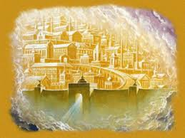
Name on the New Jerusalem
“And he carried me away in the spirit to a great and high mountain, and shewed me that great city, the holy Jerusalem, descending out of heaven from God, Having the glory of God: and her light was like unto a stone most precious, even like a jasper stone, clear as crystal; And had a wall great and high, and had twelve gates, and at the gates twelve angels, and names written thereon, which are the names of the twelve tribes of the children of Israel: On the east three gates; on the north three gates; on the south three gates; and on the west three gates.” Rev. 21:10-13

Slide 6
Gad Would Not Be Mistreated!
Because of her standing in the family unit as a servant, and now Jacob’s 4th wife, Zilpah would make sure that her boy would not be treated with less dignity and fairness just because of where she came from. He would have all the rights and privileges of a son of Jacob. Zilpah would see to that! Her boy would not be looked down upon in any way, shape, or form!

Slide 7
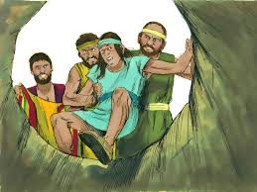
Only One Window into his Life!
Gad’s life was basically silent. The only things we know were:
1. He grew up in a messed up family.
2. He came from a servant wife of Jacob.
3. He was part of the treachery practiced on Joseph.
4. He followed the advice of bully, big brother, Simeon!

Slide 8
He was there too!
“And when they saw him afar off, even before he came near unto them, they conspired against him to slay him. And they said one to another, Behold, this dreamer cometh. Come now therefore, and let us slay him, and cast him into some pit, and we will say, Some evil beast hath devoured him: and we shall see what will become of his dreams. And Reuben heard it, and he delivered him out of their hands; and said, Let us not kill him. And Reuben said unto them, Shed no blood, but cast him into this pit that is in the wilderness, and lay no hand upon him; that he might rid him out of their hands, to deliver him to his father again. And it came to pass, when Joseph was come unto his brethren, that they stript Joseph out of his coat, his coat of many colours that was on him; And they took him, and cast him into a pit: and the pit was empty, there was no water in it.” Genesis 37:18-24

Slide 9
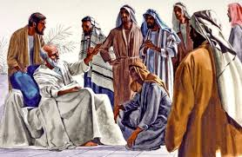
Jacob’s Dying Benediction
“Gad, a troop shall overcome him: but he shall overcome at the last.” Genesis 49:19
Wow, that doesn’t help much! Well, a troop shall overcome him! Everything in Gad’s life would not be a bed of roses as the Joseph experience would indicate. Gad would have his troubles; he would succumb big time to sin and other’s influences!

Slide 10

Gad is Sooo Hopeful
Gad would fall. Others would lead him astray! His life would not be a bed of roses. BUT, he would eventually overcome! Do not give up on your Gad’s or on yourself if you are a Gad! Do not stop praying for the Gad in your life! The Lord is not through with him/her! Gad finally gets it; he finally comes to the end of his rope and learns to trust in Jesus and His love!

Slide 11
On the Other Side of Jordan
Now the children of Reuben and the children of Gad had a very great multitude of cattle: and when they saw the land of Jazer, and the land of Gilead, that, behold, the place was a place for cattle; The children of Gad and the children of Reuben came and spake unto Moses, and to Eleazar the priest, and unto the princes of the congregation, saying, Ataroth, and Dibon, and Jazer, and Nimrah, and Heshbon, and Elealeh, and Shebam, and Nebo, and Beon, Even the country which the LORD smote before the congregation of Israel, is a land for cattle, and thy servants have cattle: Wherefore, said they, if we have found grace in thy sight, let this land be given unto thy servants for a possession, and bring us not over Jordan. And Moses said unto the children of Gad and to the children of Reuben, Shall your brethren go to war, and shall ye sit here? And wherefore discourage ye the heart of the children of Israel from going over into the land which the LORD hath given them?” Numbers 32:1-7

Slide 12
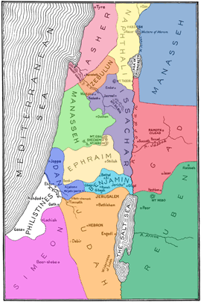
Could be Misunderstood?!?
“And they came near unto him, and said, We will build sheepfolds here for our cattle, and cities for our little ones: But we ourselves will go ready armed before the children of Israel, until we have brought them unto their place: and our little ones shall dwell in the fenced cities because of the inhabitants of the land. We will not return unto our houses, until the children of Israel have inherited every man his inheritance. For we will not inherit with them on yonder side Jordan, or forward; because our inheritance is fallen to us on this side Jordan eastward.” Numbers 32:16-19

Slide 13
Checkered Career
Throughout the life of the tribe of Gad was seen the fulfillment of Jacob’s words, “Gad, a troop shall overcome him: but he shall overcome at the last.” Genesis 49:19 When it came time for the settlement of Canaan, Gad apparently wanted to inherit his piece and leave the other tribes to gain theirs on the other side of the Jordan. Unlike at the selling of Joseph, this time the Gadites rose to the occasion and worked valiantly on behalf of their brethren. Joshua had this to say about them.

Slide 14

Home at Last!
“Then Joshua called the Reubenites, and the Gadites, and the half tribe of Manasseh, And said unto them, Ye have kept all that Moses the servant of the LORD commanded you, and have obeyed my voice in all that I commanded you: Ye have not left your brethren these many days unto this day, but have kept the charge of the commandment of the LORD your God. And now the LORD your God hath given rest unto your brethren, as he promised them: therefore now return ye, and get you unto your tents, and unto the land of your possession, which Moses the servant of the LORD gave you on the other side Jordan.” Joshua 22:1-4

Slide 15
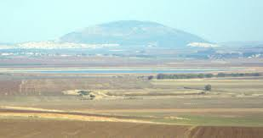
Megiddo Was Different
“And the princes of Issachar were with Deborah; even Issachar, and also Barak: he was sent on foot into the valley. For the divisions of Reuben there were great thoughts of heart. Why abodest thou among the sheepfolds, to hear the bleatings of the flocks? For the divisions of Reuben there were great searching's of heart. Gilead abode beyond Jordan: and why did Dan remain in ships? Asher continued on the sea shore, and abode in his breaches.” judges 5:15-17

Slide 16
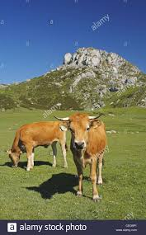
Taking Care of Business
In the case of one of Israel’s greatest battles, in the valley of Megiddo, Gad was nowhere to be found. Issachar and Zebulon were risking their lives. The men of Naphtali were there too, giving their all, but Gad was taking care of his cattle, putting earthly interests above the divine. We all must take care of earthly interests, but when those supersede the will and cause of God, then our priorities are misplaced and we are making gods of mammon!

Slide 17
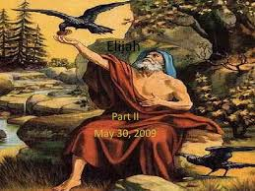
The Most Famous Gadite was………..
It was none other than Elijah!! “And Elijah the Tishbite, who was of the inhabitants of Gilead, said unto Ahab, As the LORD God of Israel liveth, before whom I stand, there shall not be dew nor rain these years, but according to my word.” 1 King 17:1

Slide 18
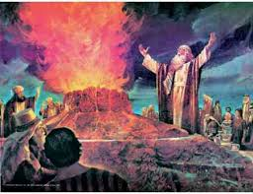
One Minute, Standing on Mt. Carmel……
“Facing King Ahab and the false prophets, and surrounded by the assembled hosts of Israel, Elijah stands, the only one who has appeared to vindicate the honor of Jehovah. He whom the whole kingdom has charged with its weight of woe is now before them, apparently defenseless in the presence of the monarch of Israel, the prophets of Baal, the men of war, and the surrounding thousands. But Elijah is not alone. Above and around him are the protecting hosts of heaven, angels that excel in strength.” PK, pg. 147

Slide 19
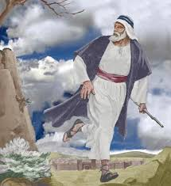
Running for his Life from Jezebel
“A troop shall overcome him, but he shall overcome at the last.” Genesis 49:19 Truly a descendent of Gad, Elijah was fearless and afraid; powerful and weak. Yet, through all the vicissitudes of life, to Elijah and his forefather, Heaven would be their inheritance. “The steps of a good man are ordered by the LORD: and he delighteth in his way. Though he fall, he shall not be utterly cast down: for the LORD upholdeth him with his hand.” Ps. 37:23,24

Slide 20
The Difference Maker
The still, small voice of the Lord ever whispered to Gad! “Come unto me, all ye that labour and are heavy laden, and I will give you rest. Take my yoke upon you, and learn of me; for I am meek and lowly in heart: and ye shall find rest unto your souls. For my yoke is easy, and my burden is light.” Matthew 11:28-30 Gad finally got it!
“The sons of Reuben, and the Gadites, and half the tribe of Manasseh, of valiant men, men able to bear buckler and sword, and to shoot with bow, and skilful in war, were four and forty thousand seven hundred and threescore, that went out to the war. And they made war with the Hagarites, …. and the Hagarites were delivered into their hand, and all that were with them: for they cried to God in the battle, and he was intreated of them; because they put their trust in him.”
1 Chronicles 5: 18-20

Slide 21
“Inspiration faithfully records the faults of good men, those who were distinguished by the favor of God; indeed, their faults are more fully presented than their virtues. This has been a subject of wonder to many, and has given the infidel occasion to scoff at the Bible. But it is one of the strongest evidences of the truth of Scripture, that facts are not glossed over, nor the sins of its chief characters suppressed. The minds of men are so subject to prejudice that it is not possible for human histories to be absolutely impartial. Had the Bible been written by uninspired persons, it would no doubt have presented the character of its honored men in a more flattering light. But as it is, we have a correct record of their experiences.
Men whom God favored, and to whom He entrusted great responsibilities, were sometimes overcome by temptation and committed sin, even as we at the present day strive, waver, and frequently fall into error. Their lives, with all their faults and follies, are open before us, both for our encouragement and warning. If they had been represented as without fault, we, with our sinful nature, might despair at our own mistakes and failures. But seeing where others struggled through discouragements like our own, where they fell under temptations as we have done, and yet took heart again and conquered through the grace of God, we are encouraged in our striving after righteousness. As they, though sometimes beaten back, recovered their ground, and were blessed of God, so we too may be overcomers in the strength of Jesus.” PP, pg. 238

