Slide 1
Revelation 21
The Restored Creation

Slide 2
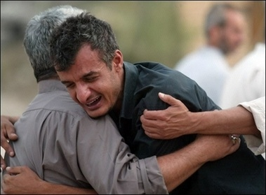
No more SEa
Rev. 21:1 “And I saw a new heaven and a new earth: for the first heaven and the first earth were passed away; and there was no more sea.”

Slide 3
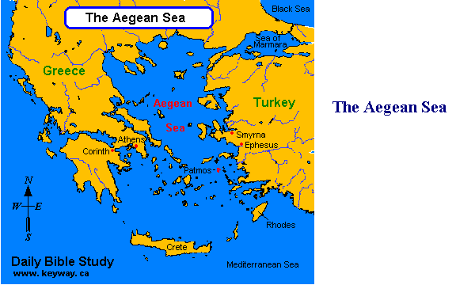
Patmos
Patmos kept John from the people he loved. The Aegean Sea separated him from loved ones and home. One day, there will be no more separation. Loved ones will never leave in that place. No more pain of splitting apart will be found there.

Slide 4
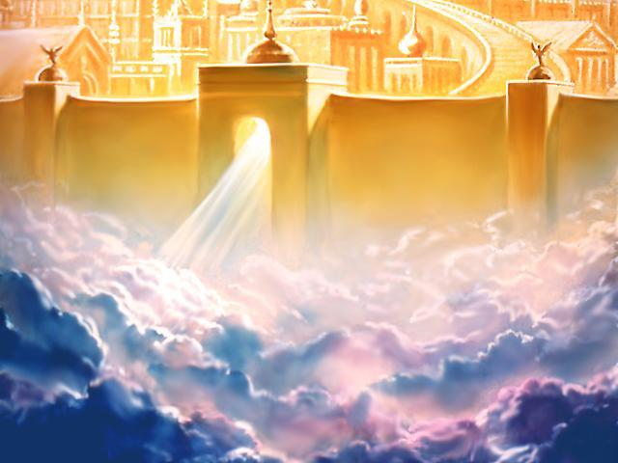
The Holy City
Rev. 21:2 “And I John saw the holy city, new Jerusalem, coming down from God out of heaven, prepared as a bride adorned for her husband.”

Slide 5
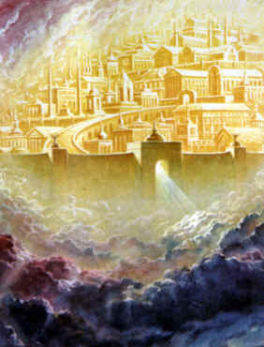
Immanuel
“And I heard a great voice out of heaven saying, Behold, the tabernacle of God is with men, and he will dwell with them, and they shall be his people, and God himself shall be with them, and be their God. And God shall wipe away all tears from their eyes; and there shall be no more death, neither sorrow, nor crying, neither shall there be any more pain: for the former things are passed away. And he that sat upon the throne said, Behold, I make all things new. And he said unto me, Write: for these words are true and faithful.”

Slide 6
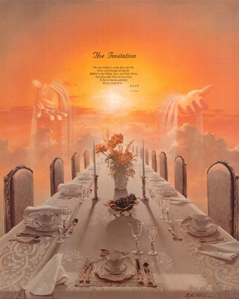
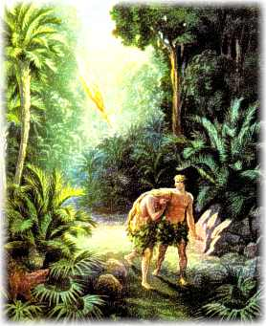
No More Tears

Slide 7
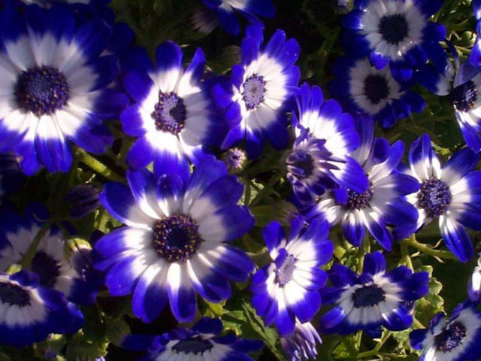
All Things New
How do you picture or describe perfection? Everything we see and are is not perfect, but God will make everything perfect again. He will restore things the way they use to be. Praise God!!

Slide 8
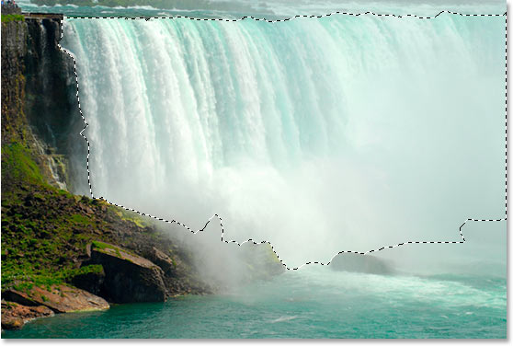
Fountains of Living Water
“And he said unto me, It is done. I am Alpha and Omega, the beginning and the end. I will give unto him that is athirst of the fountain of the water of life freely. He that overcometh shall inherit all things; and I will be his God, and he shall be my son.” Rev. 21:6,7

Slide 9
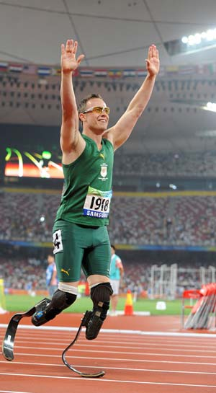
For the Victorious
“Know ye not that they which run in a race run all, but one receiveth the prize? So run, that ye may obtain. And every man that striveth for the mastery is temperate in all things. Now they do it to obtain a corruptible crown; but we an incorruptible. I therefore so run, not as uncertainly; so fight I, not as one that beateth the air: But I keep under my body, and bring it into subjection: lest that by any means, when I have preached to others, I myself should be a castaway.” 1Corinthians 9:24-27

Slide 10
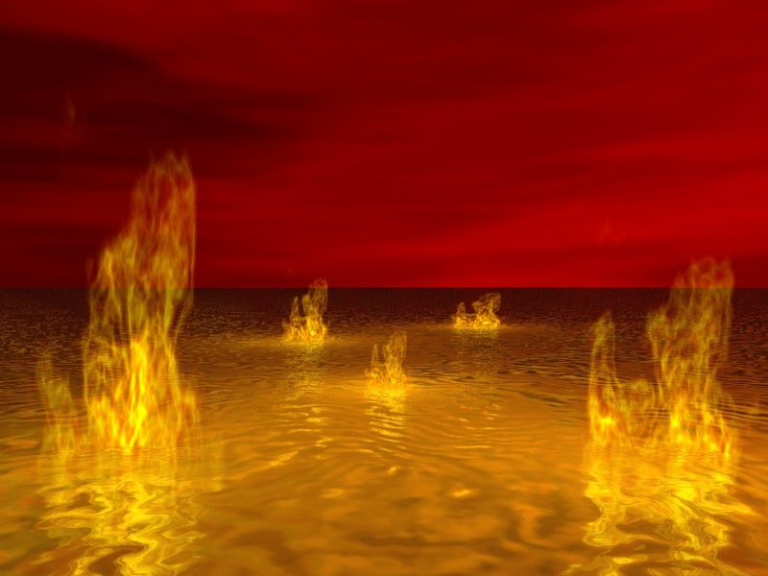
It will not come up again!
“But the fearful, and unbelieving, and the abominable, and murderers, and whoremongers, and sorcerers, and idolaters, and all liars, shall have their part in the lake which burneth with fire and brimstone: which is the second death.” Rev. 21:8

Slide 11
Sin Will Be Destroyed
“But with an overrunning flood he will make an utter end of the place thereof, and darkness shall pursue his enemies. What do ye imagine against the LORD? he will make an utter end: affliction shall not rise up the second time.” Nahum 1:9
“One reminder alone remains: Our Redeemer will ever bear the marks of His crucifixion. Upon His wounded head, upon His side, His hands and feet, are the only traces of the cruel work that sin has wrought. Says the prophet, beholding Christ in His glory: "He had bright beams coming out of His side: and there was the hiding of His power." Habakkuk 3:4, margin. That pierced side whence flowed the crimson stream that reconciled man to God--there is the Saviour's glory, there "the hiding of His power." "Mighty to save," through the sacrifice of redemption, He was therefore strong to execute justice upon them that despised God's mercy. And the tokens of His humiliation are His highest honor; through the eternal ages the wounds of Calvary will show forth His praise and declare His power.” GC, pg 674

Slide 12
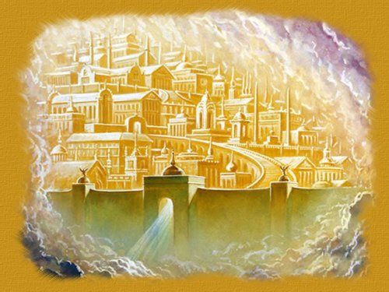
The Bride
“And there came unto me one of the seven angels which had the seven vials full of the seven last plagues, and talked with me, saying, Come hither, I will shew thee the bride, the Lamb's wife. And he carried me away in the spirit to a great and high mountain, and shewed me that great city, the holy Jerusalem, descending out of heaven from God.” Rev. 21:9,10

Slide 13
She is Ready!
“The Holy City, the New Jerusalem, which is the capital and representative of the kingdom, is called "the bride, the Lamb's wife." Said the angel to John: "Come hither, I will show thee the bride, the Lamb's wife." "He carried me away in the spirit," says the prophet, "and showed me that great city, the holy Jerusalem, descending out of heaven from God." Revelation 21:9, 10. Clearly, then, the bride represents the Holy City, and the virgins that go out to meet the bridegroom are a symbol of the church. In the Revelation the people of God are said to be the guests at the marriage supper. Revelation 19:9. If guests, they cannot be represented also as the bride. Christ, as stated by the prophet Daniel, will receive from the Ancient of Days in heaven, "dominion, and glory, and a kingdom;" He will receive the New Jerusalem, the capital of His kingdom, "prepared as a bride adorned for her husband." Daniel 7:14; Revelation 21:2. Having received the kingdom, He will come in His glory, as King of kings and Lord of lords, for the redemption of His people, who are to "sit down with Abraham, and Isaac, and Jacob," at His table in His kingdom (Matthew 8:11; Luke 22:30), to partake of the marriage supper of the Lamb.” GC, pg. 426,427

Slide 14
The 12 Tribes
“Having the glory of God: and her light was like unto a stone most precious, even like a jasper stone, clear as crystal; And had a wall great and high, and had twelve gates, and at the gates twelve angels, and names written thereon, which are the names of the twelve tribes of the children of Israel: On the east three gates; on the north three gates; on the south three gates; and on the west three gates. “ Rev. 21: 11-13

Slide 15
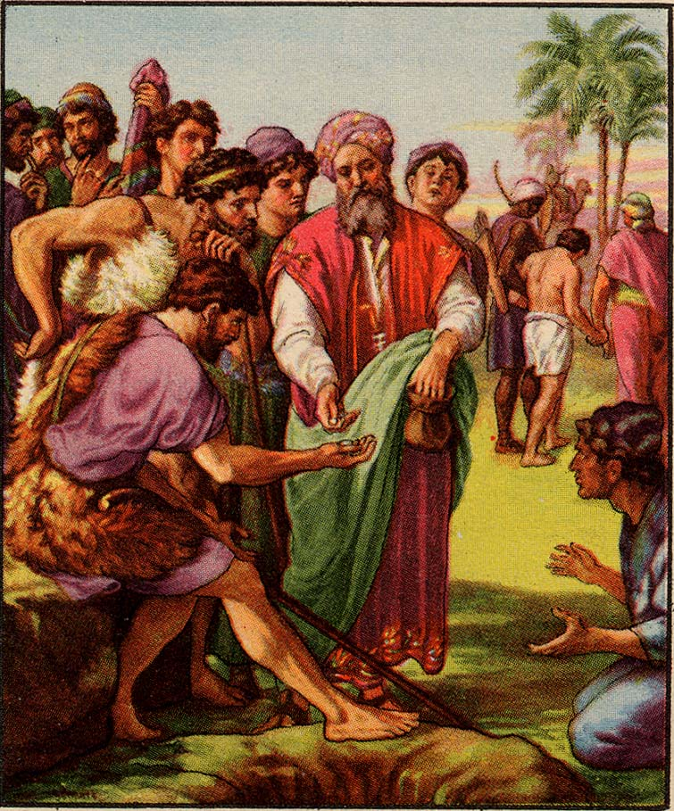
Restored Creation and Creatures
Rueben the incestuous, Simeon and Levi the murderers, Judah the whoremonger, the rest full of treachery and deceit; all will be there because thru the grace of Christ and their willingness to die to self, they have overcome and been washed in the blood of the Lamb

Slide 16
The Restorer
“Faithfully did he repent of his sin and trust in the merits of the promised Saviour, and he died in the hope of a resurrection. The Son of God redeemed man's failure and fall; and now, through the work of the atonement, Adam is reinstated in his first dominion. Transported with joy, he beholds the trees that were once his delight--the very trees whose fruit he himself had gathered in the days of his innocence and joy. He sees the vines that his own hands have trained, the very flowers that he once loved to care for. His mind grasps the reality of the scene; he comprehends that this is indeed Eden restored, more lovely now than when he was banished from it. The Saviour leads him to the tree of life and plucks the glorious fruit and bids him eat. He looks about him and beholds a multitude of his family redeemed, standing in the Paradise of God. Then he casts his glittering crown at the feet of Jesus and, falling upon His breast, embraces the Redeemer. He touches the golden harp, and the vaults of heaven echo the triumphant song: "Worthy, worthy, worthy is the Lamb that was slain, and lives again!" The family of Adam take up the strain and cast their crowns at the Saviour's feet as they bow before Him in adoration.” GC. Pg.

Slide 17
The 12 Apostles
“And the wall of the city had twelve foundations, and in them the names of the twelve apostles of the Lamb. And he that talked with me had a golden reed to measure the city, and the gates thereof, and the wall thereof. And the city lieth foursquare, and the length is as large as the breadth: and he measured the city with the reed, twelve thousand furlongs. The length and the breadth and the height of it are equal. And he measured the wall thereof, an hundred and forty and four cubits, according to the measure of a man, that is, of the angel. And the building of the wall of it was of jasper: and the city was pure gold, like unto clear glass. “ Rev. 21:14-18
The grace of Christ transformed men with evil tempers, men with lustful thoughts, men who had a hard time trusting, men who wanted to do things their way; the grace of God transformed them. Praise God for His wonders that He performs!
“All who have truly repented of sin, and by faith claimed the blood of Christ as their atoning sacrifice, have had pardon entered against their names in the books of heaven; as they have become partakers of the righteousness of Christ, and their characters are found to be in harmony with the law of God, their sins will be blotted out, and they themselves will be accounted worthy of eternal life.” GC. Pg. 483

Slide 18
Furlongs
It is equal to one-eighth of a mile, 220 yards, 660 feet or 201.168 meters.^{[1]}
Five furlongs are approximately 1 kilometer (1.00584 km to be exact). Since the original definition of the meter was one-quarter of one ten-millionth of the circumference of the Earth (along the great circle coincident with the meridian of longitude passing through Paris), the circumference of the Earth is about 40,000 km or about 200,000 furlongs.
The city is 12,000 furlongs.
220 x 12,000= 264,000 yards or 1500 miles. This is the flying distance between Miami to Boston. This is the length and breadth of the New Jerusalem.

Slide 19
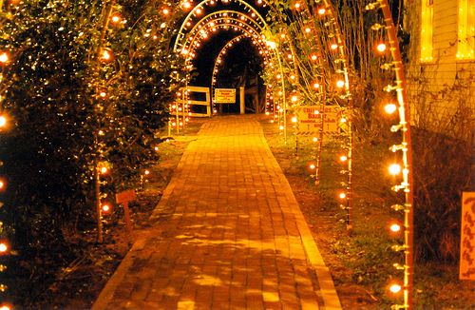
Eye Has not Seen
“But as it is written, Eye hath not seen, nor ear heard, neither have entered into the heart of man, the things which God hath prepared for them that love him.” 1Corinthians 2:9

Slide 20
The City and the Priest
“And the foundations of the wall of the city were garnished with all manner of precious stones. The first foundation was jasper; the second, sapphire; the third, a chalcedony; the fourth, an emerald; The fifth, sardonyx; the sixth, sardius; the seventh, chrysolite; the eighth, beryl; the ninth, a topaz; the tenth, a chrysoprasus; the eleventh, a jacinth; the twelfth, an amethyst. And the twelve gates were twelve pearls; every several gate was of one pearl: and the street of the city was pure gold, as it were transparent glass.” Rev. 21:19-21
“And thou shalt set in it settings of stones, even four rows of stones: the first row shall be a sardius, a topaz, and a carbuncle: this shall be the first row. And the second row shall be an emerald, a sapphire, and a diamond. And the third row a ligure, an agate, and an amethyst. And the fourth row a beryl, and an onyx, and a jasper: they shall be set in gold in their inclosings. “ Ex. 28:17-20

Slide 21
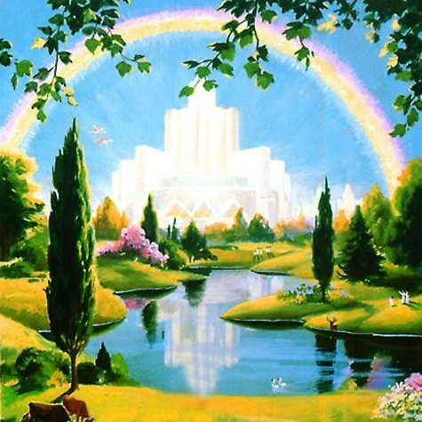
Awesome
“And I saw no temple therein: for the Lord God Almighty and the Lamb are the temple of it. And the city had no need of the sun, neither of the moon, to shine in it: for the glory of God did lighten it, and the Lamb is the light thereof. And the nations of them which are saved shall walk in the light of it: and the kings of the earth do bring their glory and honour into it. And the gates of it shall not be shut at all by day: for there shall be no night there. And they shall bring the glory and honour of the nations into it.” Rev. 21:22-26

Slide 22
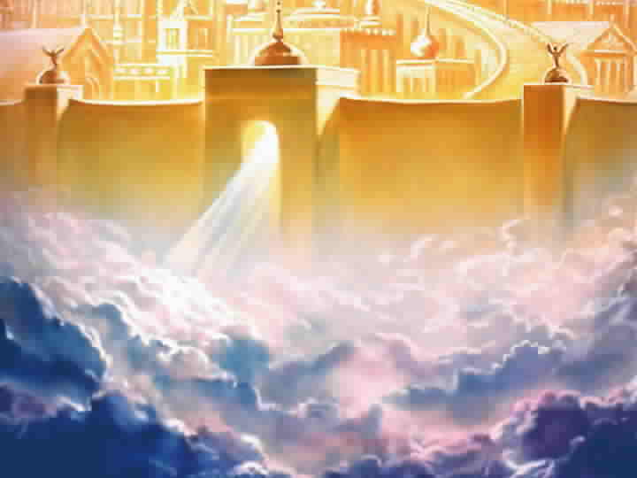
Behold!!!!!!!!!!!!!!!!
“But as it is written, Eye hath not seen, nor ear heard, neither have entered into the heart of man, the things which God hath prepared for them that love him.” 1Corinthians 2:9

Slide 23
Eternity
“The loves and sympathies which God Himself has planted in the soul shall there find truest and sweetest exercise. The pure communion with holy beings, the harmonious social life with the blessed angels and with the faithful ones of all ages who have washed their robes and made them white in the blood of the Lamb, the sacred ties that bind together "the whole family in heaven and earth" (Ephesians 3:15)--these help to constitute the happiness of the redeemed. There, immortal minds will contemplate with never-failing delight the wonders of creative power, the mysteries of redeeming love. There will be no cruel, deceiving foe to tempt to forgetfulness of God. Every faculty will be developed, every capacity increased. The acquirement of knowledge will not weary the mind or exhaust the energies. There the grandest enterprises may be carried forward, the loftiest aspirations reached, the highest ambitions realized; and still there will arise new heights to surmount, new wonders to admire, new truths to comprehend, fresh objects to call forth the powers of mind and soul and body. All the treasures of the universe will be open to the study of God's redeemed….

Slide 24
Continued
Unfettered by mortality, they wing their tireless flight to worlds afar--worlds that thrilled with sorrow at the spectacle of human woe and rang with songs of gladness at the tidings of a ransomed soul. With unutterable delight the children of earth enter into the joy and the wisdom of unfallen beings. They share the treasures of knowledge and understanding gained through ages upon ages in contemplation of God's handiwork. With undimmed vision they gaze upon the glory of creation--suns and stars and systems, all in their appointed order circling the throne of Deity. Upon all things, from the least to the greatest, the Creator's name is written, and in all are the riches of His power displayed. And the years of eternity, as they roll, will bring richer and still more glorious revelations of God and of Christ. ..The more men learn of God, the greater will be their admiration of His character. As Jesus opens before them the riches of redemption and the amazing achievements in the great controversy with Satan, the hearts of the ransomed thrill with more fervent devotion, and with more rapturous joy they sweep the harps of gold; and ten thousand times ten thousand and thousands of thousands of voices unite to swell the mighty chorus of praise. “ GC. Pgs. 677,678

Slide 25
Is My Name Written There?
“And there shall in no wise enter into it any thing that defileth, neither whatsoever worketh abomination, or maketh a lie: but they which are written in the Lamb's book of life.”
“He that overcometh, the same shall be clothed in white raiment; and I will not blot out his name out of the book of life, but I will confess his name before my Father, and before his angels.”

