Slide 1
What is the Difference Between Mormons, Jehovah’s Witnesses, and Seventh-day Adventists? pt 12

Slide 2
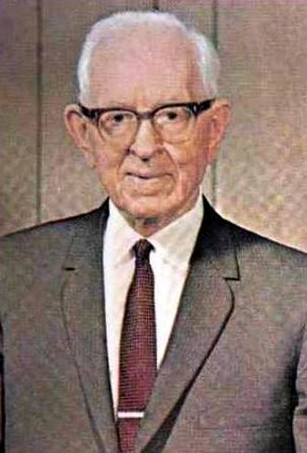
Mormonism—Against Marriage and Families
“When the wife is faithful and desires to obey the divine law and the husband is rebellious, or unwilling to obey the will of the Lord, if she maintains her integrity to the best of her ability, she will be given to another husband in eternity and will receive all the blessings of the celestial kingdom.” (Joseph Fielding Smith, Doctrines and Salvation, Answers to Gospel Questions, Vol. 3, Pg. 23, 24. Pub. 195)

Slide 3
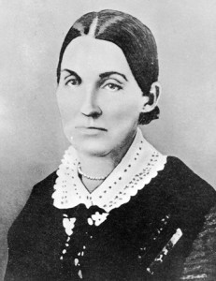
Emma, Get with the Program or Die
“54 And I command mine handmaid, Emma Smith, to abide and cleave unto my servant Joseph, and to none else. But if she will not abide this commandment she shall be destroyed, saith the Lord; for I am the Lord thy God, and will destroy her if she abide not in my law. 55 But if she will not abide this commandment, then shall my servant Joseph do all things for her, even as he hath said; and I will bless him and multiply him and give unto him an hundred-fold in this world, of fathers and mothers, brothers and sisters, houses and lands, wives and children, and crowns of eternal lives in the eternal worlds. . . 61 And again, as pertaining to the law of the priesthood—if any man espouse a virgin, and desire to espouse another, and the first give her consent, and if he espouse the second, and they are virgins, and have vowed to no other man, then is he justified; he cannot commit adultery for they are given unto him; for he cannot commit adultery with that that belongeth unto him and to no one else. 62 And if he have ten virgins given unto him by this law, he cannot commit adultery, for they belong to him, and they are given unto him; therefore is he justified. (D&C 132:54-55, 61-62)

Slide 4
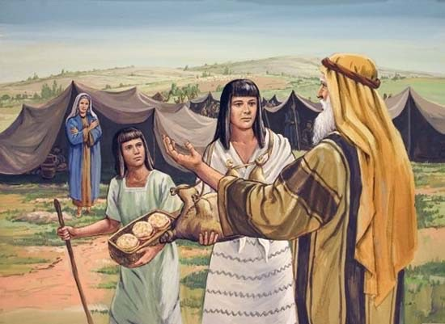
God Told Abraham to Take Hagar?
“63 But if one or either of the ten virgins, after she is espoused, shall be with another man, she has committed adultery, and shall be destroyed; for they are given unto him to multiply and replenish the earth, according to my commandment, and to fulfil the promise which was given by my Father before the foundation of the world, and for their exaltation in the eternal worlds, that they may bear the souls of men; for herein is the work of my Father continued, that he may be glorified. . . . 65 Therefore, it shall be lawful in me, if she receive not this law, for him to receive all things whatsoever I, the Lord his God, will give unto him, because she did not believe and administer unto him according to my word; and she then becomes the transgressor; and he is exempt from the law of Sarah, who administered unto Abraham according to the law when I commanded Abraham to take Hagar to wife.” (D&C 132:63, 65)

Slide 5
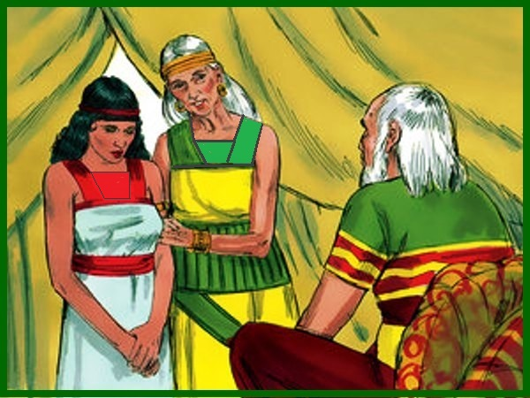
The Bible Disproves D&C 132
Gen. 16:1-4 “Now Sarai Abram's wife bare him no children: and she had an handmaid, an Egyptian, whose name was Hagar. And Sarai said unto Abram, Behold now, the Lord hath restrained me from bearing: I pray thee, go in unto my maid; it may be that I may obtain children by her. And Abram hearkened to the voice of Sarai. And Sarai Abram's wife took Hagar her maid the Egyptian, after Abram had dwelt ten years in the land of Canaan, and gave her to her husband Abram to be his wife. And he went in unto Hagar, and she conceived: and when she saw that she had conceived, her mistress was despised in her eyes”

Slide 6
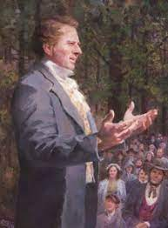
No Wonder He Said This…
“I charged the Saints not to follow the example of the adversary in accusing the brethren, and said “if you do not accuse each other God will not accuse you. If you have no accuser you will enter heaven; and if you will follow the Revelations and instructions which God gives you through me, I will take you into heaven as my back load. If you will not accuse me, I will not accuse you. If you will throw a cloak of charity over my sins, I will over yours— for charity covereth a multitude of sins. What many people call sin is not sin; I do many things to break down superstition, and I will break it down:” (History, 1838–1856, volume C-1 Addenda)

Slide 7
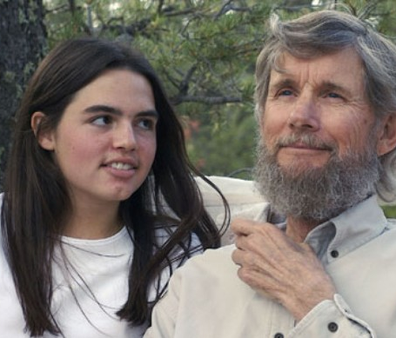
Interesting Insights From Jonathan Streeter
"Keep in mind that special divine permission is nothing new... Self proclaimed prophet David Koresh and the Branch Davidians claimed special divine permission to take child brides for the purpose of producing the 24 elders foretold in the Book of Revelations. Self proclaimed prophet Wayne Bent of the Lord Our Righteousness Church claimed special divine permission for having sexual relations with children, even his own daughter in law in order to avoid God's punishment. Self proclaimed prophet Julius Shacknow of the sect known as The Work, claimed special privilege to promise salvation in exchange for sexual intercourse with women and children, including his own stepdaughter. Self proclaimed prophet Tony Alamo of Alamo Christian Ministries claimed special biblical permission to illegally marry multiple women and children. Self proclaimed prophet David Berg of the Children of God claimed special divine permission to normalize sexual relation with children. Prophets, justifying their own predations as special, divine permission through the use of pious language and religious sentiment, is nothing new.“—Jonathan Streeter, Mormon Discussion: 342: Nancy Rigdon and the Happiness Letter by Bill, August 21, 2019

Slide 8
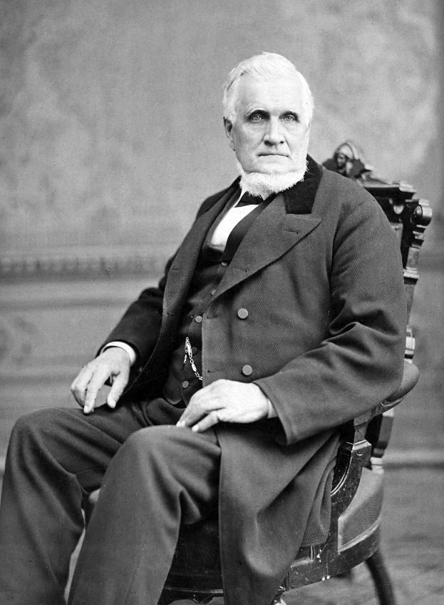
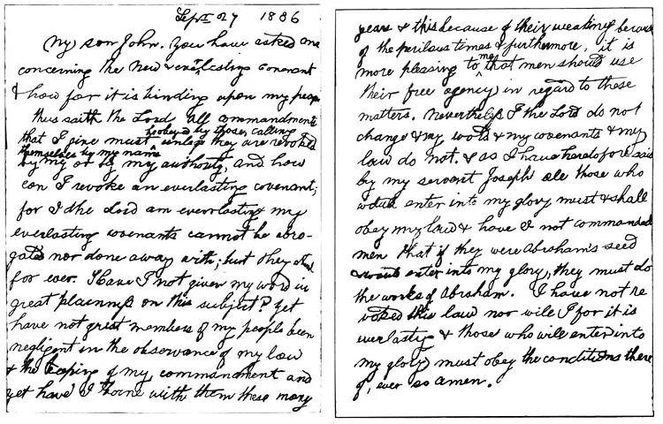

Slide 9
John Taylor’s Revelation
1886 Revelation: Given to President John Taylor September 27, 1886
“My son John, you have asked me concerning the New and Everlasting Covenant how far it is binding upon my people. Thus saith the Lord: All commandments that I give must be obeyed by those calling themselves by my name unless they are revoked by me or by my authority, and how can I revoke an everlasting covenant, for I the Lord am everlasting and my everlasting covenants cannot be abrogated nor done away with, but they stand forever. Have I not given my word in great plainness on this subject? Yet have not great numbers of my people been negligent in the observance of my law and the keeping of my commandments, and yet have I borne with them these many years; and this because of their weakness—because of the perilous times, and furthermore, it is more pleasing to me that men should use their free agency in regard to these matters. Nevertheless, I the Lord do not change and my word and my covenants and my law do not, and as I have heretofore said by my servant Joseph: All those who would enter into my glory must and shall obey my law. And have I not commanded men that if they were Abraham’s seed and would enter into my glory, they must do the works of Abraham. I have not revoked this law, nor will I, for it is everlasting, and those who will enter into my glory must obey the conditions thereof; even so, Amen.”

Slide 10
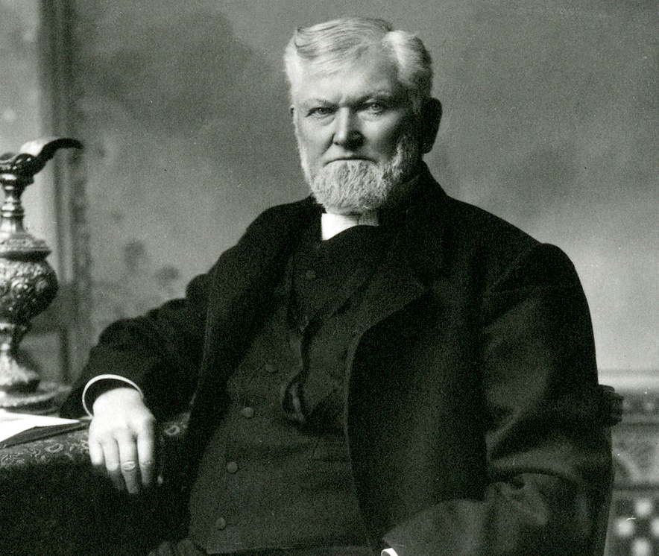
Mormon Double Talk
Prophet Woodruff stated in 1888: “We are not going to stop the practice of plural marriage until the Coming of the Son of Man.” (Diary of Heber J. Grant, Prophet Woodruff at the Manti Temple Dedication, May 17, 1888)
Official Declaration of 1890: “We are not teaching polygamy or plural marriage, nor permitting any person to enter into its practice, and I deny that either forty or any other number of plural marriages have during that period been solemnized in our Temples or in any other place in the Territory.” (D&C, Official Declaration)

Slide 11
The Conclusion…
Evidence that Doctrines and Covenants is not of God:
“Lectures on Faith” Removed by later leadership, even though high-ranking leaders insist it is Scripture (by other LDS denominations as well)—it also contains doctrines which contradict current teachings
Updates and Revisions don’t just add, but change the meanings of former passages, always expanding Joseph Smith’s privileges and never curtailing them—even though high-ranking members say falsely that it had not been changed. Do your own research! “scripture does not change”
The D&C condemns and weakens any and all possible opposition to Joseph Smith’s power and/or desires. Oliver Cowdery’s role is weakened between 1833 vs 1835 editions. Emma is threatened with eternal death if she does not allow Joseph to cheat on her
The D&C contradicts and removes former passages– D&C 5, D&C 101 vs D&C 132
The D&C contradicts the Book of Mormon Jacob 2 vs D&C 132
The D&C is anti-family, anti-marriage, and promotes the idea that a woman’s heaven is to be an eternally pregnant concubine who shares a husband with dozens to hundred, and even thousands of other women
The D&C contradicts the Bible, Abraham’s Story, the Word of God does not change

Slide 12
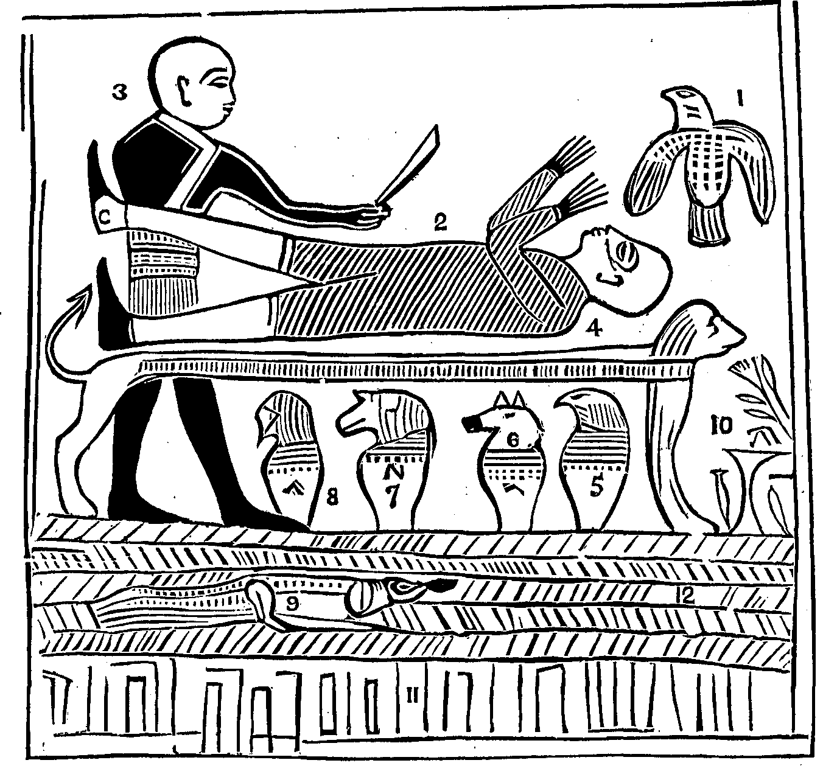
The Book of Abraham: Backdrop
“In the summer of 1835, an entrepreneur named Michael Chandler arrived at Church headquarters in Kirtland, Ohio, with four mummies and multiple scrolls of papyrus. Chandler found a ready audience... By the time the collection arrived in Kirtland, all but four mummies and several papyrus scrolls had already been sold. A group of Latter-day Saints in Kirtland purchased [for $2,400] the remaining artifacts for the Church. After Joseph Smith examined the papyri and commenced "the translation of some of the characters or hieroglyphics," his history recounts, "much to our joy [we] found that one of the rolls contained the writings of Abraham.“ churchofjesuschrist.org, Gospel Essays, Translation and Historicity of the Book of Abraham
The Book of Abraham was probably translated between 1835-1842

Slide 13
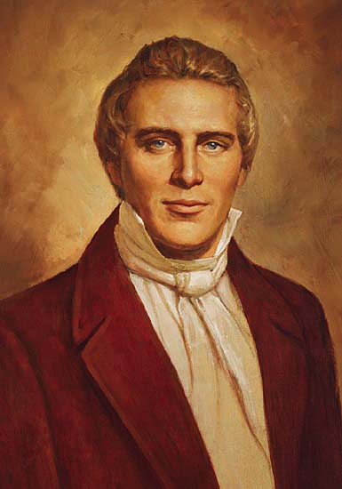
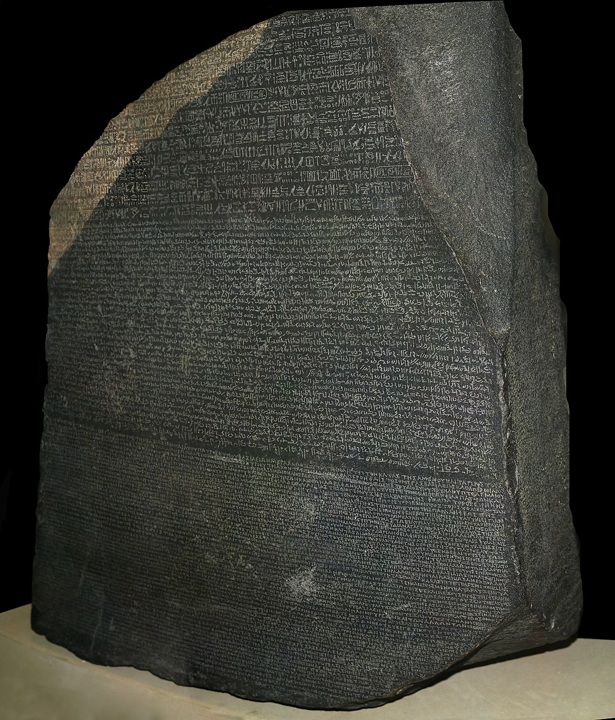
Joseph Smith, True or False Prophet?
Something really important to remember is that the 1800s America (and many European countries) were going through a time which would later be referred to as Egypt-mania. Fascination with ancient Egyptian artifacts, mummies, and writings were extremely popular, as a means of gaining “hidden knowledge” for some and just cool for others. Joseph Smith and Charles Taze Russell both clearly were enamoured with Egypt as their theology reflects in their origin stories. The Rosetta Stone was found in 1799 by Napolean’s armies. Jean-François Champollion announced that he had finally deciphered the stone on September 22, 1822, which was written in Egyptian heiroglyphics, Egyptian cursive (demotic script) and Greek. In America it was not widely known that Egyptian hieroglyphic writing had been decoded, so Joseph Smith claiming the ability to translate Egyptian posed no risk to his office or reputation—he could not be checked on this, or so he thought. The original papyris were thought to have been lost in the Chicago fire, but facsimiles were later found and authenticated by the Mormon church. Let’s take a closer look!

Slide 14
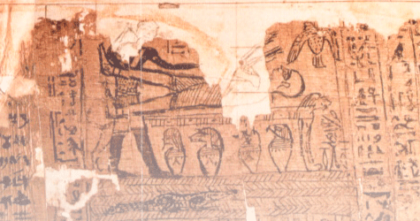

Slide 15
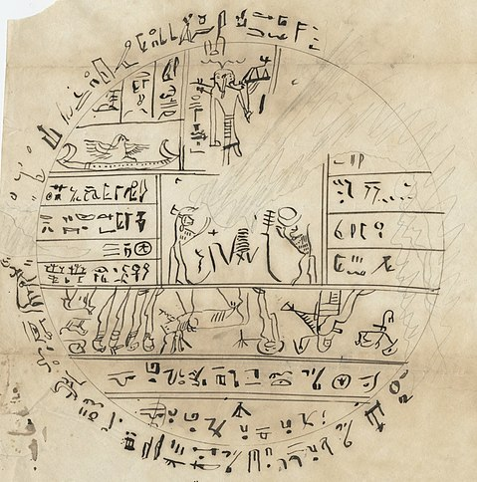
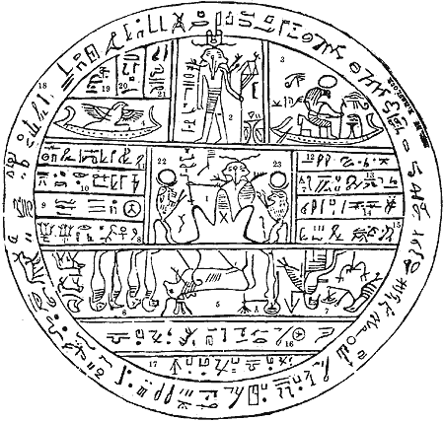
Facsimile 2

Slide 16
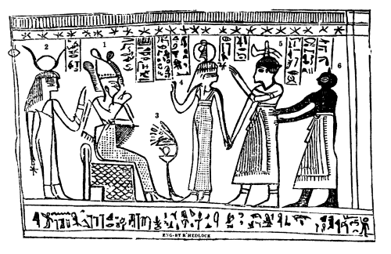
Facsimile 3

Slide 17
Facsimile 1
Fraudulent Translation
Egyptologist Gustav Seyffarth stated in 1856: “The papyrus roll is not a record but an invocation to the Deity Osiris, in which occurs the name of the person, and a picture of the attendant spirits, introducing the dead to the Judge, Osiris." (Ritner, Robert K. (2013). The Joseph Smith Egyptian Papyri: A Complete Edition, p. 62)

Slide 18
Another Egyptologist
“It was sometime during the year 1856, about five years after the Pearl of Great Price had been printed in England, when one of the small pamphlets found its way to the Louvre in Paris. There the facsimiles from the Book of Abraham, together with Joseph's accompanying explanations, were brought to the attention of M. Theodule Deveria. As one of the pioneers in the field of Egyptology, Deveria was asked to offer any comments on them he cared to make. To Deveria the project probably did not seem worth the minimal effort it would require. However, he proceeded, and immediately recognized all three drawings as copies of rather common Egyptian funerary documents, of which he had examined hundreds. . . . most of the major elements fit very well into the established pattern associated with Egyptian mythology and the preparation of common funerary documents. Enough of the writing was legible for Deveria to decipher the names and titles of various Egyptian gods and goddesses, and on one of the drawings (Facsimile No. 3) he was able to determine the name of the deceased Egyptian for whom the scroll had originally been prepared. Concerning Facsimile No. 3 he wrote: The deceased led by Ma into the presence of Osiris. His name is Horus, as may be seen in the prayer which is at the bottom of the picture, and which is addressed to the divinities of the four cardinal points.” (Charles Larson, By His Own Hand Upon Papyrus, p. 10)

Slide 19
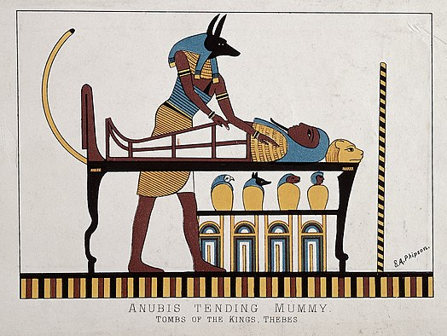

Slide 20
Translation vs Reality
Joseph-Angel of the LORD, Reality-The ba-spirit Osiris, miscopied with the head of a bird rather than that of a human
Joseph-Abraham Reality-Osirus
Joseph-Idolatrous Priest Elkenah about to offer Abraham as a sacrifice, Reality-Anubis

Slide 21
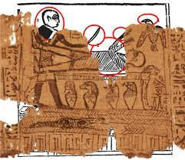
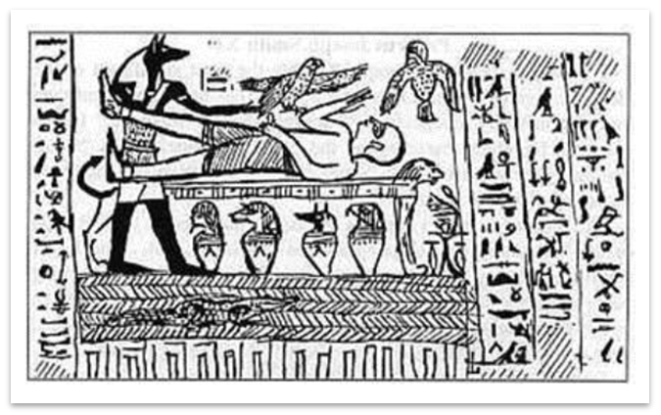
The Mormon Church Admits Its Fake
"None of the characters on the papyrus fragments mentioned Abraham’s name or any of the events recorded in the book of Abraham. Mormon and non-Mormon Egyptologists agree that the characters on the fragments do not match the translation given in the book of Abraham, though there is not unanimity, even among non-Mormon scholars, about the proper interpretation of the vignettes on these fragments. Scholars have identified the papyrus fragments as parts of standard funerary texts that were deposited with mummified bodies. These fragments date to between the third century B.C.E. and the first century C.E., long after Abraham lived.“—churchofjesuschrist.org, Gospel Topics Essays, The Book of Abraham

Slide 22
The Conclusion…
Evidence that the Book of Abraham is not of God:
It is clear that Joseph Smith was banking on the hope that Egyptian would never be translated and thus reveal him to be a false prophet and charlatan, but Egyptian was deciphered, and Joseph short-term gain in wooing his followers with his prophetic translation abilities, turned into a long-term loss
Joseph, by “revelation” filled in the missing pieces of the papyris that was found with incorrect information—both the translation and the images produced by Joseph Smith are verifiably false
The Book of Abraham is actually common funerary documents intended to prepare the dead for the afterlife—the writing is actually one of the most common Egyptian artifacts that you will find—again, Joseph Smith is simply not telling the truth about this writing.

Slide 23
Time-setting Again! 1975
"Choosing the Best Way of Life". The Watchtower. March 15, 1980. pp. 17–18. With the appearance of the book Life Everlasting—in Freedom of the Sons of God, ... considerable expectation was aroused regarding the year 1975. ... there were other statements published that implied that such realization of hopes by that year was more of a probability than a mere possibility. It is to be regretted that these latter statements apparently overshadowed the cautionary ones and contributed to a buildup of the expectation already initiated. ... persons having to do with the publication of the information ... contributed to the buildup of hopes centered on that date.
"What will the 1970's Bring?". Awake!. Watch Tower Society. October 8, 1968. p. 14. Does this mean that the above evidence positively points to 1975 as the complete end of this system of things? Since the Bible does not specifically state this, no man can say... If the 1970s should see intervention by Jehovah God to bring an end to a corrupt world drifting toward ultimate disintegration, that should surely not surprise us.
"How Are You Using Your Life?". Our Kingdom Ministry. May 1, 1974. p. 63. Reports are heard of brothers selling their homes and property and planning to finish out the rest of their days in this old system in the pioneer service. Certainly, this is a fine way to spend the short time remaining before the wicked world's end.

Slide 24
Decline of the Watch Tower After Death
Chicago Daily Tribune October 30, 1949 pg 18: "Pastor Russell died in 1916. In the 33 years since, the methods of this sect have deviated completely from those of Pastor Russell and his manner of teaching."

