Slide 1
War -Ukraine, pt. 3

Slide 2
Ellen White and the Great Controversy’s End Look
Over the last 45 years, Ellen white has come under satanic attack inside and outside the church! Here are a few of the attacks:
1. Desmond Ford- 1970’s
2. Walter Rea- 1980’s
3. Neil Wilson, George Vandemann, also 1980’s
4. William Johnson, Roy Adams, General Conference, 1990’s
5. Ted Wilson, Jan Paulsen, Guanone Diop, 2,000’s
6. Jan Paulien, Loren Seibold, 2,000’s
All have subtly or openly attacked Ellen White and her understanding of end time events. All of them have been shown to be pretenders. The great controversy theme still stands today!!

Slide 3
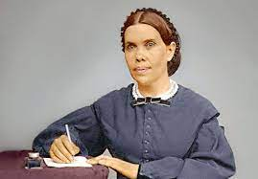
She has been led of God to declare the following as key movers and shakers in end time events. These are all in harmony with Scripture!
1. The papal power “The Roman Church is far-reaching in her plans and modes of operation. She is employing every device to extend her influence and increase her power in preparation for a fierce and determined conflict to regain control of the world, to re-establish persecution, and to undo all that Protestantism has done.” GC. Pg. 565
The papacy is rising today!!

Slide 4
The Threefold Union!
2. Apostate Protestantism “When the leading churches of the United States, uniting upon such points of doctrine as are held by them in common, shall influence the state to enforce their decrees and to sustain their institutions, then Protestant America will have formed an image of the Roman hierarchy, and the infliction of civil penalties upon dissenters will inevitably result.” GC, pg. 445
This is happening!
3. Spiritualism “The Protestants of the United States will be foremost in stretching their hands across the gulf to grasp the hand of spiritualism; they will reach over the abyss to clasp hands with the Roman power; and under the influence of this threefold union, this country will follow in the steps of Rome in trampling on the rights of conscience.”
The Virgin Mary is being invoked bigtime over Ukraine!

Slide 5
Apostasy in Adventism
“As the storm approaches, a large class who have professed faith in the third angel's message, but have not been sanctified through obedience to the truth, abandon their position and join the ranks of the opposition. By uniting with the world and partaking of its spirit, they have come to view matters in nearly the same light; and when the test is brought, they are prepared to choose the easy, popular side. Men of talent and pleasing address, who once rejoiced in the truth, employ their powers to deceive and mislead souls. They become the most bitter enemies of their former brethren. When Sabbath keepers are brought before the courts to answer for their faith, these apostates are the most efficient agents of Satan to misrepresent and accuse them, and by false reports and insinuations to stir up the rulers against them.” GC, pg. 608 Right before our Eyes!!

Slide 6
Natural Disasters Used to bring in Sunday
“In accidents and calamities by sea and by land, in great conflagrations, in fierce tornadoes and terrific hailstorms, in tempests, floods, cyclones, tidal waves, and earthquakes, in every place and in a thousand forms, Satan is exercising his power. He sweeps away the ripening harvest, and famine and distress follow. He imparts to the air a deadly taint, and thousands perish by the pestilence. These visitations are to become more and more frequent and disastrous. Destruction will be upon both man and beast. “The earth mourneth and fadeth away,” “the haughty people ... do languish. The earth also is defiled under the inhabitants thereof; because they have transgressed the laws, changed the ordinance, broken the everlasting covenant.” Isaiah 24:4, 5.
And then the great deceiver will persuade men that those who serve God are causing these evils. The class that have provoked the displeasure of Heaven will charge all their troubles upon those whose obedience to God's commandments is a perpetual reproof to transgressors. It will be declared that men are offending God by the violation of the Sunday sabbath; that this sin has brought calamities which will not cease until Sunday observance shall be strictly enforced;…” GC, pg.589,590

Slide 7
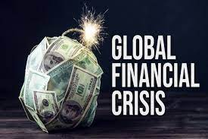
One Other Major Element- Financial Collapse
“And he causeth all, both small and great, rich and poor, free and bond, to receive a mark in their right hand, or in their foreheads: And that no man might buy or sell, save he that had the mark, or the name of the beast, or the number of his name.” Rev. 13:16,17
“When our nation, in its legislative councils, shall enact laws to bind the consciences of men in regard to their religious privileges, enforcing Sunday observance, and bringing oppressive power to bear against those who keep the seventh-day Sabbath, the law of God will, to all intents and purposes, be made void in our land, and national apostasy will be followed by national ruin.--7BC 977 (1888). {LDE 133.5}
“It is at the time of the national apostasy when, acting on the policy of Satan, the rulers of the land will rank themselves on the side of the man of sin. It is then the measure of guilt is full. The national apostasy is the signal for national ruin.--2SM 373 (1891). {LDE 134.1}

Slide 8
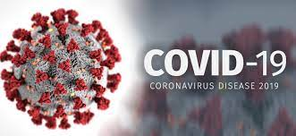
First the Pandemic….
‘The economic fallout from COVID-19 dominates risk perceptions, but there is a unique opportunity to reshape the global economy.
Greenpeace International’s Jennifer Morgan, IMF chief economist Gita Gopinath and ITUC head Sharan Burrow discuss how they perceive a reset.
There won’t be many among the 7.7 billion people on Earth who haven’t been affected in some way by COVID-19.
From sickness and the death of loved ones to work shortages and school closures, the pandemic’s ramifications have touched every part of society – and thrown inequalities into sharp relief.’ World Economic Forum

Slide 9
“With the virus, Rome wanted to destroy the economies of the prosperous nations of earth and create the Great Reset whereby all people would become salves, basically, to the Vatican! Listen to this, “Amid the 2020 global covid lockdowns and economic dislocations it has caused, Klaus Schwab, a previously low-profile founder of a Swiss-based business forum, emerged on the world stage calling for what he called a Great Reset of the entire world economy, using the pandemic as driver. He even published a book in July 2020 outlining his blueprint. It has been rightly called a technocratic society with global top-down central planning. Schwab uses global warming fears and the plight of the world's poor to justify what is in effect a plan for global totalitarianism where, as the Davos website puts it, nobody will own anything. What is not well-known is the fact that the inspiration for Schwab's dystopian plans comes from a Catholic bishop whom he met in Brazil in the 1970's. That bishop links Schwab's vast globalist network with the powerful political influence of the present Pope Francis.” F. William Engdahl New Eastern Outlook, Fri, 24 Dec 2021

Slide 10
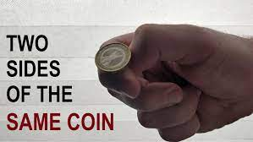
Didn’t Get it; Try Again!
“Klaus Schwab and the WEF happily announced that the pandemic was the beginning of the “Great Reset” and the 4th Industrial Revolution, stating that the covid crisis presented a perfect “opportunity” for change… Imagine if they had the power to simply shut down your ability to get a job, to shop in grocery stores and even shut down access to your money?” ,” What Is The “Great Reset” And What Do the Globalists Actually Want? Brandon Smith

Slide 11
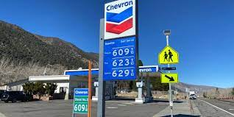
CoVid: The Beginning: The War phase Two
For 2 plus years, it was virus, virus, and more virus! All of a sudden, the virus virtually died, and the war in the Ukraine took front and center! A gentleman from Ghana asked me this question, “What suddenly has just happened that Covid-19 has disappeared and now Russia vs Ukraine. Where are we heading?” CoVid 19 was headline news for a few years and then, all of a sudden, it is virtually gone! I’m talking about the virus. Where did it go? And then, out of the blue, there is a war in the Ukraine. Front page headlines for weeks now. This seemed very choreographed, planned to the hilt. Is there a connection to covid 19 and the war in the Ukraine?

Slide 12
How War in Ukraine Threatens the World’s Economic Recovery Bloomberg Economics examines how the conflict could impact growth, inflation and monetary policy. ByBen Holland, Scott Johnson, Jamie Rush, Anna Wong, and Tom Orlik February 25, 2022

Slide 13
Choreographed???
“Russia’s invasion of Ukraine carries huge risks for a world economy that’s yet to fully recover from the pandemic shock…The assault followed weeks of tensions that already sent tremors through the world economy by ratcheting up energy prices. That accelerated on Thursday. Oil briefly climbed past $100 a barrel for the first time since 2014, while European natural gas jumped as much as 62%... As Ukraine fights for survival, Western governments are taking steps to punish Russia. They’re aware that by doing so, they could heighten the conflict’s impact on their own economies. U.S. President Joe Biden — who on Thursday announced new sanctions that target Russia’s banks and its ability to trade in dollars — has warned that there’ll be also a price to pay at home, where expensive gasoline is already eroding his support among voters.”

Slide 14
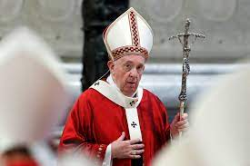
The Economy of Pope Francis Will Transform the World in Preparation for the Coming Mark of the Beast
This is the actual image and message of the Laudato Si’ Action Platform. It reveals their global aspirations to unite the whole world on Catholic social doctrine (Revelation 13:3).
Anthony M. Annett is a professor at Fordham Jesuit University’s Gabelli School of Business. [2] Jeffrey Sachs is an American economist who was recently named to the Vatican-based Pontifical Academy of Social Sciences by Pope Francis. [3] These two individuals collaborated on an essay that appeared in the National Catholic Reporter on March 29, 2022, and lays out the Vatican’s strategy for the future new economy and the construction of a “better world.” They claim that by embracing the “Economy of Francesco,” a global Catholic initiative based on Pope Francis’ teachings, notably Laudato Si’ and Fratelli Tutti, a better world with a new economic structure may be achieved.” Advent Messenger

Slide 15
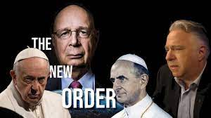
CoVid 19, War in Ukraine Set Up for New Economy?
“And he exerciseth all the power of the first beast before him, and causeth the earth and them which dwell therein to worship the first beast, whose deadly wound was healed. And he doeth great wonders, so that he maketh fire come down from heaven on the earth in the sight of men, And deceiveth them that dwell on the earth by the means of those miracles which he had power to do in the sight of the beast; saying to them that dwell on the earth, that they should make an image to the beast, which had the wound by a sword, and did live. And he had power to give life unto the image of the beast, that the image of the beast should both speak, and cause that as many as would not worship the image of the beast should be killed. And he causeth all, both small and great, rich and poor, free and bond, to receive a mark in their right hand, or in their foreheads: And that no man might buy or sell, save he that had the mark, or the name of the beast, or the number of his name.” Rev. 13:12-17

