Slide 1
The Magnificence of Literature Evangelism!

Slide 3
Does God NEED Literature Evangelism to spread the Gospel???
Answer: Absolutely NOT! God doesn’t “NEED” anything! He is fully self-sufficient in every way! No question at all—God’s Will is in no way reliant on anyone or anything!

Slide 4
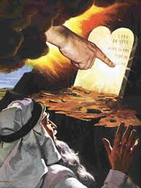
The Importance of Literature in the Bible
Ex. 31:18 “And he gave unto Moses, when he had made an end of communing with him upon mount Sinai, two tables of testimony, tables of stone, written with the finger of God.”
2 Kings 2:19 “And the rest of the acts of Joash, and all that he did, are they not written in the book of the chronicles of the kings of Judah?”

Slide 5
Prophecies are Locked in Literature!
Daniel 12:4 “But thou, O Daniel, shut up the words, and seal the book, even to the time of the end: many shall run to and fro, and knowledge shall be increased.”
Revelation 10:10 “And I took the little book out of the angel's hand, and ate it up; and it was in my mouth sweet as honey: and as soon as I had eaten it, my belly was bitter.”

Slide 6
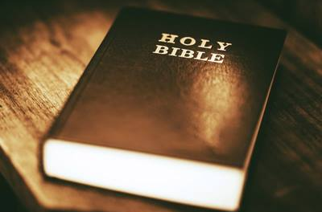
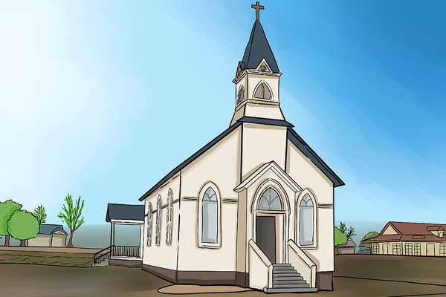
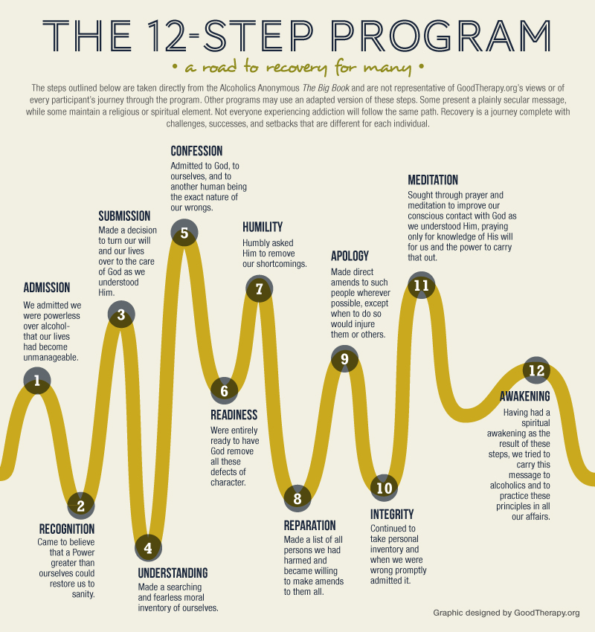
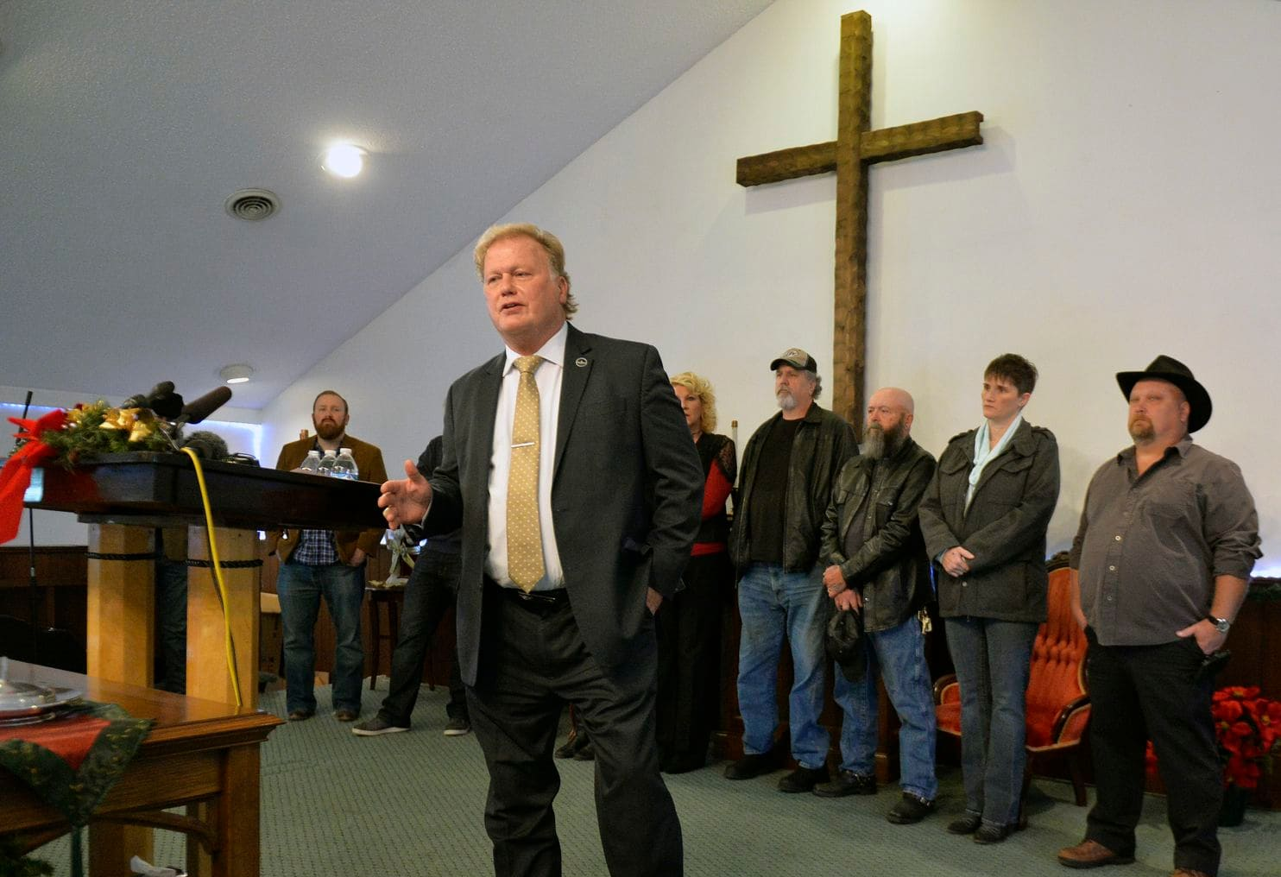
Literature is the “Chosen Vessel”

Slide 7
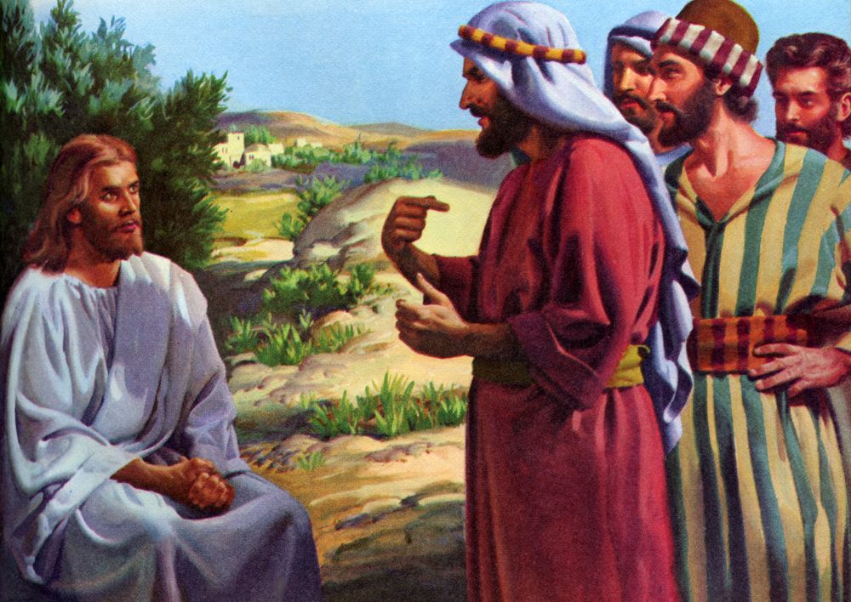
There was only 1 time on Earth that salvation was found in a preacher! And what did He say?
Luke 10:24-28 “For I tell you, that many prophets and kings have desired to see those things which ye see, and have not seen them; and to hear those things which ye hear, and have not heard them. And, behold, a certain lawyer stood up, and tempted him, saying, Master, what shall I do to inherit eternal life? He said unto him, What is written in the law? how readest thou? And he answering said, Thou shalt love the Lord thy God with all thy heart, and with all thy soul, and with all thy strength, and with all thy mind; and thy neighbour as thyself. And he said unto him, Thou hast answered right: this do, and thou shalt live.”

Slide 8
“A sermon may be preached and soon forgotten, but a book remains”(Life Sketches, p. 382).

Slide 9
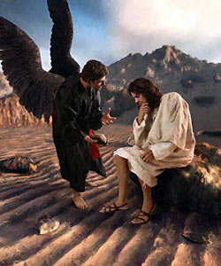
Jesus’ Biggest and Many Times Only Weapon…
Matt 4:3-4, 7, “And when the tempter came to him, he said, If thou be the Son of God, command that these stones be made bread. But he answered and said, It is written, Man shall not live by bread alone, but by every word that proceedeth out of the mouth of God. . . Jesus said unto him, It is written again, Thou shalt not tempt the Lord thy God. . . Then saith Jesus unto him, Get thee hence, Satan: for it is written, Thou shalt worship the Lord thy God, and him only shalt thou serve.

Slide 10
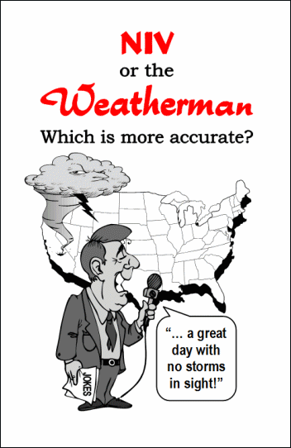
Spirit of Prophecy confirms!!!
“More than one thousand will soon be converted in one day, most of whom will trace their convictions to the reading of our publications” (Colporteur Ministry, p. 151).
“The publications sent forth from our printing houses are to prepare a people to meet God. Throughout the world they are to do the same work that was done by John the Baptist for the Jewish nation”(Colporteur Ministry, p. 3).

Slide 11
“Our publications should go everywhere. Let them be issued in many languages. The third angel’s message is to be given through this medium and through the living teacher. You who believe the truth for this time, wake up. It is your duty now to bring in all the means possible to help those who understand the truth to proclaim it. . . . There are many places in which the voice of the minister cannot be heard, places which can be reached only by our publications,—the books, papers, and tracts filled with the Bible truths that the people need. Our literature is to be distributed everywhere. The truth is to be sown beside all waters; for we know not which will prosper, this, or that. In our erring judgment we may think it unwise to give literature to the very ones who would accept the truth the most readily. We know not what may be the results of giving away a leaflet containing present truth.”—(MS 127, 1909.)

