Slide 1
Church and State, pt. 6
God Sent a Man!

Slide 2
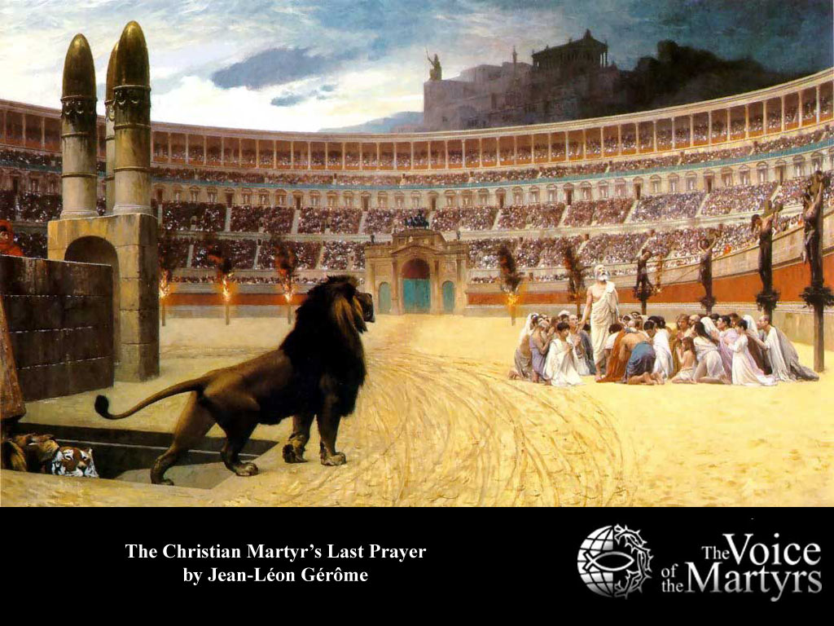
The Words of Christ Rejected
“And he said unto them, Render therefore unto Caesar the things which be Caesar's, and unto God the things which be God's.” Luke 20:25
“He declared that since they were living under the protection of the Roman power, they should render to that power the support it claimed, so long as this did not conflict with a higher duty. But while peaceably subject to the laws of the land, they should at all times give their first allegiance to God…. “ DA, pg. 602

Slide 3

Would it Ever Stop?
From the Roman emperors to Constantine, to Augustine and Charlemagne, the popes and still more popes, the battle raged. The popes and the kings; Henry VIII and James I, Luther, Zwingli, Calvin, and the Puritans; would there ever be an asylum of peace where one could worship after the dictates of his own conscience? Would their ever be such a place?

Slide 4
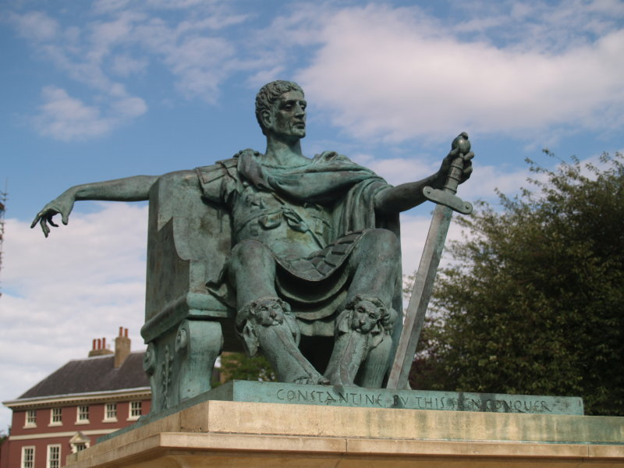
Conformity and Uniformity
Throughout the history of this world, there have been repeated efforts by devil possessed men to force conformity on the inhabitants of the world. This conformity has always demanded humanity to worship God in a particular way. Since Christ, it has been attempted by Constantine, Charlemagne, the Catholic church, some ‘Protestant’ kings and queens, and even by Calvinistic Puritans in America.

Slide 5
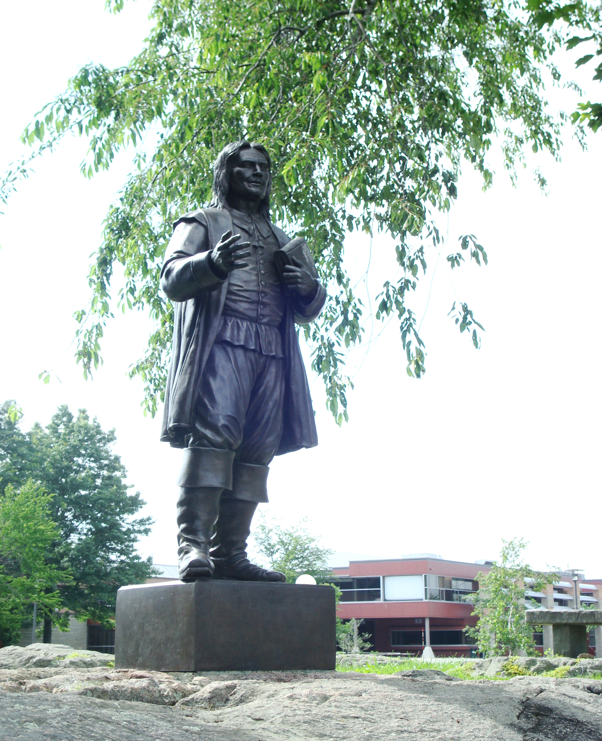
Land of the Free/Home of the Brave
Prophecy, the Constitution, and the Star Spangled Banner sing a different song; a song of freedom, a song of diversity, and a place to worship God as one chooses. From where did these ideals originate? To whom do we owe these treasures that have blessed this land?

Slide 6
Apostle of Soul Liberty
“Eleven years after the planting of the first colony, Roger Williams came to the New World. Like the early Pilgrims he came to enjoy religious freedom; but, unlike them, he saw --what so few in his time had yet seen--that this freedom was the inalienable right of all, whatever might be their creed. He was an earnest seeker for truth, with Robinson holding it impossible that all the light from God's word had yet been received. Williams "was the first person in modern Christendom to establish civil government on the doctrine of the liberty of conscience, the equality of opinions before the law."--Bancroft, pt. 1, ch. 15, par. 16. He declared it to be the duty of the magistrate to restrain crime, but never to control the conscience. "The public or the magistrates may decide," he said, "what is due from man to man; but when they attempt to prescribe a man's duties to God, they are out of place, and there can be no safety; for it is clear that if the magistrates has the power, he may decree one set of opinions or beliefs today and another tomorrow; as has been done in England by different kings and queens, and by different popes and councils in the Roman Church; so that belief would become a heap of confusion."--Martyn, vol. 5, p. 340. GC, pg. 293,294

Slide 7
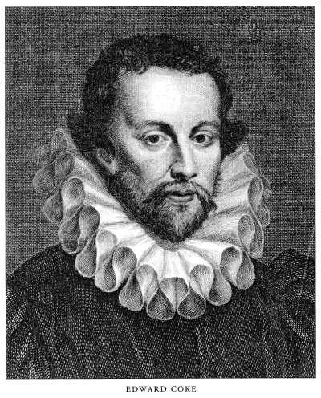
Who is He? From whence did he come?
Born in England, around 1603, Williams’ parents were not pleased when he became a Christian nor were they happy when he turned away from the church of England, believing it was too corrupt. Around 1627, he became a Puritan.
As a teenager, Williams worked for Edward Coke; the most famous lawyer/jurist in 17th century England. Coke, like few before him, “supported individual liberty against arbitrary government and sought to ensure that the king's authority was circumscribed by law.” Wikipedia
Coke had a tremendous influence over Roger Williams.

Slide 8
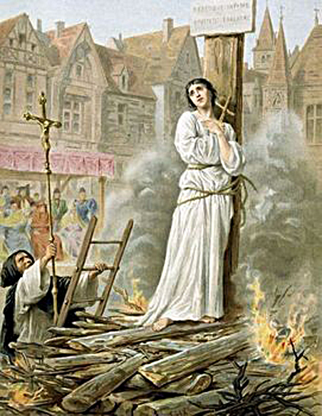
Profound Influence
Beside the profound influence of Coke, Williams was also deeply affected by seeing first hand the martyrdom of people in England dying for their faith. “His London home was near New gate Prison and only a short distance from Smithfield Plaza, where so many of the so called heretics were burned at the stake, or ‘hung by the neck’ until they were dead. These executions were frequent in the days of young Williams. His sympathies were stirred as he witnessed these executions for conscience sake, and he developed a spirit of independent inquiry and a feeling of abhorrence against religious persecution.” Charles Longacre, ‘Roger Williams: His Life, Work, and Ideals’, pg. 8

Slide 9

Boston and the Charles River
Accepting a call from the Puritans and John Winthrop in particular, of Boston, Williams arrived in America in 1631. The prevailing attitude that Williams beheld in Boston is best summed up in the words of a Puritan pastor. The Puritan pastor was asked, “Are you the parson who serves here?” He replied, “I am, sir, the parson who RULES here.” Williams wouldn’t remain in Boston for very long!!!

Slide 10
Welcome to America
“Uniformity” was maintained by the civil authorities whose magistrates regarded themselves as responsible for enforcing the ‘first’ as well as the ‘second’ table of the Decalogue…the life and worship of the colony was controlled by legislation, and no deviation was permitted. Blasphemy and swearing were punished, and a rigid observance of the Sunday Sabbath was required of all, non members as well as members, in the hope that by regular attendance, the non members would hear and respond to the call of God. Absentees were subject to fines.” Emmerson, pg. 165

Slide 11
What a Man!!!!!!
“ Williams declared that the state could legitimately concern itself only with matters of civil order, but not religious belief. The state had no business in trying to enforce the “first Table” of the Ten Commandments, those first commandments that dealt with the relationship between God and persons. The state must confine itself to the commandments that dealt with the relations between people: murder, theft, adultery, lying, honoring parents, and so forth. He regarded any effort by the state to dictate religion or promote any particular religious idea or practice to be “forced worship.” And he colorfully declared that “forced worship stinks in the nostrils of God.” He would write that he saw no warrant in the New Testament to use the sword to promote religious belief. Indeed, he said that Constantine had been a worse enemy to true Christianity than Nero because Constantine’s support had corrupted Christianity and led to the death of the Christian church. In the strongest language he described the attempt to compel belief to be rape of the soul, and he spoke of the “oceans of blood” shed as a result of trying to command conformity.” Wikipedia

Slide 12

Wall of Separation
“Williams was the first to use the phrase "wall of separation" to describe the relationship of the church and state. He called for a high wall of separation between the "Garden of Christ" and the "Wilderness of the World." This idea is one of the foundations of the religion clauses in the U.S. Constitution and First Amendment to the United States Constitution.” Wikipedia

Slide 13

Williams was ‘Intolerable’.
Roger William’s ideas would permeate the colonies. This could not and would not be. It was determined that he would be sent back to England. Knowing this, Williams and a few friends left Salem in the dead of winter, 1635, and for 14 weeks braved the New England winter, not knowing from where their next meal would come! They ended up in the area of Narragansett Bay and purchased land from the Indians there. Today, this area is known as Rhode Island!!

Slide 14
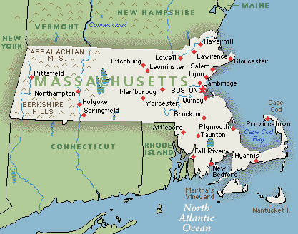
The ‘Mustard Seed’ Colony
Williams grand experiment in Rhode Island gave freedom, civil and religious, to ALL people. Other colonies, like Pennsylvania and Catholic Maryland, had granted liberty, but it was never for EVERYONE. Williams, in Rhode Island, declared these freedoms to be inalienable rights of all. People flocked to his territory. Amazingly, the area was purchased from the Narragansett Indians. The great principles of civil and religious liberty found their home in Indian lands rather than in the lands of the white Europeans!!! Remember it well!!!!

Slide 15
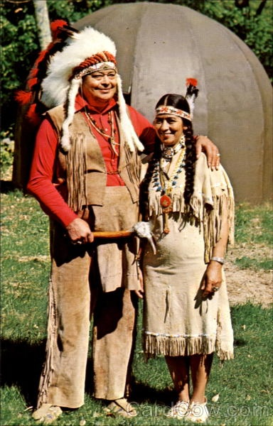
Savage Christians or Christian Savages?
As Rhode Island grew, the leaders of Massachusetts Bay colony feared Williams would revenge himself for their cruel treatment of him and invited him to join his colony to “I feel safer down here among the Christian savages along Narragansett Bay than I do among the savage Christians of Massachusetts Bay Colony.”
Which one are we?

Slide 16
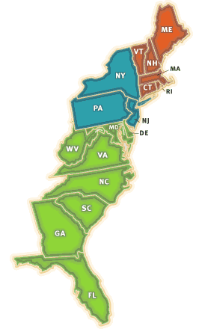
Spreading the Light!!
One of the groups of people that found asylum in Rhode Island were the…Anabaptists. Williams message was their message. “The Baptists carried that message to Virginia, where they suffered much persecution; and Thomas Jefferson and James Madison became their attorneys and the defenders and champions of their cause fro the disestablishment of religion. The ideas of Roger Williams found a rebirth in these two American champions of civil and religious liberty, and Thomas Jefferson gave expression to them in the Declaration of Independence, and James Madison in the constitution of the United States.” Longacre, Roger Williams: His life and work, pg. 100, 101

Slide 17
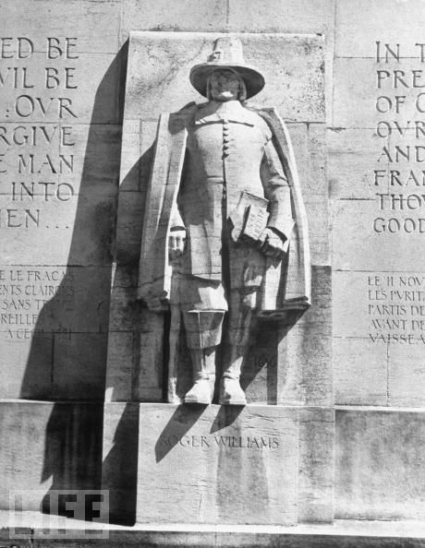
Apostle of Liberty
“Roger Williams was the trailblazer for the men who framed the American Constitution. He made the trail which they completed and beautified as the pathway to freedom; we walk unfettered, unhindered, along this royal road. He laid the foundation fro the temple of freedom which they completed and glorified; we dwell within its stately halls. He sowed the seed of liberty which brought forth a bountiful harvest; we enjoy its multiplied blessings.” Varner Johns, 40 Centuries of Law and Liberty.

Slide 18
Two Horns Like a Lamb
“The fundamental principle of Roger William's colony was "that every man should have liberty to worship God according to the light of his own conscience."--Ibid., vol. 5, p. 354. His little state, Rhode Island, became the asylum of the oppressed, and it increased and prospered until its foundation principles--civil and religious liberty--became the cornerstones of the American Republic.
In that grand old document which our forefathers set forth as their bill of rights--the Declaration of Independence--they declared: "We hold these truths to be self-evident, that all men are created equal; that they are endowed by their Creator with certain unalienable rights; that among these are life, liberty, and the pursuit of happiness." And the Constitution guarantees, in the most explicit terms, the inviolability of conscience: "No religious test shall ever be required as a qualification to any office of public trust under the United States." "Congress shall make no law respecting an establishment of religion, or prohibiting the free exercise thereof.“ The framers of the Constitution recognized the eternal principle that man's relation with his God is above human legislation, and his rights of conscience inalienable.” GC, pg. 295

Slide 19
The Sacral Head Arises
1810-war raged over postmasters working on Sunday.
1815-chains placed across postal roads in Philadelphia to stop postmasters from carrying mail.
1830-repudiation of Sunday law legislation
1856-judge defends Sunday laws in Arkansas.
1888-Blair bill sponsored a Lord’s Day measure.
Richard Johnson declares that no religion should be upheld by government. (1820’s)
William L. Garrison declared government stay out of all religious discussions. (1840’s)
RW Crockett, grandson of Davy, pleaded for religious liberty. (1880’s)
A.T. Jones locks horns with Senator Blair. (late 1880’s)

Slide 20
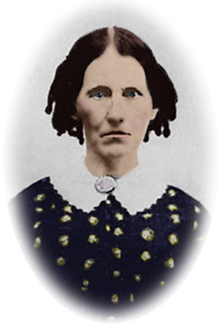
From Whence Came Us?
The Sabbatarian Anabaptists of Europe spread the truth throughout the continent. When persecuted, they fled to England and then to the New World. They found asylum in Rhode Island and spread the truth from there. They influenced Madison and Jefferson and in the 19th century, it was a Sabbatarian Anabaptist named Rachel Preston who spoke to the Wheeler and Farnsworth families. These then spoke with Joseph Bates who shared with James and Ellen White!! Our ancestors are the Radical Sabbatarian Anabaptists of the Reformation era!

