Slide 1
Jones and Wagoner/ 1888 Again? Again!!!
The Battle Still Rages

Slide 2
So Many Voices
So many voices tell the story of 1888. Most are wrong. Many focus on their ‘pet’ ideas and make them 1888. Some say 1888 was all about the doctrine of the Godhead; WRONG!
Some say 1888 was all about forensic only justification; WRONG! This means that a person is justified before God and continues to live in sin, but yet saved!
1888; there are many facets to the meetings held at that time. The covenants, the law in Galatians, the nature of Christ, and even the 10 horns of Daniel 7. However, none of these were the BIG issue!

Slide 3
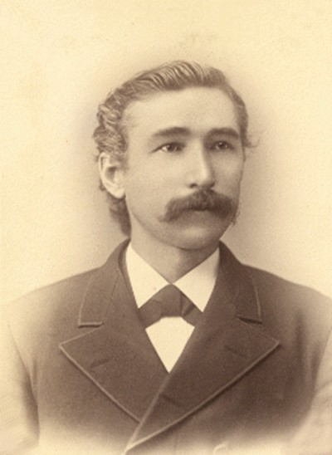
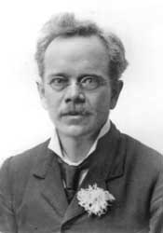
The characters involved

Slide 4
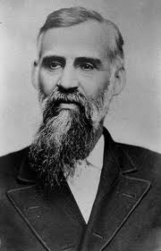
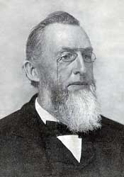
The Seasoned Warriors

Slide 5
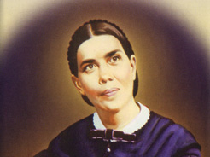
Lady in the Middle
The young upstarts from California; Jones and Wagoner on one side; the seasoned veterans, George Butler and Uriah Smith on the other; 1888 turned into a battle that has never really gone away. In fact, what happened at 1888 is still happening today. Will we let it continue?

Slide 6
1888 and Ellen White
"The Lord in His great mercy sent a most precious message to His people through Elders Waggoner and Jones. This message was to bring more prominently before the world the uplifted Saviour, the sacrifice for the sins of the whole world. It presented justification through faith in the Surety; it invited the people to receive the righteousness of Christ, which is made manifest in obedience to all the commandments of God. . .This is the message that God commanded to be given to the world. It is the third angel's message, which is to be proclaimed with a loud voice, and attended with the outpouring of His Spirit in a large measure." Testimonies to Ministers, page 91, 92

Slide 7
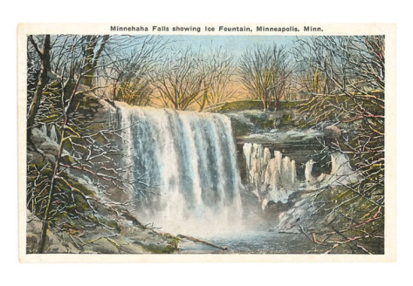
Minnehaha, Minnesota
Like the waterfalls of Minnehaha, Minnesota, Ellen White described the blessings the Lord came to bestow upon His people through Jones and Wagoner in 1888, but through the influence of Butler and Smith, the message was largely rejected and still is today and FOR THE SAME REASON!!

Slide 8
The Message
“We have heard many people tell how hard they found it to do right. Their Christian life was most unsatisfactory to them, being marked only by failure, and they were tempted to give up in discouragement. No wonder they get discouraged. Continual failure is enough to discourage anybody. The bravest soldier in the world would become faint-hearted if he had been defeated in every battle. Sometimes these persons will mournfully tell that they have about lost confidence in themselves. Poor souls. If they would only lose confidence in themselves entirely and would put their whole trust in the One who is mighty to save, they would have a different story to tell. They would then "joy in God through our Lord Jesus Christ." Says the apostle, "Rejoice in the Lord always, and again I say, Rejoice." Phil. 4:4. The man who doesn't rejoice in God, even though tempted and afflicted, is not fighting the good fight of faith. He is fighting the poor fight of self-confidence and defeat.” Wagoner, Lessons on Faith.

Slide 9
Again
“Here is the secret of strength. It is Christ, the Son of God, the One to whom all power in heaven and earth is given, Who does the work. If He lives in the heart to do the work, is it boasting to say that continual victories may be gained? Yes, it is boast; but it is boasting in the Lord, and that is allowable. Says the psalmist, "My soul shall make her boast in the Lord" and Paul says, "God forbid that I should glory save in the cross of our Lord Jesus Christ, by whom the world is crucified unto me and I unto the world." Gal. 6:14.
The soldiers of Alexander were reckoned invincible. Why? Was it because they were naturally stronger and more courageous than all their enemies? No, but because they were led by Alexander. Their strength was in his leadership. Under another leader they would often have been defeated. When the Union army was fleeing panic- stricken before the enemy at Winchester, the presence of Sheridan turned their defeat into victory. Without him the men were a quaking mob. With him at their head they were an invincible army. If you had listened to the remarks after the battle of the soldiers who served under those and similar leaders, you would have heard the praises of their general mingled with all their rejoicing. They were strong because he was; they were inspired by the same spirit that he had.”

Slide 10
Finally
“John says that he that is born of God overcomes the world, through faith. Faith lays hold of the arm of God and His mighty power does the work. How the power of God can work in a man, accomplishing that which he could not possibly do for himself, no one can tell. It would be as easy to tell how God can give life to the dead. Says Jesus, "The wind bloweth where it listeth and thou hearest the sound thereof but canst not tell whence it cometh and whither it goeth; so is everyone that is born of the Spirit." John 3:8. How the Spirit works in a man to subdue his passions and to make him victorious over pride, envy, and selfishness is known only to the Spirit. It is sufficient for us to know that it is done and will be done in everyone who wants that work wrought in him, above all things else, and who trusts God for the performance of it. We cannot tell how Peter was enabled to walk on the water when the waves were rolling about him, but we know that at the command of the Lord he did it. So long as he kept his eye fixed on the Master, divine power enabled him to walk as easily as though it were solid rock underneath.”

Slide 11
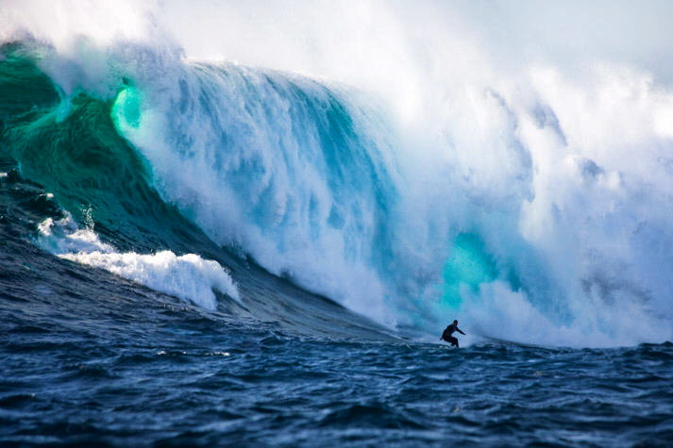
Jones and Wagoner Believed
The message they brought was:
1. Forgiveness for past sins was received by faith in Jesus Christ.
2. Power to overcome sin is received by faith in Jesus Christ.
“Now unto him that is able to keep you from falling, and to present you faultless before the presence of his glory with exceeding joy,” Jude 24

Slide 12
Righteousness by Faith
“It was possible for Adam, before the fall, to form a righteous character by obedience to God's law. But he failed to do this, and because of his sin our natures are fallen and we cannot make ourselves righteous. Since we are sinful, unholy, we cannot perfectly obey the holy law. We have no righteousness of our own with which to meet the claims of the law of God. But Christ has made a way of escape for us. He lived on earth amid trials and temptations such as we have to meet. He lived a sinless life. He died for us, and now He offers to take our sins and give us His righteousness. If you give yourself to Him, and accept Him as your Saviour, then, sinful as your life may have been, for His sake you are accounted righteous. Christ's character stands in place of your character, and you are accepted before God just as if you had not sinned. More than this, Christ changes the heart. He abides in your heart by faith. You are to maintain this connection with Christ by faith and the continual surrender of your will to Him; and so long as you do this, He will work in you to will and to do according to His good pleasure. So you may say, "The life which I now live in the flesh I live by the faith of the Son of God, who loved me, and gave Himself for me." Galatians 2:20. So Jesus said to His disciples, "It is not ye that speak, but the Spirit of your Father which speaketh in you." Matthew 10:20. Then with Christ working in you, you will manifest the same spirit and do the same good works --works of righteousness, obedience.” Steps to Christ, pgs. 62,63

Slide 13
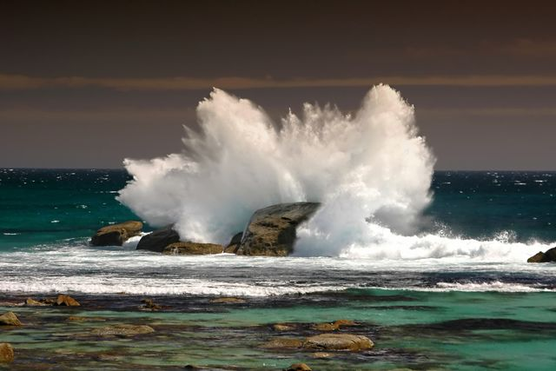
The Old Warriors Respond
The backdrop for George Butler’s and Uriah Smith’s opposition to Jones and Wagoner was Galatians 3. They felt the California men were speaking lightly on the law of God and they would be the bulldogs for the faith. As the following quotes will show, the issue was truly ‘how does one attain to righteousness?’

Slide 14
Uriah Smith
“Some of our correspondents are beginning to drop remarks leaning very suspiciously toward the view that any attempt on our part to keep the commandments, is simply an attempt to make ourselves better., which we can never do; that is an attempt to be righteous, which is simply to cover ourselves with filthy rags…Just how much they are intended to express, we are unable to determine, but it seems to us that they are unconsciously turning their steps toward a position held by a class of bitter opposers of our cause and work, and who draw largely on this line of thought for their material…

Slide 15
Continued
“Perfect obedience to it [the law] will develop perfect righteousness, and that is the only way any one can attain to righteousness…Christ comes in and closes up the gulf between us and God by providing a sacrifice to cancel past sin and to bring us back into harmony with the law…Here is where our Methodist friend made a mistake…not perceiving that the whole object of Christ’s work for us is to bring us back to the law, that its righteousness may be fulfilled in us by our obedience to it. We are not to rest on the stool of do-nothing, as a mass of inertia in the hands of the Redeemer. But it is asked, if a man undertakes to keep the law in his own strength and work out his own righteousness, can he do it? Is he not clothing himself with filthy rags?...

Slide 16
Finished
We do know, however, that there is not a Seventh-day Adventist in the land who has not been taught better than to suppose that in his own strength he could keep the commandments…We doubt if even the Pharisees rested their self-righteousness on the perfection of their personal obedience to the 10 commandments. There is a righteousness we must have, in order to see the kingdom of heaven, which is called our righteousness and this righteousness comes from being in harmony with the law of God.” RH, 6-11-1889 pg. 376

Slide 17
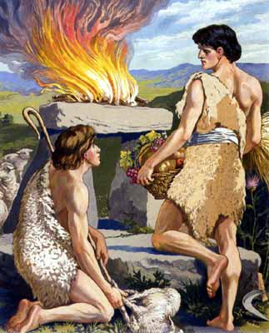
Righteousness by Works
“The class of worshipers who follow the example of Cain includes by far the greater portion of the world; for nearly every false religion has been based on the same principle--that man can depend upon his own efforts for salvation.“ PP 73

Slide 18
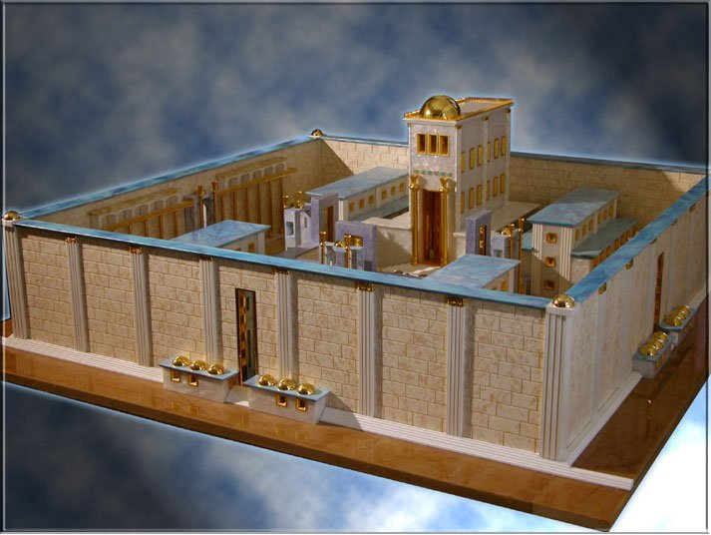
God’s Professed People
“So it was with Israel. The principle that man can save himself by his own works lay at the foundation of every heathen religion; it had now become the principle of the Jewish religion. Satan had implanted this principle. Wherever it is held, men have no barrier against sin.” DA, pg. 35,36

Slide 19
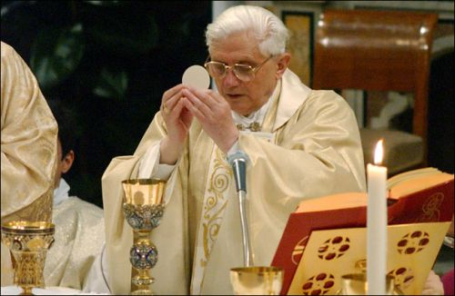
The Papacy
“What they desire is a method of forgetting God which shall pass as a method of remembering Him. The papacy is well adapted to meet the wants of all these. It is prepared for two classes of mankind, embracing nearly the whole world--those who would be saved by their merits, and those who would be saved in their sins. Here is the secret of its power.” GC, pg. 572

Slide 20
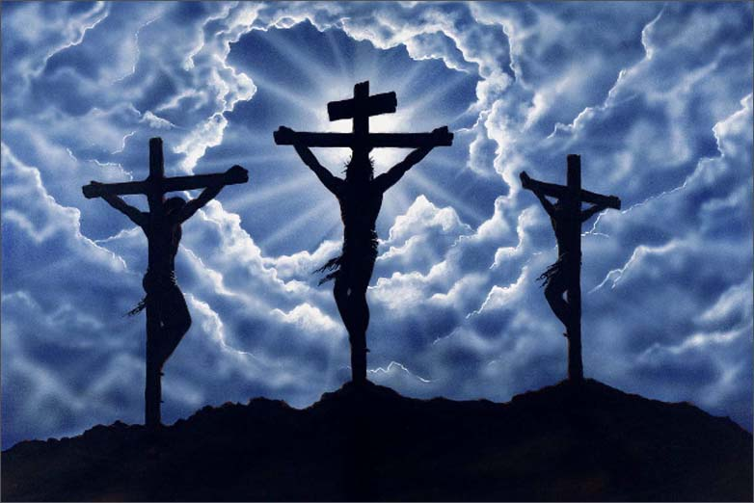
1888 Rejected
The message of 1888 was rejected predominately by the church. The reason was because the leading brethren didn’t go along with the message. This was just like the Pharisees of old, rejecting Christ because the leaders said so!!! Woe, woe, woe!!!

Slide 21
Like those who rejected CHRIST!
“There has been a departure from God among us, and the zealous work of repentance and return to our first love essential to restoration to God and regeneration of heart has not yet been done. Infidelity to God has been making its inroads in our ranks; for it is the fashion to depart from Christ, and give place to skepticism. The cry of the heart has been, "We will not have this man to reign over us." Baal, Baal, is the choice. The religion of many among us will be the religion of apostate Israel, because they love their own way, and forsake the way of the Lord. The true religion, the only religion of the Bible, that teaches forgiveness through the merits of a crucified and risen Saviour, that advocates righteousness by the faith of the Son of God, has been slighted, spoken against, ridicules. It has been denounced as leading to enthusiasm and fanaticism….

Slide 22
Continued
“…Take it back while it is not too late for wrongs to be righted; for you have sinned against God. But it is the life of Jesus Christ in the soul, it is the active principle of love imparted by the Holy Spirit, that alone will make the soul fruitful unto good works. The love of Christ is the force and power of every message that ever fell from human lips. What kind of a future is before us, if we shall fail to come into the unity of the faith. When we are united in the unity for which Christ prayed, this long controversy which has been kept up through Satanic agency, will end, and we shall not see men framing plans after the order of the world, because they have not spiritual eyesight to discern spiritual things. They now see men as trees walking, and they
need the divine touch, that they may see as God sees, and work as Christ worked….

Slide 23
Finished
“Then will Zion's watchmen sound the trumpet in clearer, louder notes; for they will see the sword coming, and realize the danger in which the people of God are placed. There is no time now to range ourselves on the side of the transgressors of God's law, to see with their eyes, to hear with their ears, and to understand with their perverted senses. We must press together. We must become a unit, to be holy in life and pure in character. Let us no longer bow down to the idol of men's opinions, no longer be slaves to any shameful lust, no longer bring a polluted offering to the Lord, a sin-stained soul, which is represented by the offerings of the Moabites and Amorites. O, shall not repentance take the place of unbelief and rebellion. Or shall this state of impenitence and blindness continue until it shall be said unto us, as to the cities that spurned the offered mercies of Christ in the days of his ministry, "Woe unto thee, Chorazin! Woe unto thee, Bethsaida! for if the mighty works had been done in Tyre and Sidon, which have been done in you, they had a great while a go repented, sitting in sackcloth and ashes.“ 1888 Materials, pgs. 444-446

