Slide 1
Elijah, pt. 4
“Troubler in Israel”

Slide 2

Time For a Showdown
Elijah had been away for quite awhile; three and a half years to be exact. Things were looking horrible throughout the land of Israel. The famine was ripping apart the once proud nation. The time had come for Elijah to return.

Slide 3
Desperation!
“Thus it had come to pass that God was now visiting His people with the severest of His judgments. The prediction of Elijah was meeting with terrible fulfillment. For three years the messenger of woe was sought for in city after city and nation after nation. At the mandate of Ahab, many rulers had given their oath of honor that the strange prophet could not be found in their dominions. Yet the search was continued, for Jezebel and the prophets of Baal hated Elijah with a deadly hatred, and they spared no effort to bring him within reach of their power. And still there was no rain.
At last, "after many days," the word of the Lord came to Elijah, "Go, show thyself unto Ahab; and I will send rain upon the earth."
In obedience to the command, "Elijah went to show himself unto Ahab." About the time that the prophet set forth on his journey to Samaria, Ahab had proposed to Obadiah, the governor of his household, that they make thorough search for springs and brooks of water, in the hope of finding pasture for their starving flocks and herds.” PK, pg. 137

Slide 4
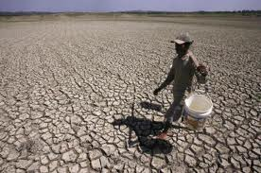
The Search is On!
“And Ahab called Obadiah, which was the governor of his house. (Now Obadiah feared the LORD greatly: For it was so, when Jezebel cut off the prophets of the LORD, that Obadiah took an hundred prophets, and hid them by fifty in a cave, and fed them with bread and water.) And Ahab said unto Obadiah, Go into the land, unto all fountains of water, and unto all brooks: peradventure we may find grass to save the horses and mules alive, that we lose not all the beasts.” 1 Kings 18:3-5

Slide 5
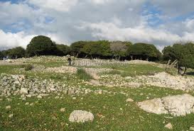
Along Came………….a Man!
“So they divided the land between them to pass throughout it: Ahab went one way by himself, and Obadiah went another way by himself. And as Obadiah was in the way, behold, Elijah met him: and he knew him, and fell on his face, and said, Art thou that my lord Elijah? And he answered him, I am: go, tell thy lord, Behold, Elijah is here.” 1 Kings 18:6-8

Slide 6

Nobody and Everybody!
Elijah was a feared man and nobody really wanted to see him. Yet, everyone wanted to see him because in him was Israel’s only hope of getting rain! Noone and yet everybody wanted to see this most feared man!

Slide 7
Blessed; Thought Cursed!
“And as Obadiah was in the way, behold, Elijah met him: and he knew him, and fell on his face, and said, Art thou that my lord Elijah? And he answered him, I am: go, tell thy lord, Behold, Elijah is here. And he said, What have I sinned, that thou wouldest deliver thy servant into the hand of Ahab, to slay me? As the LORD thy God liveth, there is no nation or kingdom, whither my lord hath not sent to seek thee: and when they said, He is not there; he took an oath of the kingdom and nation, that they found thee not. And now thou sayest, Go, tell thy lord, Behold, Elijah is here. And it shall come to pass, as soon as I am gone from thee, that the Spirit of the LORD shall carry thee whither I know not; and so when I come and tell Ahab, and he cannot find thee, he shall slay me: but I thy servant fear the LORD from my youth. Was it not told my lord what I did when Jezebel slew the prophets of the LORD, how I hid an hundred men of the LORD'S prophets by fifty in a cave, and fed them with bread and water? And now thou sayest, Go, tell thy lord, Behold, Elijah is here: and he shall slay me. And Elijah said, As the LORD of hosts liveth, before whom I stand, I will surely shew myself unto him to day.” 1 Kings 18:7-15

Slide 8
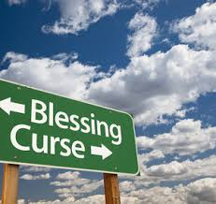
Obadiah’s Dilemma
God blessed Obadiah to see Elijah first. He was highly honored, but he didn’t see it that way! When he saw Elijah, he was sure it meant disaster! He felt this was it for him. How often we see the ways of God in the same light, counting a blessing a curse!

Slide 9
Disaster
“During the apostasy of Israel, Obadiah had remained faithful. His master, the king, had been unable to turn him from his allegiance to the living God. Now he was honored with a commission from Elijah, who said, "Go, tell thy lord, Behold, Elijah is here."
Greatly terrified, Obadiah exclaimed, "What have I sinned, that thou wouldest deliver thy servant into the hand of Ahab, to slay me?" To take such a message as this to Ahab was to court certain death.” PK, pg. 138

Slide 10
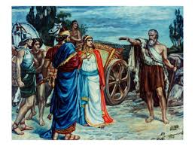
Petrified!
Ahab had hunted all over the Middle East for Elijah, but now that he was going to finally see him, he was scared to death! A 1,000 questions presented themselves to his mind. Another judgment? Worse than the last? Will I die?

Slide 11
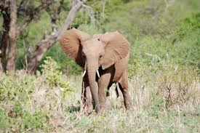
Helpless and powerful; powerful and helpless!!!!
Elijah went to meet Ahab alone! Ahab went to meet Elijah with myriads of soldiers. Elijah was helpless and powerful! Ahab had all the resources on his side, all the weapons, and he was powerless! With God, we are in the majority!!

Slide 12
Showdown
“In astonishment mingled with terror the king listened to the message from the man whom he feared and hated, and for whom he had sought so untiringly. Well he knew that Elijah would not endanger his life merely for the sake of meeting him. Could it be possible that the prophet was about to utter another woe against Israel? The king's heart was seized with dread. He remembered the withered arm of Jeroboam. Ahab could not avoid obeying the summons, neither dared he lift up his hand against the messenger of God. And so, accompanied by a bodyguard of soldiers, the trembling monarch went to meet the prophet.
The king and the prophet stand face to face. Though Ahab is filled with passionate hatred, yet in the presence of Elijah he seems unmanned, powerless. In his first faltering words, "Art thou he that troubleth Israel?" he unconsciously reveals the inmost feelings of his heart. Ahab knew that it was by the word of God that the heavens had become as brass, yet he sought to cast upon the prophet the blame for the heavy judgments resting on the land.” PK, pg.139

Slide 13
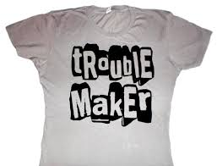
Troublemaker!
“And it came to pass, when Ahab saw Elijah, that Ahab said unto him, Art thou he that troubleth Israel?” 1 Kings 18:17 Ahab was the one doing the wrong. He was the one encouraging false worship, butchering the SOP, promoting spiritual formation, and women’s ordination, and unity, but Elijah was the problem!

Slide 14
Elijah Troubles Israel!
It is natural for the wrongdoer to hold the messengers of God responsible for the calamities that come as the sure result of a departure from the way of righteousness. Those who place themselves in Satan's power are unable to see things as God sees them. When the mirror of truth is held up before them, they become indignant at the thought of receiving reproof. Blinded by sin, they refuse to repent; they feel that God's servants have turned against them and are worthy of severest censure. Standing in conscious innocence before Ahab, Elijah makes no attempt to excuse himself or to flatter the king. Nor does he seek to evade the king's wrath by the good news that the drought is almost over. He has no apology to offer. Indignant, and jealous for the honor of God, he casts back the imputation of Ahab, fearlessly declaring to the king that it is his sins, and the sins of his fathers, that have brought upon Israel this terrible calamity.” PK, pgs. 139, 140

Slide 15
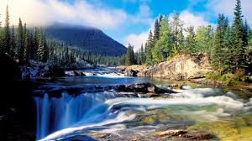
Unity Never at cost of Truth!
Elijah would have loved unity, but at the cost of truth, let there be war! There could be no unity between light and darkness. Ahab was rebuked by Elijah and this forced from him the angry words that Elijah was causing the trouble!

Slide 16
God’s Faithful Always Trouble!
Whether it be Elijah, Jeremiah, John the Baptist, Jesus, or Paul, the faithful have always been troublemakers, divisive, and out of sorts.
“So there was a division among the people because of him.” John 7:43
“Then answered them the Pharisees, Are ye also deceived? Have any of the rulers or of the Pharisees believed on him?” Jn. 7:47,48
“And brought them to the magistrates, saying, These men, being Jews, do exceedingly trouble our city,” Acts 16:20
“And when they found them not, they drew Jason and certain brethren unto the rulers of the city, crying, These that have turned the world upside down are come hither also;” Acts 17:6

Slide 17
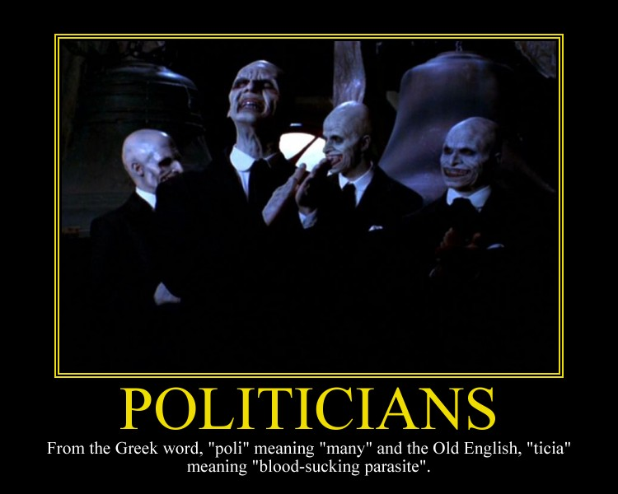
Watch Out for Politicians!
A religious politician today will:
1. tell you you will keep sinning until Jesus comes.
2. promote unity above all else.
3. endorses the ordaining of women to pastoral ministry.
4. pushes spiritual formation.

Slide 18
Stern Rebuke or Status Quo?
“Those ministers who are men pleasers, who cry, Peace, peace, when God has not spoken peace, might well humble their hearts before God, asking pardon for their insincerity and their lack of moral courage. It is not from love for their neighbor that they smooth down the message entrusted to them, but because they are self-indulgent and ease-loving. True love seeks first the honor of God and the salvation of souls. Those who have this love will not evade the truth to save themselves from the unpleasant results of plain speaking. When souls are in peril, God's ministers will not
consider self, but will speak the word given them to speak, refusing to excuse or palliate evil.” PK, pgs. 141,142

