Slide 1
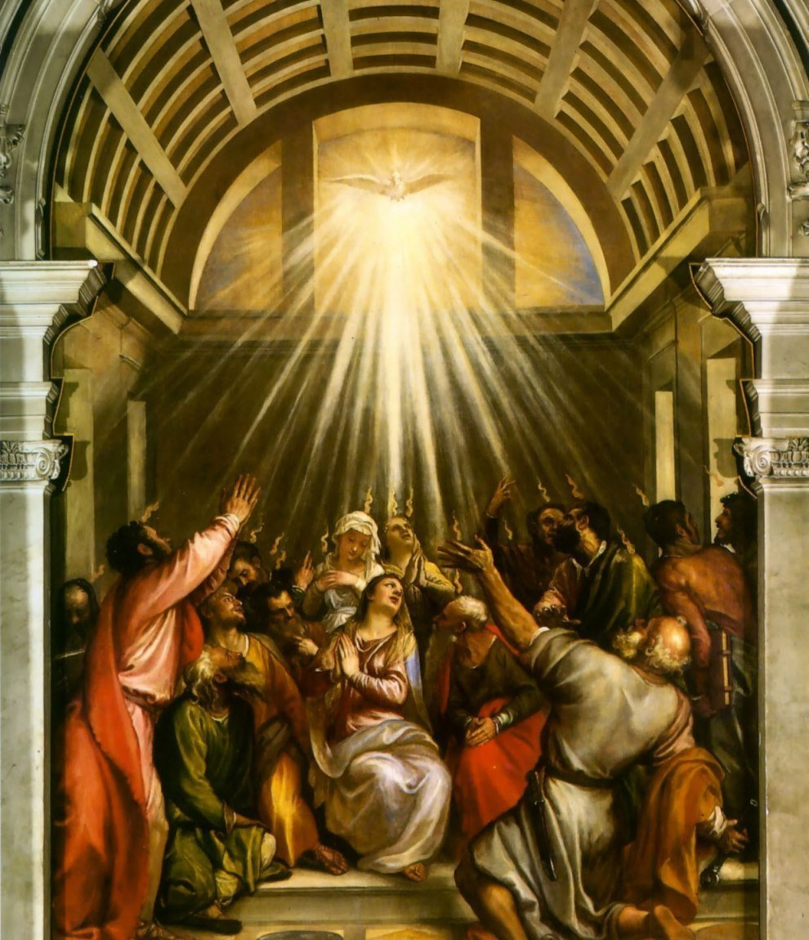
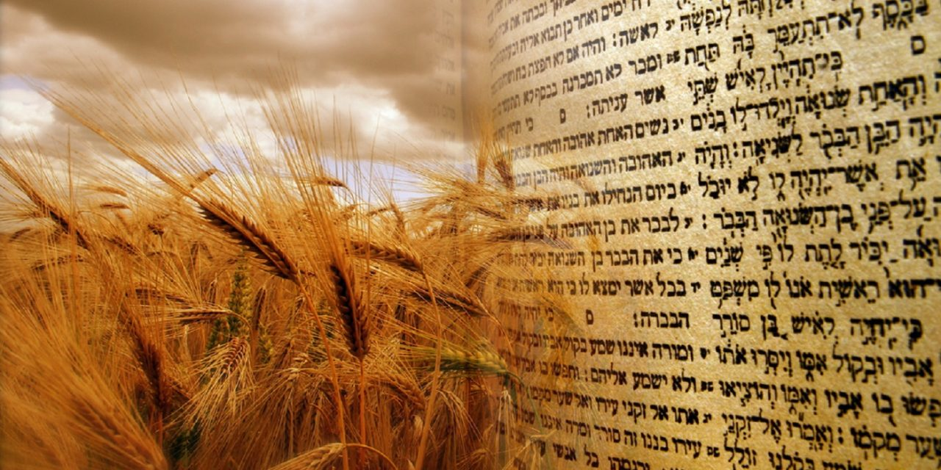
The Sanctuary pt 48: The Feast of Weeks/Pentecost

Slide 2
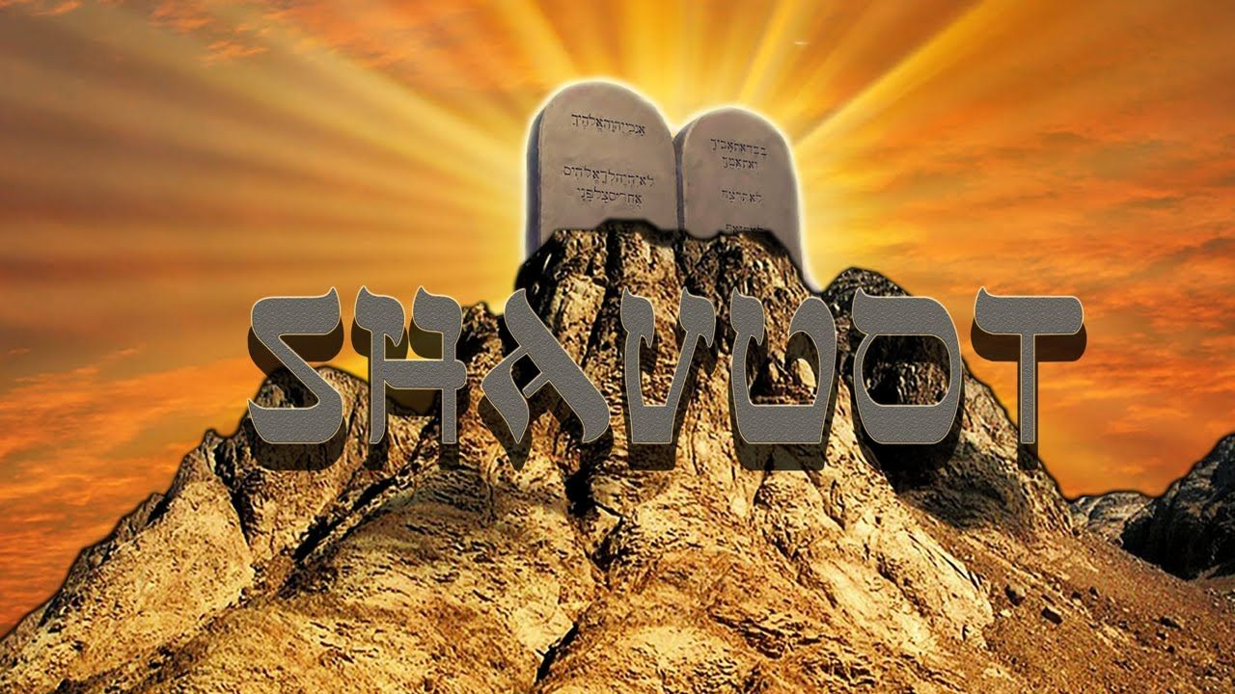
What We will Study Today:
What Happened during this feast
What it meant for ancient Israel and What it means for us today
It’s prophetic fulfillment

Slide 3
Ex. 12:24 “And ye shall observe this thing for an ordinance to thee and to thy sons for ever.”
1 Sam. 1:22 “But Hannah went not up; for she said unto her husband, I will not go up until the child be weaned, and then I will bring him, that he may appear before the Lord, and there abide for ever.”

Slide 4
From Ex. 12:24 “For ever”
For 5704 (ad) (1) as far as, even to, until, up to, while
Ever 5769 (owlam or olam) (1) long duration, antiquity, futurity, forever, ever, perpetual, old, ancient

Slide 5
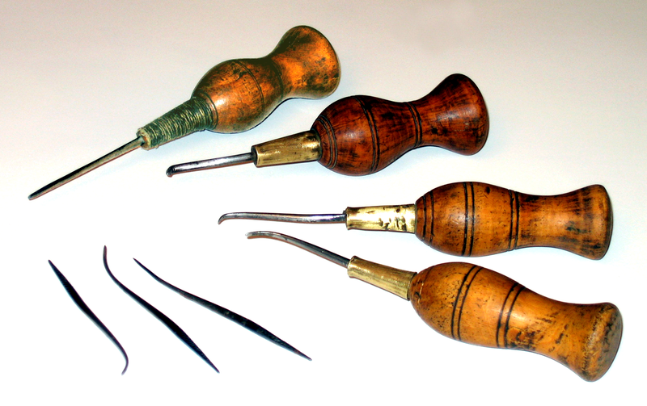
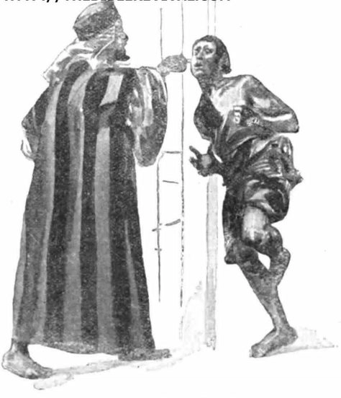
Deut. 15:12-17 “And if thy brother, an Hebrew man, or an Hebrew woman, be sold unto thee, and serve thee six years; then in the seventh year thou shalt let him go free from thee. And when thou sendest him out free from thee, thou shalt not let him go away empty: Thou shalt furnish him liberally out of thy flock, and out of thy floor, and out of thy winepress: of that wherewith the Lord thy God hath blessed thee thou shalt give unto him. And thou shalt remember that thou wast a bondman in the land of Egypt, and the Lord thy God redeemed thee: therefore I command thee this thing to day. And it shall be, if he say unto thee, I will not go away from thee; because he loveth thee and thine house, because he is well with thee; Then thou shalt take an aul, and thrust it through his ear unto the door, and he shall be thy servant for ever. And also unto thy maidservant thou shalt do likewise.”

Slide 6
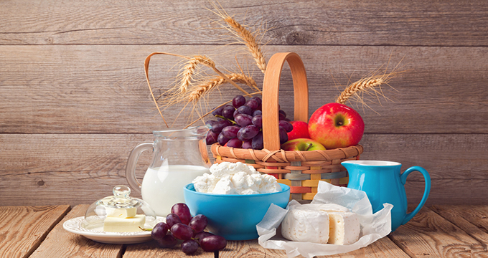
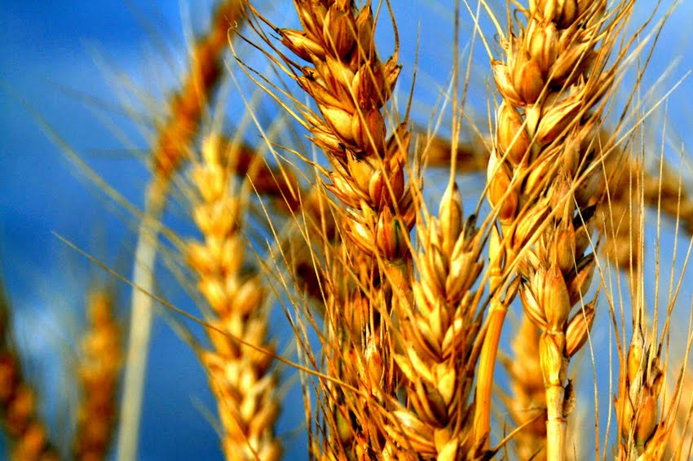
Pentecost—the Spring Harvest!
Pentecost, The Feast of Weeks, or The Feast of Harvest had everything to do with the supplies collected from the spring harvest. The first full harvest of the year (not including Firstfruits), Pentecost marked the special providential blessing of God coming off the “dead” winter. This harvest would effectively set the pace for the rest of the year. Moreover, this feast is directly connected with Passover, The Feast of Unleavened Bread and the Wave Sheaf because it was numbered 50 days from the first holy convocation (sabbath) during the Feast of Unleavened Bread. Firstfruits was essentially to represent the taste of things to come and the Feast of Weeks the genuine article. Due to the fact that Christ is the Firstfruits of the harvest—we can expect this feast to have harvesttime prophetic significance as well.

Slide 8
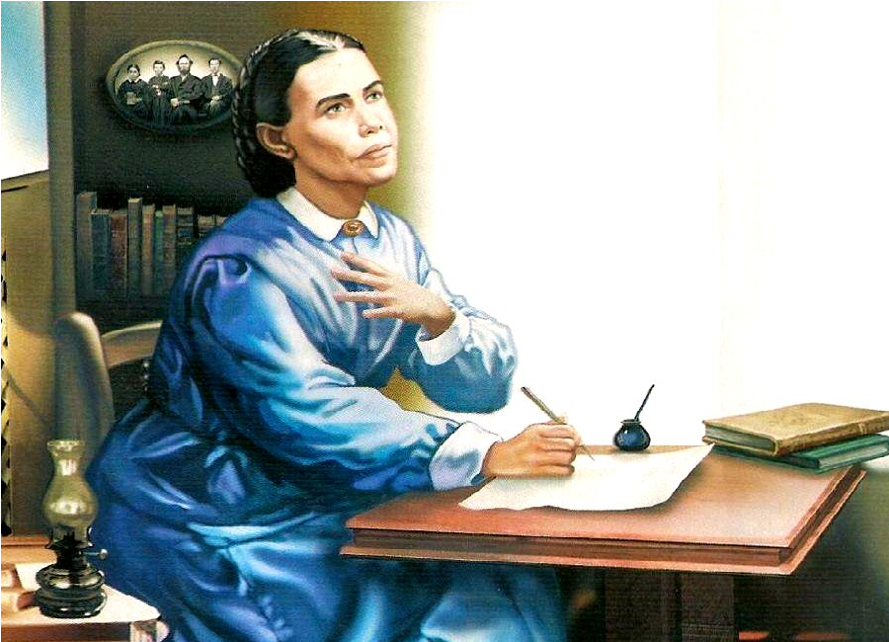
Patriarchs and Prophets Gives Us a Basis
“Fifty days from the offering of first fruits, came the Pentecost, called also the feast of harvest and the feast of weeks. As an expression of gratitude for the grain prepared as food, two loaves baked with leaven were presented before God. The Pentecost occupied but one day, which was devoted to religious service.” PP, 540

Slide 9
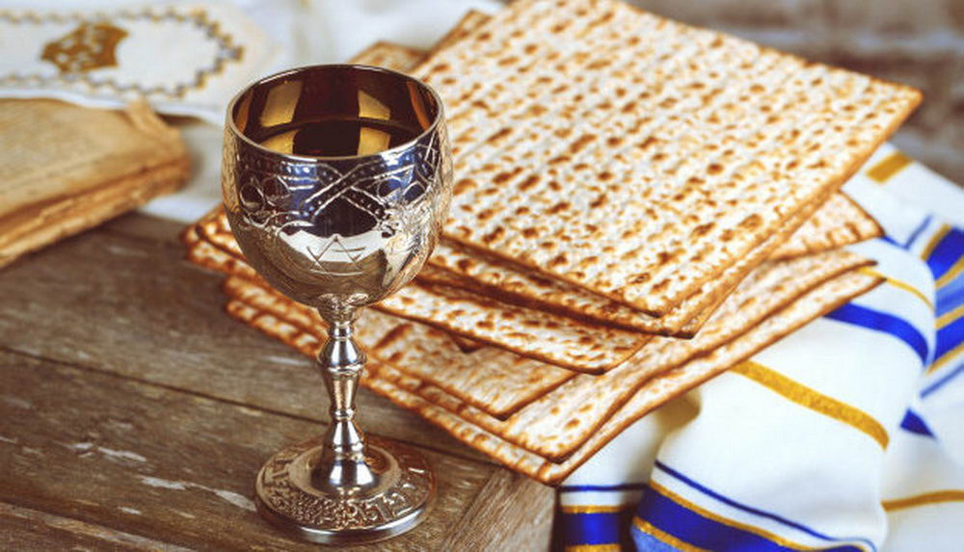
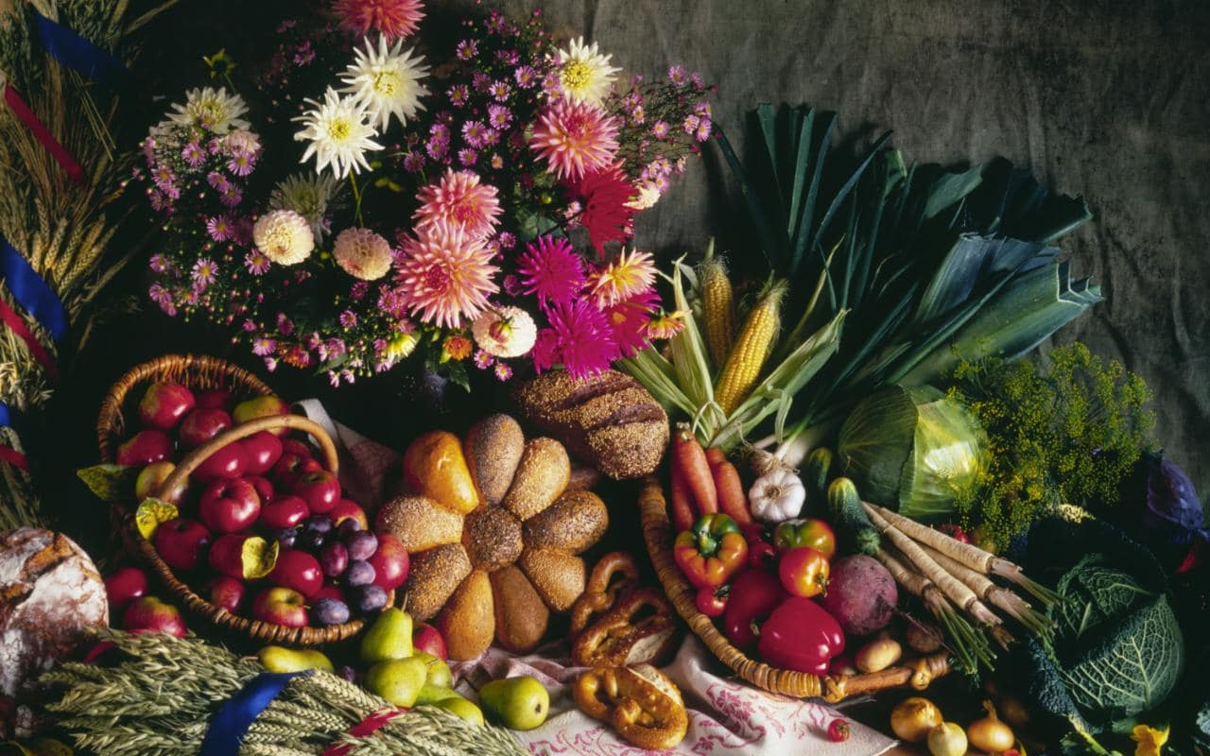
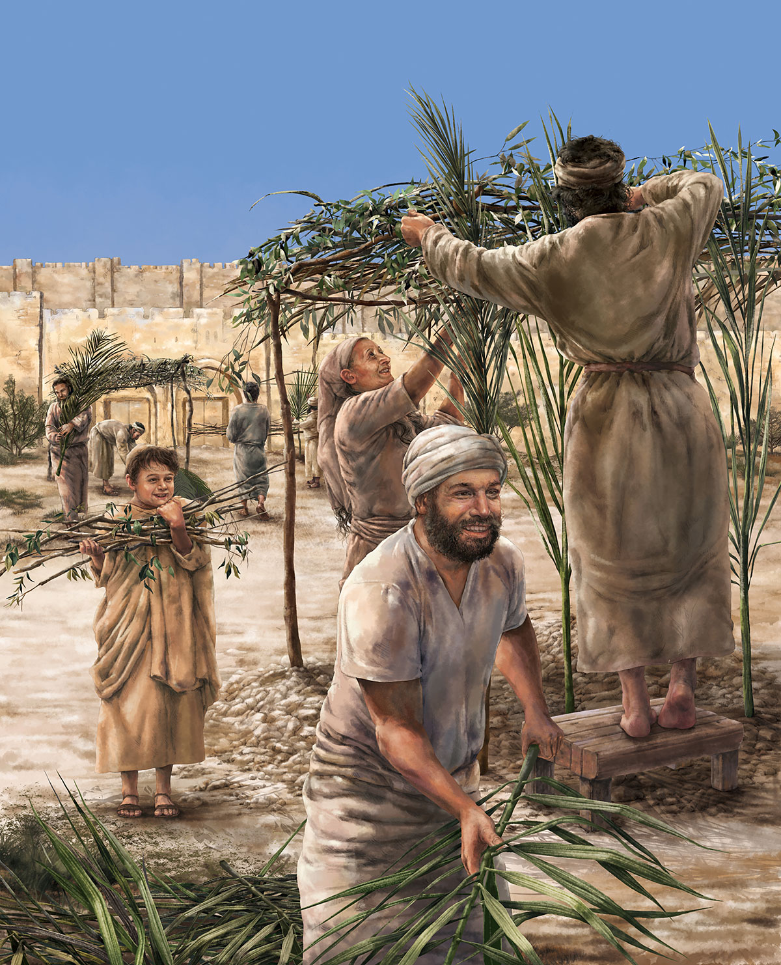
1 of the 3 Most Important Feasts
Deut. 16:16 “Three times in a year shall all thy males appear before the Lord thy God in the place which he shall choose; in the feast of unleavened bread, and in the feast of weeks, and in the feast of tabernacles: and they shall not appear before the Lord empty”

Slide 10
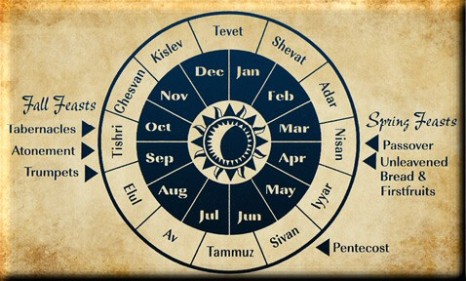
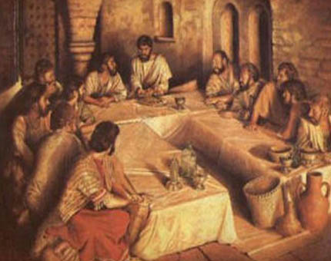
“The Feast of Harvest”
Ex. 23:13-17 “And in all things that I have said unto you be circumspect: and make no mention of the name of other gods, neither let it be heard out of thy mouth. Three times thou shalt keep a feast unto me in the year. Thou shalt keep the feast of unleavened bread: (thou shalt eat unleavened bread seven days, as I commanded thee, in the time appointed of the month Abib; for in it thou camest out from Egypt: and none shall appear before me empty:) And the feast of harvest, the firstfruits of thy labours, which thou hast sown in the field: and the feast of ingathering, which is in the end of the year, when thou hast gathered in thy labours out of the field. Three times in the year all thy males shall appear before the Lord God.”

Slide 11
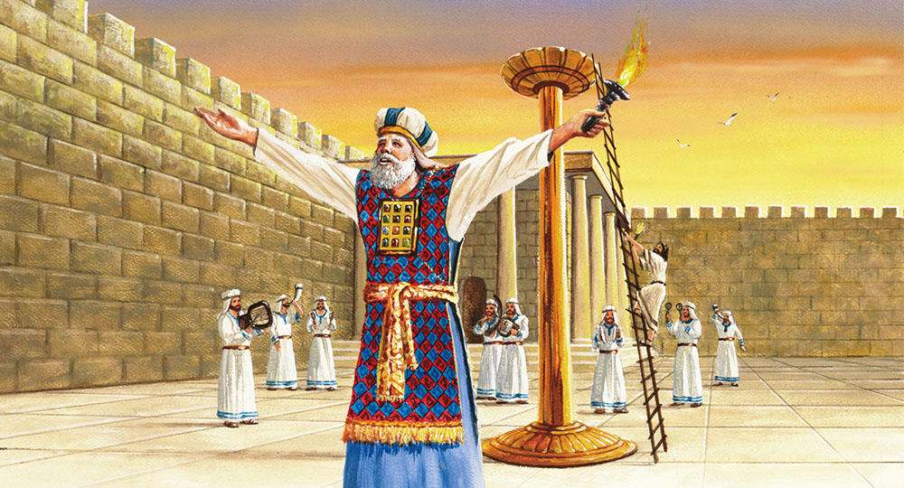
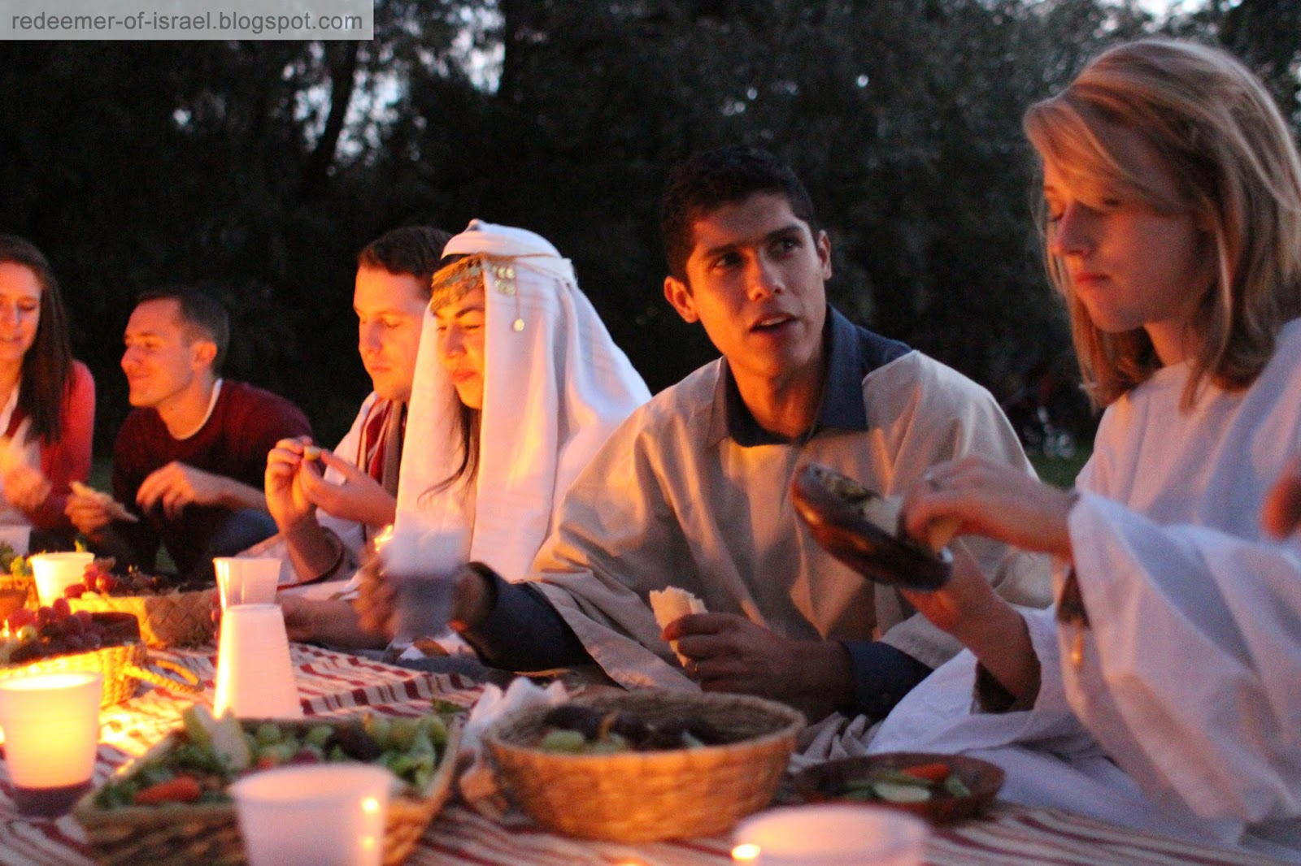
More Foundation
“With those who lived at a distance from the tabernacle, more than a month of every year must have been occupied in attendance upon the annual feasts. This example of devotion to God should emphasize the importance of religious worship and the necessity of subordinating our selfish, worldly interests to those that are spiritual and eternal. We sustain a loss when we neglect the privilege of associating together to strengthen and encourage one another in the service of God. The truths of His word lose their vividness and importance in our minds. Our hearts cease to be enlightened and aroused by the sanctifying influence, and we decline in spirituality. In our intercourse as Christians we lose much by lack of sympathy with one another. He who shuts himself up to himself is not filling the position that God designed he should. We are all children of one Father, dependent upon one another for happiness. The claims of God and of humanity are upon us. It is the proper cultivation of the social elements of our nature that brings us into sympathy with our brethren and affords us happiness in our efforts to bless others.” PP, 541

Slide 12
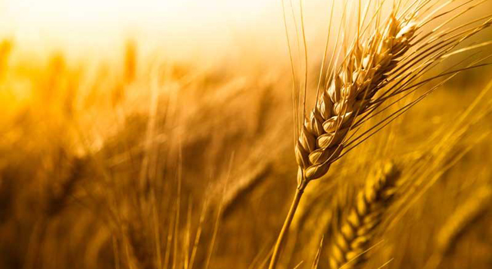
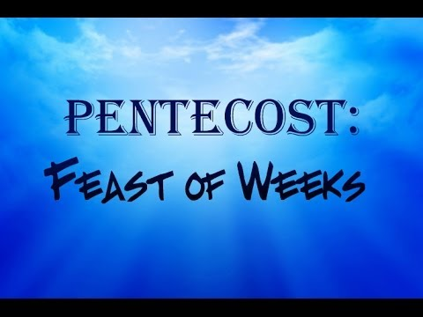
50 Days After Feast of Unleavened Bread
Lev. 23:12-16 “And ye shall offer that day when ye wave the sheaf an he lamb without blemish of the first year for a burnt offering unto the Lord. And the meat offering thereof shall be two tenth deals of fine flour mingled with oil, an offering made by fire unto the Lord for a sweet savour: and the drink offering thereof shall be of wine, the fourth part of an hin. And ye shall eat neither bread, nor parched corn, nor green ears, until the selfsame day that ye have brought an offering unto your God: it shall be a statute for ever throughout your generations in all your dwellings. And ye shall count unto you from the morrow after the sabbath, from the day that ye brought the sheaf of the wave offering; seven sabbaths shall be complete: Even unto the morrow after the seventh sabbath shall ye number fifty days; and ye shall offer a new meat offering unto the Lord.”

Slide 13
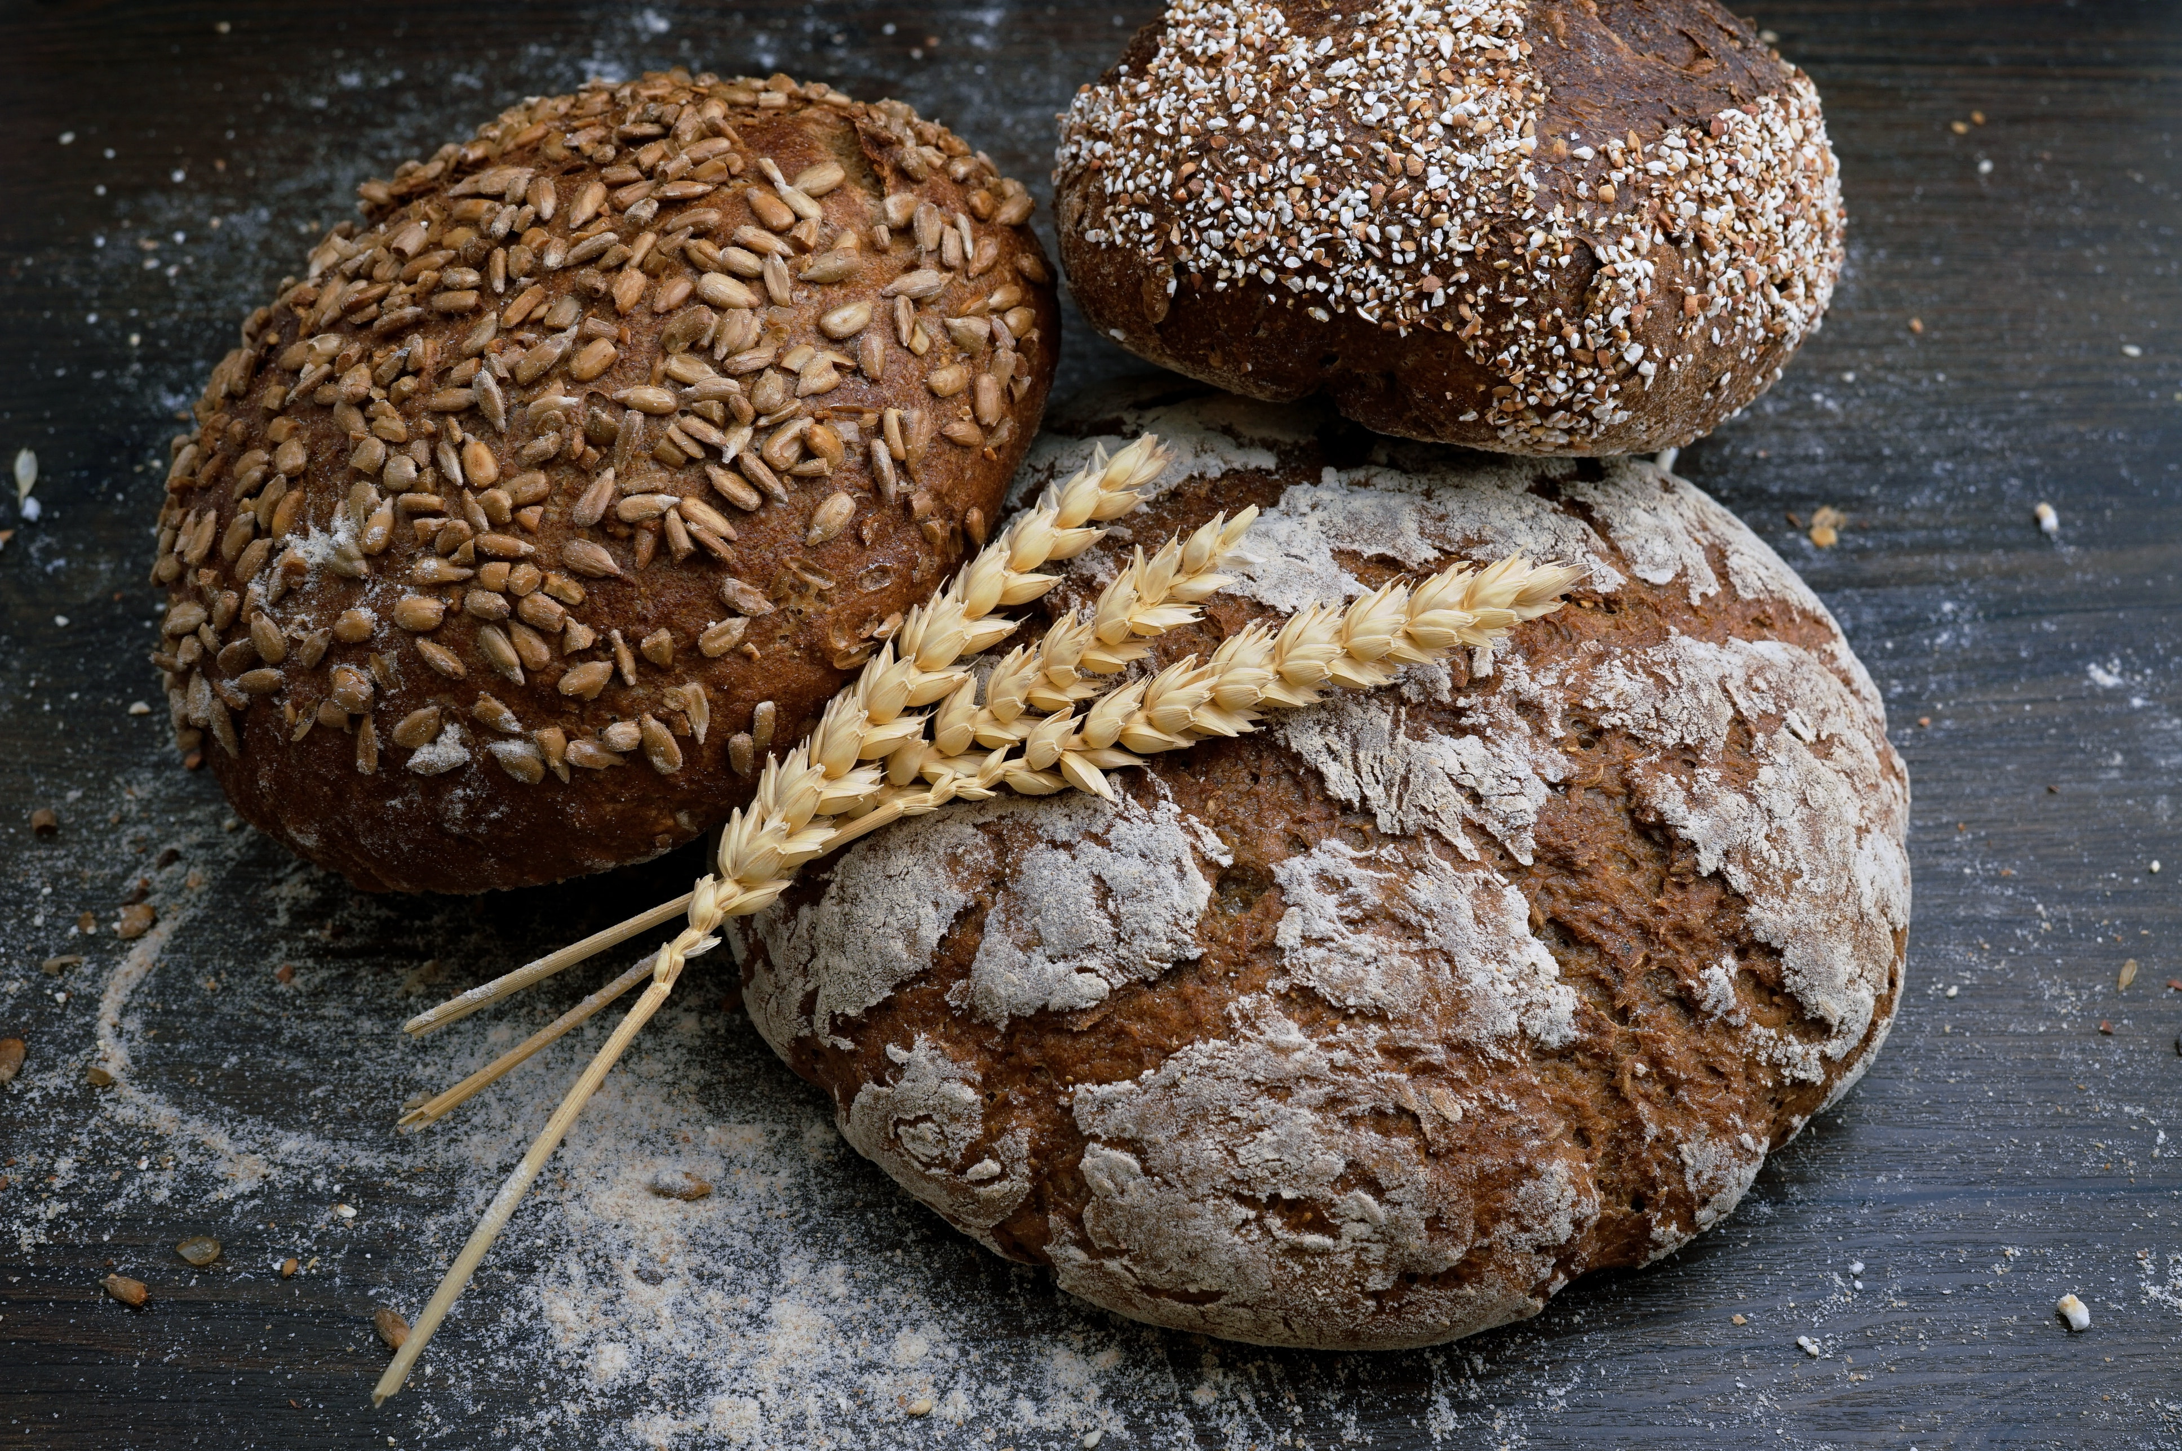
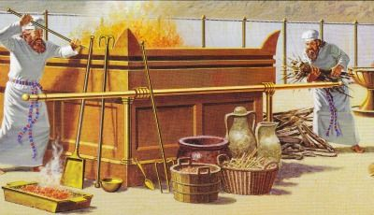
Leviticus Continues
Lev. 23:17-21“Ye shall bring out of your habitations two wave loaves of two tenth deals; they shall be of fine flour; they shall be baken with leaven; they are the firstfruits unto the Lord. And ye shall offer with the bread seven lambs without blemish of the first year, and one young bullock, and two rams: they shall be for a burnt offering unto the Lord, with their meat offering, and their drink offerings, even an offering made by fire, of sweet savour unto the Lord. Then ye shall sacrifice one kid of the goats for a sin offering, and two lambs of the first year for a sacrifice of peace offerings. And the priest shall wave them with the bread of the firstfruits for a wave offering before the Lord, with the two lambs: they shall be holy to the Lord for the priest. And ye shall proclaim on the selfsame day, that it may be an holy convocation unto you: ye shall do no servile work therein: it shall be a statute for ever in all your dwellings throughout your generations.”

Slide 14
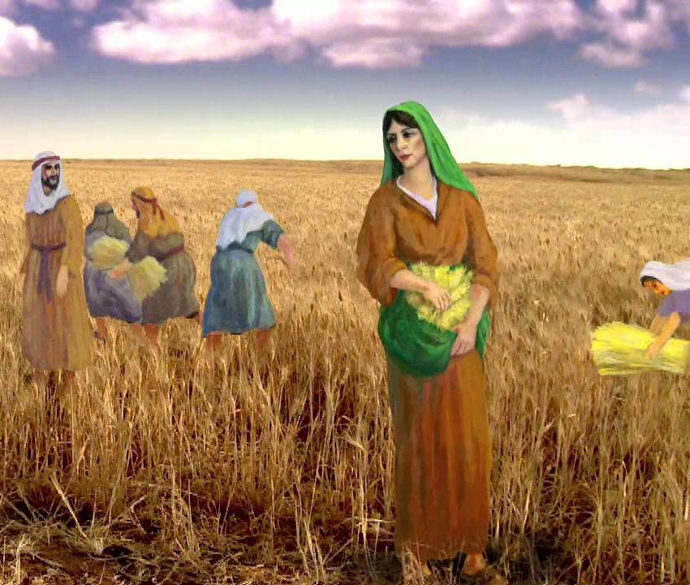
A Poor Tax….
Lev. 23:22 “And when ye reap the harvest of your land, thou shalt not make clean riddance of the corners of thy field when thou reapest, neither shalt thou gather any gleaning of thy harvest: thou shalt leave them unto the poor, and to the stranger: I am the Lord your God.”

Slide 15
This “Tax” Sustained Ruth and Jesus Christ
Ruth 2:2-9, 16-17 “And Ruth the Moabitess said unto Naomi, Let me now go to the field, and glean ears of corn after him in whose sight I shall find grace. And she said unto her, Go, my daughter. And she went, and came, and gleaned in the field after the reapers: and her hap was to light on a part of the field belonging unto Boaz, who was of the kindred of Elimelech. And, behold, Boaz came from Bethlehem, and said unto the reapers, The Lord be with you. And they answered him, The Lord bless thee. Then said Boaz unto his servant that was set over the reapers, Whose damsel is this? And the servant that was set over the reapers answered and said, It is the Moabitish damsel that came back with Naomi out of the country of Moab: And she said, I pray you, let me glean and gather after the reapers among the sheaves: so she came, and hath continued even from the morning until now, that she tarried a little in the house. Then said Boaz unto Ruth, Hearest thou not, my daughter? Go not to glean in another field, neither go from hence, but abide here fast by my maidens: Let thine eyes be on the field that they do reap, and go thou after them: have I not charged the young men that they shall not touch thee? and when thou art athirst, go unto the vessels, and drink of that which the young men have drawn. . . . And let fall also some of the handfuls of purpose for her, and leave them, that she may glean them, and rebuke her not. So she gleaned in the field until even, and beat out that she had gleaned: and it was about an ephah of barley.”

Slide 16
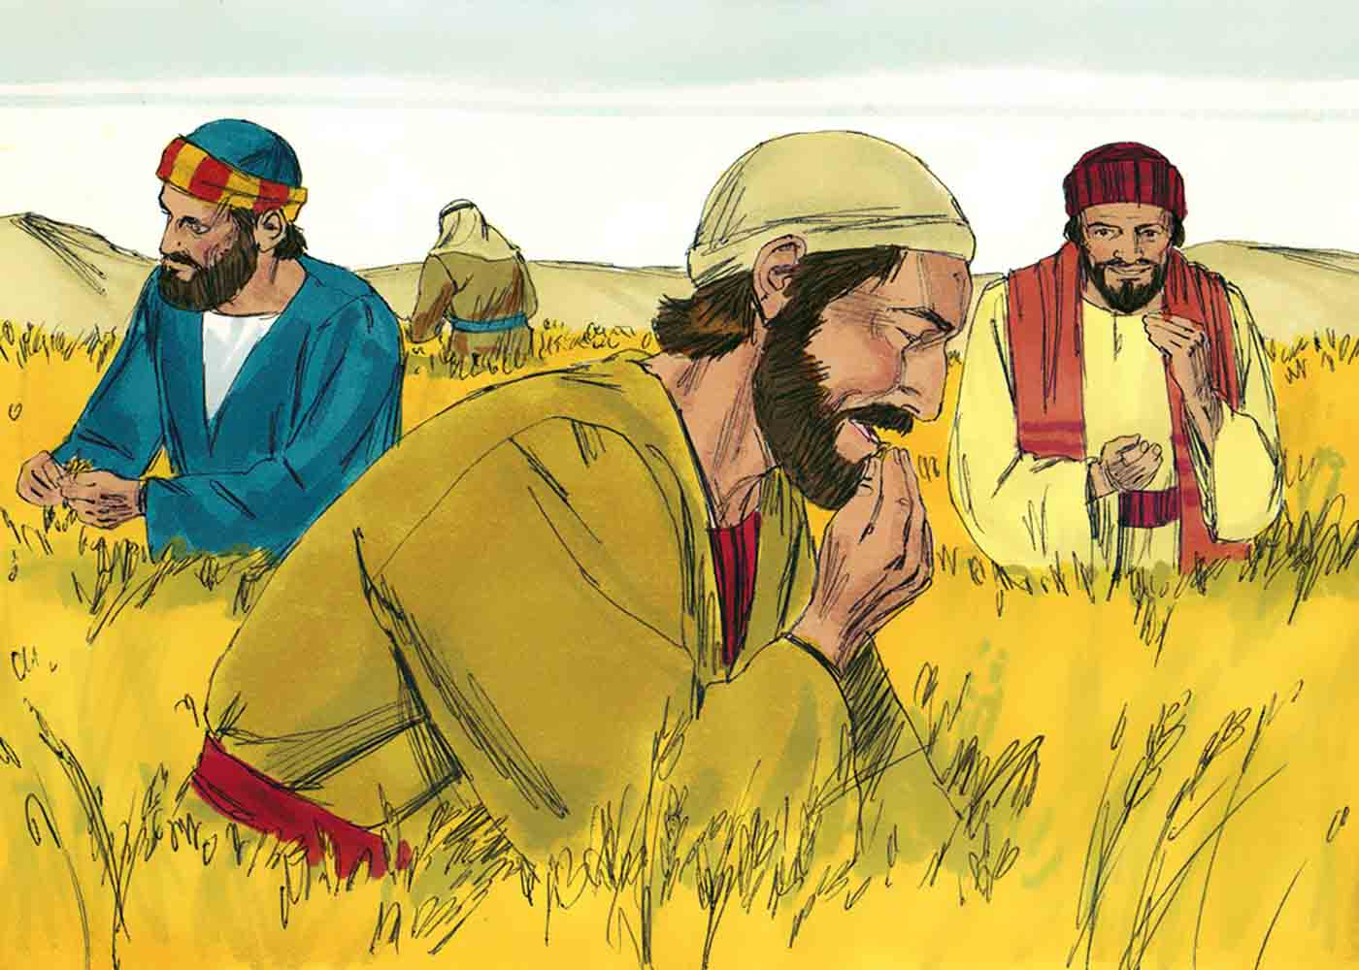
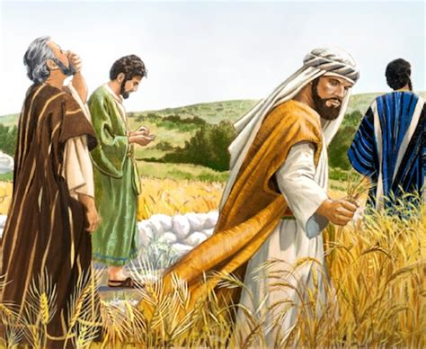
God’s Will
Matt. 12:1-8 “At that time Jesus went on the sabbath day through the corn; and his disciples were an hungred, and began to pluck the ears of corn and to eat. But when the Pharisees saw it, they said unto him, Behold, thy disciples do that which is not lawful to do upon the sabbath day. But he said unto them, Have ye not read what David did, when he was an hungred, and they that were with him; How he entered into the house of God, and did eat the shewbread, which was not lawful for him to eat, neither for them which were with him, but only for the priests? Or have ye not read in the law, how that on the sabbath days the priests in the temple profane the sabbath, and are blameless? But I say unto you, That in this place is one greater than the temple. But if ye had known what this meaneth, I will have mercy, and not sacrifice, ye would not have condemned the guiltless. For the Son of man is Lord even of the sabbath day.”

Slide 17
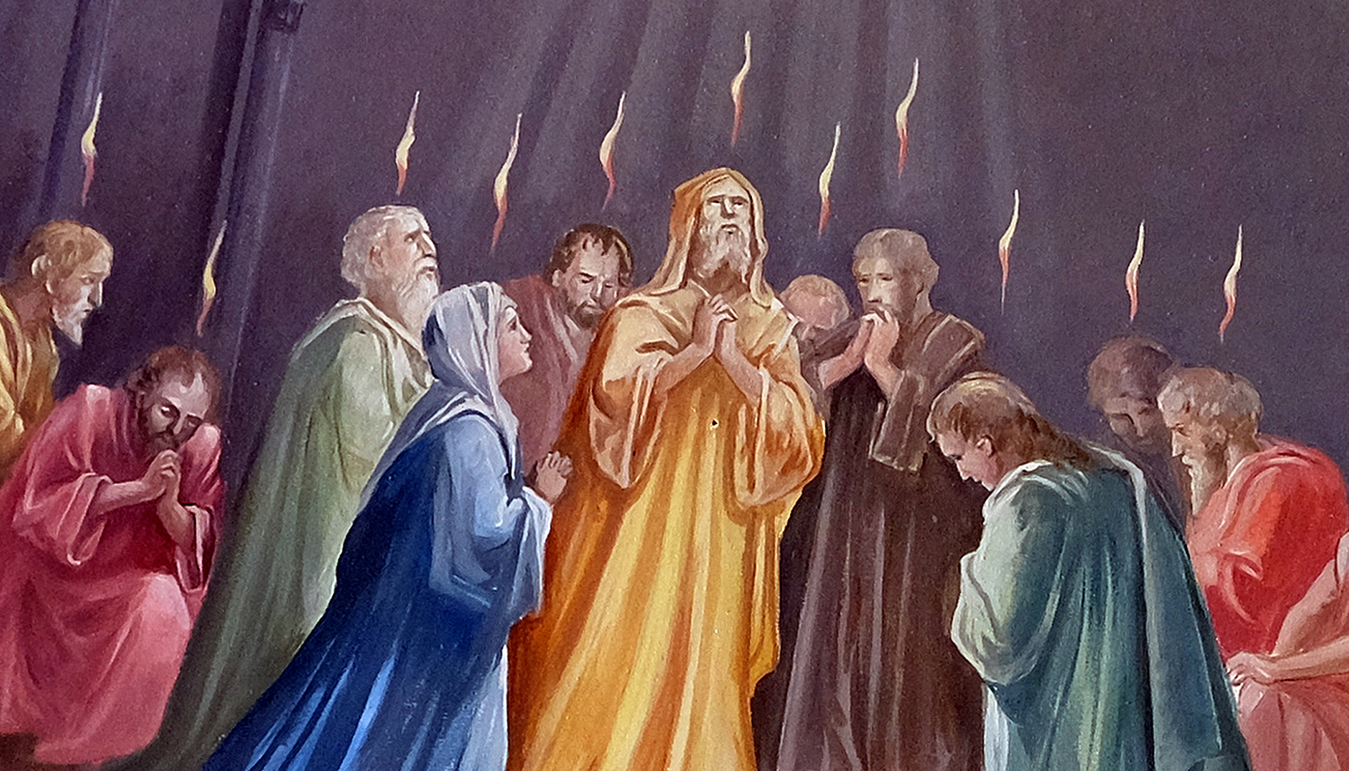
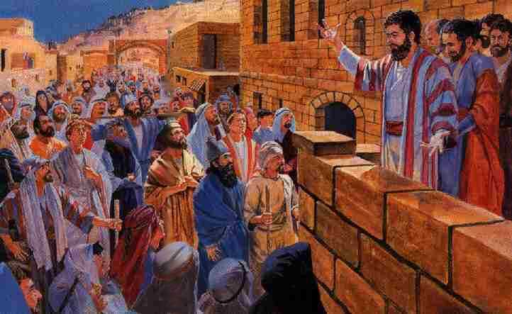
What Happened on the Antitypical Pentecost?
Acts 2:1-6, 41-42 “And when the day of Pentecost was fully come, they were all with one accord in one place. And suddenly there came a sound from heaven as of a rushing mighty wind, and it filled all the house where they were sitting. And there appeared unto them cloven tongues like as of fire, and it sat upon each of them. And they were all filled with the Holy Ghost, and began to speak with other tongues, as the Spirit gave them utterance. And there were dwelling at Jerusalem Jews, devout men, out of every nation under heaven. Now when this was noised abroad, the multitude came together, and were confounded, because that every man heard them speak in his own language. . . . Then they that gladly received his word were baptized: and the same day there were added unto them about three thousand souls. And they continued stedfastly in the apostles' doctrine and fellowship, and in breaking of bread, and in prayers.”

Slide 18
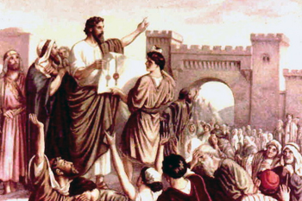
The Early Rain Ripened the Harvest
Acts 2:15-18 “For these are not drunken, as ye suppose, seeing it is but the third hour of the day. But this is that which was spoken by the prophet Joel; And it shall come to pass in the last days, saith God, I will pour out of my Spirit upon all flesh: and your sons and your daughters shall prophesy, and your young men shall see visions, and your old men shall dream dreams: And on my servants and on my handmaidens I will pour out in those days of my Spirit; and they shall prophesy”

Slide 19
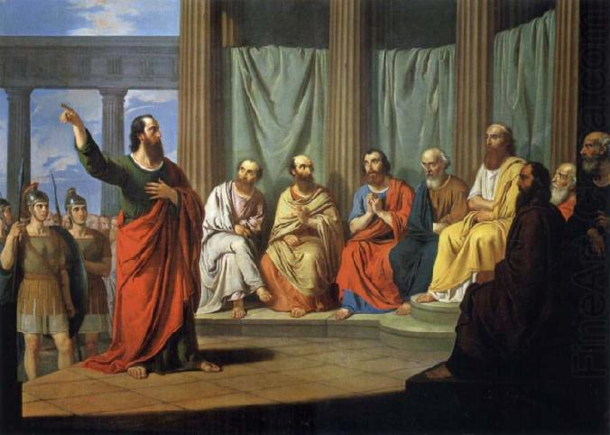
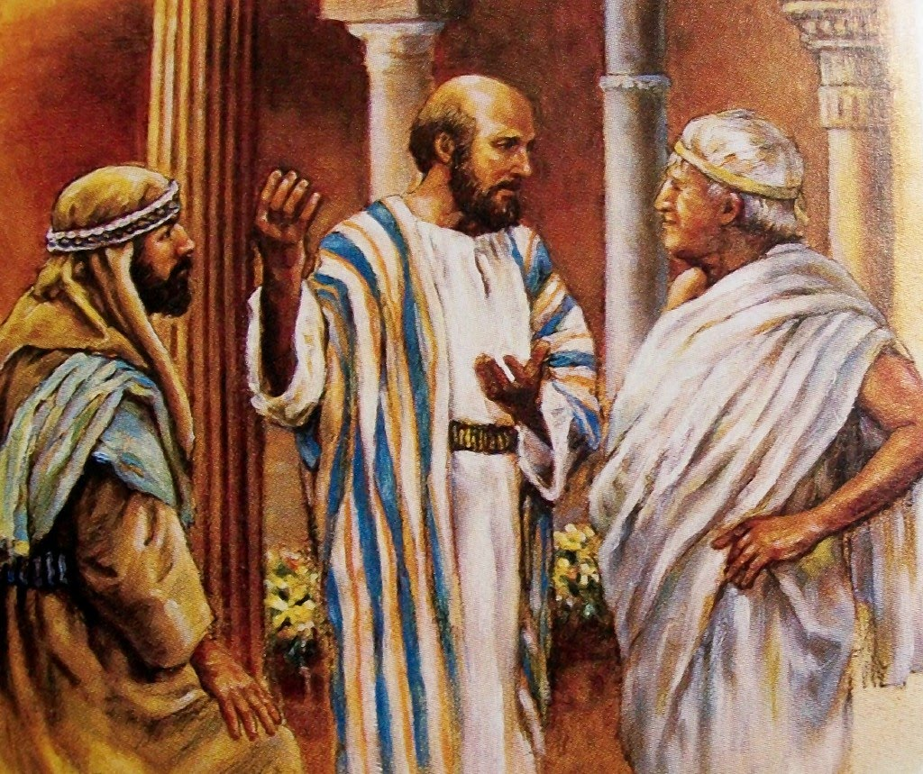
The Outpouring the Spirit—Early and Latter
“The outpouring of the Spirit in the days of the apostles was the "former rain;" and glorious was the result. But the "latter rain" will be still more abundant. What is the promise to those living in these last days?--"Turn you to the stronghold, ye prisoners of hope; even today do I declare that I will render double unto thee." "Ask ye of the Lord rain in the time of the latter rain; so the Lord shall make bright clouds, and give them showers of rain, to every one grass in the field.“--Signs of the Times, March 15, 1910

Slide 20
Pentecost to Be Repeated!
“It is with an earnest longing that I look forward to the time when the events of the day of Pentecost shall be repeated with even greater power than on that occasion [Revelation 18:1 quoted] . . . Then, as at the Pentecostal season, the people will hear the truth spoken to them, every man in his own tongue. God can breathe the new life into every soul that sincerely desires to serve Him, and can touch the lips sincerely with a live coal from off the altar, and cause them to become eloquent with His praise. Thousands of voices will be embued with the power to speak forth the wonderful truths of God’s word. The stammering tongue will be unloosed, and the timid will be made strong to bear courageous testimony to the truth. May the Lord help His people to cleanse the soul temple from every defilement, and to maintain such a close connection with Him that they may be partakers of the Latter Rain when it shall be poured out”—Review and Herald, Jan. 29, 1886

Slide 21
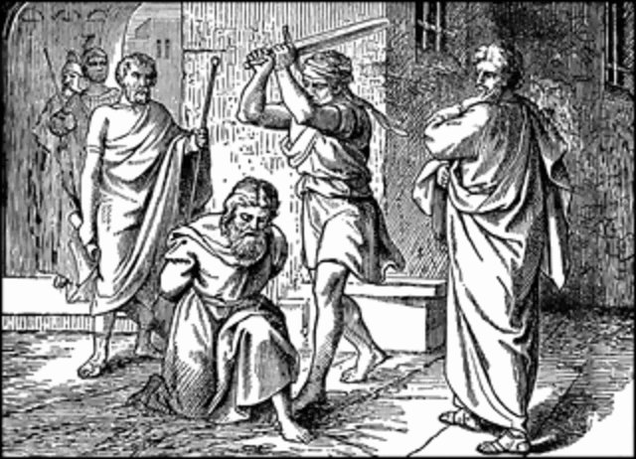
The Former Rain in the Acts of the Apostles
The Apostle Peter, Paul, James, John, the Deacon Stephen, Barnabas, Luke, Silas, Apollos, Timothy, John Mark, Phillip, Simon of Cyrene, the Ethiopian Eunuch preached the Gospel in Jerusalem, Samaria, Syria Antioch, Galatia, Crete, the Roman Empire, Malta, Berea, Lystra, Philippi, Thessalonica, Macedonia, Troas, Corinth, Athens, Ephesus, Asia Minor, Rome, Patmos, Northern Africa, Ethiopia, and more! (Peter and Paul were martyred in Rome, Stephen, James were martyred in Jerusalem)

Slide 22
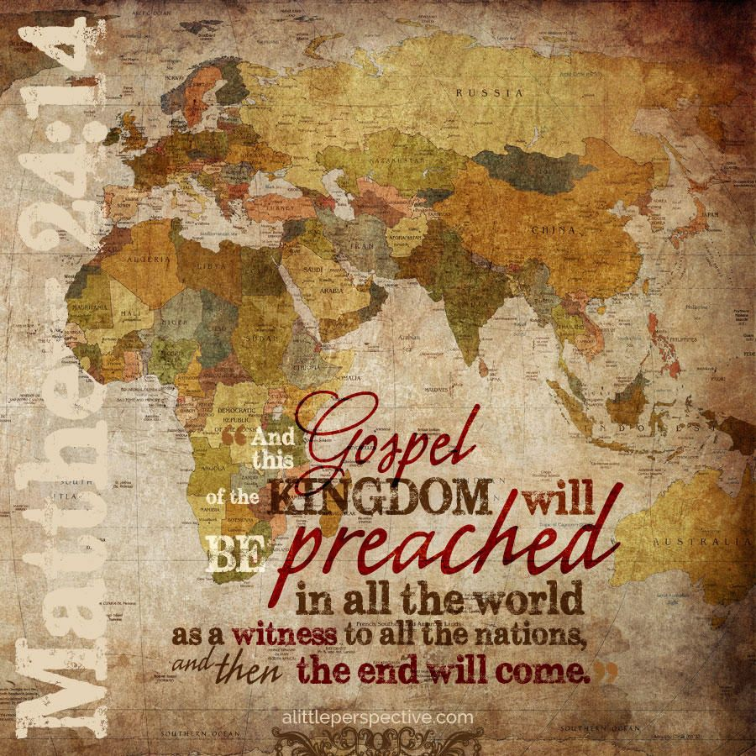
Earth’s Lost History
Foxe’s Book of Martyrs records that Philip the Disciple preached the Gospel in Upper Asia, and was crucified in Heliopolis, Phrygia in 54 AD [Asia Minor] (p. xi), Matthew preached in Parthia and Ethiopia, and was slain in 60 AD (p. xi), Andrew preached in Greece, and was crucified in Edessa (p. xii), Mark preached in the Roman Empire and was martyred in Alexandria, Egypt (p. xii), Bartholomew preached the Gospel in India—translating Matthews Gospel into the native language (p. xiii), Thomas preached and was martyred in India (p. xiii), Simon the Zealot preached in Northwestern Africa (Mauritania) and then later crucified in Britain in 74 AD (p. xiv)

Slide 23
Comparison
Feast Day:
Pointed to total dependence on God for sustenance. God’s bounty and blessing gives the fruits!
It was a thank offering, offered with leaven, for the priests and people
Was precipitated by the “early rain”
Occurred 50 days after Feast of Unleavened Bread
Apostles’s Day:
Pentecost kicked off with an outpouring of the Holy Spirit—all God’s Work Again! He gives the fruits!
Pentecost kicked off a conversion of 3,000 people after hearing 1 sermon!
Was precipitated by the “Early Rain”
Occurred 50 days after the Antitypical Feast of Unleavened Bread

Slide 24
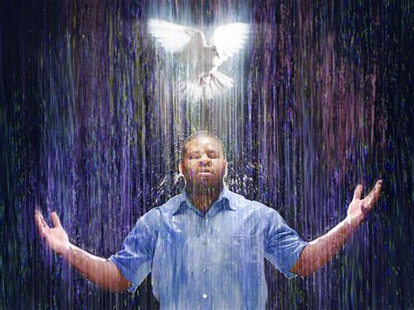
Latter Rain Prepares the Fall Harvest!
“The latter rain, ripening earth's harvest, represents the spiritual grace that prepares the church for the coming of the Son of Man. But unless the former rain has fallen, there will be no life; the green blade will not spring up. Unless the early showers have done their work, the latter rain can bring no seed to perfection.”—Review and Herald, March 2, 1897

Slide 25
Great Controversy Explains
“The great work of the gospel is not to close with less manifestation of the power of God than marked its opening. The prophecies which were fulfilled in the outpouring of the former rain at the opening of the gospel are again to be fulfilled in the latter rain at its close. Here are ‘the times of refreshing’ to which the apostle Peter looked forward when he said: ‘Repent ye therefore, and be converted, that your sins may be blotted out, when the times of refreshing shall come from the presence of the Lord; and He shall send Jesus.’ Acts 3:19, 20.”—GC, p. 611-612

Slide 26
Do Not Fail to Receive Your Personal Latter Rain
“Many have in a great measure failed to receive the former rain. They have not obtained all the benefits that God has thus provided for them. They expect that the lack will be supplied by the latter rain. When the richest abundance of grace shall be bestowed, they intend to open their hearts to receive it. They are making a terrible mistake. The work that God has begun in the human heart in giving his light and knowledge, must be continually going forward. Every individual must realize his own necessity. The heart must be emptied of every defilement, and cleansed for the indwelling of the Spirit. It was by the confession and forsaking of sin, by earnest prayer and consecration of themselves to God, that the early disciples prepared for the outpouring of the Holy Spirit on the day of Pentecost. The same work, only in greater degree, must be done now. Then the human agent had only to ask for the blessing, and wait for the Lord to perfect the work concerning him. It is God who began the work, and he will finish his work, making man complete in Jesus Christ. But there must be no neglect of the grace represented by the former rain. Only those who are living up to the light they have, will receive greater light. Unless we are daily advancing in the exemplification of the active Christian virtues, we shall not recognize the manifestations of the Holy Spirit in the latter rain. It may be falling on hearts all around us, but we shall not discern or receive it.”—Review and Herald, March 2, 1897

Slide 27
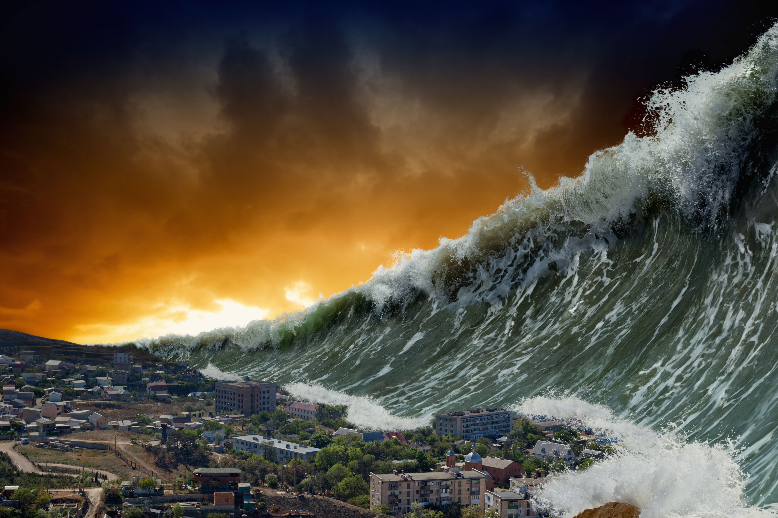
10 Times the Power of the Midnight Cry
“The angel said, some tried too hard to believe. Faith is so simple they look above it. Satan has deceived some, and got them to looking at their own unworthiness. I saw they must look away from self to the worthiness of Jesus, and throw themselves just as they are, needy, dependent upon His mercy, and draw by faith strength and nourishment from Him. . . . I saw that our minds must be stayed upon God, and we must not fear the fear of the wicked. Evil angels are around us trying to invent a new way to destroy us. The Lord would lift up a standard against him (the devil). We must take the shield of faith. You are getting the coming of the Lord too far off. I saw the latter rain was coming as [suddenly as] the midnight cry, and with ten times the power.” Spalding and Magan Collection, p. 3-4

