Slide 1
Final Scenes, pt. 6
Discourse on Prophecy

Slide 2
A Thoughtful Hour
“It would be well for us to spend a thoughtful hour each day in contemplation of the life of Christ. We should take it point by point, and let the imagination grasp each scene, especially the closing ones. As we thus dwell upon His great sacrifice for us, our confidence in Him will be more constant, our love will be quickened, and we shall be more deeply imbued with His spirit. If we would be saved at last, we must learn the lesson of penitence and humiliation at the foot of the cross.” Desire of Ages, pg. 83

Slide 3
Only One
In all of Christ’s messages, there is only one recorded where He spoke on prophecy. This was found in Matthew.
Christ had just finished His woes on the scribes and Pharisees. He had just uttered His scathing rebuke, “O Jerusalem, Jerusalem, thou that killest the prophets, and stonest them which are sent unto thee, how often would I have gathered thy children together, even as a hen gathereth her chickens under her wings, and ye would not! Behold, your house is left unto you desolate.” Matthew 23:37,38
The disciples were very concerned about the destruction of the temple in Jerusalem. They went to Christ to gain insight into His statement. It was this that prompted Christ’s discourse on prophecy laid out in Matthew 24.

Slide 4
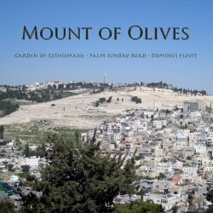
The Talk Begins
“And Jesus went out, and departed from the temple: and his disciples came to him for to shew him the buildings of the temple. And Jesus said unto them, See ye not all these things? verily I say unto you, There shall not be left here one stone upon another, that shall not be thrown down. And as he sat upon the mount of Olives, the disciples came unto him privately, saying, Tell us, when shall these things be? and what shall be the sign of thy coming, and of the end of the world?” Matthew 24:1-3

Slide 5
Two Events Together
The disciples believed that the destruction of the temple and the second coming of Christ were simultaneous events. Jesus full well knew that the events would be far separated in time, but when giving His answer to their two-pronged question, Christ only gave a single answer. The reason: Christ knew that the events surrounding Jerusalem’s destruction and the second coming would be identical. Therefore, His answer would apply in both cases!

Slide 6
Deception Beware
“And Jesus answered and said unto them, Take heed that no man deceive you. For many shall come in my name, saying, I am Christ; and shall deceive many.” Matthew 24:4,5
This was uppermost in Christ’s mind as He began His discourse. He repeated it twice more in Matthew 24:11,24! 4 times, Christ warned of DECEPTION!

Slide 7
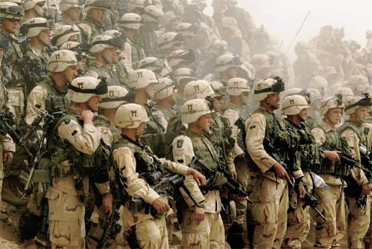
Wars between Nations
“And ye shall hear of wars and rumours of wars: see that ye be not troubled: for all these things must come to pass, but the end is not yet. For nation shall rise against nation, and kingdom against kingdom:” Matthew 24:6,7

Slide 8
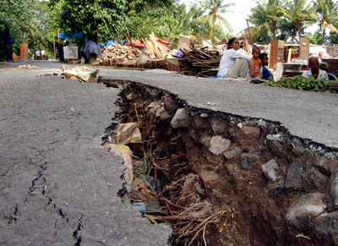
Upheaval in the World
“…and there shall be famines, and pestilences, and earthquakes, in divers places; All these are the beginning of sorrows. ” verses 7,8

Slide 9
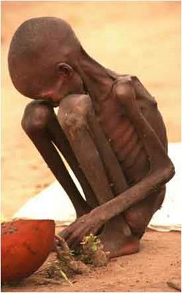
Christ Foretold
Christ foretold events transpiring all about us. His discourse in Matthew 24 started out looking at things that would effect much of humanity and then He zeroed in on His children in particular.

Slide 10
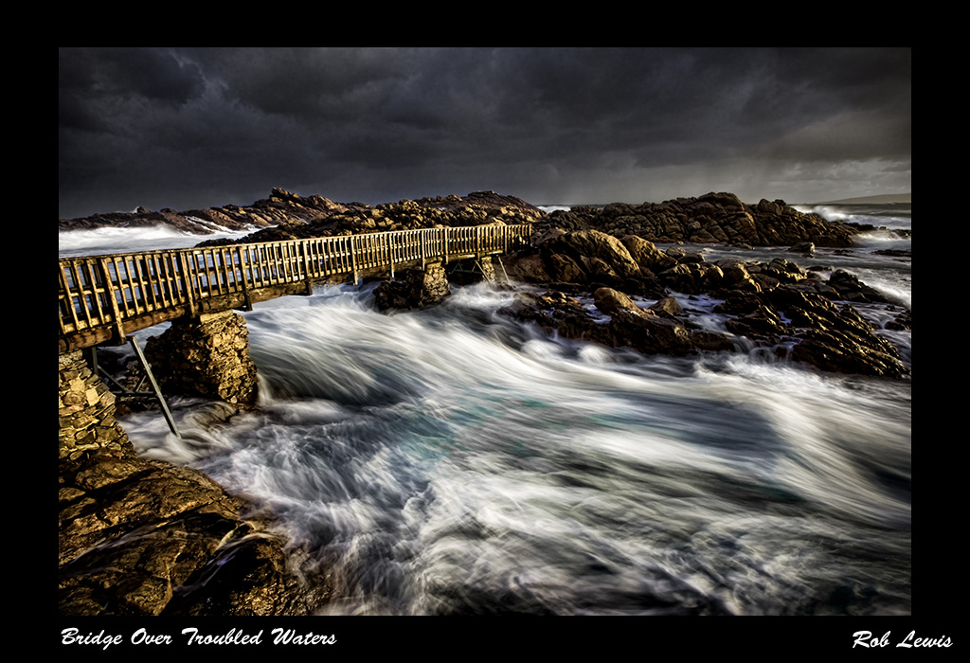
Troubled Waters
“Then shall they deliver you up to be afflicted, and shall kill you: and ye shall be hated of all nations for my name's sake. And then shall many be offended, and shall betray one another, and shall hate one another. And many false prophets shall rise, and shall deceive many. And because iniquity shall abound, the love of many shall wax cold. But he that shall endure unto the end, the same shall be saved.” Matthew 24:9-13

Slide 11
His Namesake
Rev. 14:1 “And I looked, and, lo, a Lamb stood on the mount Zion, and with him an hundred forty and four thousand, having his Father's name written in their foreheads.” “ And I saw another angel ascending from the east, having the seal of the living God: and he cried with a loud voice to the four angels, to whom it was given to hurt the earth and the sea, Saying, Hurt not the earth, neither the sea, nor the trees, till we have sealed the servants of our God in their foreheads.” Rev. 7:2,3
Matthew 24:9 declares that we will be hated for God’s namesake and God’s name is in the forehead and this is the Sabbath. The Sabbath is a sign of God’s holiness in the mind; wholeness for God. “
“Moreover also I gave them my sabbaths, to be a sign between me and them, that they might know that I am the LORD that sanctify them.” Ezekiel 20:12

Slide 12
From Whence Cometh?
“As the storm approaches, a large class who have professed faith in the third angel's message, but have not been sanctified through obedience to the truth, abandon their position and join the ranks of the opposition. By uniting with the world and partaking of its spirit, they have come to view matters in nearly the same light; and when the test is brought, they are prepared to choose the easy, popular side. Men of talent and pleasing address, who once rejoiced in the truth, employ their powers to deceive and mislead souls. They become the most bitter enemies of their former brethren. When Sabbath keepers are brought before the courts to answer for their faith, these apostates are the most efficient agents of Satan to misrepresent and accuse them, and by false reports and insinuations to stir up the rulers against them.
In this time of persecution the faith of the Lord's servants will be tried. They have faithfully given the warning, looking to God and to His word alone. God's Spirit, moving upon their hearts, has constrained them to speak. Stimulated with holy zeal, and with the divine impulse strong upon them, they entered upon the performance of their duties without coldly calculating the consequences of speaking to the people the word which the Lord had given them.” GC, 608,609

Slide 13
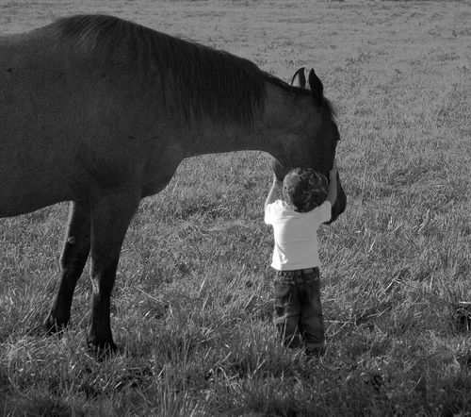
Keep Your Heart Soft
“And be ye kind one to another, tenderhearted, forgiving one another, even as God for Christ's sake hath forgiven you.” Eph. 4:32
Grudges, bitterness, anger toward someone; we must give it to Christ. It doesn’t hurt the person to whom we feel that way; it hurts US!

Slide 14
Those Who Endure!
It isn’t a one time deal! The prize is for those who continue to abide in Christ. “Abide in me, and I in you. As the branch cannot bear fruit of itself, except it abide in the vine; no more can ye, except ye abide in me. I am the vine, ye are the branches: He that abideth in me, and I in him, the same bringeth forth much fruit: for without me ye can do nothing.” Jn. 15:4,5

Slide 15
A Proclamation
“And this gospel of the kingdom shall be preached in all the world for a witness unto all nations; and then shall the end come.” Matthew 24:14
“And I saw another angel fly in the midst of heaven, having the everlasting gospel to preach unto them that dwell on the earth, and to every nation, and kindred, and tongue, and people, Saying with a loud voice, Fear God, and give glory to him; for the hour of his judgment is come: and worship him that made heaven, and earth, and the sea, and the fountains of waters. And there followed another angel, saying, Babylon is fallen, is fallen, that great city, because she made all nations drink of the wine of the wrath of her fornication. And the third angel followed them, saying with a loud voice, If any man worship the beast and his image, and receive [his] mark in his forehead, or in his hand,

Slide 16
Abomination of Desolation
“When ye therefore shall see the abomination of desolation, spoken of by Daniel the prophet, stand in the holy place, (whoso readeth, let him understand:)” Matthew 24:15
“The dreaded hour would come suddenly and swiftly. And the Savior warned His followers: "When ye therefore shall see the abomination of desolation, spoken of by Daniel the prophet, stand in the holy place, (whoso readeth, let him understand:) then let them which be in Judea flee into the mountains." Matthew 24:15, 16; Luke 21:20, 21. When the idolatrous standards of the Romans should be set up in the holy ground, which extended some furlongs outside the city walls, then the followers of Christ were to find safety in flight. When the warning sign should be seen, those who would escape must make no delay. Throughout the land of Judea, as well as in Jerusalem itself, the signal for flight must be immediately obeyed.” GC, pgs. 25,26
The idolatrous standard of the Romans contained many configurations of their idol gods. Their were many representations. One that held a predominate role was the sun. The Romans were worshippers of the sun! Christ warned His followers that when the Roman standard was set up in the holy place to flee out of Jerusalem to a remote location.

Slide 17
Application for the End
“By the decree enforcing the institution of the papacy in violation of the law of God, our nation will disconnect herself fully from righteousness. When Protestantism shall stretch her hand across the gulf to grasp the hand of the Roman power, when she shall reach over the abyss to clasp hands with spiritualism, when, under the influence of this threefold union, our country shall repudiate every principle of its Constitution as a Protestant and republican government, and shall make provision for the propagation of papal falsehoods and delusions, then we may know that the time has come for the marvelous working of Satan and that the end is near. As the approach of the Roman armies was a sign to the disciples of the impending destruction of Jerusalem, so may this apostasy be a sign to us that the limit of God's forbearance is reached, that the measure of our nation's iniquity is full, and that the angel of mercy is about to take her flight, never to return. “ 5 Testimonies, pg. 451

Slide 18
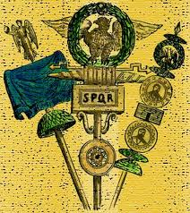
Roman Standard

Slide 19
Counsel
“Then let them which be in Judaea flee into the mountains: Let him which is on the housetop not come down to take any thing out of his house: Neither let him which is in the field return back to take his clothes. And woe unto them that are with child, and to them that give suck in those days! But pray ye that your flight be not in the winter, neither on the sabbath day:” Matthew 24:16-20

Slide 20
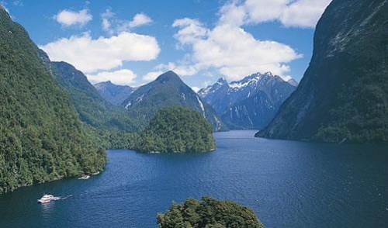
Still binding
“But pray ye that your flight be not in the winter, neither on the sabbath day:“ Matthew 24:20
Since this passage has application at the end of time, then the Sabbath is binding until the end of time. This is one of the most profound passages in the Bible that shows the eternal character of the ten commandments and especially, the 7th day Sabbath!

