Slide 1
Hebrews 12 ‘Running With Patience’

Slide 2
We Have Seen
1. The Supremacy of Christ over angels and Moses.
2. Christ’s Amazing Condescension in taking upon Himself man’s carnal nature.
3. Christ’s Work as our Great High Priest.
4. Christ is the Lord of the Sabbath.
5. The Melchisedec priesthood of Christ is greater than the Levitical priesthood.
6. Christ would carry on two ministries in the Heavenly Sanctuary just as the earthly priests had two ministries.
7. Everything in the earthly temple reflected on Christ’s sacrifice, and priesthood.
8. All the people mentioned in Hebrews 11 learned of Christ’s love!

Slide 3
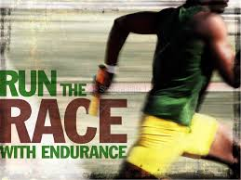
Witnesses of Christ’s Greatness
“Wherefore seeing we also are compassed about with so great a cloud of witnesses, let us lay aside every weight, and the sin which doth so easily beset us, and let us run with patience the race that is set before us, Looking unto Jesus the author and finisher of our faith; who for the joy that was set before him endured the cross, despising the shame, and is set down at the right hand of the throne of God.” Hebrews 12:1,2

Slide 4
Weights and Witnesses
“The weights that are here referred to are the evil habits and practices we have formed by following our own natural dispositions. Who are the witnesses? They are those spoken of in the previous chapter—those who have breasted the evils and difficulties in their way, and who in the name of the Lord have braced themselves successfully against the opposing forces of evil. They were sustained and strengthened and the Lord held them by His hand.
There are other witnesses. All about us are those who are watching us closely, to see how we who profess a belief in the truth conduct ourselves. At all times and in all places, so far as possible, we must magnify the truth before the world (Manuscript 61, 1907).

Slide 5
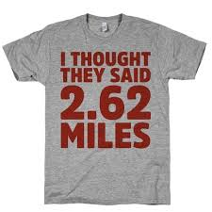
Two Types of Races: Sprint and Long Distance
Sprints are over very quickly, usually lasting somewhere between 10 and 30 seconds. A long distance run can take upwards of several minutes to a few hours. In a long distance race, it must be run with perseverance, overcoming pain and obstacles, patiently plodding along until you see the finish line. A long distance run demands patience and strategy because one must conserve energy and save it for emergencies.

Slide 6
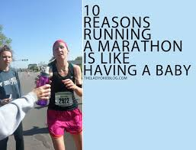
They have gone Before
The witnesses in Hebrews 11 all had times in their lives when failure was their lot. They struggled, battled, and got up again and were victorious over sin! “
“ And they overcame him by the blood of the Lamb, and by the word of their testimony; and they loved not their lives unto the death.” Rev. 12:11

Slide 7
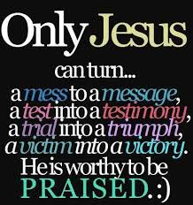
He Persevered
“Looking unto Jesus the author and finisher of our faith; who for the joy that was set before him endured the cross, despising the shame, and is set down at the right hand of the throne of God. For consider him that endured such contradiction of sinners against himself, lest ye be wearied and faint in your minds. Ye have not yet resisted unto blood, striving against sin.” Hebrews 12:2-4

Slide 8
He Did It!
“The Son of God was assaulted at every step by the powers of darkness. After His baptism He was driven of the Spirit into the wilderness, and suffered temptation for forty days. Letters have been coming in to me, affirming that Christ could not have had the same nature as man, for if He had, He would have fallen under similar temptations. If He did not have man's nature, He could not be our example. If He was not a partaker of our nature, He could not have been tempted as man has been. If it were not possible for Him to yield to temptation, He could not be our helper. It was a solemn reality that Christ came to fight the battles as man, in man's behalf. His temptation and victory tell us that humanity must copy the Pattern; man must become a partaker of the divine nature.
In Christ, divinity and humanity were combined. Divinity was not degraded to humanity; divinity held its place, but humanity, by being united to divinity, withstood the fiercest test of temptation in the wilderness. The prince of this world came to Christ after His long fast, when He was an hungered, and suggested to Him to command the stones to become bread. But the plan of God, devised for the salvation of man, provided that Christ should know hunger, and poverty, and every phase of man's experience. He withstood the temptation, through the power that man may command. He laid hold on the throne of God, and there is not a man or woman who may not have access to the same help through faith in God. Man may become a partaker of the divine nature; not a soul lives who may not summon the aid of Heaven in temptation and trial. Christ came to reveal the source of His power, that man might never rely on his unaided human capabilities.” The Review and Herald, February 18, 1890).

Slide 9
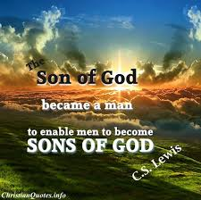
“For what the law could not do, in that it was weak through the flesh, God sending his own Son in the likeness of sinful flesh, and for sin, condemned sin in the flesh: That the righteousness of the law might be fulfilled in us, who walk not after the flesh, but after the Spirit.” Romans 8:3,4

Slide 10
Discipline
“And ye have forgotten the exhortation which speaketh unto you as unto children, My son, despise not thou the chastening of the Lord, nor faint when thou art rebuked of him: For whom the Lord loveth he chasteneth, and scourgeth every son whom he receiveth. If ye endure chastening, God dealeth with you as with sons; for what son is he whom the father chasteneth not? But if ye be without chastisement, whereof all are partakers, then are ye bastards, and not sons. Furthermore we have had fathers of our flesh which corrected us, and we gave them reverence: shall we not much rather be in subjection unto the Father of spirits, and live? For they verily for a few days chastened us after their own pleasure; but he for our profit, that we might be partakers of his holiness. Now no chastening for the present seemeth to be joyous, but grievous: nevertheless afterward it yieldeth the peaceable fruit of righteousness unto them which are exercised thereby.” Hebrews 12:5-11

Slide 11
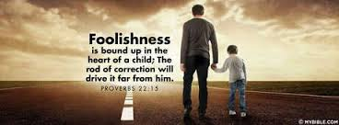
Normally, the chastising we receive comes as the natural result/consequence of our wrong choices. God does not stop the effects of our foolishness. He cannot! The intention is for us to learn that sinful choices/behavior leads to unhappiness and that the best way is found in submission to His gracious authority!

Slide 12
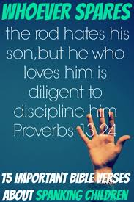
Sometimes, we think that the corrective/disciplining process takes too long. Consider how many years we followed a wayward, rebellious path. The length of our disciplining corresponds to the length of our rebelliousness. In the midst of our self inflicted sorrow, we see the gracious hand of the Lord who tenders the rod with lovingkindness. God’s whole intent in this is to see the true fountain of joy in our lives as we humbly minister in kindness to fallen humanity and in surrender to His gracious leading!

Slide 13
“Faith, patience, forbearance, heavenly-mindedness, trust in your wise, heavenly Father, are the perfect blossoms which mature amidst clouds and disappointments and bereavements (Letter 1, 1883).”
“My brethren, count it all joy when ye fall into divers temptations; Knowing this, that the trying of your faith worketh patience. But let patience have her perfect work, that ye may be perfect and entire, wanting nothing.” James 1:2-4
“For his anger endureth but a moment; in his favour is life: weeping may endure for a night, but joy cometh in the morning.” Ps. 30:5

Slide 14
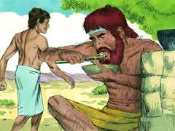
He Never Got it!
“Looking diligently lest any man fail of the grace of God; lest any root of bitterness springing up trouble you, and thereby many be defiled; Lest there be any fornicator, or profane person, as Esau, who for one morsel of meat sold his birthright. For ye know how that afterward, when he would have inherited the blessing, he was rejected: for he found no place of repentance, though he sought it carefully with tears.” Hebrews 12:15-17

Slide 15
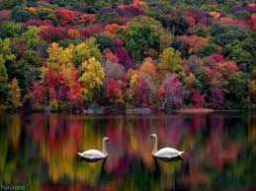
Esau threw away his temporal and spiritual birthrights by his giving into the flesh. Nothing good ever comes by giving in to the flesh! He lost everything in this life and in the life to come by his indulgence to the flesh! “Love not the world, neither the things that are in the world. If any man love the world, the love of the Father is not in him. For all that is in the world, the lust of the flesh, and the lust of the eyes, and the pride of life, is not of the Father, but is of the world. And the world passeth away, and the lust thereof: but he that doeth the will of God abideth for ever.“ 1 John 2:15-17

Slide 16
Threw Away his Birthright!
“A short time at most would have secured him food in his father's tents, but to satisfy the desire of the moment he carelessly bartered the glorious heritage that God Himself had promised to his fathers. His whole interest was in the present. He was ready to sacrifice the heavenly to the earthly, to exchange a future good for a momentary indulgence. "Thus Esau despised his birthright." In disposing of it he felt a sense of relief. Now his way was unobstructed; he could do as he liked. For this wild pleasure, miscalled freedom, how many are still selling their birthright to an inheritance pure and undefiled, eternal in the heavens! Ever subject to mere outward and earthly attractions, Esau took two wives of the daughters of Heth. They were worshipers of false gods, and their idolatry was a bitter grief to Isaac and Rebekah. Esau had violated one of the conditions of the covenant, which forbade intermarriage between the chosen people and the heathen; yet Isaac was still unshaken in his determination to bestow upon him the birthright.” PP, pg. 179

Slide 17
The Choice is Ours!
“For ye are not come unto the mount that might be touched, and that burned with fire, nor unto blackness, and darkness, and tempest, And the sound of a trumpet, and the voice of words; which voice they that heard intreated that the word should not be spoken to them any more: (For they could not endure that which was commanded, And if so much as a beast touch the mountain, it shall be stoned, or thrust through with a dart: And so terrible was the sight, that Moses said, I exceedingly fear and quake:) But ye are come unto mount Sion, and unto the city of the living God, the heavenly Jerusalem, and to an innumerable company of angels, To the general assembly and church of the firstborn, which are written in heaven, and to God the Judge of all, and to the spirits of just men made perfect, And to Jesus the mediator of the new covenant, and to the blood of sprinkling, that speaketh better things than that of Abel.” Hebrews 12:18-24

Slide 18
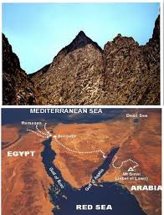
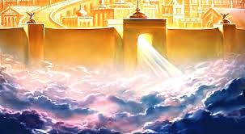
Mountain of Judgment or Mountain of Glory

