Slide 1
Hebrews 11
“The One Who is Faithful”

Slide 2
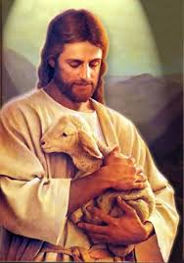
The Great Hall of Faith
Oftentimes when studying Hebrews 11, I think of the great men in the Hall of Faith! How truly wrong an impression that really is!!! The Hall of Faith should really be made up of One Man and One alone who has been, is, and always will be faithful. Hebrews 11 is made up of liars, drunkards, murderers, deceivers, immoral pigs, and whores! Each of them is found in Hebrews 11 as a result of them recognizing their deep spiritual need of Christ and of His being faithful inspite of their unfaithfulness!

Slide 3
Faith is Critical
“Now faith is the substance of things hoped for, the evidence of things not seen. For by it the elders obtained a good report. Through faith we understand that the worlds were framed by the word of God, so that things which are seen were not made of things which do appear. By faith Abel offered unto God a more excellent sacrifice than Cain, by which he obtained witness that he was righteous, God testifying of his gifts: and by it he being dead yet speaketh. By faith Enoch was translated that he should not see death; and was not found, because God had translated him: for before his translation he had this testimony, that he pleased God. But without faith it is impossible to please him: for he that cometh to God must believe that he is, and that he is a rewarder of them that diligently seek him.” Hebrews 11:1-6

Slide 4
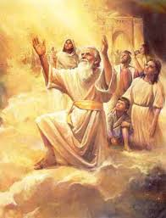
Abel and Enoch
While no sin is recorded against either of these men, we know that “all have sinned, and come short of the glory of God; Being justified freely by his grace through the redemption that is in Christ Jesus:” Romans 3:23,24
“The closer the connection with God, the deeper was the sense of his own weakness and imperfection. Distressed by the increasing wickedness of the ungodly, and fearing that their infidelity might lessen his reverence for God, Enoch avoided constant association with them, and spent much time in solitude, giving himself to meditation and prayer. Thus he waited before the Lord, seeking a clearer knowledge of His will, that he might perform it. To him prayer was as the breath of the soul; he lived in the very atmosphere of heaven.” PP, pg. 85

Slide 5
The Ship Builder
“By faith Noah, being warned of God of things not seen as yet, moved with fear, prepared an ark to the saving of his house; by the which he condemned the world, and became heir of the righteousness which is by faith.” Hebrews 11:7 Noah grasped man’s great need for righteousness outside of himself and preached this message!
“And Noah began to be an husbandman, and he planted a vineyard: And he drank of the wine, and was drunken; and he was uncovered within his tent. And Ham, the father of Canaan, saw the nakedness of his father, and told his two brethren without. And Shem and Japheth took a garment, and laid it upon both their shoulders, and went backward, and covered the nakedness of their father; and their faces were backward, and they saw not their father's nakedness. And Noah awoke from his wine, and knew what his younger son had done unto him. And he said, Cursed be Canaan; a servant of servants shall he be unto his brethren.” Genesis 9:20-25

Slide 6
Noah’s Need for the Righteousness of Christ
“Men whom God favored, and to whom He entrusted great responsibilities, were sometimes overcome by temptation and committed sin, even as we at the present day strive, waver, and frequently fall into error. Their lives, with all their faults and follies, are open before us, both for our encouragement and warning. If they had been represented as without fault, we, with our sinful nature, might despair at our own mistakes and failures. But seeing where others struggled through discouragements like our own, where they fell under temptations as we have done, and yet took heart again and conquered through the grace of God, we are encouraged in our striving after righteousness. As they, though sometimes beaten back, recovered their ground, and were blessed of God, so we too may be overcomers in the strength of Jesus. On the other hand, the record of their lives may serve as a warning to us. It shows that God will by no means clear the guilty. He sees sin in His most favored ones, and He deals with it in them even more strictly than in those who have less light and responsibility.” PP. pg. 238

Slide 7
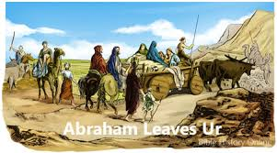
He Got More Ink than all the Rest!
Of all the men in the Hall of Faith in Hebrews 11, no one received more ink than Abraham. Of the 40 verses in the chapter, he got 12 verses. Moses was the closest to him, receiving 6 verses. Both men had to learn a lesson. “He had yet to learn the same lesson of faith that Abraham and Jacob had been taught--not to rely upon human strength or wisdom, but upon the power of God for the fulfillment of His promises. And there were other lessons that, amid the solitude of the mountains, Moses was to receive. In the school of self-denial and hardship he was to learn patience, to temper his passions.” PP, pg. 247

Slide 8
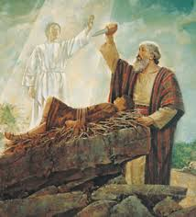
Abraham
“By faith Abraham, when he was tried, offered up Isaac: and he that had received the promises offered up his only begotten son, Of whom it was said, That in Isaac shall thy seed be called: Accounting that God was able to raise him up, even from the dead; from whence also he received him in a figure.” Hebrews 11:17-19

Slide 9
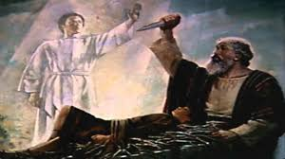
Father of the Faithful
“By faith Abraham, when he was called to go out into a place which he should after receive for an inheritance, obeyed…” Hebrews 11:8
“By faith he sojourned in the land of promise, as in a strange country,” Hebrews 11:9
“By faith Abraham, when he was tried, offered up Isaac:” Hebrews 11:17

Slide 10
The Closest Test!
“God had called Abraham to be the father of the faithful, and his life was to stand as an example of faith to succeeding generations. But his faith had not been perfect. He had shown distrust of God in concealing the fact that Sarah was his wife, and again in his marriage with Hagar. That he might reach the highest standard, God subjected him to another test, the closest which man was ever called to endure. In a vision of the night he was directed to repair to the land of Moriah, and there offer up his son as a burnt offering upon a mountain that should be shown him.” PP, pg. 147

Slide 11
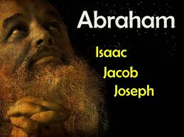
“By faith Isaac blessed Jacob and Esau concerning things to come. By faith Jacob, when he was a dying, blessed both the sons of Joseph; and worshipped, leaning upon the top of his staff. By faith Joseph, when he died, made mention of the departing of the children of Israel; and gave commandment concerning his bones.” Hebrews 11:20-22

Slide 12
Moses!
“By faith Moses, when he was born, was hid three months of his parents, because they saw he was a proper child; and they were not afraid of the king's commandment. By faith Moses, when he was come to years, refused to be called the son of Pharaoh's daughter; Choosing rather to suffer affliction with the people of God, than to enjoy the pleasures of sin for a season; Esteeming the reproach of Christ greater riches than the treasures in Egypt: for he had respect unto the recompence of the reward. By faith he forsook Egypt, not fearing the wrath of the king: for he endured, as seeing him who is invisible. Through faith he kept the Passover, and the sprinkling of blood, lest he that destroyed the firstborn should touch them.” Hebrews 11:23-28

Slide 13
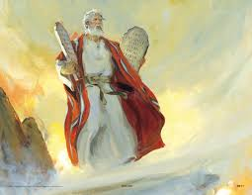
Amazing!
The great lawgiver would readily cast down all of his accolades at the feet of Jesus, who alone should be exalted! The man who saw water split before him and rocks split by his touch knew from whence these miracles came! “Shut in by the bulwarks of the mountains, Moses was alone with God. The magnificent temples of Egypt no longer impressed his mind with their superstition and falsehood. In the solemn grandeur of the everlasting hills he beheld the majesty of the Most High, and in contrast realized how powerless and insignificant were the gods of Egypt. Everywhere the Creator's name was written. Moses seemed to stand in His presence and to be over-shadowed by His power. Here his pride and self-sufficiency were swept away. In the stern simplicity of his wilderness life, the results of the ease and luxury of Egypt disappeared. Moses became patient, reverent, and humble,…” PP, pgs. 248-251

Slide 14
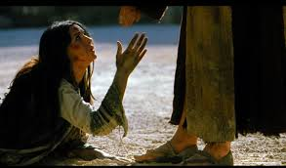
How does one say this? The greatest of all men of Scripture; be it Abraham, Moses, or Daniel; would all agree that that they are nothing and that the Lord is everything. “Therefore I was left alone, and saw this great vision, and there remained no strength in me: for my comeliness was turned in me into corruption, and I retained no strength.” Daniel 10:8 The greatest realized that the highest place was at the feet of Jesus!

Slide 15
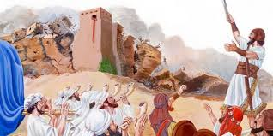
“By faith the walls of Jericho fell down, after they were compassed about seven days. By faith the harlot Rahab perished not with them that believed not, when she had received the spies with peace.” Hebrews 11:30,31

Slide 16
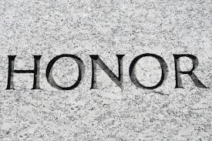
Rahab is Honored!!
To the humble, repentant, lowly Rahab of Jericho, the Lord gave such high, exalted honor!! Wow!! She, who had made such a mess of things, is in the hall of faith and Daniel is left out!! Then, when it comes to the genealogy of the Lord, there she is again!!! What respect, kindness, condescension! “And Salmon begat Booz of Rachab; and Booz begat Obed of Ruth; and Obed begat Jesse; And Jesse begat David the king; and David the king begat Solomon of her that had been the wife of Urias;” Matt. 1:5,6

Slide 17
Amazing Grace!
“The LORD is high above all nations, and his glory above the heavens. Who is like unto the LORD our God, who dwelleth on high, Who humbleth himself to behold the things that are in heaven, and in the earth! He raiseth up the poor out of the dust, and lifteth the needy out of the dunghill; That he may set him with princes, even with the princes of his people.” Ps. 113:4-8

Slide 18
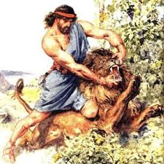
“And what shall I more say? for the time would fail me to tell of Gideon, and of Barak, and of Samson, and of Jephthah; of David also, and Samuel, and of the prophets: Who through faith subdued kingdoms, wrought righteousness, obtained promises, stopped the mouths of lions, Quenched the violence of fire, escaped the edge of the sword, out of weakness were made strong, waxed valiant in fight, turned to flight the armies of the aliens.” Hebrews 11:32-34

Slide 19
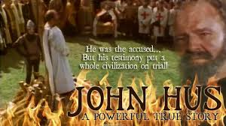
“Women received their dead raised to life again: and others were tortured, not accepting deliverance; that they might obtain a better resurrection: And others had trial of cruel mockings and scourgings, yea, moreover of bonds and imprisonment: They were stoned, they were sawn asunder, were tempted, were slain with the sword: they wandered about in sheepskins and goatskins; being destitute, afflicted, tormented; (Of whom the world was not worthy:) they wandered in deserts, and in mountains, and in dens and caves of the earth.” Hebrews 11:35-38

Slide 20
Victorious
“In all ages the Saviour's chosen have been educated and disciplined in the school of trial. They walked in narrow paths on earth; they were purified in the furnace of affliction. For Jesus' sake they endured opposition, hatred, calumny. They followed Him through conflicts sore; they endured self-denial and experienced bitter disappointments. By their own painful experience they learned the evil of sin, its power, its guilt, its woe; and they look upon it with abhorrence. A sense of the infinite sacrifice made for its cure humbles them in their own sight and fills their hearts with gratitude and praise which those who have never fallen cannot appreciate. They love much because they have been forgiven much. Having been partakers of Christ's sufferings, they are fitted to be partakers with Him of His glory. The heirs of God have come from garrets, from hovels, from dungeons, from scaffolds, from mountains, from deserts, from the caves of the earth, from the caverns of the sea. On earth they were "destitute, afflicted, tormented." Millions went down to the grave loaded with infamy because they steadfastly refused to yield to the deceptive claims of Satan. By human tribunals they were adjudged the vilest of criminals. But now "God is judge Himself." Psalm 50:6. Now the decisions of earth are reversed. "The rebuke of His people shall He take away." Isaiah 25:8. "They shall call them, The holy people, The redeemed of the Lord." He hath appointed "to give unto them beauty for ashes, the oil of joy for mourning, the garment of praise for the spirit of heaviness." Isaiah 62:12; 61:3. They are no longer feeble, afflicted, scattered, and oppressed. Henceforth they are to be ever with the Lord. They stand before the throne clad in richer robes than the most honored of the earth have ever worn. They are crowned with diadems more glorious than were ever placed upon the brow of earthly monarchs. The days of pain and weeping are forever ended. The King of glory has wiped the tears from all faces; every cause of grief has been removed. Amid the waving of palm branches they pour forth a song of praise, clear, sweet, and harmonious; every voice takes up the strain, until the anthem swells through the vaults of heaven: "Salvation to our God which sitteth upon the throne, and unto the Lamb." And all the inhabitants of heaven respond in the ascription: "Amen: Blessing, and glory, and wisdom, and thanksgiving, and honor, and power, and might, be unto our God for ever and ever." Revelation 7:10, 12.” GC, pgs. 649-651

