Slide 1
Church and State, pt. 3
The Reformers

Slide 2
The Dark Ages

Slide 3
Revelation’s Churches
“But I have a few things against thee, because thou hast there them that hold the doctrine of Balaam, who taught Balac to cast a stumbling block before the children of Israel, to eat things sacrificed unto idols, and to commit fornication.” Rev. 2:14
“Notwithstanding I have a few things against thee, because thou sufferest that woman Jezebel, which calleth herself a prophetess, to teach and to seduce my servants to commit fornication, and to eat things sacrificed unto idols.” Rev. 2:20
Both Pergamos (313-538 AD) and Thyatira (538-1517) committed fornication, uniting church and state together!

Slide 4
Sardis and history
The church period for Sardis was from 1517-1798. “And unto the angel of the church in Sardis write; These things saith he that hath the seven Spirits of God, and the seven stars; I know thy works, that thou hast a name that thou livest, and art dead. Be watchful, and strengthen the things which remain, that are ready to die: for I have not found thy works perfect before God.” Rev. 3:1,2 The Reformation church claimed to accept only that which was in the Bible, but did they? They claimed to be totally separate from Rome, but were they? They weren’t charged with fornication, but did they commit it by keeping the church and state together?

Slide 5
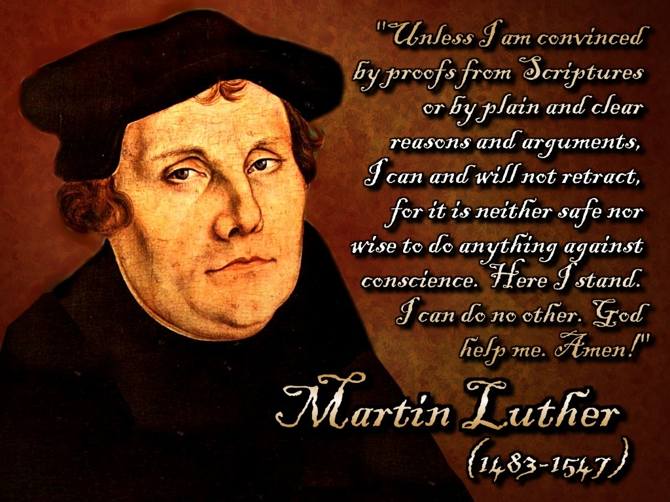
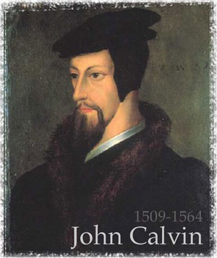
Two Great Reformers

Slide 6
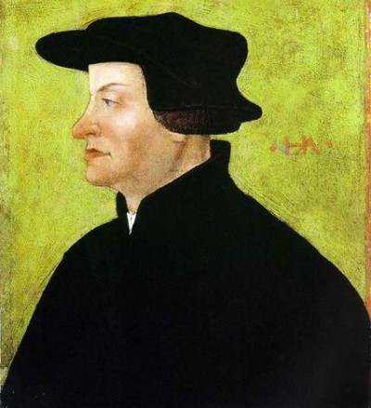
Ulrich Zwingli
Swiss reformer, Ulrich Zwingli, along with Luther and Calvin, were among the greatest reformers of the 16th century. How did these men relate to the church and state? Did they seek to legislate religion and use force to maintain their doctrines? Or, did they, like the papacy use the government to crush their religious opponents?

Slide 7
Luther!
"I will preach, discuss, and write; but I will constrain none, for faith is a voluntary act. See what I have done. I stood up against the pope, indulgences, and papists, but without violence or tumult. I put forward God's word; I preached and wrote--this was all I did. And yet while I was asleep, . . . the word that I had preached overthrew popery, so that neither prince nor emperor has done it so much harm. And yet I did nothing; the word alone did all. If I had wished to appeal to force, the whole of Germany would perhaps have been deluged with blood. But what would have been the result? Ruin and desolation both to body and soul. I therefore kept quiet, and left the word to run through the world alone."--Ibid., b. 9, chap. 8. GC, pg. 190
Later…a helper of Luther’s declared “

Slide 8
Urbanus Rhegius, Luther’s trusted Associate
“The Truth leaves you no choice; you must agree that the magistracy has the authority to coerce his subjects to the gospel. And if you say, ‘Yes, but with admonition and well chosen words but not by force” then would I answer that to get people to the services with fine words and admonitions is the preacher’s duty, but to keep them there with recourse to force if need be and to frighten them away from error is the proper function of the rulers….” Quellen Hesse, pg. 102f

Slide 9
Again!
“God raises up the magistracy against heretics, faction makers, and schismatic's in the Christian Church…Therefore, a Christian magistrate must make it his first concern to keep the Christian religion pure….All who know history will know what has been done in this matter by such men as Constantine, Theodius, Charlemagne, and others.” Quellen Hesse, pg. 112f Yes, they killed those who didn’t go along with the government in religious matters!!

Slide 10
Luther Stopped!
“When, at the Reformation, the spiritual shackles of Rome were thrown off, the idea of corpus Christianum, (church-state together) like a number of other unbiblical features of the medieval church, was unfortunately retained. As a result, the beliefs and practices of the only half-reformed church came under the control and protection of the ‘godly prince’ and dissent from Luther’s doctrine proved to be as inadmissible in the Lutheran territorial church as had been dissent from papal doctrines when Catholicism was in control.” Emmerson, The Reformation and the Advent Movement, pgs. 21,22

Slide 11
Luther!
“This is one of the reformers blackest marks! On April 23, 1529 the Catholic and Protestant Princes gathered at the second Diet of Speyer and one of their decrees was: "every Anabaptist and rebapitized man and woman of the age of reason shall be condemned and brought from natural life into death by fire, sword, and the like, according to the person, without proceeding by the inquisition of the spiritual judges."
Speaking for Luther and himself, Melanchthon, making no distinction between the quiet reformers who believed in baptism and the radicals who had used mob action (peasant's revolt)to war against papal oppression, wrote (February, 1530) "The government is under obligation to kill them:" A year later, Luther himself wrote: "I approve, ...although it is terrible to view."
Here we have a classic example where the lawless deeds of some is used to persecute the true, honest believers in Biblical truth. And the mainline Reformers sided with the Papal position. Proper procedure would have been to punish those individuals who instigated the violence, but instead they condemned truth and persecuted those who followed it.” Emmerson, pgs. 83,84

Slide 12
Luther’s Struggle
The battle raged from every quarter against Luther. There were the papists and Charles V. To the other extreme were the fanatics. “Thomas Munzer, the most active of the fanatics, was a man of considerable ability, which, rightly directed, would have enabled him to do good; but he had not learned the first principles of true religion. "He was possessed with a desire of reforming the world, and forgot, as all enthusiasts do, that the reformation should begin with himself."--Ibid., b. 9, chap. 8. He was ambitious to obtain position and influence, and was unwilling to be second, even to Luther. He declared that the Reformers, in substituting the authority of Scripture for that of the pope, were only establishing a different form of popery. He himself, he claimed, had been divinely commissioned to introduce the true reform. "He who possesses this spirit," said Munzer, "possesses the true faith, although he should never see the Scriptures in his life."--Ibid., b. 10, chap. 10.
There were the fanatics. There were those who wanted to return to a truly Biblical faith. They couldn’t agree with Luther on communion, infant baptism, seeking the aid of the government, soul sleep, and even the Sabbath! They felt Luther didn’t go far enough in reform. They called him and others ‘halfway men’. These people were known as Anabaptists.

Slide 13
Luther didn’t go far enough!
Luther came out of horrible and dense darkness. God caused great light to be shed upon his path. One of the greatest religious movements in the 20th century was effected by this man. While he failed to grasp the necessity of separating the church and state; nevertheless, he was used by God in a mighty way.
Another man, “If William Miller could have seen the light of the third message, many things which looked dark and mysterious to him would have been explained. But his brethren professed so deep love and interest for him, that he thought he could not tear away from them. His heart would incline toward the truth, and then he looked at his brethren; they opposed it. Could he tear away from those who had stood side by side with him in proclaiming the coming of Jesus? He thought they surely would not lead him astray. God suffered him to fall under the power of Satan, the dominion of death, and hid him in the grave from those who were constantly drawing him from the truth. Moses erred as he was about to enter the Promised Land. So also, I saw that William Miller erred as he was soon to enter the heavenly Canaan, in suffering his influence to go against the truth. Others led him to this; others must account for it. But angels watch the precious dust of this servant of God, and he will come forth at the sound of the last trump.” GC., pg. 258

Slide 14
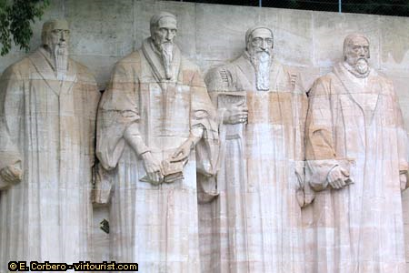
Ulrich Zwingli
“So in the days of the Great Reformation. The leading Reformers were men from humble life--men who were most free of any of their time from pride of rank and from the influence of bigotry and priest craft. It is God's plan to employ humble instruments to accomplish great results. Then the glory will not be given to men, but to Him who works through them to will and to do of His own good pleasure.
A few weeks after the birth of Luther in a miner's cabin in Saxony, Ulrich Zwingli was born in a herdsman's cottage among the Alps.” GC, pg. 171

Slide 15
Zwingli used mightily
“Already an interest had been awakened in the truths he taught; and the people flocked in great numbers to listen to his preaching. Many who had long since ceased to attend service were among his hearers. He began his ministry by opening the Gospels and reading and explaining to his hearers the inspired narrative of the life, teachings, and death of Christ. Here, as at Einsiedeln, he presented the word of God as the only infallible authority and the death of Christ as the only complete sacrifice. "It is to Christ," he said, "that I desire to lead you--to Christ, the true source of salvation." --Ibid., b. 8, chap. 6. Around the preacher crowded the people of all classes, from statesmen and scholars to the artisan and the peasant. With deep interest they listened to his words. He not only proclaimed the offer of a free salvation, but fearlessly rebuked the evils and corruptions of the times. Many returned from the cathedral praising God. "This man," they said, "is a preacher of the truth. He will be our Moses, to lead us forth from this Egyptian darkness."--Ibid., b. 8, chap. 6. GC, pg. 177

Slide 16
Zwingli Stops
Zwingli declared, “The Christian city is the Christian church and the great council is the highest authority among us.” Walton, Zwingli’s Theocracy, pgs. 218, 180 On this basis he believed that the Reformation was to proceed only as fast as the city council would legislate it to happen. Zwingli, like Luther, was to restrict doctrinal development and slow down the work of reform. Several of Zwingli’s followers became upset over having to wait for the council to act. They disagreed with Zwingli over communion, infant baptism, and idol worship. Therefore, a split came. Zwingli realized that to get rid of infant baptism would break the connection between the church and state and would establish a free church independent of the state. He drew back, “It is better not to preach it (infant baptism) until the world is ready to take it.” Verduin, The Reformers and their Stepchildren, pg. 199

Slide 17
Zwingli Debates and Loses
“The Zurich council decided that no compromise was possible. On 7 March 1526 it released the notorious mandate that no one shall rebaptise another under the penalty of death.^{[52]} Although Zwingli, technically, had nothing to do with the mandate, there is no indication that he disapproved. Felix Manz, who had sworn to leave Zurich and not to baptise any more, had deliberately returned and continued the practice. After he was arrested and tried, he was executed on 5 January 1527 by being drowned in the Limmat river. He was the first Anabaptist martyr; three more were to follow, after which all others either fled or were expelled from Zurich.”^{[53][54]} Burkhardt, Ferne (2004-07-09). "Mennonite World Conference Press Release". Mennonite World Conference. Retrieved 2008-03-03. The descendant of the Zwinglian Reformation, the Reformed Church of Zurich, and the descendants of the Anabaptist movement (Amish, Hutterites, and Mennonites) held a Reconciliation Conference at the Grossmünster on 26 June 2004.

Slide 18
Zwingli’s Death
“By 1530, Zwinglian reforms had spread through Switzerland and south Germany. But not all of Switzerland rallied to Zwingli. The so-called Forest cantons, the original heart of old Switzerland, resisted and reaffirmed their ancient Catholic faith. In this time period religious reform was a political issue, so the Protestant cantons organized into an alliance. The Catholic cantons allied themselves with Austria.
In 1529 came, as we have seen, the Marburg colloquy, at which Zwingli and Luther failed to come to any agreement about the Eucharist. Religious disagreement meant political fragmentation. The Protestants could not unite militarily unless they united theologically. The Swiss were left hanging, but kept applying pressure to the forest cantons, including a blockade, in the belief that this would keep them with the upper hand. But in 1531 the forest cantons attacked. At the battle of Cappel, October 11, 1531, the Zurichers were defeated, and Zwingli, in military armor, was killed. Hillerbrand says:
But more had died at Cappel than Zwingli and the soldiers. Militarily the battle was an insignificant affair, but politically it was of the utmost importance. For the first time the unsettled questions of religion were to be solved on the battlefield -- a sad event repeated again and again during the next century.”
Hillerbrand, The Reformation, p. 109)

Slide 19
John Calvin
“For nearly thirty years Calvin labored at Geneva, first to establish there a church adhering to the morality of the Bible, and then for the advancement of the Reformation throughout Europe. His course as a public leader was not faultless, nor were his doctrines free from error. But he was instrumental in promulgating truths that were of special importance in his time, in maintaining the principles of Protestantism against the fast-returning tide of popery, and in promoting in the reformed churches simplicity and purity of life, in place of the pride and corruption fostered under the Romish teaching. {GC 236.1}
From Geneva, publications and teachers went out to spread the reformed doctrines. To this point the persecuted of all lands looked for instruction, counsel, and encouragement. The city of Calvin became a refuge for the hunted Reformers of all Western Europe.” GC, pg. 236

Slide 20
The Death of Michael Servetus
“Meaning to flee to Italy, Servetus inexplicably stopped in at Geneva, where Calvin and his Reformers had denounced him. On 13 August, he attended a sermon by Calvin at Geneva. He was immediately recognized and arrested after the service^{[18]} and was again imprisoned. All his property was confiscated. French Inquisitors asked that Servetus be extradited to them for execution. Calvin wanted to show himself as firm in defense of Christian orthodoxy as his usual opponents. "He was forced to push the condemnation of Servetus with all the means at his command."^{[18]} Calvin's delicate health meant he did not personally appear against Servetus.^{[19]} Nicholas de la Fontaine played the more active role in Servetus's prosecution and the listing of points that condemned him.”
Calvin was instrumental in putting this man to death simply because they disagreed on doctrine. Melanchthon, Luther’s right hand man, totally supported Calvin in his killing of Servetus!

Slide 21
Can I choose to be wrong?
Even if I don’t agree,
You still have the right to what you believe.
Even the Creator allows us to be free,
To destroy ourselves if need be.
Can I choose to be wrong?
Can I sing a different song?
“And he said unto them, Render therefore unto Caesar the things which be Caesar's, and unto God the things which be God's.

