Slide 1
Elijah, pt. 1
The Backdrop

Slide 2
What’s Up?
Some 50 years after the death of Solomon, the world he left had changed so drastically. The nation of Israel was now divided into two groups. The Northern Kingdom of Israel and the Southern Kingdom of Judea. Following their split from the south, the northern tribes had fallen into terrible apostasy. From Jeroboam, a servant of Solomon, all the way to Omri, the north had gone from bad to worse. Now, Israel had its worst king of all. His name was Ahab!

Slide 3
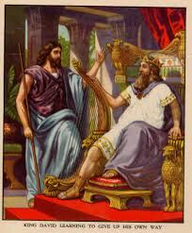
Most Wicked
“And in the thirty and eighth year of Asa king of Judah began Ahab the son of Omri to reign over Israel: and Ahab the son of Omri reigned over Israel in Samaria twenty and two years. And Ahab the son of Omri did evil in the sight of the LORD above all that were before him.” ! Kings 16:29,30

Slide 4
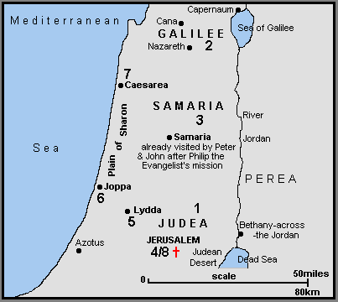
Samaria
Shomron (lit. watch-tower) was located in the heart of the mountains of Judaea/Israel, a few miles northwest of Shechem, adjacent to the town of Sebastia. The "hill of Shomron" is an oblong hill, with steep but not inaccessible sides, and a long flat top. According to biblical tradition, Omri, the king of Israel, purchased this hill from Shemer its owner for two talents of silver, and built on its broad summit the city to which he gave the name of "Shomeron", i.e., Samaria,

Slide 5
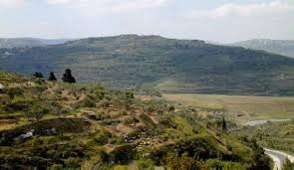
Beautiful City
Samaria was nicely situated and very advantageous in times of battle. It was exalted about 300-400 feet high and was not easy to access. Ahab’s father, Omri, built it and made it the capital in the northern kingdom of Israel.

Slide 6
He Topped them All!
“Two years before the death of Asa, Ahab began to rule in the kingdom of Israel. From the beginning his reign was marked by a strange and terrible apostasy. His father, Omri, the founder of Samaria, had "wrought evil in the eyes of the Lord, and did worse than all that were before him" (1 Kings 16:25); but the sins of Ahab were even greater. He "did more to provoke the Lord God of Israel to anger than all the kings of Israel that were before him," acting "as if it had been a light thing for him to walk in the sins of Jeroboam the son of Nebat." Verses 33, 31. Not content with encouraging the forms of religious service followed at Bethel and Dan, he boldly led the people into the grossest heathenism, by setting aside the worship of Jehovah for Baal worship.” PK, pg. 114

Slide 7
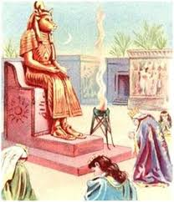
Sanctified Sin in God’s Name!
He not only encouraged the worship of idols; he brought in women to be temple prostitutes. He told the people that if they slept with a temple prostitute, they would be drawn closer to God and to heaven! This happened in the groves and in the temple in Samaria!

Slide 8
In those strange times, everything was all right. Sin was good. Sleeping with Jezebel’s temple whores brought one closer to God! Everyone was going to heaven regardless of their lives, regardless of who they worshipped!

Slide 9
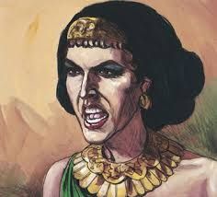
Jezebel
“And it came to pass, as if it had been a light thing for him to walk in the sins of Jeroboam the son of Nebat, that he took to wife Jezebel the daughter of Ethbaal king of the Zidonians, and went and served Baal, and worshipped him.” 1 Kings 16:31

Slide 10
Jezebel/Baal/Immorality
“Taking to wife Jezebel, "the daughter of Ethbaal king of the Zidonians" and high priest of Baal, Ahab "served Baal, and worshiped him. And he reared up an altar for Baal in the house of Baal, which he had built in Samaria." Verses 31, 32.
Not only did Ahab introduce Baal worship at the capital city, but under the leadership of Jezebel he erected heathen altars in many "high places," where in the shelter of surrounding groves the priests and others connected with this seductive form of idolatry exerted their baleful influence, until well-nigh all Israel were following after Baal. "There was none like unto Ahab," who "did sell himself to work wickedness in the sight of the Lord, whom Jezebel his wife stirred up. And he did very abominably in following idols, according to all things as did the Amorites, whom the Lord cast out before the children of Israel." 1 Kings 21:25, 26.” PK, pgs. 114,115

Slide 11
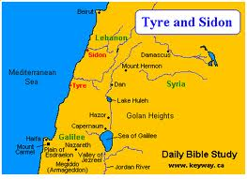
Jezebel was Sidonian Trash!
Jezebel had been immersed in the false worship of the heathen deities Baal and Ashtoreth. These gods and their followers were foremost in attacking the commandments of God; especially the 4th and 7thcommandments! Religion was a license to do wrong!

Slide 12
Apostasy!
“Ahab was weak in moral power. His union by marriage with an idolatrous woman of decided character and positive temperament resulted disastrously both to himself and to the nation. Unprincipled, and with no high standard of right doing, his character was easily molded by the determined spirit of Jezebel. His selfish nature was incapable of appreciating the mercies of God to Israel and his own obligations as the guardian and leader of the chosen people.
Under the blighting influence of Ahab's rule, Israel wandered far from the living God and corrupted their ways before Him. For many years they had been losing their sense of reverence and godly fear; and now it seemed as if there were none who dared expose their lives by openly standing forth in opposition to the prevailing blasphemy. The dark shadow of apostasy covered the whole land. Images of Baalim and Ashtoreth were everywhere to be seen. Idolatrous temples and consecrated groves, wherein were worshiped the works of men's hands, were multiplied.” PK, pg. 115

Slide 13
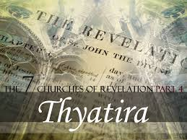
Jezebel’s Counterpart
Jezebel’s atrocities were matched by the papal power during the dark ages. Notice the similarities.
1. Attacked the law of God.
2. Persecuted God’s people.
3. Used the government to enforce her ideas.
4. Set up false priest system.
5. World suffered for 1260 days/years!

Slide 14
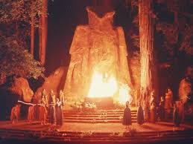
Baal Worship
Baal worship was a bold denial of the Creator. Baal was given the titles of creator, provider, and sustainer. Baal was said to bring the rain and sunshine to make the crops grow. To him was attributed the powers to create and recreate! This was a complete rejection of God as our Creator!

Slide 15
Baal
“The air was polluted with the smoke of the sacrifices offered to false gods. Hill and vale resounded with the drunken cries of a heathen priesthood who sacrificed to the sun, moon, and stars.
Through the influence of Jezebel and her impious priests, the people were taught that the idol gods that had been set up were deities, ruling by their mystic power the elements of earth, fire, and water. All the bounties of heaven--the running brooks, the streams of living water, the gentle dew, the showers of rain which refreshed the earth and caused the fields to bring forth abundantly--were ascribed to the favor of Baal and Ashtoreth, instead of to the Giver of every good and perfect gift. The people forgot that the hills and valleys, the streams and fountains, were in the hand of the living God, that He controlled the sun, the clouds of heaven, and all the powers of nature.” PK, pgs. 115,116

Slide 16
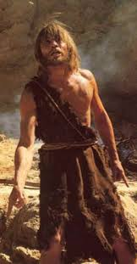
The Lord sought to bring His people to repentance, but nothing helped. Voices were silenced, prophets were killed and nothing would stand in the way of this new movement.
Only one option remained; the Lord must speak to Israel thru judgments!

Slide 17
The Lord Tried!
“Through faithful messengers the Lord sent repeated warnings to the apostate king and the people, but in vain were these words of reproof. In vain aid the inspired messengers assert Jehovah's right to be the only God in Israel; in vain did they exalt the laws that He had entrusted to them. Captivated by the gorgeous display and the fascinating rites of idol worship, the people followed the example of the king and his court, and gave themselves up to the intoxicating, degrading pleasures of a sensual worship. In their blind folly they chose to reject God and His worship. The light so graciously given them had become darkness. The fine gold had become dim.
Alas, how had the glory of Israel departed! Never before had the chosen people of God fallen so low in apostasy. Of "the prophets of Baal" there were "four hundred and fifty," besides four hundred "prophets of the groves." 1 Kings 18:19. Nothing short of the miracle-working power of God could preserve the nation from utter destruction.” PK, pg. 116

Slide 18
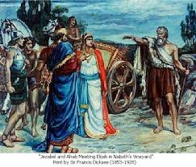
Time for Another Voice
“The Lord in compassion still yearned after those who had been led into sin, and He was about to send to them one of the mightiest of His prophets, through whom many were to be led back to allegiance to the God of their fathers.” PK,pg. 116

