Slide 1
What is the Difference Between Mormons, Jehovah’s Witnesses, and Seventh-day Adventists? pt 16

Slide 2
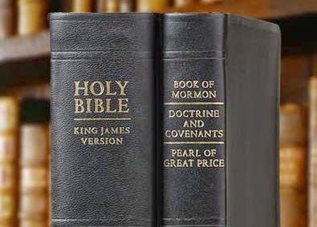
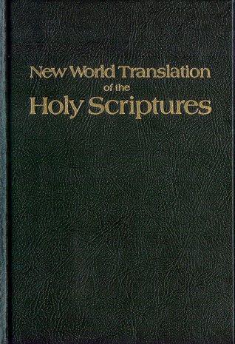
What We Will Study….
Origins of the Religion
Their Authorities and/or Authoritative Texts
Their Doctrinal Differences
Their Message to the World

Slide 3
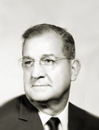
Russell → Rutherford → Knorr
“Nathan Knorr was appointed as third president of the Watch Tower Bible and Tract Society in 1942. He commissioned a new translation of the Bible, the New World Translation of the Holy Scriptures, the full version of which was released in 1961” Wikipedia, Nathan Knorr

Slide 4
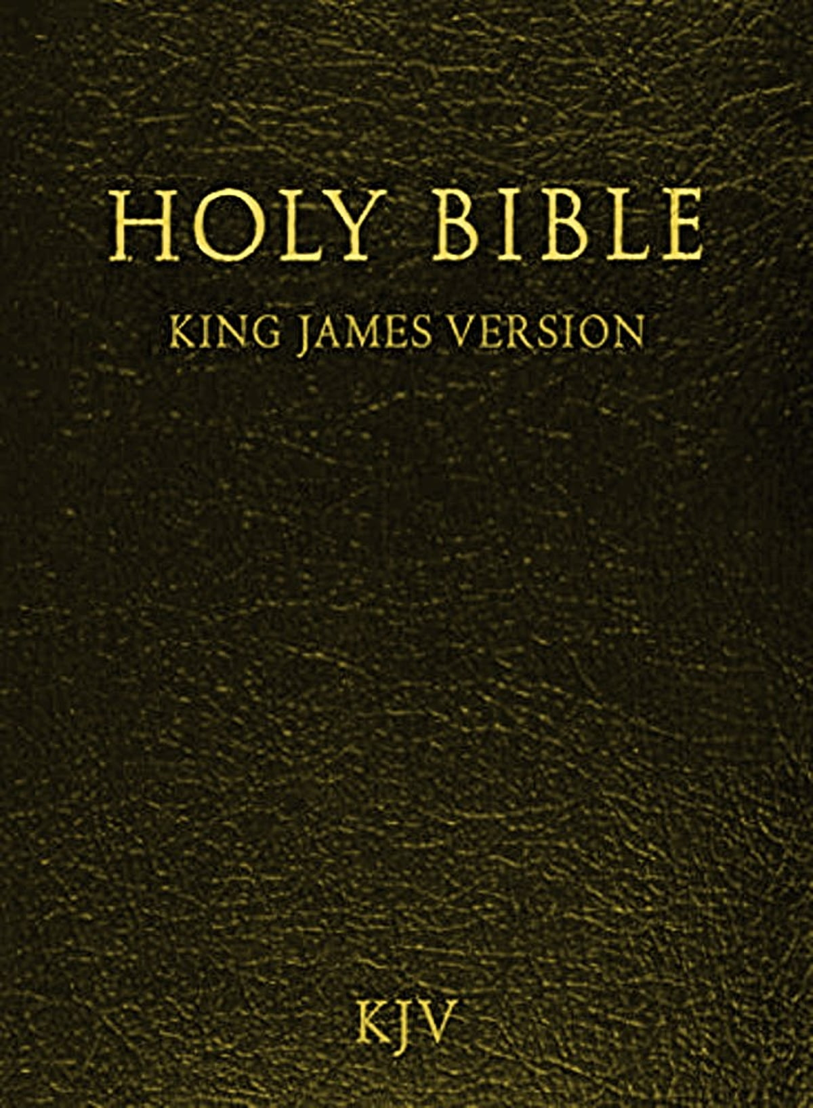
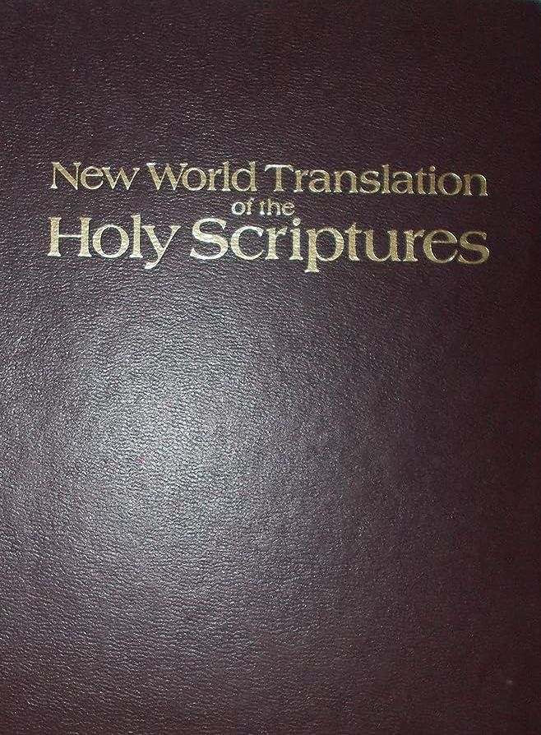
History of the New World Translation
“The New Testament portion was released first, in 1950, as The New World Translation of the Christian Greek Scriptures, with the complete New World Translation of the Bible released in 1961. . . . Until the release of the New World Translation, Jehovah's Witnesses in English-speaking countries primarily used the King James Version. According to the publishers, one of the main reasons for producing a new translation was that most Bible versions in common use, including the Authorized Version (King James), employed archaic language” Wikipedia, New World Translation of the Holy Scriptures

Slide 5
Who Are the Translators?
“Work began on December 2, 1947, when the "New World Bible Translation Committee" was formed, composed of Jehovah's Witnesses who professed to be anointed. . . . This committee is said to have comprised unnamed members of multinational background. The committee requested that the Watch Tower Society not publish the names of its members, stating that they did not want to ‘advertise themselves but let all the glory go to the Author of the Scriptures, God,’ adding that the translation, ‘should direct the reader, not to the translators, but to the Bible’s Author, Jehovah God’. The publishers stated that ‘the particulars of [the New World Bible Translation Committee's members] university or other educational training are not the important thing’ and that ‘the translation testifies to their qualification’”—Wikipedia, New World Translation of the Holy Scriptures

Slide 6
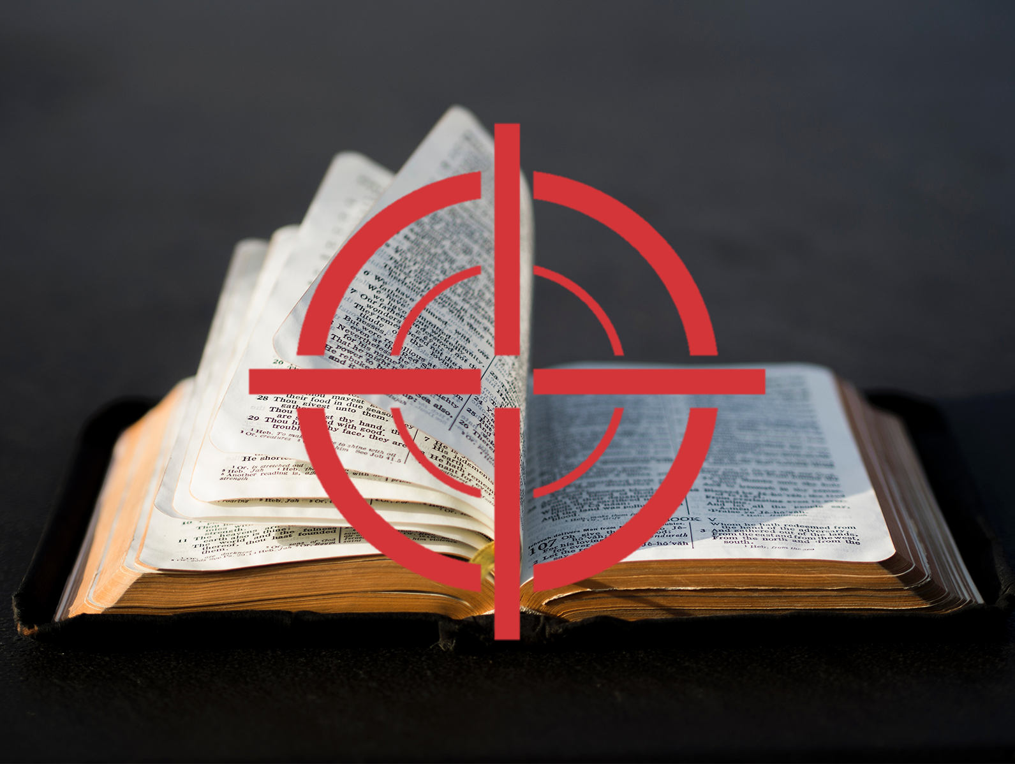
The Bible: A Target!
“Then the Bible [King James Version], that serpent which, with head erect and eyes flashing fire, threatens us with its venom whilst it trails along the ground, shall be changed again into a rod as soon as we are able to seize it; and what wounds will we not inflict with it upon these hardened Pharaohs and their cunning magicians! what miracles will we not work by its means! Oh , then, mysterious rod! we will not again suffer thee to escape from our hands, and fall to the earth! For you know but too well that, for three centuries past, this cruel asp has left us no repose; you well know with what folds it entwines us, and with what fangs it gnaws us!” – The Jesuit conspiracy, The Abbate Leone. (1848), p. 98

Slide 7
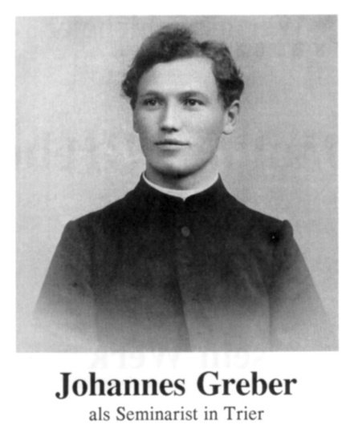
Scholarly Backing….
"Similar is the reading by a former Catholic priest: In the beginning was the Word and the Word was with God, and the word was a god. This was with God in the beginning." [A footnote cites Greber's New Testament translation and notes the 1937 "front cover of this edition being stamped with a golden cross“]--(The Watchtower, 09/15/1962, p. 554)—(The quote is reused also in the following JW sources: The Word: Who is He According to John, 1962 ed., p. 5; and Aid to Bible Understanding 1969 ed., p. 1669)
Trier: Church of the Holy Trinity, A Jesuit University

Slide 8
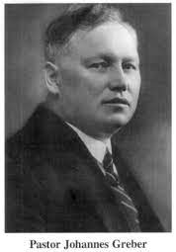
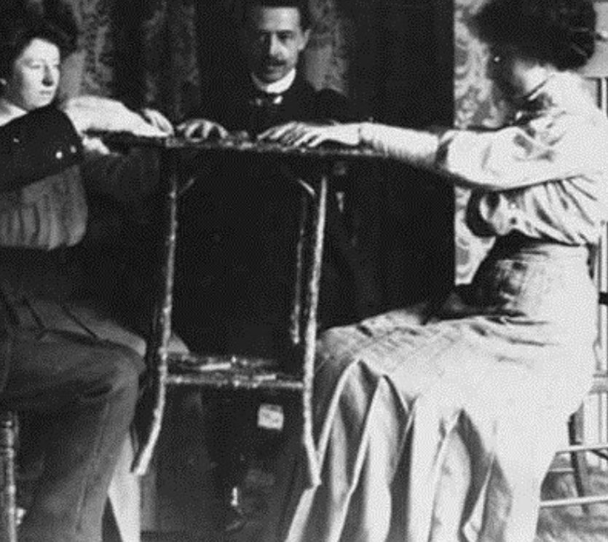
Scholarly Backing… From Spiritists???
“Johannes Greber (1874–1944) born in Wenigerath, Germany, was a Catholic priest. He claimed he had never become a medium himself; his wife later became a medium and was involved in a variety of spiritualist activities. In Germany, he was ordained in 1900 and served a church in the poor area of Hunsrueck. . . . In 1923, he attended a séance and his life was changed. He renounced his vows and left the Catholic church. He emigrated to the USA in 1929 and began a nondenominational church, with prayer and healing sessions in Teaneck, NJ. He later worked on a translation of the New Testament, publishing ‘’The New Testament, A New Translation and Explanation Based on the Oldest Manuscripts’’ (1935). He claimed using the oldest sources available including the Greek codex D. Where a meaning was not clear, according to his prologue, he received supernatural guidance as he translated, after much time in prayer, with his wife acting as a medium, and with visions of the actual words given to him on occasion. “In the rare instances in which a text pronounced correct by the divine spirits can be found in none of the manuscripts available today, I have the text as given by the spirits.”—Wikipedia, Johannes Greber

Slide 10
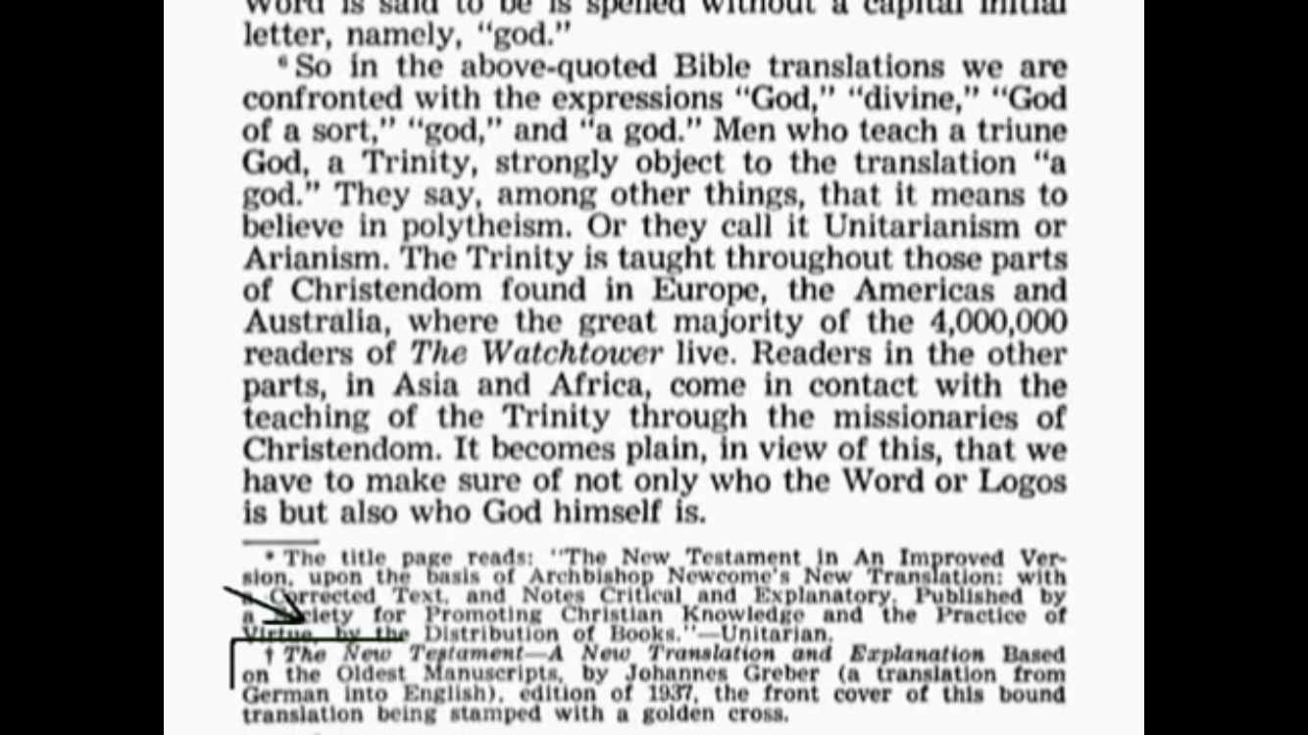

Slide 11
Johannes Greber Known to Be a Spiritist by JWs
“Is such official Catholic teaching as the above an impenetrable defense against the invasion of spiritism? No! It is an invitation to spiritism, and the conditions in Roman Catholic lands, such as Peru, Costa Rica, Cuba, and Haiti, show Roman Catholicism to be no bulwark against this spreading peril. In such lands the Catholcic people, even up to 90 per cent, mix spiritism or voodooism right in with Roman Catholicism, practicing both at the same time with no objection or penalty by the priests. It comes as no surprise that one Johannes Greber, a former Catholic clergyman, has become a spiritualist and has published the book entitled ‘Communication with the Spirit World, Its Laws and Its Purpose’ (1932, Macoy Publishing Company, New York) In its Foreword he makes the typical misstatement: ‘The most significant spiritualistic book is the Bible; for its principle contents hinge upon the messages of the beyond to those existing in the present’”—Booklet: “What do the Scriptures say about survival after death”, (1955) p. 88

Slide 12
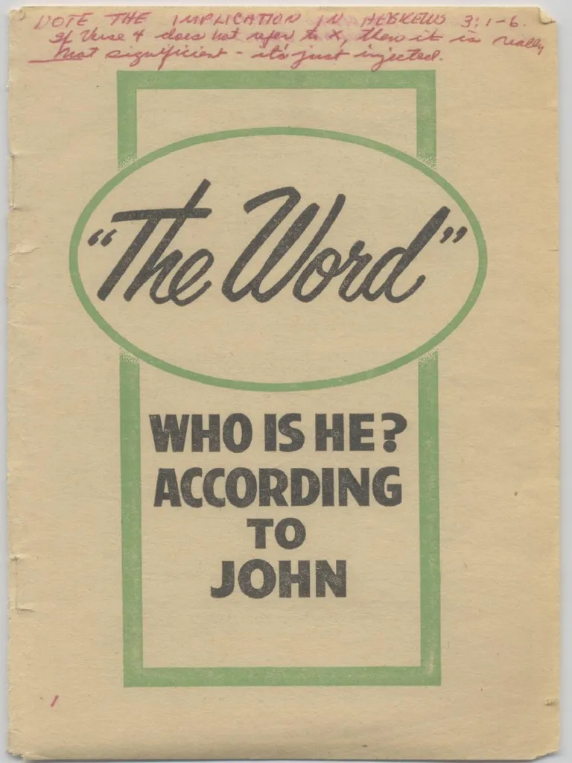
Satanic Scholar Backs the JW Bible
“’Communication with the Spirit-World: Its Laws and Its Purpose’ (Pages 15, para. 2, 3) In keeping with his Roman Catholic extraction Greber’s translation is bound with a gold-leaf cross on its stiff front cover. In the Foreword of his aforementioned book ex-priest Greber says: ‘The most significant spiritualistic book is the Bible.’ Under this impression Greber endeavors to make his new Testament translation read very spiritualistic.”—Watchtower 02/15/1956

Slide 13
Other Scholars Rail-Roaded Into “Supporting” the NWT
Source: Witnesses of Jehovah (1986), Written and Directed by Leonard Chretien, 19:00—JWs misquote Dr. Julius R. Mantey

Slide 14
KJV vs NWT
John 1:1 “In the beginning was the Word, and the Word was with God, and the Word was God.”
John 1:1 “In the beginning was the Word, and the Word was with God, and the Word was a god.”
The NWT also inserts the word “Jehovah” to refer to God 237 times in the New Testament where the original Greek does not signify

Slide 15
KJV vs NWT
Matt. 23:14 “Woe unto you, scribes and Pharisees, hypocrites! for ye devour widows' houses, and for a pretence make long prayer: therefore ye shall receive the greater damnation.”
Matt. 23:14 Omitted

Slide 16
KJV vs NWT
Mark 16:9-16 “Now when Jesus was risen early the first day of the week, he appeared first to Mary Magdalene, out of whom he had cast seven devils. And she went and told them that had been with him, as they mourned and wept. And they, when they had heard that he was alive, and had been seen of her, believed not. After that he appeared in another form unto two of them, as they walked, and went into the country. And they went and told it unto the residue: neither believed they them. Afterward he appeared unto the eleven as they sat at meat, and upbraided them with their unbelief and hardness of heart, because they believed not them which had seen him after he was risen. And he said unto them, Go ye into all the world, and preach the gospel to every creature. He that believeth and is baptized shall be saved; but he that believeth not shall be damned. And these signs shall follow them that believe; In my name shall they cast out devils; they shall speak with new tongues; They shall take up serpents; and if they drink any deadly thing, it shall not hurt them; they shall lay hands on the sick, and they shall recover. So then after the Lord had spoken unto them, he was received up into heaven, and sat on the right hand of God. And they went forth, and preached every where, the Lord working with them, and confirming the word with signs following. Amen.”
Mark 16:9-16 Omitted

Slide 17
KJV vs NWT
Rev. 12:17 “And the dragon was wroth with the woman, and went to make war with the remnant of her seed, which keep the commandments of God, and have the testimony of Jesus Christ.”
Rev. 12:17 “So the dragon became enraged at the woman and went off to wage war with the remaining ones of her offspring, who observe the commandments of God and have the work of bearing witness concerning Jesus”

Slide 18
KJV vs NWT
Rev. 22:14 “Blessed are they that do his commandments, that they may have right to the tree of life, and may enter in through the gates into the city.”
Rev. 22:14 “Happy are those who wash their robes, so that they may have authority to go to the trees of life and that they may gain entrance into the city through its gates”

Slide 19
KJV vs NWT
John 8:1-12 “Jesus went unto the mount of Olives. And early in the morning he came again into the temple, and all the people came unto him; and he sat down, and taught them. And the scribes and Pharisees brought unto him a woman taken in adultery; and when they had set her in the midst, They say unto him, Master, this woman was taken in adultery, in the very act. Now Moses in the law commanded us, that such should be stoned: but what sayest thou? This they said, tempting him, that they might have to accuse him. But Jesus stooped down, and with his finger wrote on the ground, as though he heard them not. So when they continued asking him, he lifted up himself, and said unto them, He that is without sin among you, let him first cast a stone at her. And again he stooped down, and wrote on the ground. And they which heard it, being convicted by their own conscience, went out one by one, beginning at the eldest, even unto the last: and Jesus was left alone, and the woman standing in the midst. When Jesus had lifted up himself, and saw none but the woman, he said unto her, Woman, where are those thine accusers? hath no man condemned thee? She said, No man, Lord. And Jesus said unto her, Neither do I condemn thee: go, and sin no more.”
John 8:1-11 Omitted

Slide 20
KJV vs NWT
John 8:58 “Jesus said unto them, Verily, verily, I say unto you, Before Abraham was, I am.”
John 8:58 “Jesus said to them: ‘Most truly I say to you, before Abraham came into existence, I have been.’”
Is Jesus God?
“This is what Jehovah says, The King of Israeli and his Repurchaser, Jehovah of armies: ‘I am the first and I am the last.’ There is no God but me.” (Is. 44:6 NWT)
“And he laid his right hand on me and said: ‘Do not be afraid. I am the First and the Last, and the living one, and I became dead, but look! I am living forever and ever, and I have the keys of death and of the Grave’” (Rev. 1:17-18)

Slide 21
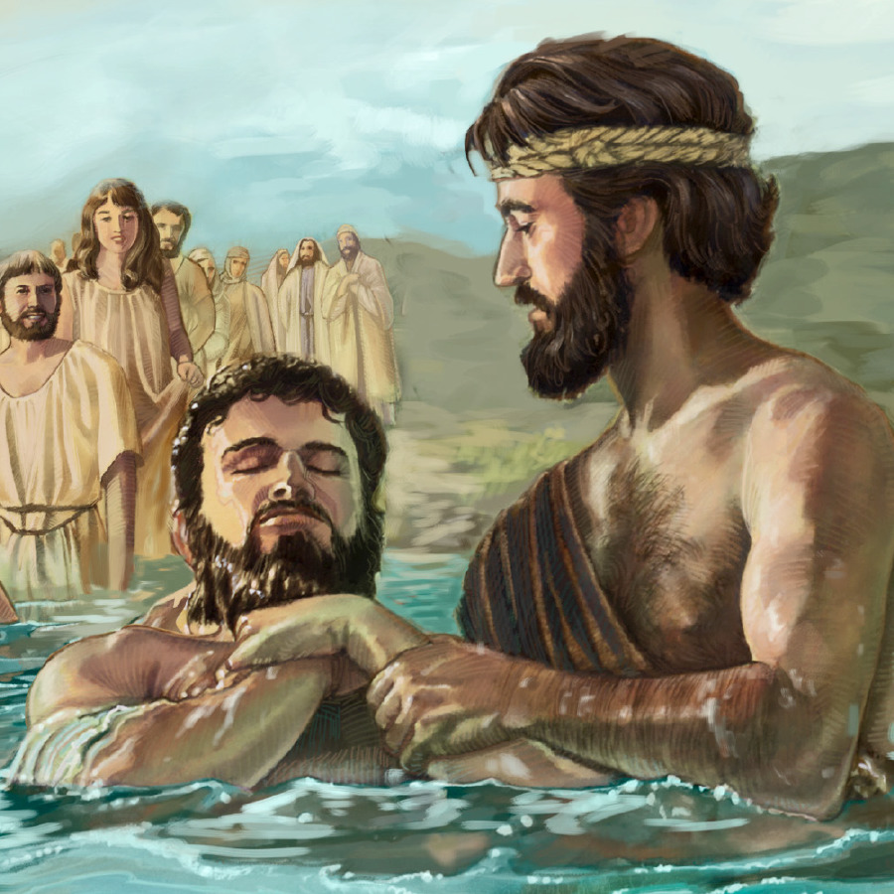
Isaiah Spells it Out
“A voice of one calling out in the wilderness: “Clear up the way of Jehovah! Make a straight highway through the desert for our God” (Is. 40:3 NWT)
“This, in fact, is the one spoken of through Isaiah the prophet in these words: ‘A voice of one calling out in the wilderness: ‘Prepare the way of Jehovah! Make his roads straight.’’” (Matt. 3:3 NWT)

Slide 22
KJV vs NWT
Col. 1:16 “For by him were all things created, that are in heaven, and that are in earth”
Col. 1:16 “because by means of him all other things were created in the heavens and on the earth”
“‘Look! I am coming quickly, and the reward I give is with me, to repay each one according to his work. I am the Alʹpha and the O·meʹga,*p the first and the last, the beginning and the end.’ . . . ‘The one who bears witness of these things says, ‘Yes, I am coming quickly.’ ‘Amen! Come, Lord Jesus.’” (Rev. 22:12-13, 20 NWT)
Is. 48:12 “Listen to me, O Jacob, and Israel, whom I have called. I am the same One.t I am the first; I am also the last.” (Is. 48:12 NWT)

Slide 23
KJV vs NWT
Titus 2:13 “Looking for that blessed hope, and the glorious appearing of the great God and our Saviour Jesus Christ”
Titus 2:13 “while we wait for the happy hope and glorious manifestation of the great God and of our Savior, Jesus Christ”
JW.org, Kingdom Interlinear, Titus 2:13

Slide 24
KJV vs NWT
Heb. 1:8 “But unto the Son he saith, Thy throne, O God, is for ever and ever: a sceptre of righteousness is the sceptre of thy kingdom.”
Heb. 1:8 “But about the Son, he says: ‘God is your throne forever and ever, and the scepter of your Kingdom is the scepter of uprightness.’”
JW.org, Kingdom Interlinear, Heb. 1:8

Slide 25
KJV vs NWT
Phil. 2:6, 9 “Who, being in the form of God, thought it not robbery to be equal with God . . . Wherefore God also hath highly exalted him, and given him a name which is above every name”
Phil. 2:6, 9 “who, although he was existing in God’s form, did not even consider the idea of trying to be equal to God . . . For this very reason, God exalted him to a superior position and kindly gave him the name that is above every other name”

Slide 26
Even Their Sources Show Errors!
JW.org, Kingdom Interlinear, Phil. 2:9
Reasons the NWT is uninspired:
It’s author’s are anonymous
They first expose a spiritualist ex-Catholic priest Greber, then later use him as a source as support their translation—(there’s no excuse, they knew he was in communion with devils, but still used him to support their translation—what does that tell you about their translation?)
They omit the same, and even more Scriptures that the faulty NIV
They use bad manuscripts, that agree with Rome—not the one that the Apostles, Reformers, etc. used
Their translation does not even agree with the Greek that they did use—see their interlinear
They contradict the true Bible—Jesus and Jehovah are “the First and the Last” even in their translation

