Slide 1
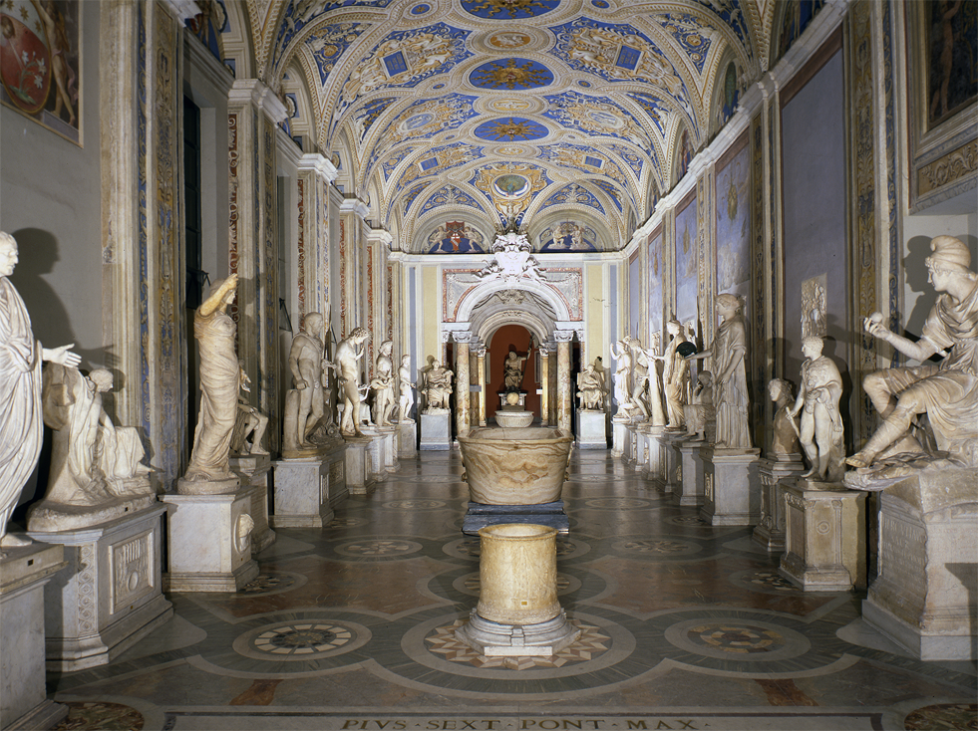
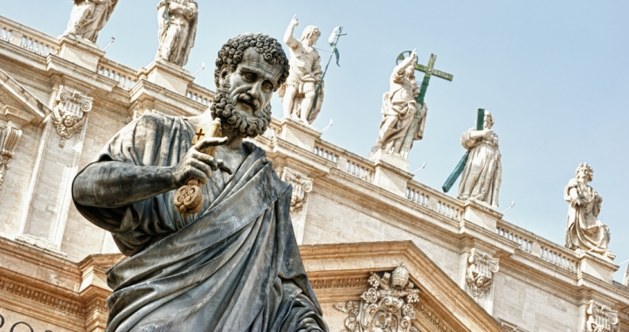
Even the Statues/Saints?!?!

Slide 2
Ancient Rome prayed to their Patron gods, Papal Rome prays to their Patron Saints
“As was taught by St. Augustine … Catholics, while giving to God alone adoration strictly so-called, honor the saints because of the Divine supernatural gifts which have earned them eternal life, and through which they reign with God in the heavenly fatherland as His chosen friends and faithful servants. In other words, Catholics honor God in His saints as the loving distributor of supernatural gifts. The worship of latria …or strict adoration is given to God alone; the worship, or dulia …or honor and humble reverence, is paid the saints; the worship of hyperdulia …on account of her greater excellence, [is directed] to the Blessed Virgin Mary” (Vol. II, “Saints,” 1907, Online Edition, 1999, Kevin Knight).

Slide 3
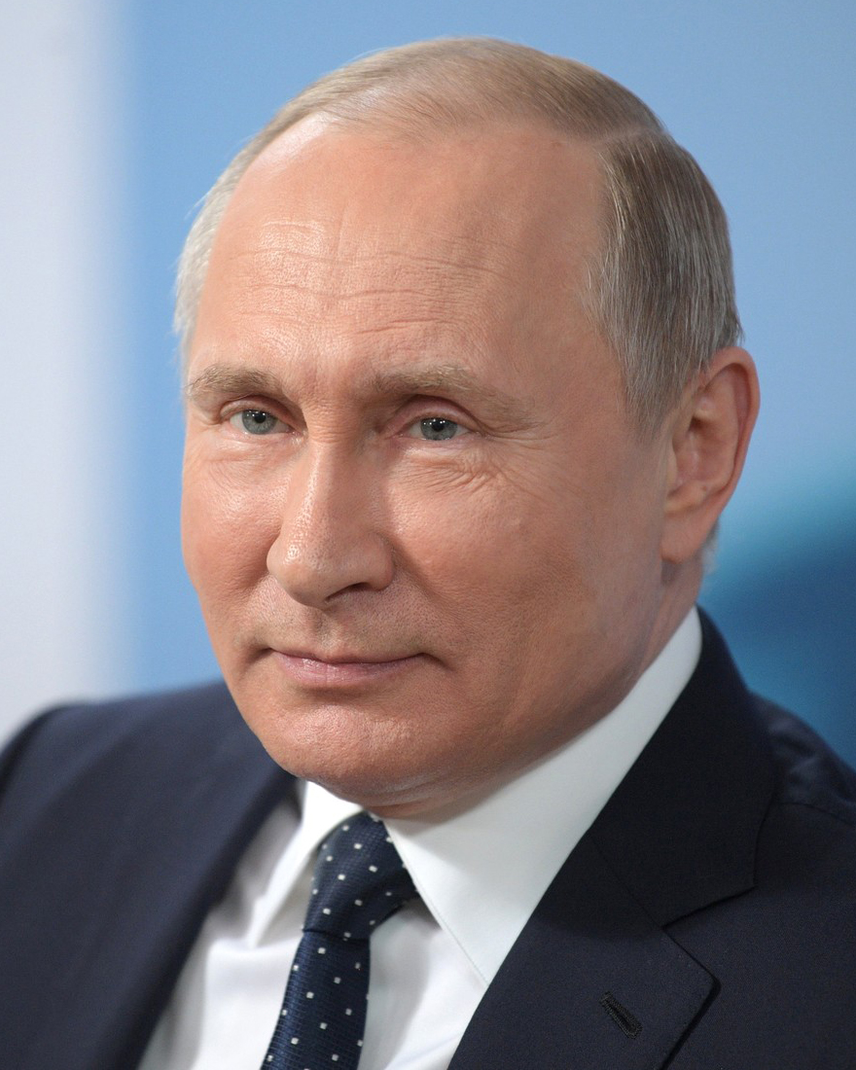
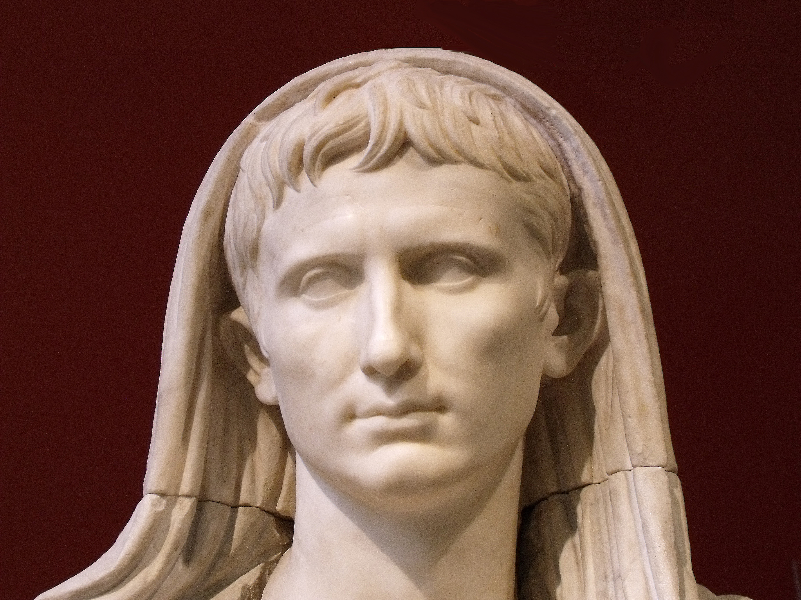
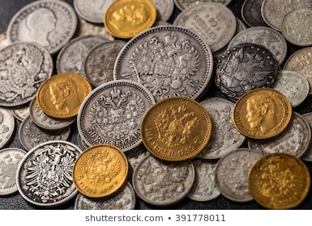
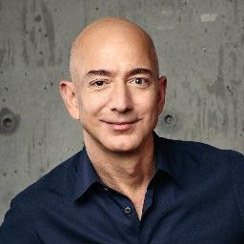
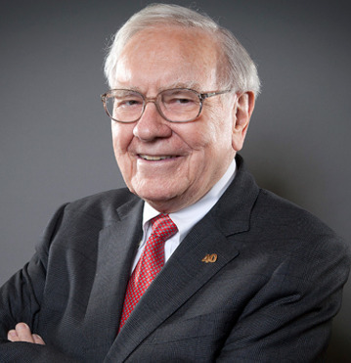
Wealth/Greed
“Vladimir Putin’s wealth, even by the most generous of calculations, pales in comparison. In fact, throw in the vast riches of Microsoft MSFT, +2.13% co-founder Bill Gates, Warren Buffett of Berkshire Hathaway BRK.A, +1.10% fame and Amazon’s AMZN, +3.24% Jeff Bezos, and their combined fortune doesn’t even approach the riches of history’s wealthiest figures. Take Augustus Caesar, for example. The first Roman emperor tops the list, according to the Visual Capitalist blog. The adopted son of Julius Caesar controlled much of the world’s most powerful states — including Egypt — as part of his estimated $4.6 trillion net worth. Egypt made up at least 25% of global GDP at the time.”—Shawn Langlois, “The Richest Men in History, marketwatch.com

Slide 4
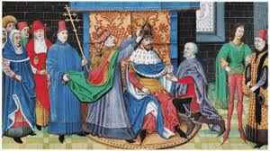
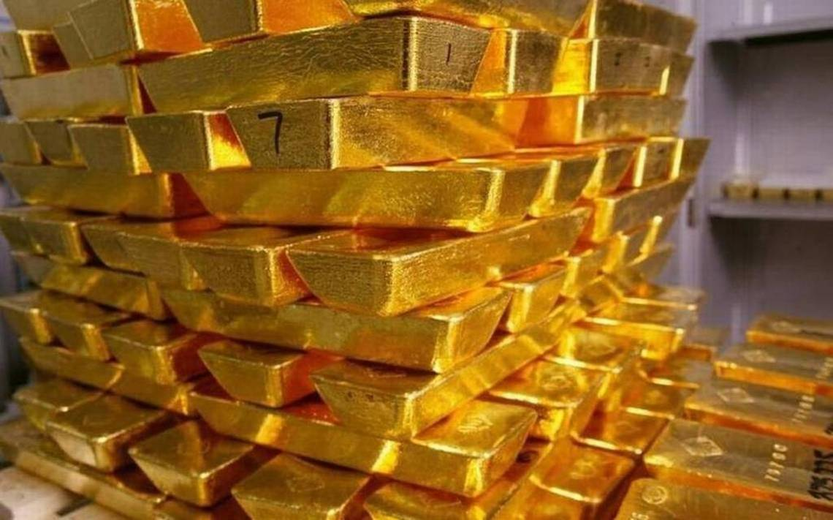
“The fiscal machinery of the church, with its lines passing through the greatest monarchs down to the humblest country priest, was perhaps the most efficient system ever devised for a continent-wide extraction of gold. And with these extractions went their records—the enabling bulls, the reports of legates, letters, petitions—the rustle of parchment inevitably accompanying the chink of gold. . . ‘Whenever I entered the chambers of the ecclesiastics I found brokers and clergy engaged in weighing and reckoning the money which lay in heaps before them’”—The Bad Popes, p. 129-131. (quote: de planctu ecclesia, quoted in Pastor, I, p. 72)

Slide 5
It is certainly NO WONDER why the Bible warns…
“ For the love of money is the root of all evil: which while some coveted after, they have erred from the faith, and pierced themselves through with many sorrows.” 1 Tim. 6:10

Slide 6
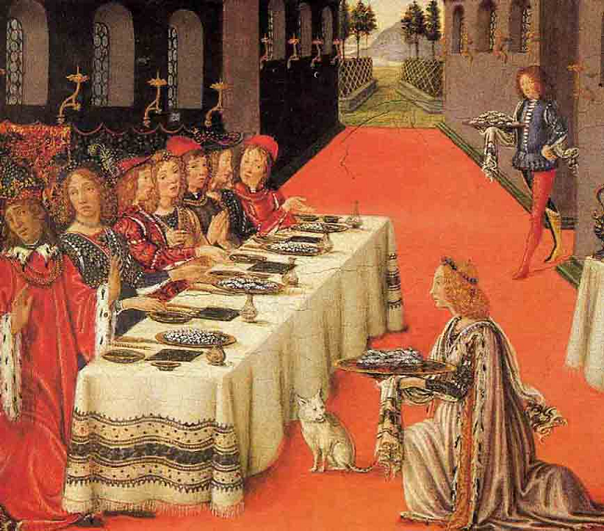
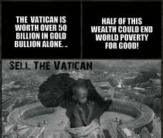
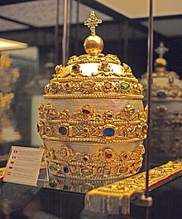
In the Late 1300s
“Instead of the Apostles who went barefoot we now see satraps mounted on horses decked with gold and champing golden bits and whose very hoofs will soon be shod in gold if God does not restrain their arrogant wealth. They could be taken for kings of the Persians or Parthians, who demand to be worshipped and into whose presence must no man come empty-handed”—Petrarch, Lettere familiari, XIV

Slide 7
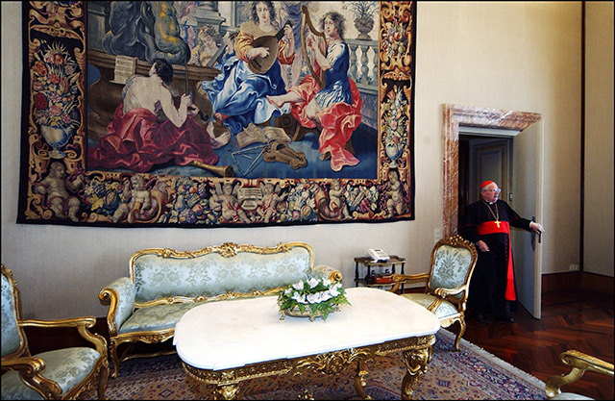
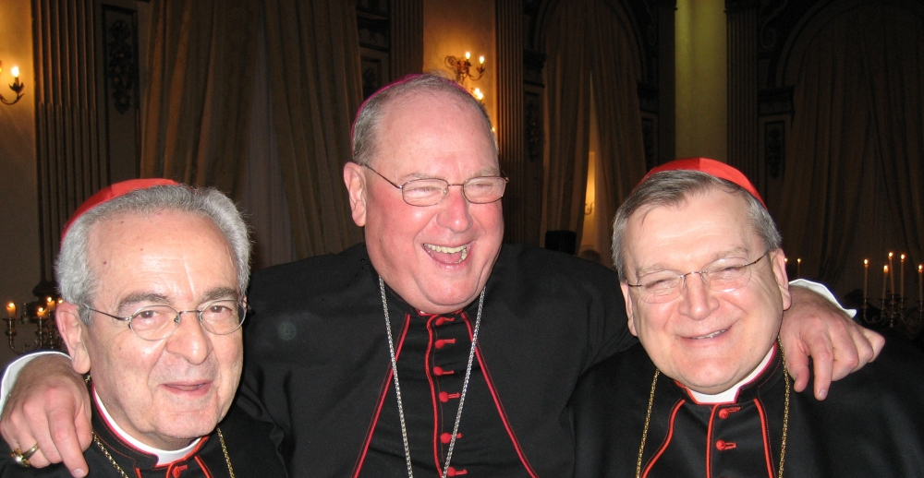
Anything Changed Today?
“Records reveal that 10 of the country's top church leaders defy the Pope's example and live in residences worth more than $1 million.”—CNN, Daniel Burke, “Lavish Homes of American Archbishops

