Slide 1
What is the Difference Between Mormons, Jehovah’s Witnesses, and Seventh-day Adventists? pt 21

Slide 2
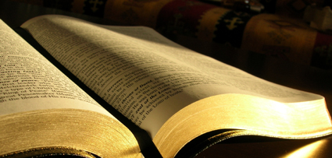
Tests Continued…
They will NOT contradict the Bible or the Law of God
Is. 8:20 “To the law and to the testimony: if they speak not according to this word, it is because there is no light in them.”
“The people of God are directed to the Scriptures as their safeguard against the influence of false teachers and the delusive power of spirits of darkness. . . The last great delusion is soon to open before us. Antichrist is to perform his marvelous works in our sight. So closely will the counterfeit resemble the true that it will be impossible to distinguish between them except by the Holy Scriptures. By their testimony every statement and every miracle must be tested.”—Great Controversy, 593

Slide 3
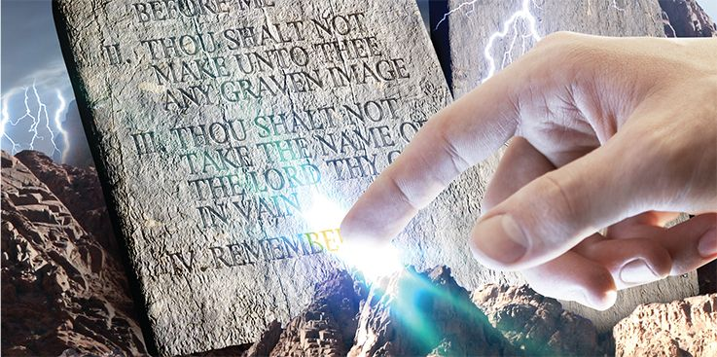
Upholds the Law of God
“Then present to them the prophecies; show them the purity and binding claims of the law of God, Not one jot or tittle of this law is to lose its force, but hold its binding claims upon every soul to the end of time.”—Manuscript Releases vol. 15, p. 351

Slide 4
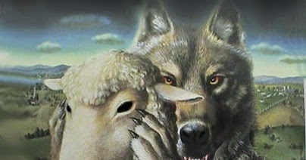
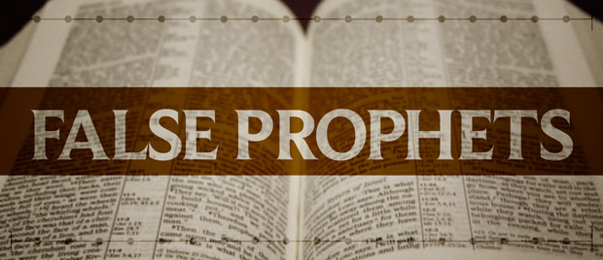
A Prophet’s Predictions Must Come True
Deut 18:15, 21-22 “The Lord thy God will raise up unto thee a Prophet from the midst of thee, of thy brethren, like unto me; unto him ye shall hearken. . . And if thou say in thine heart, How shall we know the word which the Lord hath not spoken? When a prophet speaketh in the name of the Lord, if the thing follow not, nor come to pass, that is the thing which the Lord hath not spoken, but the prophet hath spoken it presumptuously: thou shalt not be afraid of him.”
*Prophet must prophesy truth *Prophets spring up from within the Church

Slide 5
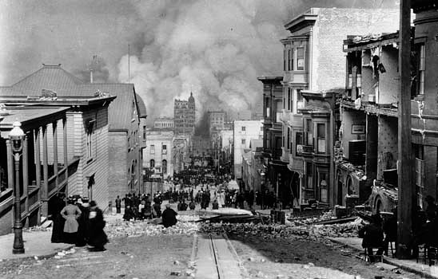
The San Francisco Earthquake
Sept. 1, 1902: Well-equipped tent meetings should be held in the large cities, such as San Francisco; for not long hence these cities will suffer under the judgments of God. San Francisco and Oakland are becoming as Sodom and Gomorrah, and the Lord will visit them in wrath. (Manuscript 1902, p. 114)
The San Francisco Earthquake of April 18, 1906 was followed by a fire lasting four days and destroying 497 city blocks covering five square miles. 28,188 buildings were demolished, causing approximately a billion dollars in damage and costing 500 lives.

Slide 6
“In the world gigantic monopolies will be formed. Men will bind themselves together in unions that will wrap them in the folds of the enemy. A few men will combine to grasp all the means to be obtained in certain lines of business. Trades unions will be formed, and those who refuse to join these unions will be marked men”—Letter 26, 1903

Slide 7
Health predictions… How did she know which ones???
1864: “Tobacco is a poison” (Spiritual Gifts, vol 4a, p. 128----1957 that the American Cancer Society concluded that smoking was a factor in lung cancer)

Slide 8
1863: “There are those who ought to be awake to the danger of meat eating, who are still eating the flesh of animals, thus endangering the physical, mental, and spiritual health” (R & H, May 27, 1902-----World Health Organization classifies Meat as a carcinogen in 2014)

Slide 9
Carnivore Crisis
“CLAIM: Lab-grown meat is made out of cancerous animal cells. AP’S ASSESSMENT: False. Meat grown in labs is made using cells taken from animals, but those cells are not cancerous and there are many safeguards in place to ensure that the end product is safe to consume, experts told The Associated Press. The false claim stems from the fact that, like cancer cells, those used in lab-grown meat often go through a process that allows them to divide indefinitely. But cells must exhibit other traits to be considered cancerous. . . . Cancer cells are also considered immortalized, but that is only one trait that makes them cancerous. Other characteristics that can indicate cancer in cells include unpredictable, uncontrollable behavior or the creation of separate blood vessels, Swartz said. But cells intentionally immortalized to create lab-grown meat have behavior that is, by necessity, predictable and controllable. ‘All cancers are immortalized, but not all immortalized cells are cancer,’ Swartz said. ‘So it’s sort of like how not all rectangles are squares.’”—Melissa Golden, Associated Press, June 30 2023, AP Fact Check, “Animal cells used to create lab-grown meat are not cancerous, experts say”

Slide 11
But Jesus Ate Fish…
“New Food and Drug Administration (FDA) data show mercury contamination of fish is more serious than federal scientists previously assumed. Tests on mercury in fish found that four species — canned albacore tuna, grouper, sea bass and bluefish — have higher average mercury levels than historic data used by the FDA in developing its mercury health advisory, according to an analysis by the Environmental Working Group. EWG obtained the data through the Freedom of Information Act. The EWG review shows that mercury levels in popular canned albacore tuna are of particular concern, challenging FDA's stance that fetuses face no risk if their mothers consume it. Canned albacore, known as white tuna, had mercury levels twice as high as past FDA estimates for canned tuna, and three times the levels in light tuna . . . These findings confirm the results of recent independent tests of canned albacore tuna showing that a small but significant percentage (2 to 5 percent) of albacore tuna tested exceeds the FDA action level for mercury of 1 part per million. Previous FDA studies have found albacore tuna with mercury levels over 1 part per million. Fish with mercury levels above 1 part per million have traditionally been included on the FDA "do not eat" list for pregnant women. In the data release by FDA to EWG, maximum mercury levels in canned albacore tuna were just shy of the 1 part per million limit. Mercury is toxic to the developing brain and nervous system. Elevated exposures during fetal development can have long lasting adverse effects on intelligence, speech, and motor development. According to the Centers for Disease Control and Prevention, 8 percent of U.S. women of childbearing age have levels of mercury in their blood that present developmental risks for their babies.” ewg.com, New Government Fish Tests Raise Mercury Concerns, September 27, 2007, https://www.ewg.org/news-insights/news/new-government-fish-tests-raise-mercury-concerns

Slide 12
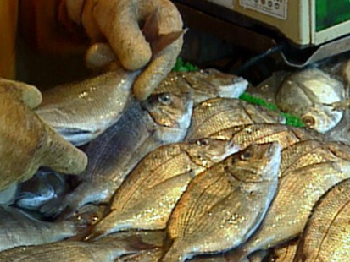
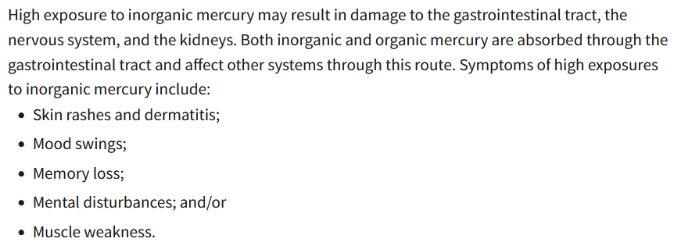
Mercury Mind Virus

Slide 13
1905: “Tea and coffee do not nourish the system. Their effect is produced before there has been time for digestion and assimilation, and what seems to be strength is only nervous excitement” (Ministry of Healing, p. 326)--------1967 "Illness otherwise unexplained may be caused by excessive ingestion of xantine cocoa alkaloids, including those in coffee, tea, cocoa, and those in some popular beverages.“--H. A. Riemann, Journal of the American Medical Associator

Slide 14
John Harvey Kellogg
“Dr. John Harvey Kellogg, in his prime is without any question the most competent and most important witness to Ellen White’s teachings in the field of health. He was a physician and surgeon well trained in scientific lines, having studied both in America and Europe. He traveled widely, lectured frequently, and carried on a constant line of investigation and experimentation. He was medical superintendent of the Battle Creek Sanitarium, the foremost such medical institution in the world, which attracted such of the world’s great as Taft, Rockefeller, Edison, Ford, Burbank, etc. True, because of the innovations made at the Battle Creek Sanitarium, Kellogg was at times under fire by fellow physicians. But if the reader would see Ellen White emerge in her true image, he may well look to Kellogg before his defection, and even after his defection Kellogg never repudiated or discounted Ellen White’s health teachings. For this reason as we introduce his 1890 Preface statement to Christian Temperance and Bible Hygiene, the first part of which is a compilation of E. G. White materials, we quote at length, urging the reader to peruse it carefully to gain its full impact. Please note Kellogg’s frequent reference to “the principles taught” by Ellen White: ‘Nearly thirty years ago there appeared in print the first of a series of remarkable and important articles on the subject of health, by Mrs. E. G. White. These articles at once commanded earnest consideration by those who were acquainted with Mrs. White’s previous writings and labors. Thousands were led to change life-long habits, and to renounce practices thoroughly fixed by heredity as well as by long indulgence. So great a revolution could not be wrought in a body of people without the aid of some powerful incentive, which in this case was undoubtedly the belief that the writings referred to not only bore the stamp of truth, but were endorsed as such by a higher than human authority. This is not the proper place for the consideration of the grounds upon which this belief was based, but the reader’s attention is invited to a few facts of interest in this connection’— Ellen White Estate, A Critique of the Book ‘Prophetess of Health, p. 17

Slide 15
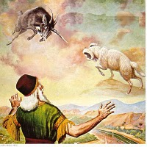
The Biblical Physical Signs
Dan. 10:8, 16-18 “Therefore I was left alone, and saw this great vision, and there remained no strength in me: for my comeliness was turned in me into corruption, and I retained no strength. And, behold, one like the similitude of the sons of men touched my lips: then I opened my mouth, and spake . . . straightway there remained no strength in me, neither is there breath left in me. Then there came again and touched me one like the appearance of a man, and he strengthened me,”
Num. 24:4 “He hath said, which heard the words of God, which saw the vision of the Almighty, falling into a trance, but having his eyes open”
* No strength * speaks but has no breath * strengthened
* Eyes remain open entire time

Slide 16
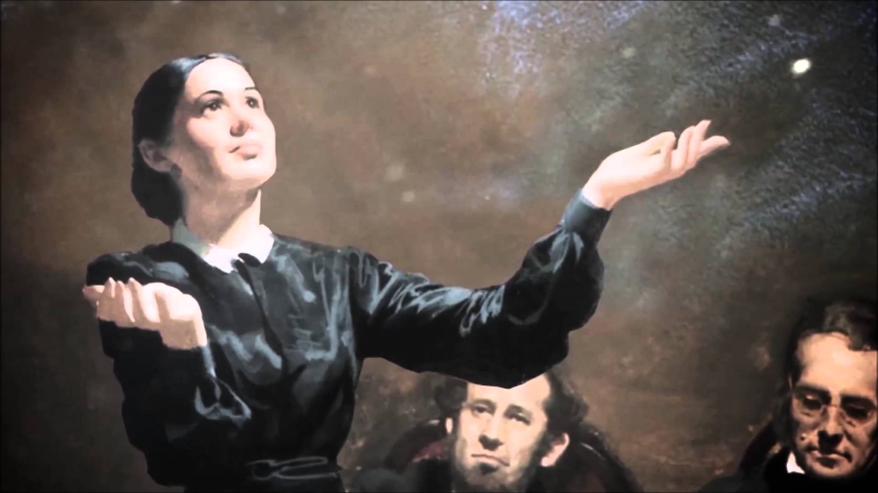
The Physical Tests Fulfilled:
“In vision her eyes were open. There was no breath, but there were graceful movements of the shoulders, arms and hands expressive of what she saw. It was impossible for anyone else to move her hands or arms. . . When the vision ended . . . She was then limp and strengthless.”—Martha Amadon, Notebook Leaflets

Slide 17
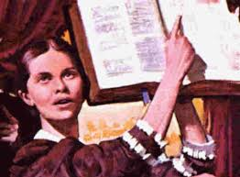
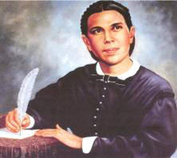
“June 28, 1857, I saw Sister Ellen G. White in vision for the first time. I was an unbeliever in the visions; but one circumstance among others that I might mention convinced me that her visions were of God. To satisfy my mind as to whether she breathed or not, I first put my hand on her chest sufficiently long to know that there was no more heavings of the lungs than there would have been had she been a corpse. I then took my hand and placed it over her mouth, pinching her nostrils between my thumb and forefinger, so that it was impossible for her to exhale or inhale air, even if she had desired to do so. I held her thus with my hand about ten minutes, long enough for her to suffocate under ordinary circumstances; she was not in the least affected by this ordeal. Since witnessing this wonderful phenomenon, I have not once been inclined to doubt the divine origin of her visions.”—Statement by D.T. Bourdeau, Battle Creek, Michigan, given Feb. 4, 1891

Slide 18
A Skeptic/Doctor’s Account
Michigan, May 20, 1853, at a meeting held in Tyrone, Livingston County. “Sister White was in vision about twenty minutes or half an hour. As she went into vision everyone present seemed to feel the power and presence of God, and some of us did indeed feel the Spirit of God resting upon us mightily. We were engaged in prayer and social meeting Sabbath morning at about nine o’clock. Brother White, my father, and Sister White had prayed, and I was praying at the time. There had been no excitement, no demonstrations. We did plead earnestly with God, however, that He would bless the meeting with His presence, and that He would bless the work in Michigan. As Sister White gave that triumphant shout of “Glory! g-l-o-r-y! g-l-o-r-y!” which you have heard her give so often as she goes into vision, Brother White arose and informed the audience that his wife was in vision. After stating the manner of her visions, and that she did not breathe while in vision, he invited any one who wished to do so to come forward and examine her. Dr. Drummond, a physician, who was also a First-day Adventist preacher, who (before he saw her in vision) had declared her visions to be of mesmeric origin, and that he could give her a vision, stepped forward, and after a thorough examination, turned very pale, and remarked, “She doesn’t breathe!” I am quite certain that she did not breathe at that time while in vision, nor in any of several others which she has had when I was present. The coming out of the vision was as marked as her going into it. The first indication we had that the vision was ended, was in her again beginning to breathe. She drew her first breath, deep, long, and full, in a manner showing that her lungs had been entirely empty of air. After drawing the first breath, several minutes passed before she drew the second, which filled the lungs precisely as did the first; then a pause of two minutes, and a third inhalation, after which the breathing became natural.”—Merritt. G. Kellogg, MD, Battle Creek, Mich., Dec. 28, 1890; Great Second Advent Movement, p. 206 (quoted in Messenger to the Remnant, pp. 22-23)

Slide 19
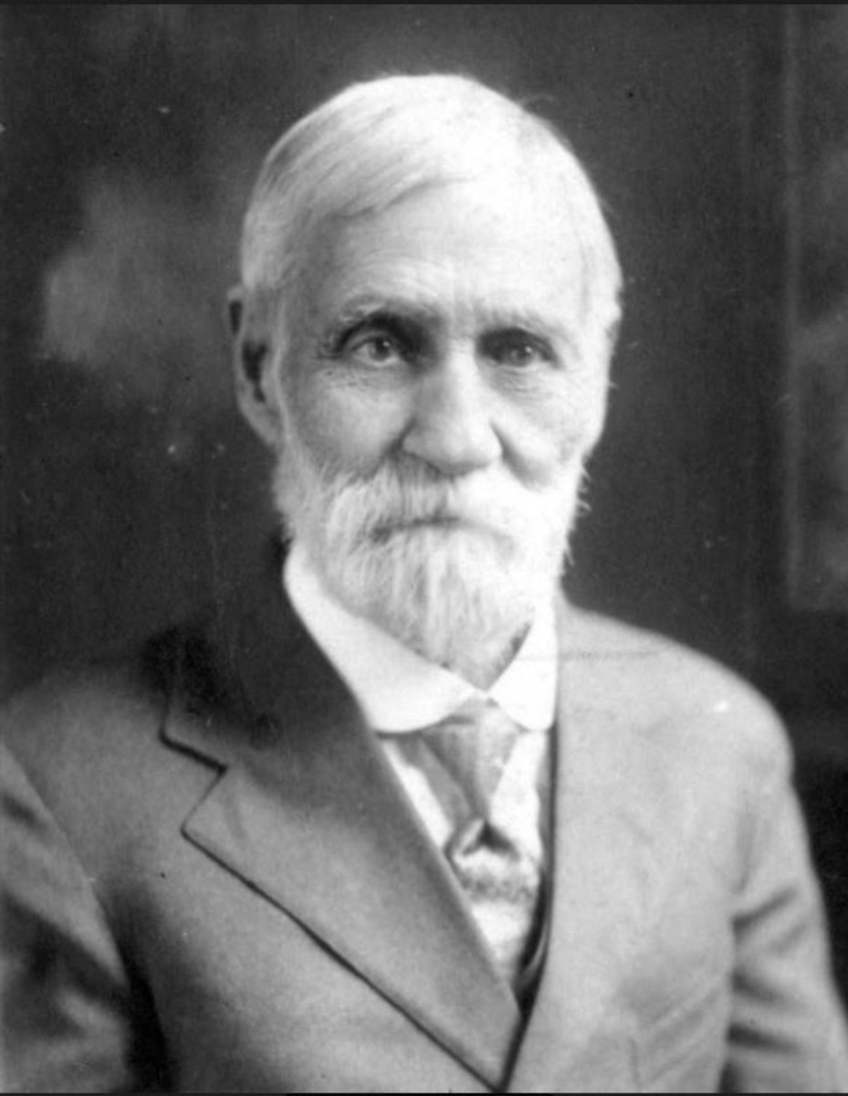
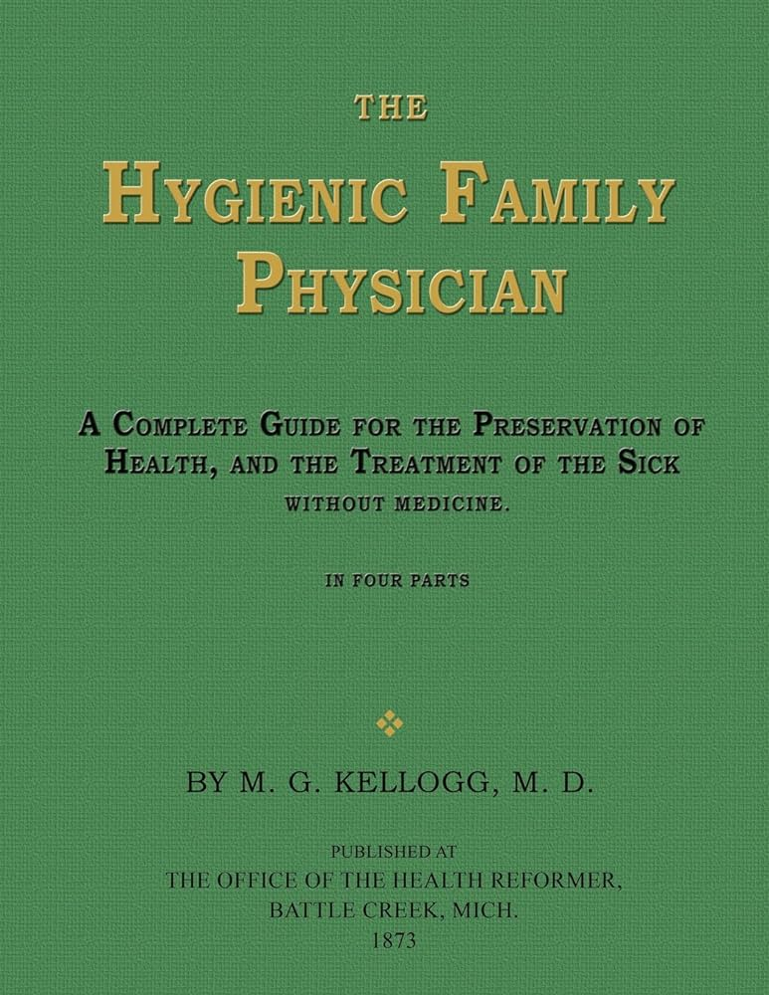

Slide 20
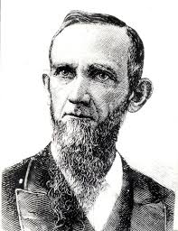
What About the Critics???
BEFORE:
“One thing I have remarked, and that is, that the most bitter opponents of the visions of Sister White admit that she is a Christian. How they can make this admission is more than I know. They try to fix it up by saying that she is deceived. They are not able to put their finger upon a single stain in all her life, nor an immoral sentence in all her writings. They have to admit that much of her writings are excellent, and whoever would live out all she says would be a good Christian, sure of Heaven. This is passing strange if she is a tool of the devil, inspired by Satan, or if her writings are immoral or the vagaries of her own mind.”—R&H, April 26, 1877.
Dudley M. Canright (1840-1919)

Slide 21
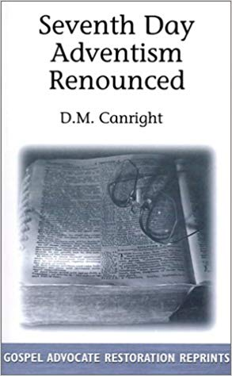
AFTER:
“That she is not inspired is plainly shown by many facts. She has never wrought a single miracle. The old prophets and the apostles wrought miracles freely, to prove that God had sent them. In all these seventy years, in all her forty volumes, not a single prediction has she ever made that has come to pass. This is astonishing, considering that she dwells almost wholly in predictions. It seems as though she ought to have blundered into many things which could afterward be construed into a fulfilled prophecy. But not one can be found. This shows how wild and utterly wrong her theories have been.”—Dudley Canright, Seventh-day Adventism Renounced, p. 138

Slide 22
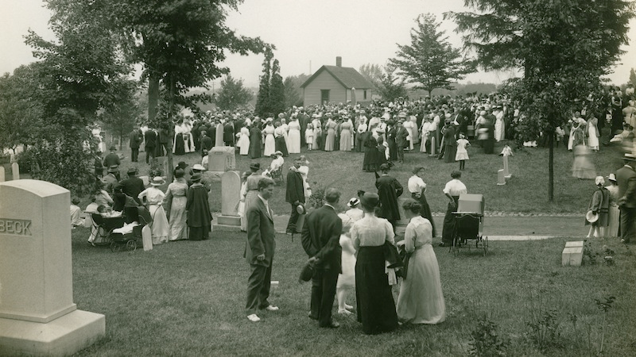
“My brother [Dudley M. Canright] rested his hand upon the side of the casket, and with tears rolling down his cheeks, he said brokenly ‘There is a noble Christian woman gone.’”—WA Spicer, The Spirit of Prophecy in the Advent Movement, p. 127

Slide 23
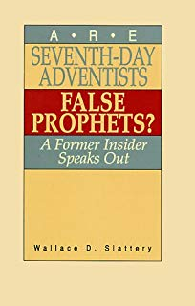
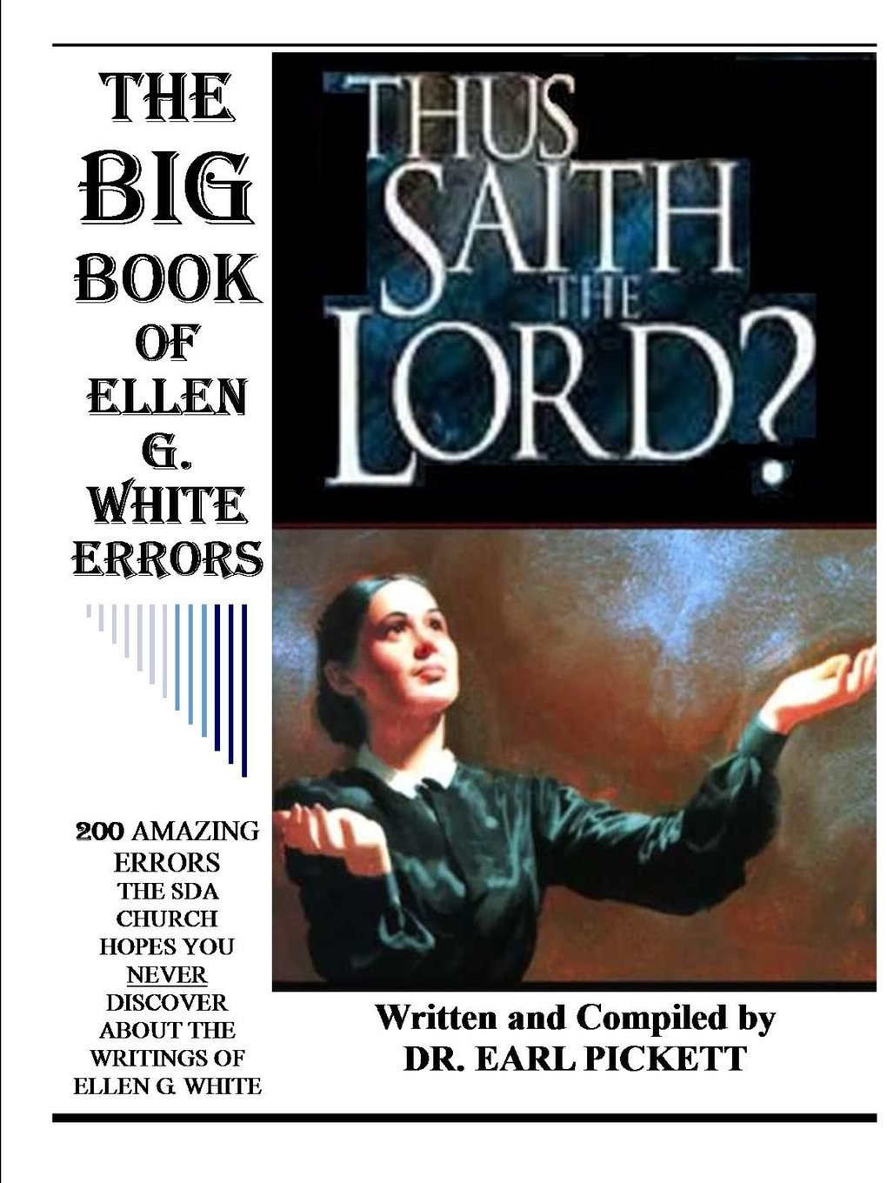
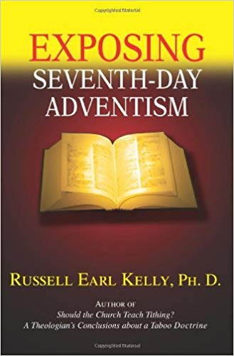
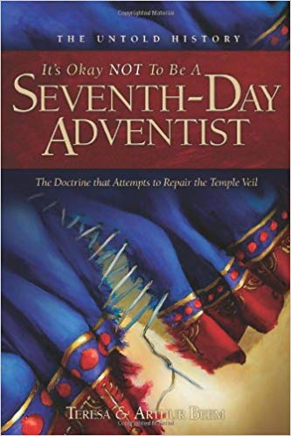
For The Others…
John 15:18-20 “If the world hate you, ye know that it hated me before it hated you. If ye were of the world, the world would love his own: but because ye are not of the world, but I have chosen you out of the world, therefore the world hateth you. Remember the word that I said unto you, The servant is not greater than his lord. If they have persecuted me, they will also persecute you; if they have kept my saying, they will keep yours also.”
How were the other prophets treated? Jesus? What about women’s suffrage?

Slide 24
Will We Listen to God’s Last Day Council?
“How many have read carefully Patriarchs and Prophets, The Great Controversy, and The Desire of Ages? I wish all to understand that my confidence in the light that God has given stands firm, because I know that the Holy Spirit's power magnified the truth, and made it honorable, saying: “This is the way, walk ye in it.” In my books, the truth is stated, barricaded by a “Thus saith the Lord.” The Holy Spirit traced these truths upon my heart and mind as indelibly as the law was traced by the finger of God, upon the tables of stone, which are now in the ark, to be brought forth in that great day when sentence will be pronounced against every evil, seducing science produced by the father of lies.”—Letter 90, 1906

