Slide 1
What is the Difference Between Mormons, Jehovah’s Witnesses, and Seventh-day Adventists? pt 10

Slide 2
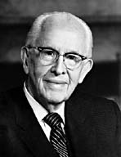
An Important Statement From an LDS Prophet
Prophet Ezra Taft: “the Book of Mormon is the keystone of our religion. This was the Prophet Joseph Smith’s statement. He testified that “the Book of Mormon was the most correct of any book on earth, and the keystone of our religion” (Introduction to the Book of Mormon). A keystone is the central stone in an arch. It holds all the other stones in place, and if removed, the arch crumbles.” (October 1986 General Conference)

Slide 3
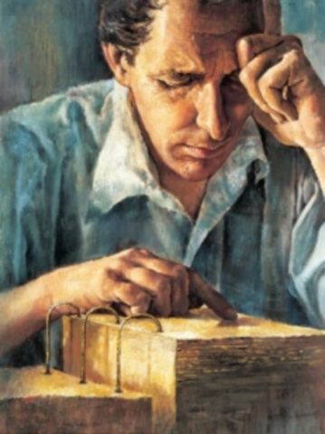
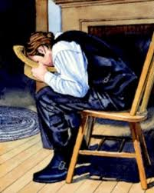
The Book of Mormon, Scripture?
2 Pet. 1:19-21 “We have also a more sure word of prophecy; whereunto ye do well that ye take heed, as unto a light that shineth in a dark place, until the day dawn, and the day star arise in your hearts: Knowing this first, that no prophecy of the scripture is of any private interpretation. For the prophecy came not in old time by the will of man: but holy men of God spake as they were moved by the Holy Ghost.”

Slide 4
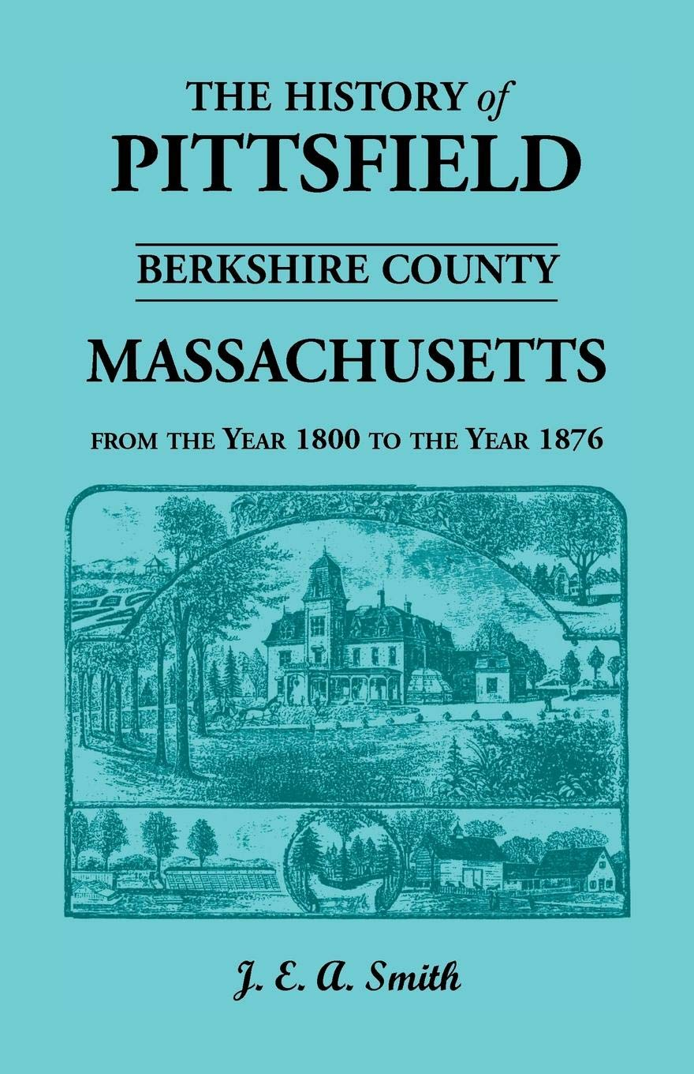
Native Americans = Lost Tribes???
J. E. A. Smith’s History of Pittsfield, [Mass.] 1734-1800 (written in 1869):
”On Indian Hill, in 1815, Capt. Joseph Merrick turned up with his plough a Jewish frontlet, which being opened, displayed the usual sentences of Hebrew scripture, beautifully inscribed upon parchment, which had been kept in perfect preservation by leathern casings. The theory that the American Indians are the descendants of the lost tribes of Israel had then many ardent supporters, who, of course, hailed Capt. Merrick’s waif as confirmation of their faith, in a double sense ‘strong as Holy Writ.’ Deposited with the Antiquarian Society at Worcester, it was learnedly discussed; and we still find it occasionally mentioned in books.”

Slide 5
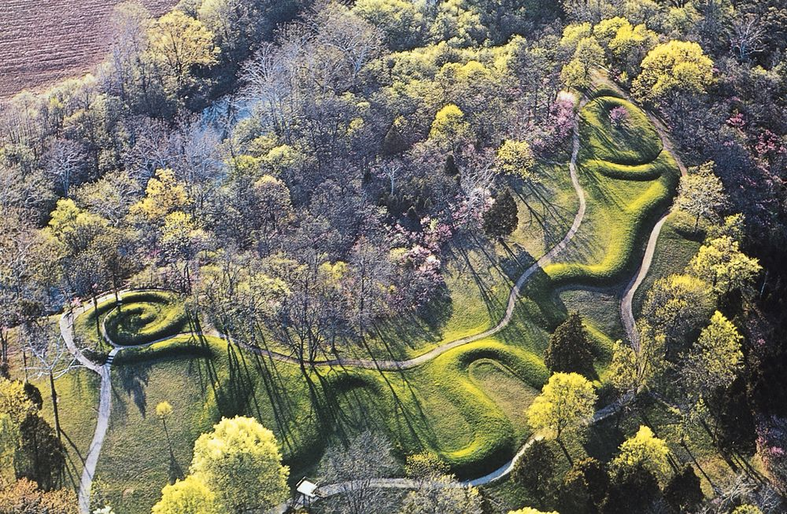
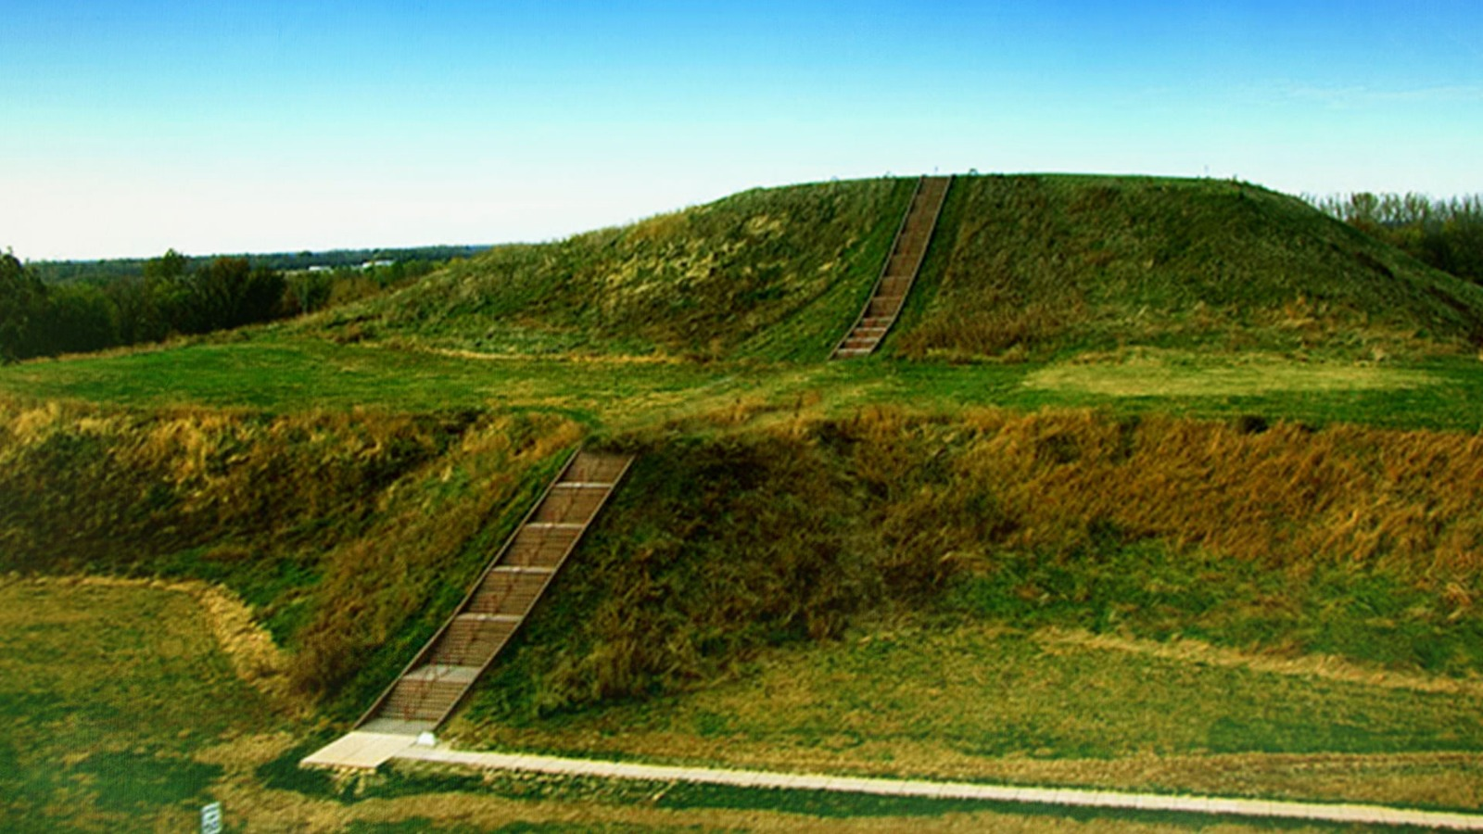
Moundbuilders
The Great Serpent Mound Ohio Historical Marker, Peebles, Ohio
The Cahokia Mounds State Historic Site, near St Louis, Missouri

Slide 6
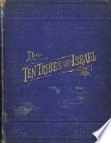
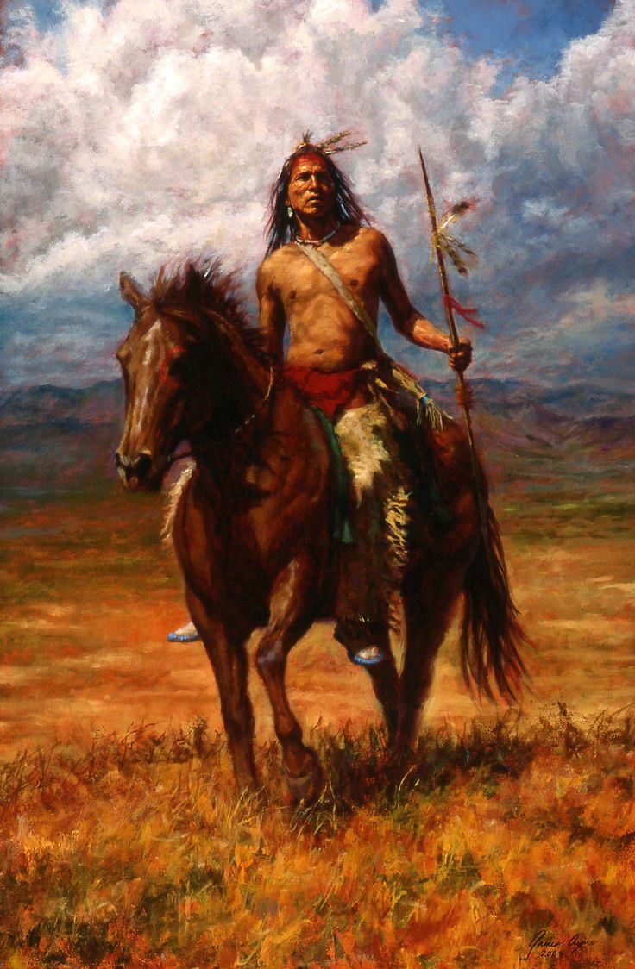
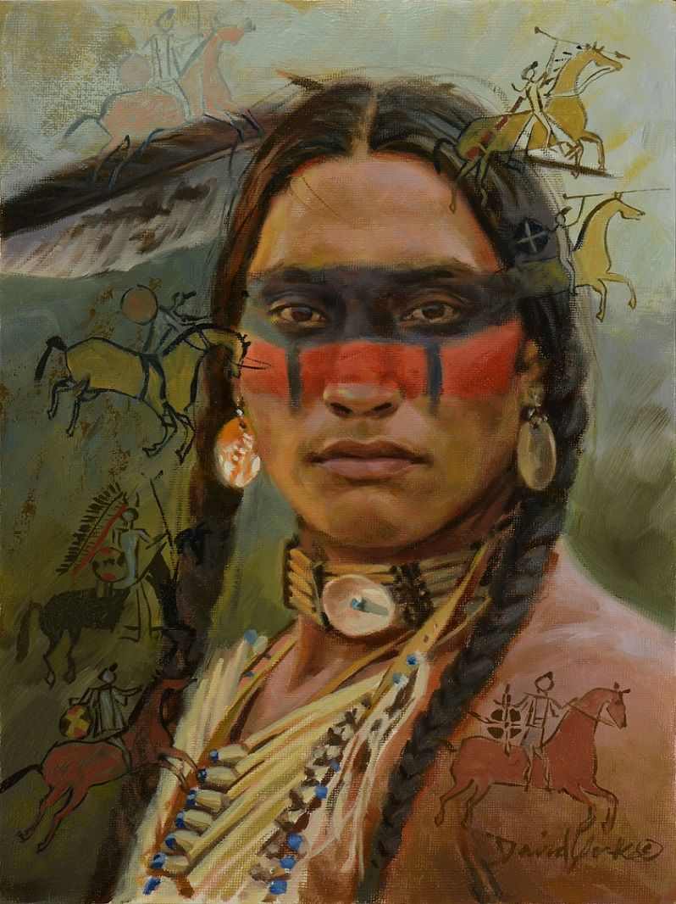
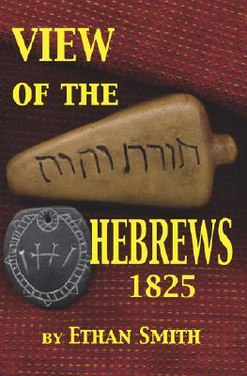
Belief in Indians being lost tribes common
-Ten Tribes of Israel (1883) Timothy Jenkins
-Discourse on the Evidences of the American Indians, Being the Descendants of the Lost Tribes of Israel Delivered Before the Mercantile Library Association, Clinton Hall (1837) M. M. Noah
-View of the Hebrews (1823) Ethan Smith, a Congregationalist minister in Vermont
“Numerous commentators on Mormon history, from LDS Church general authority B. H. Roberts to Fawn M. Brodie, biographer of Joseph Smith, have noted similarities in the content of View of the Hebrews and the Book of Mormon, which was first published in 1830, seven years after Ethan Smith's book.” Wikipedia, View of the Hebrews

Slide 7
DNA tests
“Mormon researchers such as anthropologist Thomas W. Murphy and ex-Mormon plant geneticist Simon Southerton state that the substantial collection of Native American genetic markers now available are not consistent with any detectable presence of ancestors from the ancient Middle East. They have argued that this poses substantial evidence to contradict the account in the Book of Mormon.” Wikipedia, Genetics and the Book of Mormon

Slide 8
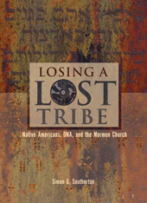
The DNA tells all… The Book of Mormon is False!
“For the past 175 years, the Latter-day Saint Church has taught that Native Americans and Polynesians are descended from ancient seafaring Israelites. Recent DNA research confirms what anthropologists have been saying for nearly as many years, that Native Americans are originally from Siberia and Polynesians from Southeast Asia. In the current volume, molecular biologist Simon Southerton explains the theology and the science and how the former is being reshaped by the latter. In the Book of Mormon, the Jewish prophet Lehi says the following after arriving by boat in America in 600 BCE: ‘Wherefore, I, Lehi, have obtained a promise, that inasmuch as those whom the Lord God shall bring out of the land of Jerusalem shall keep his commandments, they shall prosper upon the face of this land; and they shall be kept from all other nations, that they may possess this land unto themselves’ (2 Ne. 1:9).”—Losing a Lost Tribe, Book Cover, (2004) Simon Southerton

Slide 9
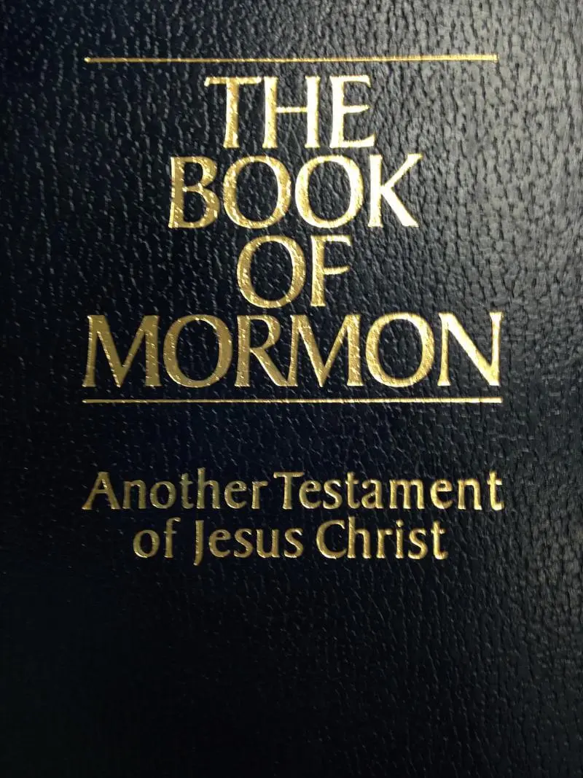
Changes to the Opening:
Introduction of the Book of Mormon, by Bruce R. McConkie (1981): "After thousands of years, all were destroyed except the Lamanites, and they are the principal ancestors of the American Indians."
Introduction of the Book of Mormon (2006): “After thousands of years, all were destroyed except the Lamanites, and they are among the ancestors of the American Indians.”

Slide 10
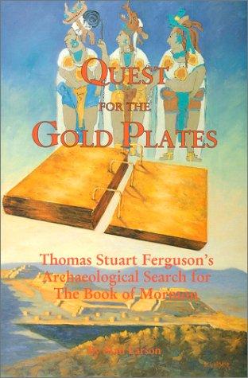
The Archeologist Who Lost His Faith in Mormonism
“Ferguson's public career as BOM defender began in 1941 when he published an article in the LDS church's monthly Improvement Era magazine (predecessor to the Ensign) espousing the then controversial "limited geography" model — that the BOM people occupied only a small region in Central America, not the entire Western Hemisphere, as had been traditionally thought. This was followed by several popular books, including Cumorah Where?, Ancient America and the Book of Mormon, co-authored with General Authority Milton R. Hunter, and One Fold and One Shepherd.”—Luke P. Wilson, A Mormon Champion's Loss of Faith | Institute for Religious Research (irr.org)
Stan Larson, Quest for the Gold Plates

Slide 11
“A lawyer by profession, Ferguson was a man whose ability and passion for defending the BOM attracted notice. J. Willard Marriot became his wealthy patron and apostle John A. Widtsoe his mentor. In 1952 Ferguson single-handedly founded the New World Archaeological Foundation (NWAF), with the vision of doing academically credible archaeological research in Central America to prove the BOM . . . Findings that once seemed promising evidence for the BOM, had proved fallacious: -Joseph Smith's 1842 identification of the ancient ruins of Palenque, Mexico as a Nephite city — which Ferguson had once cited as support for locating the Nephites in Mesoamerica — was now known to date not earlier than A.D. 600, after BOM times (22). Likewise, Joseph Smith's identification of impressive ruins and an engraved stone at Quirigua, Guatemala with such a stone mentioned in Omni 1:20, was now known to be impossible, since the ruins date after the BOM period (22-24). . . . Ferguson had come to doubt that the BOM is a translation of ancient records. To Larson's surprise, Ferguson frankly confirmed – "with no bitterness but with a touch of disappointment" – his "present skepticism about the historicity of the Book of Mormon" (xiv). ”—Ibid.

Slide 12
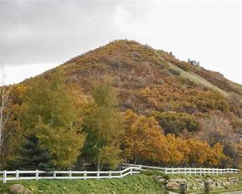
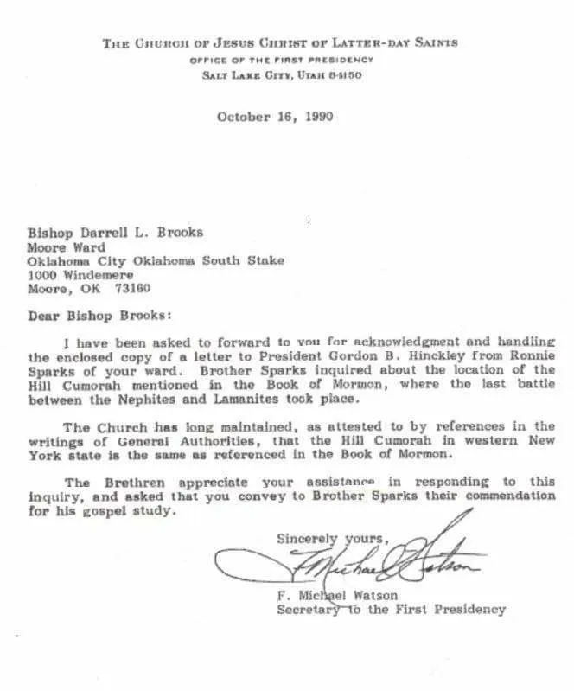
The Hill Cumorah
Elder B H Roberts, October 1927 General Conference: "Only three weeks ago, about now, I had the pleasure of standing upon the summit of the hill Cumorah in company with President Grant. Being there upon the height...I could not refrain from recalling the time when Moroni stood upon the crown of that hill with the evidence of the ruins of the civilization of his people about him. And this warning, written in the book of Ether, let me say, in closing, comes from the prophet of God who was also the historian of the great Jaredite nation, by abridging and translating their history into the Nephite language. This warning comes, then, from the historian of one civilization that had perished about the hill Cumorah; it came also from the same man who was a witness of the destruction of the civilization of his own people at the same place.“
Letter from the office of the First Presidency, 1990: "The Church has long maintained, as attested to by references in the writings of General Authorities, that the Hill Cumorah in western New York state is the same as referenced in the Book of Mormon."

Slide 13
Whoops!
—BYU Journal of Book of Mormon Studies,
vol. 14, no. 2, article 7, July 31 2005 “Looking for Artifacts at New York’s Hill Cumorah”
“the church owns Hill Cumorah and has had plenty of time to study and scan the hill for ancient artifacts and remains. There is nothing to be found - no stone box that held the 'gold plates,' no abundance of weaponry from these unprecedented battles, and no bodies from among the hundreds of thousands that died” ldsdiscussions.org, Book of Mormon: Official LDS Essay on Book of Mormon Geography, Annotated

Slide 14
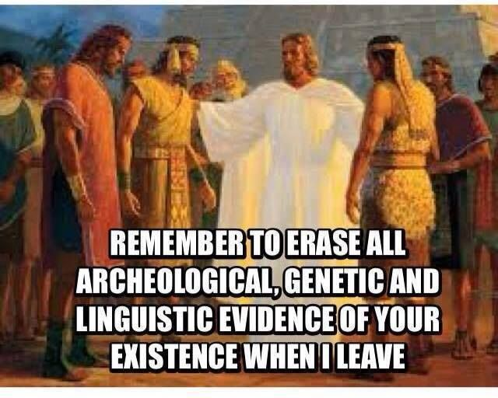

Slide 15
The New Policy on the Geography
Official Church Position: “The Church does not take a position on the specific geographic locations of Book of Mormon events in the ancient Americas. Speculation on the geography of the Book of Mormon may mislead instead of enlighten; such a study can be a distraction from its divine purpose.”—Book of Mormon Geography (churchofjesuschrist.org), Gospel Topics Essay
It’s obvious to see that the reason that the Church “does not take a position” is because when the Book of Mormon is examined in the light of any field of study: archeology, geography, linguistics, Egyptology, theology, DNA tests, and history—they are proven false. There have been found no coins, weapons, buildings, bodies from these massive battles (hundreds of thousands are said to have died at the Hill Cumorah alone). If they had some solid evidence of the events of Book of Mormon is would be plastered on every Mormon edifice in the world, presented at every opportunity, and celebrated within the church—but this is not the case.

Slide 16
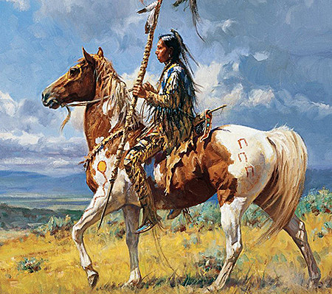
Other Problems in the Book of Mormon
1 Nephi 18:25 “And it came to pass that we did find upon the land of promise, as we journeyed in the wilderness, that there were beasts in the forests of every kind, both the cow and the ox, and the ass and the horse, and the goat and the wild goat, and all manner of wild animals, which were for the use of men. And we did find all manner of bore, both of cgold, and of silver, and of copper.
Enos 1:21 “And it came to pass that the people of Nephi did till the land, and raise all manner of grain, and of fruit, and flocks of herds, and flocks of all manner of cattle of every kind, and goats, and wild goats, and also many horses.”

Slide 17
The Book of Mormon Evidence of Fraud:
The Source (Joseph Smith-treasure-digger) is untrustworthy
The Story is doubtful (the magical overtones—Alvin)
The Characters do not make sense (Deformed English)
The Math does not add up (12 Golden Plates 22k words per page)
The DNA does not match (Indians are not Israelites)
The Archeology does not exist (No evidence of great battles, etc.)
The writings are not accurate (horses, sheep, etc.)
However, the evidence that Joseph Smith is lying is more reliable:
Joseph Smith’s accounts do not match his followers or family retelling of the same accounts (Joseph Smith vs Joseph Knight and the Alvin story)
Joseph Smith is involved in magic before, during and after the golden plates vision (treasure-digging—never finds anything for anyone, power of 3, the color black, autumnal equinox)
Joseph Smith is convicted of fraud (glass-looking) in 1826, breaking the law in New York
Joseph Smith never shows the golden plates to anyone except a few private viewings of only his most devout followers
The Book of Mormon seems to follow “View of the Hebrews”, and the characters are certified fake (looks like English)
Joseph Smith “translates” the plates by using the same methods used for glass-looking
Joseph Smith asks God 3 times to allow Martin Harris to take the first 116 pages, God allows, the pages lost, and Joseph Smith cannot retranslate them—when Joseph Smith loses control, his prophetic gifts do not work—Jeremiah rewrote his book!

Slide 18
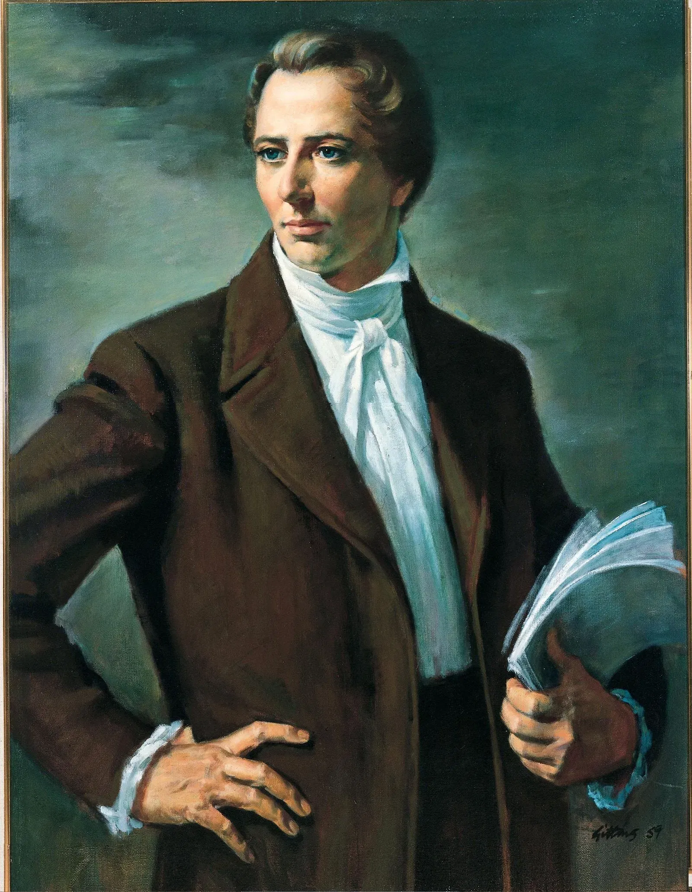
The Book of Mormon and Joseph Smith Fail the Test of Truth
2 Tim. 3:15-17 “And that from a child thou hast known the holy scriptures, which are able to make thee wise unto salvation through faith which is in Christ Jesus. All scripture is given by inspiration of God, and is profitable for doctrine, for reproof, for correction, for instruction in righteousness: That the man of God may be perfect, thoroughly furnished unto all good works.”

Slide 19
Time-setting Again! 1975
"Choosing the Best Way of Life". The Watchtower. March 15, 1980. pp. 17–18. With the appearance of the book Life Everlasting—in Freedom of the Sons of God, ... considerable expectation was aroused regarding the year 1975. ... there were other statements published that implied that such realization of hopes by that year was more of a probability than a mere possibility. It is to be regretted that these latter statements apparently overshadowed the cautionary ones and contributed to a buildup of the expectation already initiated. ... persons having to do with the publication of the information ... contributed to the buildup of hopes centered on that date.
"What will the 1970's Bring?". Awake!. Watch Tower Society. October 8, 1968. p. 14. Does this mean that the above evidence positively points to 1975 as the complete end of this system of things? Since the Bible does not specifically state this, no man can say... If the 1970s should see intervention by Jehovah God to bring an end to a corrupt world drifting toward ultimate disintegration, that should surely not surprise us.
"How Are You Using Your Life?". Our Kingdom Ministry. May 1, 1974. p. 63. Reports are heard of brothers selling their homes and property and planning to finish out the rest of their days in this old system in the pioneer service. Certainly, this is a fine way to spend the short time remaining before the wicked world's end.

Slide 20
Decline of the Watch Tower After Death
Chicago Daily Tribune October 30, 1949 pg 18: "Pastor Russell died in 1916. In the 33 years since, the methods of this sect have deviated completely from those of Pastor Russell and his manner of teaching."

